Slide 1

Big Impact; Small Scale Jennifer Kile Conservation Specialist West Virginia Conservation Agency

Slide 2
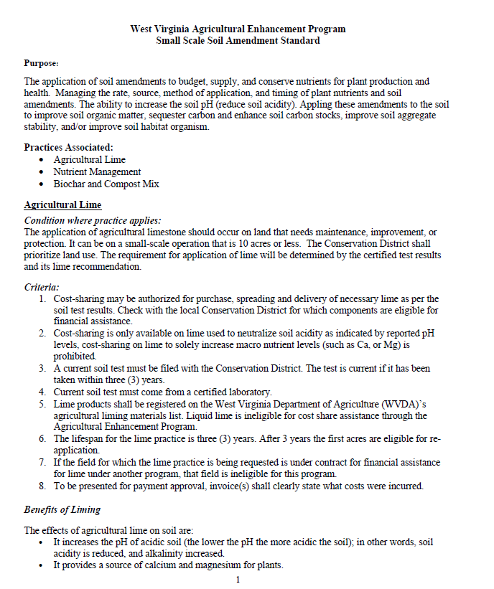

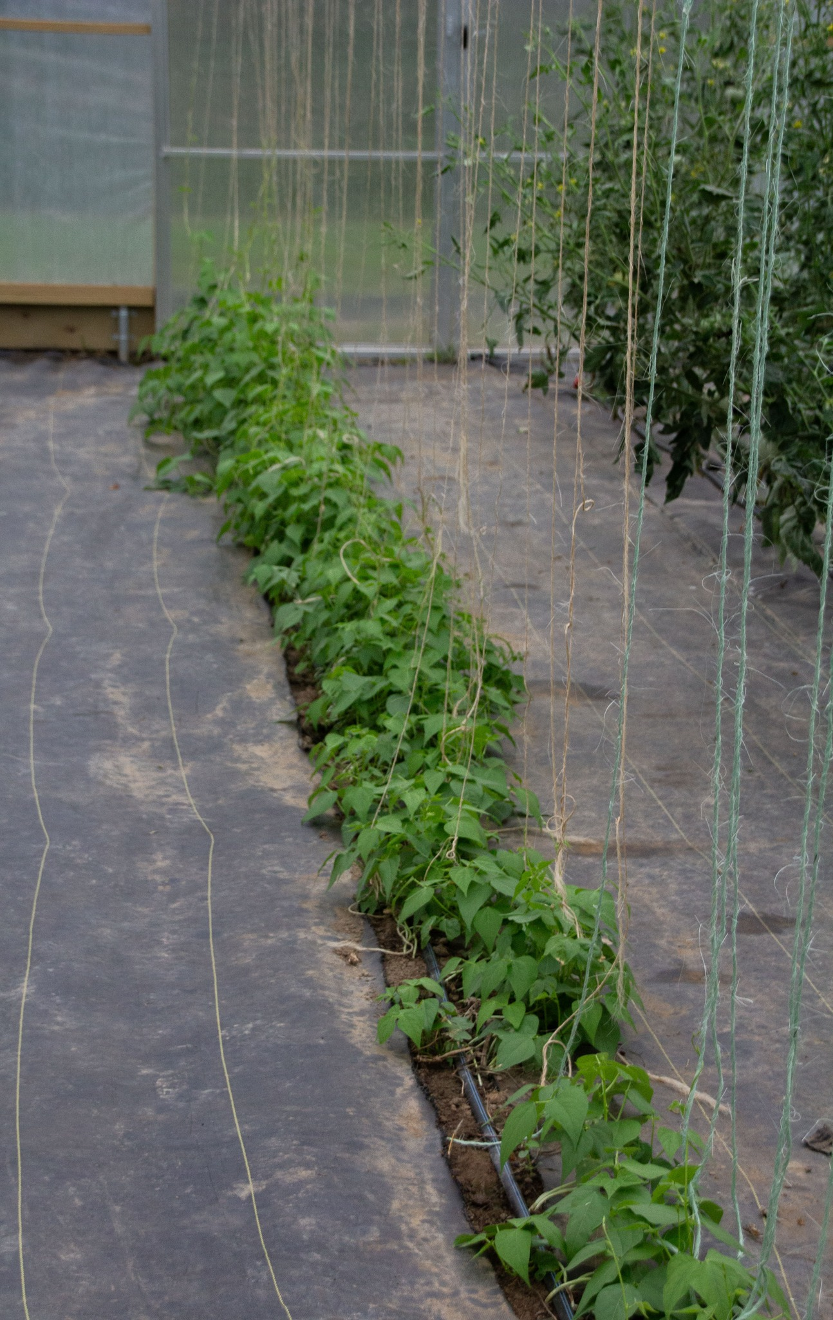
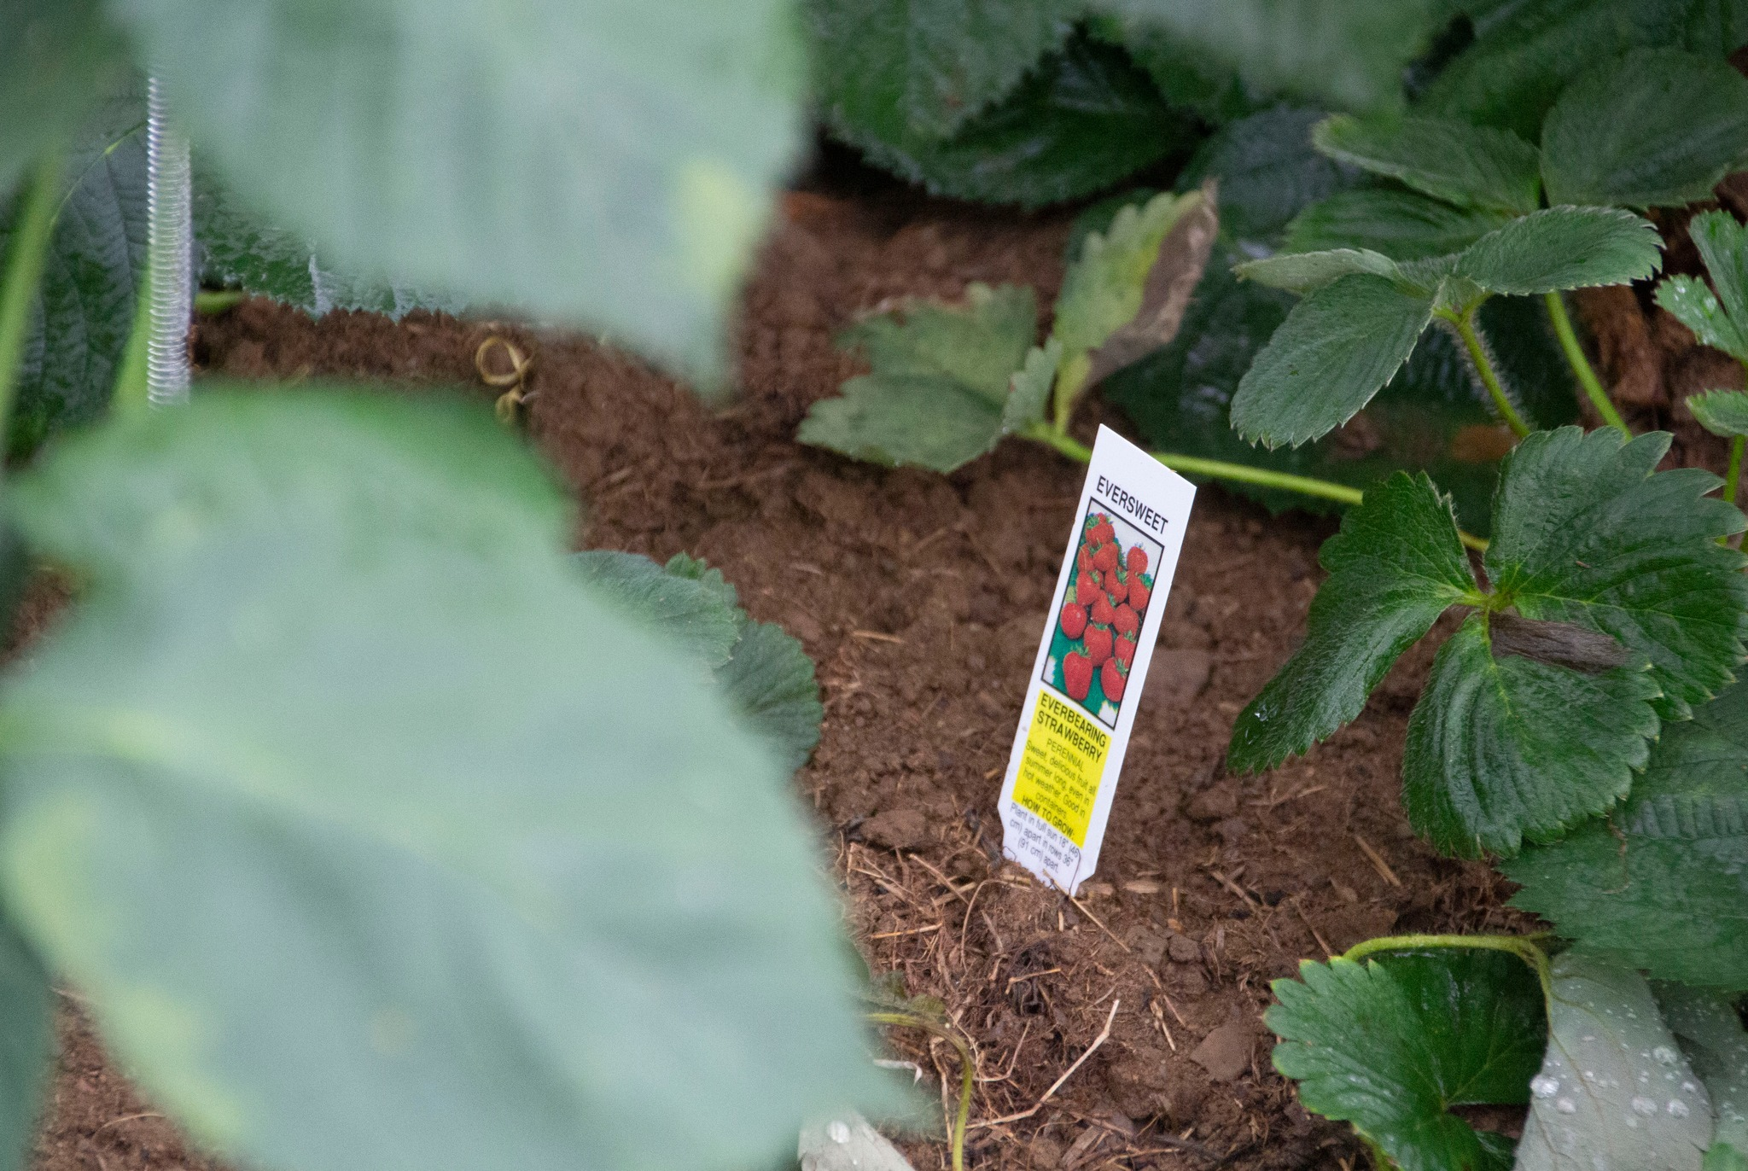



The Problem
West Virginia Agricultural Enhancement Program
Nutrient Management Program
Small Scale operations didn’t fit the program criteria.
How can we better support small scale operations?

Slide 3
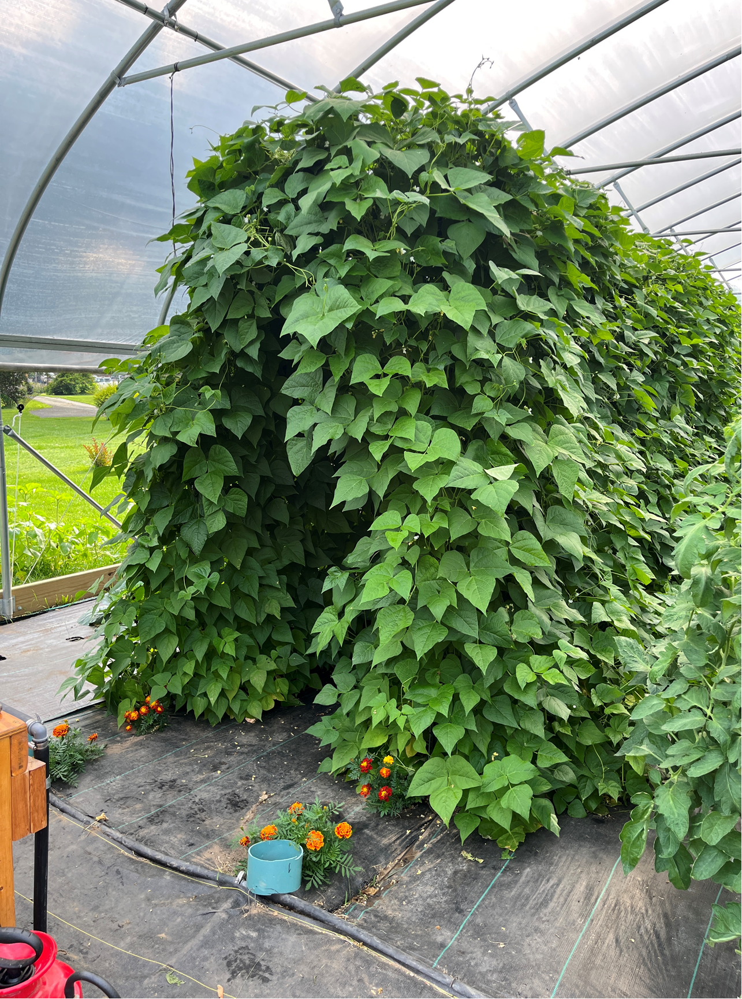

Small Scale Soil Amendment
Began development in Fall 2023
Define “small scale”
What to include

Slide 4
Purpose
The application of soil amendments to budget, supply, and conserve nutrients for plant production and soil health.
To manage the rate, source, method of application, and timing of plant nutrients and soil amendments.

Slide 5
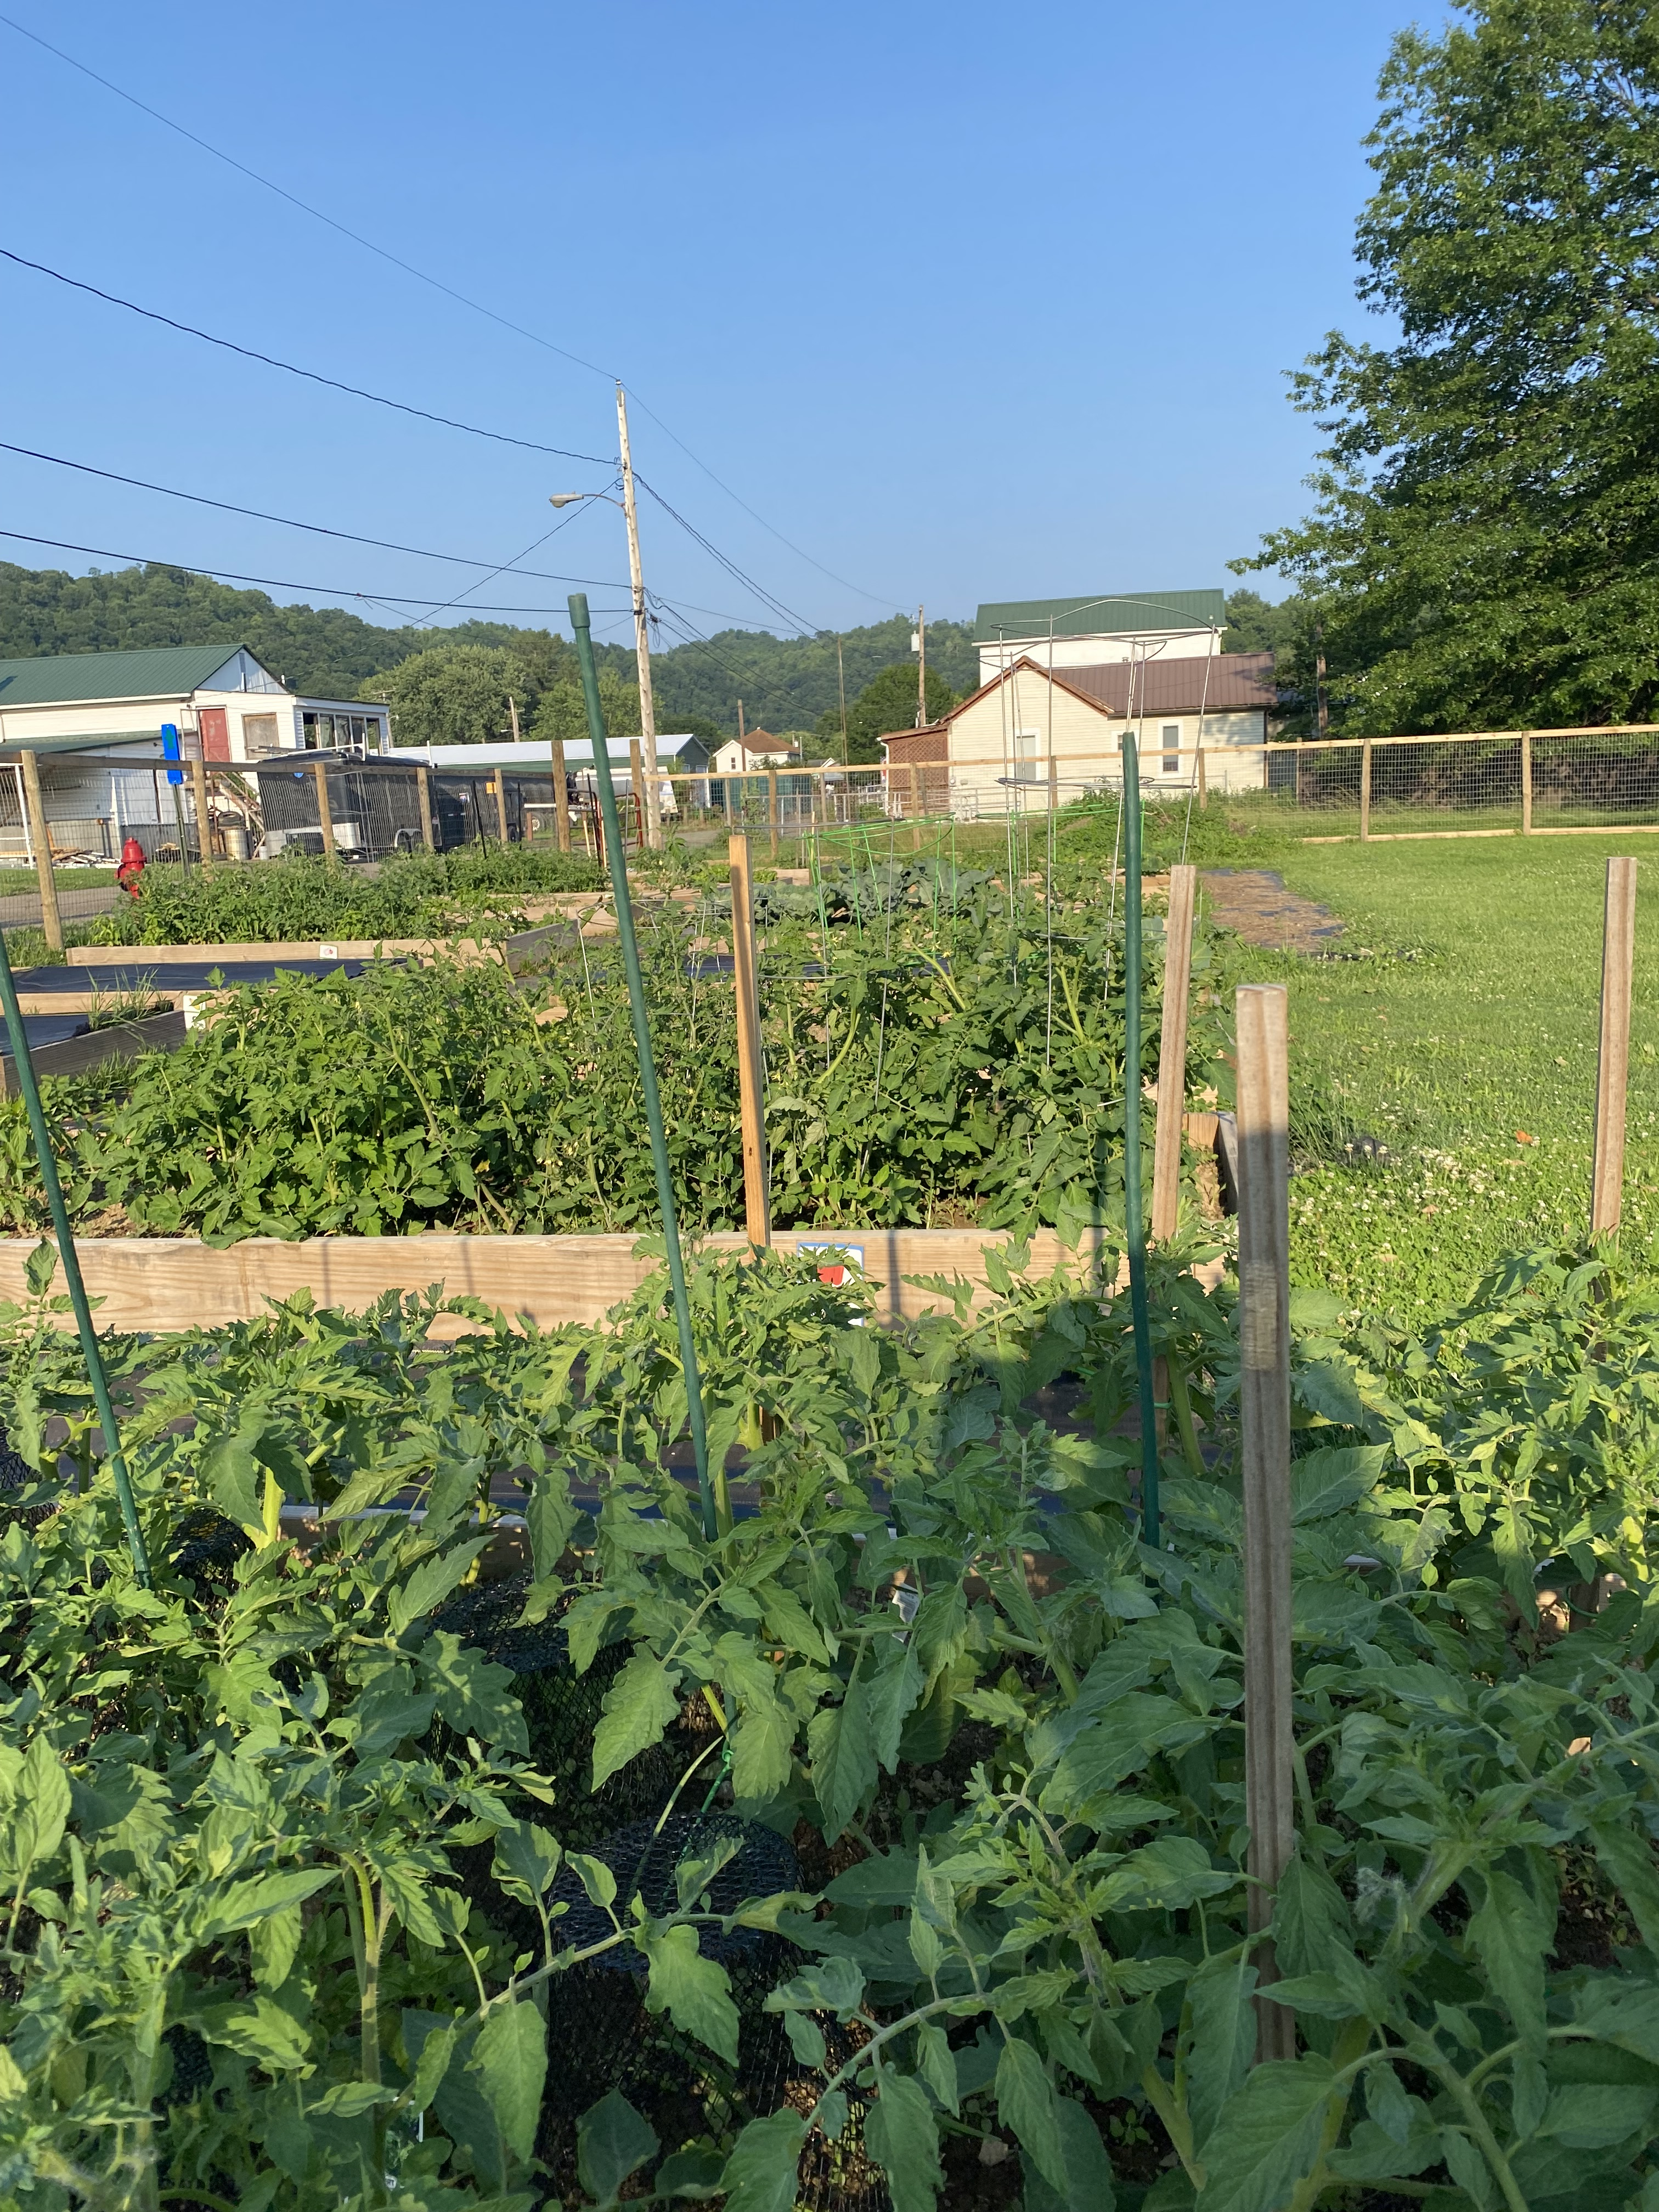

Associated Practices
Agricultural Lime
Nutrient Management
Biochar & Compost Mix

Slide 6
Agricultural Lime
Should be applied to land that needs maintenance and improvement.
Must be on a small scale operation of 10 acres or less.
Current (less then 3 years old) soil samples required.
Lifespan is 3 years.

Slide 7

Benefits of Liming
Adjusts soil pH
Enhances nutrient availability
Improves fertilizer efficiency
Adds calcium and magnesium
Promotes beneficial microbes
Reduces soil toxicity
Boosts soil structure

Slide 8
Nutrient Management
Manage rate, source, placement, and timing of plant nutrients while reducing environment impacts.
Must be on small scale operation of 10 acres or less.
Soil samples required within 1 year.
Lifespan is 1 growing year.

Slide 9
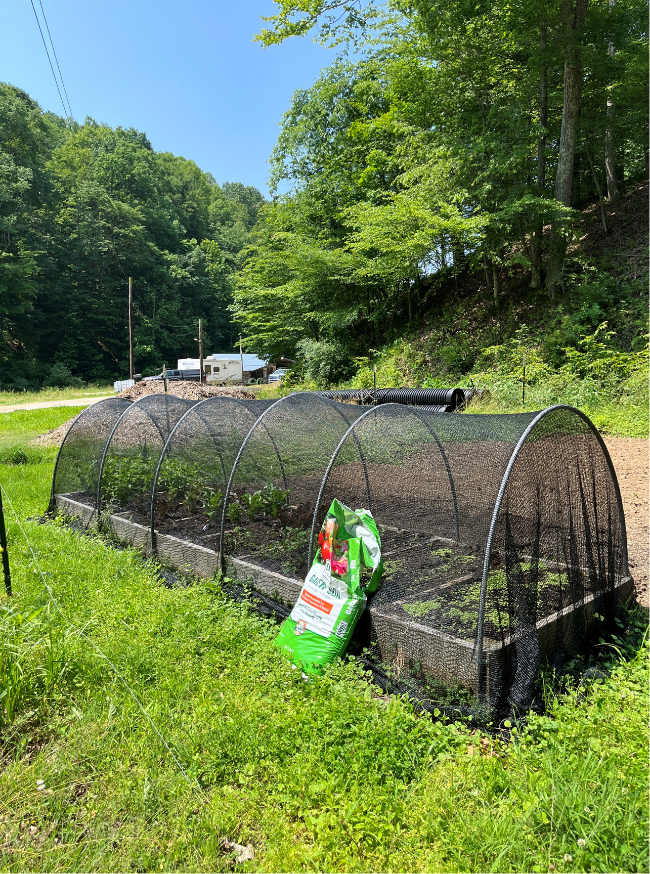
Benefits of Nutrient Management
Healthier plants
Improved soil fertility
Increased yields
Reduced environmental impacts

Slide 10
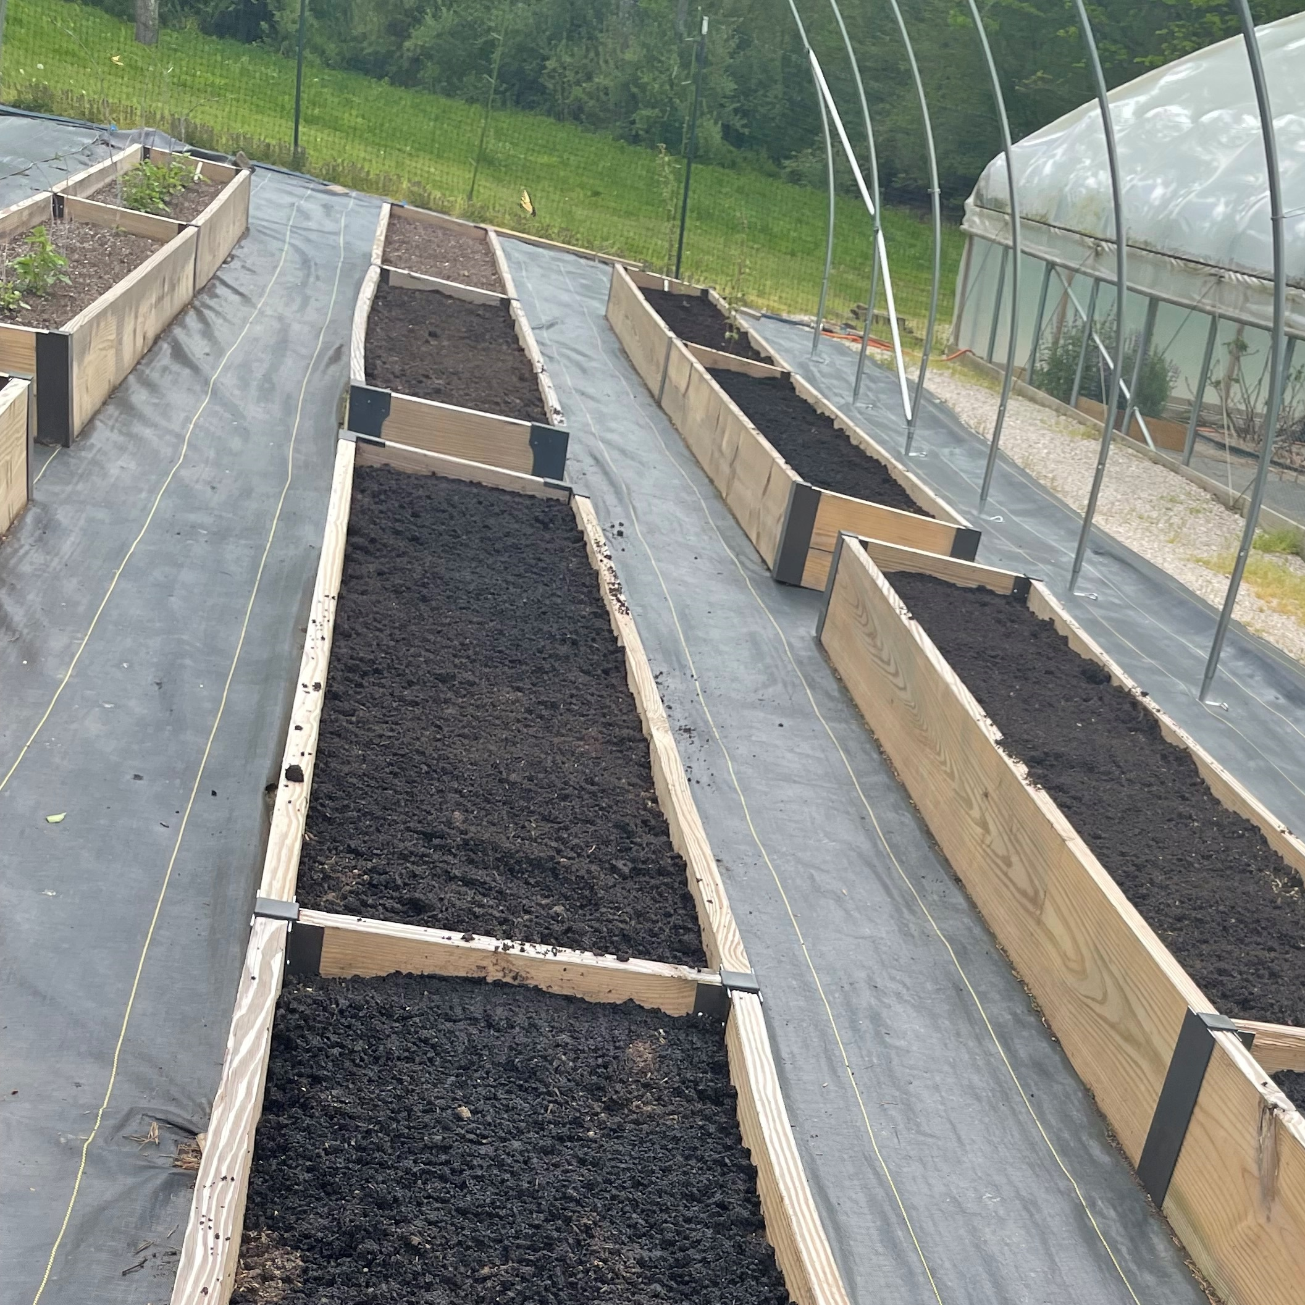
Biochar & Compost Mix
Biochar and compost mix enhances soil health.
Must be on small scale operations of 10 acres or less.
Soil samples required.

Slide 11
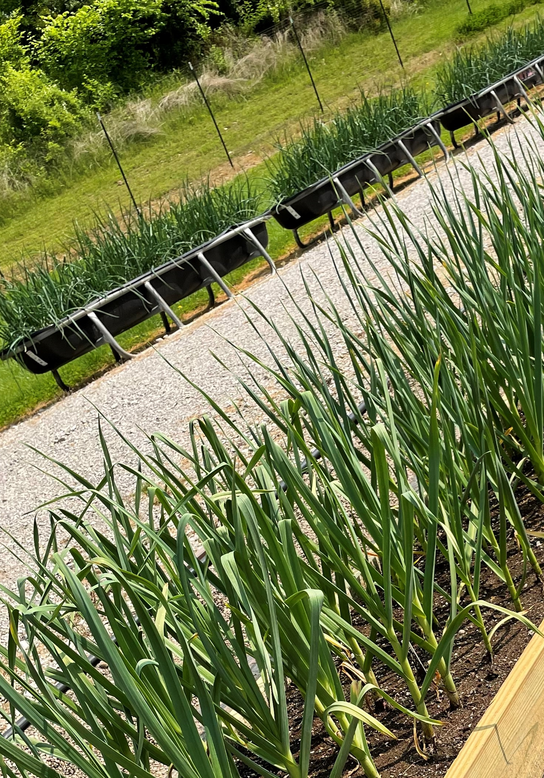
Benefits of Biochar & Compost Mix
Better water management
Increased nutrient retention
Improved soil structure
Boosts beneficial microbes
pH regulation

Slide 12
Resource Concerns
Nutrients to surface water
Nutrients to ground water
Aggregate instability
Organic matter depletion
Soil organism habitat
Plant productivity and health

Slide 13
THANK YOU
Jennifer Kile
Conservation Specialist III
West Virginia Conservation Agency
304-590-6095
jkile@wvca.us

