Slide 1
Exigency Preparedness in West Virginia
Kaitlyn Jones
West Virginia Conservation Agency
Conservation Specialist
Mon CD – Marion, Monongahela & Preston
West Fork CD - Doddridge, Gilmer, Harrison & Lewis

Slide 2
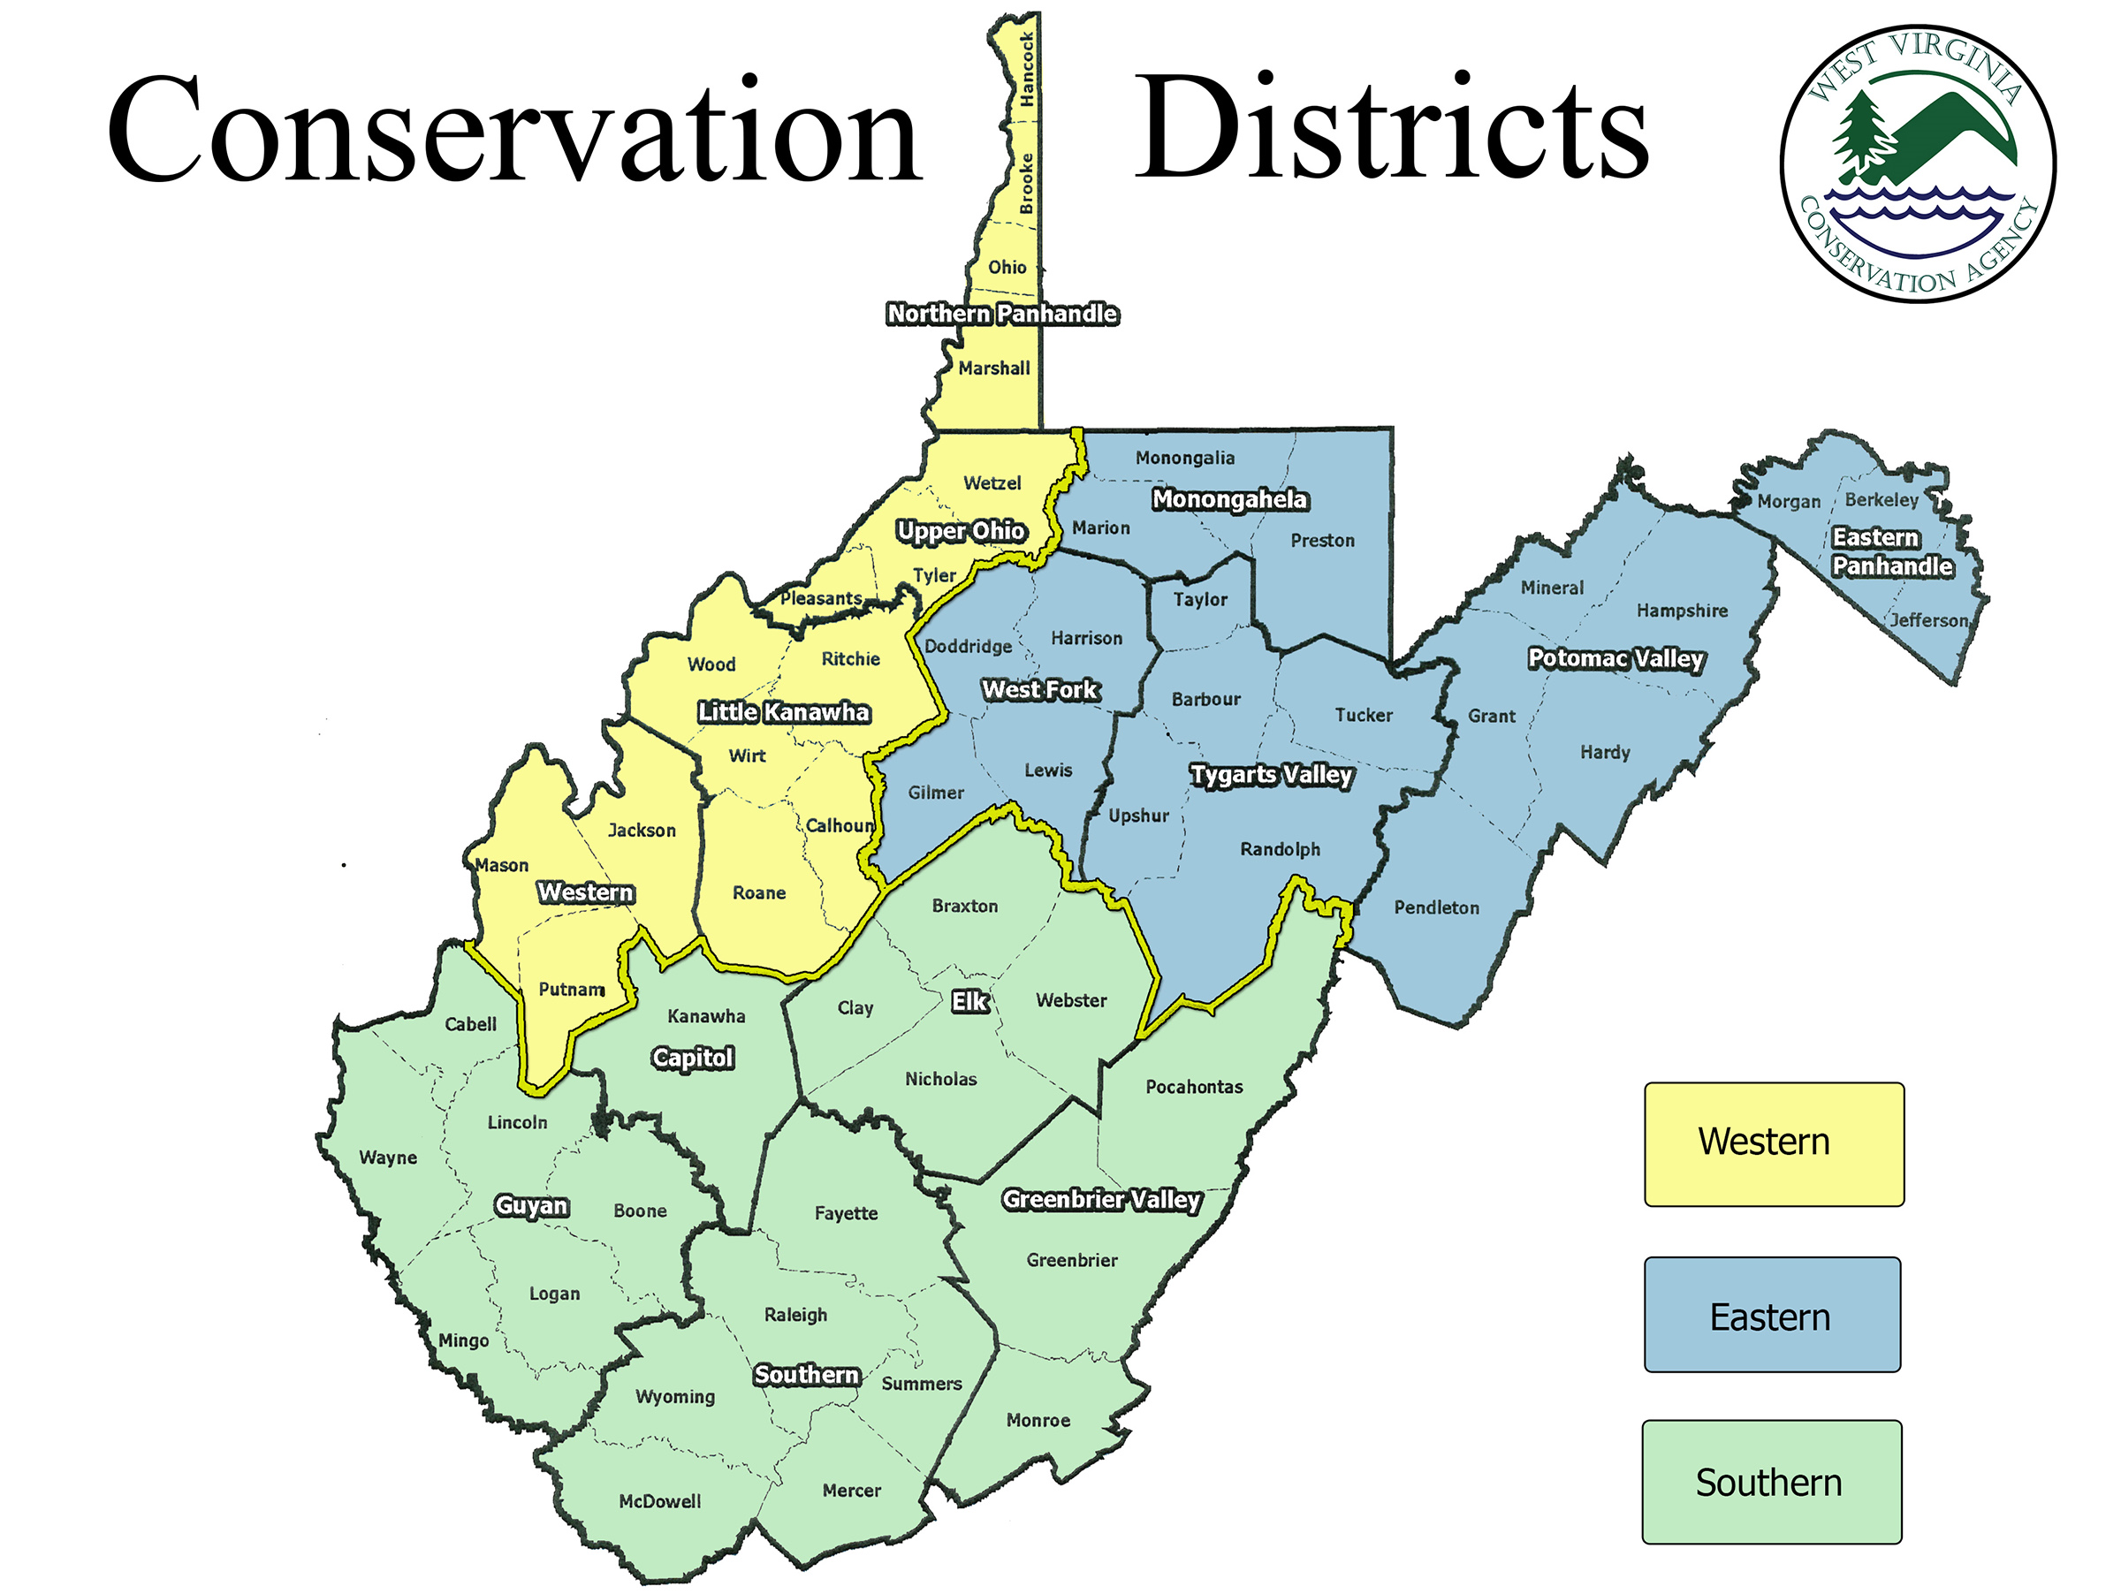
Western Northern Panhandle Upper Ohio Little Kanawha Western Eastern *Monongahela* *West Fork* Tygarts Valley Potomac Valley Eastern Pan Southern Guyan Capital Southern Elk Greenbrier Valley

Slide 3
History of Events Leading to EWP
Emergency Watershed Protection (EWP)
West Virginia changed the state law in 2006 to grant WVCA the authority to enter private property and waters of the state during times of declared emergencies to remove flood debris.
EWP is activated only when the governor issues a disaster/emergency declaration.
All EWP work shall be conducted within areas covered under the declaration.
WVCA created this policy to address response to EWP events.

Slide 4
EWP - Assistance, Implementations & Qualifications
WVCA works with the U.S. Army Corps of Engineers and DEP. • WVCA is working to involve county/city governments in recovery process. • To qualify for WVCA EWP, a project must: Pose an immediate threat to life, public health or safety; or Eliminate a threat to improved public or private property; and restore the waterway to pass a 5-year storm event. Recent examples include Spring 2019 and Fall 2019

Slide 5
Categories of Exigent Practices
Exigent Revegetation of Winter-Feeding Areas
Exigent Cover Crop Establishment
Exigent Irrigation Water Supply
Exigent Livestock Water Supply
Exigent Temporary Fence
Exigent High Tunnel and Greenhouse Repair

Slide 6
Practices Implemented Within MCD & WFCD Districts
Practice | Payment Rate | Material Cap | Cooperator Cap
Exigency Livestock Water Supply | 50% | Any approved material | $500
Exigent Temporary Fence | 50% | Any approved material | $500

Slide 7
Livestock Watering Items Eligible for Cost Share
Temporary Fencing Items Eligible for Cost Share
Materials Eligible for Cost-Share • Poly Wire • High Tensile Wire • Temporary Electric Net Fence • Insulators • Tighteners • Staples • Step In Posts • T-Posts • Corner Bracing Materials • Wooden Posts • Fence Chargers/Energizers • Ground Rods • Connectors • Other CD Approved Temporary Fencing Materials
• Portable Water Tank
• Associated Valves and Pipe Fittings
• Water Pump
• Portable Pipeline
• Portable Watering Trough

Slide 8
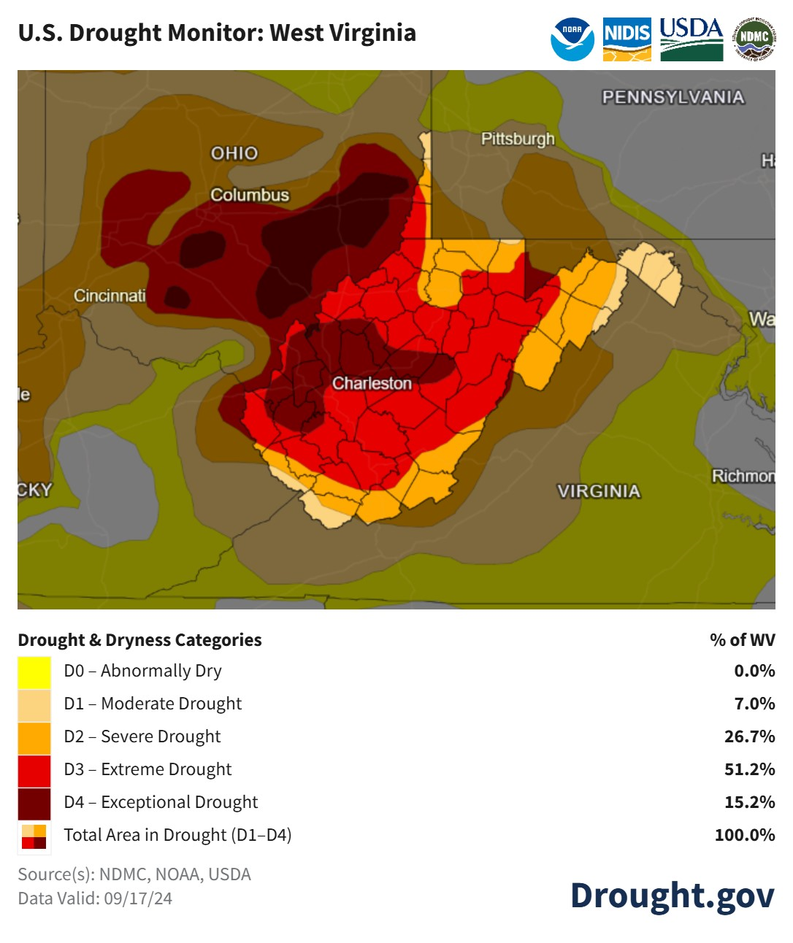

Slide 9
Other State Assistance & Information
FSA – Water systems, cost shares, hay, cattle, hauling reimbursement.
NRCS – Guidelines and assistance.
Meetings in the districts are ongoing state-wide in West Virginia and continue as a popular and priority topic.
The exigency tracking within WV Conservation Agency allows us to keep record of all drought related assistance provided.

Slide 10
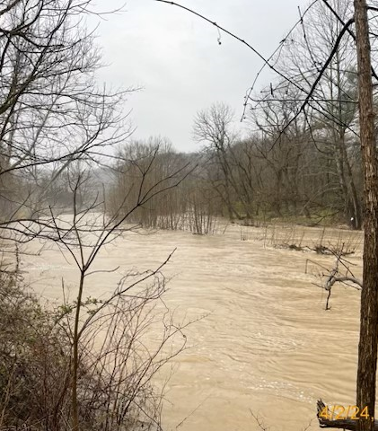
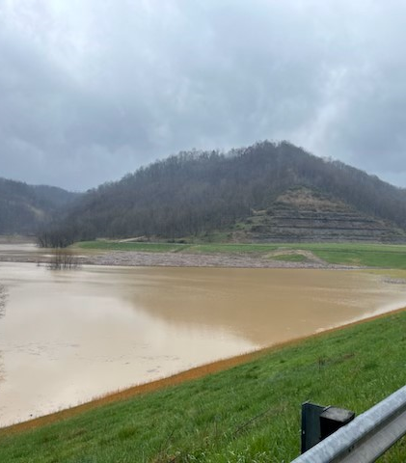
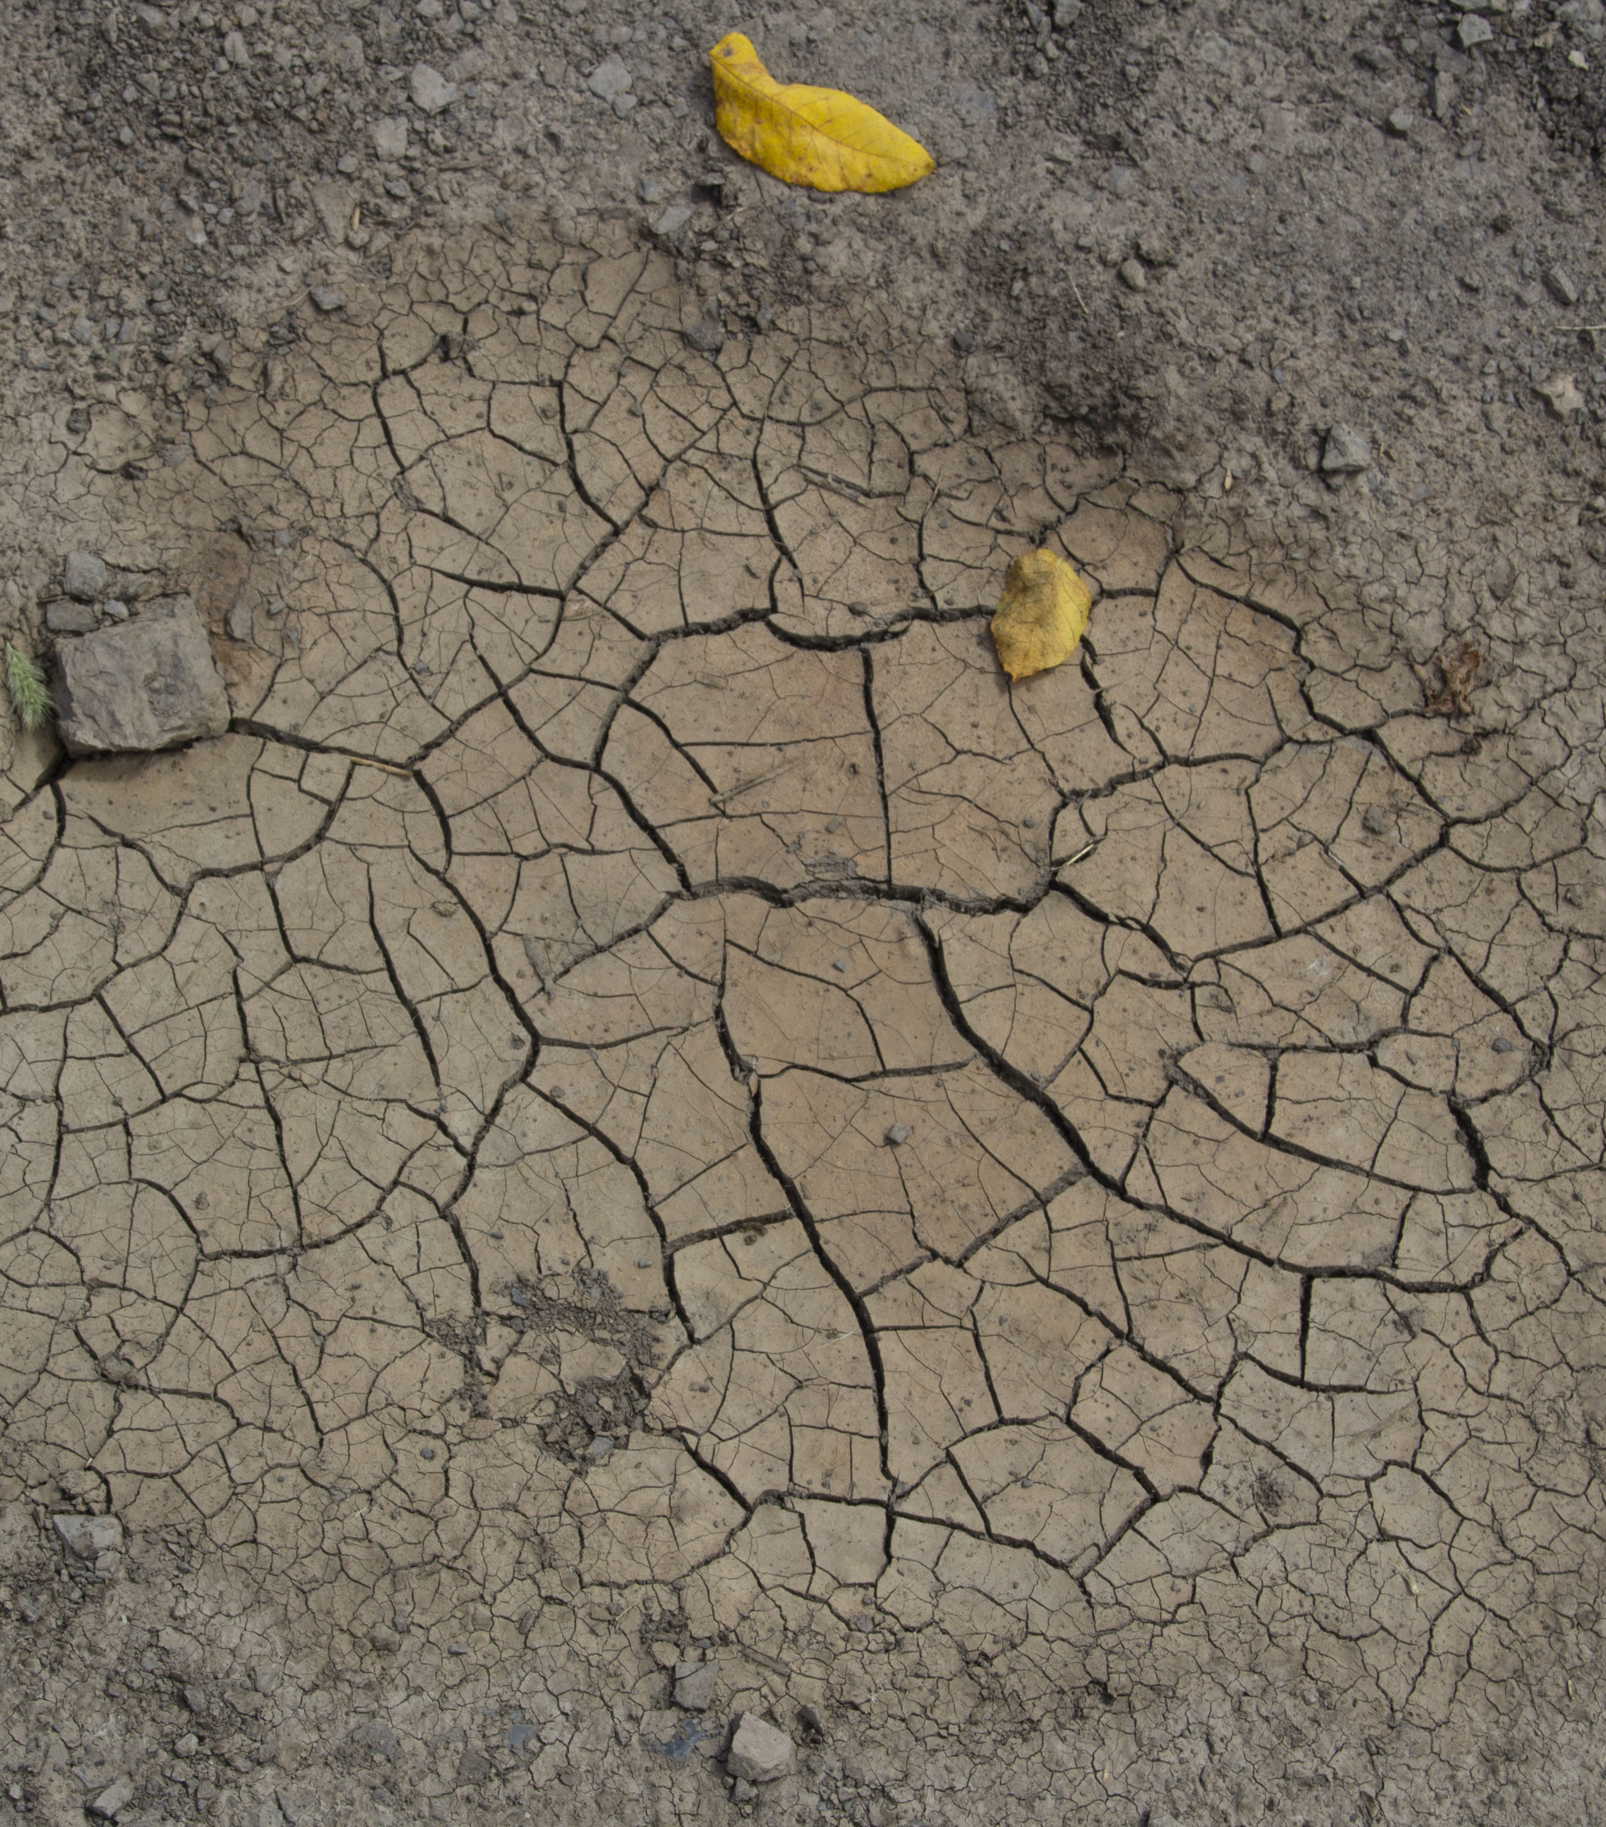
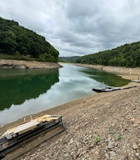
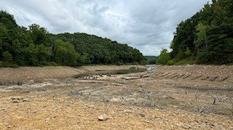
Flood and Drought
Flood - April 2024
Drought - July – September 2024

Slide 11
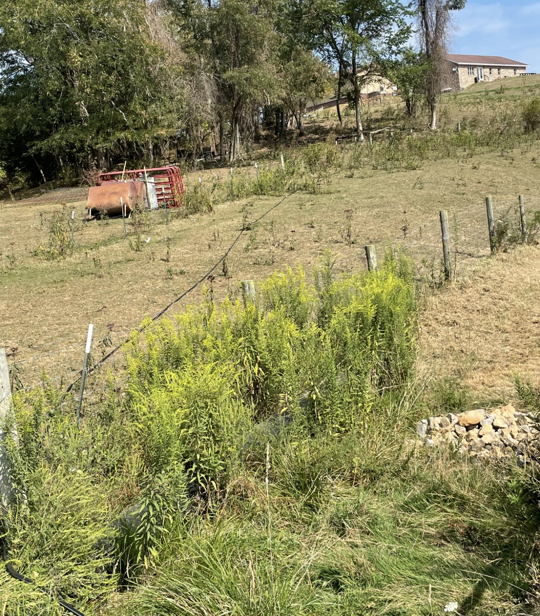
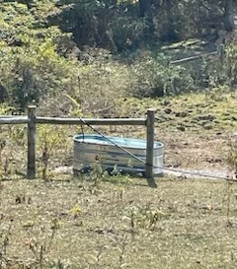
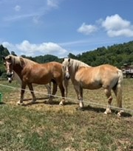
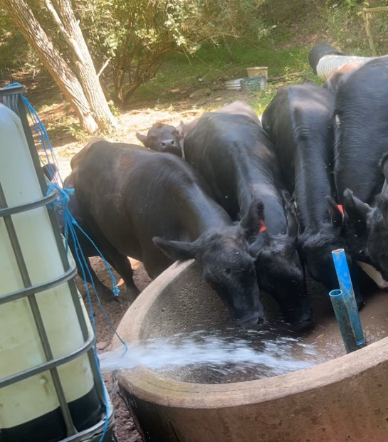
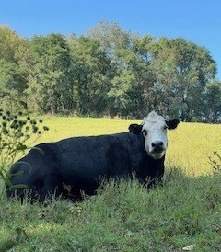
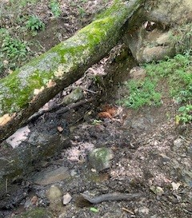
Upper Ohio district drought and water trough installation through exigency program.
Cattle in Preston County using a portable tank to get water to trough.
Horses in Gilmer and cattle in Mon using temporary fence.
Dry spring in Harrison County due to drought.

