Slide 1



Business in the front, party in the back
Mike Baden, Regional Manager
Josh Giuntoli, Regional Manager
NASCA October 2024
Notes:
This is a two part presentation

Slide 2

Washington’s Strategic Planning Guide for Conservation Districts

Slide 3
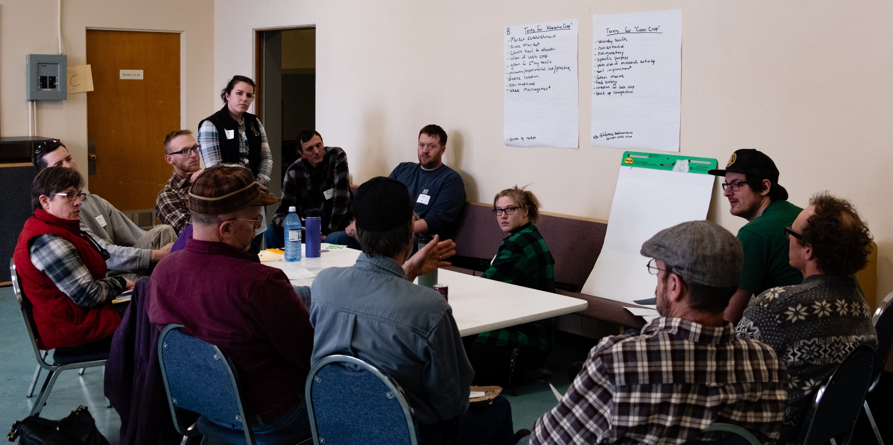
(e) The long-range renewable natural resource program, together with the supplemental annual work plans, developed by each district under the foregoing procedures shall have official status as the authorized program of the district, and it shall be published by the districts as its "renewable resources program”……..
RCW 89.08.220: Corporate status and powers of district.
Notes:
CD Planning is embedded in our enabling statute RCW 89.08

Slide 4
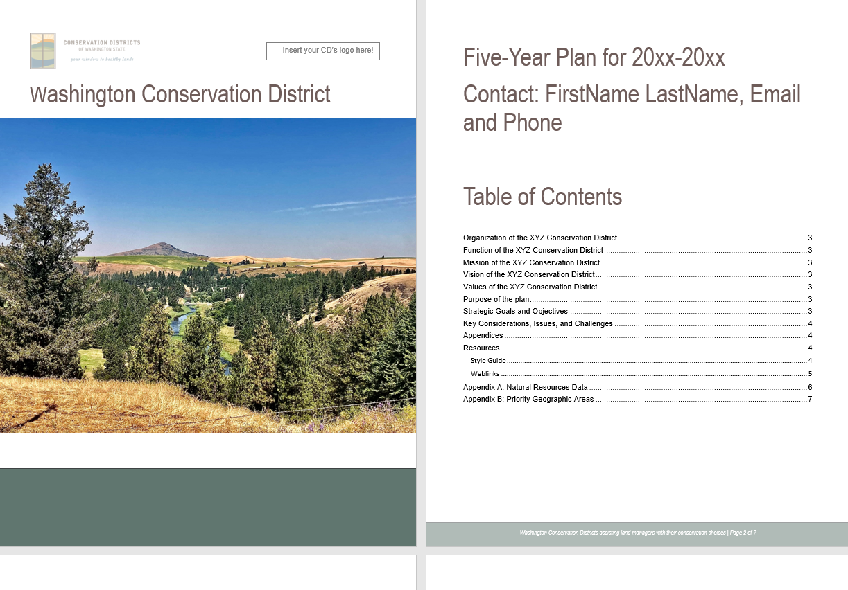
Long-Range Plan Template
Notes:
Started with a project to update our Annual and Long-Range Planning templates

Slide 5
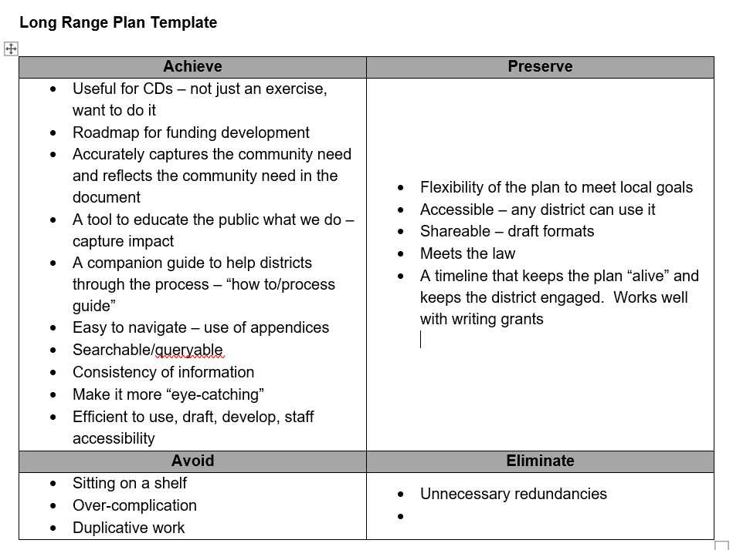
Notes:
We conducted a “Goals Grid” exercise

Slide 6

How did we get there?
Facilitated by the Commission
District Representation
Several meeting over the course of several months
Homework in between meetings
Drafting of sections assigned to individual members
Group review of drafts and finalization
Notes:
Facilitated by SCC
CD representation, CD-driven, these are their plans although information in the plans is very helpful to SCC
Lots of experience with the CD committee members
Work occurred over approximately 8 months
Homework included research, draft-writing, review
Assignments made
Feedback collected during the process
Group review led to finalization

Slide 7
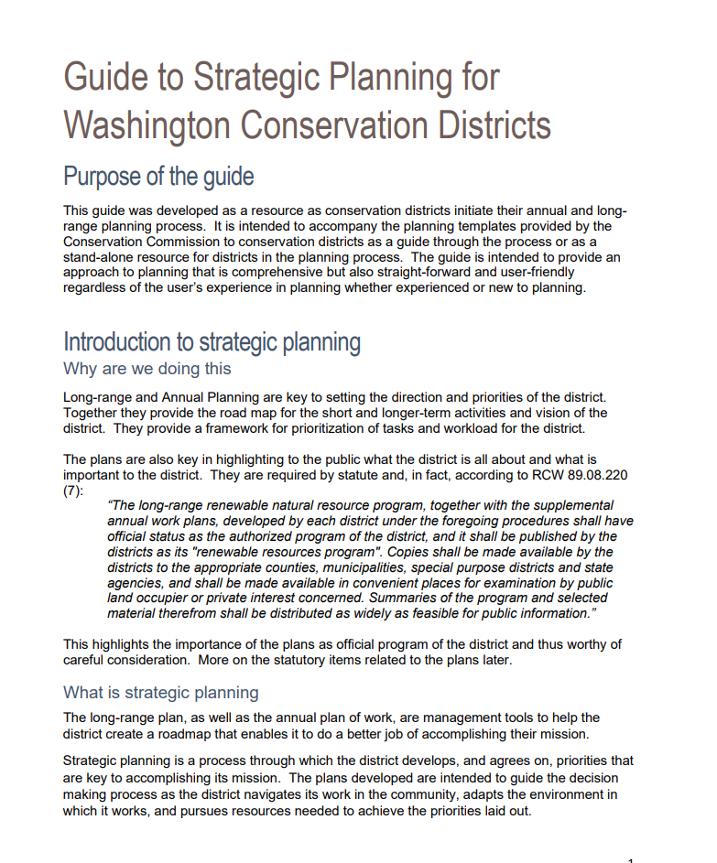
Sections
Purpose
Introduction to strategic planning
Structure of strategic planning
Assessing your situation
Content and format
From planning to implementation
Your plan as a living document
Resources
Notes:
Combination of collective expertise and experience as well as research into outside models

Slide 8

Links
Strategic Planning Guide
Long Range Plan Template
Annual Plan Template
Landing Page

Slide 9

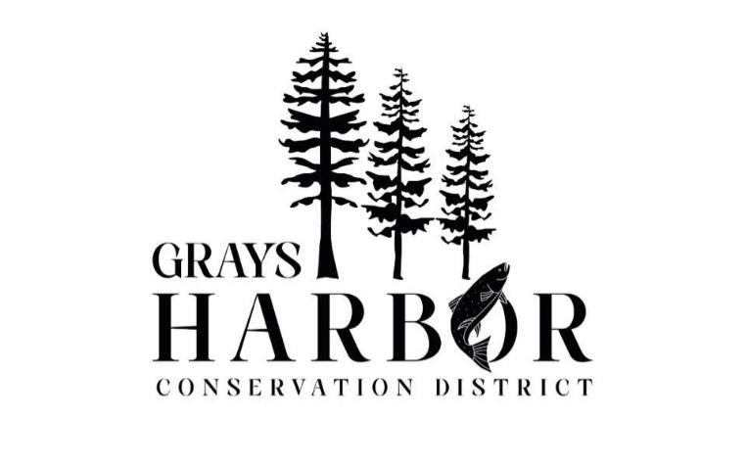
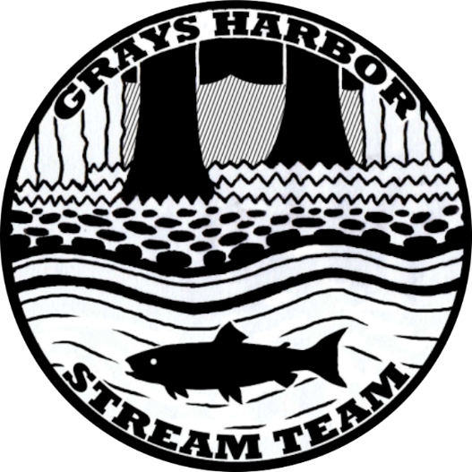
Notes:
If you were here in 2023, I shared about the unique collaboration between Grays Harbor Conservation District and Mounty Olympus Brewing in Aberdeen, Washington in support of the Grays Harbor Stream Team. For every purchase of River Roots Pale Ale, the CD commits to planting a tree in priority watersheds.

Slide 10
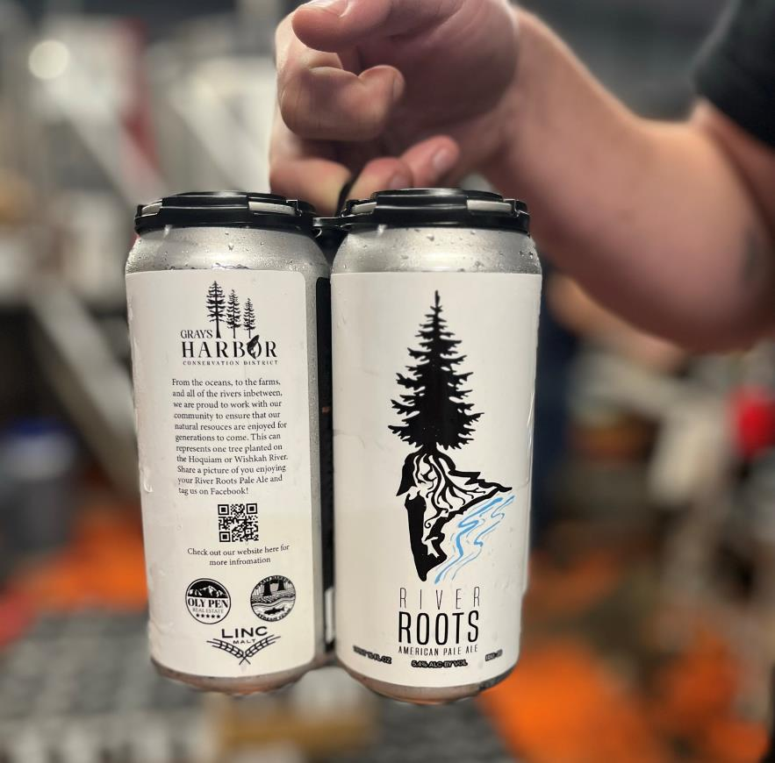
Notes:
Each can of River Roots Pale Ale includes a description of the effort, a QR code that takes you to the CD home page and features the logo of the GHCD.

Slide 11
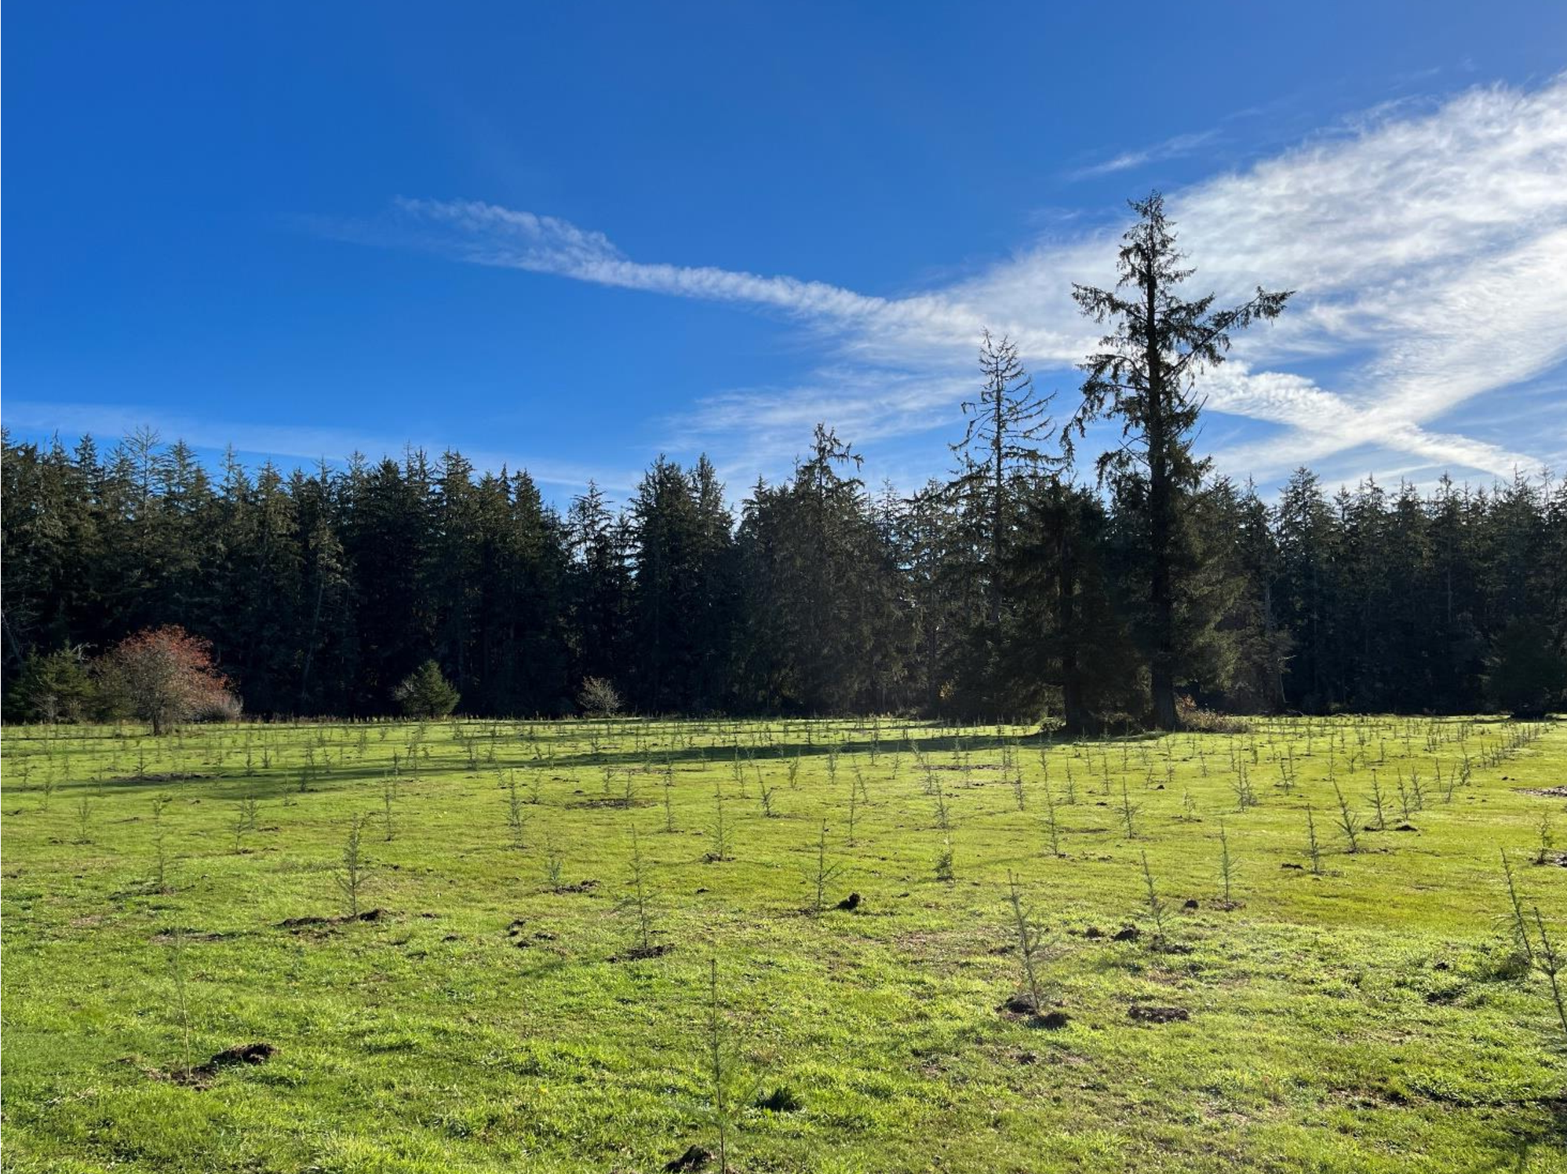
Notes:
In 2024, so far the conservation district has planted over 6500 trees in two watersheds.

Slide 12

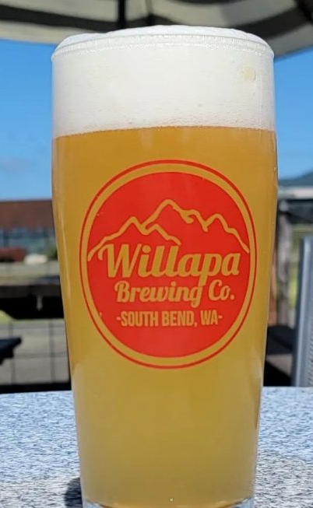

Notes:
I have another collaboration to share with you that was initiated in March 2024 between the a conservation district and another local brewery. This time with an emphasis on raising awareness concerning the invasive European Green Crab in Willapa Bay, home to some of the worlds most productive aquaculture ground and ideal growing conditions.
Pacific Conservation District partnered with Willapa Brewing Company in South Bend, WA to raise awareness and funding to save the local oyster beds from the invasive European green crab. For every Alien Crab Smash Hazy IPA, 20% of the proceeds is donated to the CD for the continued fight against the European Green Crab invasion in Willapa Bay. To date, they have sold 812 Alien Crab Smash beers which has resulted in $1,136 of donations directly from beer sales and an additional $200 from public donations (as a result of learning about the effort).

Slide 13
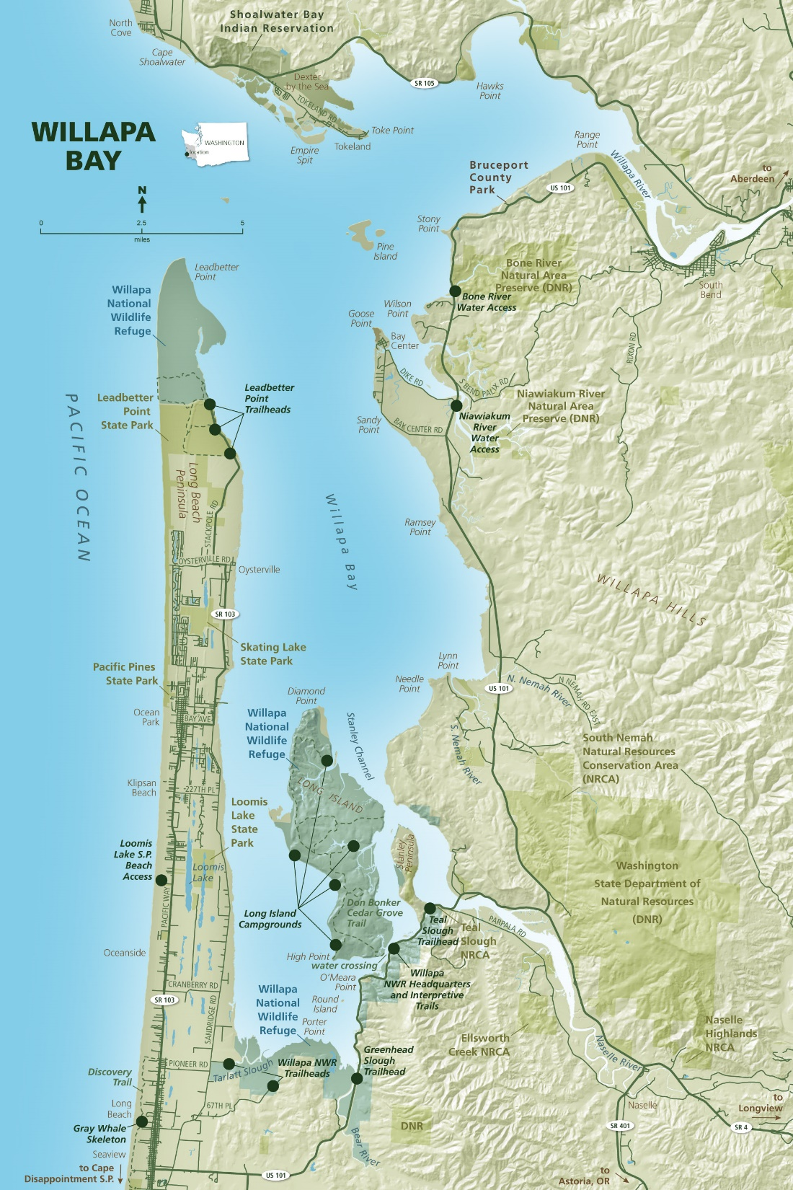
Notes:
Pacific County is a natural resource rich area of our state with commercial timber and aquaculture the predominant economic drivers. With a population of 23,000 and the median household income is 64% of the statewide average. 25% of oysters produced in the US are from Willapa Bay and neighboring Grays Harbor — the largest oyster-growing area in the country. In Willapa Bay alone, the 25-mile long embayment covering 135 square miles produces 5.95M lbs of shellfish valued at $15.6m with 15-24% of Pacific County’s labor-earned income comes from the shellfish industry accounting for $45M shellfish-related payroll in Pacific County.

Slide 14
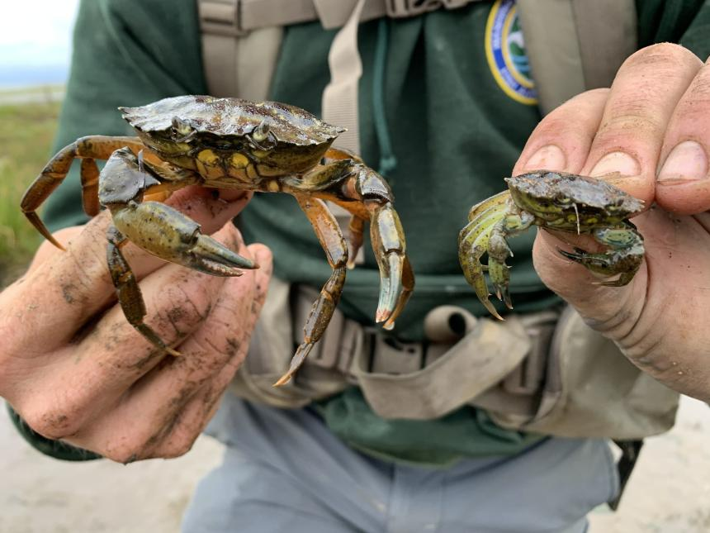
Notes:
The green crab is an effective predator, adept at opening bivalve shell. It is believed that the green crab feeds on many organisms, including clams, oysters, mussels, marine worms, and small crustaceans. Because they can prey on juvenile crabs and shellfish the Dungeness crab, clam, and oyster fisheries of the area could be at risk, and the green crab might also compete with native fish and bird species for food. In addition, the green crab is an intermediate host to a marine worm that can harm the health of local shorebirds. Since January 2022, over 600,000 green crab have been captured in the coastal area.

Slide 15
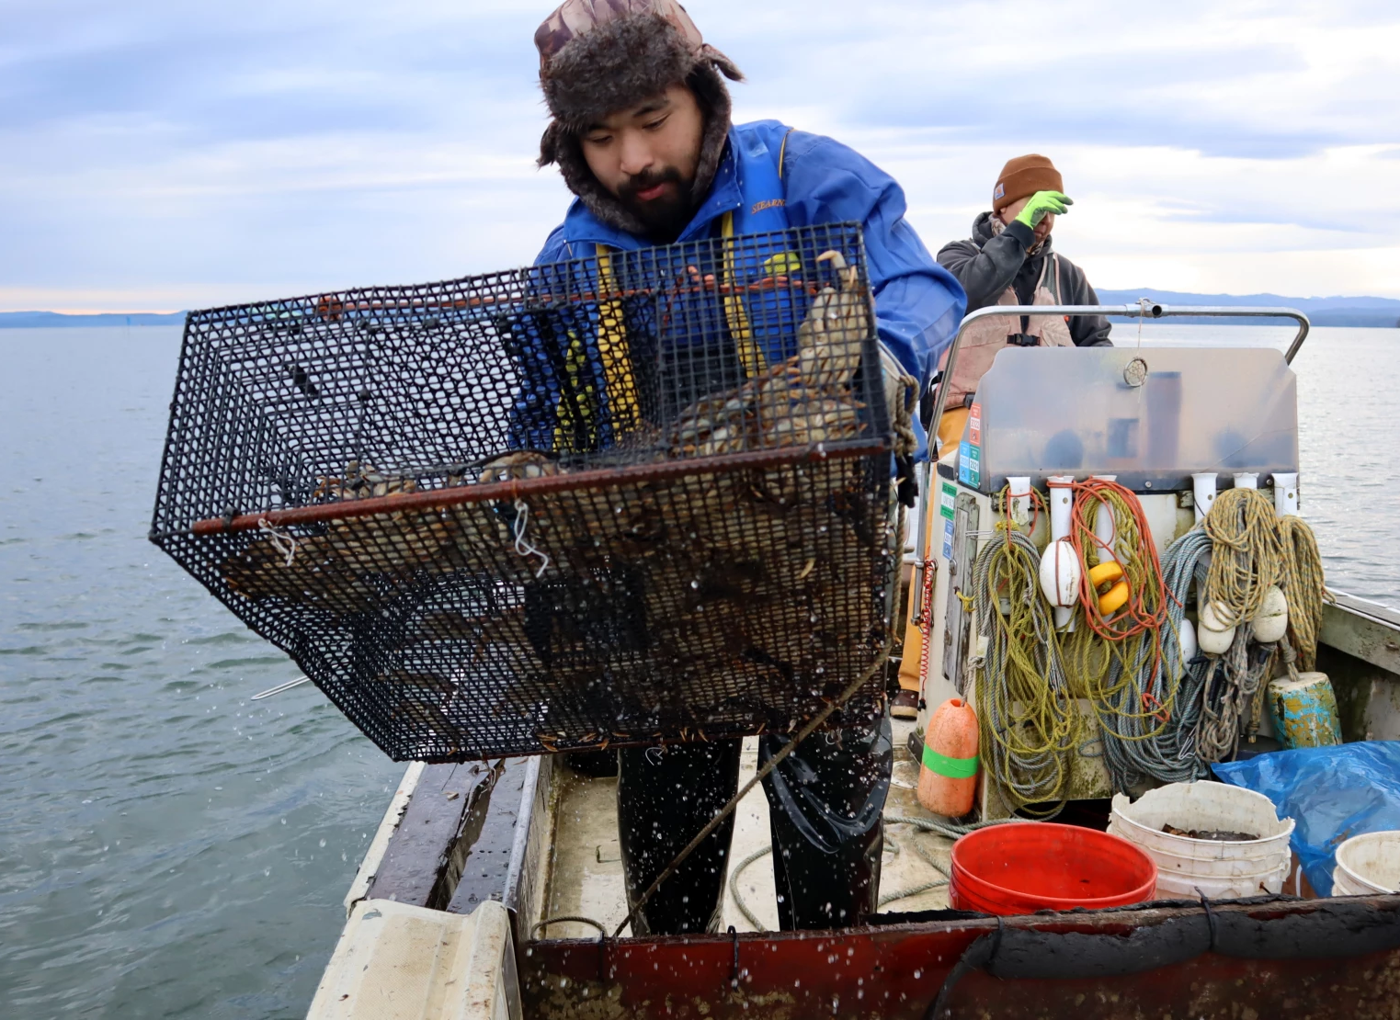
Tom Banse / NW News Network
Notes:
25% of oysters produced in the US are from Willapa Bay and neighboring Grays Harbor — the largest oyster-growing area in the country. In Willapa Bay alone, 23% of intertidal lands produce 5.95M lbs of shellfish valued at $15.6. 15-24% of Pacific County’s labor-earned income comes from the shellfish industry accounting for $45M shellfish-related payroll in Pacific County. The green crab is an effective predator, adept at opening bivalve shell. It is believed that the green crab feeds on many organisms, including clams, oysters, mussels, marine worms, and small crustaceans. Because they can prey on juvenile crabs and shellfish the Dungeness crab, clam, and oyster fisheries of the area could be at risk, and the green crab might also compete with native fish and bird species for food. In addition, the green crab is an intermediate host to a marine worm that can harm the health of local shorebirds. Since January 2022, over 600,000 green crab have been captured in these two growing areas.

Slide 16
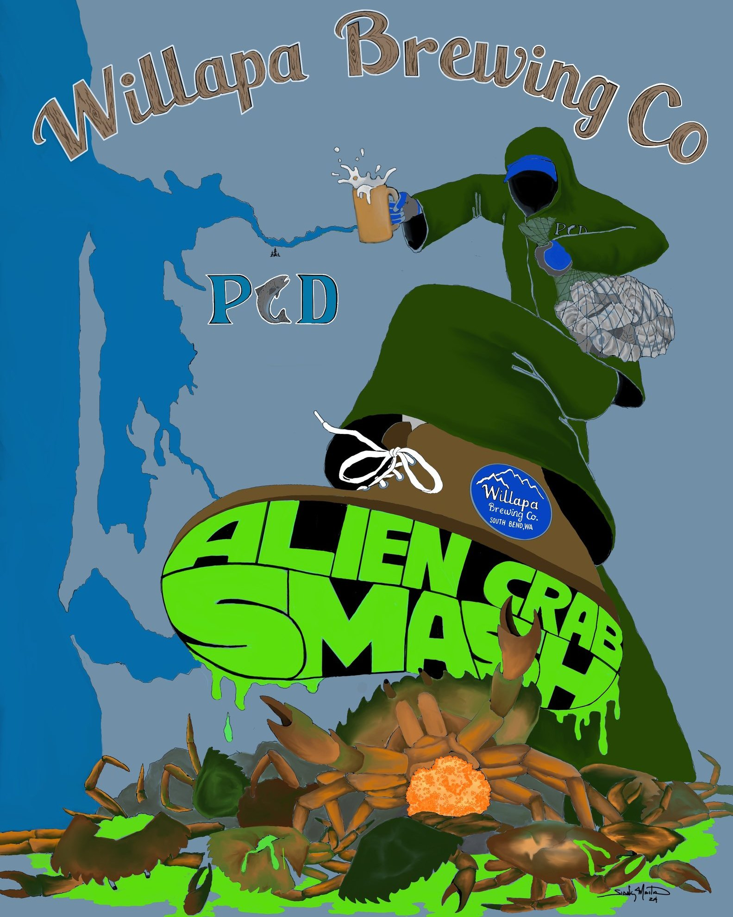
Notes:
In terms of how it this has directly impacted the CDs outreach efforts, it has given them a venue to educate people locally about this issue. Willapa Brewing is one of the more popular establishments in town and has a strong tourist draw as well due to their location and participation in the Harvest Host program which offers travelers a place to stay on their property; so not only are they able to educate locals who may not have heard about this before but they can also spread the word through those just passing by in their small town.
This beer has also been a huge conversation starter. The staff at Willapa Brewing have really gotten behind the CD and learned about the issue so they can effectively communicate it to customers and CD staff have gotten a lot of comments in passing and also just recently at the fair from people who didn't know anything about EGC until they learned about it from the beer partnership.
In terms of dollars, even though it isn't a lot so far they’ve learned from the growers who go out there and catch the crab that every dollar counts. Last year there were teams of trappers who had to stop trapping early because they ran out of money before the new biennium, so this helps bridge the gap which can be the difference of thousands of EGC. For example one of the trappers in Willapa posts updates on their catch numbers where on the low end they may catch 300 in a day and on the high end they may catch nearly 7,000 in a day. So a day they can't trap is a big loss to the effort. WDFW does offer the CD the option to apply for education and outreach dollars to come out of the pot of money for the EGC program but this effort is such good outreach that it allows us to pass on those dollars to ensure that the entirety of WDFW dollars for EGC in our county is going directly to the trapping efforts.

Slide 17

Questions?
Notes:
Closing image dimensions: 5.5x4

Slide 18
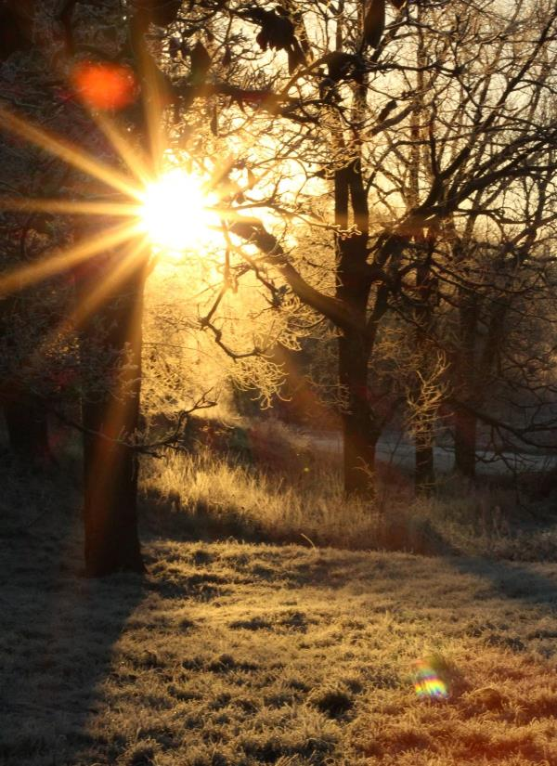


Contact:
Josh Giuntoli
SW Regional Manager
jgiuntoli@scc.wa.gov
360-485-8538
Mike Baden
NE Regional Manager
mbaden@scc.wa.gov
509-385-7510
Notes:
Closing image dimensions: 5.5x4

