Slide 1
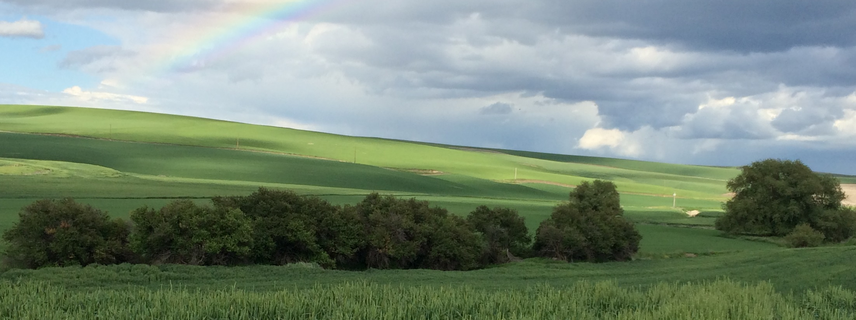


Washington State Conservation Commission District Digest
Keeping conservation districts in the know
Allisa Carlson, Central Regional Manager
NASCA Annual Conference, October 27, 2025
Notes:
Cover photo dimensions: 5x13.33

Slide 2


Communication and risk management tools
SCC to CDs
News blog
Attending board meetings
Emails
Research
CDs to SCC
1:1 phone calls/emails
Online meetings

Slide 3
Communication and risk management tools
District Digest
SCC to CDs
News blog
Attending board meetings
Emails
Research
Newsletters!
CDs to SCC
1:1 phone calls/emails
Online meetings
“monthly summary of essential information for Washington’s conservation districts”
1x/month

Slide 4
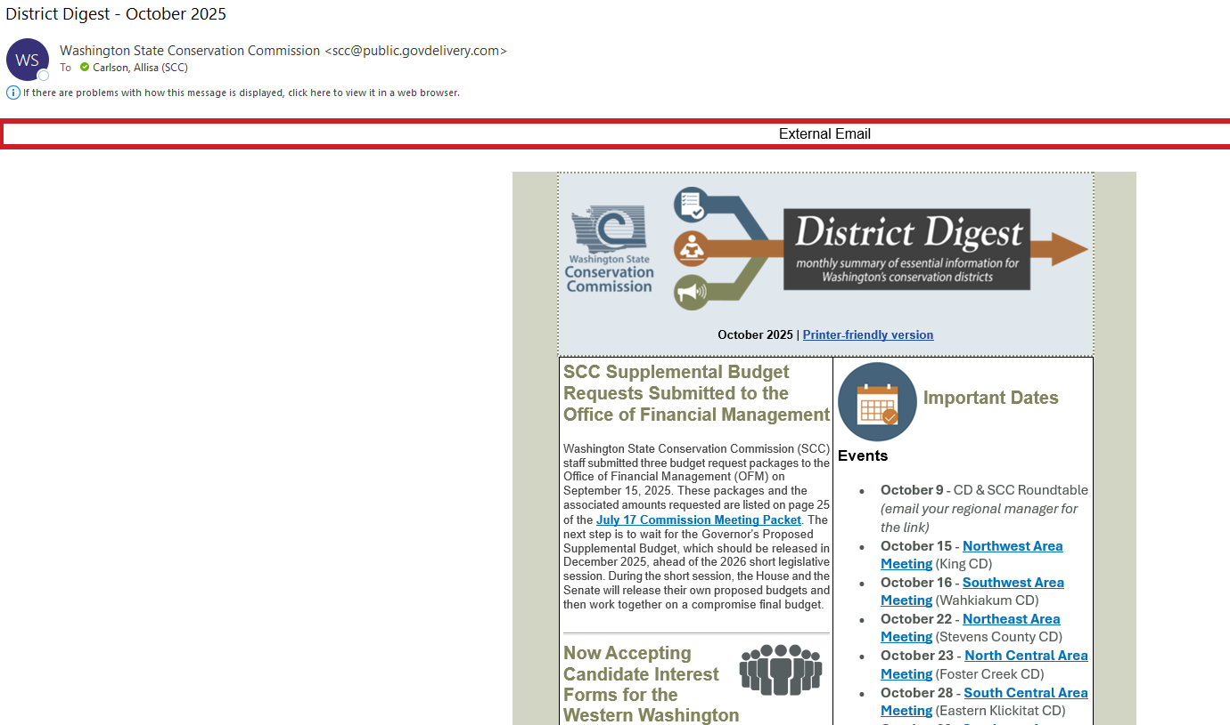

Slide 5
Topics
Important dates
Newsy bits/general updates
Policy
Programs
District operations
Elections
In partnership
Funding opportunities
Training
Q&A of the month
District Digest

Slide 6
Operating
VSP
RCPP
District Digest
45 CDs
225 board members
managers & staff leads
NRI
Shellfish
CREP
Irrigation

Slide 7
Operating
SFF
RGP
WSRRI
VSP
RCPP
District Digest
45 CDs
225 board members
managers & staff leads
NRI
Shellfish
CREP
Irrigation
RPPP
FHCWR
ACES

Slide 8
District operations
Office of the State Auditor
  Newsletter
  Audits
  Financial reports
  Trainings
Municipal Research Services Center
  Washington’s nonprofit local government legal and policy guidance center
  Blog – rule and policy updates, interpretation
  Trainings
  SCC updates that affect CD operations
  Fiscal policies and procedures
  Cultural resources
District Digest

Slide 9
Question & answer
of the month
Highlighting ‘real life’
  Open public meetings reminders
  Elections
  Grant policies/procedures
Referencing
  Municipal research & services center
  Reminding
  Cost share records retention requirements
District Digest

Slide 10

The benefits of a “one stop shop” newsletter
A proactive tool
  Directs people to information in a variety of places
  Promotes transparency, builds relationships
Raise awareness
  Help busy volunteer board members be aware of risks, such as the open public meetings act
  Ensure districts are aware of policy details and new requirements
  Share training opportunities to support capacity
  All in one place, consistently delivered
  Saves time! CDs can focus on getting conservation on the ground
Stay in the know, reduce the risk!

Slide 11
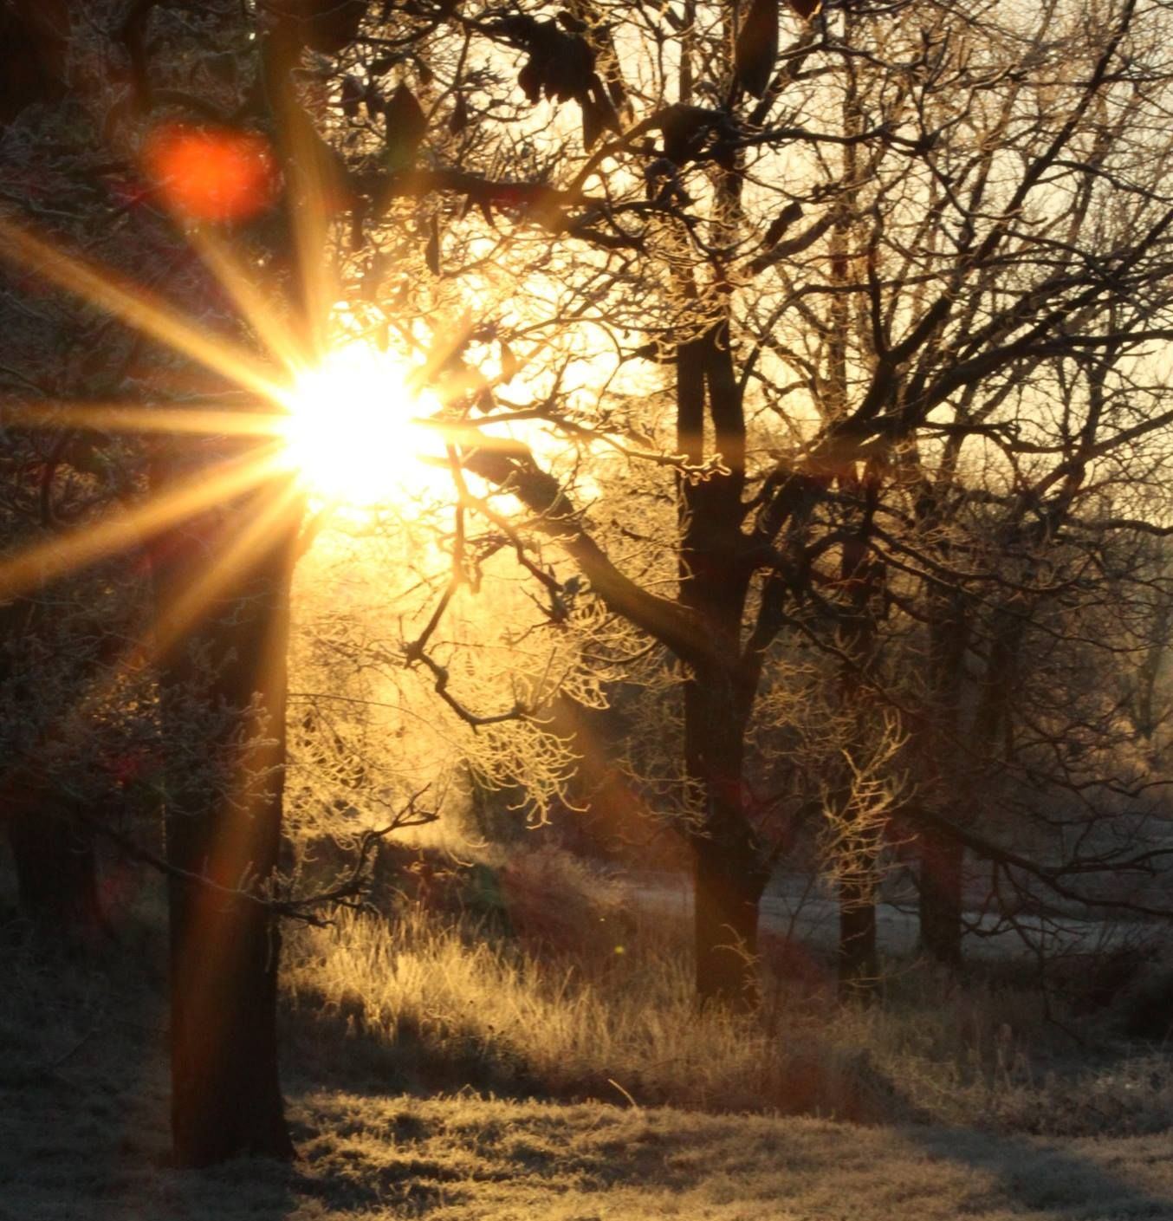


Thank you!
Contact:
Allisa Carlson
Central Regional Manager
acarlson@scc.wa.gov
360-480-6686
Notes:
Closing image dimensions: 5.5x5.3

