Slide 1
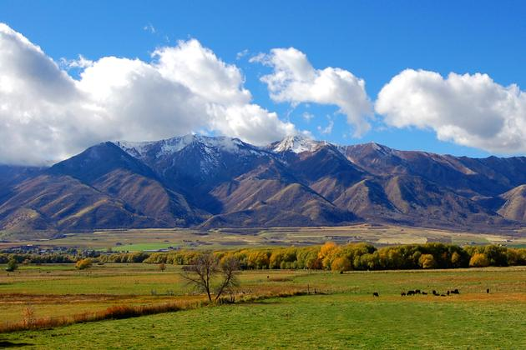

Utah Conservation Districts
Jace Farnsworth
Deputy Director –
Utah Department of Agriculture and Food

Slide 2
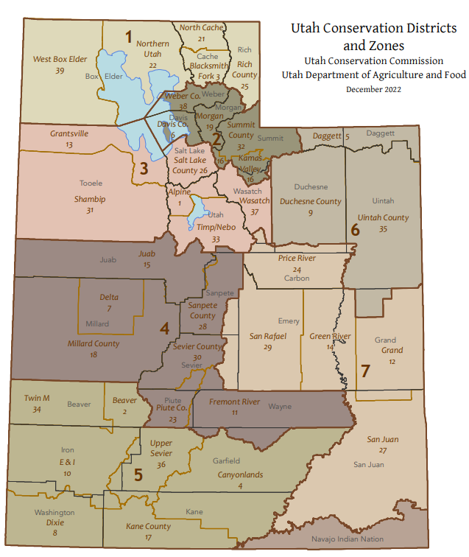
Current Conservation Districts in Utah
38 Districts ($11,000 /year)
  190 Supervisors (board Member)
  35 Clerks
  4 CD Conservation Planners
7 Zones
UDAF Funded employees
  7 Resource Coordinators
    8 Conservation Planners
    4 Watershed Coordinators
  5 program Managers
    6 Program planners
    5 Other Employees
    1 Archologist

Slide 3
Current Audit of District Meetings and Supervisor attendance over the last 3 years. Seeing a decline in Conservation District attendance and lack of drive and excitement in the districts. Worlds too busy now!!! Need to get the younger generation involved
2023
FY 2023 (July 22 – June23)
Districts held meetings Range from 42 % - 100 %
Overall Avg Supervisors attendance 74.6 %
2024
FY 2024 (July 23-June 24)
Districts held meetings Range from 33 % -100 %
Overall Avg Supervisors attendance Range from 75.5%
2025
FY 2025 (July 24 – June 25)
Districts held meetings Range from 42 % - 100 %
Overall Avg Supervisors attendance 75.2 %
State held 77 % District Meetings average of all 38 Districts
State held 78% District Meetings average of all 38 Districts
28 board members Below 50% attendance
State held 80% District Meetings average of all 38 Districts
29 board members Below 50% attendance
Super Stars
15 Board Members 100% / 3Yr
68 Board Members >90% / 3yr
1 District 100% Meetings / 3 yr
7 > 90% Meetings held / 3yr

Slide 4
Super District Concept
Consolidate Current Districts to form Super Districts
  38 Conservation Districts down to 7-10 Super Districts or just 1 per County - 29
Local Control – Keep Local control by having supervisors from current district areas represent in super districts 11-15 board members (Current 190 Board members down to 105-150)
Consolidate Funds – Currently (11k per year/ district) $418,000 total district operating funds.
Reallocate Funds – Operation cost and remaining into Project Fund Pool
  Possible Funds Breakdown (100k in operation cost and $318k in project pool funds)
Create Project Fund Pool for more meaningful district projects
Reduce number of meetings (38 districts x 12 months = 456 meetings a year + other zone outreach meetings )
  7-10 Super Districts 120 a year, 6 in-person scheduled and 6 virtual (60 In person, 60 Virtual)
Reduce Staff hours and Traveling cost to meetings (# of meetings (456) down to 60 Meetings
  Currently some up to 6 hours travel time 2 hour meeting full 8 hour day for 1 meeting.
Make meetings more meaningful in hopes of better attendance

Slide 5
Thoughts? Questions? Comments?
Will this work and be the future of Conservation Districts?

