Slide 1
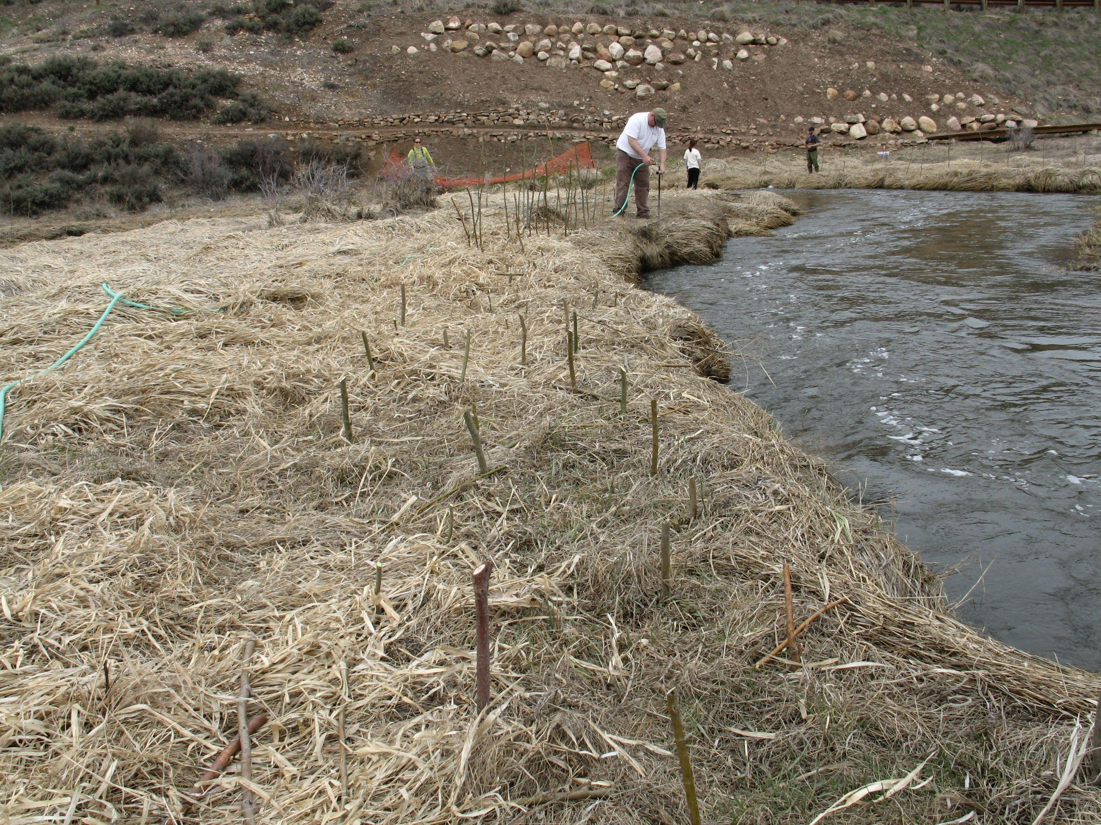

Engaging Conservation Districts
In Watershed Planning
Utah Department of Agriculture and Food
Brian Christensen – Resource Coordinator
Darrell Gillman – Resource Coordinator

Slide 2
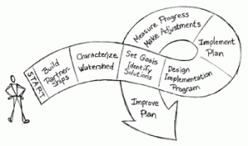
Watershed Planning Process
The watershed planning process works within a framework to identify and quantify specific causes and sources of water quality problems. It also identifies water quality goals and specific actions required to solve water resource challenges.
Introduction to Watershed Planning – U.S EPA

Slide 3
Goals for Watershed Planning
Access funding and resources
Identify projects for implementation
Build partnerships among stakeholders
Monitor
Establish goals and objectives
Identify and prioritize areas of concern
Monitor and evaluate improvement
Districts are a key link between the landowners and the state and federal partnering agencies

Slide 4
The Function of the Conservation District:
To take available technical, financial, and educational resources, whatever their source, and focus or coordinate them so they meet the needs of the local land user for conservation of soil, water and related resources
Adapted from Pete Nowak’s “The Conservation District Official:
Villain or Victim?

Slide 5
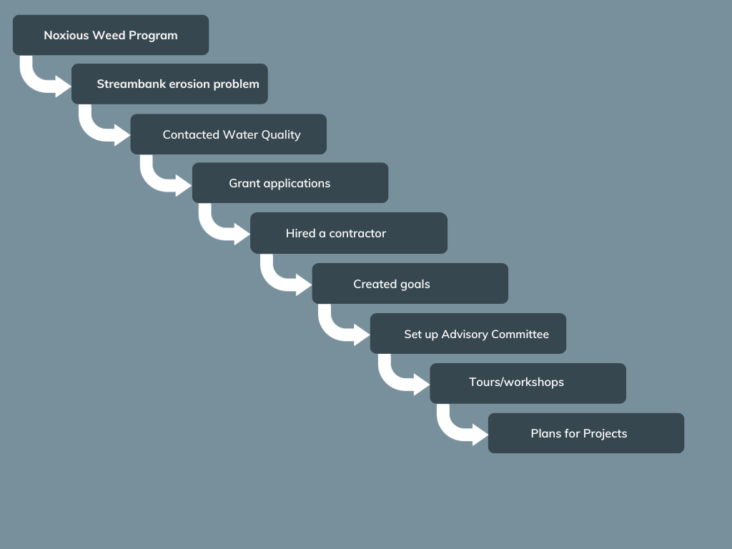
Davis Conservation District Path

Slide 6
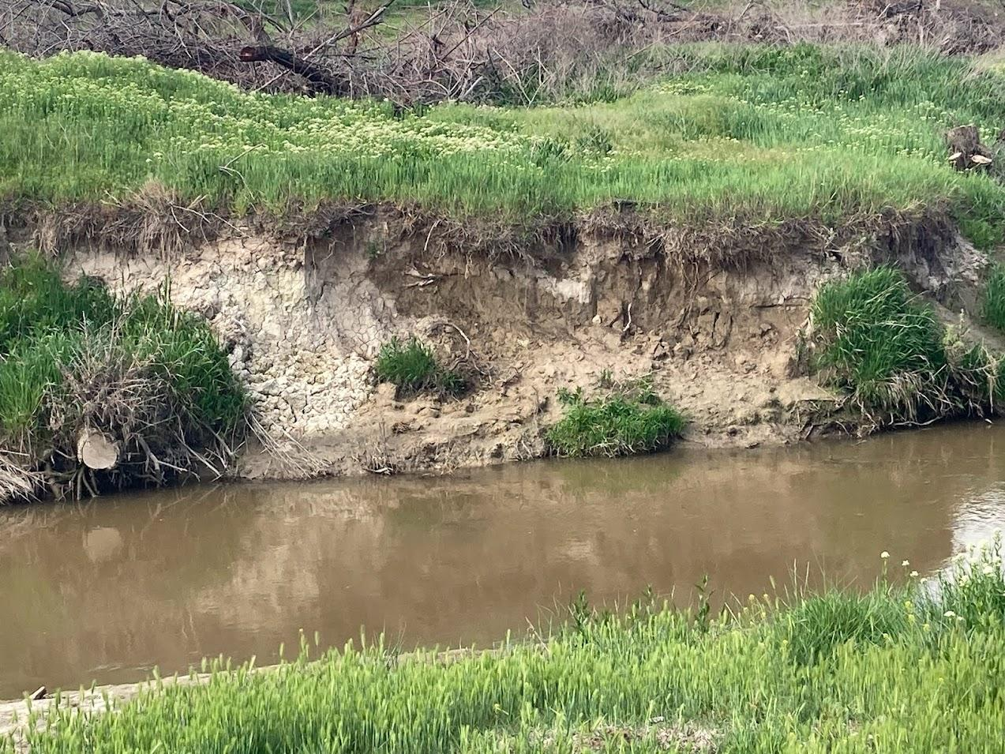
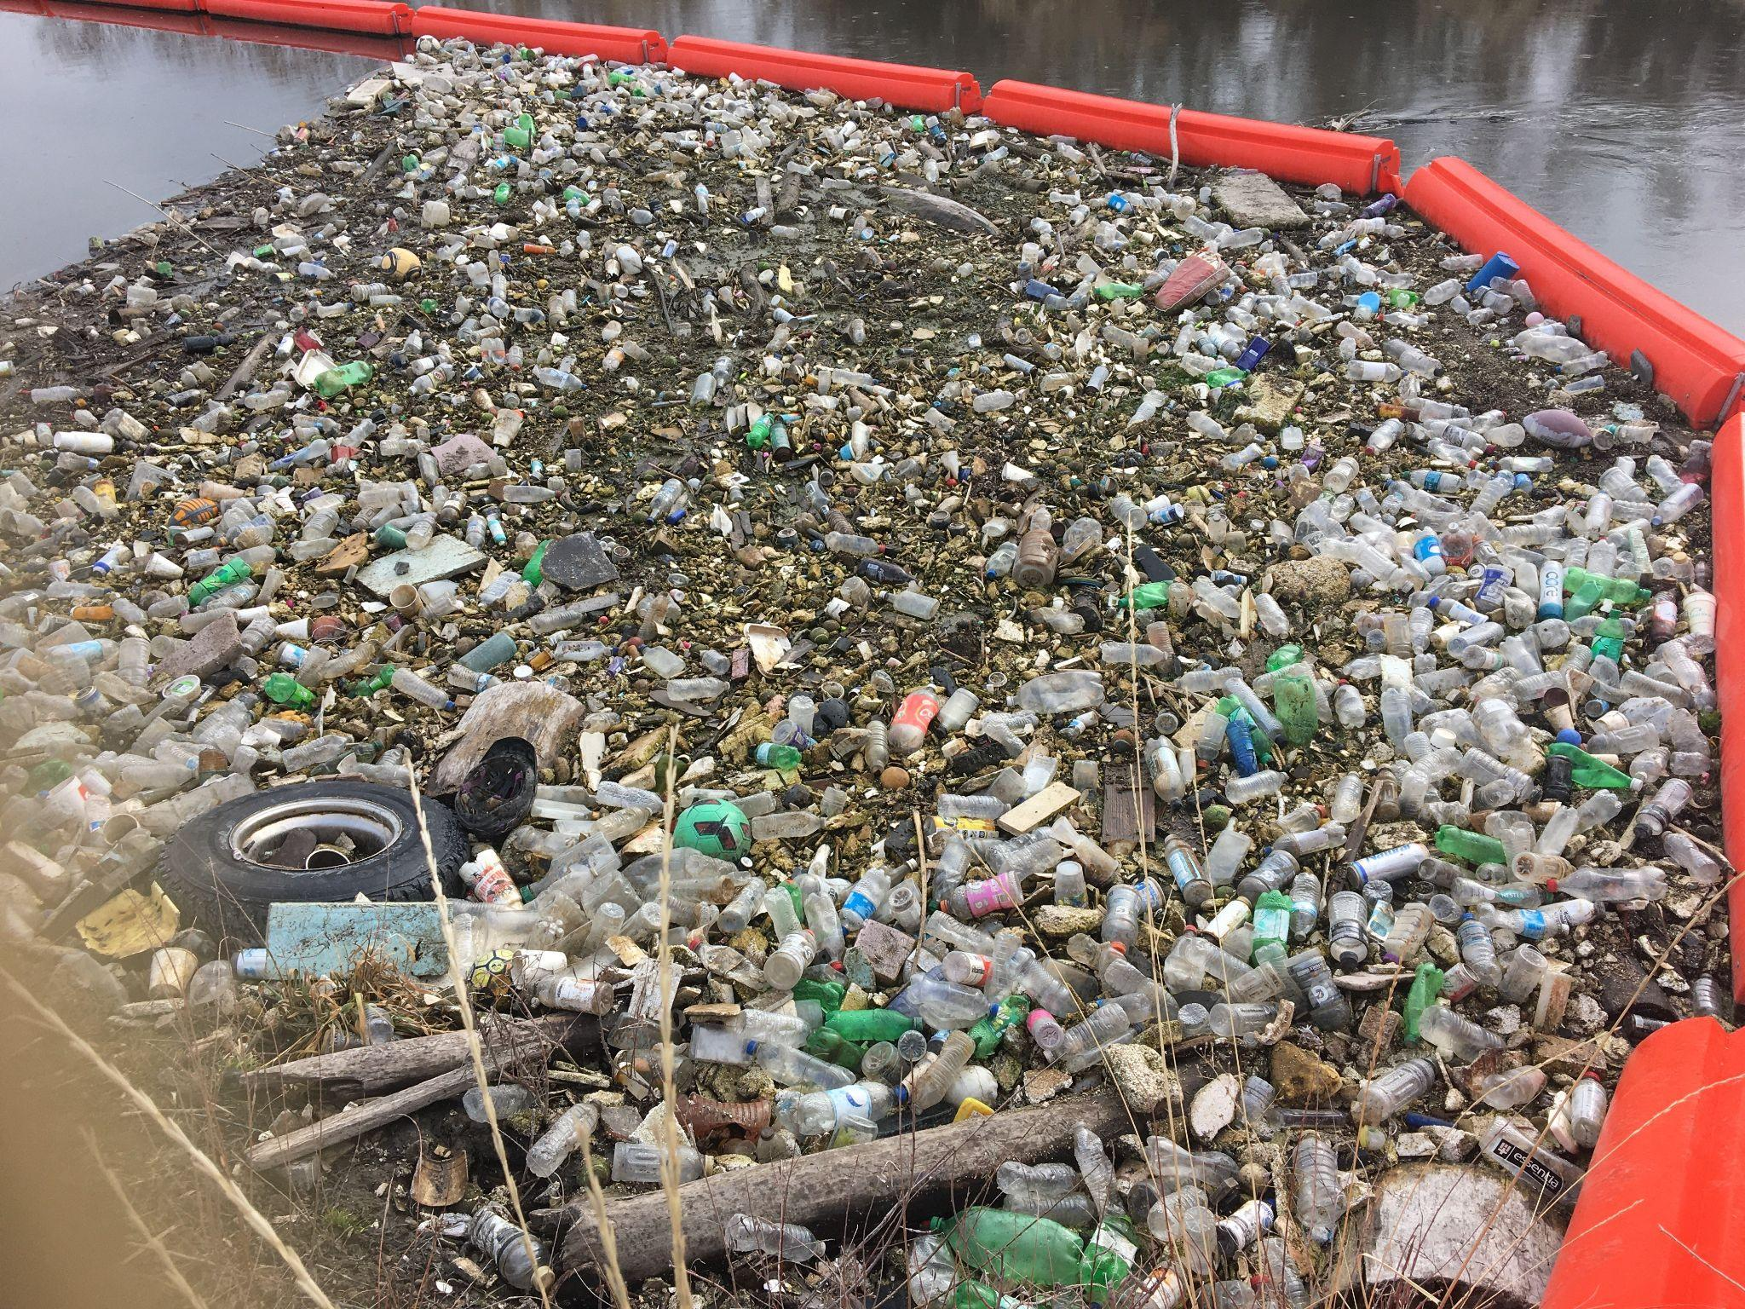
Goals
Trash
Sediment / Erosion
Preserve Open Space
Adequate Water Supply for Great Salt Lake
Remove Invasive Weeds

Slide 7
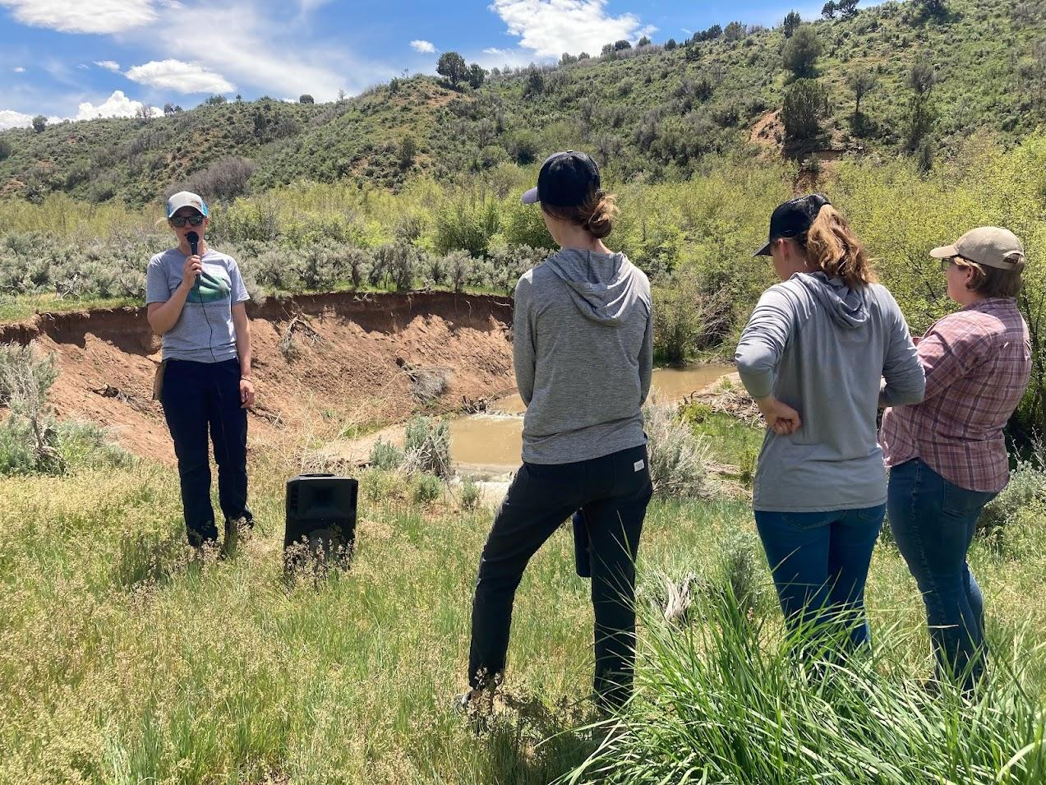
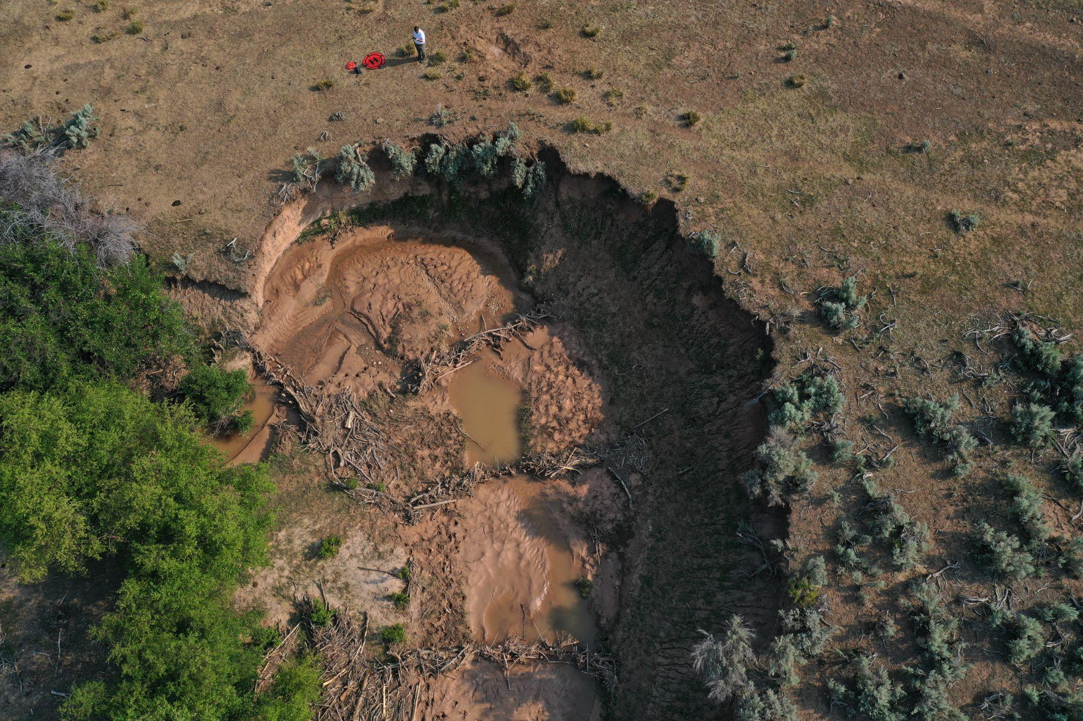
Success Project Fish Creek
Installed 70 BDAs on areas with Erosion Released Beavers | Developed Partnerships Held workshop (150 attendees)

Slide 8
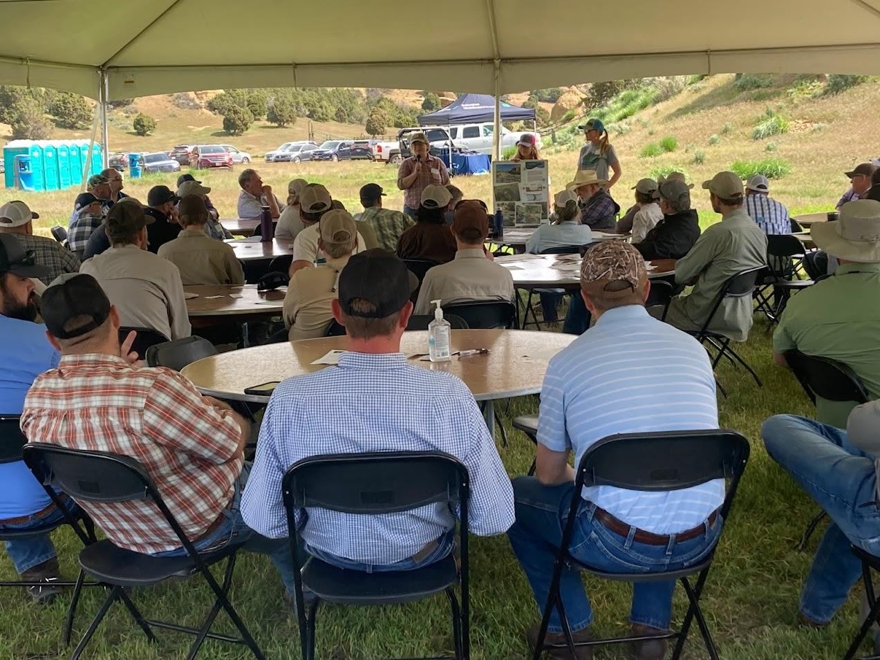
Watershed Plans Help Conservation Districts
Grants
319
Nonpoint source
Developed Partnerships
Health Departments
Stormwater coalition
State and Federal Agencies
More
Built Excitement
New Projects
Virtual Collars
New landowners

Slide 9
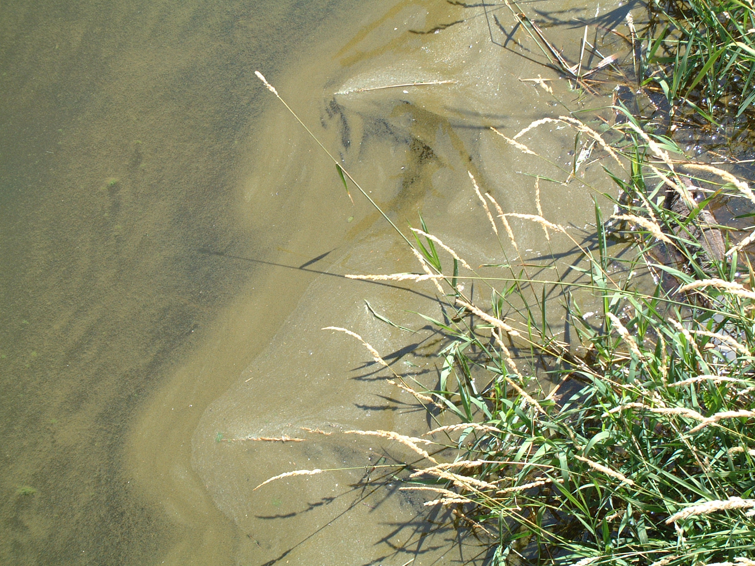
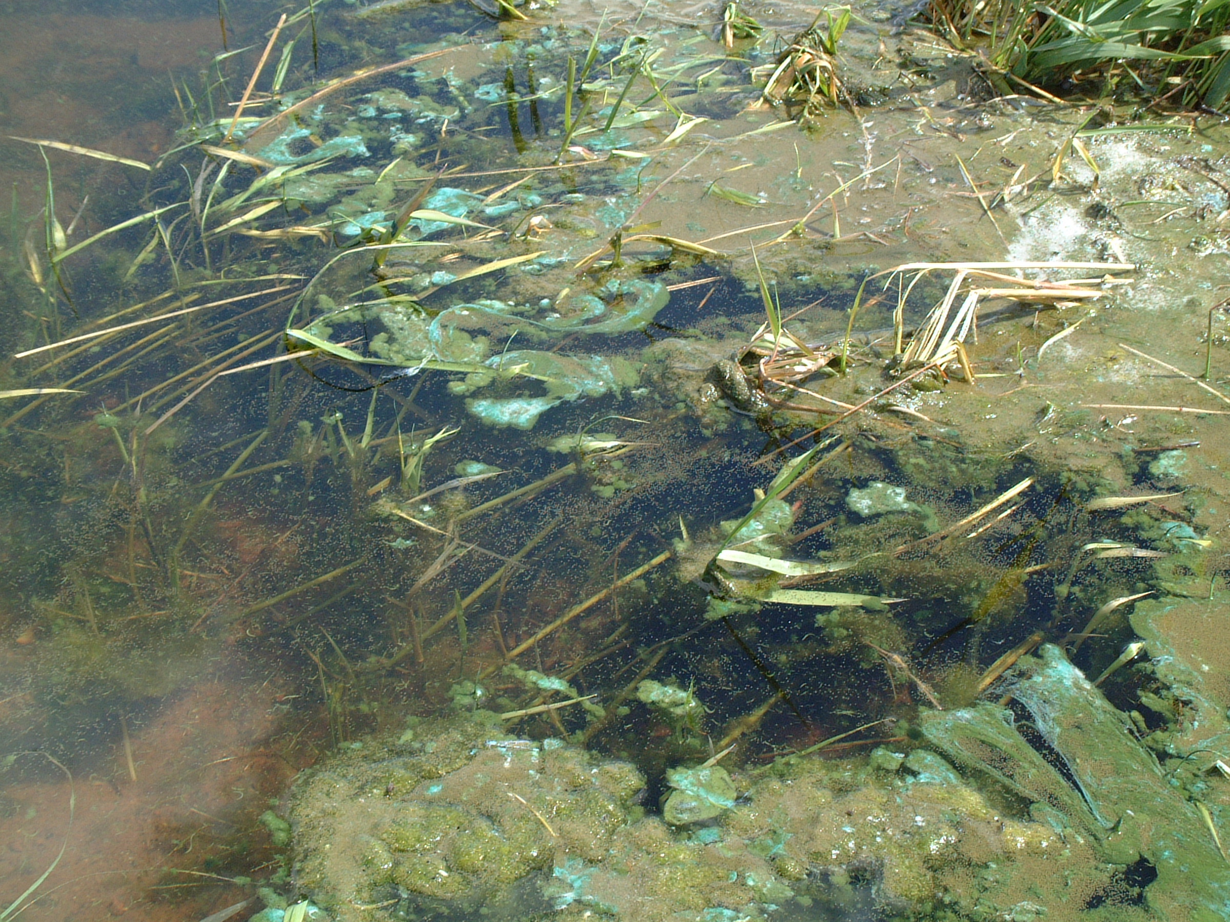
Pot Creek connects two blue ribbon fisheries. Because of high nutrients in the water, they experienced high number of winter fish kills.

Slide 10
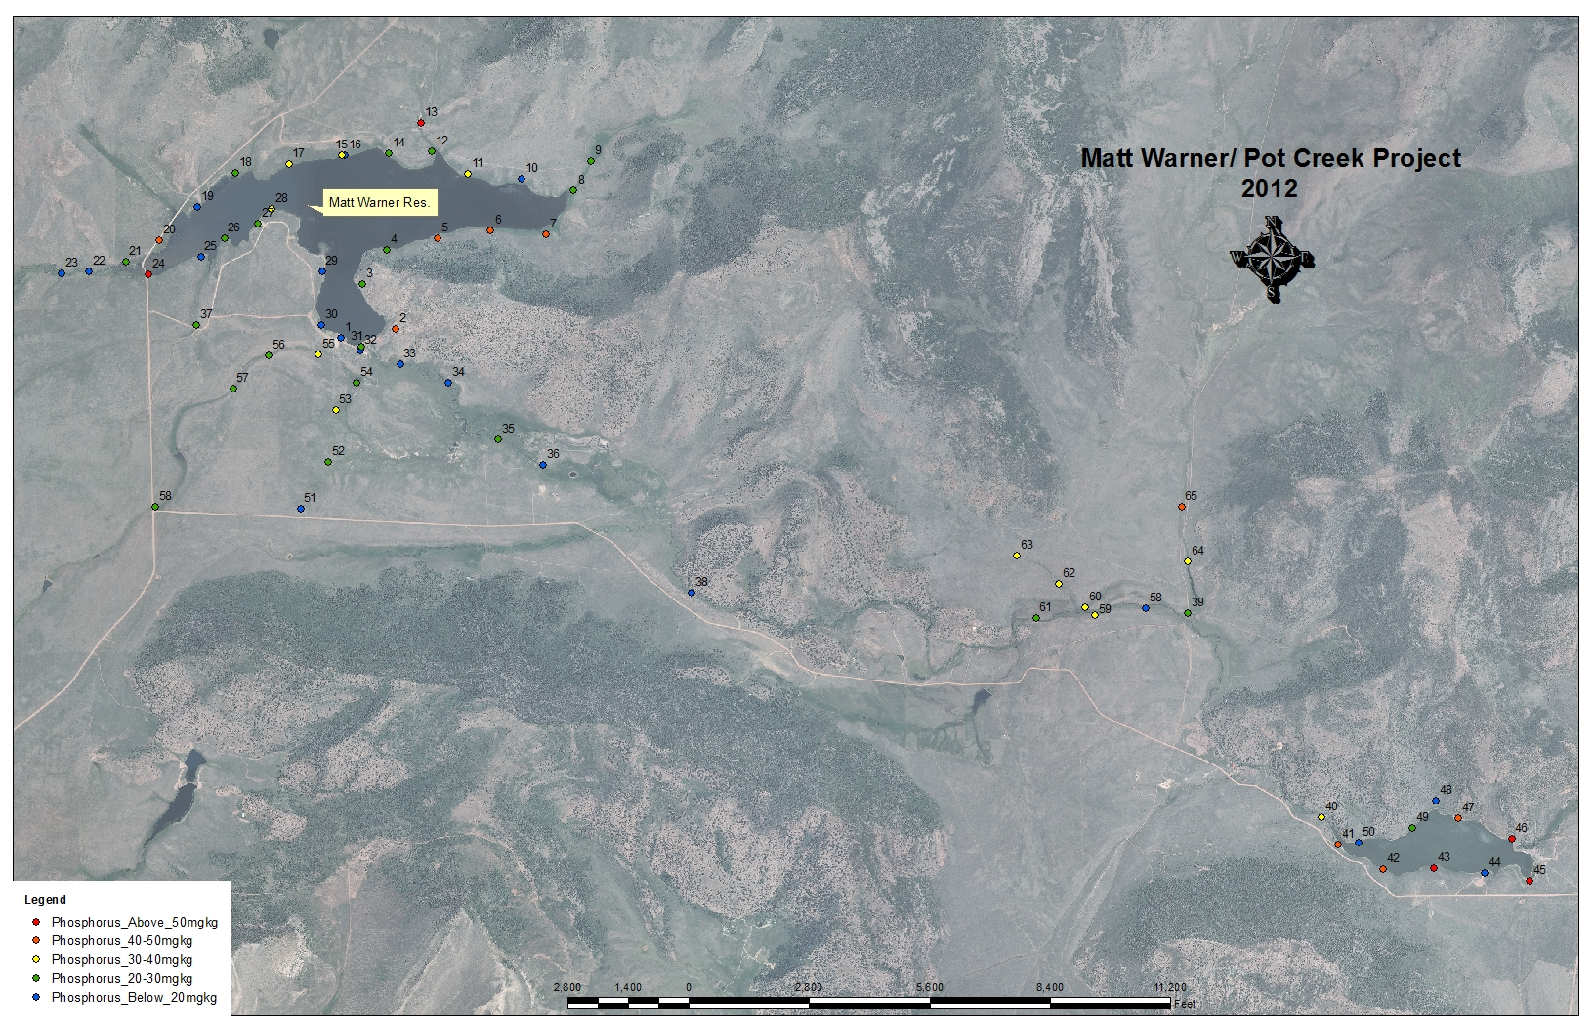
Matt Warner/Pot Creek Watershed
Soil Testing
Why the district wanted to get involved

Slide 11
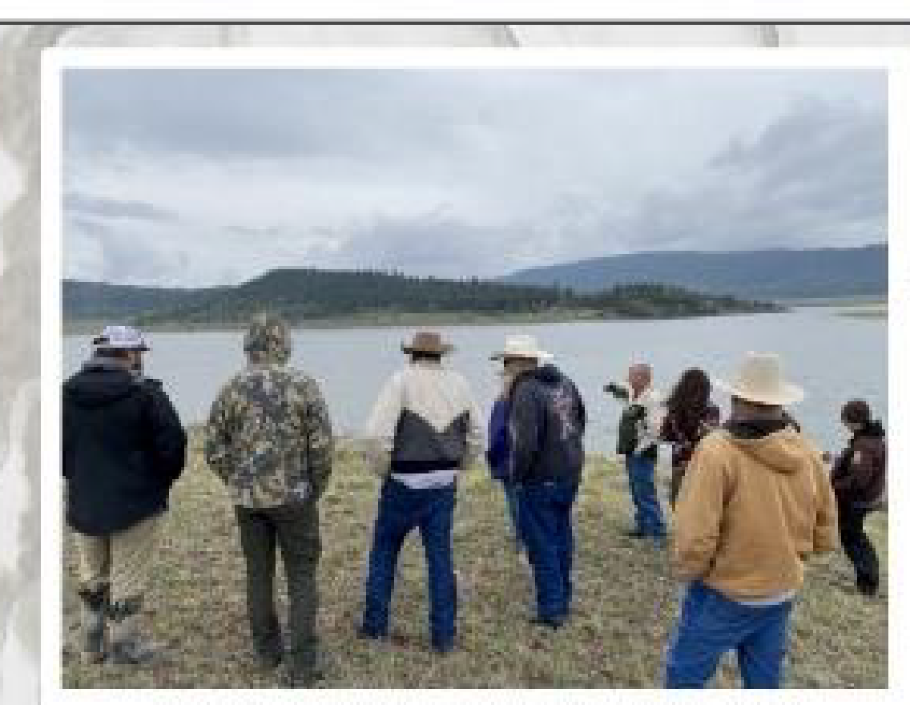
Uintah Conservation District hosted tours and workshops to inform landowners of the watershed issues
Pot Creek Watershed

Slide 12
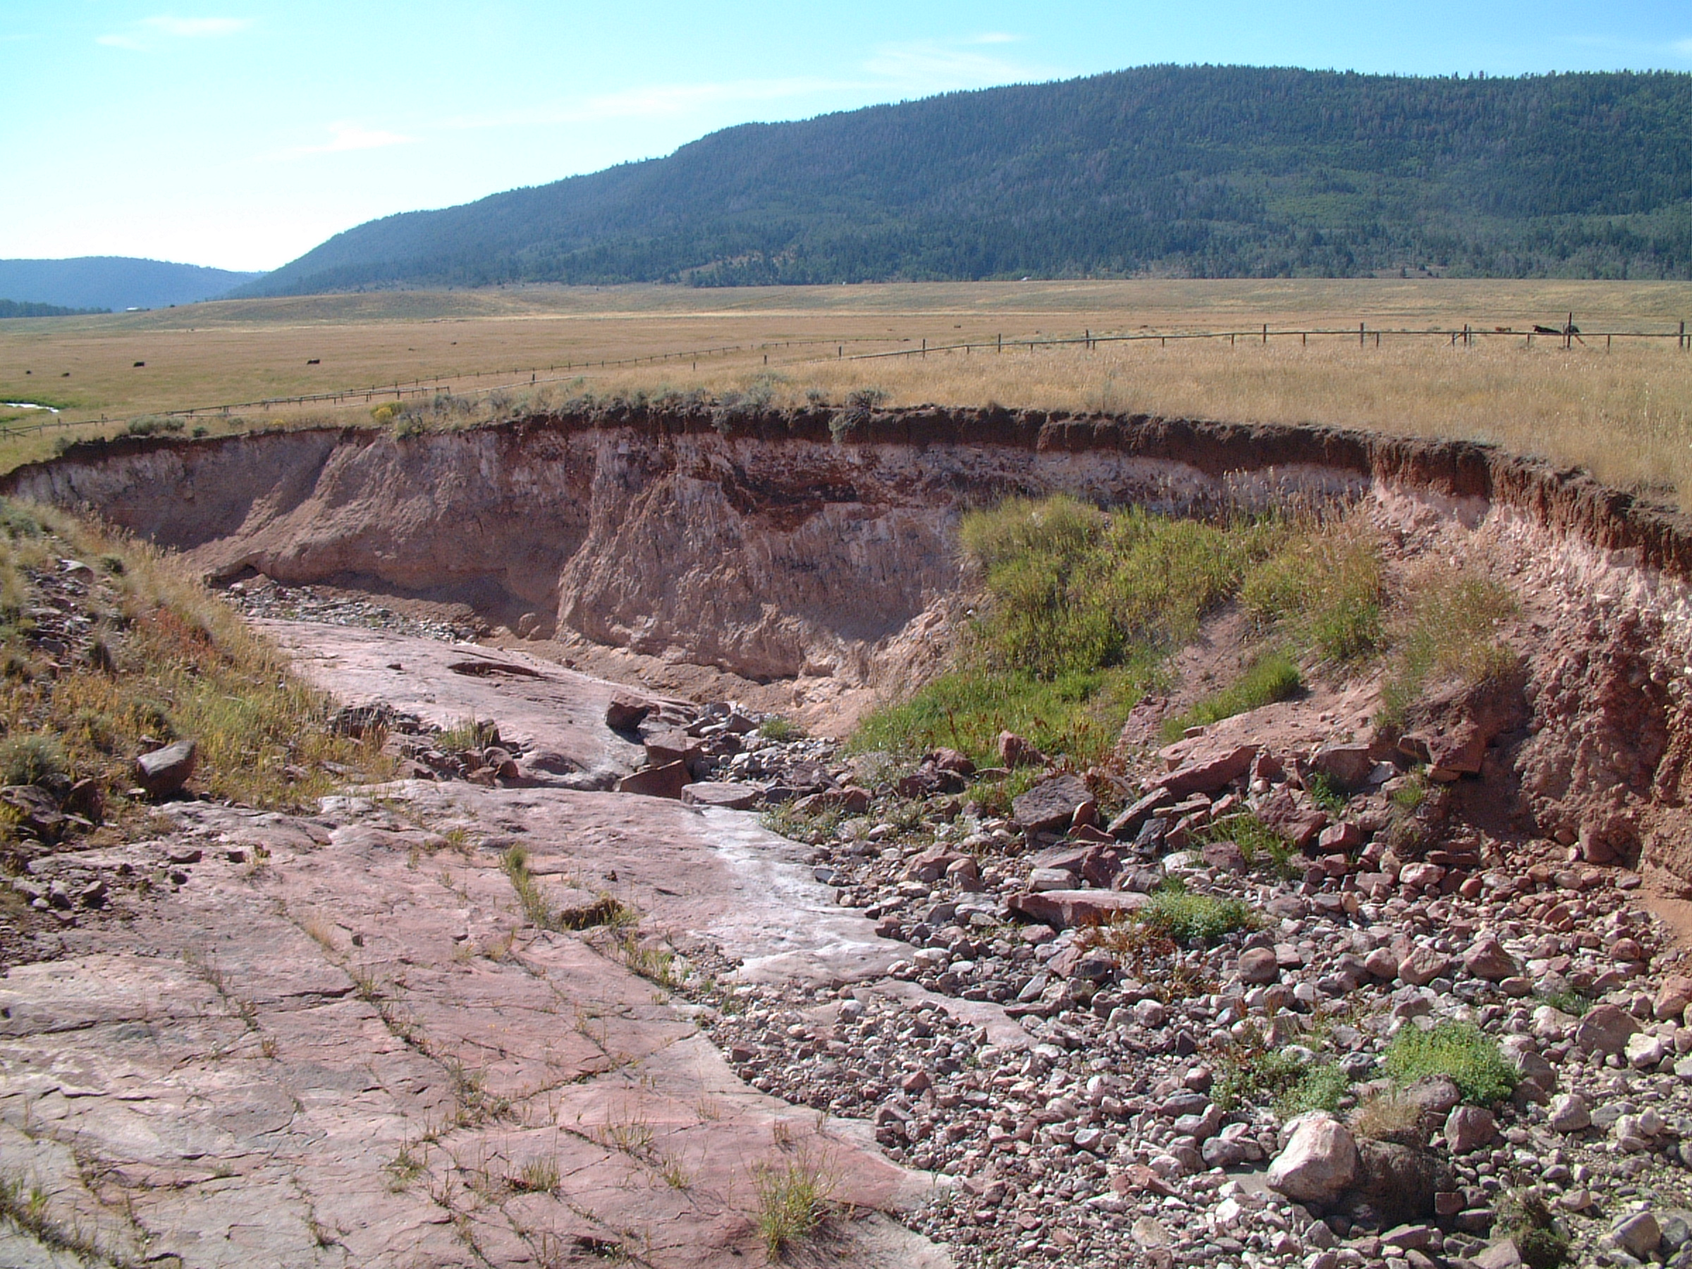
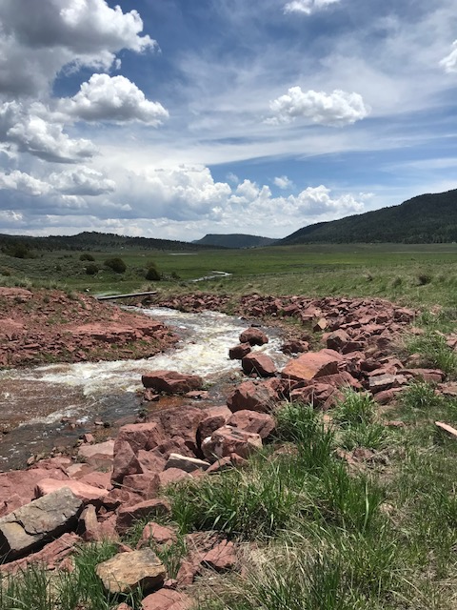
Matt Warner/Pot Creek Watershed Projects
Spillway before
Spillway after

Slide 13
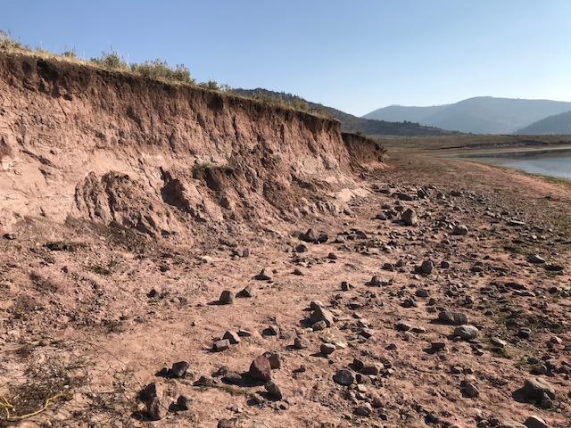
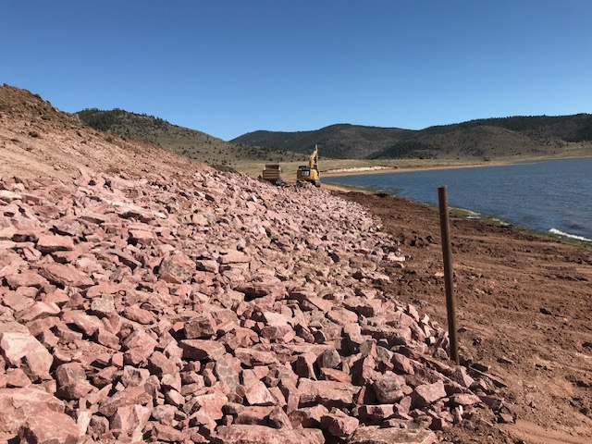
Matt Warner/Pot Creek Watershed Projects
Before
After

Slide 14
Pot Creek Watershed Projects
District continues to host tours and workshops in the area.
District continues to promote partner programs and resources.
District continues to apply for grants to assist in monitoring to measure success.

Slide 15
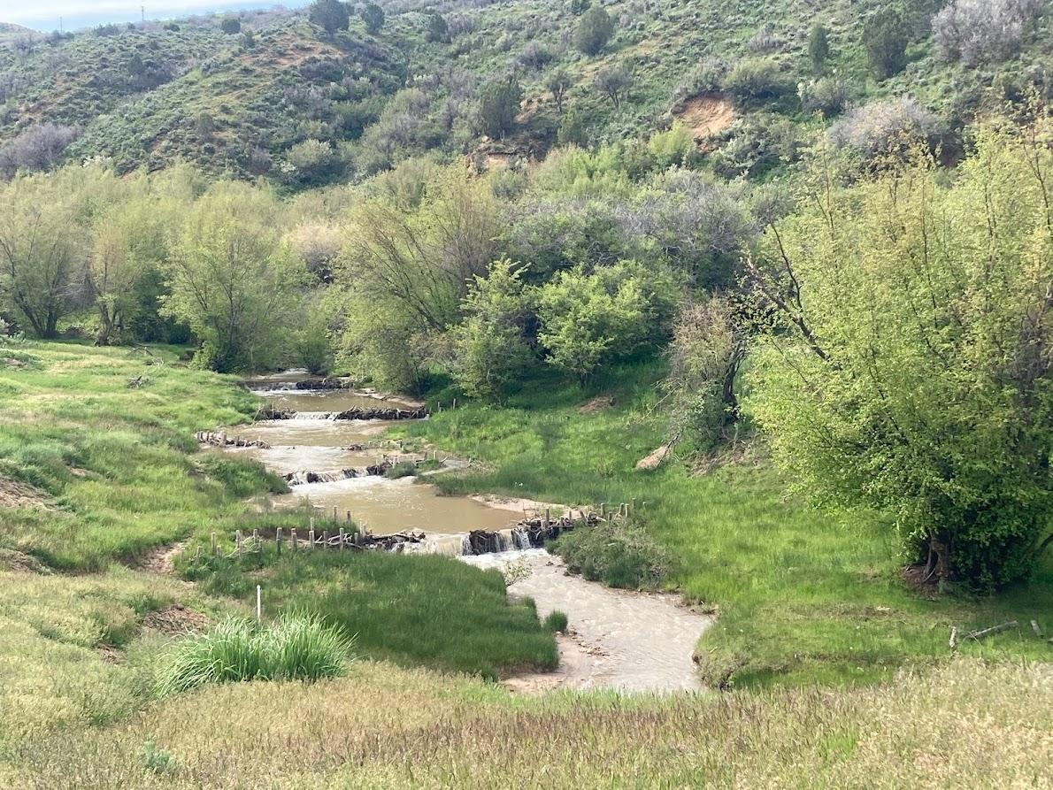
Questions
Brian Christensen
bchristensen2@utah.gov
435-494-9760
Darrell Gillman
dgillman@utah.gov
435-823-1064

