Slide 1
Flood Control Easement Notification Area Map
A Texas State Soil and Water Conservation Board attempt at Hazard Creep reduction through organized access to public information.
By: TSSWCB Flood Control Staff

Slide 2
Table of Contents
Introduction
Purpose
Why is this important Nationally?
Why is this important in Texas?
What are we going to do about it?
What do we need to tell (or ask) the public?
  How do you ask a set of questions to a lot of people?
So, what do we do?
What do we want it to share?
Notes:
https://damfailures.org/lessons-learned/the-hazard-classification-of-a-dam-can-change-over-time-hazard-creep

Slide 3
Introduction
Hazard Creep- The Association of State Dam Safety defines this as “the gradual increase in anticipated consequences of a dam failure due to infrastructure development either along the drainage below a dam or within the reservoir area upstream of the dam. Even though the physical condition of a dam may not have changed, hazard creep can result in an immediate adverse impact on the overall risk profile of a dam because the consequence component has increased. (1)”
Notes:
https://damfailures.org/lessons-learned/the-hazard-classification-of-a-dam-can-change-over-time-hazard-creep

Slide 4
Purpose
Title companies, typically, only look back 30 years for easements on land that is sold. This often leaves out easements on dams in Texas (given that the average age of these dams exceed 50 years old) (2).
Developers and landowners purchasing these properties are unaware that easements exist on the land they are purchasing, so they end up modifying/ tearing up dams as they develop.
This not only degrades a dam’s performance of its original function but also leads to this aforementioned Hazard Creep effect.
Notes:
2. https://www.southernclimate.org/hazards/texas-dam-or-levee-failure/

Slide 5
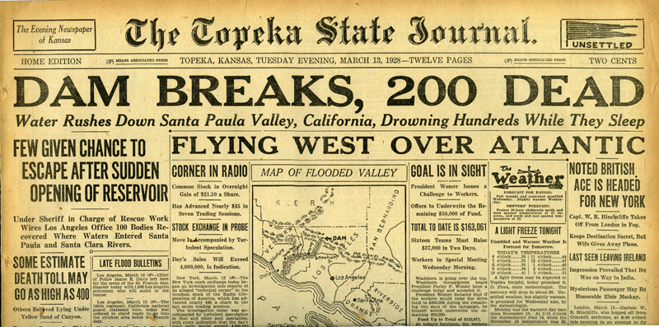
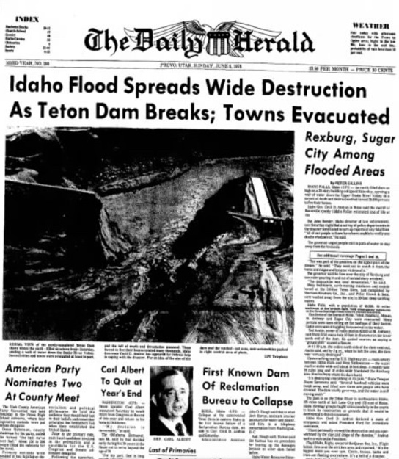
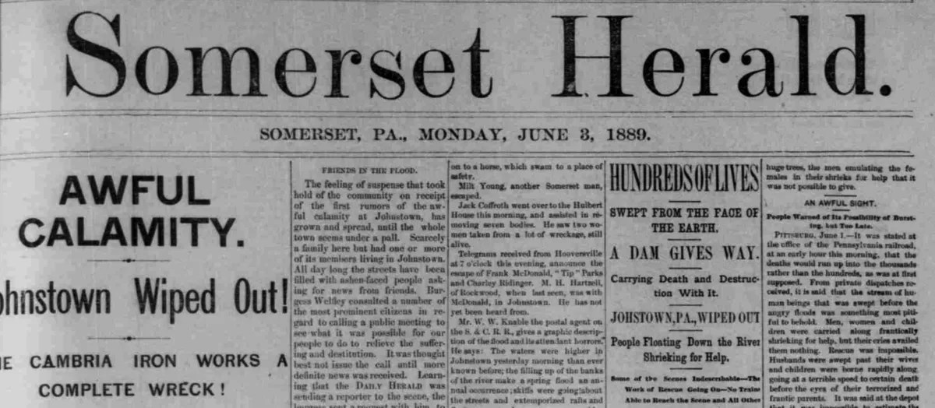
Why is this important Nationally?
Notes:
The hazards that exist with dam failures are well known and documented through the history of the United States. Towns wiped out, death tolls grow, and millions of dollars in damage has been recorded. Why is it then that developers and landowners continue to build around these areas? We continue as a nation to develop these land around these hazard areas at breakneck paces while neglecting to improve the structures themselves.
Top Left: Saint Francis Dam Disaster, March 13, 1928. - https://scvhistory.com/scvhistory/al2038.htm
Bottom Left: South Fork Dam, 31 May 1889. - https://uncommonwealth.virginiamemory.com/blog/2014/05/31/not-a-hideous-dream-125-years-ago-newspaper-coverage-of-the-johnstown-flood/
Right: Teton Dam, June 05, 1976. - https://alabamaweathernetwork.com/june-5-1976-the-teton-dam-collapse/

Slide 6
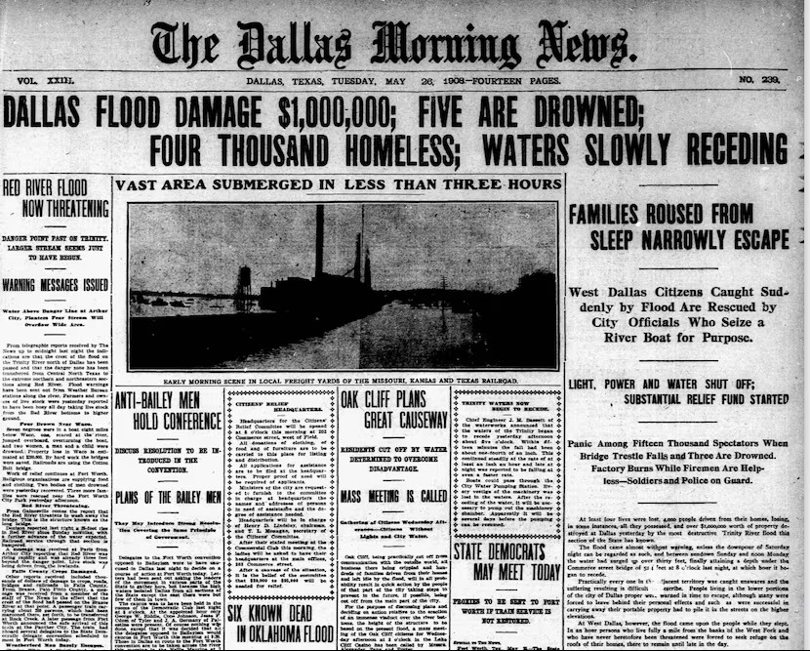
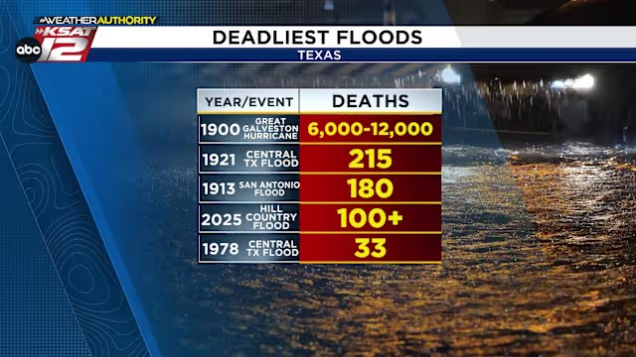
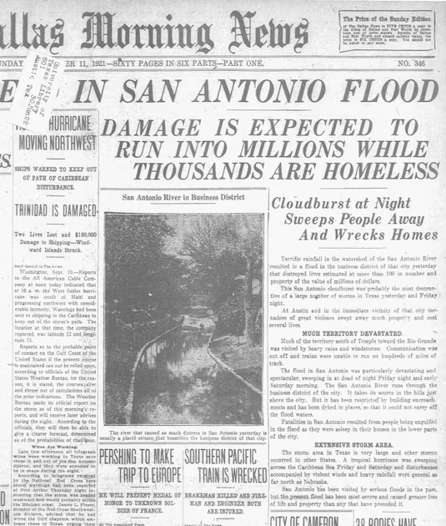
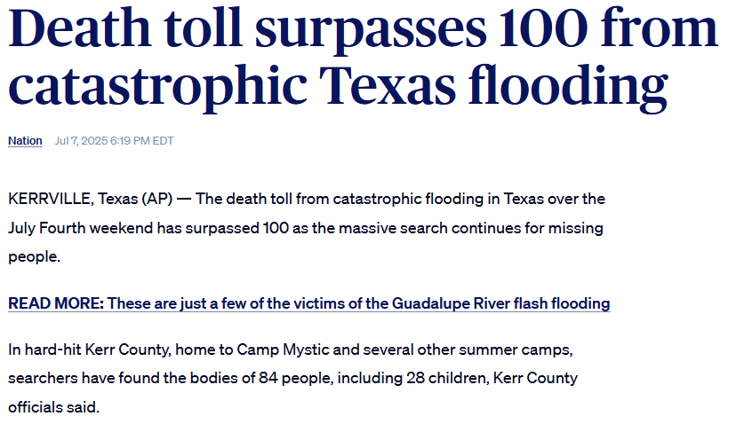
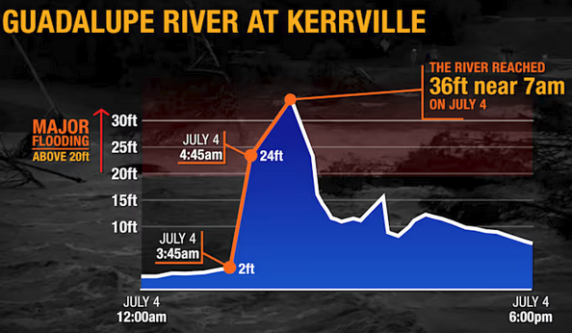
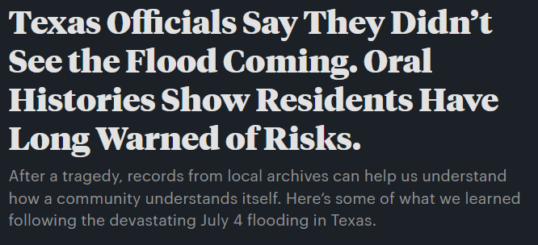
Why is this important in Texas?
Notes:
Are catastrophes that lead to a loss of life the red flag that we need to gain traction in the development and protection of these structures? How frequent do these events need to be for the issue to remain relevant?
Texas is very familiar with flooding, but it is easy to anyone forget as time moves on—especially when drought and water restrictions are almost an annual occurrence. This begs the question, who is the Responsible spokesperson to this danger so that it isn’t overlooked in hazard planning? Why is it that so many easements are overlooked during landsales? How is flooding information portrayed to the public? Is it easily accessible? Are we as conservation agencies able to provide the data to citizens searching for information? Can we at least point them in the right direction to find the information they need to ensure they are safe? The list of questions can go on and on, but the most pertinent question we should be asking is this:
** Turn to next slide**
What are we going to do about it?
Top news articles (left and right) https://www.dallasnews.com/news/weather/2025/07/05/a-look-at-some-of-the-worst-floods-in-texas-history/
Top Middle News Announcement: https://www.ksat.com/weather/2025/07/08/kerr-county-tragedy-already-one-of-the-deadliest-floods-in-texas-history/
Bottom Left Announcement: https://www.pbs.org/newshour/nation/death-toll-surpasses-100-from-catastrophic-texas-flooding
Bottom Middle: https://www.ksat.com/news/local/2025/07/06/estimated-100-billion-gallons-of-rain-fell-on-kerr-county-july-4-thats-more-than-niagara-falls-daily-flow/
Bottom Right Announcement: https://www.propublica.org/article/texas-floods-oral-histories

Slide 7
What are we going to do about it?
Notes:
5 second pause

Slide 8
What do we need to tell (or ask) everyone?
Did you know that Texas has a dam or two in it? Did you know that some of these are flood control structures? ~2,039 of the almost 7,500.
Did you know that your dam has a service life? It isn’t a permanent benefit if it’s not taken care of.
Do you live near a dam?
Do you know who to contact (the sponsor) if you notice an emergency with the dam?
Is your property within the easement of a dam?
Are you located upstream or downstream of a dam?
Do you know what your evacuation time/ plan is if the dam fails?

Slide 9
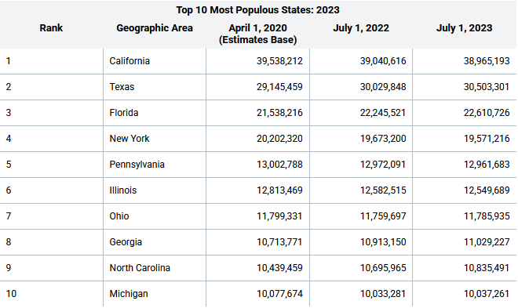
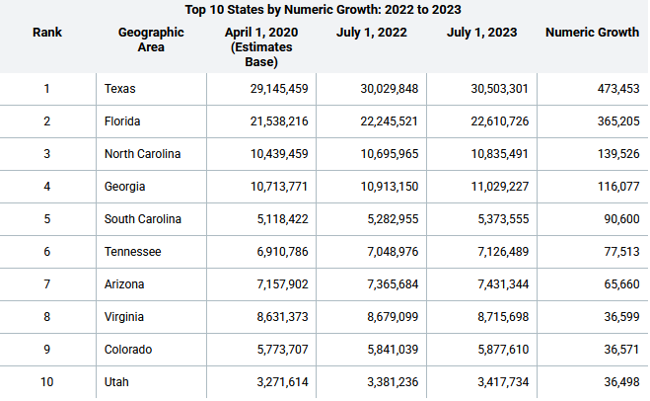






How do you ask these questions to millions of people?
Notes:
Well, the short answer is that you can’t.
You could inform the entire state of Texas, but people move in and out of the state every single day. These are some tables that are on the Census.gov website outlining the general growth of Texas from 2022-2023.

Slide 10
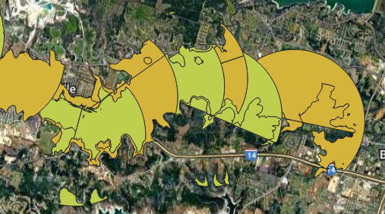
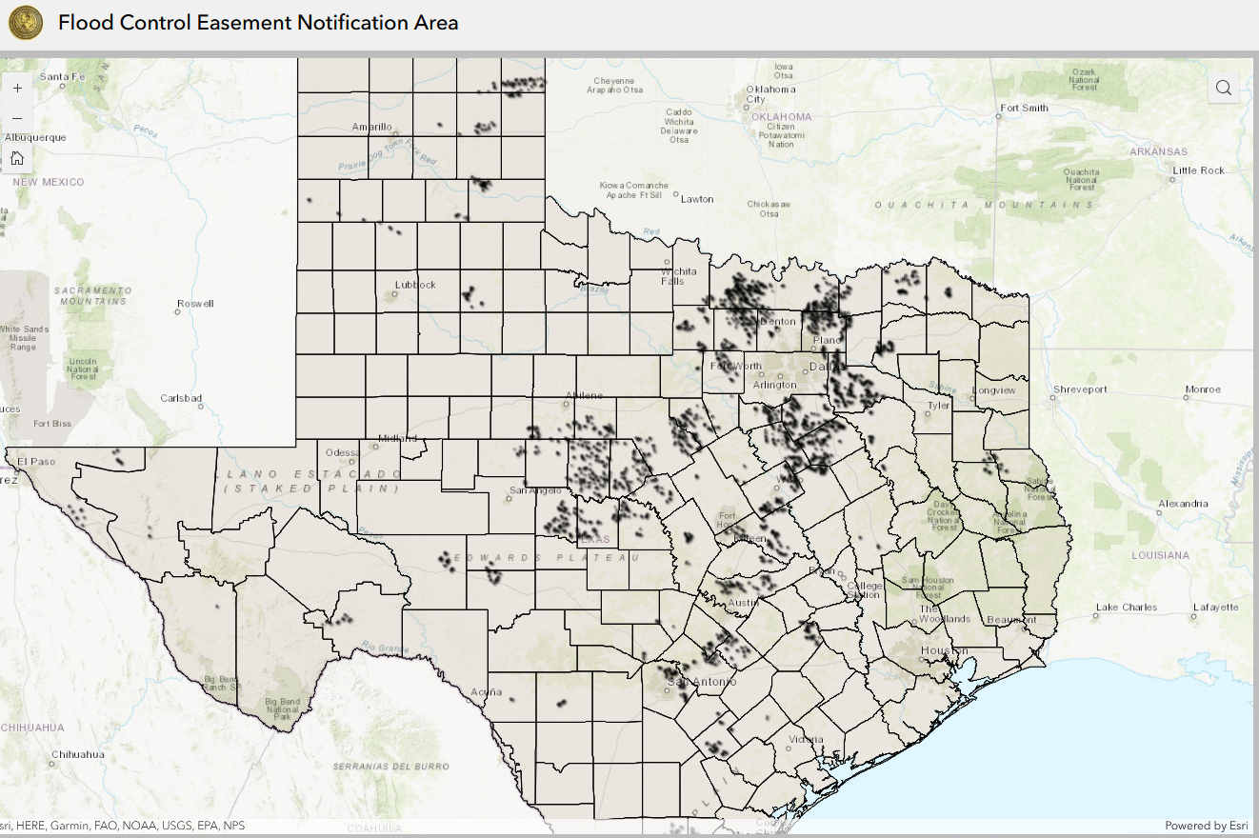
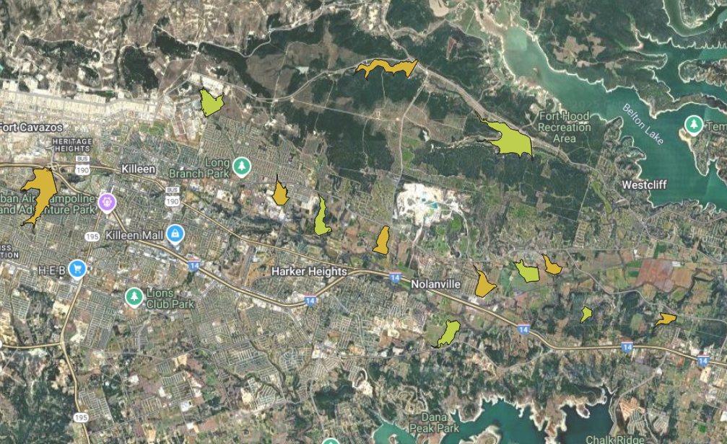
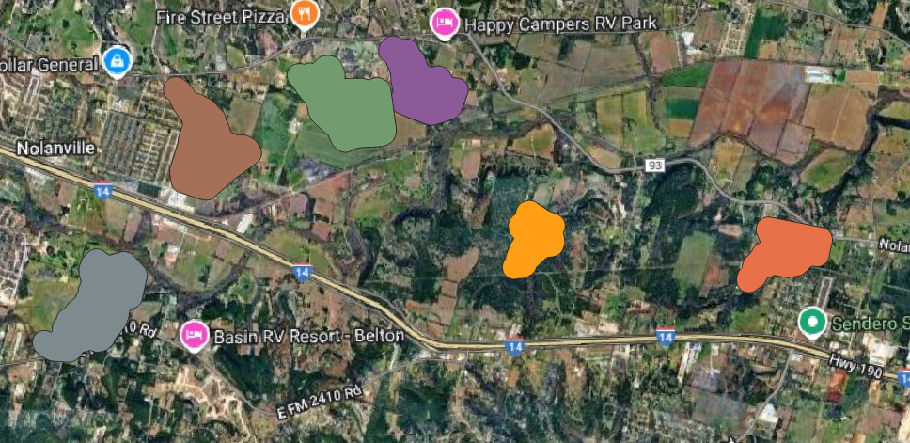
So, what do we do?
Notes:
As an agency that deals with Flood Control structures and hazards every day, we decided that we needed to do something more. There has to be a way that we can share information publicly so that the general public can easily understand the information presented. Not only that, but we could create a product that has just enough information to connect the public to the people who should have the answers to their questions.
That’s when Steve Bednarz determined that we needed a map. We weren’t sure exactly how we were going to create it, but the Flood Control Staff got the ball rolling.

Slide 11
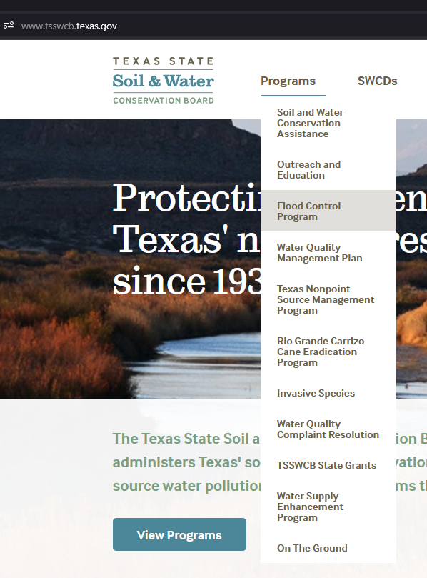
Flood Control Easement Notification Area Map-
A How-To Guide
Go to https://www.tsswcb.texas.gov/
Find your way to the “Flood Control Program” page.

Slide 12
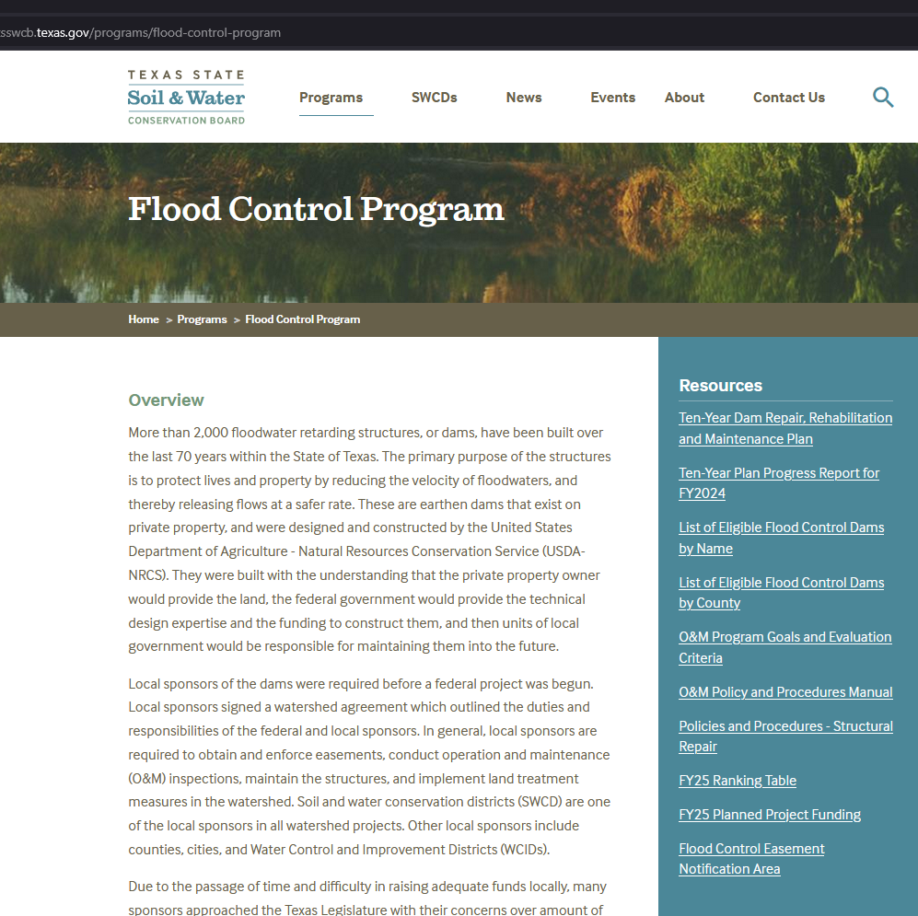
Flood Control Easement Notification Area Map-
A How-To Guide
Find the “Flood Control Easement Notification Area” link in the Resources section on the right side of the webpage.

Slide 13
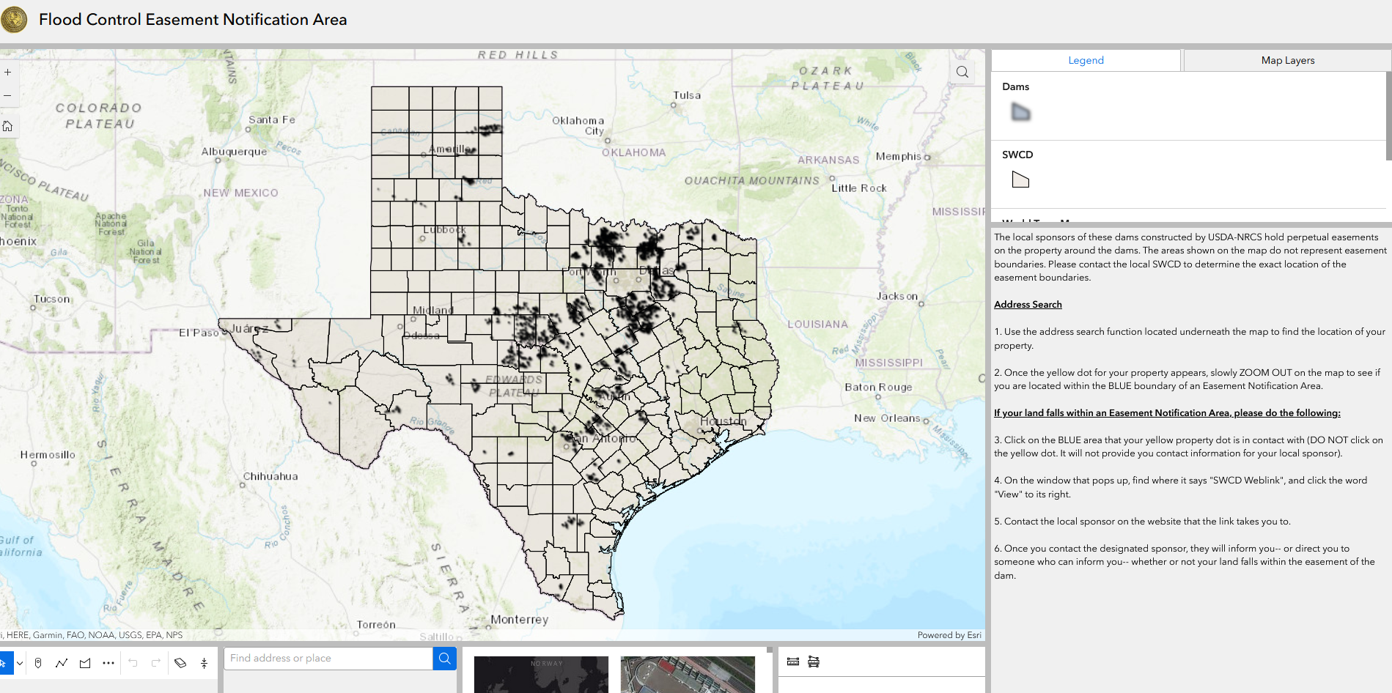
Page Layout
Legend
Now that you’ve found the map, use the instructions on the screen to help you find your property.
Measurement Tools
Map Use Instruction Box
Address Search Bar
Different Map Layers

Slide 14
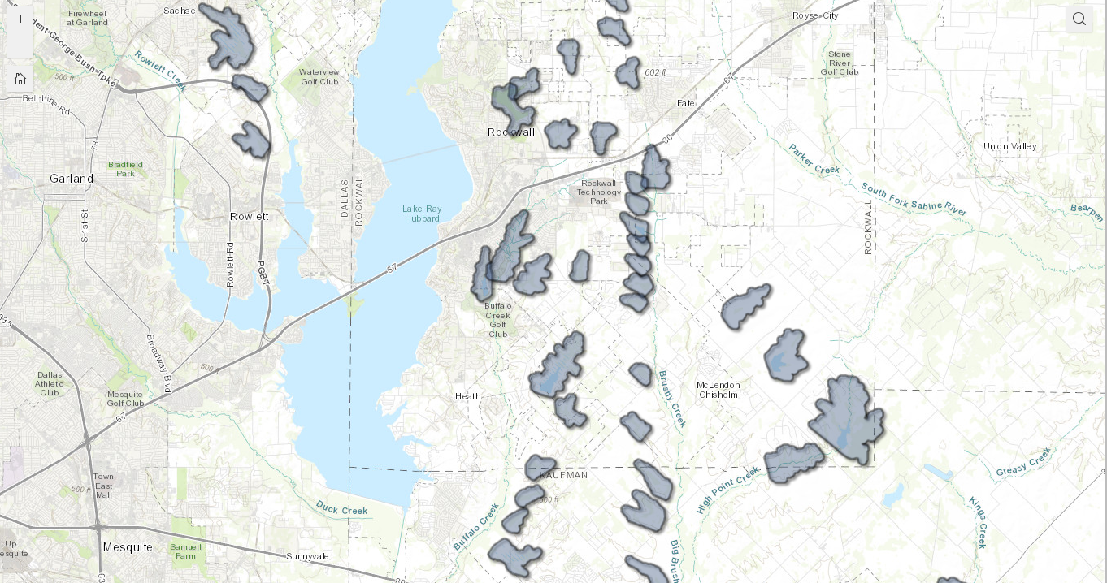

Slide 15
Live Demonstration
For this demonstration I am saying that I live at Foxchase Park
Address : Park at Foxchase, 4475 Tubbs Road, Rockwall, TX, 75032, USA
I see that I am living within a blue “Dam” polygon.
What should I do?

Slide 16
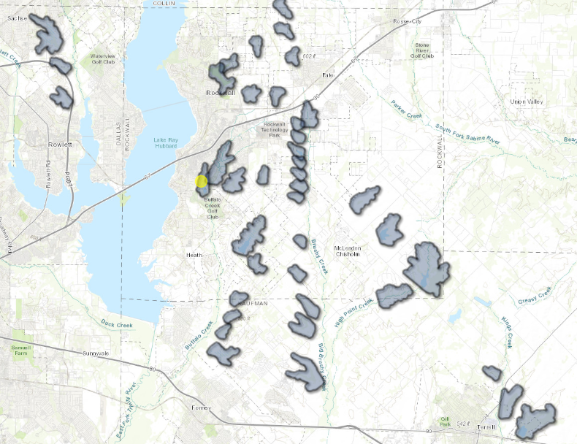
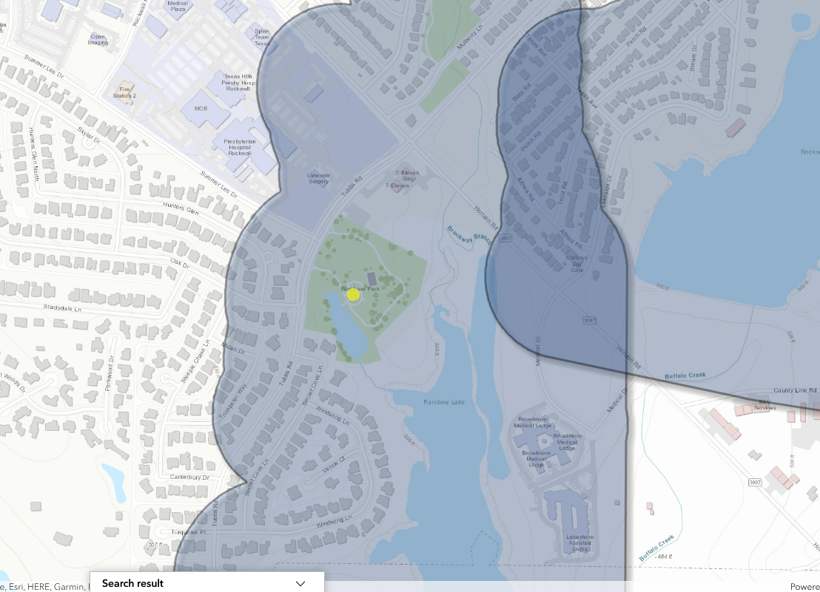
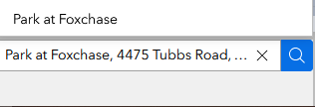
Is the address within an easement of a dam?
Search Address
Slowly zoom out, looking for any blue “dam” polygons.
We know that we are within the easement of a dam.
Notes:
Update to include the rockwall county dams instead of the

Slide 17
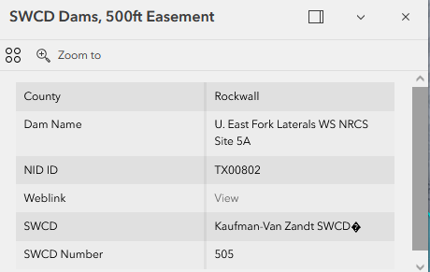
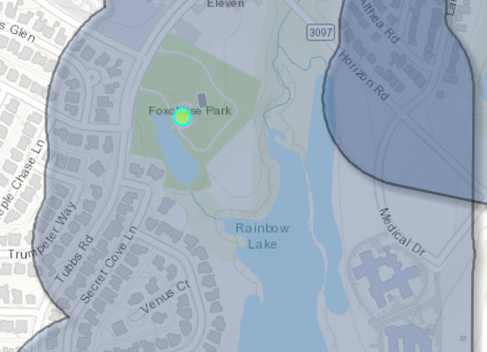
Live Demonstration
I click the blue polygon.
The data that pops up tells me that this dam is “Upper East Fork Laterals WS NRCS Site 5A”.
I click the “View” button to take me to the weblink to get point of contact information about the dam.

Slide 18
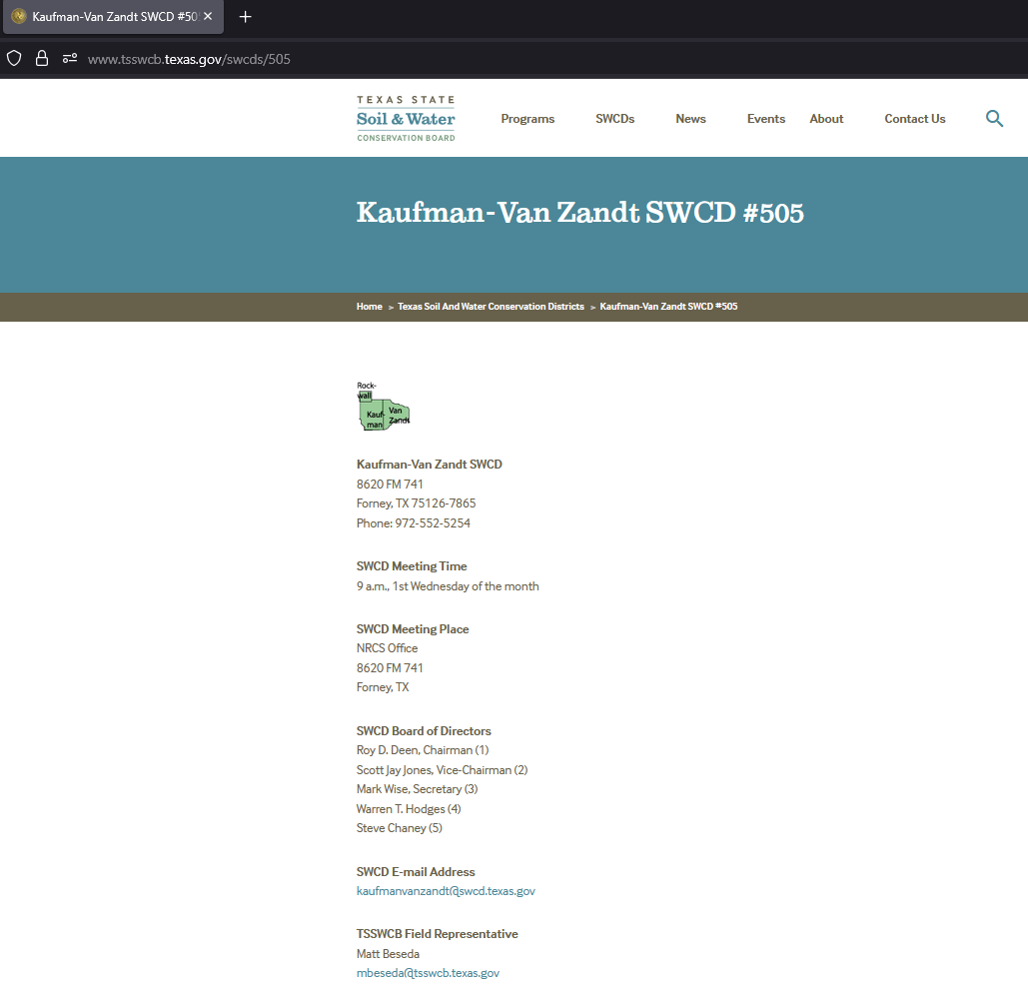
Live Demonstration
Clicking “View” takes me to a weblink that gives me the SWCD’s address, phone number, and email.
It tells me when the SWCD’s monthly meeting date and time is.
It gives me a Texas State Soil and Water Conservation Board (TSSWCB) Field Representative should I have any issues contacting the SWCD.

Slide 19
Now I know who I need to talk to about easements before I start any type of construction work.

Slide 20
Conclusion
Notes:
As agencies that deal with public safety, it is important that we are diligent in our dissemination of information. If we assume the role of informant when it comes to a topic such as flood control, we can provide information that just might save hundreds of lives and millions of dollars down the road.

Slide 21
Questions?

