Slide 1
South Carolina
Conservation Districts Training
SCDNR-Conservation Districts
Field Operations
Last edited: 10/2025
Notes:
We’re area coordinators for SCDNR…. I’m _______ then go down the line

Slide 2
Overview
Notes:
This is an overview of our training

Slide 3





Goals
COMPREHENSIVE
FREE!
INDIVIDUAL OR GROUP
INTEGRITY
INCENTIVES
Notes:
Provide a one-stop shop for all the training materials and resources related to South Carolina Soil and Water Conservation Districts.
Choosing a platform that is easy to navigate and free.
This training is voluntary and can be taken individually or as a group.
Ensure our training was of a high standard.
There is an incentive program for the districts that complete the training

Slide 4
Timeline
Developed handbook and PowerPoint slides
Collected supplemental resources
Developed implementation and certification process
Brought idea back from NASCA
Training Live
Partnership Conference 2026
Certified Districts recognized
July 2024
Dec 2024-Jan 2025
Ongoing
Oct 2023
Aug-Nov 2024
Feb 2025
2026
Began researching platforms and resources
Reviewed by staff and partners
Introduced at 2025 Partnership Conference
Support and Recognition
Notes:
This is a brief timeline for the training development.
Jessie and I got the idea from the OK, CO, & NC presentations at the NASCA State Sharing Session.
Researched different platforms that would be able to deliver online videos and quizzes.
Compiled resources that contained the information that we wanted to include in our training modules, along with developing the way we would implement the training and how our districts would become certified.
Presented the training program to all attendees at our State Partnership Conference before the launch.
The training went live in February 2025
Coordinators have been available to assist the districts with a training module question, concerns, or issues.

Slide 5
Development
Notes:
This is how we developed our training

Slide 6
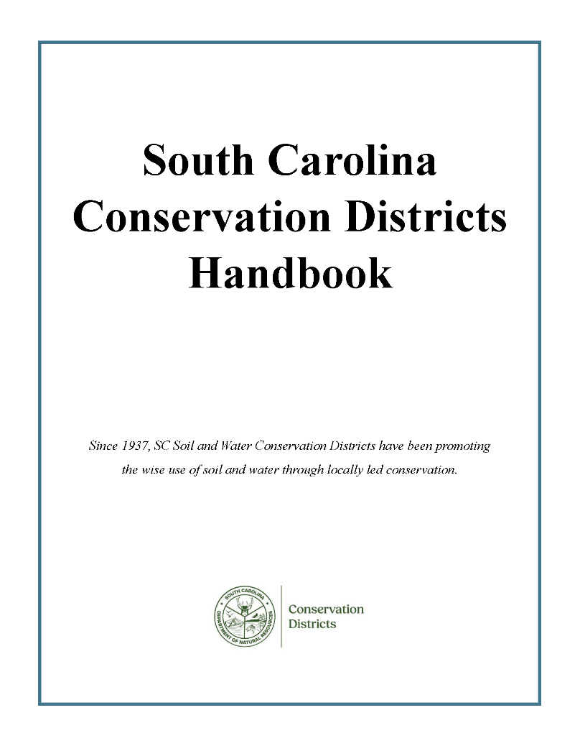
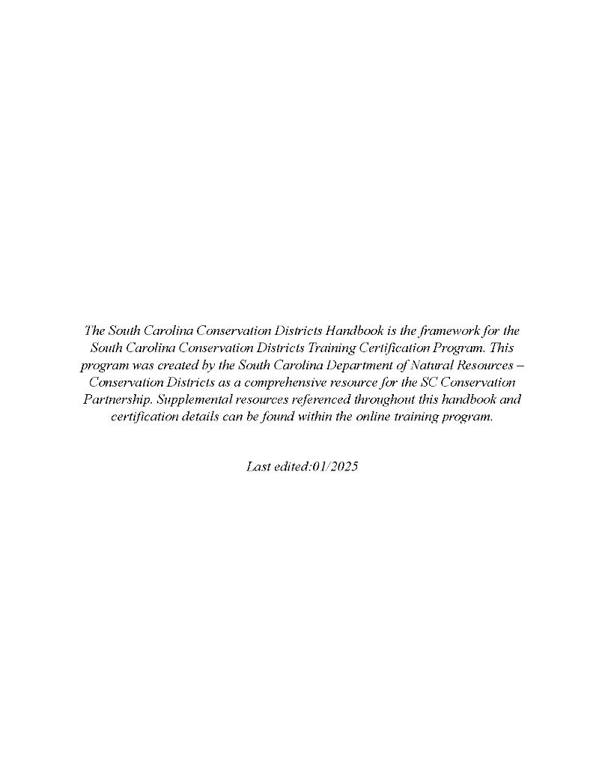
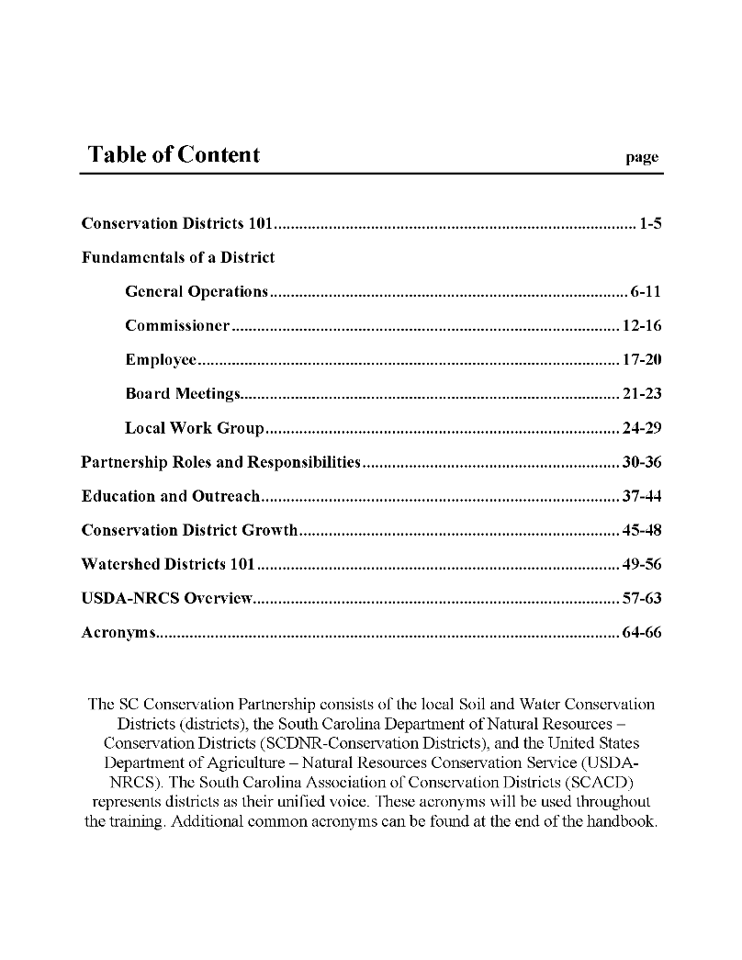
Handbook
Notes:
The new PDF version of the South Carolina Conservation Districts Handbook coincides with our online training modules. The chapters follow the order of the online modules for consistency.

Slide 7

Content Overview
Training Overview
Conservation District 101
Fundamentals of a District
  General Operations
  Commissioners
  Employees
  Board Meetings
  Local Work Group
Partnership Roles and Responsibilities
Outreach and Education
  Education and Outreach
  Conservation District Growth
  NRCS Programs
Watershed Districts
Self Certification of Completion
Notes:
Here's a breakdown of how we organized the training. We aimed to keep the modules concise and not too overwhelming, so we created five main categories with more detailed subcategories under Fundamentals of a District and Outreach & Education. In total, we have 11 training modules plus the introduction module, “Training Overview.”
**note from Jessie- let’s just glaze over this slide because they will also see these in the screen recording on slide 9??
The training overview will provide information on the training as a whole along with details regarding the certification process and you’ll find the PDF of the handbook listed there.
Conservation Districts 101 goes into the history and laws of conservation districts
Fundamentals of a districts includes 5 of the modules which cover day to day operations, commissioner and employee responsibilities, board meeting how tos and requirements, and local work group meeting guidelines
Partnership Roles and Responsibilities highlights each partner within the SC Conservation Partnership as well as other key state and national partners
Outreach and Education includes 3 modules which cover overview information on various education and outreach opportunities, conservation district growth talks about successional growth as well as financial, and NRCS programs which many of you work closely with
Watershed districts is similar to conservation districts 101. it covers the history and laws related to watershed districts.
Finally, the self certification of completion must be filled out to go along with the individual certification forms. This module will also include a feedback survey which will help us to grow and improve this training program in the future

Slide 8
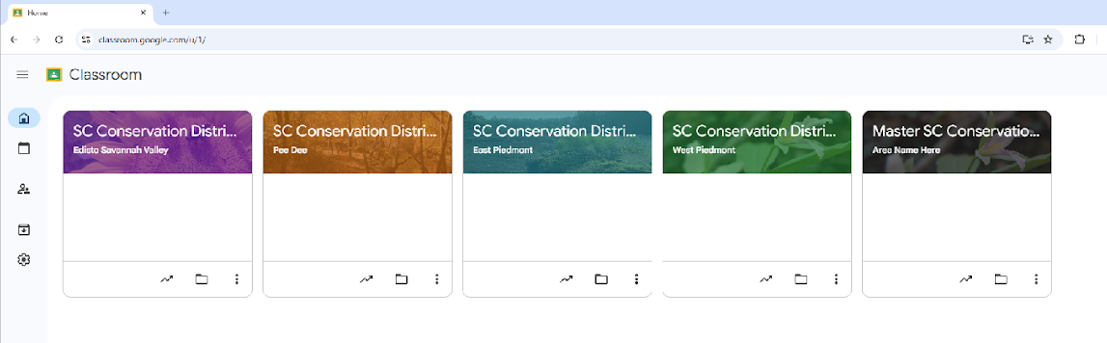
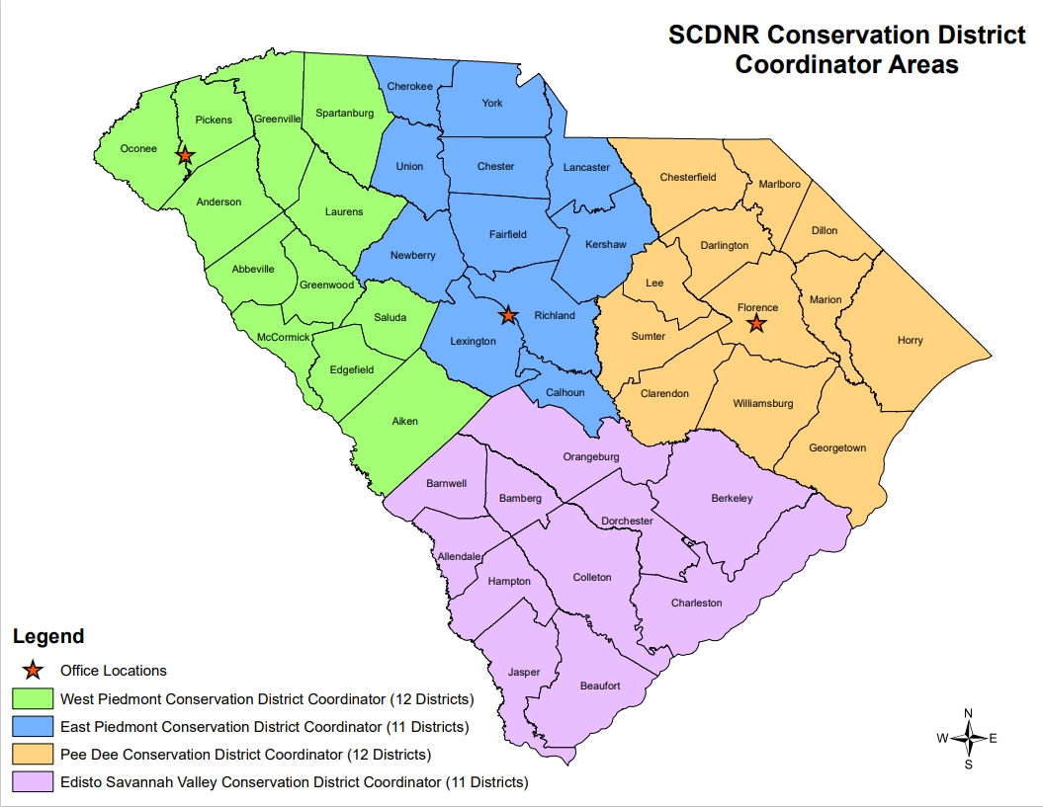
Classrooms
Created a free, generic Google Account
Set up ‘Master’ then duplicated per area
Allows 250 class members per classroom
Notes:
After researching different options we decided to go with Google classroom because it is free and user friendly. Our agency uses the Microsoft suite so we did have to create a generic SC Conservation Districts Google account
The classrooms are limited to 250 students. So to avoid maxing out the classroom or having to limit who could take it, there are area- specific classrooms based on our respective areas

Slide 9
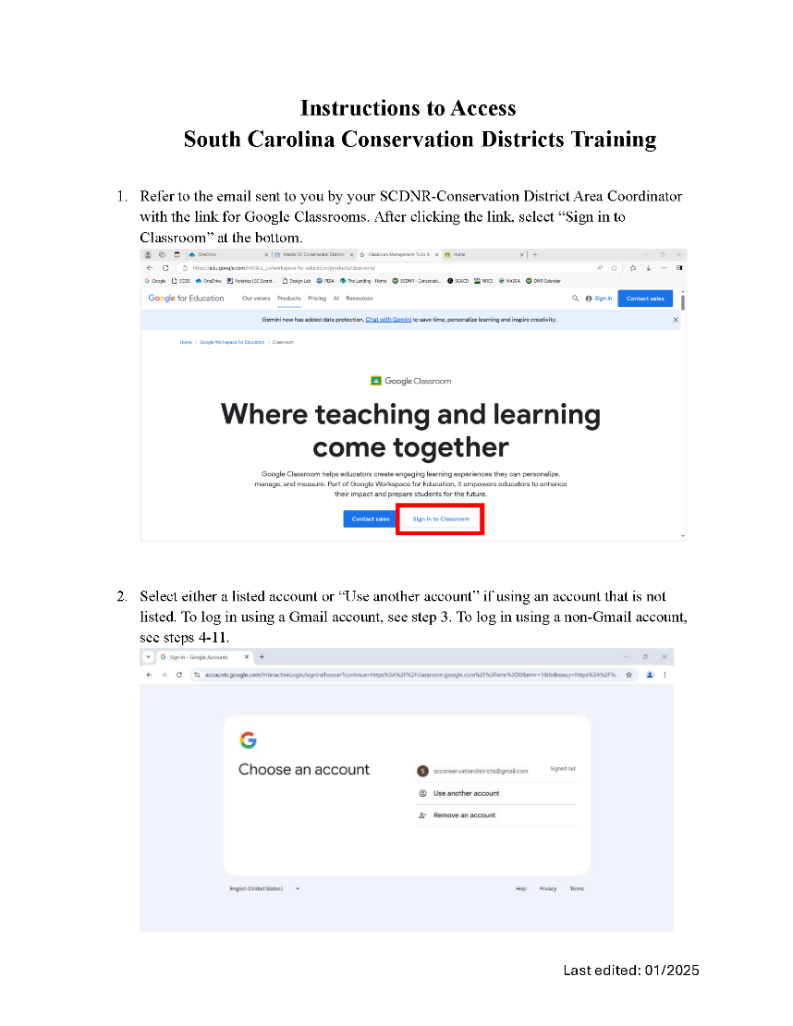
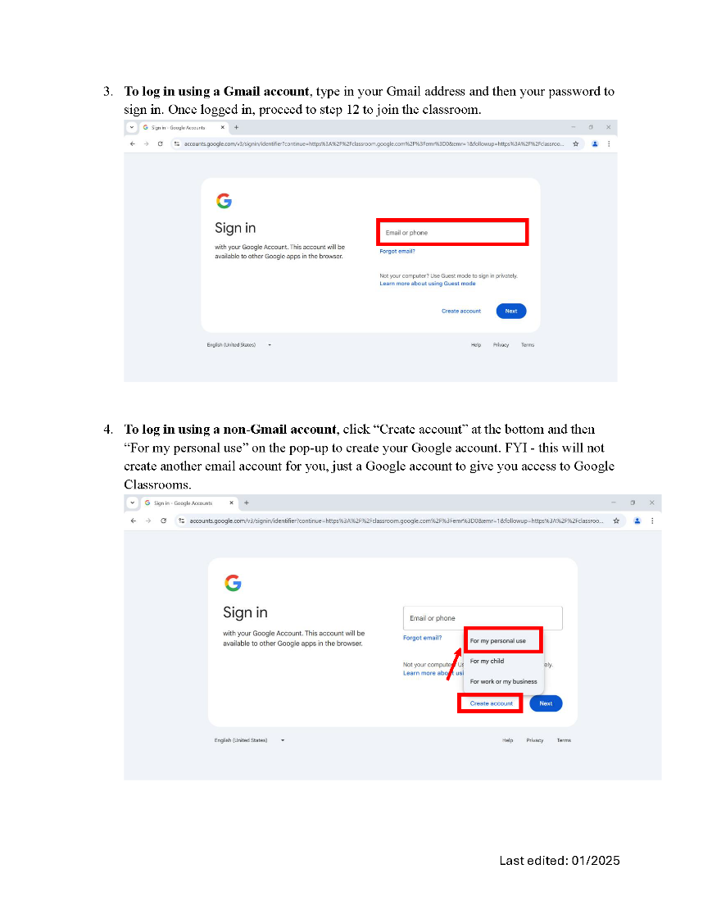
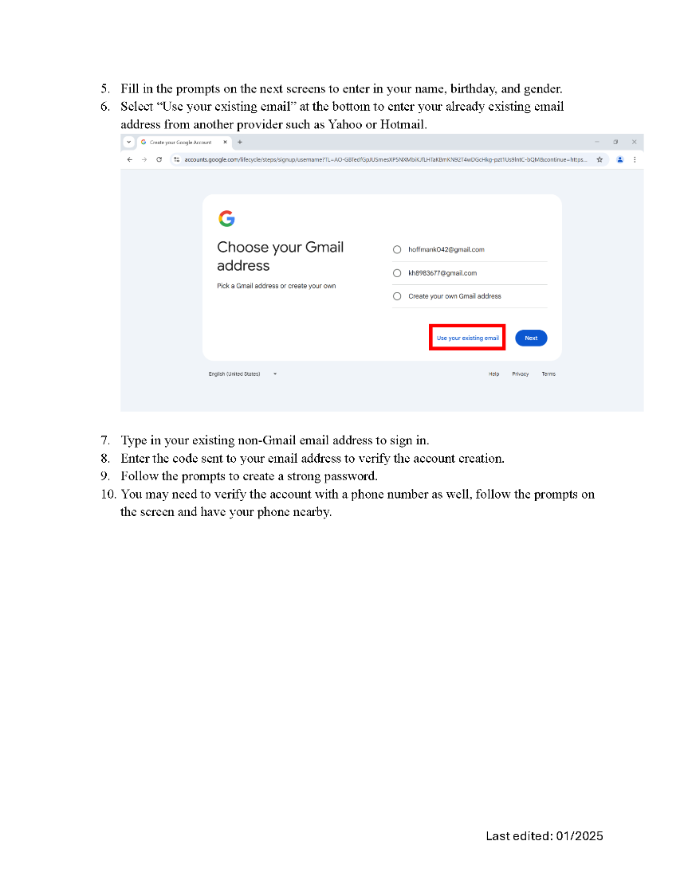
Step by Step Instructions
Notes:
To help make the process as easy and accessible as possible we created step by step instructions which were sent along with the area-specifc class code. It includes how to create a google account with an outside email address (yahoo, outlook, etc) and how to join the classroom.

Slide 10

Google Classroom
Notes:
**As video plays–
This screen recording will give you a glimpse into the classroom from the ‘student’ view. Each module has a video presentation based on that section of the handbook. Videos are on average 15 minutes long. Supplemental resources such as laws, past trainings, or templates are uploaded as PDFs so they can be easily saved or printed. Each quiz includes 5-7 multiple choice questions. Once it’s submitted participants are able to see how they did and responses are sent to our gradebook (which we will talk about later). After receiving 100 on the quiz, participants print and complete the self certification form. This layout is the same for all 11 modules and can be taken at any pace and in any order. The training conclusion includes a feedback survey to help us grow and improve the training as well as the Certification Application form.

Slide 11

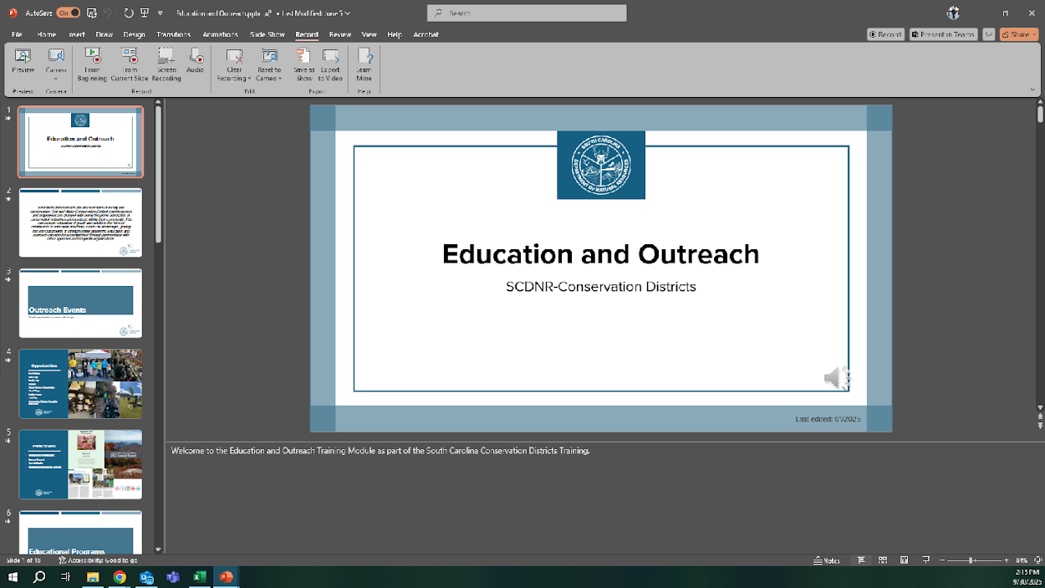
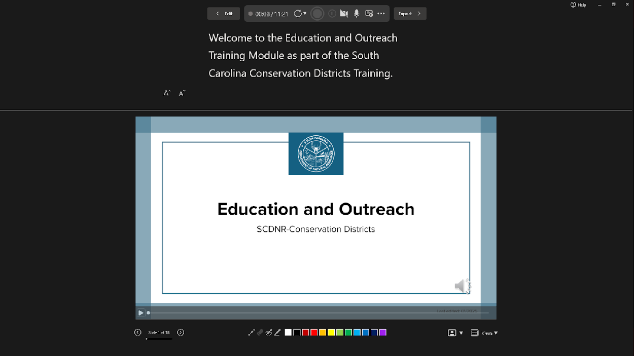
Voiceover Presentations
Recording options
Recording view
Notes:
The video presentations were recorded using the ‘record’ feature in PPT. If there were any mistakes, we could simply re-record that individual slide instead of the whole presentation. This will also benefit us in the future if information needs to be updated

Slide 12



Review Process
Notes:
As we were wrapping up development, Katie and Mary joined our team. So lucky for us we had fresh eyes who could help us to review the content and give a new perspective. We also asked a representative from each of our partners to review the handbook.

Slide 13
Certification Process
Notes:
Next I’ll touch on the process individuals and districts go through to become certified

Slide 14
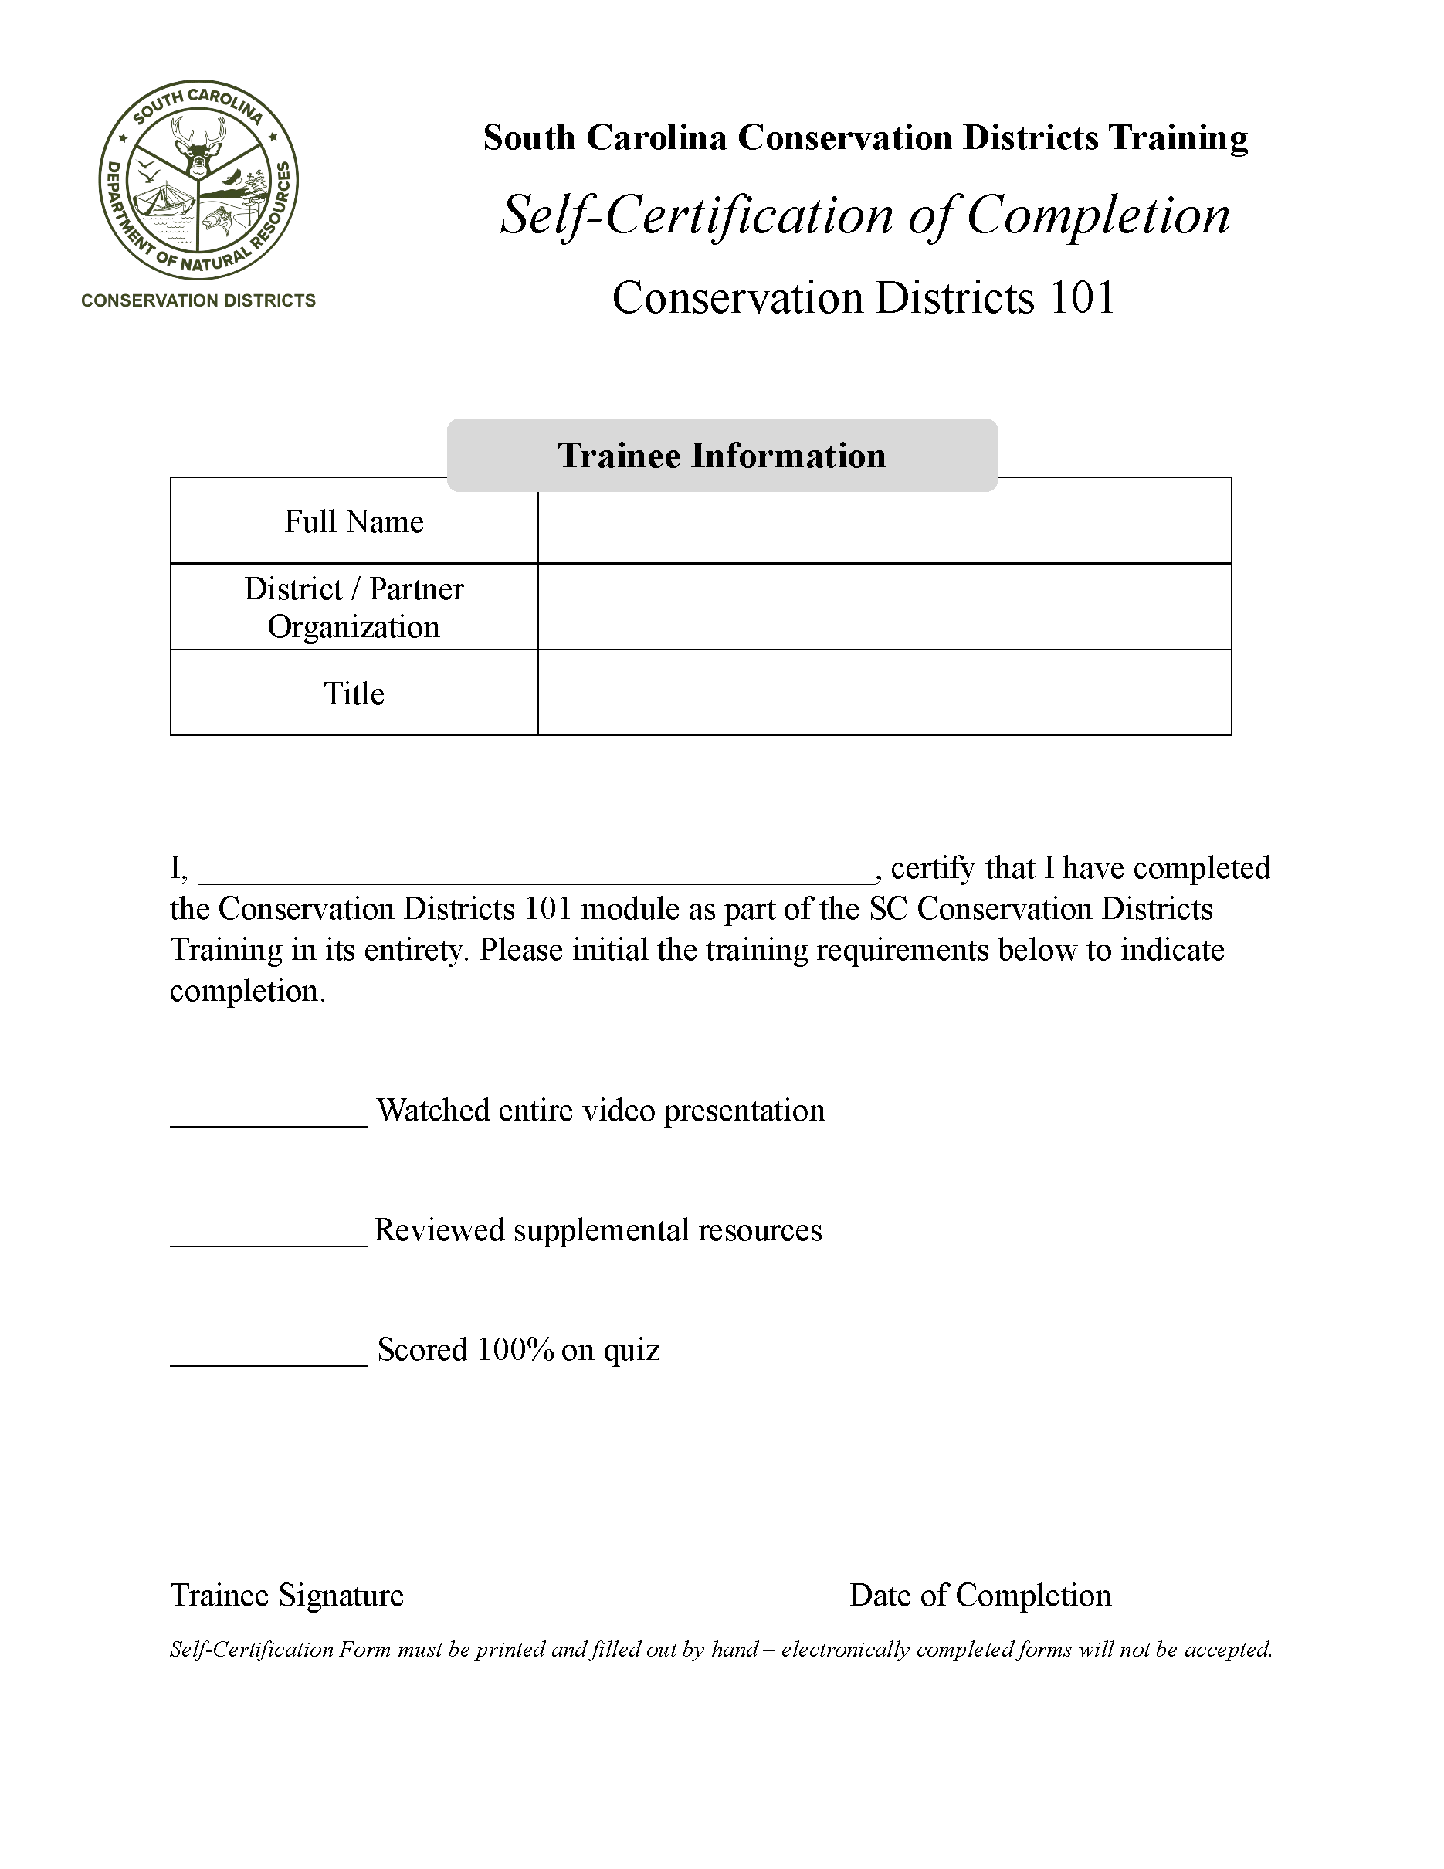
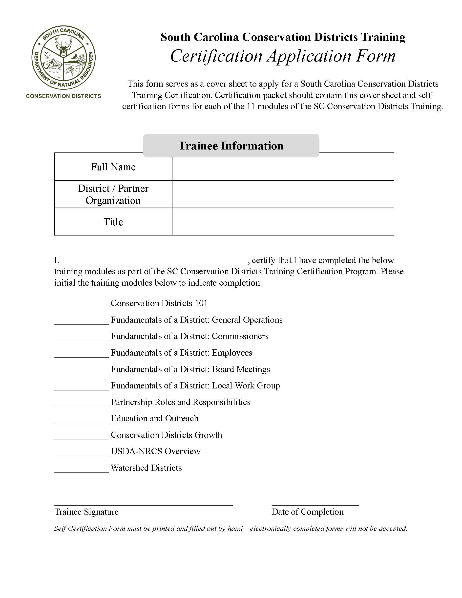

Certification Process
Notes:
-Pictured on the left are the self-certification forms for individuals to complete for each module.
-Self-certification forms are meant to be completed individually, even if modules are taken as a group.
-When all modules are completed, the self-certification forms are submitted as 1 packet in addition to the overall application form pictured on the right, which serves as a cover sheet. We ask for wet signatures over digital signatures on all forms to add a layer of integrity so that commissioners and employees are actually signing their name that they’ve done their part. We also ask for the date they completed the training and use this to keep track of an individual’s training expiration date; their certification is valid for 4 years after submission.

Slide 15
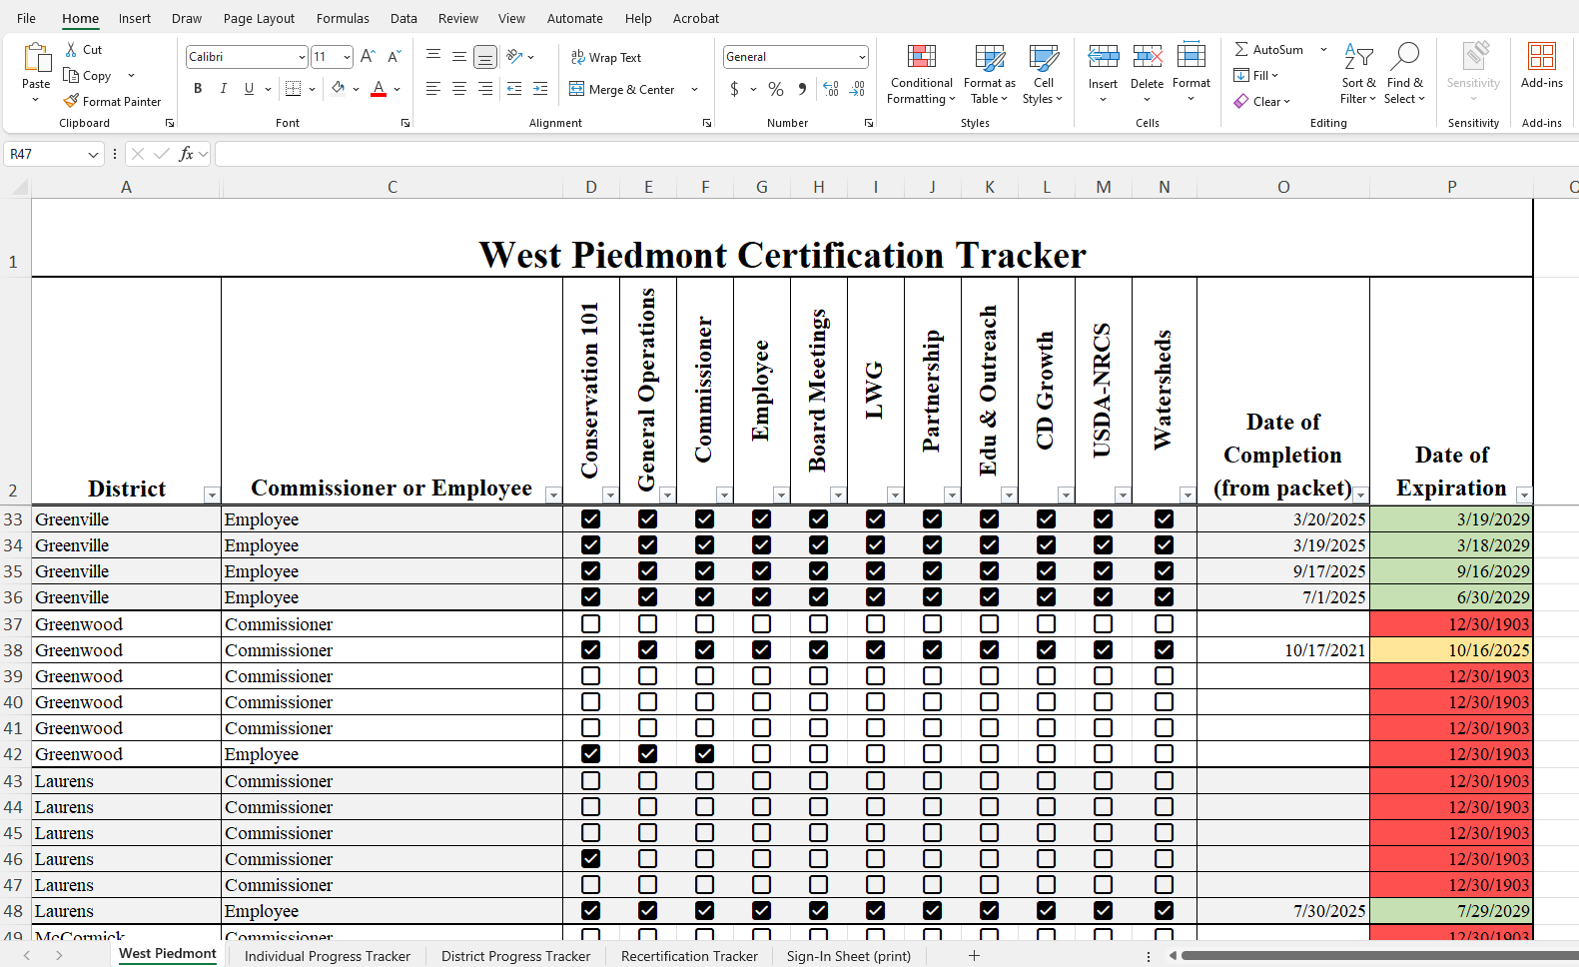
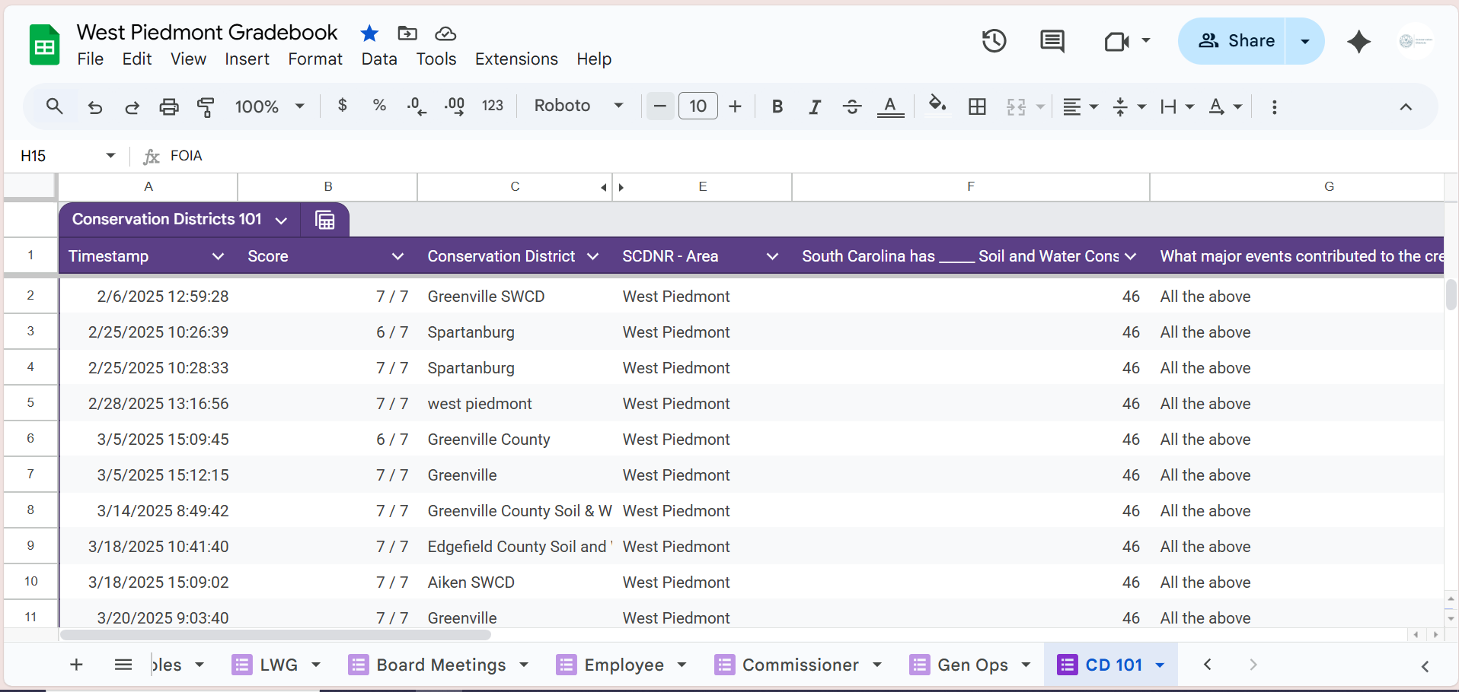
Gradebooks
1 per area
All quiz responses populate into a single Google sheet
Excel sheet tracks individual, district, and recertification progress
Notes:
-The next step in the certification process once all the paperwork is received is for area coordinators to check their respective gradebooks.
-Within Google Classrooms, we were able to get all quiz responses to automatically populate into a single Google Sheet where the different quizzes are separated by tabs. This consolidates all grades from all students within an area into 1 place for easy scorekeeping.
-The excel spreadsheet utilizes different tabs to track individual progress, district progress, and then recertification progress (which we’ll touch on recertification a bit later).
-One thing I’ll add is that currently we do not keep track of grades for associate commissioners or partners, just commissioners and employees.

Slide 16
Benefits & Stats
Notes:
-Since rolling out the training in February, we’ve seen a lot of positive impact and constructive feedback statewide.

Slide 17

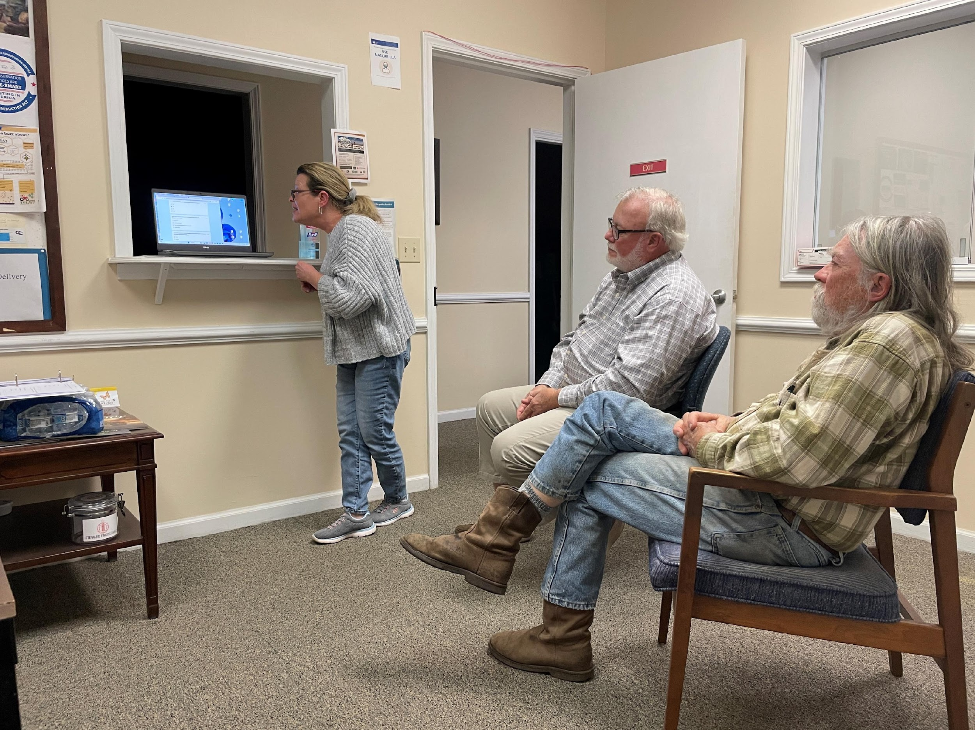
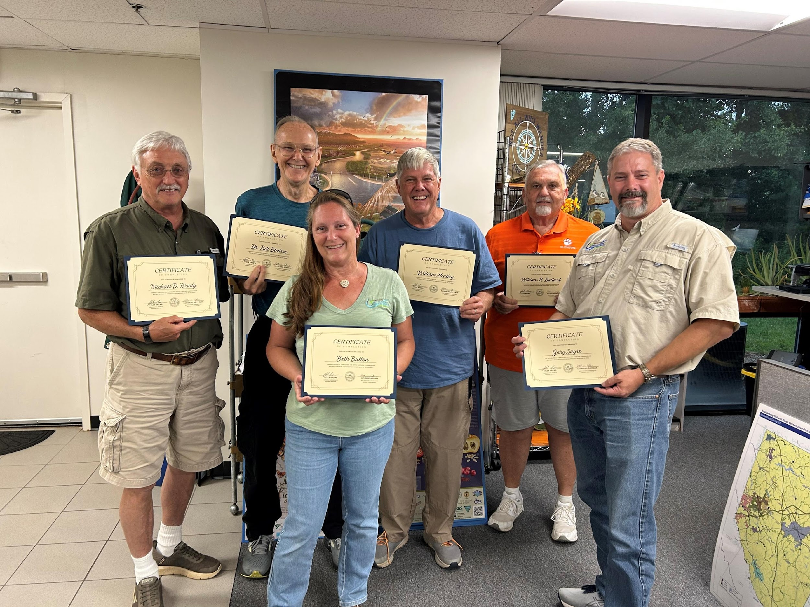
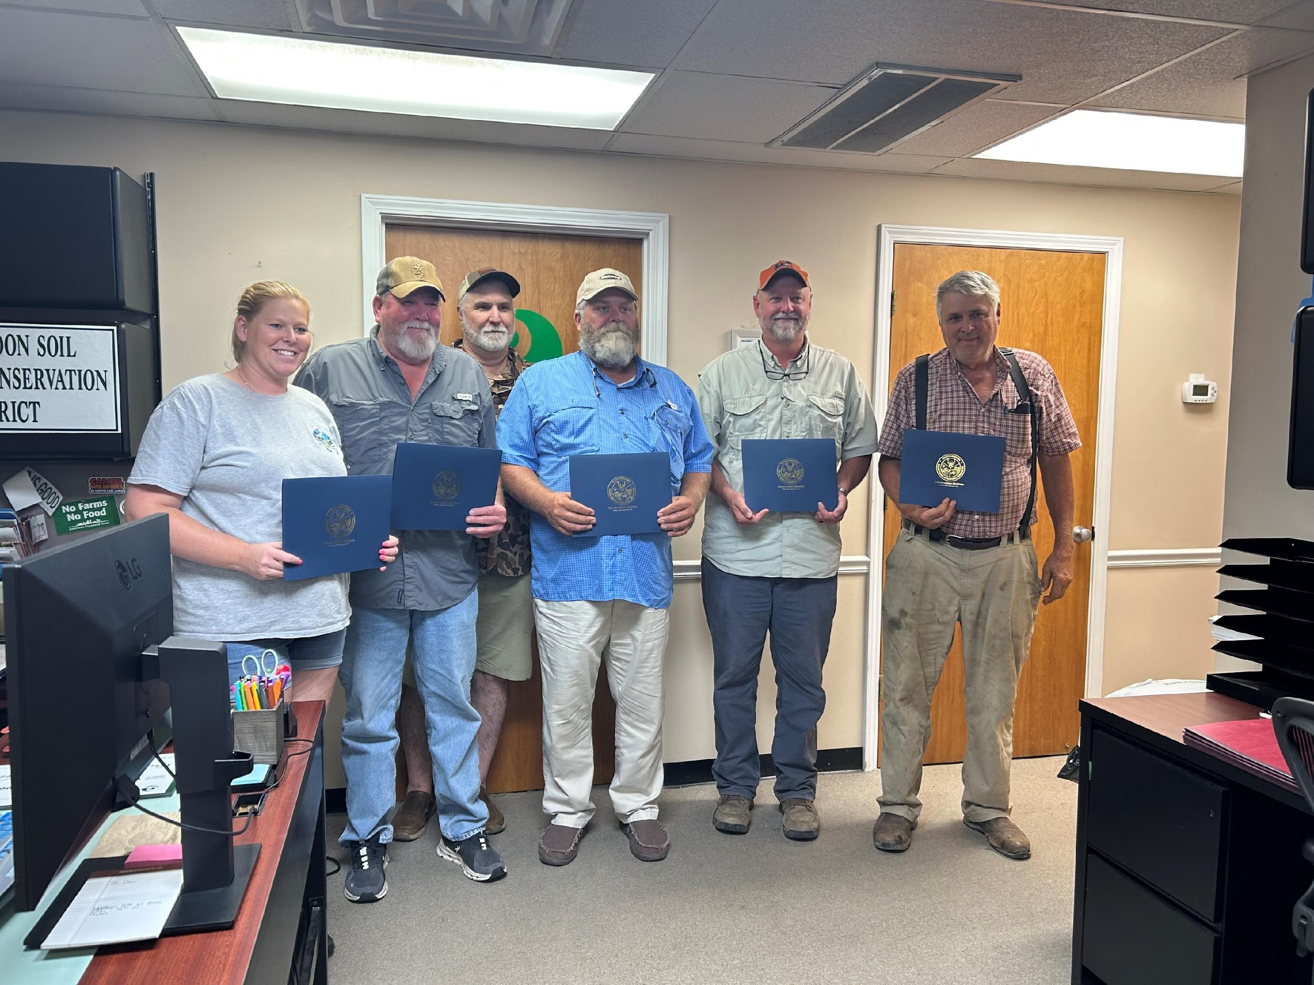
Benefits
Notes:
-One of the benefits we’ve seen from this is how taking the training together has fostered a sense of collaboration and even friendly competition between districts to see who can get it done first.
-We’ve heard from new employees how beneficial it’s been during onboarding, especially if they didn’t have a background working with conservation districts in the past.
-This has also been a mechanism for revitalizing long-time commissioners. It provides a tool for them to evaluate their own performance as a district and reminds them of specific actions they can take to be successful (like updating district SOPs, long-term and short-term plans, and employee evaluations).
-With the feedback we’ve received, we plan to update the training annually to keep this as a living training.

Slide 18
Notes:
These statistics show participation since the launch of this voluntary training 8 months ago. 76% of our 46 districts and almost half of the total individual have either started the training or completed it
**check stats – especially the ‘in progress’ this only reflect East Piedmont – to edit either: click on the pie chart -> click ‘chart design’ tab -> click ‘edit data’ -> enter your numbers beside your area’s certified & in progress
Commissioners = 230
District employee = 16 + 16 + 16 + 13 = 61
Pee Dee: Completed Individuals:14, In progress: 15, Total commissioners + Employees: 74. Districts Completed:1 Districts in progress:7
**This would be a good slide to highlight that this is completely voluntary, so this level of participation shows districts are truly excited for this training and understand the value of it

Slide 19
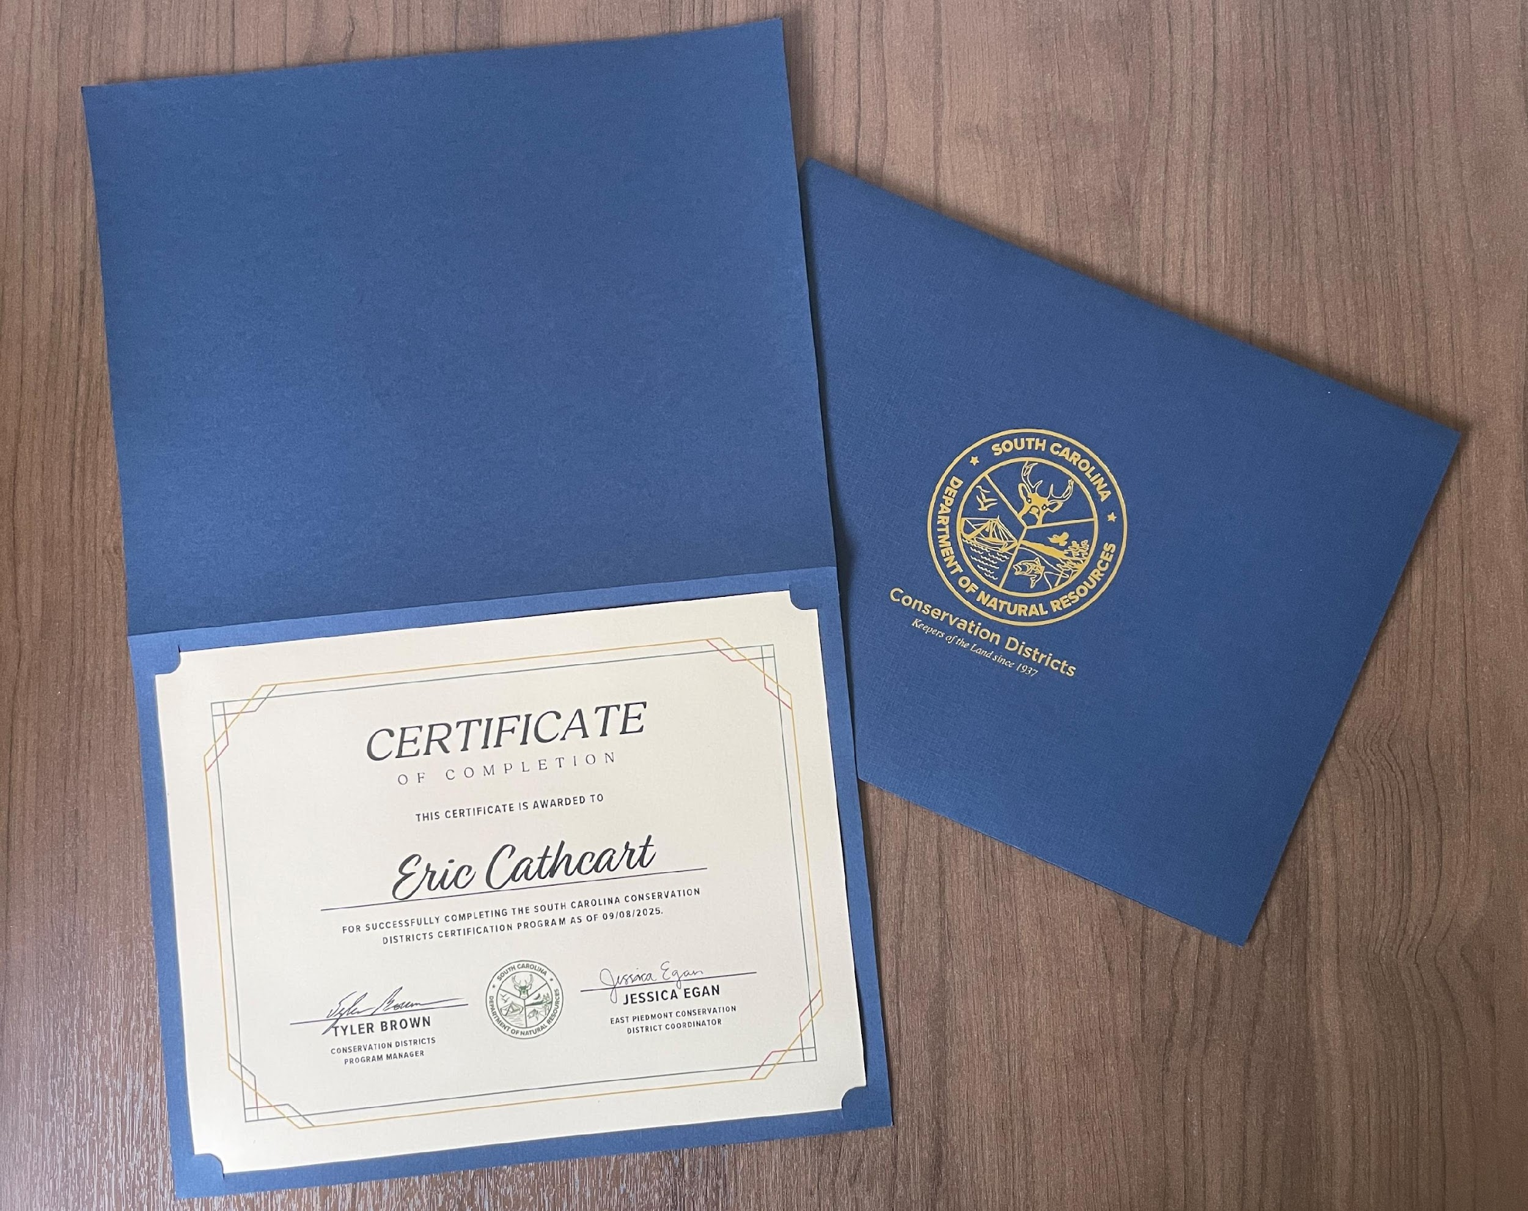
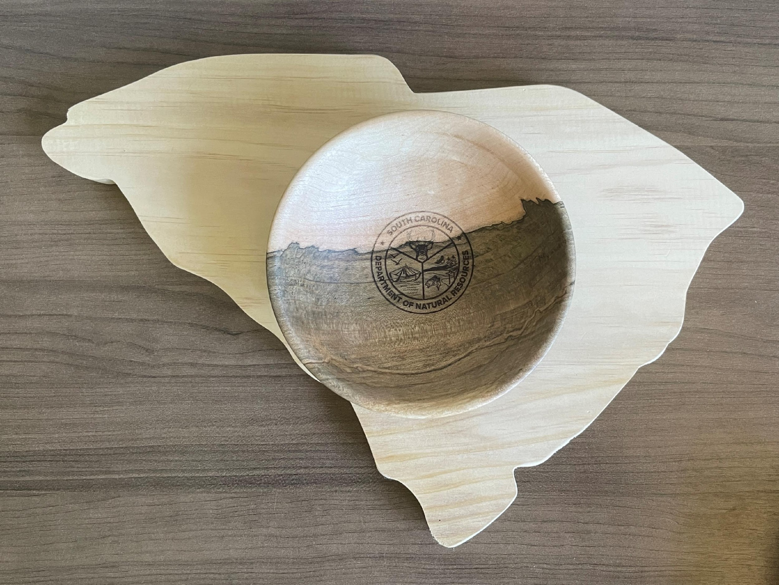
Recognition
Individual
Certified District
Notes:
As individuals complete all the training modules throughout the year, we will present a certificate of completion.
Once all commissioners and employees in a district have completed the training to become a “Certified District” they will receive a state shaped plaque at our annual partnership conference awards ceremony along with a handmade wooden dish for everyone in the district
Like Katie mentioned, while we don’t keep track of grades for associate commissioners or partners, we do provide them with certificates of completion similar to the ones we recognize commissioners and employees with.

Slide 20
Recertification
Notes:
To encourage continued education for districts, we have developed a recertification process

Slide 21
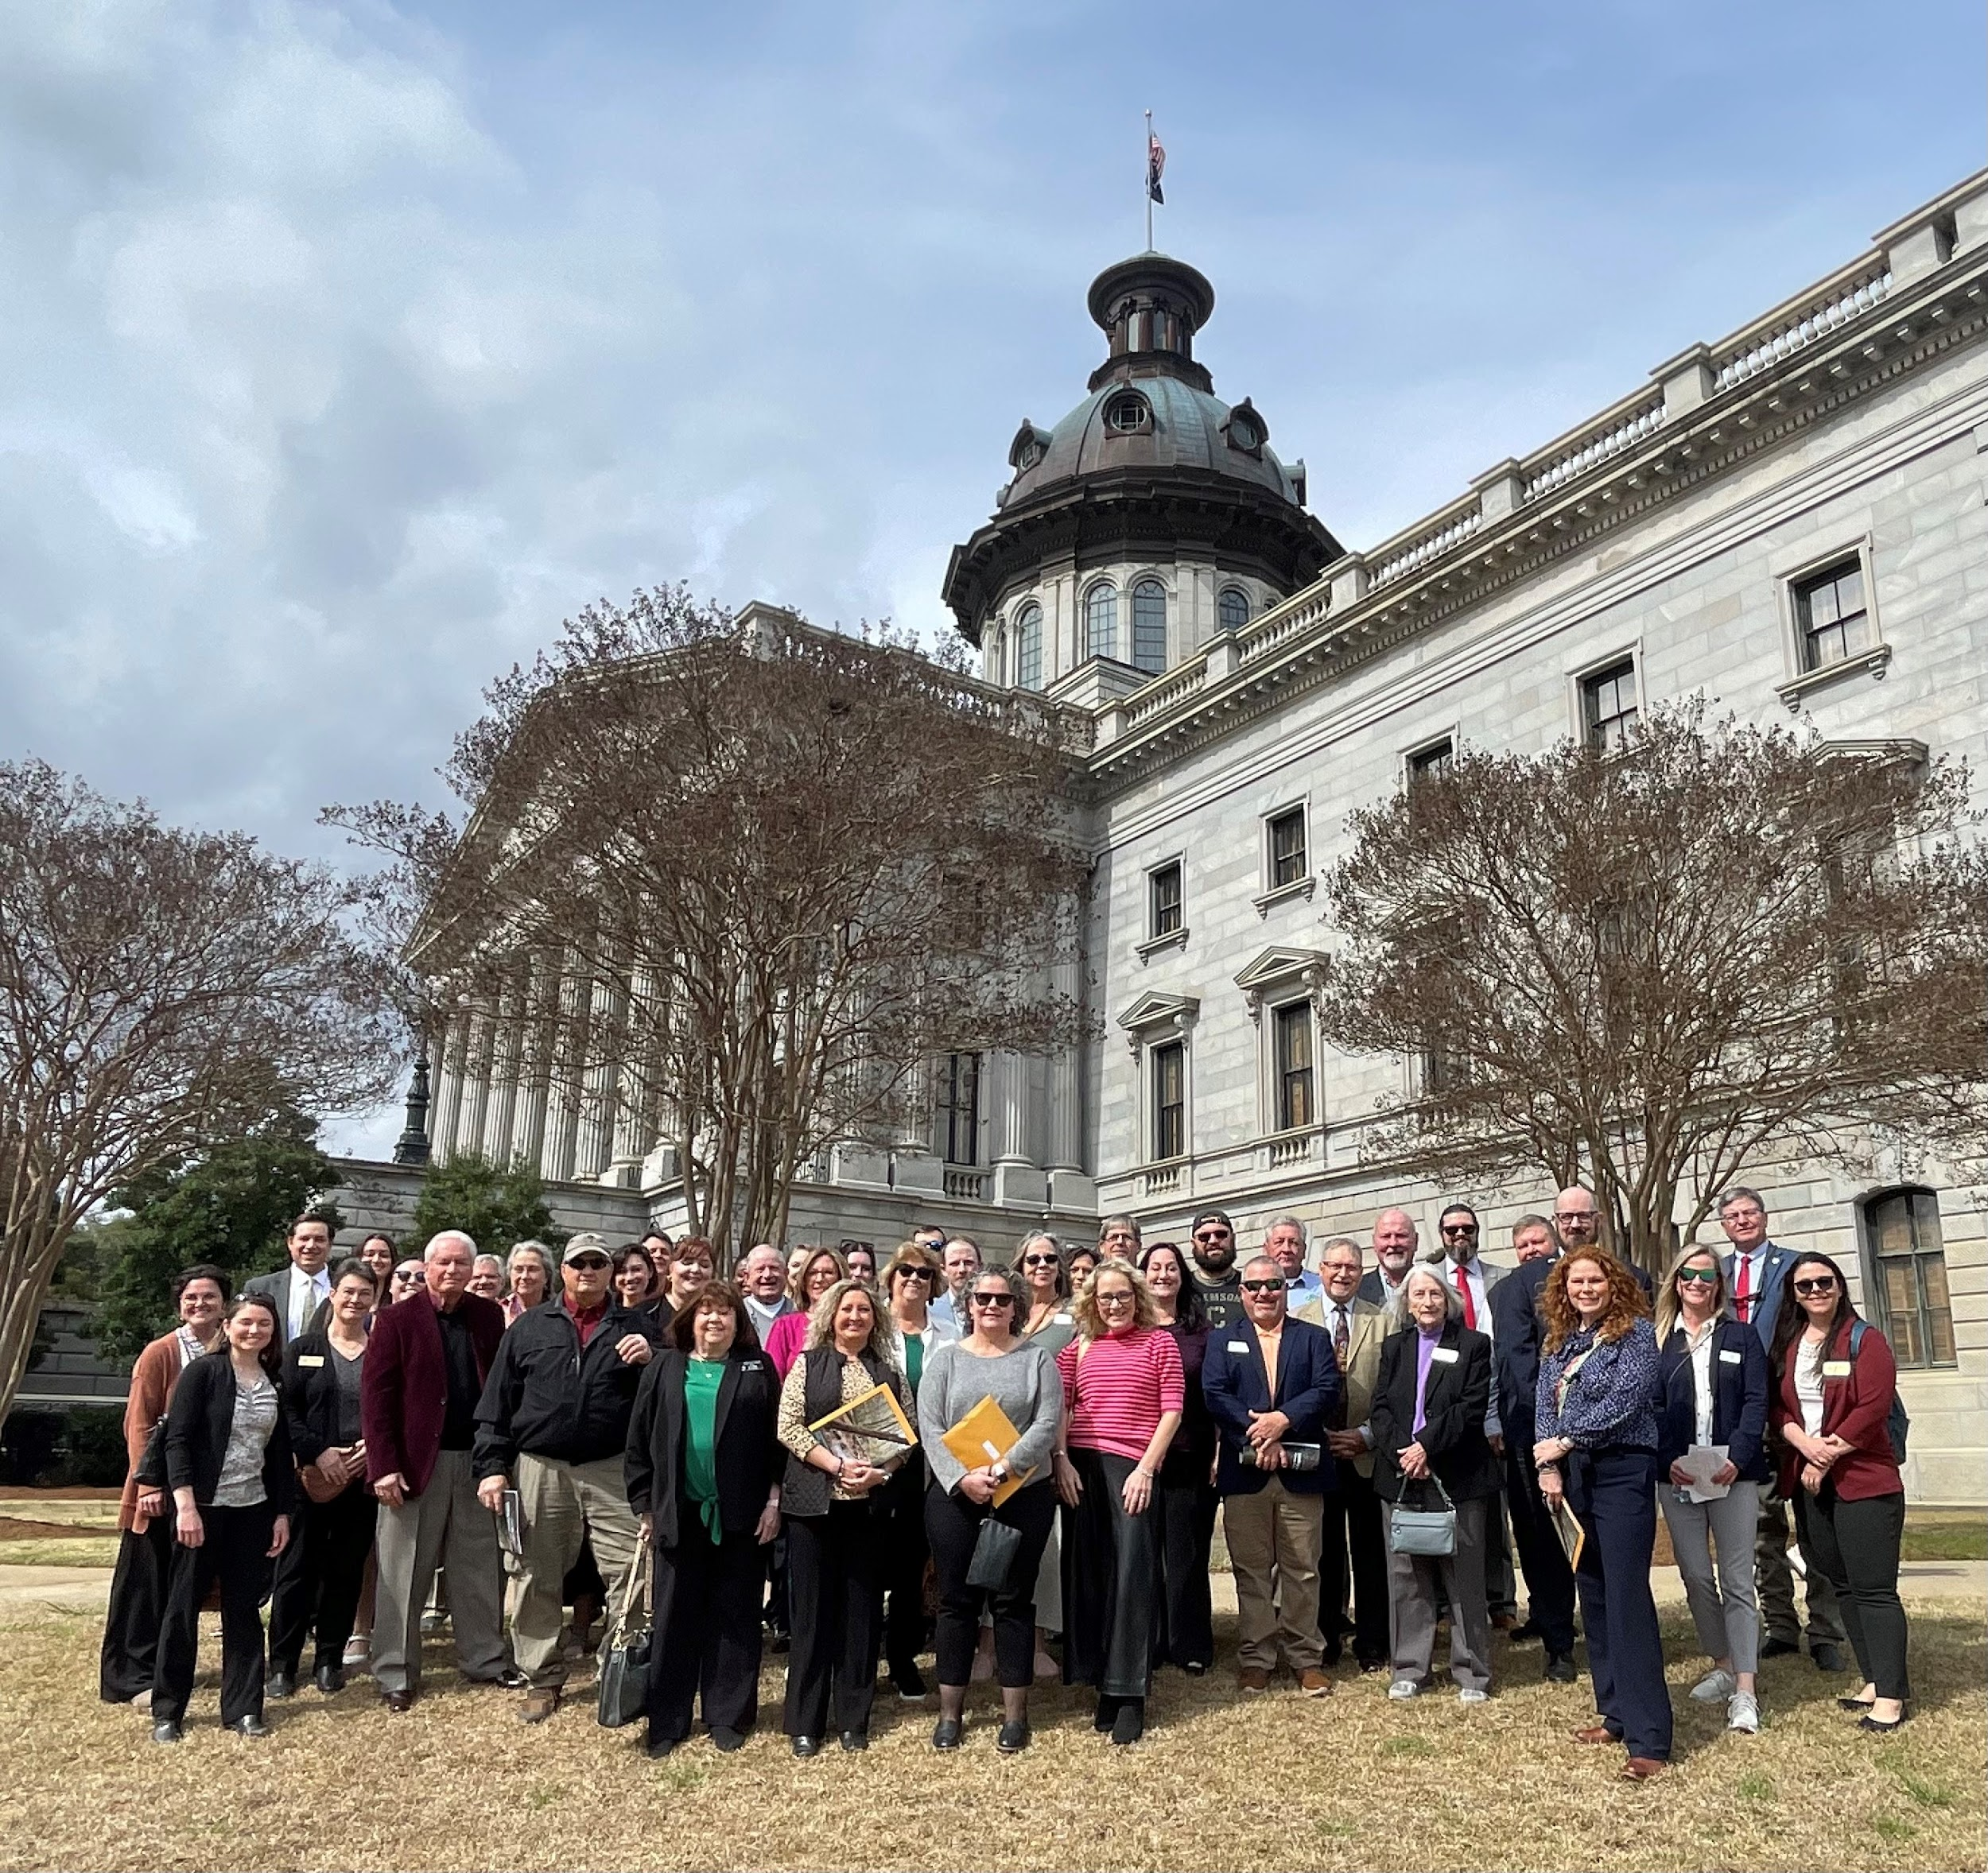
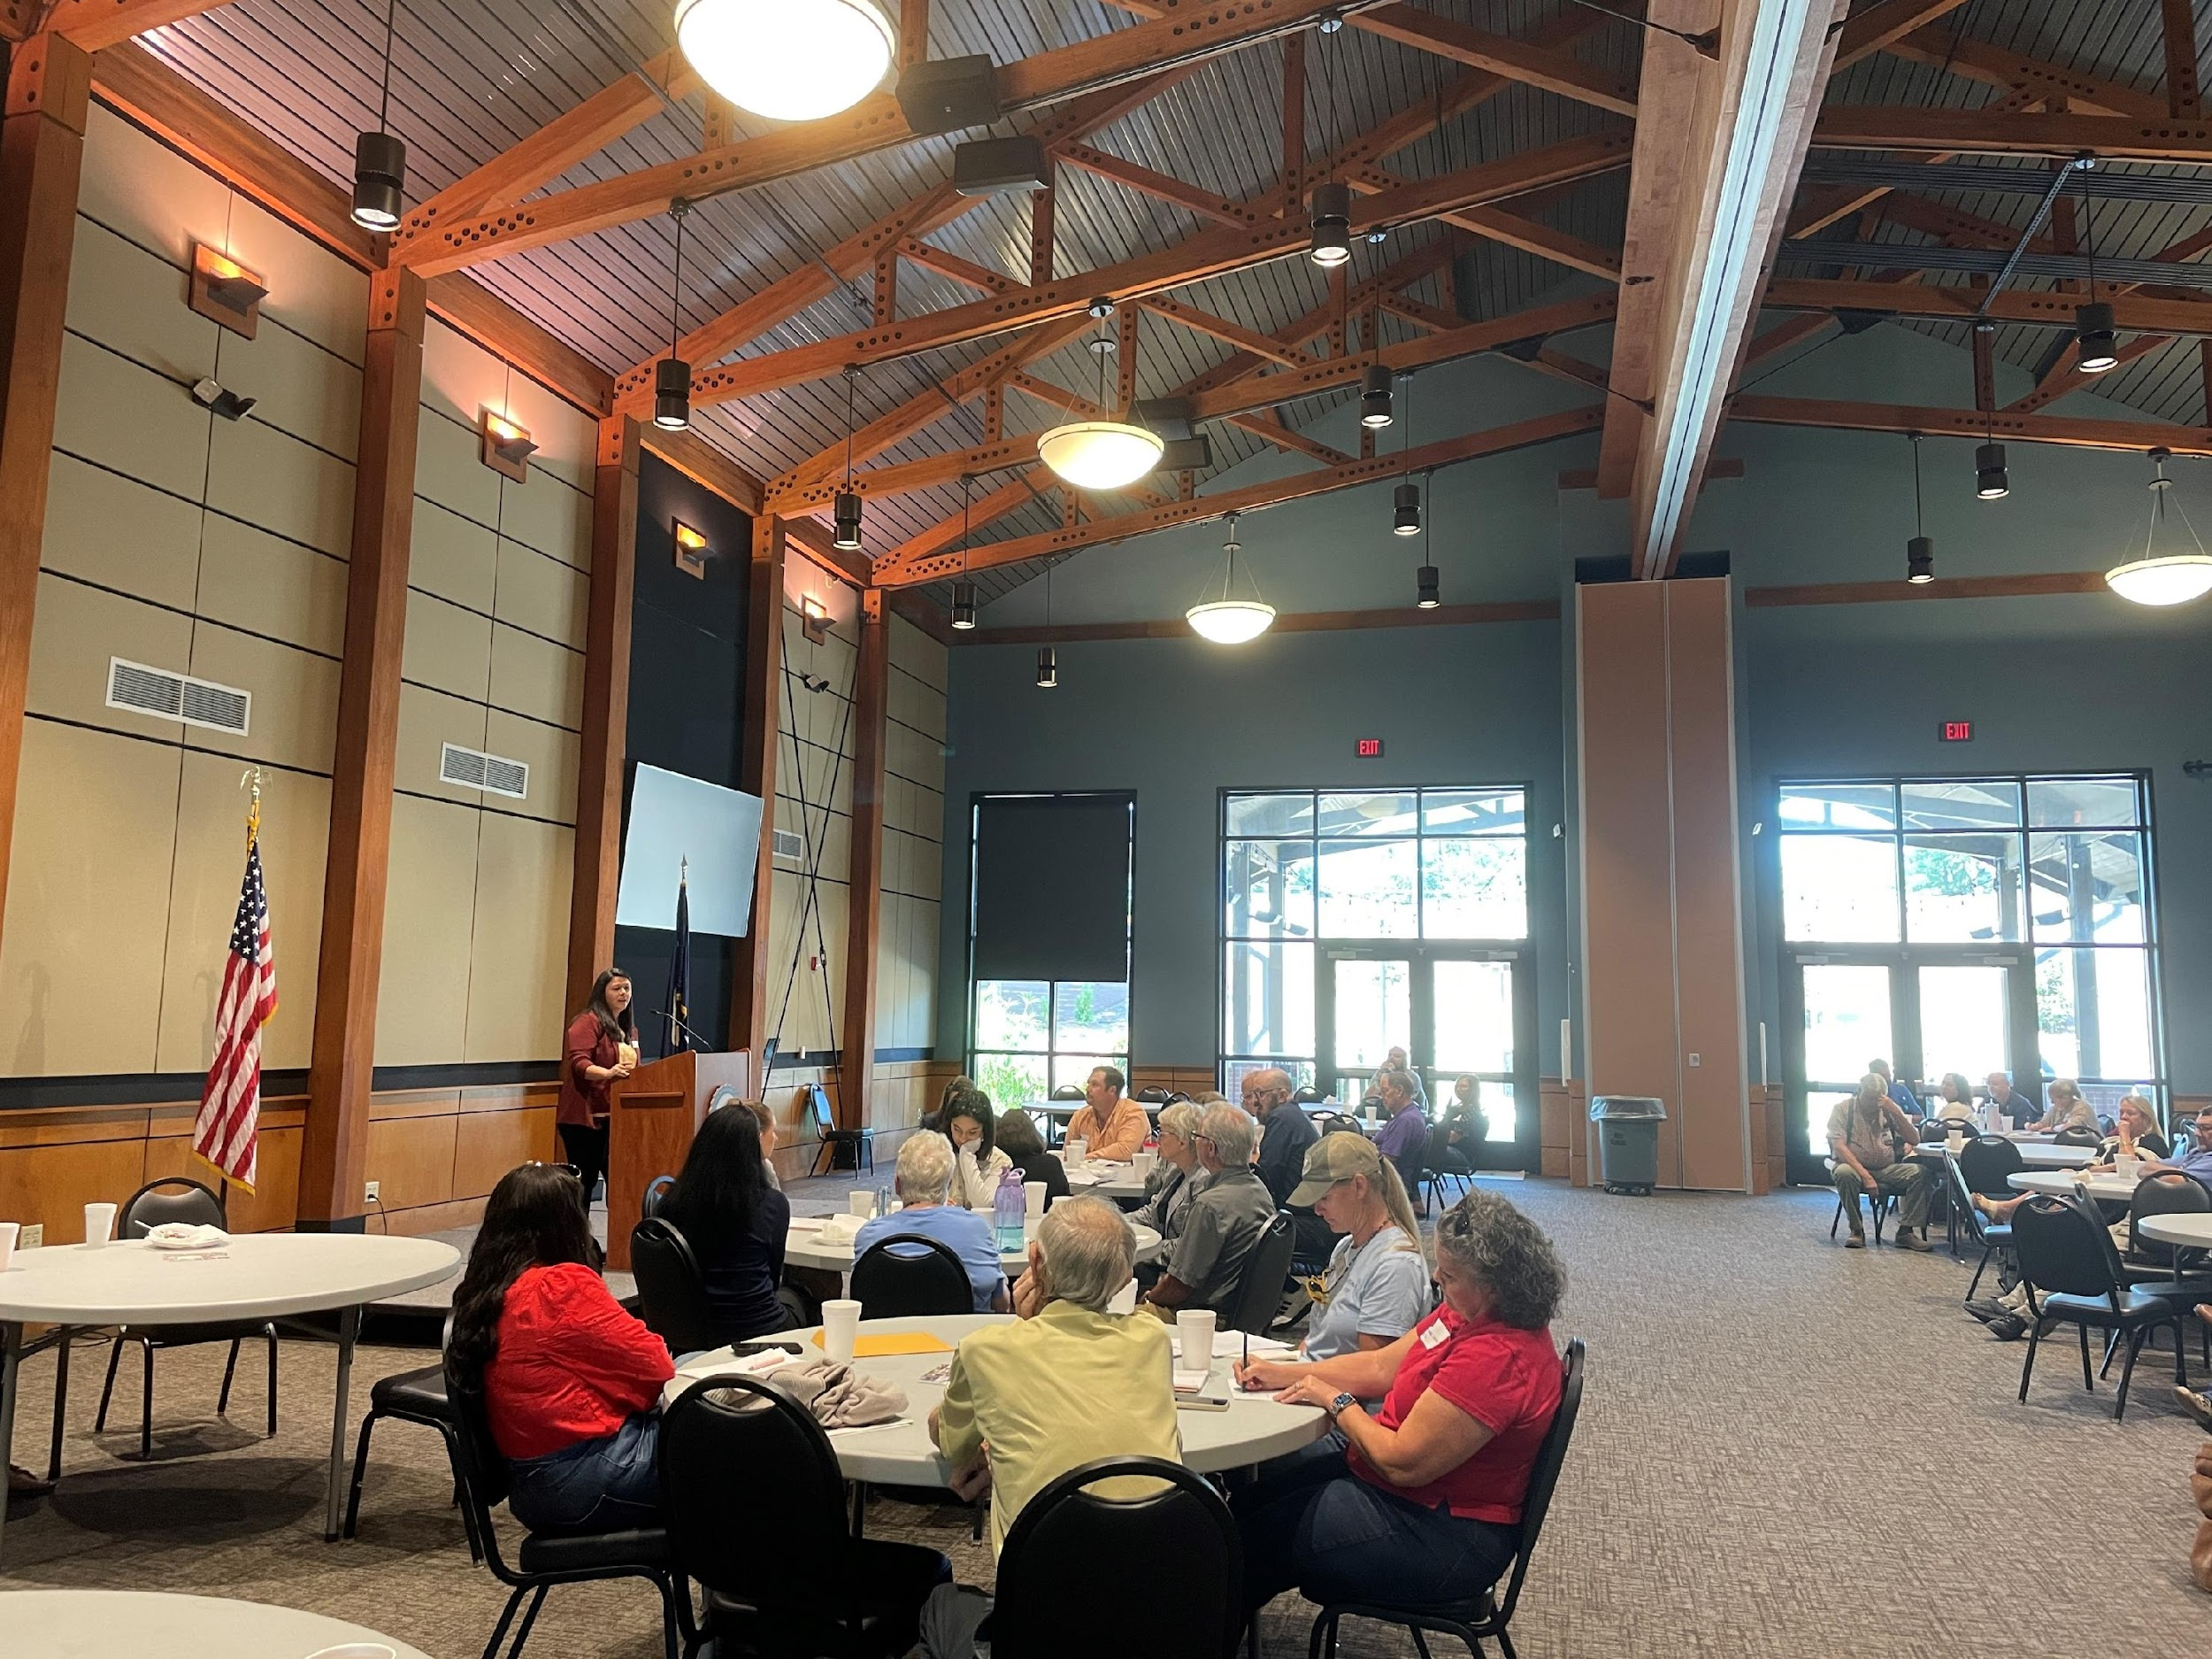
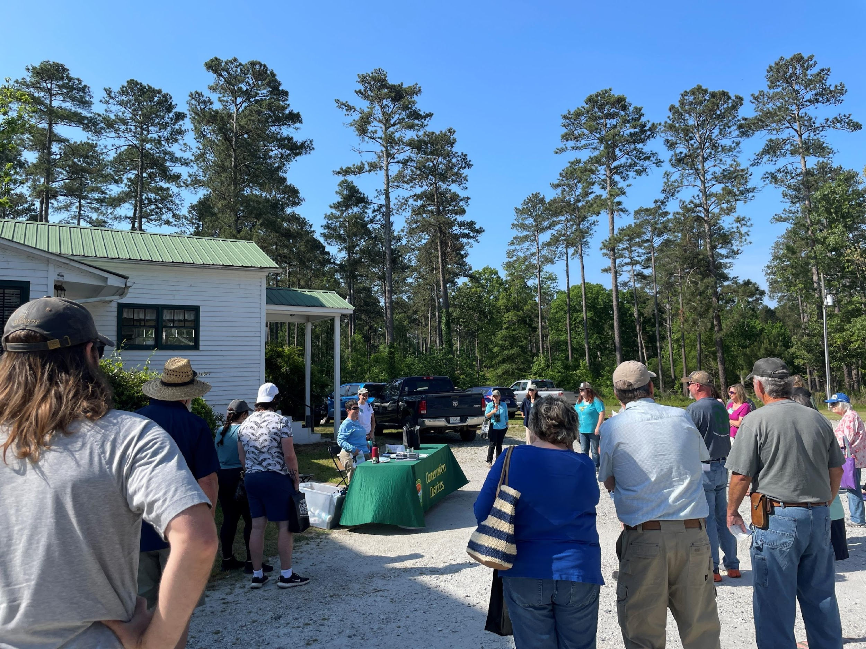
How to receive credits….
SCACD Mid-Year Meeting
Stewardship Week Field Day
Conservation Districts
day at the State House
Notes:
Individual certifications are valid for 4 years based on their date of completion. To be recertified, participants must complete a total of 12 recertification credits. Recertification credits can be received by attending events, serving in leadership or committee roles, or retaking the modules
Once you become certified, your individual certification is valid for 4 years after the date of completion listed on your certificate.
you must complete a total of 12 additional recertification credits before the date of expiration.
There are several ways to receive recertification credits:
Individuals can retake the training modules, Each module is worth 1 credit
Attend association meetings, our Conservation Districts Day at the State House, serving on various committees or in leadership roles, or attending a special training event
We do ask that the individual attend the entire event to receive full credit

Slide 22
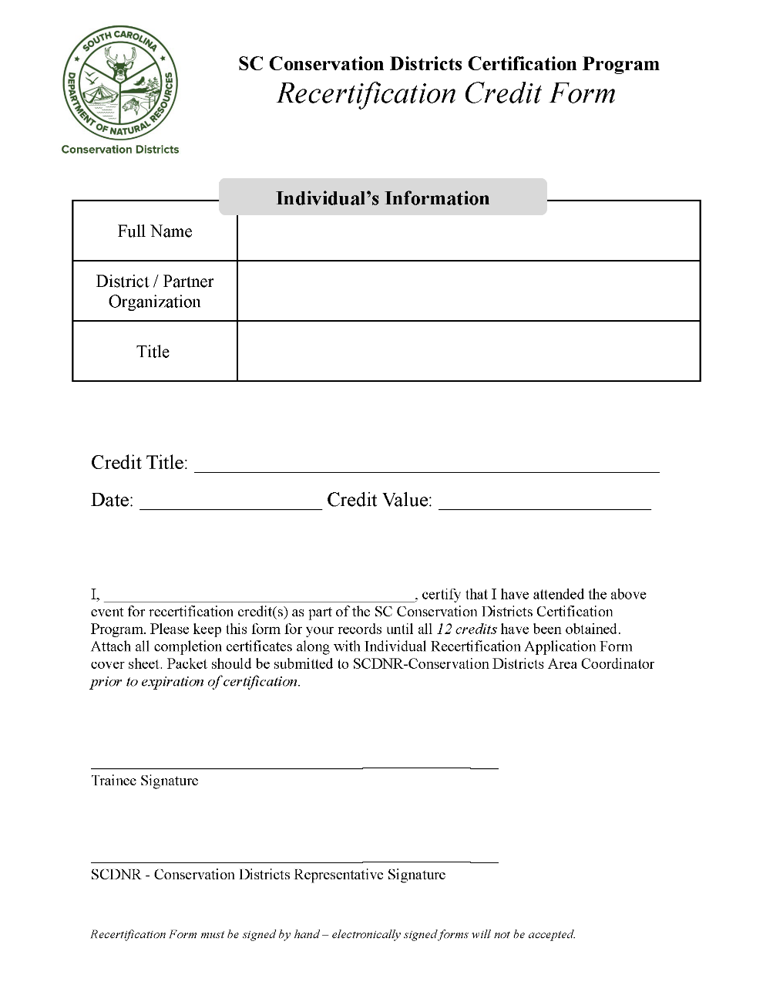
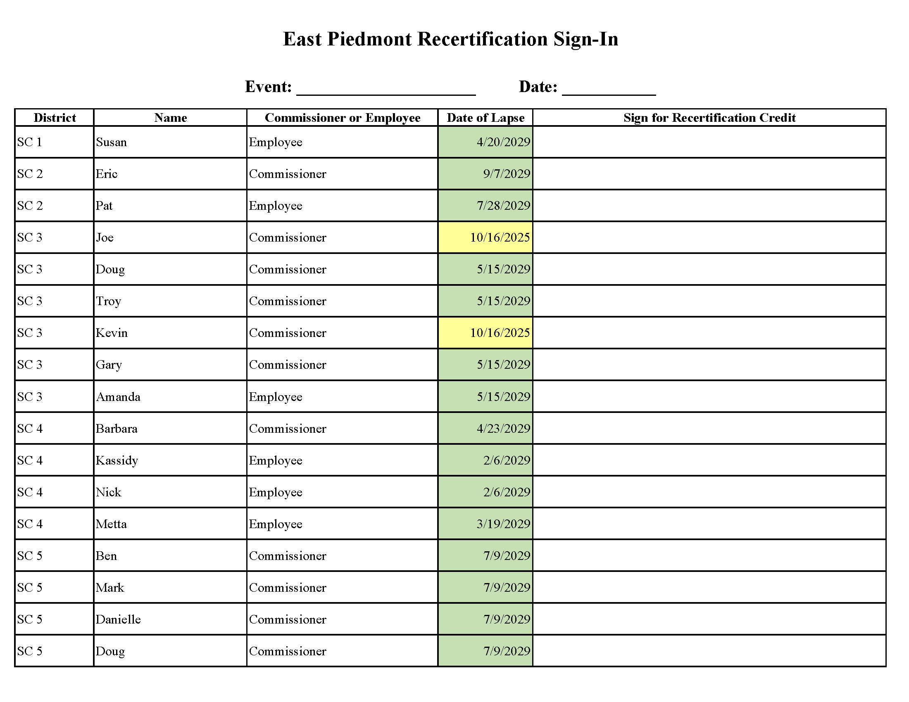
Recertification
Participants sign-in to their area-specific sign-in sheet
Area coordinator complete the Recertification Credit Form per event and send it out
Notes:
At an event, a sign-in sheet is available which includes an individual's date of expiration so everyone is constantly reminded
After the event, we will send a 'Recertification Credit Form' stating the individual attended the full event.
It is the responsibility of the individual to keep up with all of their Recertification Credit Forms, to submit for recertification at the end of their 4 years.

Slide 23
Contact us!
Tyler Brown, BrownTy@dnr.sc.gov
Conservation Districts Program Manager
Brooke Myres, MyresB@dnr.sc.gov
Field Operations Program Manager
Jordan Baker, BakerJ@dnr.sc.gov
Administrative Assistant
John Hayes, HayesJ@dnr.sc.gov
Watershed Districts Coordinator
Katie Hoffman, HoffmanKM@dnr.sc.gov
West Piedmont Conservation District Coordinator
Mary Bracey, BraceyM@dnr.sc.gov
Pee Dee Conservation District Coordinator
Jennifer Morris, MorrisJ@dnr.sc.gov
Edisto-Savannah Valley Conservation District Coordinator
Jessica Egan, EganJ@dnr.sc.gov
Program Development Coordinator
Notes:
Thank you! If you have any questions later, please feel free to reach out to us

