Slide 1
Local Work Groups
Jennifer Morris and Jessica Egan

Slide 2
What We Have Done...
Formed SC LWG Committee – NRCS, SCDNR, commissioners and district employees
Resources – guidelines, trainings, videos and staff support

Slide 3

What We Have Learned...
Return on Investment
Variability – Facilitator, Approach
Terminology
Attendance
Networking
Guest Speakers

Slide 4
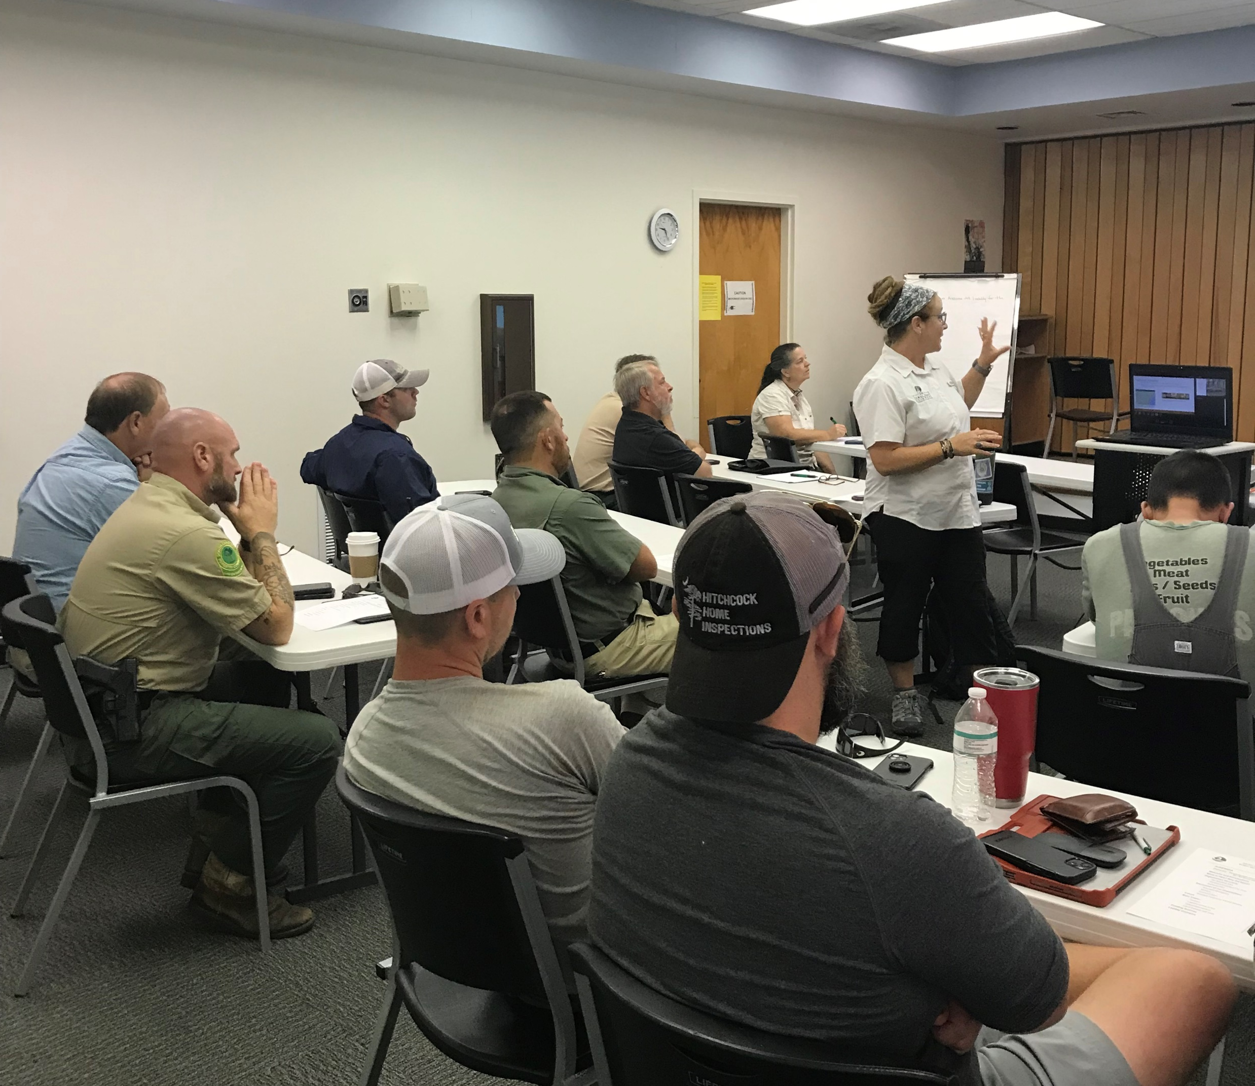
What We Will Continue Doing...
Morale
Accountability
Reporting
Awareness

Slide 5
Resources
National Conservation Planning Partnership
  https://www.nationalconservationplanningpartnership.com/local-work-group-project-resources/
South Carolina Local Work Group Guidance
Notes:
NCPP – similar on national level around the same time. One commissioner represented on both national and state

Slide 6
Contact us!
Tyler Brown
BrownTy@dnr.sc.gov
Brooke Myres
MyresB@dnr.sc.gov
Jennifer Morris
MorrisJ@dnr.sc.gov
Jessica Egan
EganJ@dnr.sc.gov

