Slide 1
Archiving Project
Jordan Baker and John Hayes
Notes:
Intro with background on our team and a little about our state.

Slide 2
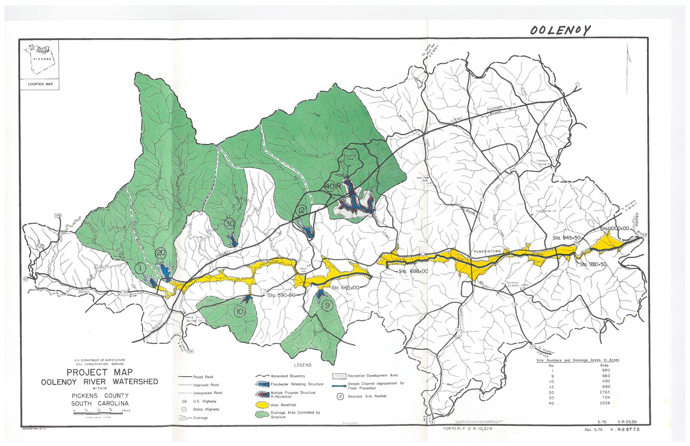
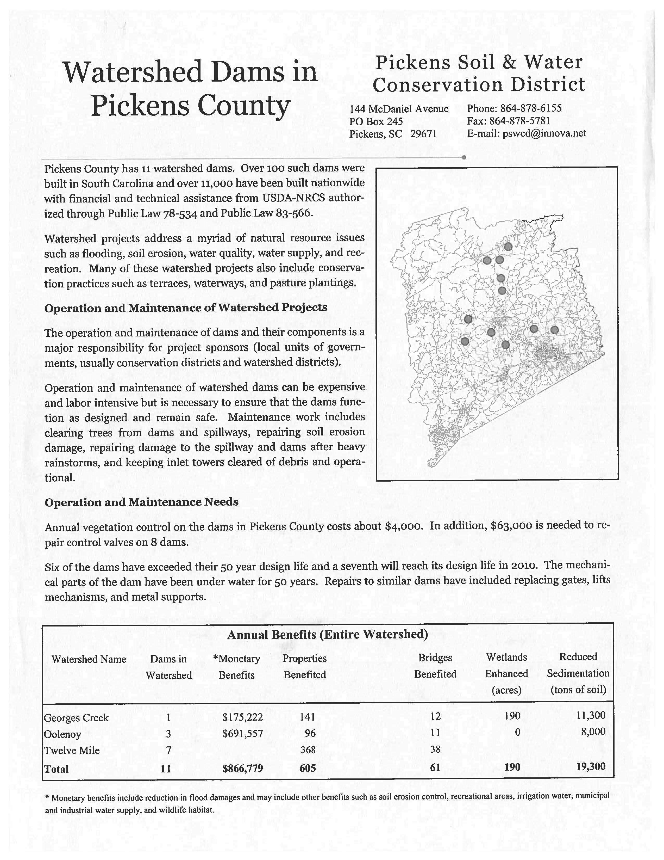
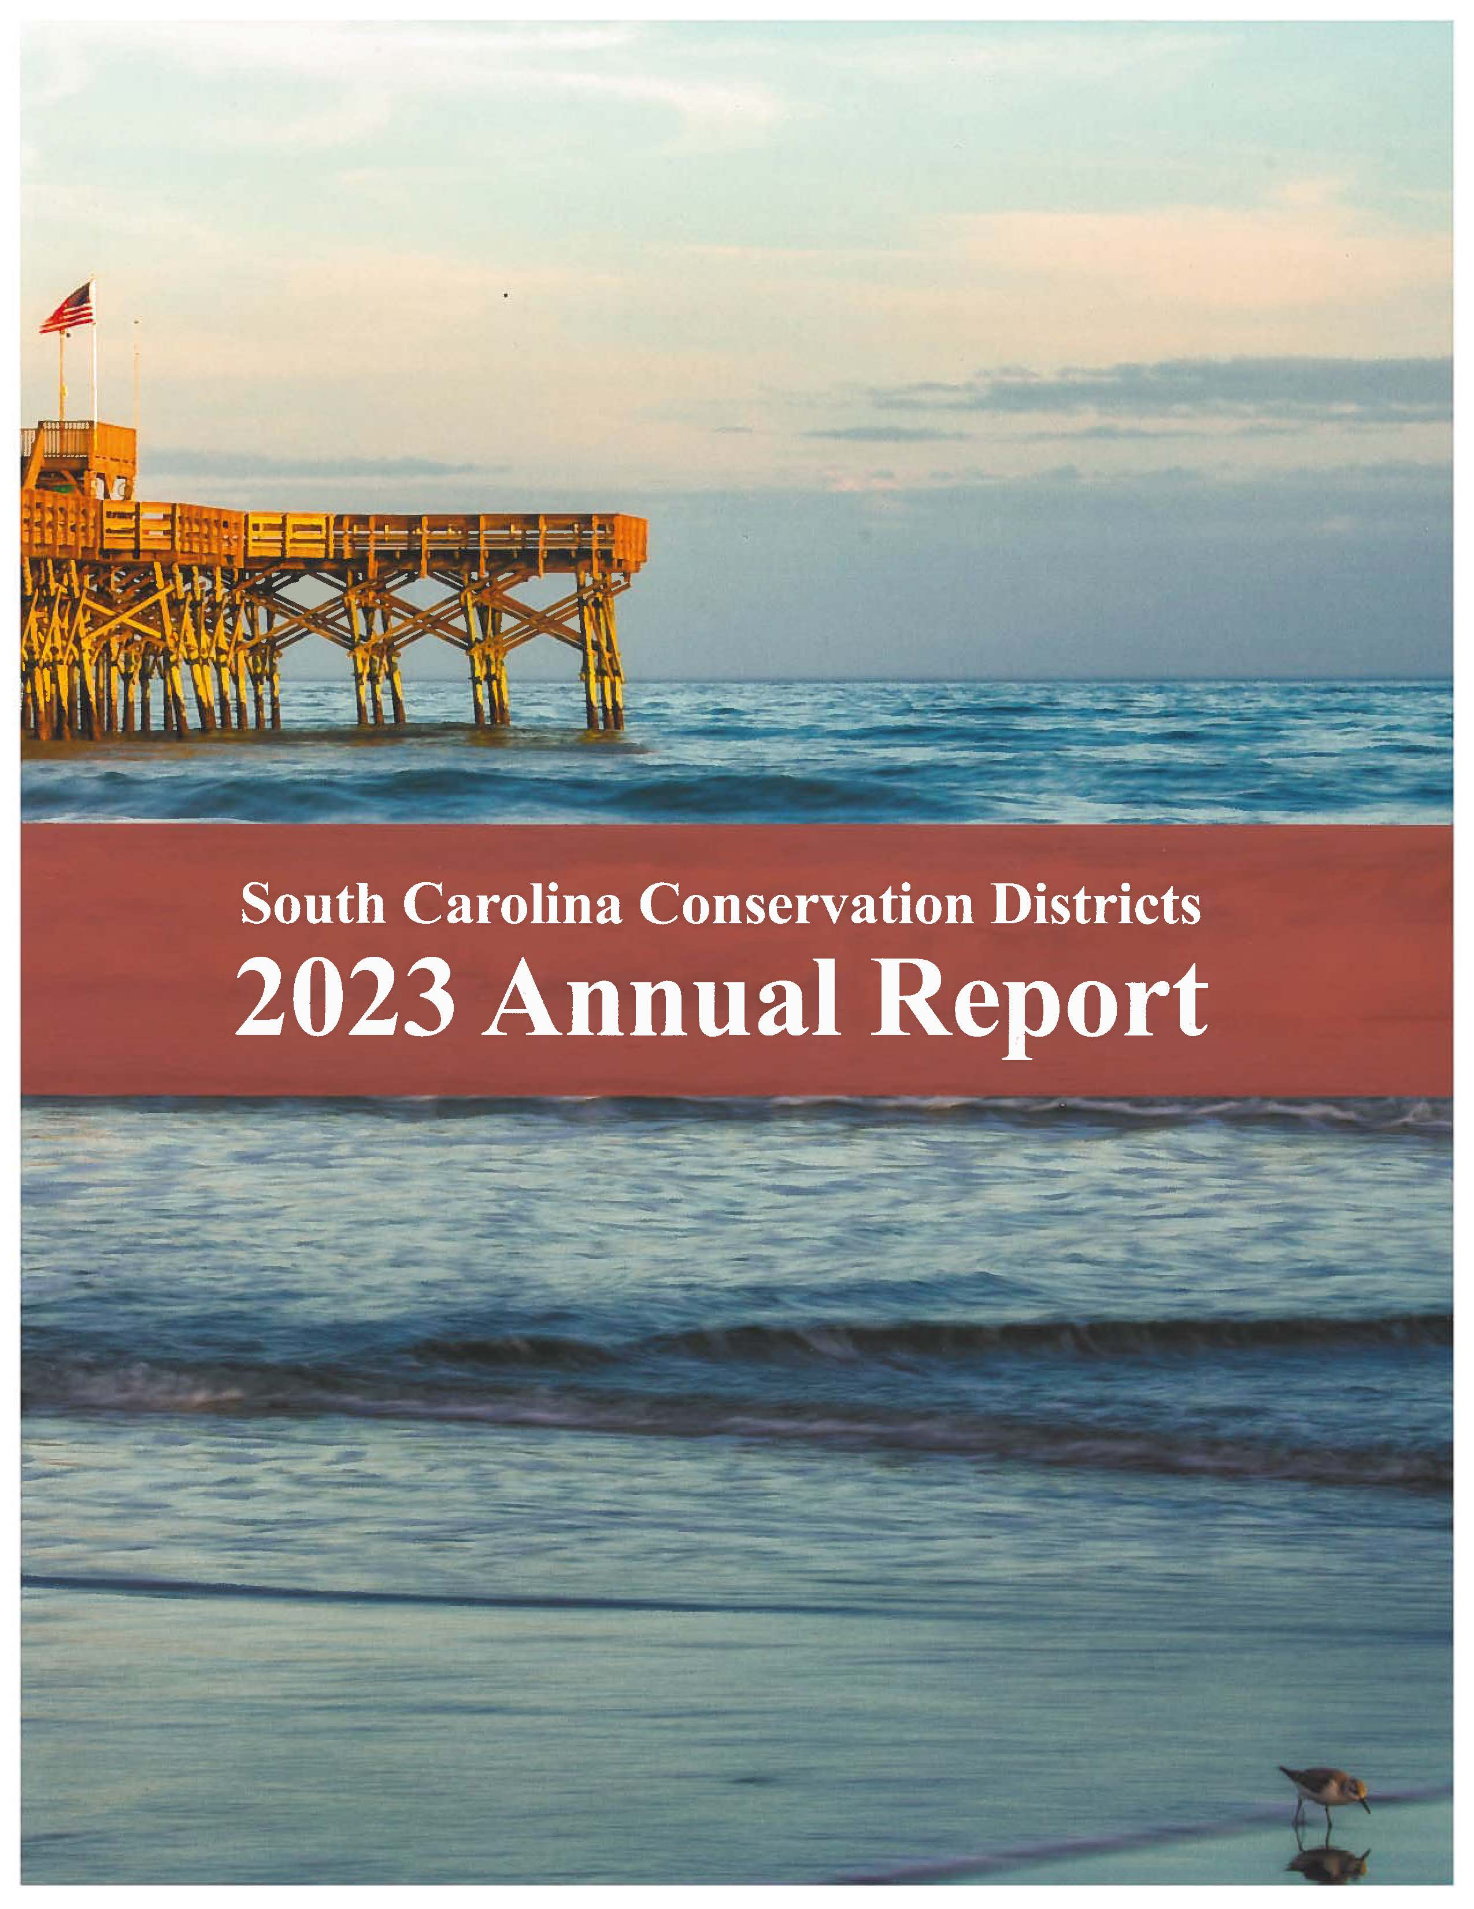
The What and Why
The documents being archived are historical and significant to the 46 conservation districts in the state.
These documents include a wide variety of letters, historical records, election results, commissioner packets, monthly reports, budgets, Watershed Dam Drawings, Easements, maps, etc.
Notes:
The documents being archived are not just records; they represent the rich history and ongoing efforts of the 46 conservation districts in our state. These archives are crucial for understanding our past and guiding future conservation efforts.
Archiving these diverse and significant documents is essential for preserving the legacy of conservation efforts in our state. They not only provide a valuable historical reference but also support ongoing education and advocacy in conservation practices.

Slide 3
Process: A Team Approach
Document Categorization
Scanning Process
Review and Quality Control
Collaboration and Communication
Notes:
Our Team chose to divide and conquer for this project
Document Categorization
Tyler led the initial sorting phase by meticulously reviewing all documents. He categorized them into two groups: those that required scanning and those that did not. This step was crucial for streamlining the workflow and ensuring that only necessary documents were digitized, saving time and resources.
Scanning Process
Each team member took ownership of specific boxes related to their assigned conservation districts. Jenn, Jessie, Jordan, and John worked collaboratively to scan the documents identified by Tyler. They ensured that the scanning process maintained high-quality standards, capturing important details for future reference. Regular check-ins among team members facilitated communication and addressed any challenges encountered during scanning.
Review and Quality Control
Brooke was responsible for the crucial final step of reviewing the digitized files. She compared the scanned documents against the originals to ensure accuracy and completeness. This process involved checking for any missed pages, ensuring legibility, and verifying that all relevant content was captured. Brooke's thorough review not only provided quality assurance but also helped identify any documents that might require rescan or additional attention.
Collaboration and Communication
Throughout the project, the team maintained open lines of communication, sharing insights and challenges. Regular team meetings allowed members to update each other on progress, brainstorm solutions, and celebrate milestones. This collaborative environment fostered a sense of shared purpose and commitment to the project’s success.

Slide 4
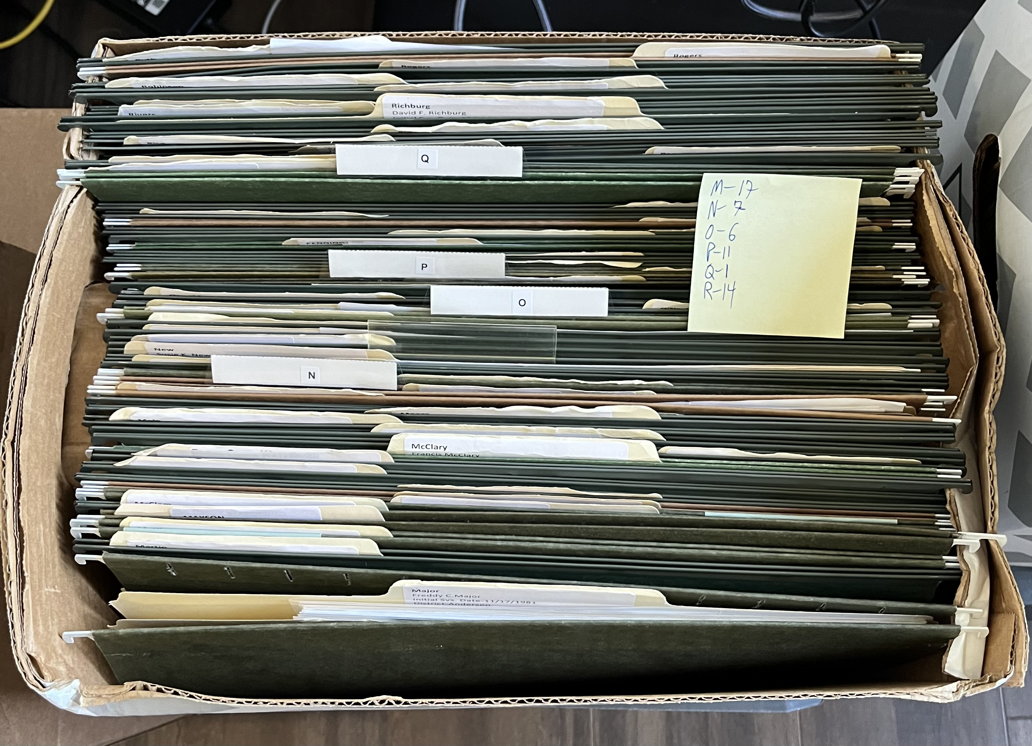
Method for Document Organization
Our team wanted a simplified process for retrieval of digitized documents. We came up with this organization and labeling strategy.
File Naming Conventions
Example DistrictMonthlyReport0920202
Centralized Storage
Agency internal Shared Drive
Organized Folder Structure
Searchability and Maintenance
Notes:
File Naming Conventions:
Each document is named using relevant keywords and dates (formatted as YYYY-MM-DD) for easy identification and sorting.
Centralized Storage:
All files are uploaded to an internal agency shared drive, ensuring easy access and collaboration among team members.
Organized Folder Structure:
A clear hierarchy categorizes documents by department, project, or date, making navigation intuitive.
Searchability and Maintenance:
Consistent keywords enhance searchability within the shared drive, and regular reviews will ensure the system remains effective and up to date.

Slide 5
Benefits
Access to organized files from anywhere.
01
Better ability to answer questions from District employees and Commissioners.
02
More storage space in our offices.
03
Notes:
With digitized documents stored in a centralized system, team members can easily access files from any location, whether working remotely or on-site. This flexibility enhances collaboration and allows for quick retrieval of important information during meetings or discussions. Improved accessibility also supports better decision-making by providing instant access to historical data and relevant documents.
A well-organized archive enables team members to respond more efficiently to inquiries from District employees and Commissioners. Having easy access to historical records and relevant documents ensures that answers are accurate and timely, fostering trust and confidence in our processes. This capability empowers staff to provide informed support, contributing to more effective governance and community engagement.
By digitizing and archiving documents, we can significantly reduce the physical storage requirements in our offices. This creates a more organized and clutter-free workspace, promoting efficiency and productivity among team members. Additionally, freed-up space can be repurposed for other essential functions or additional personnel, further enhancing our operational capacity.
Digitization ensures the long-term preservation of vital historical documents, protecting them from deterioration, loss, or damage. This safeguarding is essential for maintaining the institutional memory of conservation efforts and providing continuity for future projects. A robust archiving system also aids in compliance with legal and regulatory requirements related to document retention.

Slide 6
Benefits
Access to Organized Files from Anywhere
Enhanced Support for District Employees and Commissioners
Increased Storage Space in Our Offices
Preservation of Important Historical Records
Notes:
With digitized documents stored in a centralized system, team members can easily access files from any location, whether working remotely or on-site. This flexibility enhances collaboration and allows for quick retrieval of important information during meetings or discussions. Improved accessibility also supports better decision-making by providing instant access to historical data and relevant documents.
A well-organized archive enables team members to respond more efficiently to inquiries from District employees and Commissioners. Having easy access to historical records and relevant documents ensures that answers are accurate and timely, fostering trust and confidence in our processes. This capability empowers staff to provide informed support, contributing to more effective governance and community engagement.
By digitizing and archiving documents, we can significantly reduce the physical storage requirements in our offices. This creates a more organized and clutter-free workspace, promoting efficiency and productivity among team members. Additionally, freed-up space can be repurposed for other essential functions or additional personnel, further enhancing our operational capacity.
Digitization ensures the long-term preservation of vital historical documents, protecting them from deterioration, loss, or damage. This safeguarding is essential for maintaining the institutional memory of conservation efforts and providing continuity for future projects. A robust archiving system also aids in compliance with legal and regulatory requirements related to document retention.

Slide 7
Discussion
How do you currently keep documents like these?
What challenges, if any, have you faced while digitizing older documents?
Are there any thoughts on how we can improve our process moving forward?

Slide 8
Q&A
Thank you
Contact info:
Bakerj@dnr.sc.gov
Hayesj@dnr.sc.gov

