Slide 1
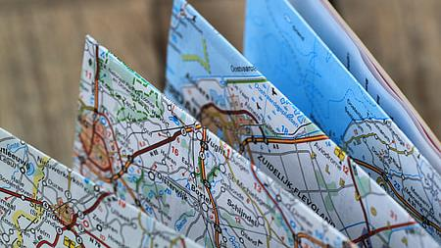
Roadmap to Oklahoma’s
Training Tour
Presented By:
Brandon Welborn, Administrative Programs Officer II
Amy Weathers, Area IV District Coordinator

Slide 2
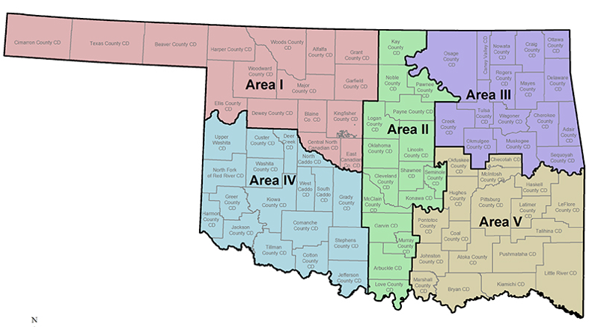

May 28- Area 4- Hobart
June 5-Area 3-Wagoner
June 9-Area 1- Woodward
June 25-Area 2- Oklahoma City
June 26-Area 5-McAlester
84 Conservation Districts
71 Attended the Training

Slide 3
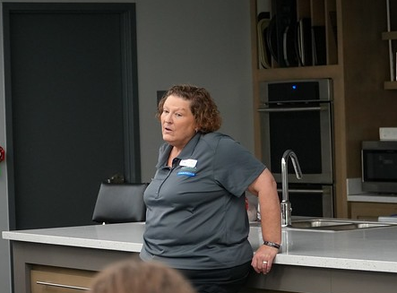

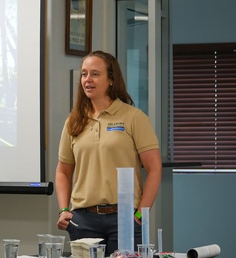


Greeting, Introductions & Program Updates
Someone accidentally
swallowed fingernail clippers and had to have them surgically removed.
She was 4!
Brenda,
District Manager
Is also a volunteer firefighter
One enjoys hauling her miniature pony around in her car for outreach events!
This Photo by Unknown Author is licensed under CC BY

Slide 4


Slide 5
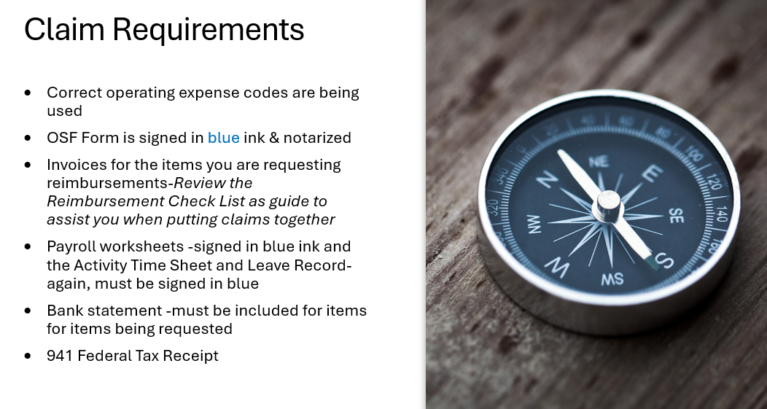
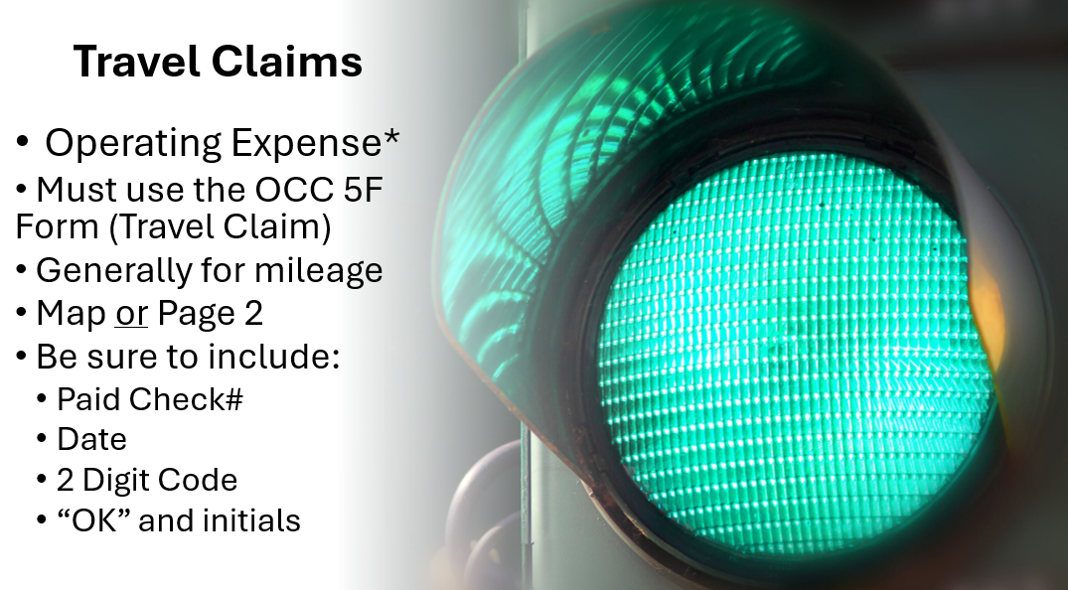

Slide 6

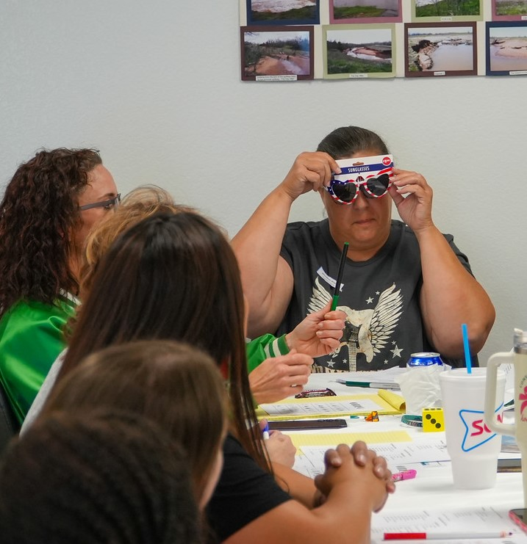
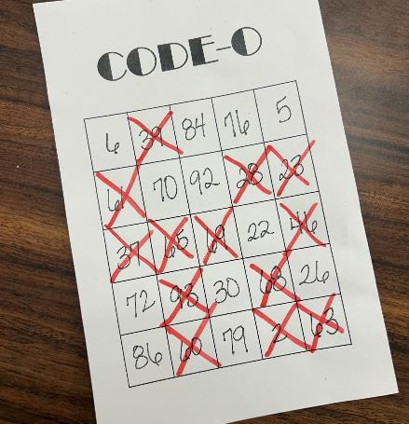
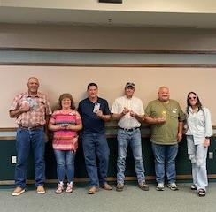

Slide 7


RECORDS ROAD
TRIPPIN’

Slide 8
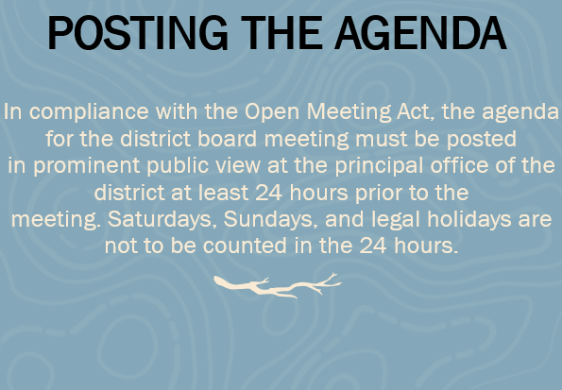
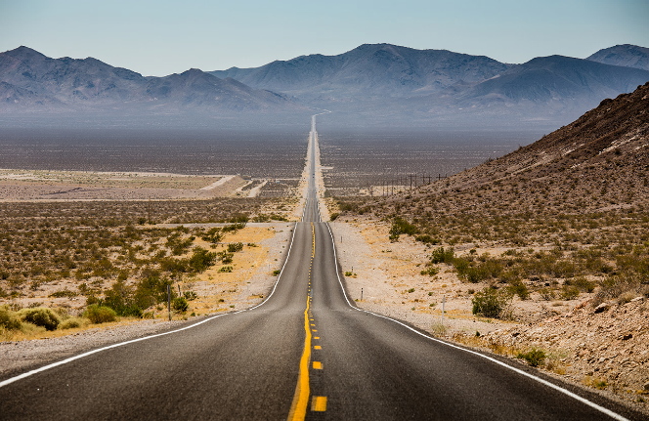
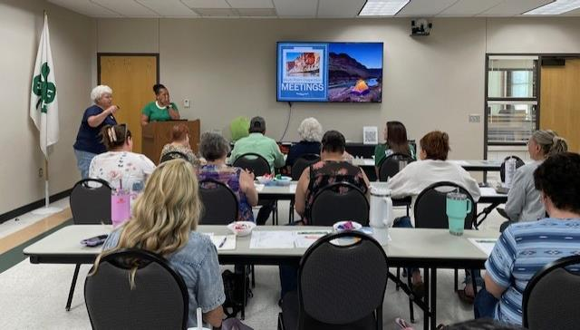
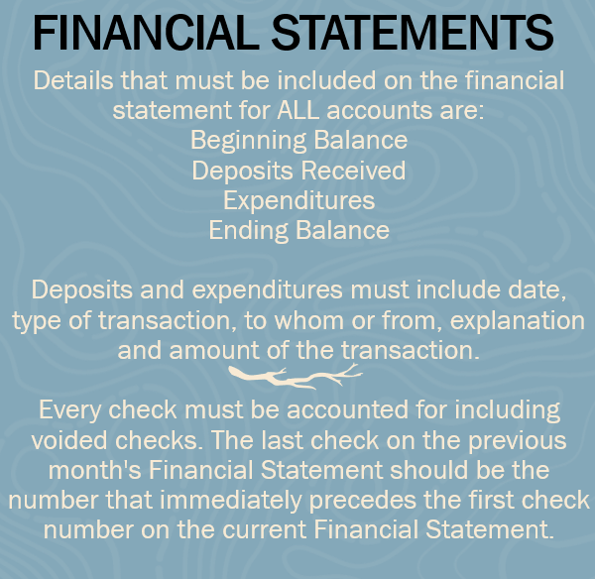
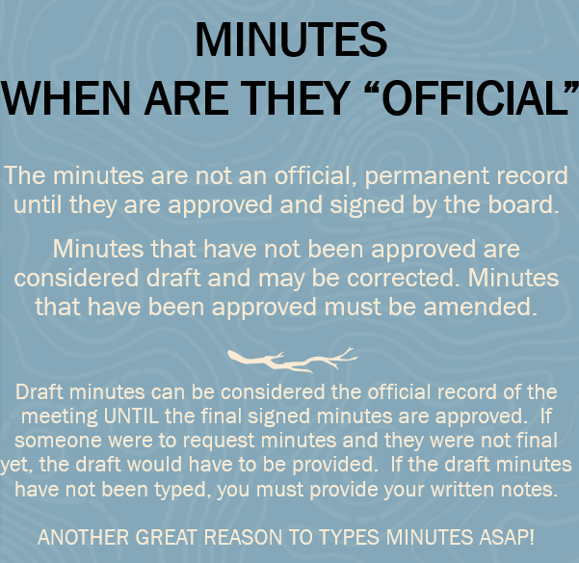

Slide 9
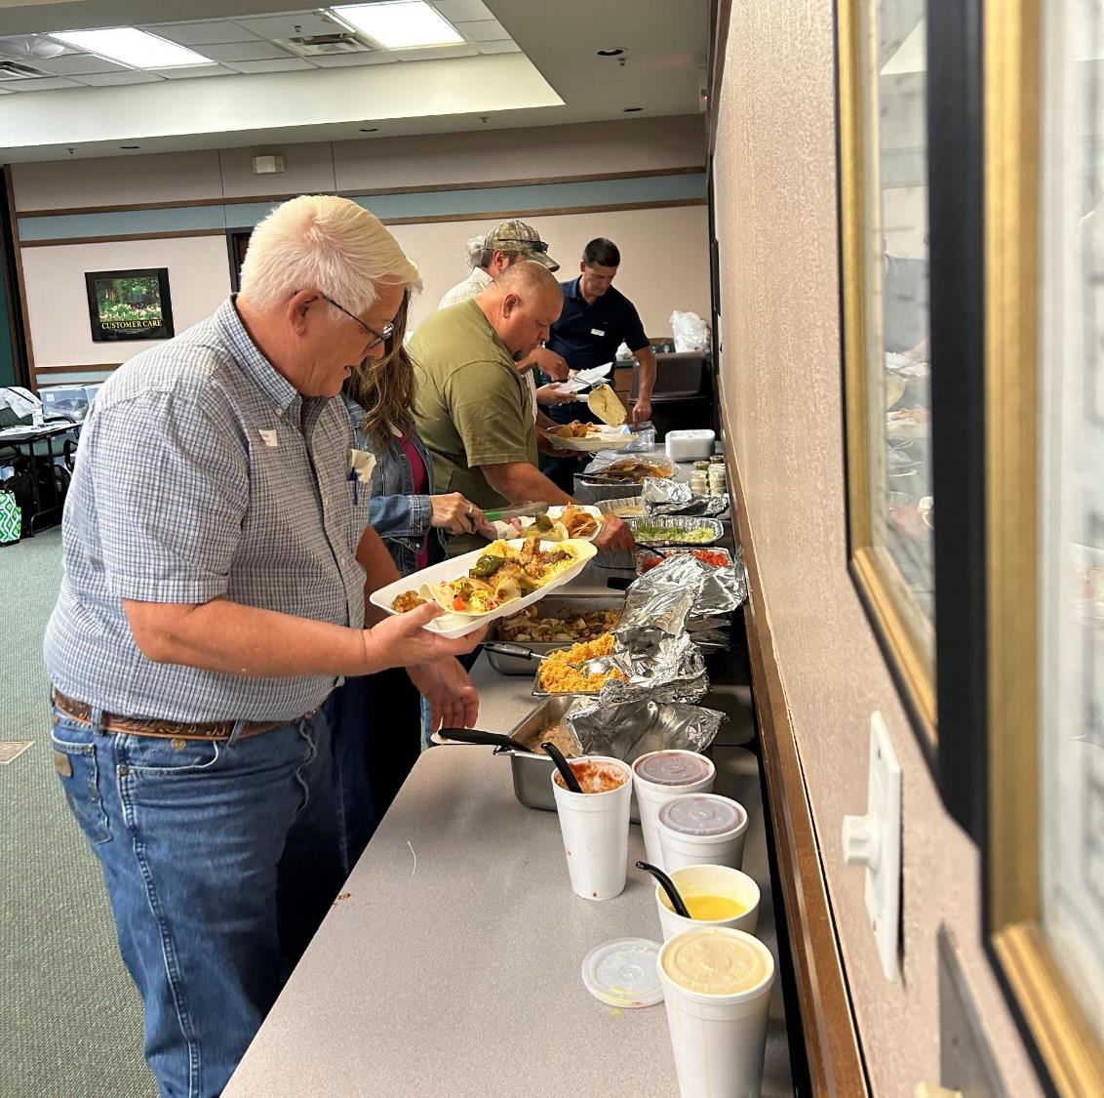
Feed Them and They Will Come!!

Slide 10
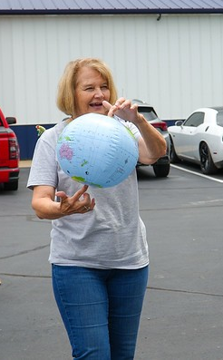
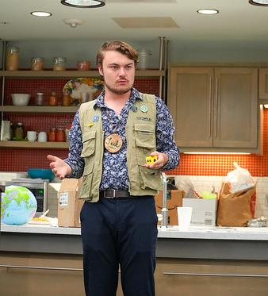

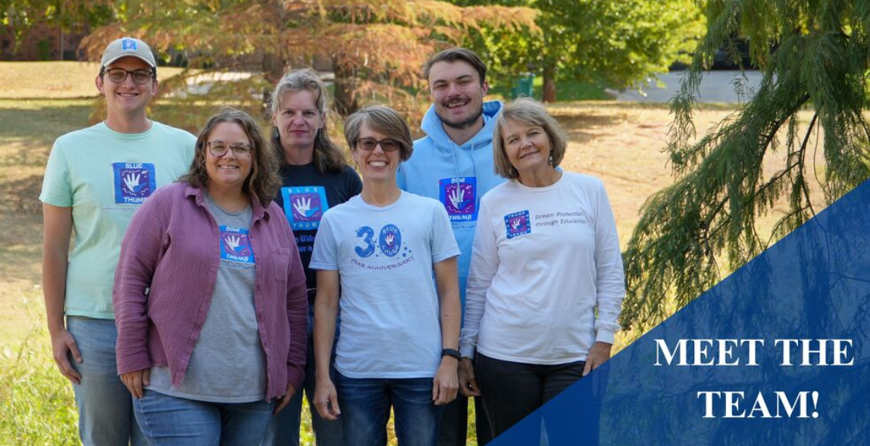

Slide 11

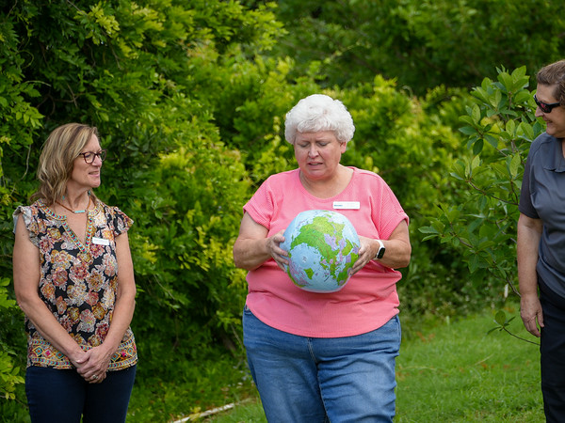
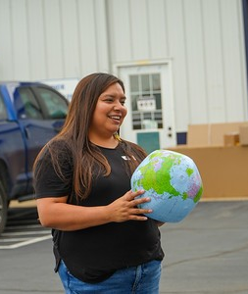
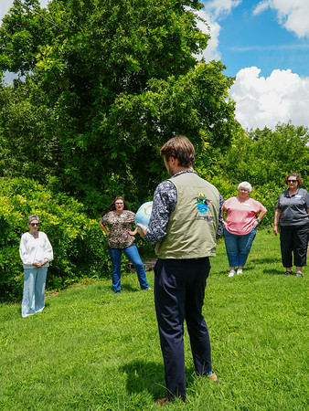
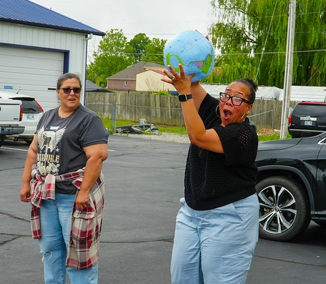
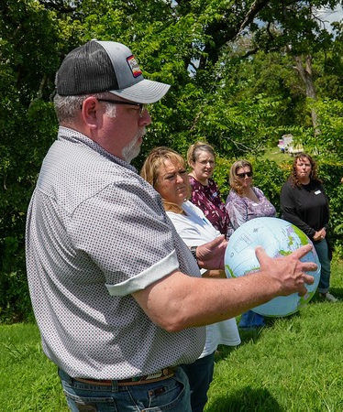
Blue Planet

Slide 12
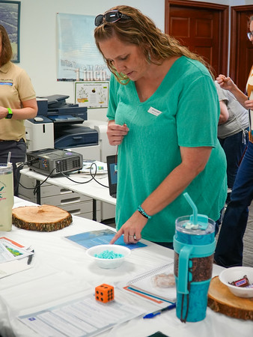
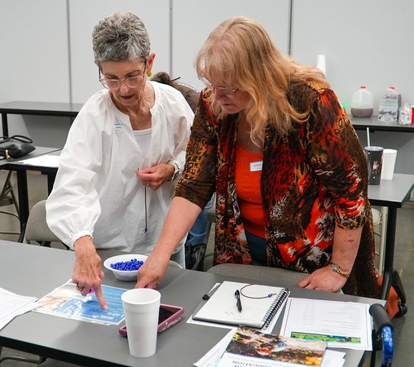
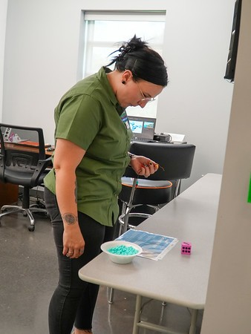
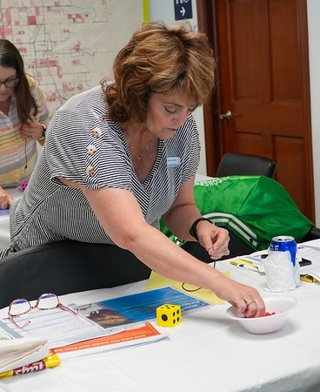
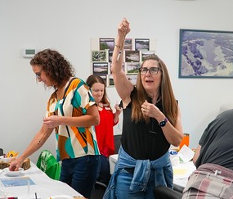
The Incredible
Journey

Slide 13

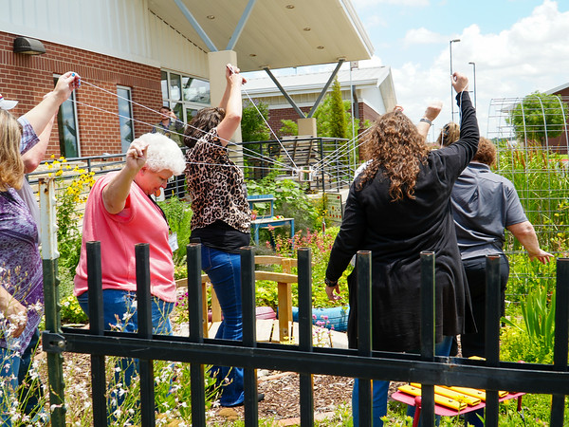
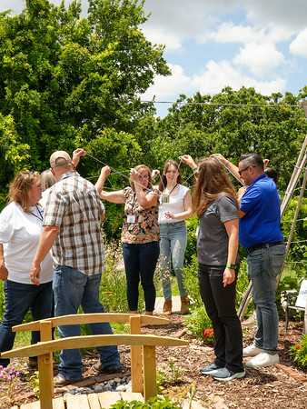
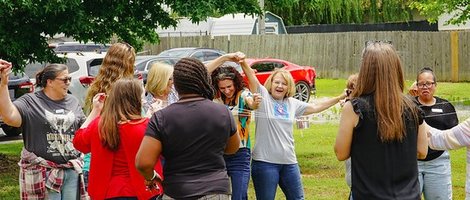
Water
For
All

Slide 14
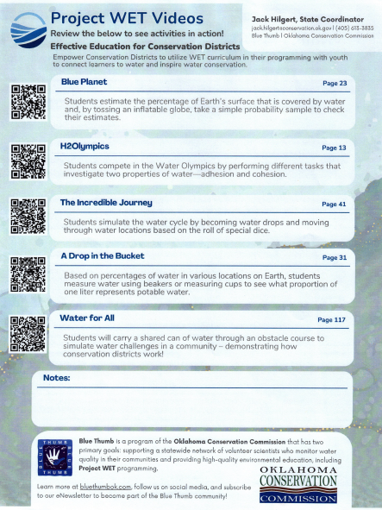
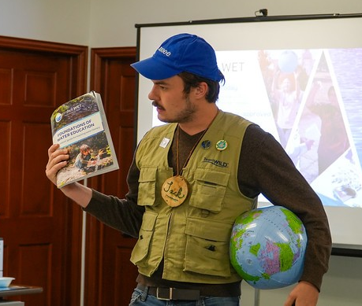

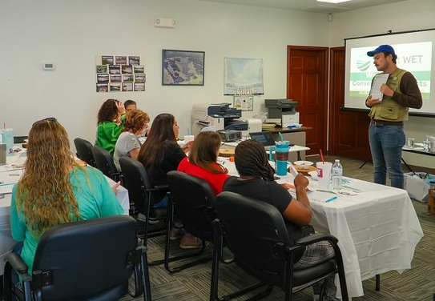
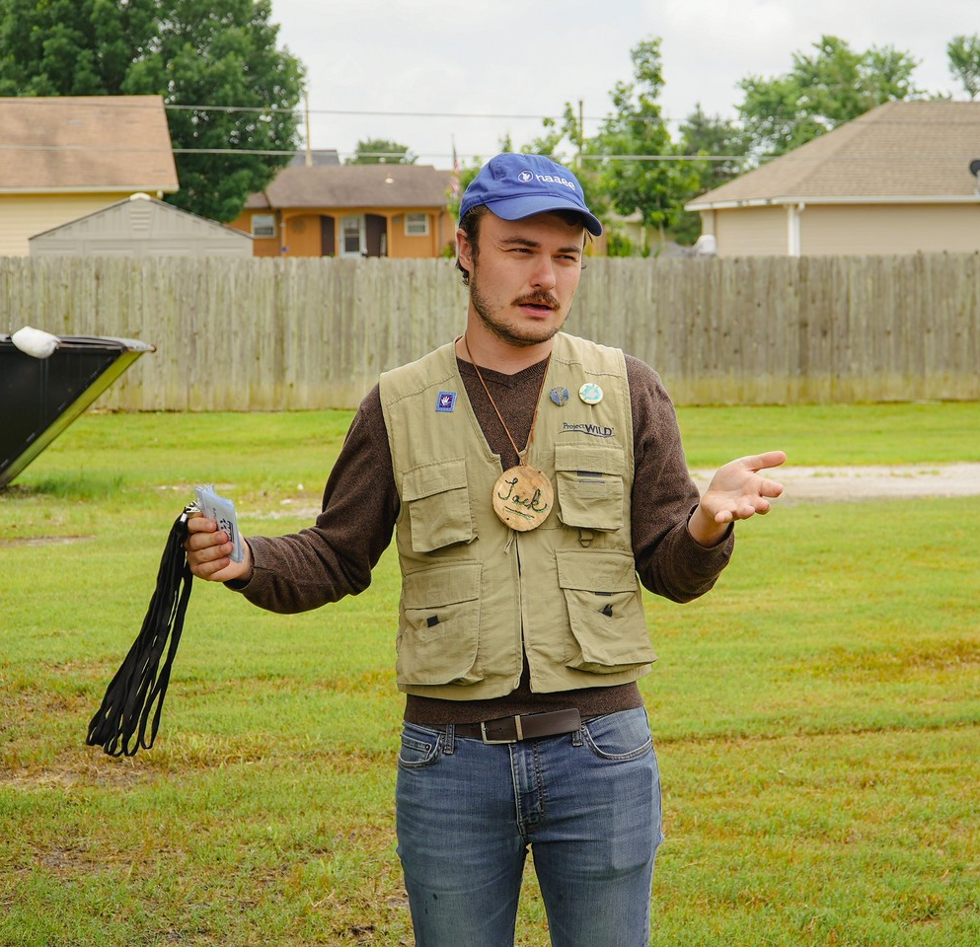

Slide 15
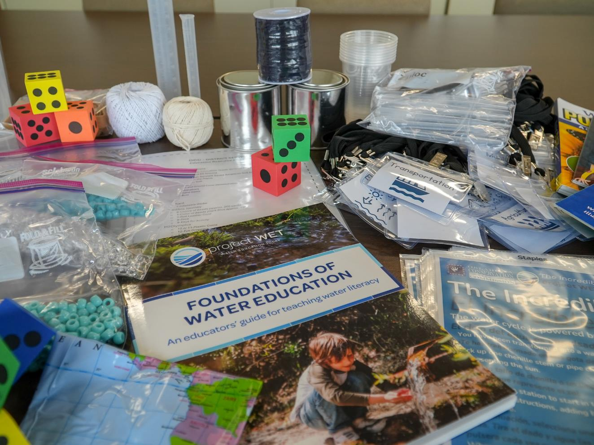

Slide 16
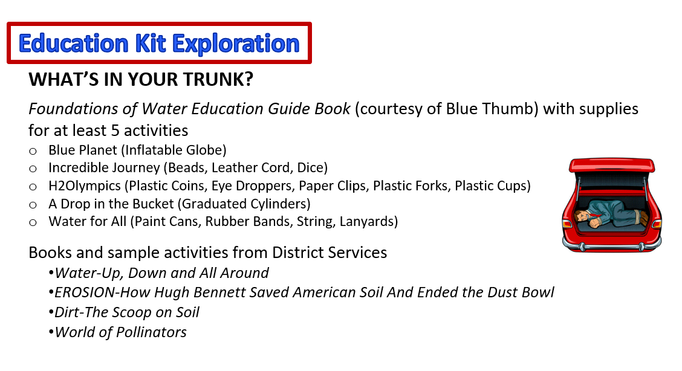

Slide 17
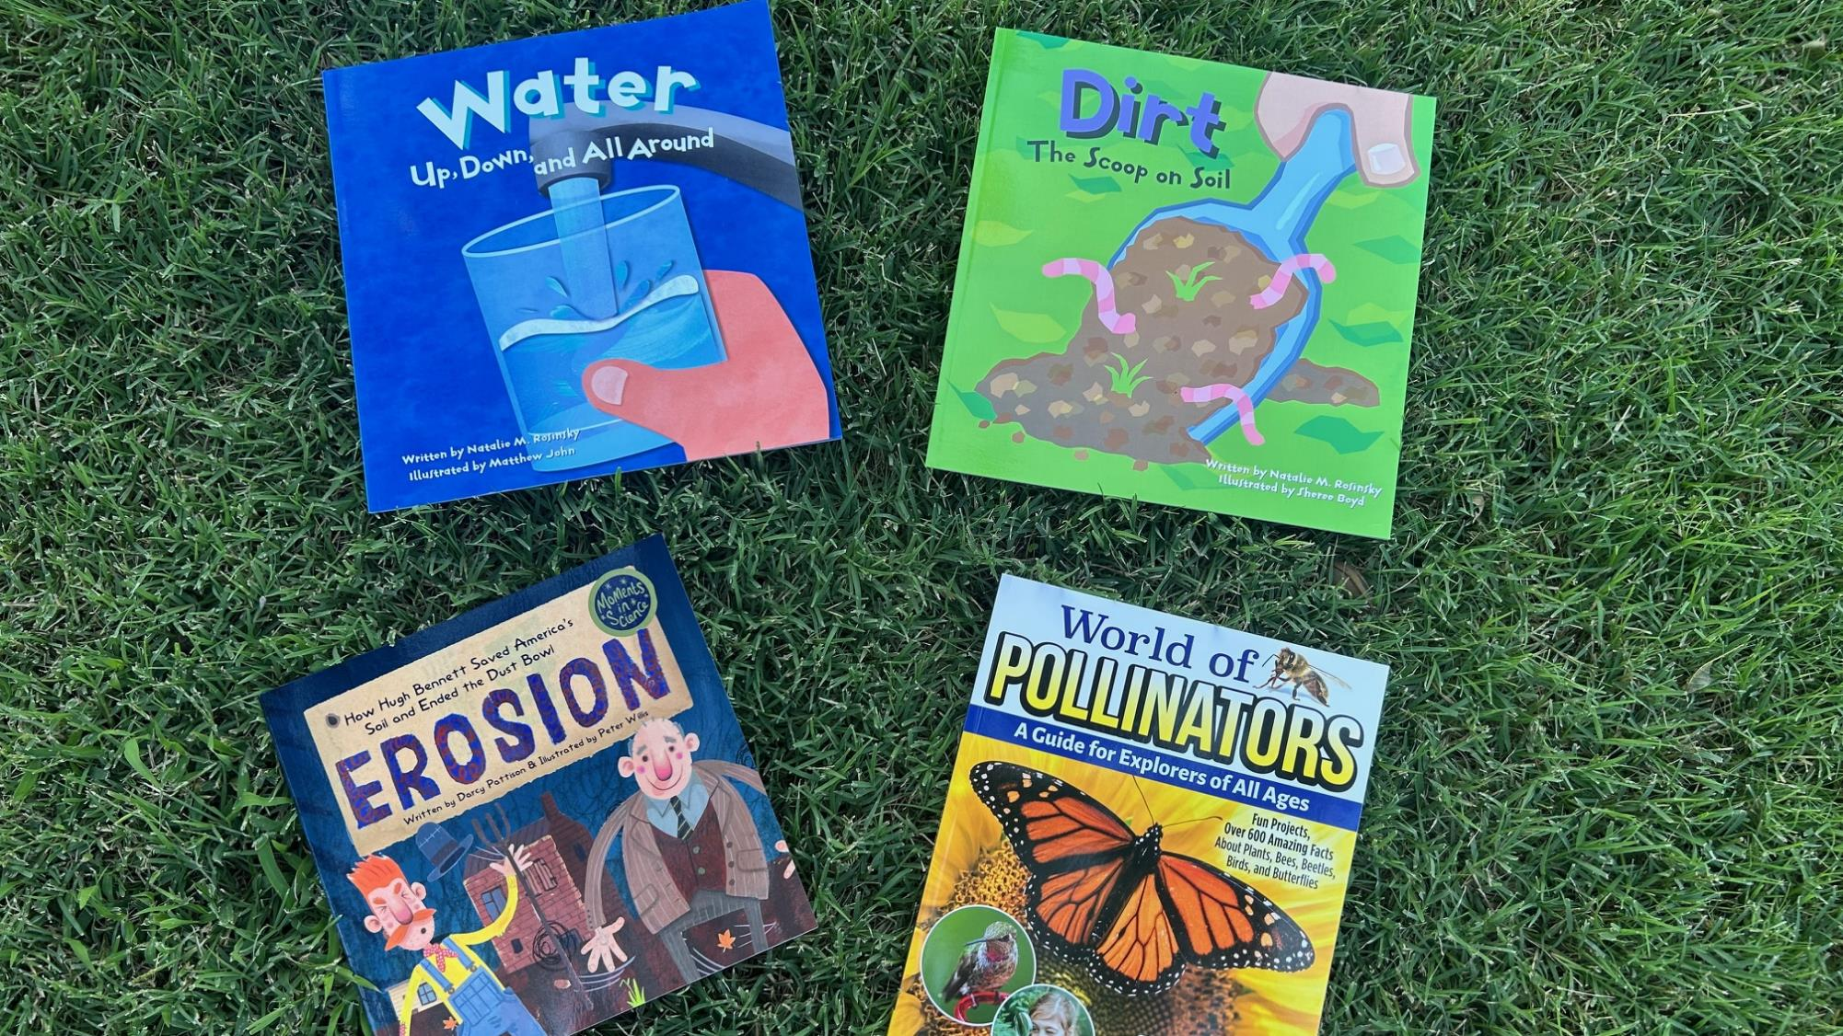
Books Provided In The Kit

Slide 18

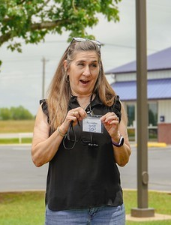
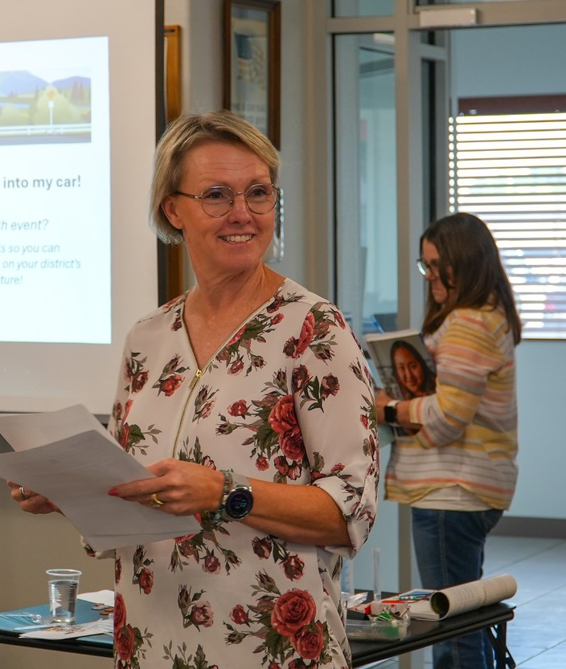
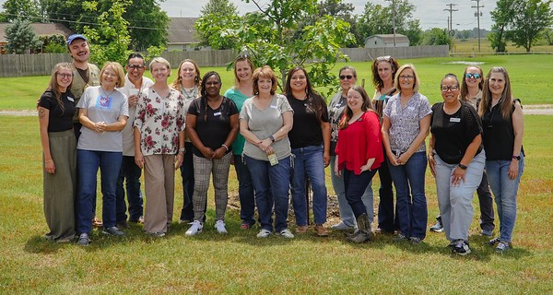
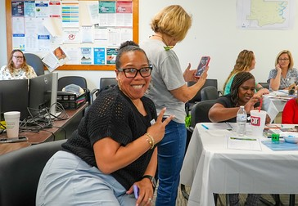

Slide 19

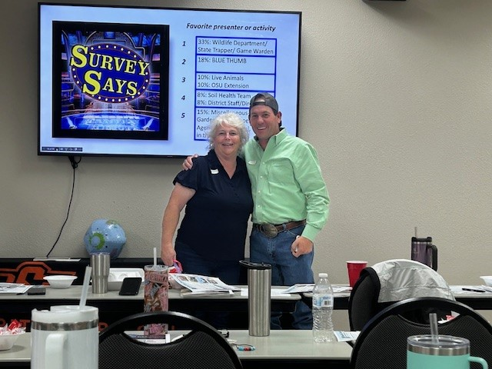
Survey
Says!
Good Answer!!

Slide 20
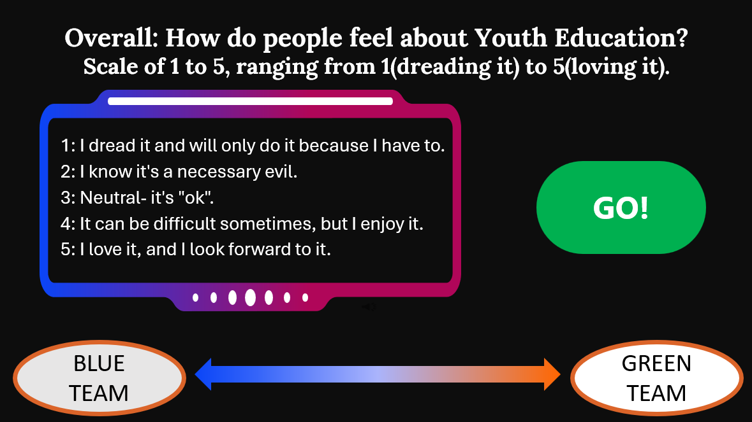
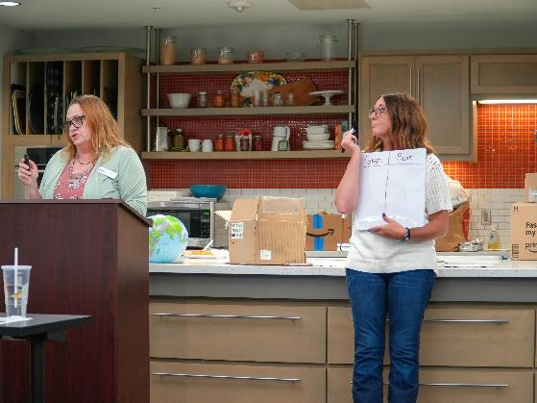
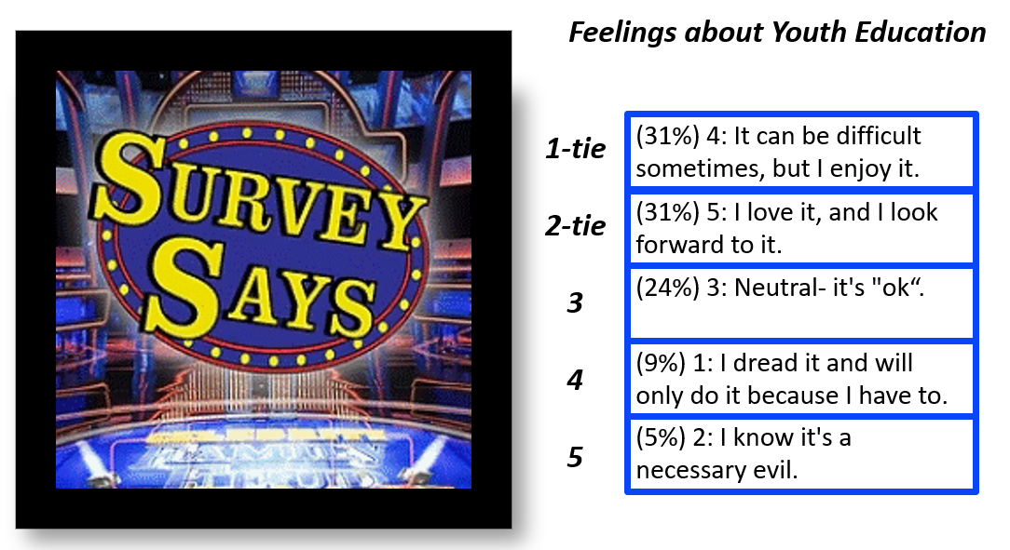
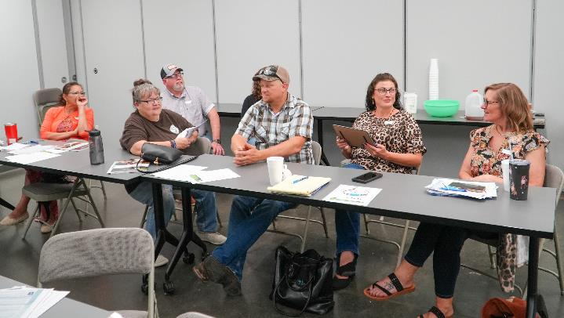

Slide 21
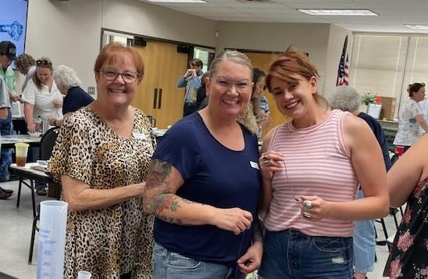
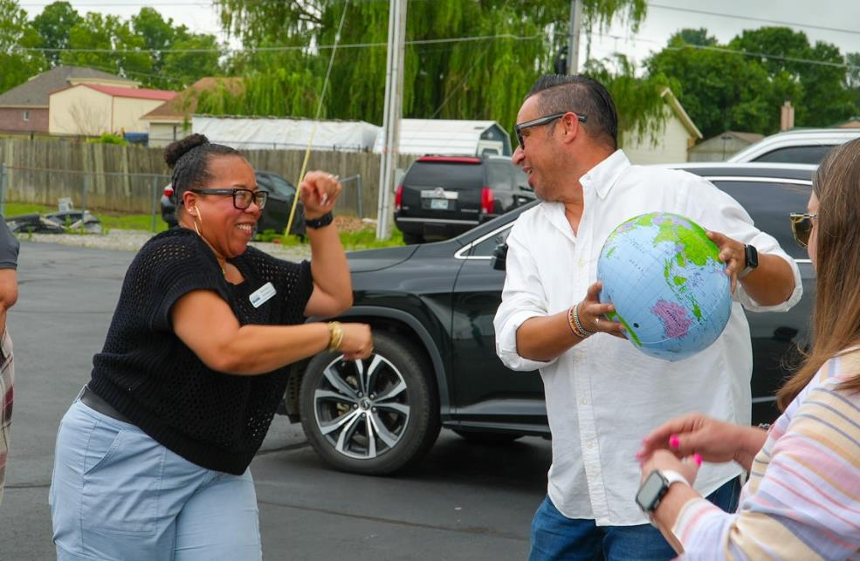
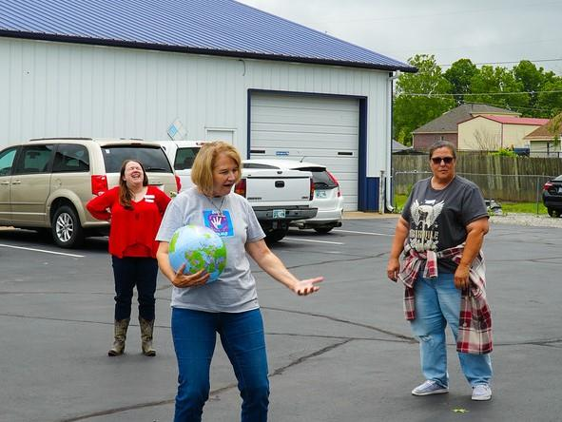



Slide 22

Employee Reviews:
District Services Training Tour
4.5 out of 5 stars
This Photo by Unknown Author is licensed under CC BY-NC-ND

Slide 23





Budget Information

Slide 24



Things
We Learned

Slide 25


Weigh the Beads!!

Slide 26


Make An Assembly Line
Check for Broken Totes

Slide 27


Read the Spec sizes for all the items ordered
Check, Check and Recheck Orders

Slide 28




Slide 29


Brandon Welborn
Programs Officer
brandon.welborn@conservation.ok.gov
572-246-5150
Amy Weathers
Area District Coordinator
amy.weathers@conservation.ok.gov
405-882-0504
Thank you
& Safe Travels

