Slide 1
All Aboard the Crazy Train
Onboarding & Offboarding of Conservation District Employees

Slide 2
WHY DID WE TAKE THIS JOURNEY?
The lack of procedures was driving us all
CRAZY!
State Agency Staff
Area Coordinators
District Directors
Newly Hired Employees
Exiting Employees

Slide 3


Stops Along the Way
01
Basic Agency Checklist
04
Left Room for Notes
02
Added District Specific Items
05
Hyperlinks to Information
03
Included Broad Topics & Tasks
06
Updated as Needed

Slide 4



ONBOARDING CHECKLIST
Vacancy Volume Efficiency/Productivity
Ease of Use Consistency/Continuity
Sets a Positive Tone Firm Expectations
Builds Confidence Clear Documentation
Checklists make weirdos like us happy!

Slide 5
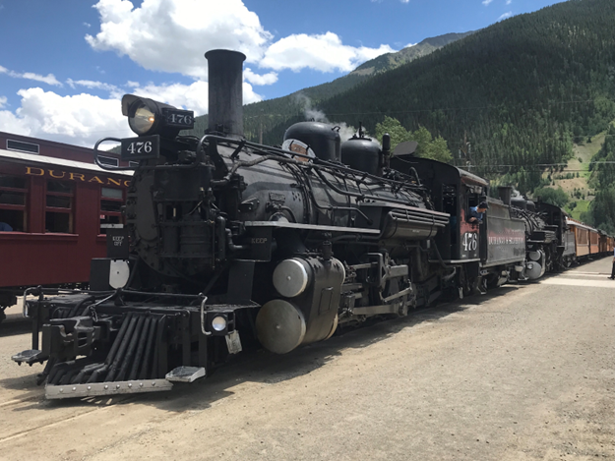
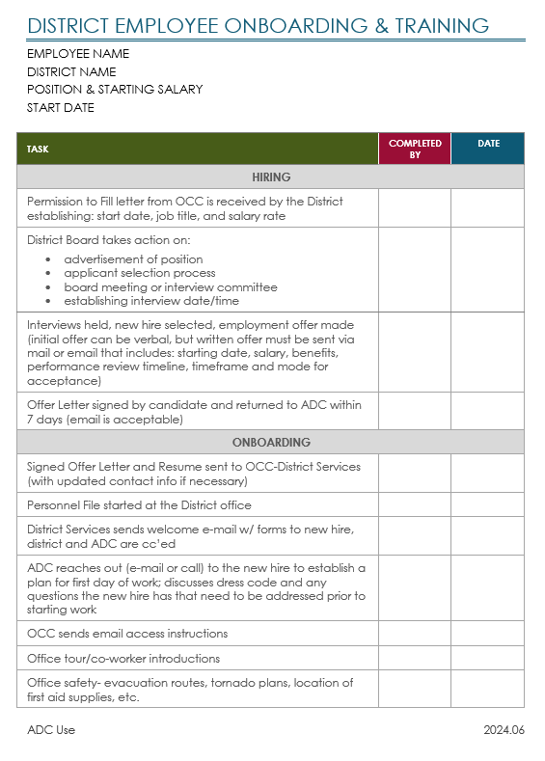
Basic Information
  Employee
  District
Phases & Tasks
  Hiring
  Onboarding
  Training

Slide 6
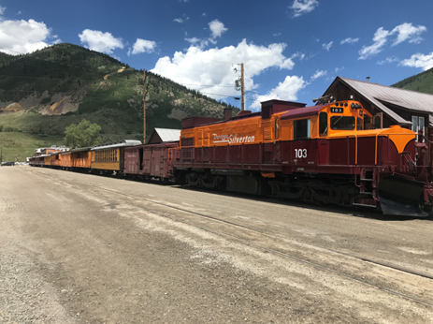
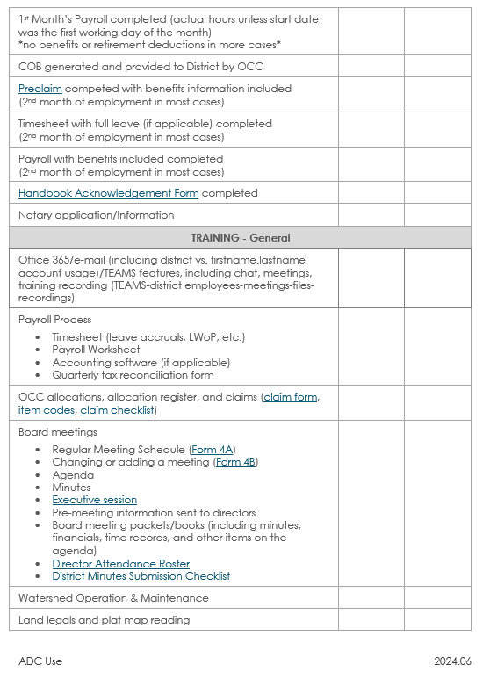
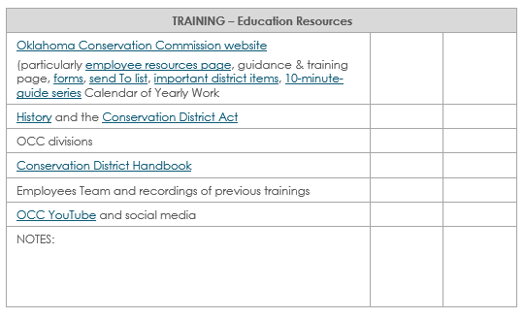
Training
    General
    Taxes
    Educational Resources

Slide 7
OFFBOARDING CHECKLIST
Smoother Process
Transfer of Assets & Knowledge
Reduces Security Risk
Establish Interim Work Processes
Clean Break, Firm End & Closure
Final Documentation for File

Slide 8
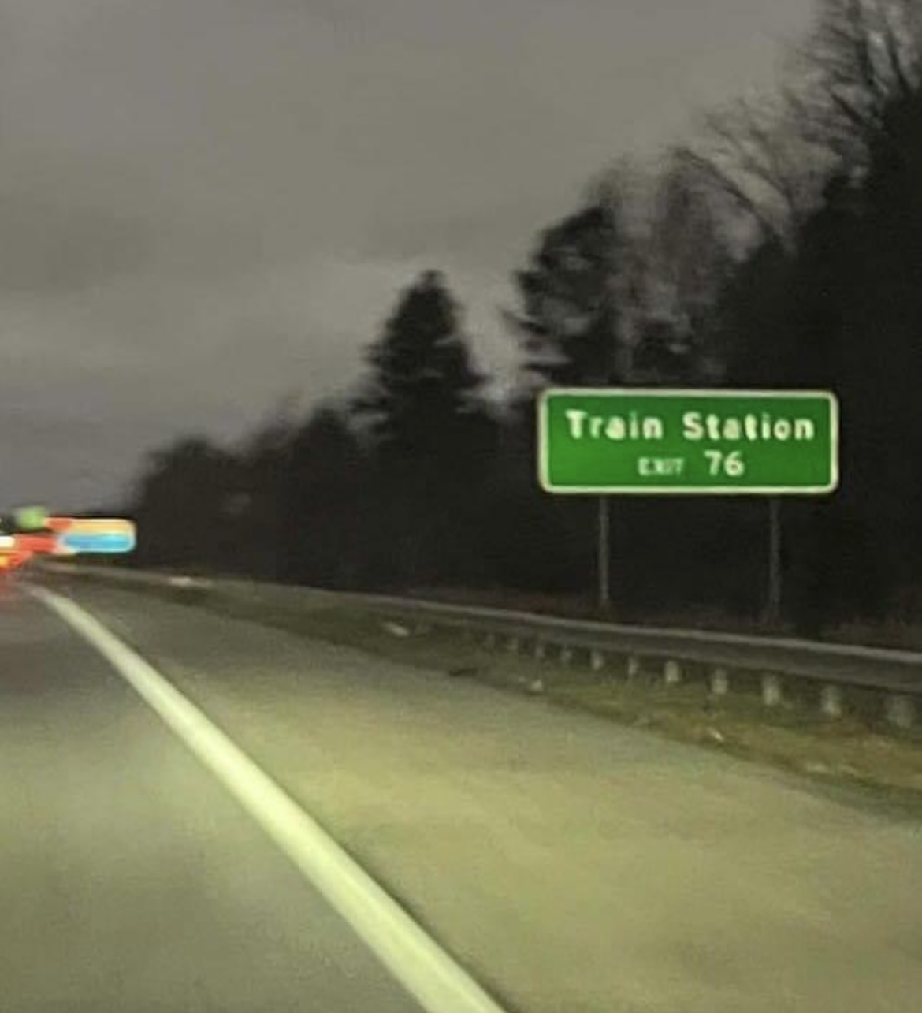
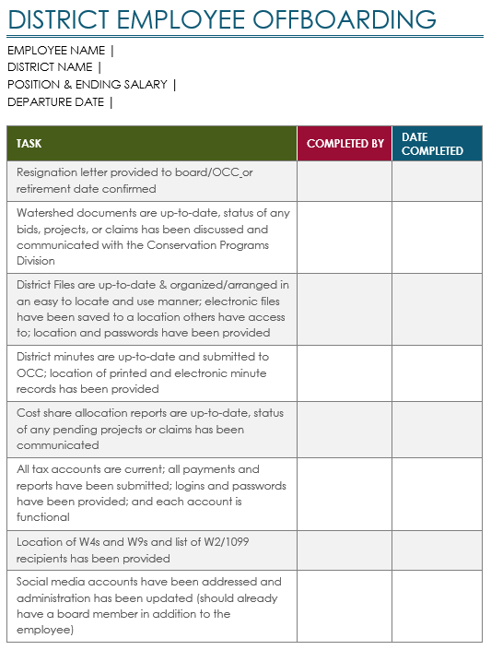
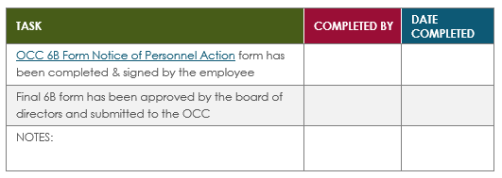
Basic Information
Tasks
Completion Dates
nOTES

Slide 9
Where are we now?
Implemented Statewide
Template is a Living Document
Completed Forms are Retained
Digital Reference Source
Continue to Question our Sanity Occasionally
FINAL DESTINATION: Training Manual

Slide 10
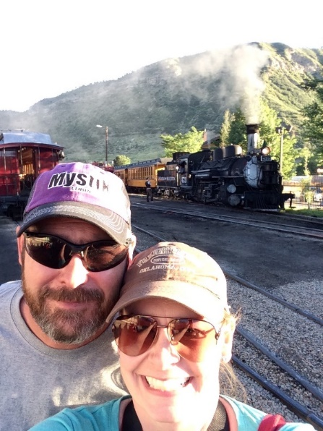
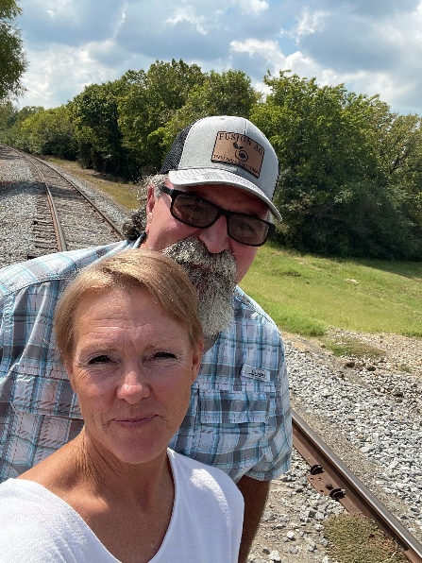
Questions?
THANK YOU

