Slide 1
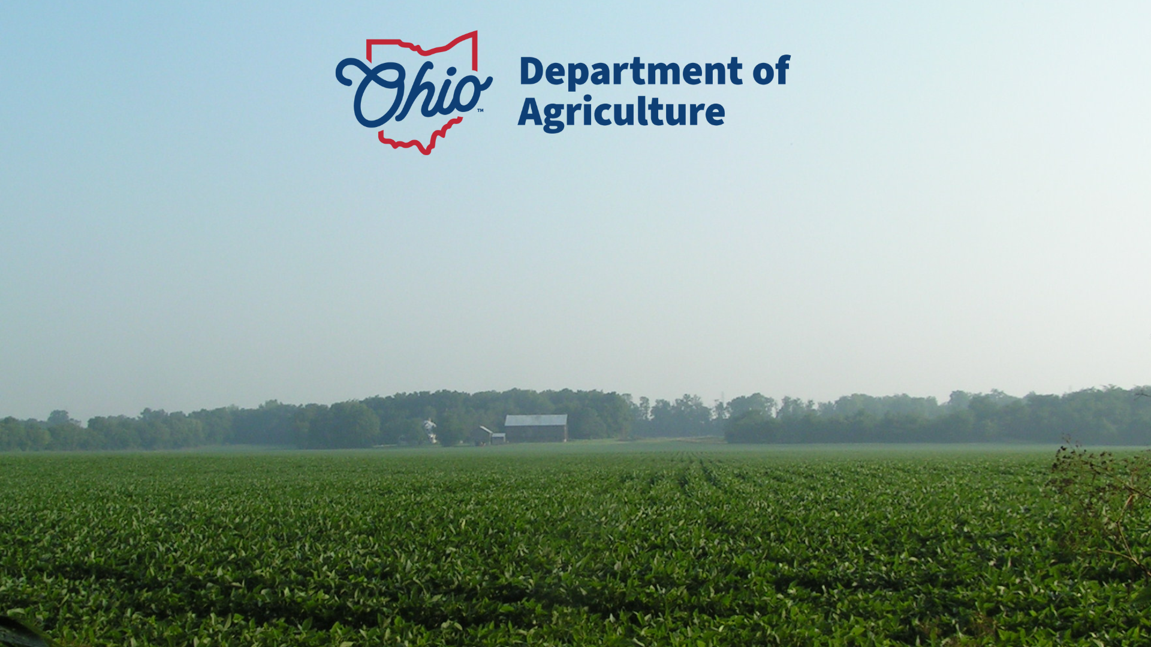
Regional Conservation Partnership Program (RCPP) Proposal
*Pending
H2Ohio Pasture Hayland Project

Slide 2
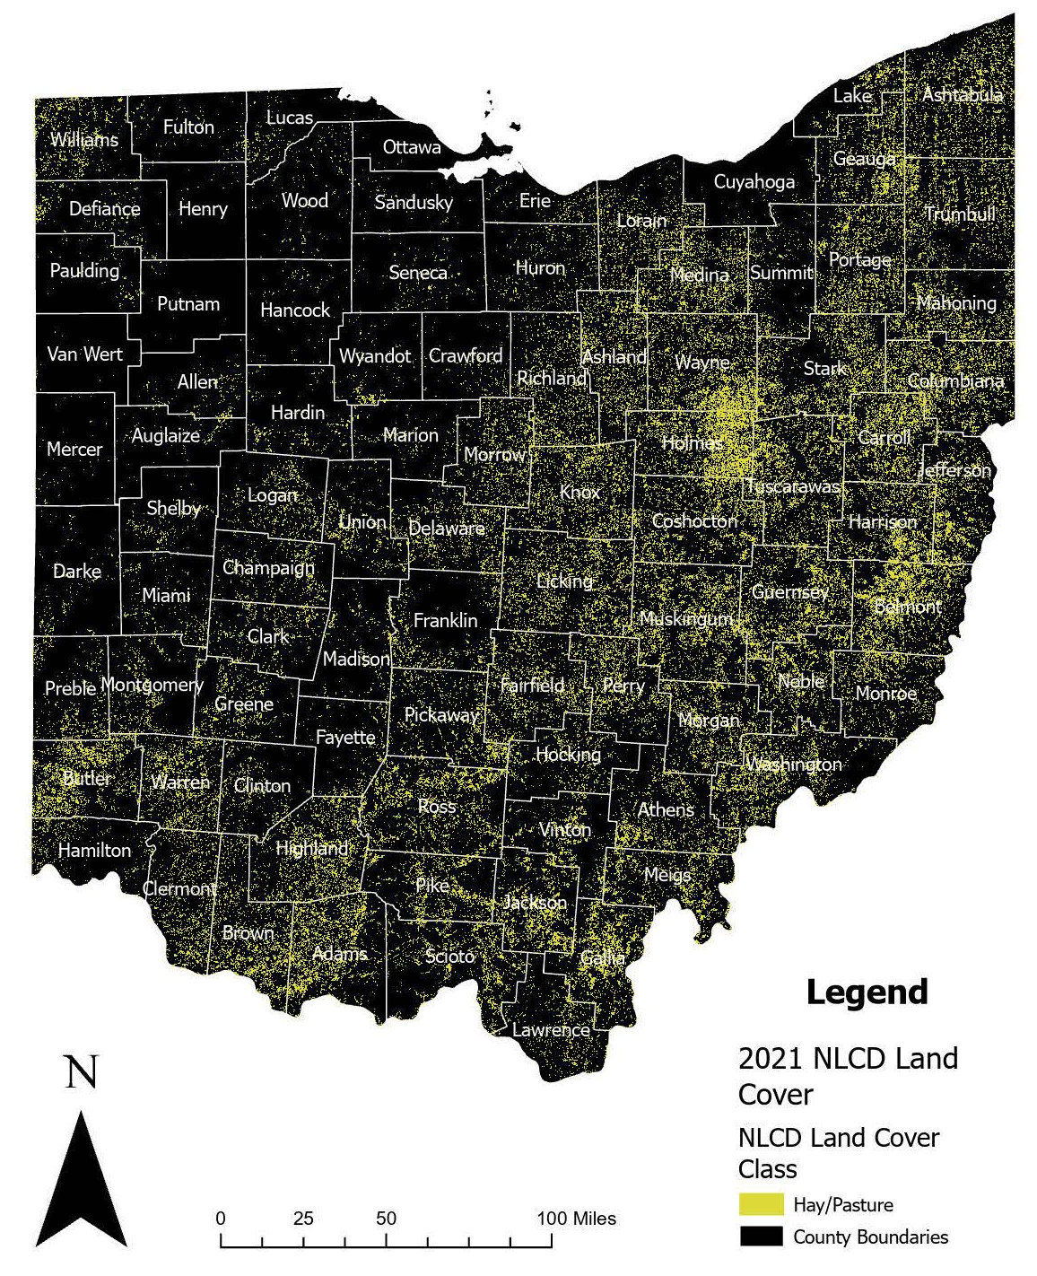
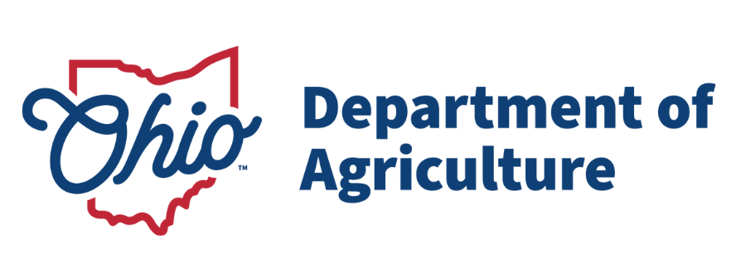
Overview
Pasture and Hayland is a major agricultural land use in southern/eastern Ohio regard compared to central and western Ohio which is predominantly row crops.
Common need for more funding of grazing and hayland practices was given in interviews with SWCDs and other partners over the past few years.
*Pending

Slide 3
RCPP Application Type
Classic RCPP focusing on land management practices focused on pasture and hayland.
CCA: Mississippi River Basin – Water Quality Degradation-Field Sediment, Nutrient, and Pathogen Loss.
Utilize the Climate Smart practice of Prescribed Grazing (528), Pasture and Hay Planting (512), and Nutrient Management (590) as the core practice with supplemental practices to assist in implementation.
Total application of almost $10 million.
*Pending

Slide 4
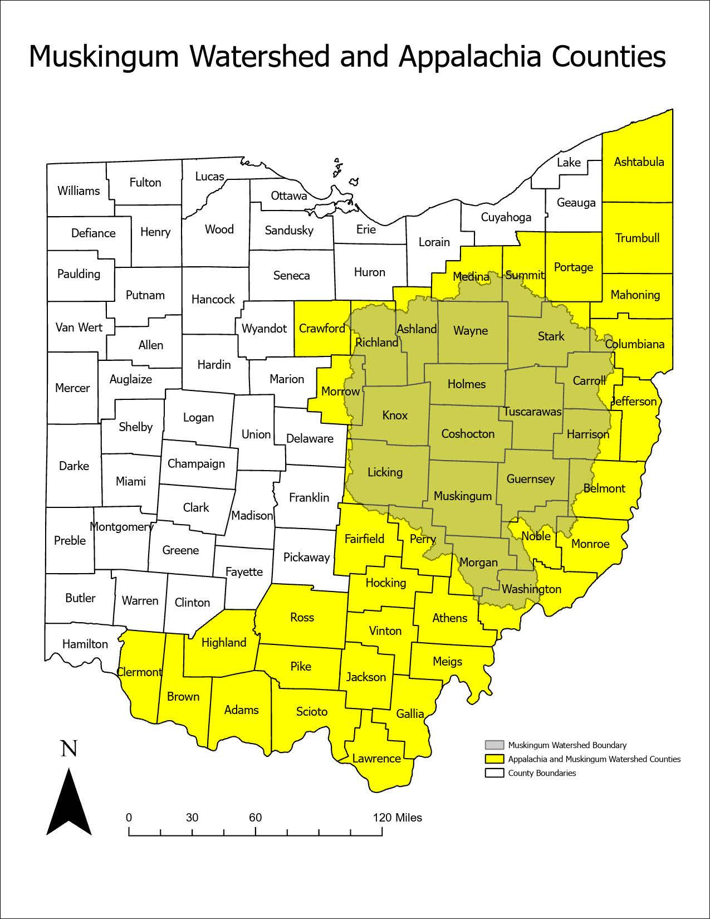
Project Area
*Pending
All counties with the state of Ohio designated as part of Appalachia
Additional counties included within the Muskingum watershed basin
Totaling for ½ the state of Ohio, 44 counties

Slide 5
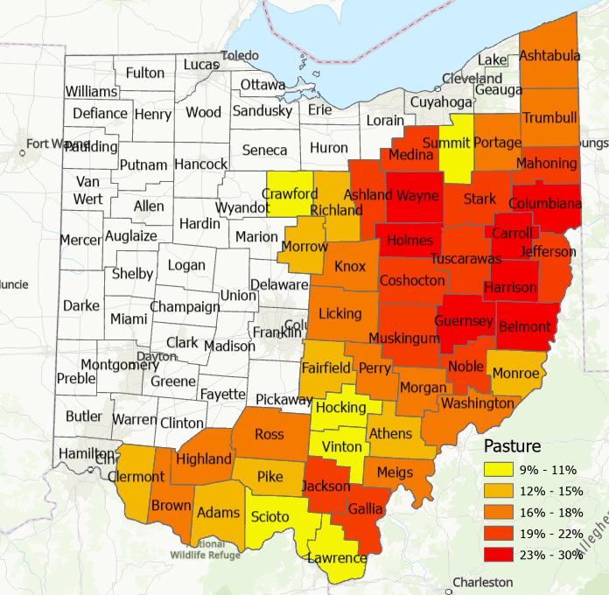
Project Area
*Pending
44 Counties
Total Agricultural Ground: 4,996,886 acres
Total Grass/Pasture: 2,504,522 acres
50% of Agricultural Ground is categorized as Grass/Pasture
18% of Total Area is Grass/Pasture

Slide 6
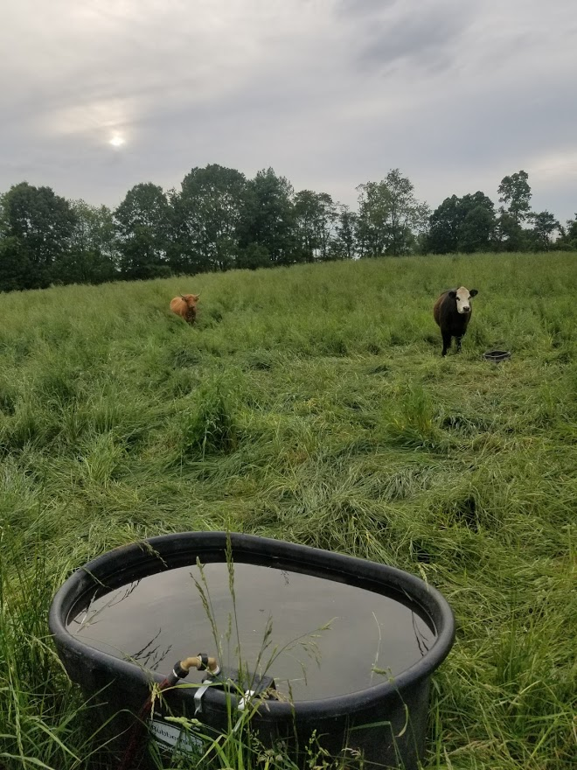
Goals and Objectives
Goal: Reduce the amount of nutrients, sediment and pathogens entering waterbodies from agricultural operations.
Objectives:
1. Improved water quality due to reduction of field sediment, nutrients, and pathogens. ​
​
Reduce sedimentation in sensitive aquatic habitat by prioritizing pasture and haylands adjacent to streams and within impaired HUC-12 watersheds.
Targets to meet objectives by:
A. 200+ contracts through RCPP.
B. 95,000 acres of nutrient management plans through H2Ohio.
*Pending

Slide 7
Potential Practices
Supplemental Practices (Tentative)
Livestock Pipeline 516
Spring Development 574
Underground Outlet 620
Watering Facility 614
Fence 382
Heavy Use Area Protection 561
Access Road 560
Stream Crossing 578
Herbaceous Weed Treatment (On Pasture/Hay) 315
Brush Management (On Pasture/Hay) 314
Access Control 472
Strategic Harvested Forage Management 827
Core Climate-Smart Ag. Practices
Prescribed Grazing - 528
Pasture & Hayland Planting -512
Nutrient Management -590

