Slide 1
NASCA 2024 Annual Meeting, Duluth, MN

Slide 2
Ohio’s District Support Programs
Technician Development Program (TDP)
Administrative Development Program (ADP)
Agriculture Assistance Grant

Slide 3
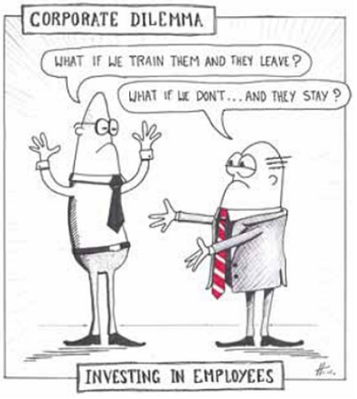
Technician Development Program
A training program to enhance the technical ability of our partners leading to better planned, designed, and constructed conservation practices

Slide 4
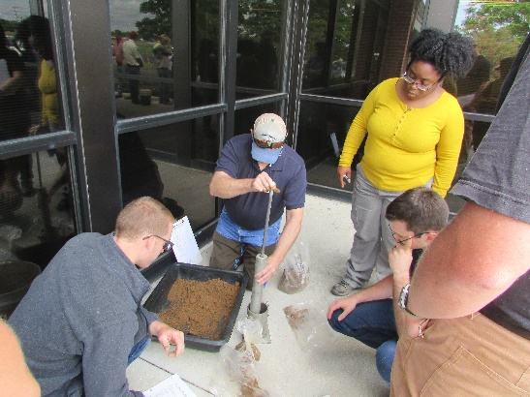
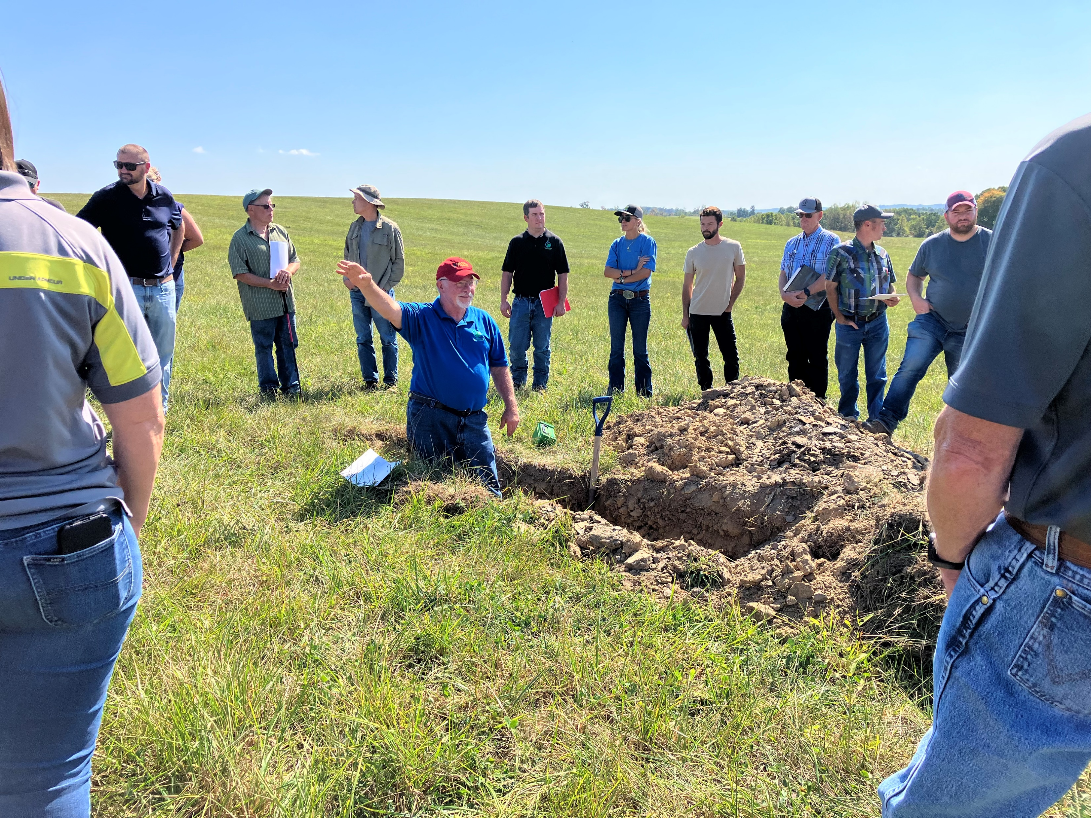
Technician Development Program
Classroom and Online options
Focus Areas
Beginner Level
Advanced Level
Grazing
Urban

Slide 5
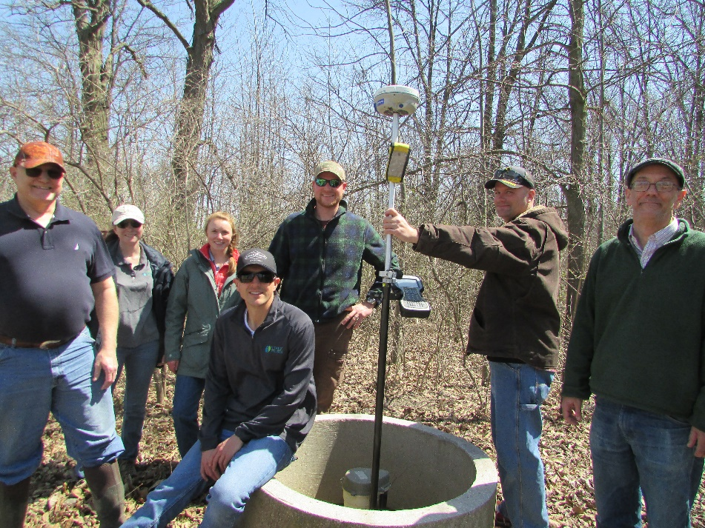
Technician Development Program
Designed for SWCD and NRCS Technical Staff
Over 1000 individuals have attended since 2003 with participation from every district in the state
Typical class size is 35
Instructed by practicing engineers and professionals

Slide 6
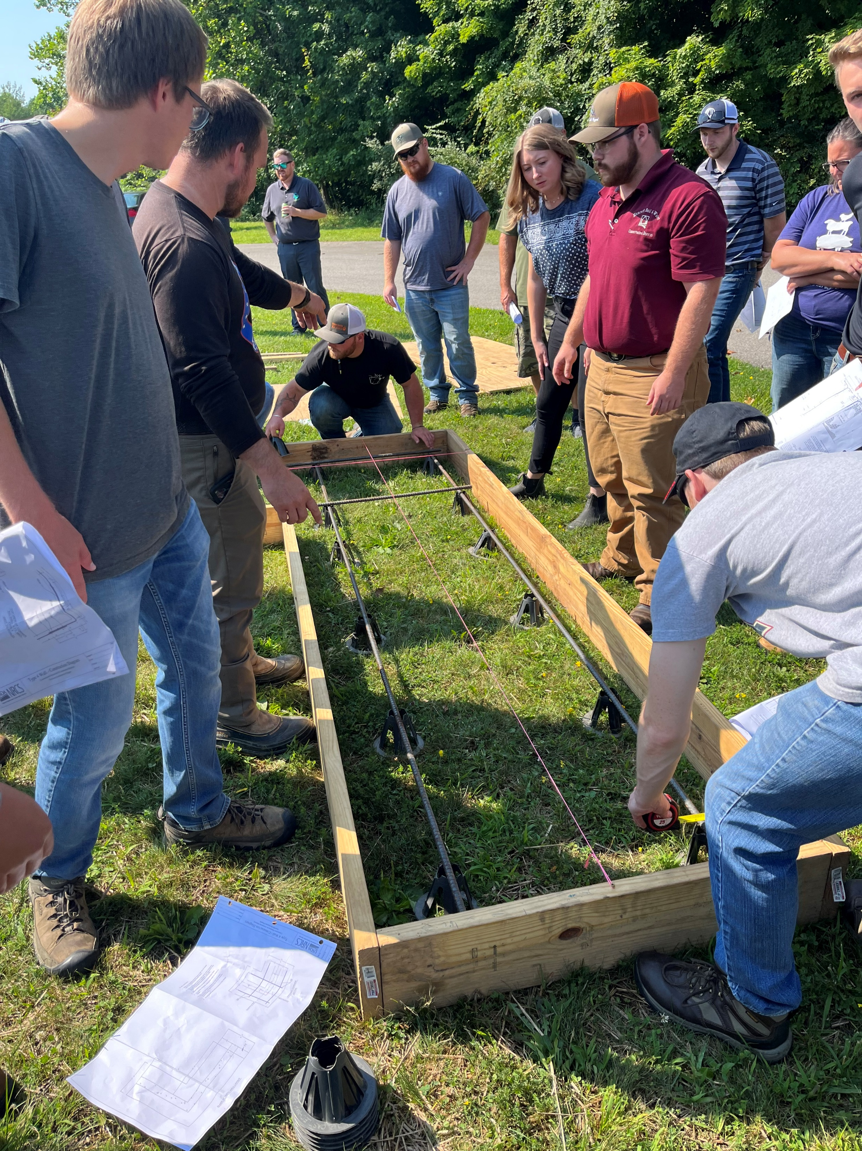
Technician Development Program
Offering 13 in-person classes in 2024
Training topics include:
Hydrology
Surveying
Nutrient Management
Soils
Grazing Plans
Wetlands
Grassed Waterways
Fencing

Slide 7

Administrative Development Program
Training targeted to the administrative professionals serving our SWCDs to propel districts to the top in conservation management

Slide 8

Administrative Development Program
Program began in 2018 and targets administrative staff and board members
Provides great networking and mentoring opportunities by bringing together new and seasoned staff

Slide 9

Administrative Development Program
Offering 7 trainings in 2024
Training topics include:
Human Resources
Strategic Planning
Fiscal Management
Board Governance
Program Development
Marketing & Branding
Grant Management
Leadership & Communication

Slide 10


Agriculture Assistance Grant
A potential agreement with NRCS and OSWCC to provide funding to lower staffed districts to increase technical staffing

Slide 11
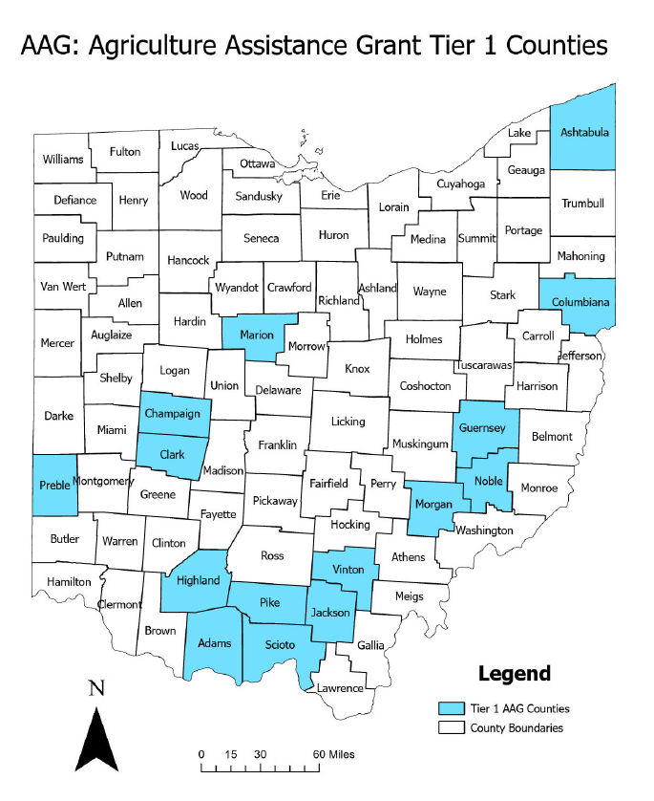
Agriculture Assistance Grant
Targeted towards SWCDs that have 3 or less employees
Identified 15 districts that expressed an interest in hiring additional staff

Slide 12
Requirements
Must hire a new part-time or full-time employee
Hold a local work group meeting annually
Develop and submit an APW that would show planned activities and the focus of additional technical assistance. Development of plan must include local NRCS representative
Education & Training commitment from SWCD Board
Semi-annual reporting to OFSWCD for federal funds

Slide 13
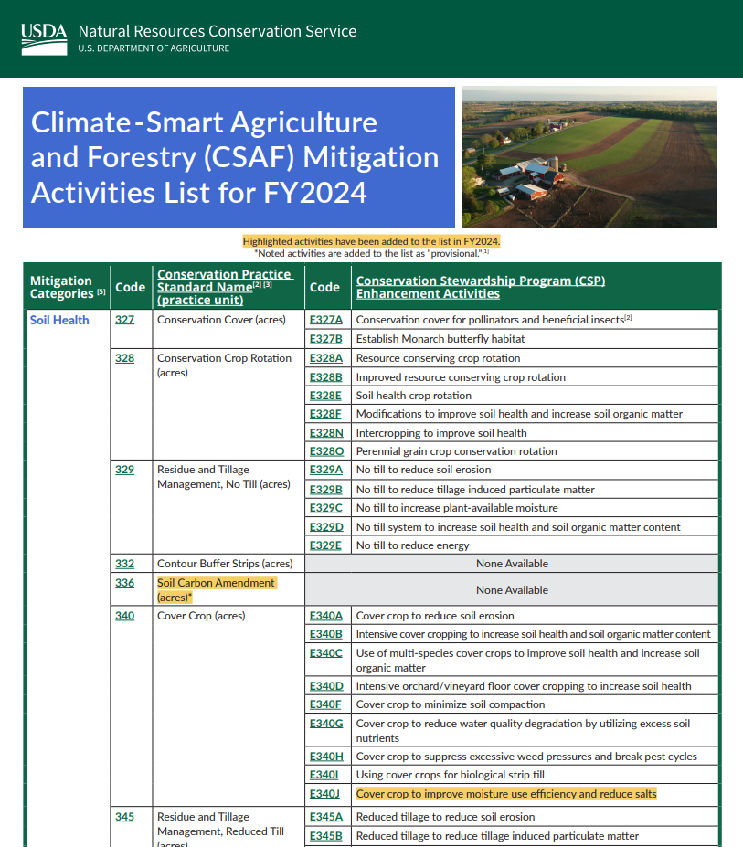
Requirements
Climate Smart Activities Include: Soil Health Nutrient Management Grazing & Pasture Forestry & Wildlife 50% of TA must be Climate Smart related.
APAP and H2Ohio support

