Slide 1
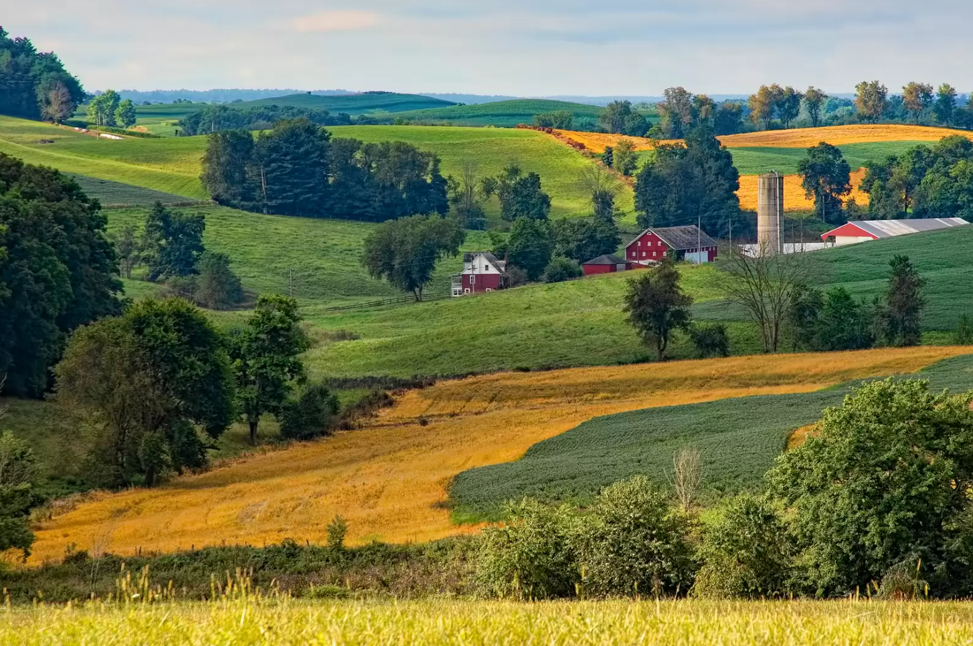


Expansion of ODA Nonpoint Source Programs
NASCA, Salt Lake City, Utah October 2023

Slide 2
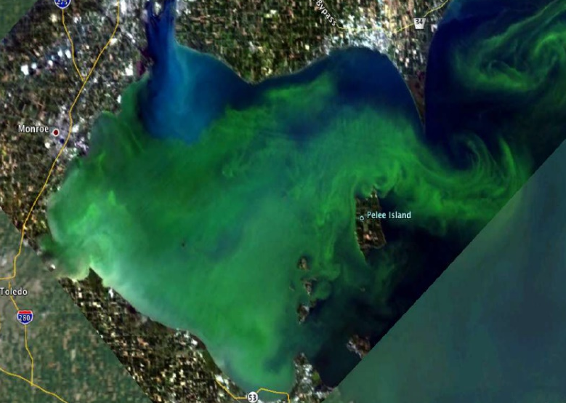
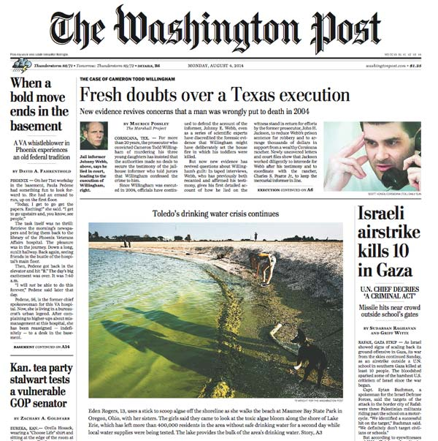
H2Ohio
H2Ohio announced November 2019
To address water issues
Harmful algal blooms
Failing drinking water systems
Wastewater, and home sewage treatment systems
Lead contamination
ODA’s focus is Phosphorus and Nitrogen load reductions to Lake Erie from the Western Lake Erie Basin
The Domestic Action Plan (DAP) was signed in 2015, and establishes a goal of a 40% reduction in Phosphorus loads from 2008 levels

Slide 3
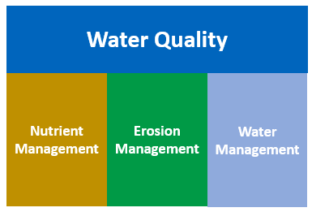


H2Ohio
Water quality improvement program funded by the state of Ohio. Program is managed by Ohio EPA, ODNR, and ODA
Approximately 1.5 million acres of cropland currently enrolled across the 24-county project area
Over $180 million dollars have been encumbered to the project area to date
Statewide expansion underway – targeting 500,000 acres of Voluntary Nutrient Management Plans
Notes:
Also in the process of applying for a non-competitive GLRI grant for drainage management with water harvesting and irrigation

Slide 4
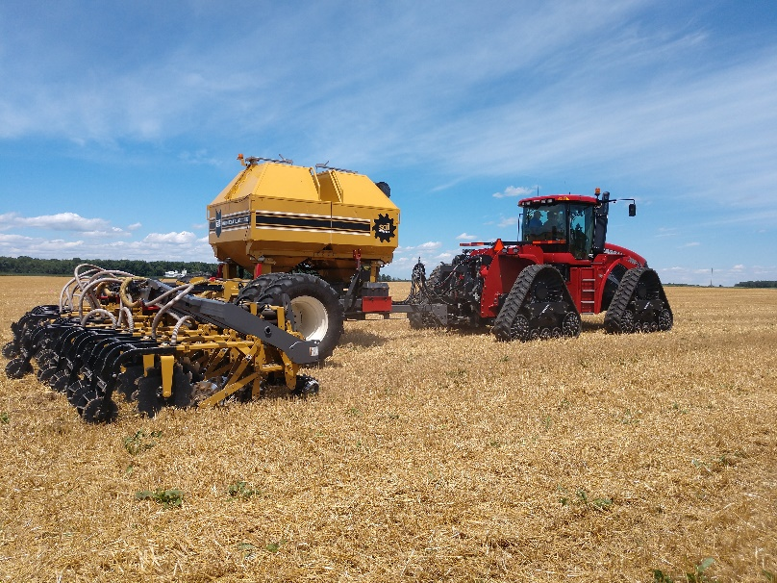
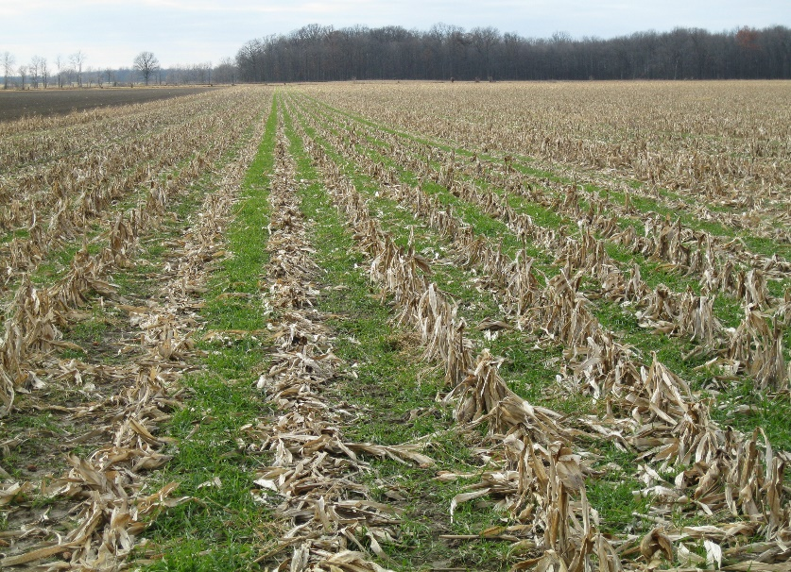
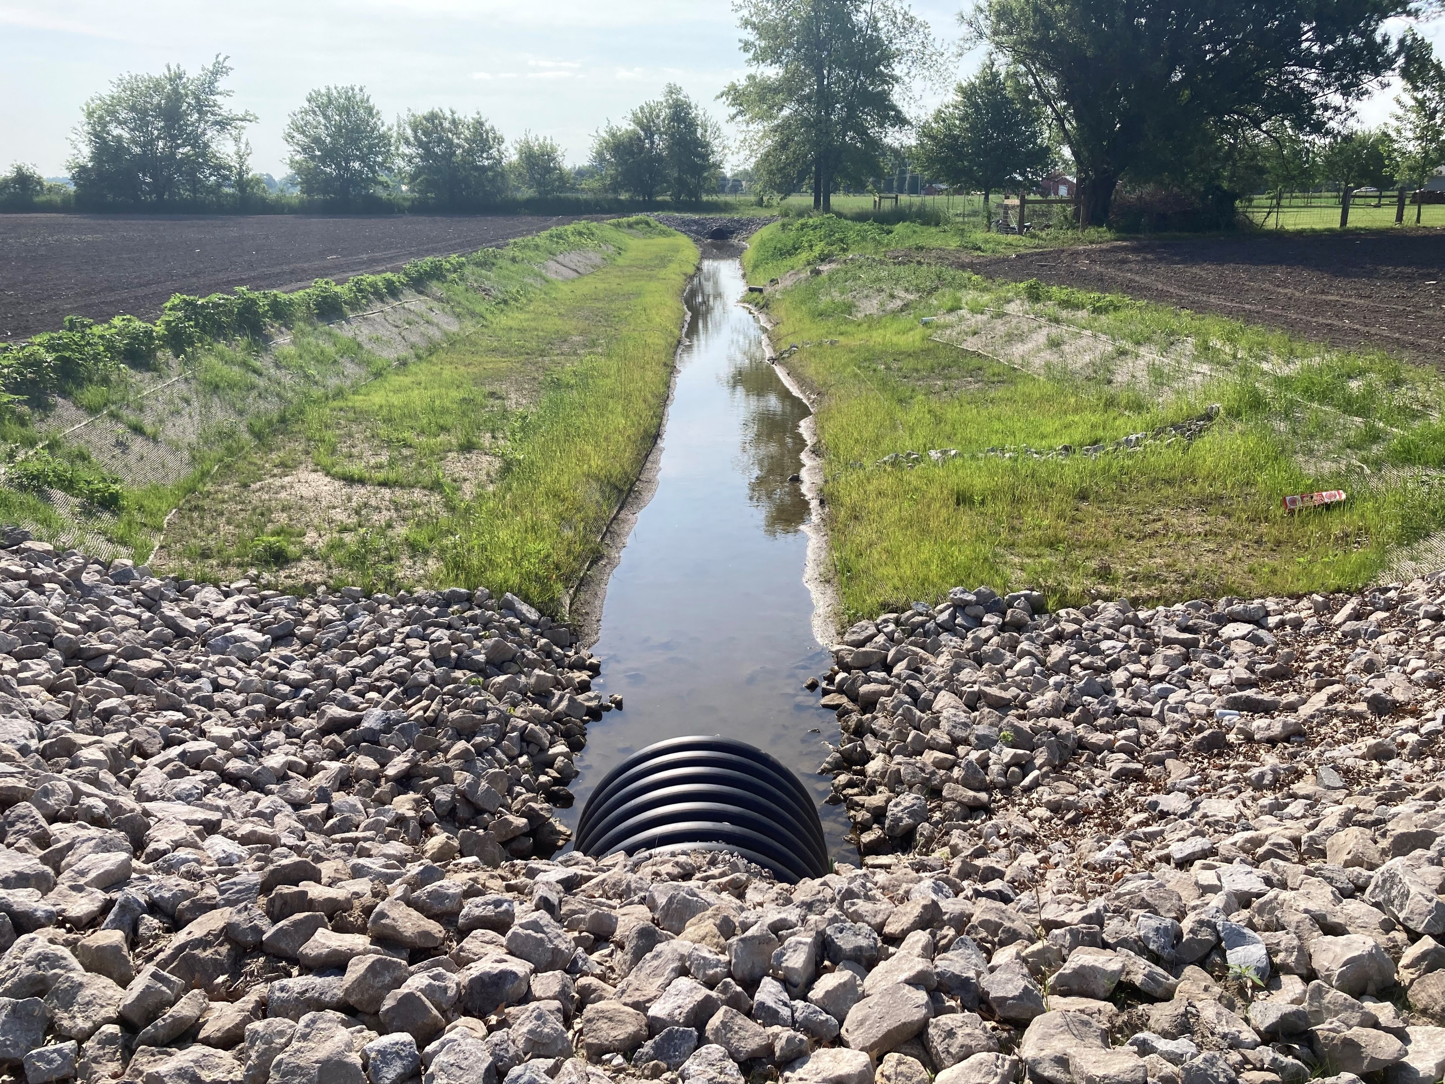
H2Ohio - Best Management Practices
Voluntary Nutrient Management Plan
Variable Rate Phosphorus Application
Subsurface Phosphorus Placement
Manure Incorporation
Original 7 BMPs offered
10
Small Grains
Forages
Overwintering Cover Crops
Conservation Ditches
New practice added in 2022

Slide 5
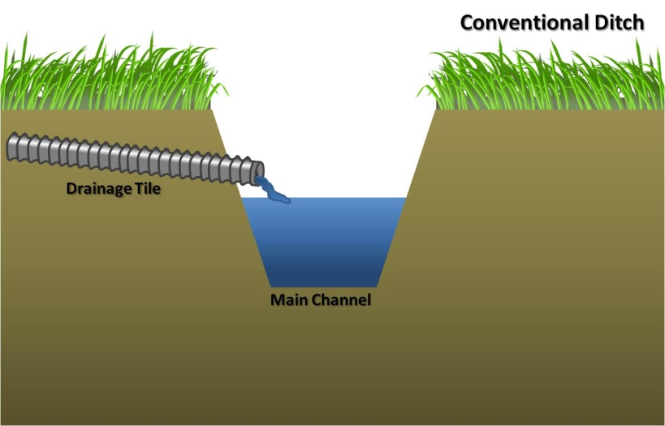
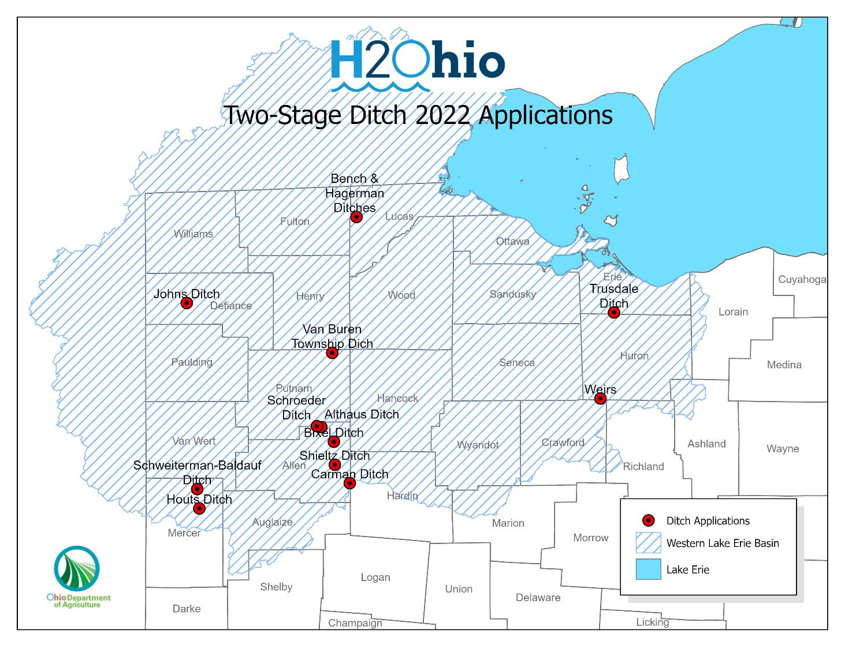
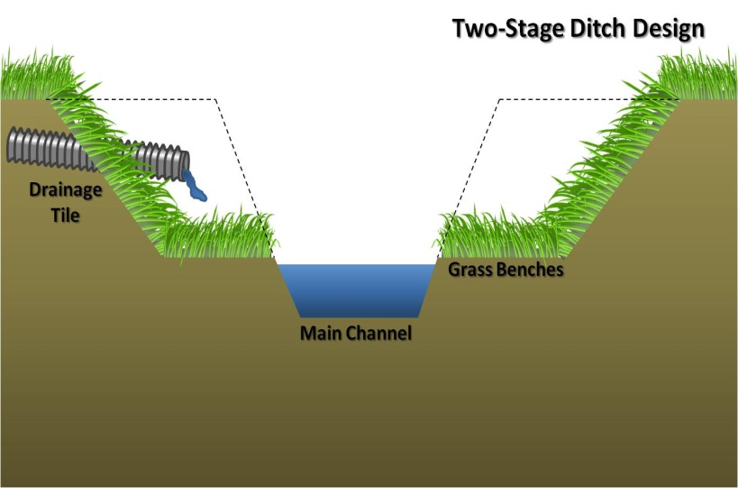
Conservation Ditch Program

Slide 6
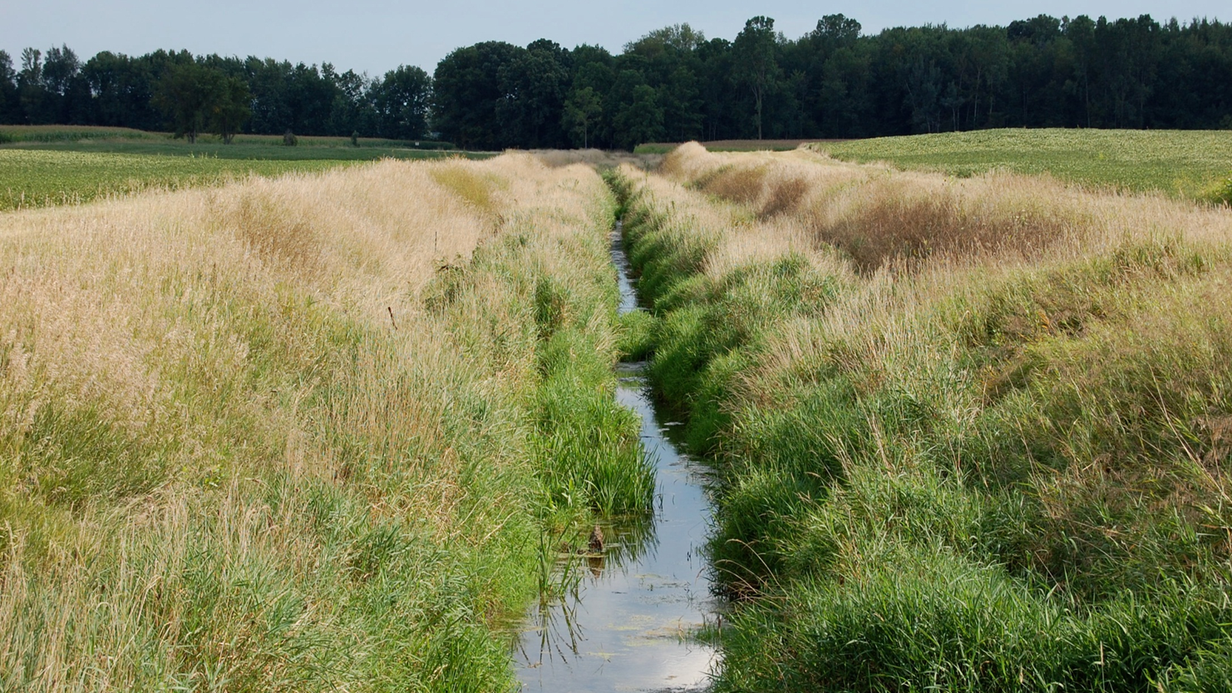
2022 Conservation Ditch Program Stats
12 applications received
$4.2 million in total requests
$94 per linear foot cost ($25 to $190)
$80 to $180 per pound P reduced (self-forming only)
Notes:
12 applications received
6 SWCD + 6 County Engineer
7 counties
4 Self-Forming + 8 Two-Stage
6 agreements signed, 5 waiting, and 1 fell through.
$4.2 Million in total requests
8.4 total miles
$94 per linear foot cost ($25 to $190)
120 acres to 4,800 acres watershed sizes
$0.02 to $0.32 per acre watershed per foot
$80 to $180 per pound P reduced (self-forming only)
Second round of enrollment open, no applications finalized yet but working with Districts on several.

Slide 7
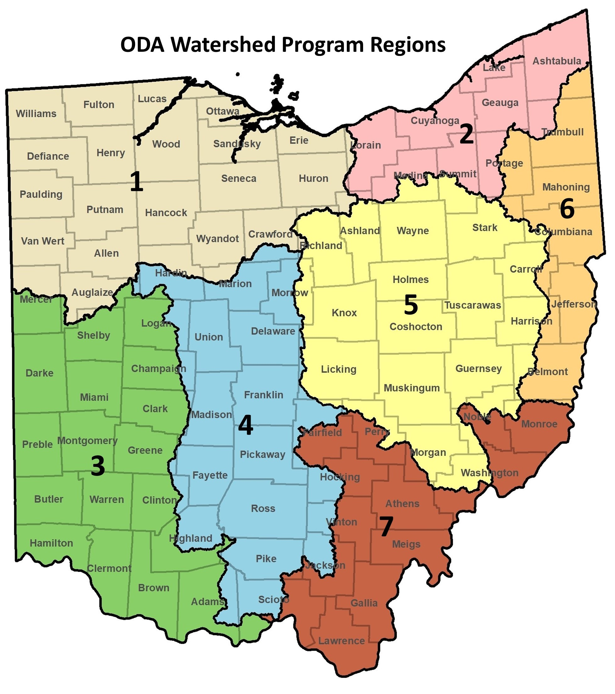
ODA Watershed Program
Legislative mandate (2021) – statewide watershed planning and management
No specific funding allocated (currently on H2Ohio)
Watershed manager for each region
Developed regional watershed plans
Supporting local efforts
Developing new regional initiatives
Fill gaps in existing Federal/State programs

Slide 8
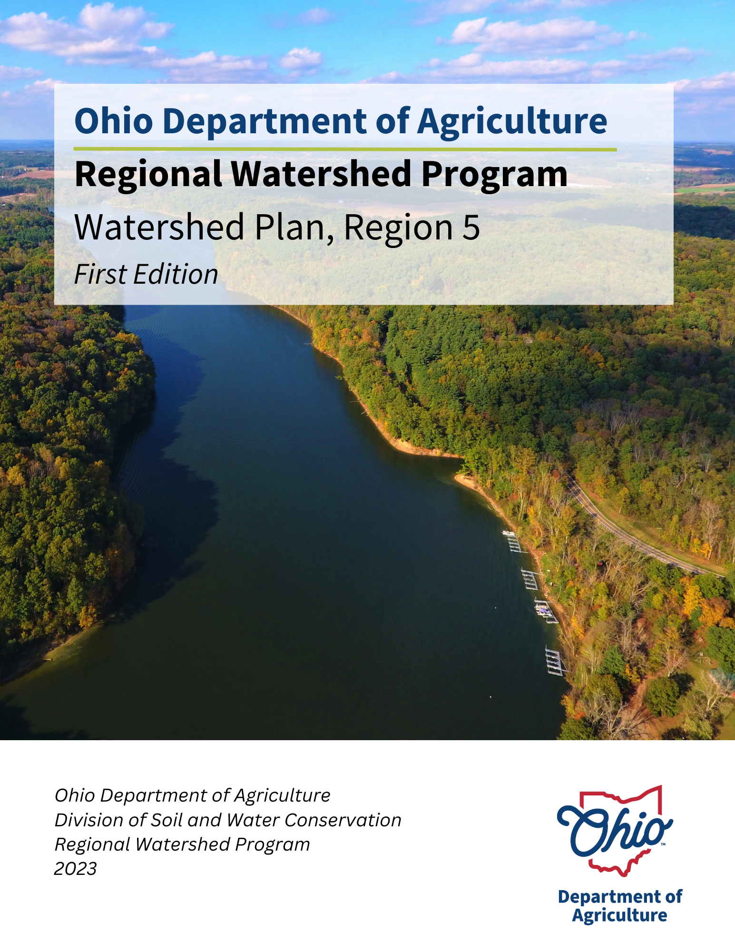
Watershed Plan Utilization
Inform conservation planners (State Agency, SWCD, NGOs, etc.)
Provide larger context to local projects
Align efforts with regional goals and priorities
BMP guidance - applicable to regional concerns
Use regional plans to leverage State/Federal funding
Provide data/sources and support to NPS-IS development
Guide H2Ohio expansion
New regional-scale initiatives

Slide 9
Thank you!
Questions
Greg Nageotte Greg.Nageotte@agri.ohio.gov
Peter McDonough Peter.McDonough@agri.ohio.gov

