Slide 1
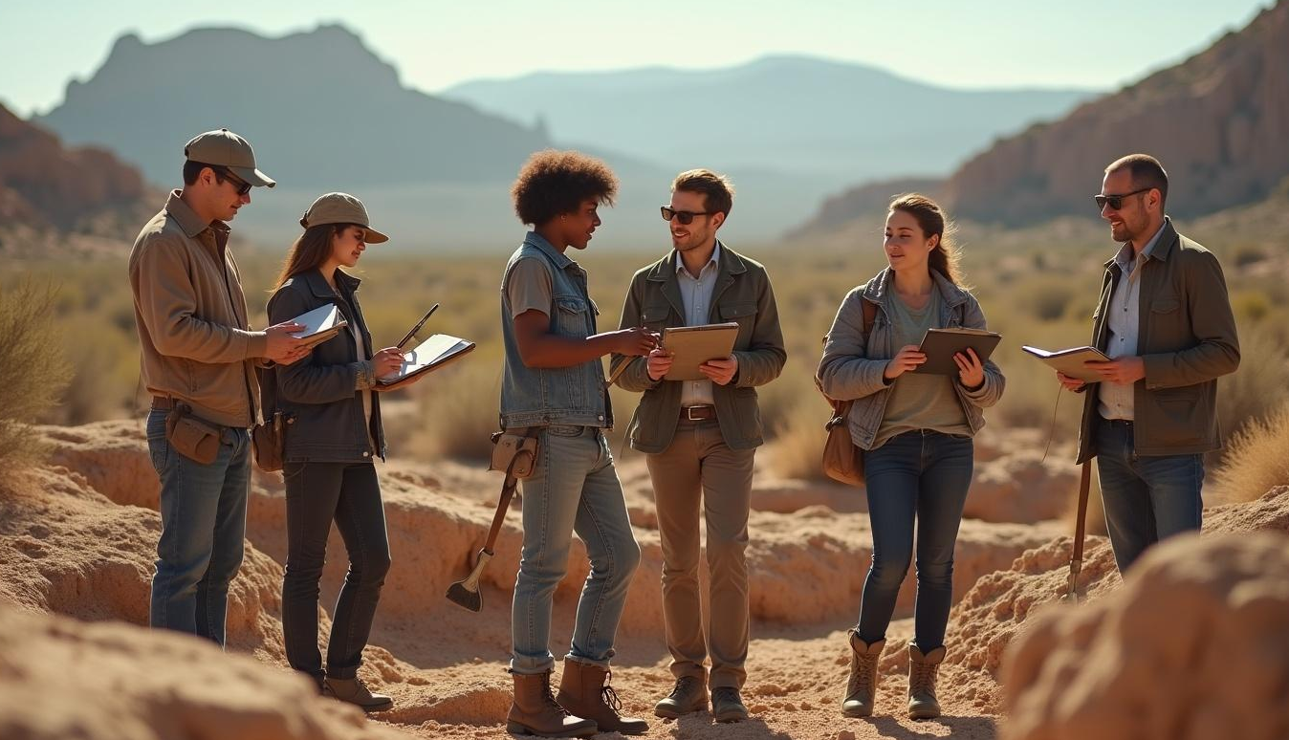
Archaeology Program
Statewide Training Initiative Overview

Slide 2
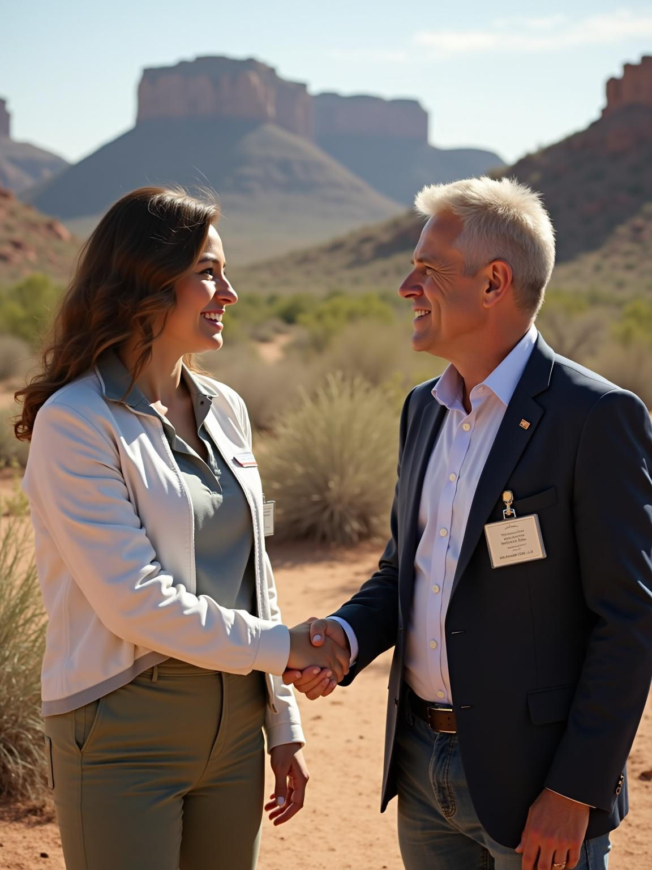
New Mexico Office of Archaeological Studies & NMDA New Mexico Department of Agriculture FIELD TRAINING PROGRAM
The New Mexico Department of Agriculture (NMDA), in partnership with the Department of Cultural Affairs (NMDCA), launched a statewide archaeological field training program in 2025. This pilot program aims to equip New Mexicans with the professional skills necessary for archaeological fieldwork, enhancing workforce development in this sector through a structured, multi-phase training model.

Slide 3
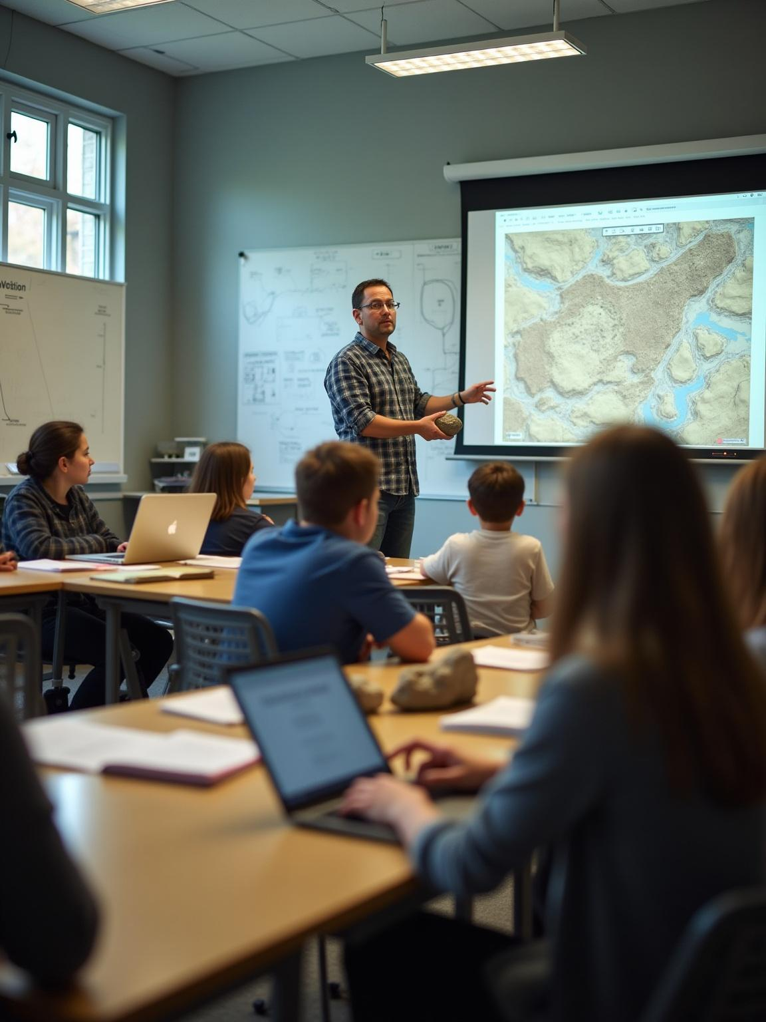
Program Overview TRAINING TRACKS: Two tracks for different levels of experience
Field Technician Track
• Entry-level training in basic archaeological skills
• No previous experience required
• Successful participants will gain the professional skills and experience to work as a technician on a field crew Supervisor Track
Supervisor Track
• Advanced training for those with intermediate knowledge and previous field experience
• Requires an educational background in a related field
• Successful participants will gain skills and supervisory experience directly applicable to becoming a field crew supervisor

Slide 4
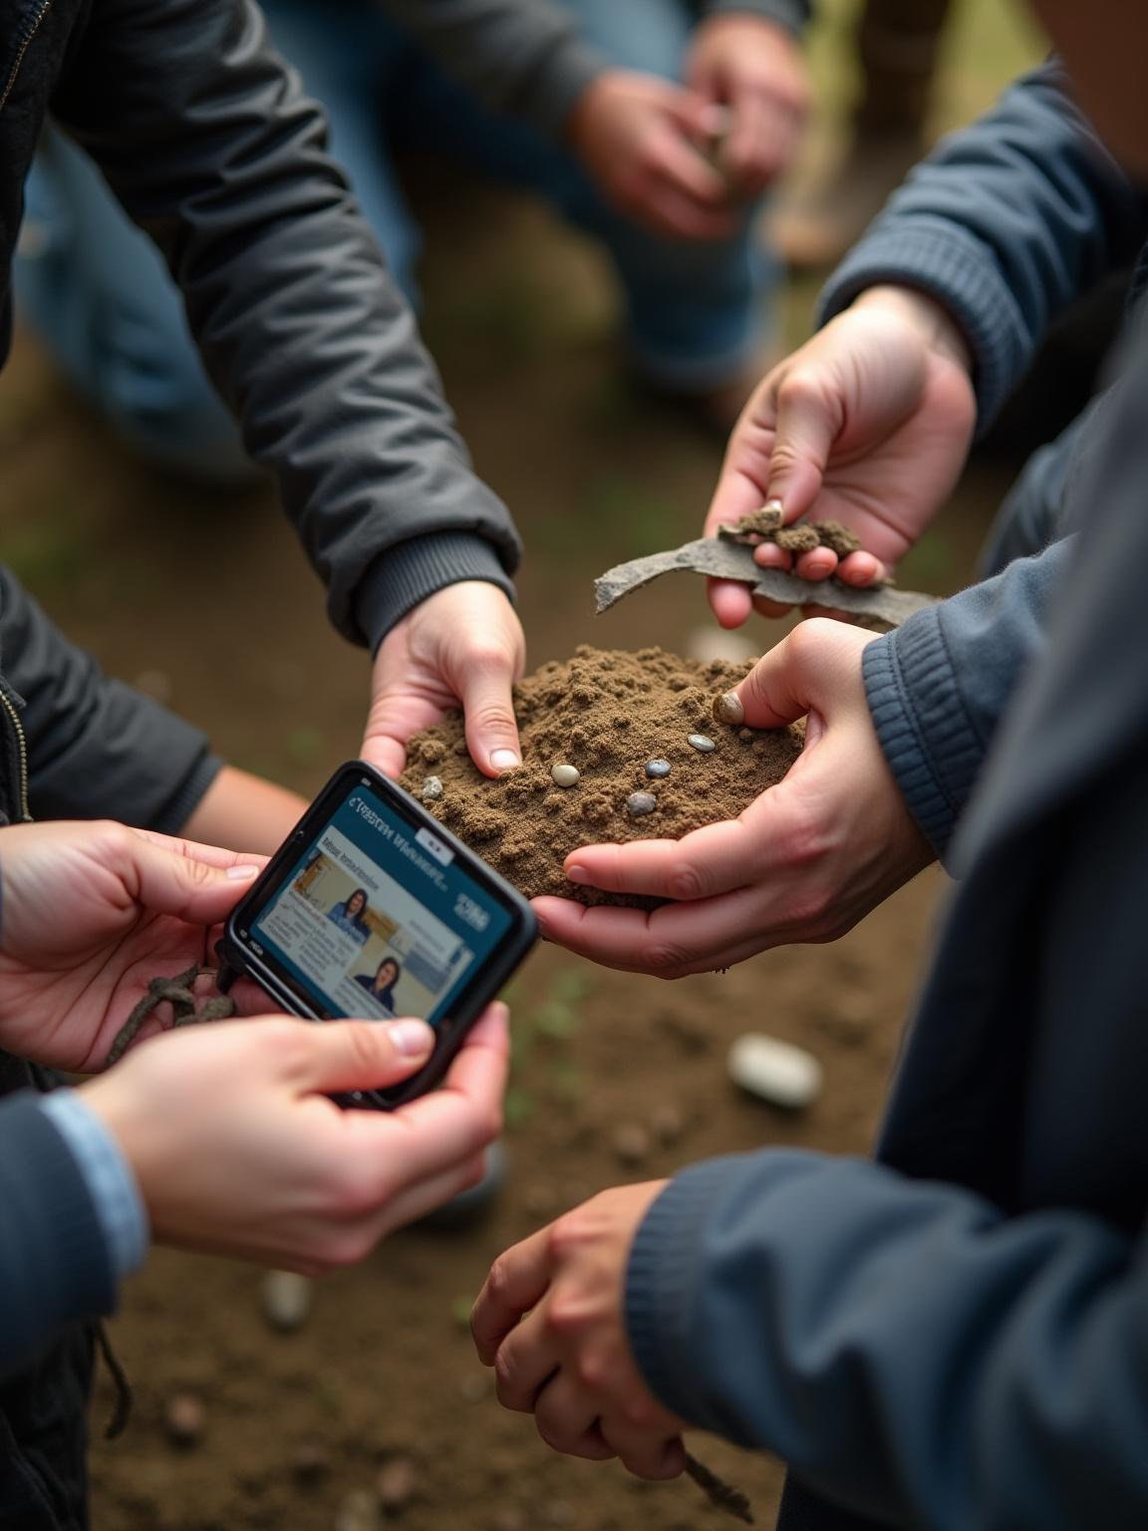
Purpose and Goals
This program is designed to provide professional archaeological training to New Mexico residents, preparing participants for careers as field technicians or supervisors. It focuses on practical skill development.
Online education
In-person field training
Real-world field experience

Slide 5
Funding and Resources
The New Mexico Legislature funded this initiative, allowing NMDA to administer it with support from the NMDCA.
The program is offered at no cost to participants, with financial support available for travel, living expenses, and compensation for fieldwork, ensuring accessibility and encouraging broad community participation.

Slide 6
Collaboration Between NMDA and NMDCA
The New Mexico Department of Agriculture (NMDA) administers the program in partnership with the New Mexico Department of Cultural Affairs (NMDCA) Office of Archaeological Studies. This collaboration ensures specialized course development and delivery, combining administrative support with archaeological expertise. The partnership strengthens statewide training and leverages resources for effective program implementation.

Slide 7
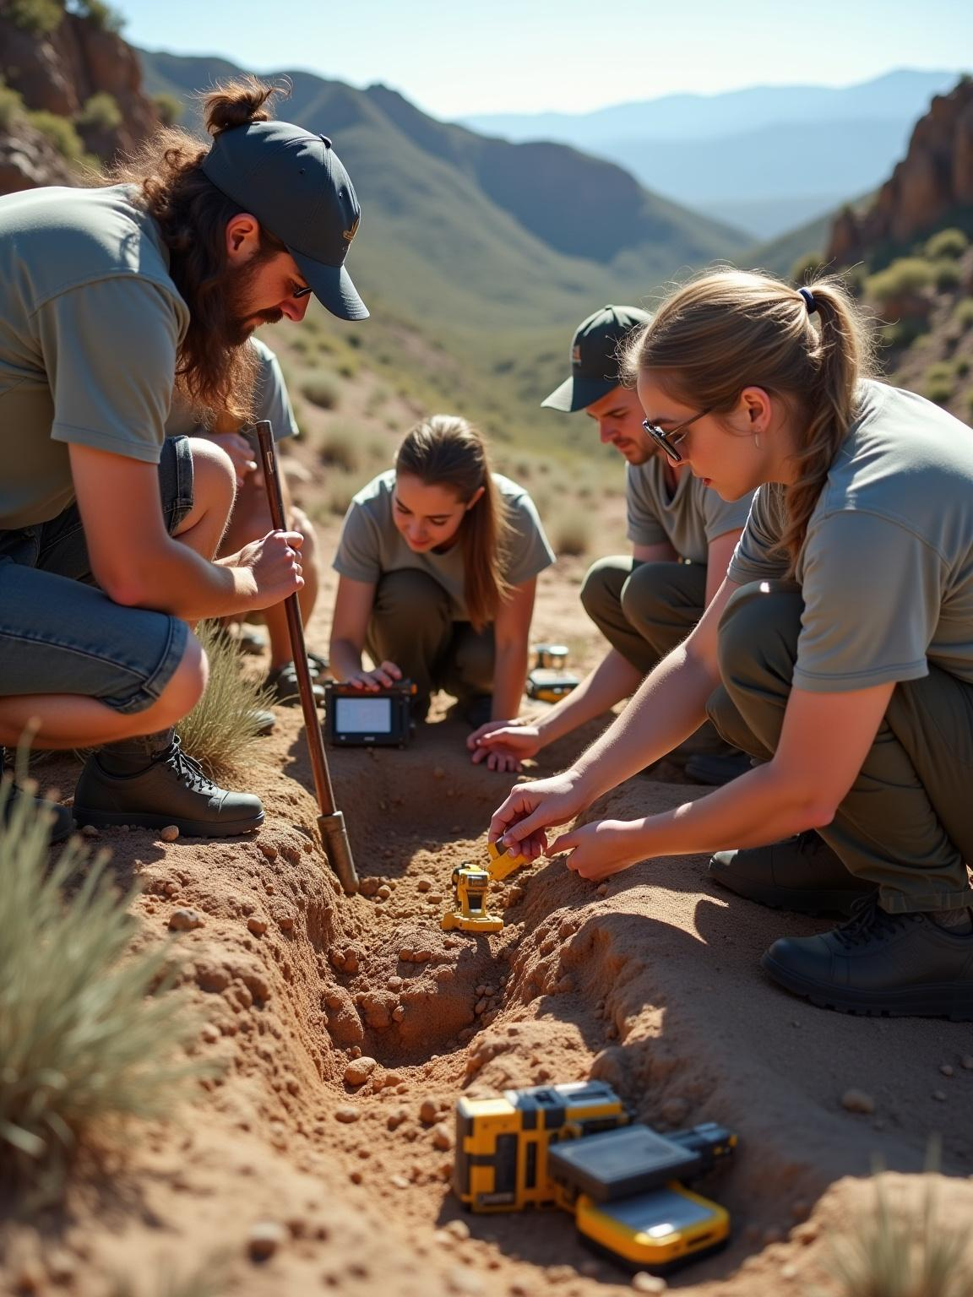
Implementation Strategy
Online Course 2 Weeks, Part-Time | 2-week course to prepare participants for field work. 10 hours per week Self-paced
Field Training 3 Days, Full Time | 3-day, In-person Locations across NM
Field Experience 3 Weeks, Full Time | 3-week field crew Complete tasks demonstrating require skills. NMDA placement of particpants

Slide 8
Fieldwork Logistics and Site Selection
Field trainings and fieldwork occur across diverse New Mexico locations to expose participants to varied archaeological contexts.
Sites are selected strategically to match participants’ locations and schedules.
The program includes compensation and financial support to cover travel and living costs, ensuring accessibility regardless of participant location.

Slide 9
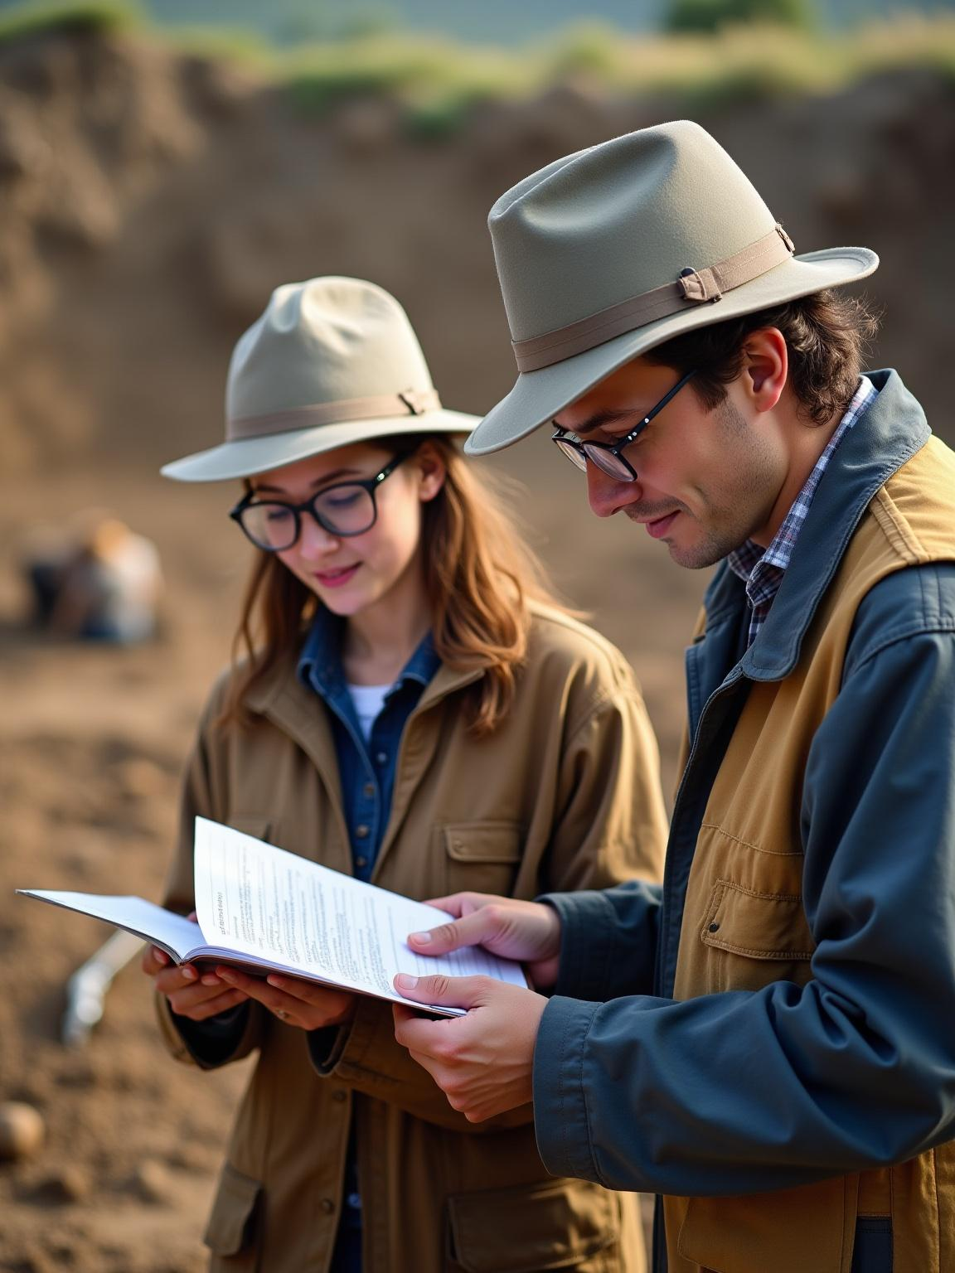
Monitoring and Evaluation Methods
Participants’ progress is tracked through task books completed during field experiences, demonstrating required competencies.
Continuous evaluation via live check-ins and real-time feedback to maintain high training standards.
Participant eligibility criteria and physical requirements ensure readiness for demanding field conditions.

Slide 10
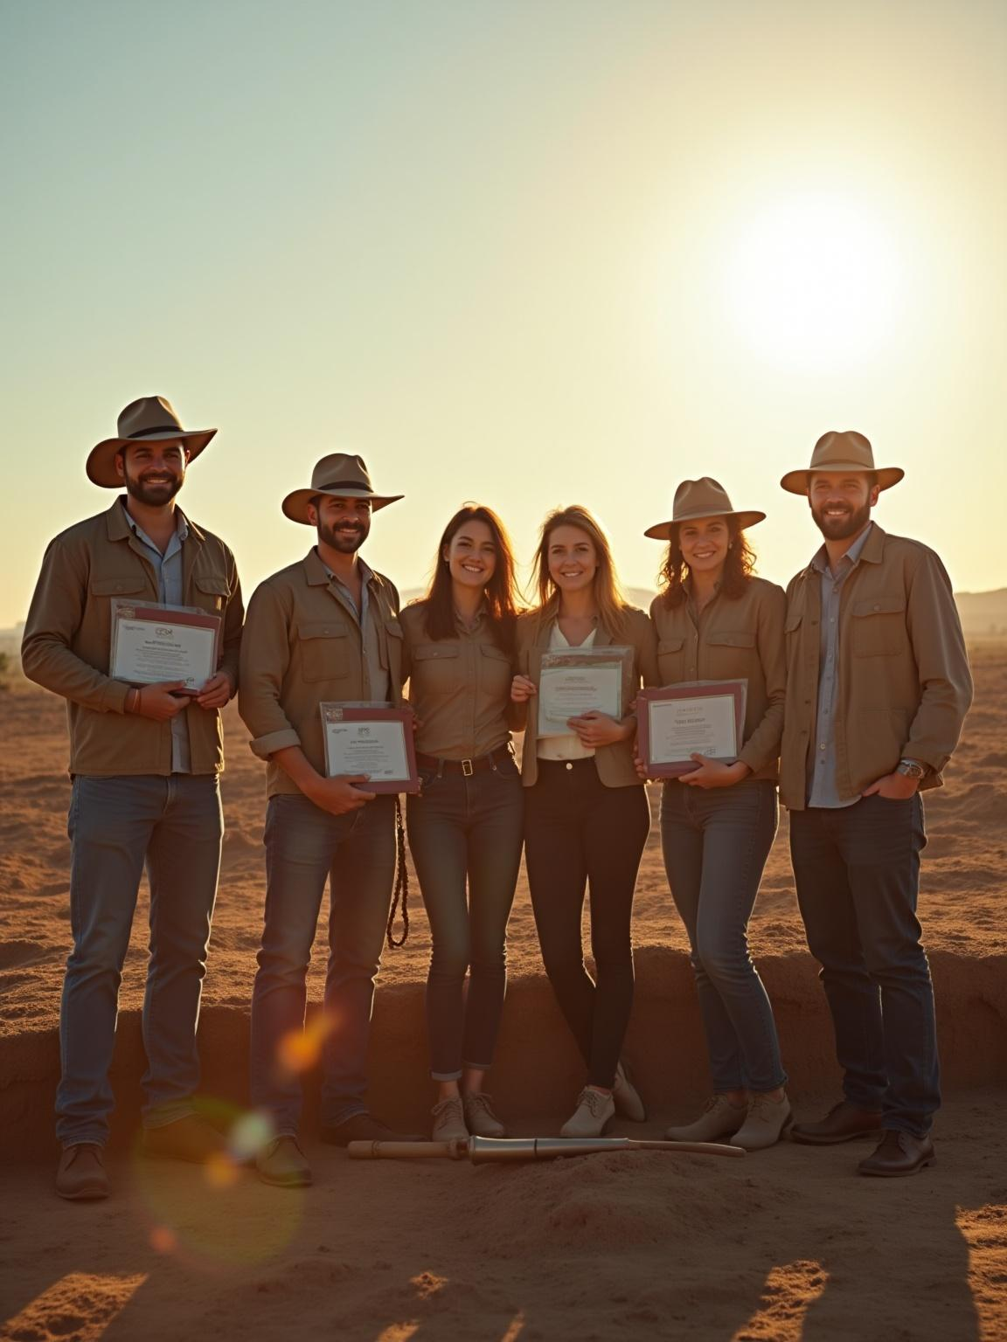
Conclusions
*This statewide archaeological training program is a robust collaboration that enhances New Mexico’s workforce in heritage preservation. Through comprehensive curriculum design, strategic site selection, and rigorous evaluation, it equips residents with marketable skills.
*Financial support and practical experiences ensure broad participation, promoting a sustainable model for ongoing archaeological training and professional development.

Slide 11

Thank You!
Do you have any questions?
Miles Mitchell
SWCD Specialist
NMDA Natural Resource Policy/Planning Analyst
(575) 339 3105
mmitchell@nmda.nmsu.edu

