Slide 1

New Mexico
Land of Enchantment Legacy Fund
Healthy Soil Program
Soil and Water Conservation District Program
Noxious Weeds Program
Presented to the National Association of State Conservation Agencies October 6-10, 2024

Slide 2
NM Land of Enchantment Legacy Fund “Conservation Legacy Permanent Fund”
NM State Agency Participation FY 2025
NM Department of Agriculture
NM Energy, Minerals and Natural Resource Department
NM Environmental Department
NM Economic Development Department
NM Game & Fish Department

Slide 3
NMDA Land of Enchantment (LOE) Legacy Fund Programs
Allocations FY25
NMDA receives 22.5% of annual LOE Legacy Fund disbursement and allocates funding between three programs:
Healthy Soil Program
SWCD Program
Noxious Weeds Program
NMDA Disbursement in FY25:
$ 2,812,500.00
NEW MEXICO DEPARTMENT OF AGRICULTURE

Slide 4
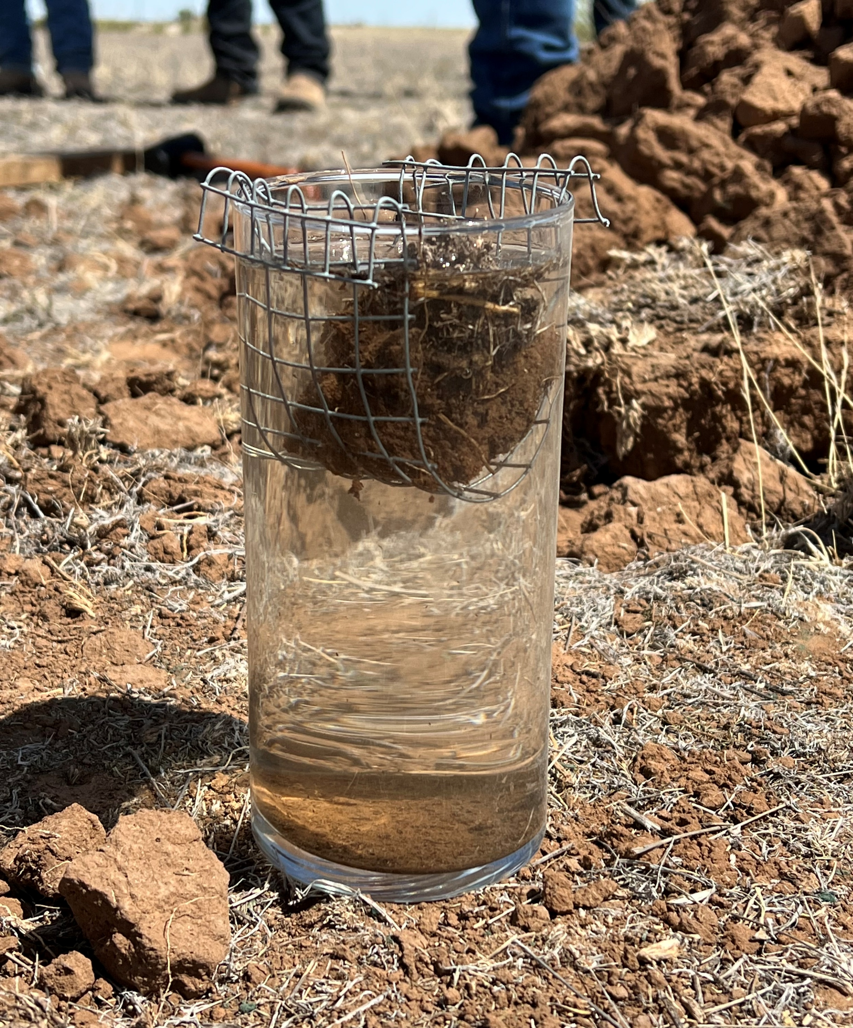
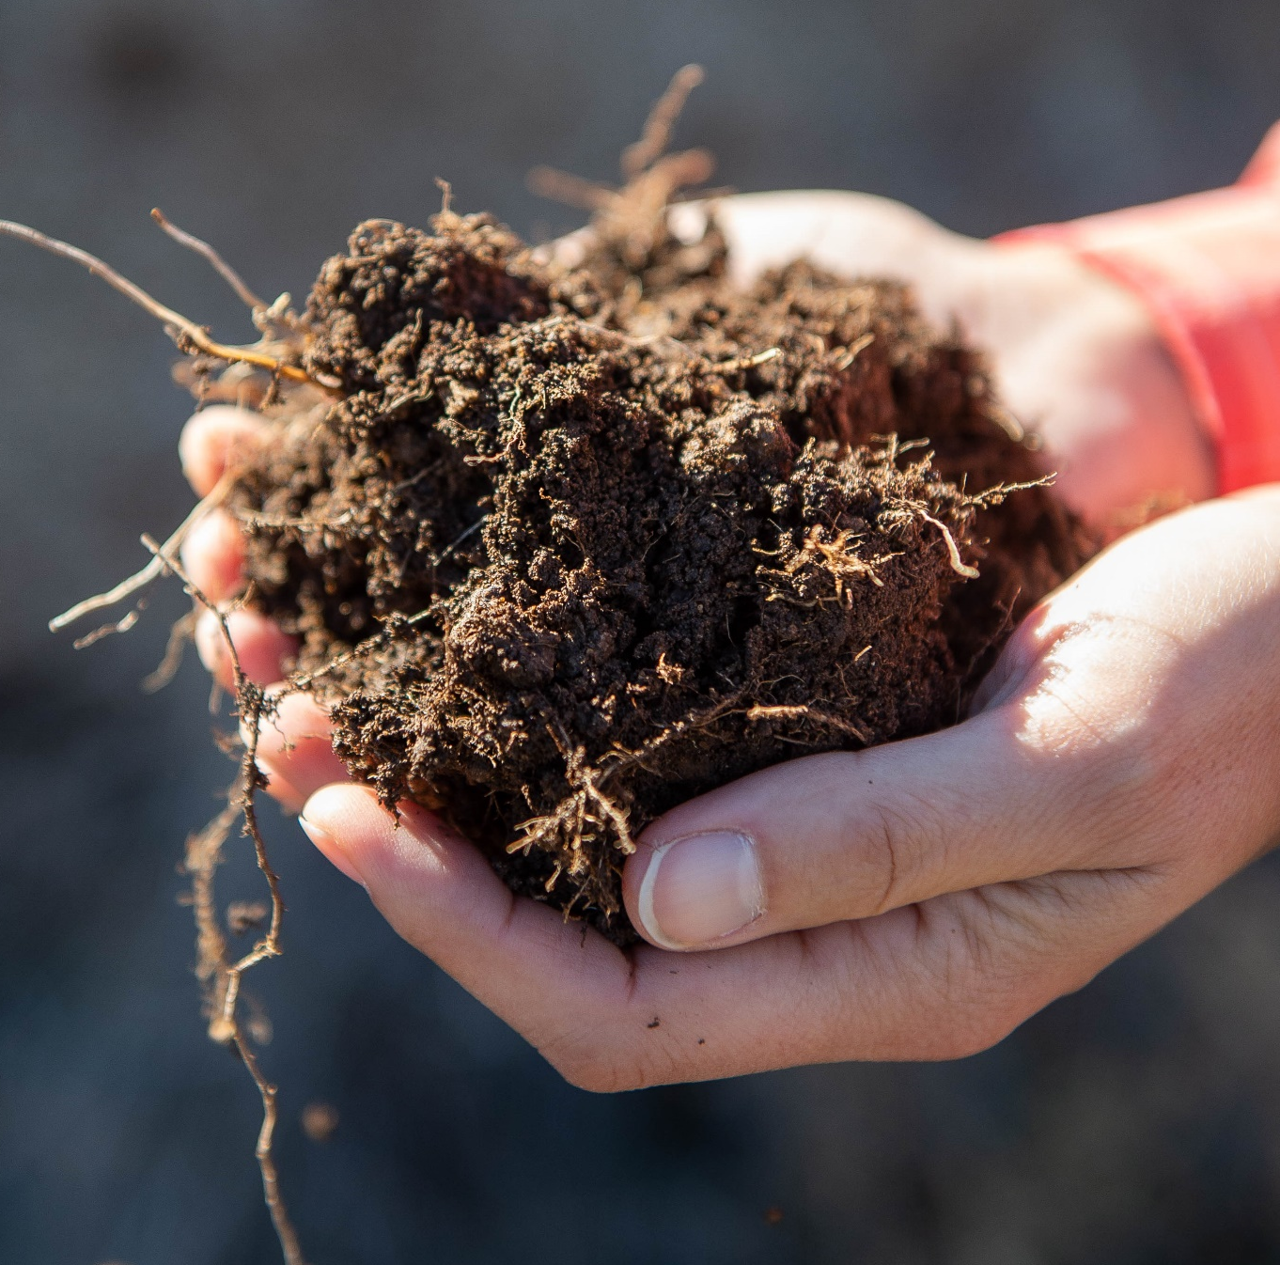
NMDA’s Healthy Soil Program
The purpose of the Healthy Soil Program is “to promote and support farming and ranching systems and other forms of land management that increase soil organic matter, aggregate stability, microbiology and water retention to improve the health, yield and profitability of the soils of the state.”
In Fiscal Year 2025, NMDA’s Healthy Soil Program:
88 (Eligible Entities & Individual Applicants) applied for grants.
Totaling $1,814,529 in funding requested
53 on-the-ground projects awarded grants.
Totaling $1,416,087 in funding
This includes $354K in recurring state monies, plus $490K in match funding from NRCS
NEW MEXICO DEPARTMENT OF AGRICULTURE

Slide 5
Legacy Funding for Soil and Water Conservation District Program
Legislative Monies to Pilot Eligible Entity projects Only
There are 47 soil and water conservation districts (SWCDs) in New Mexico.
SWCDs & Watershed Districts submitted 57 projects totaling $3,520,000 in funding requests
NMDA awarded funding to 31 projects totaling $1,038,946
Categories of projects selected for funding:
Capacity Building Projects
Conservation Planning Projects
Landscape-Scale Restoration Projects
Community Outreach & Education Projects
NEW MEXICO DEPARTMENT OF AGRICULTURE

Slide 6
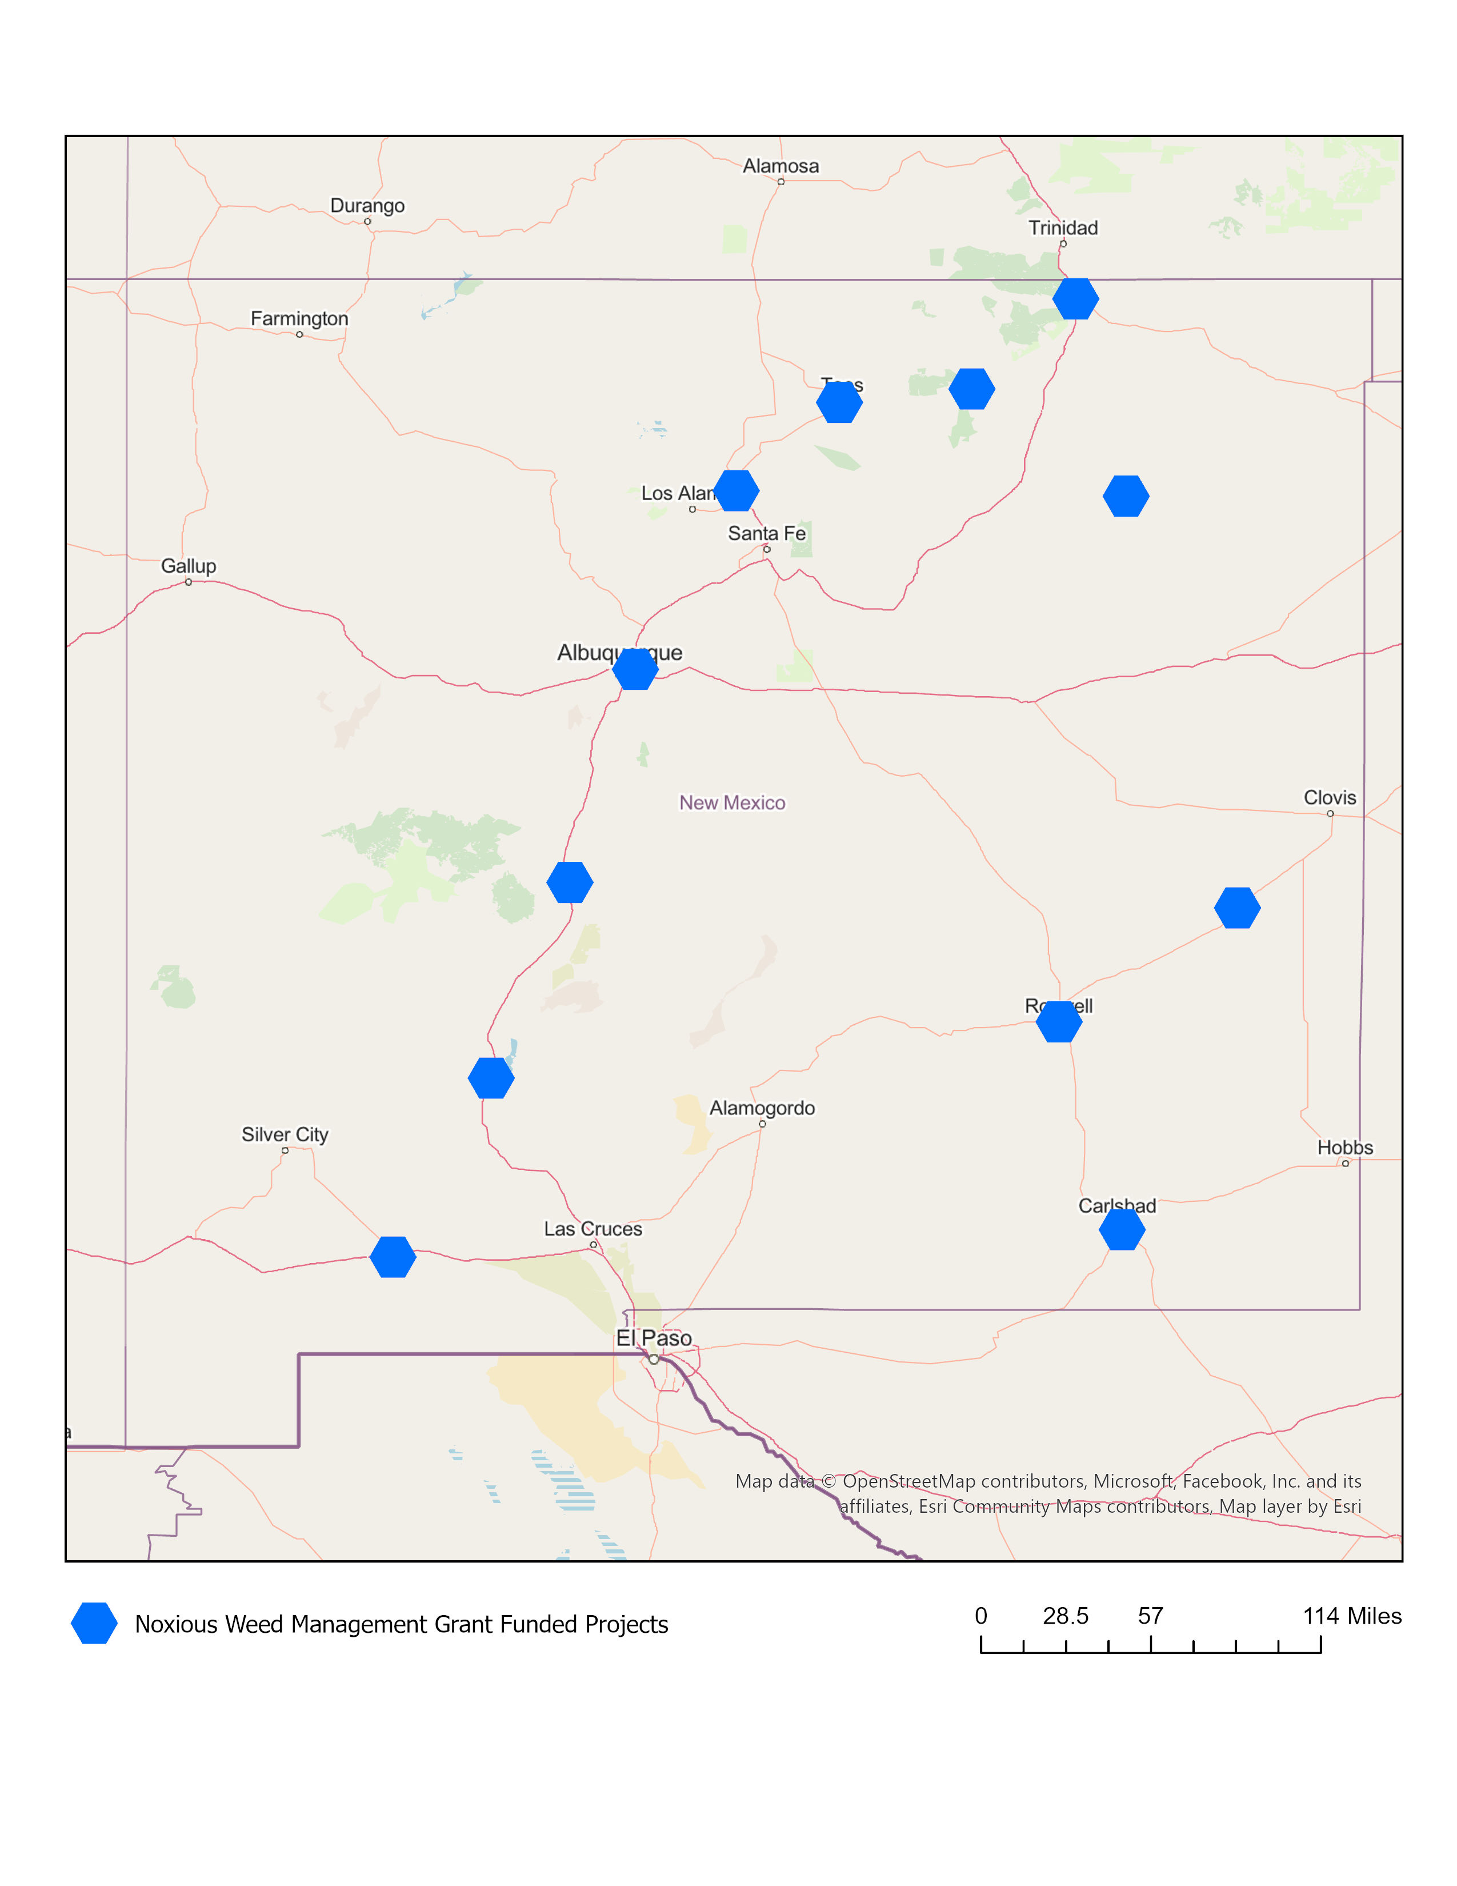
Legacy Funding for Noxious Weeds Program
Eligible Entity projects Only
NMDA coordinates integrated noxious weed management programs in New Mexico
In FY25, NMDA’s Noxious Weed Management Grant
15 project grant applications received.
Totaling $829,089 in funding requested
12 project grant applications awarded
Totaling of $685,336
$200K awarded contracts to map noxious weeds in the state.
NEW MEXICO DEPARTMENT OF AGRICULTURE

Slide 7
The Healthy Soil Program, Soil and Water Conservation District Program, and Noxious Weed Program all reside in NMDA’s Agricultural Programs & Resources (APR) Division.
Learn more:
www.nmdeptag.nmsu.edu/ agricultural-programs-and-resources.html
575-646-2642

