Slide 1
New Jersey ManureLink
Where to Find What Feeds Your Field
https://njmanurelink.rutgers.edu
2022 NRCS-NJ Conservation Innovation Grant #NR222B29XXXXG002
Sandra Howland https://www.nj.gov/agriculture

Slide 2
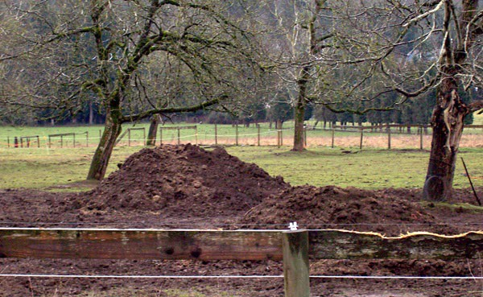
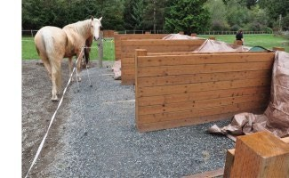
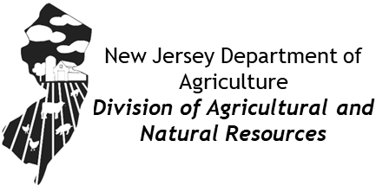
NJ ManureLink – Background & Need
New Jersey's has many small-acreage farms
Small farm have limited capacity to use manure on-farm, especially horse farms. The
equine industry is unique - typically no associated cropland & manure is considered waste.
Addresses need for manure transport, moving nutrients from areas of excess to nutrient-deficient crop fields, composters, and urban farms.
Connects farms with a cost-effective soil amendment and connect farmers to compost as growing media for our urban farms.
At a statewide scale, address agricultural organic waste materials, as well as increased
education and adoption of composting practices as noted in the NJDEP’s Global Warming Response Act 80 x 50 Report (Oct. 2020)

Slide 3

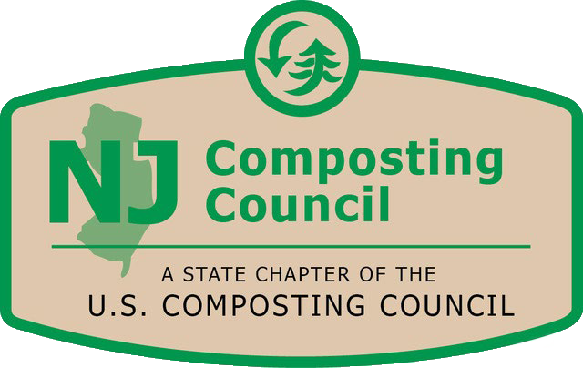

NJ ManureLink – Partners
NJDA has partnered with
Rutgers University, Office of Research Analytics – website development New Jersey Compost Council (NJCC) - education and outreach

Slide 4
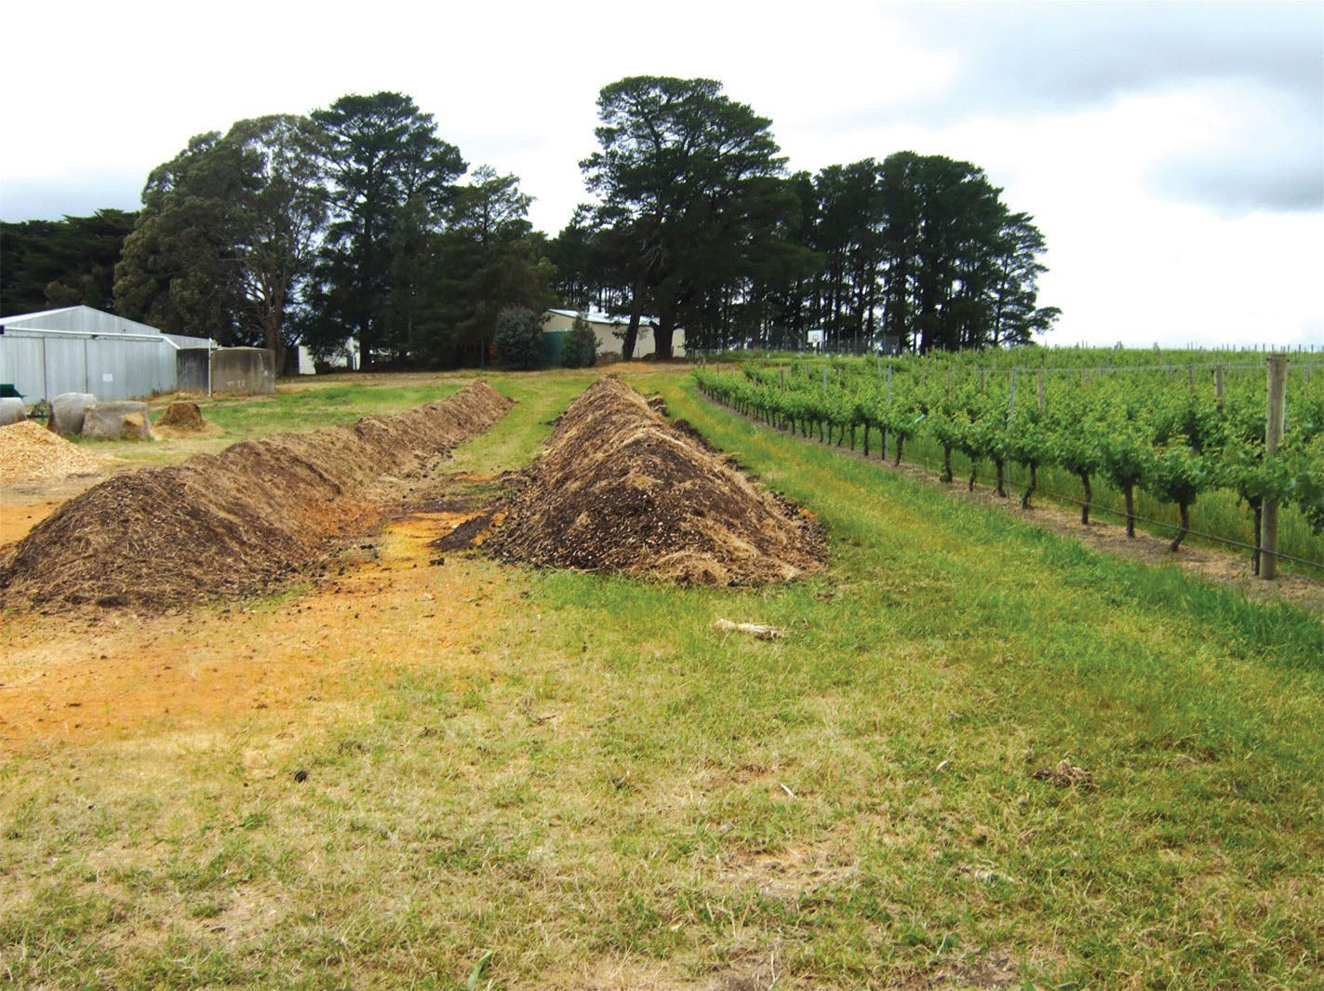
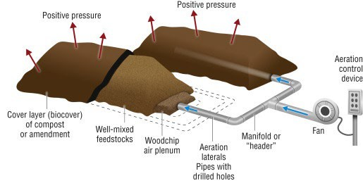
NJ ManureLink Project Overview
2022 NRCS-NJ Conservation Innovation Grant #NR222B29XXXXG002
Develop website to connect producers with manure and compost
  njmanurelink.rutgers.edu
Host educational events: 2024 & 2025 Webinars and Field Days
Adapt practices and educational materials for New Jersey farms;
Assist producers with implementing composting and nutrient management practices through development of technical assistance

Slide 5

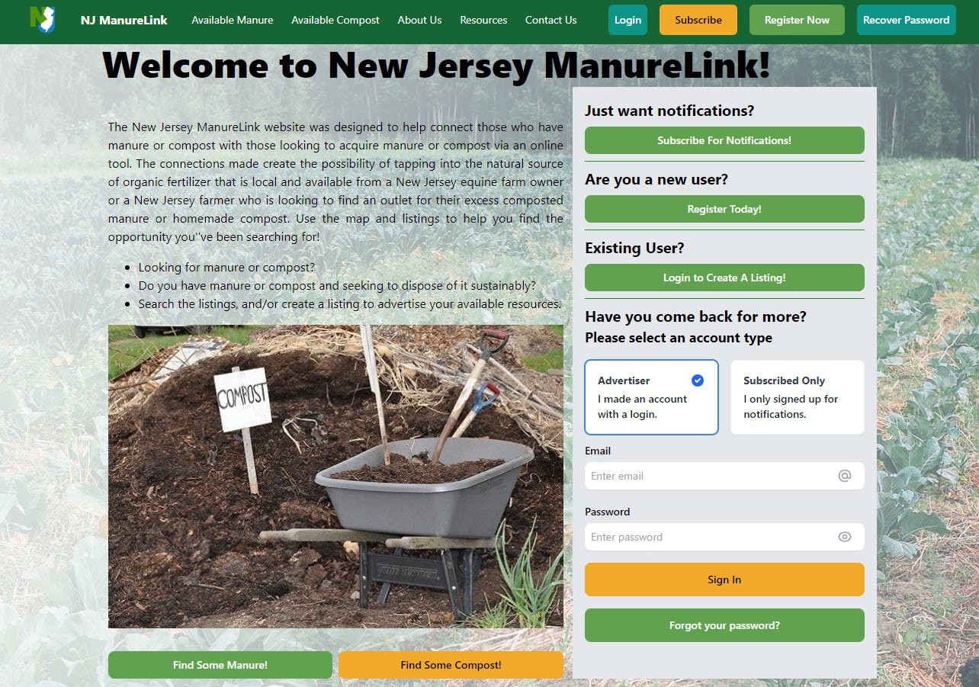
https://njmanurelink.rutgers.edu/
W
e b s I
t e
D
e m o

Slide 6
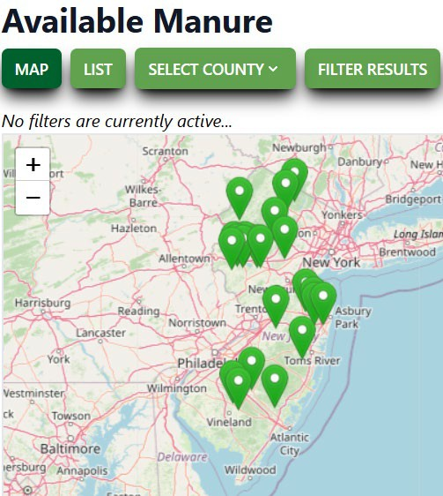
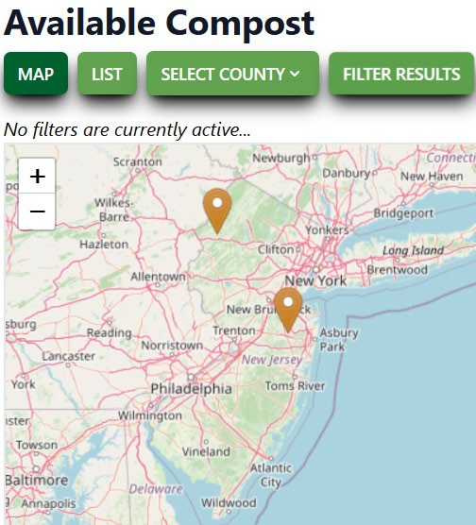

























Status update Oct. 2025
Users: 189
Listings: 25
  24 Manure
  2 Compost
Listings (multi-counted)
Horse
Chicken Alpaca Cow Other Sheep Goat Pig
_{6%}3%3%
6%
6%
6%
12%
…and growing every day
58%

Slide 7




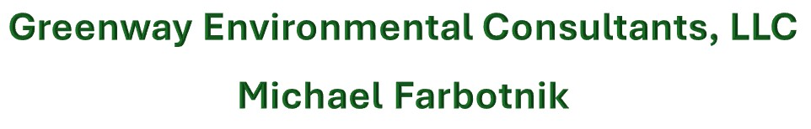

Educational Partners
Project Lead
Education and Outreach
Website Development
Field Day Hosts
Technical Service Providers
Funding provided through NJ Conservation Innovation Grant

Slide 8
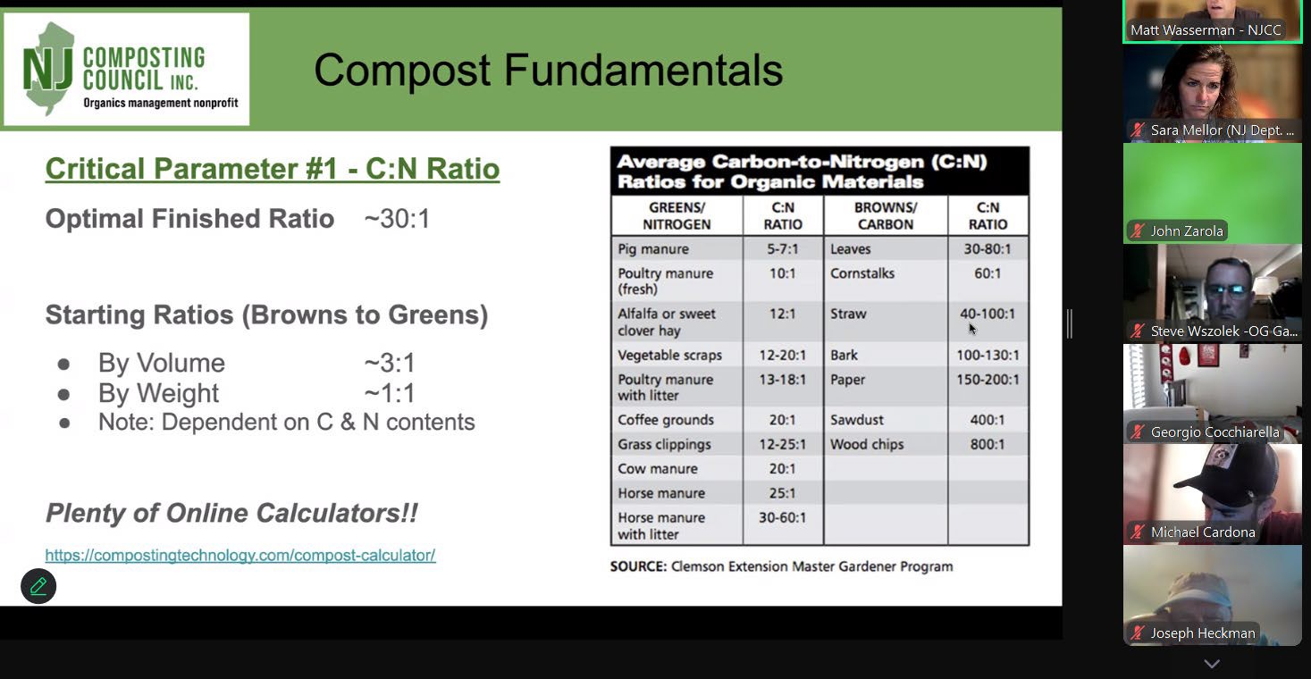
Webinar 1 July 10, 2024: 25 participants; recording available.
Webinars
Overview of NJManureLink Website
NJ Animal Waste Management Regulations
Composting
  1. Compost Fundamentals
  2. Why Compost Manure?
  3. Methods and Process of Composting
  4. Technology
  5. Compost Utilization/Spreading
  6. Compost Economics, Markets, and Testing
Nutrient Management
Resources and Assistance Opportunities
Webinar 2 May 13, 2025: 22 participants.

Slide 9
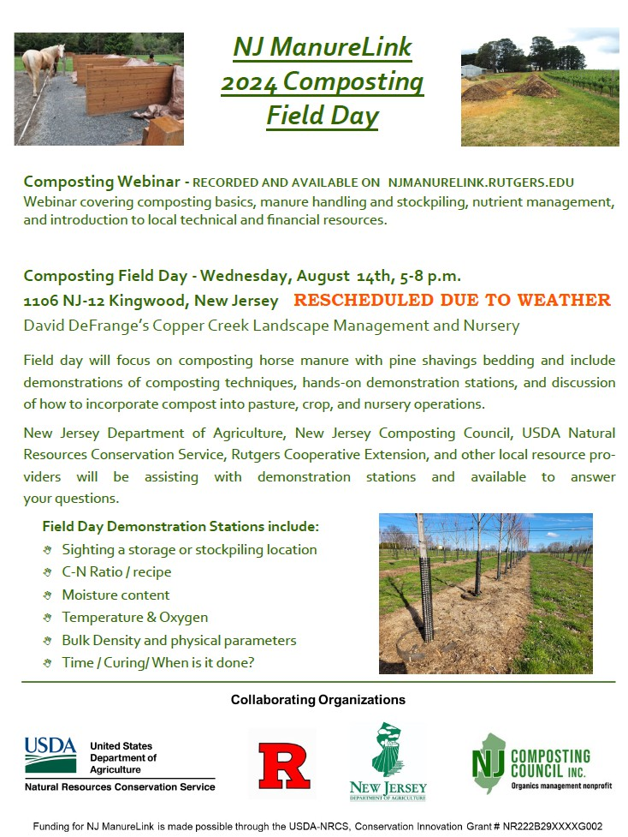
Field Day 2024

Slide 10
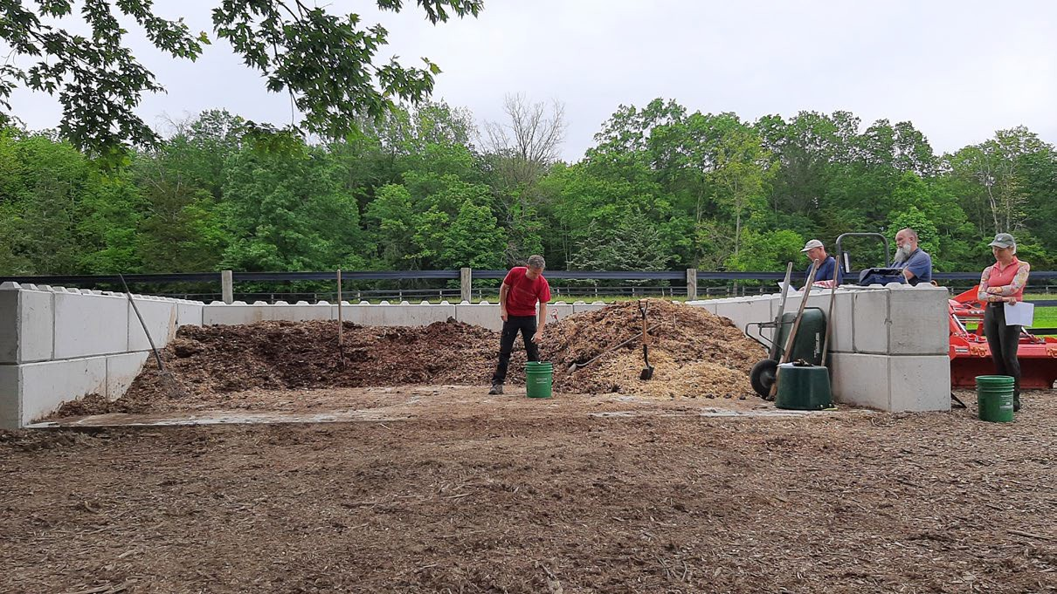
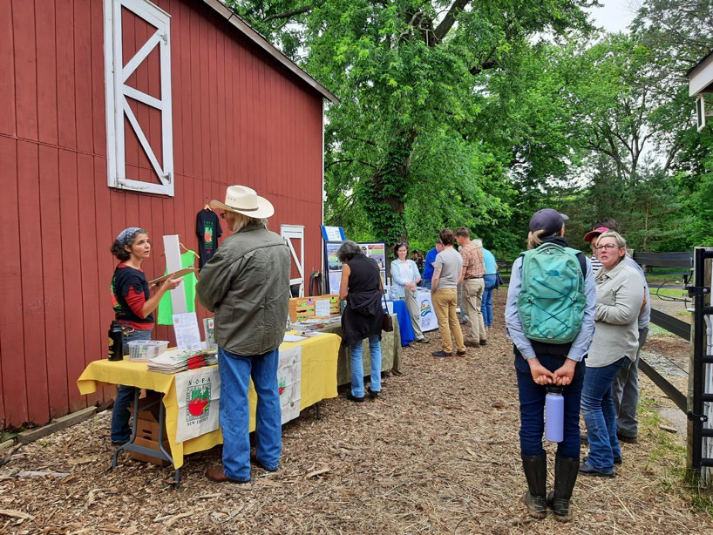
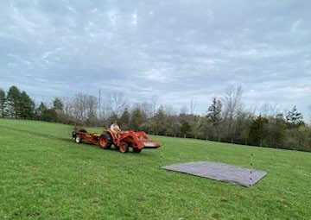
Field Day 2025
Field Day Demonstrations include:
How to choose a storage or stockpiling location
Compost recipes and characteristics
Time / Curing/ When is it done and ready to spread
Nutrient Management and using compost in pastures
Manure Spreader Calibration Demonstration
NM CECs offered for PA and MD
Field Day 2024
Field Day 2025
23 attendees.
22 attendees
Total engaged across events:
92 participants.

Slide 11
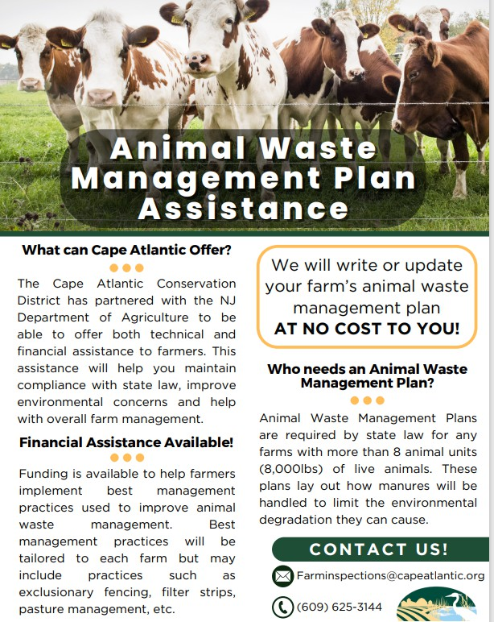
Opportunities through the
Division of Agricultural and Natural Resources Programs
Animal Waste Management Plan Development and
BMP Implementation Grants
  From NJDA to Soil Conservation Districts.
  Producer opportunities throughout the State
  cost-share funding for implementation of best management practices
  Funding can be stand-alone or paired with USDA-NRCS or other sources
  Sandra.howland@ag.nj.gov or 609-815-6159 (me ☺ )
North NJ – Upper Delaware Soil Conservation District
Sandra Myers @ 908-852-2579; SMYERS@UPPERDELAWARESCD-NJ.COM
South NJ – Cape Atlantic Soil Conservation District
Riley Blankenship @ 609-625-3144; farminspections@capeatlantic.org

Slide 12
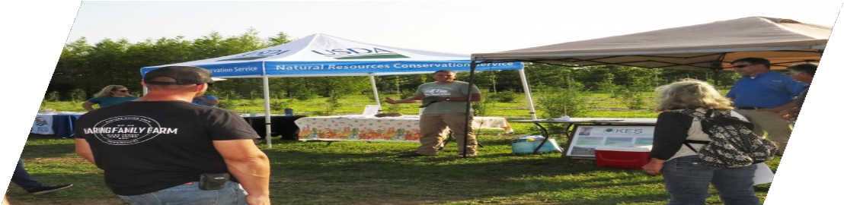
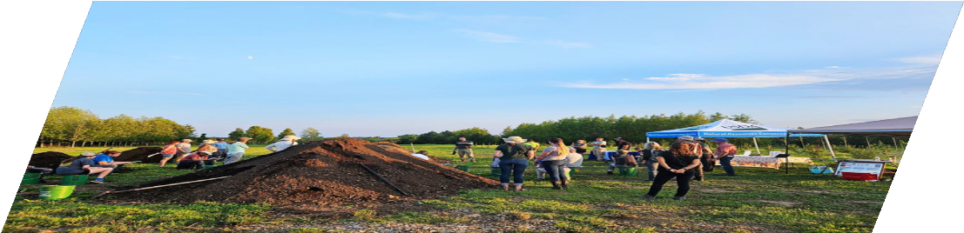
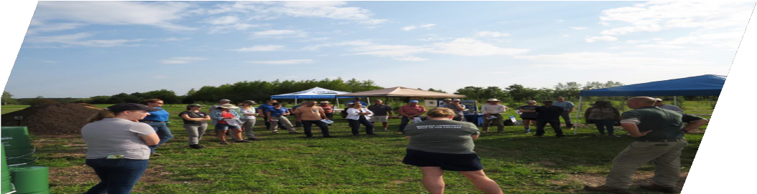
At the field day,
meet your local resources…
Michael Farbotnik, Certified Professional Soil Scientist Greenway Environmental Consultants
New Jersey Water Supply Authority
North Jersey Resource Conservation and Development Northeast Organic Farming Association – NJ
Rutgers Soils Lab/Rutgers Cooperative Extension TSP John Kluthe, KES Environmental Services
USDA Natural Resource Conservation Service
And of course…NJ Department of Agriculture and NJ Composting Council

Slide 13
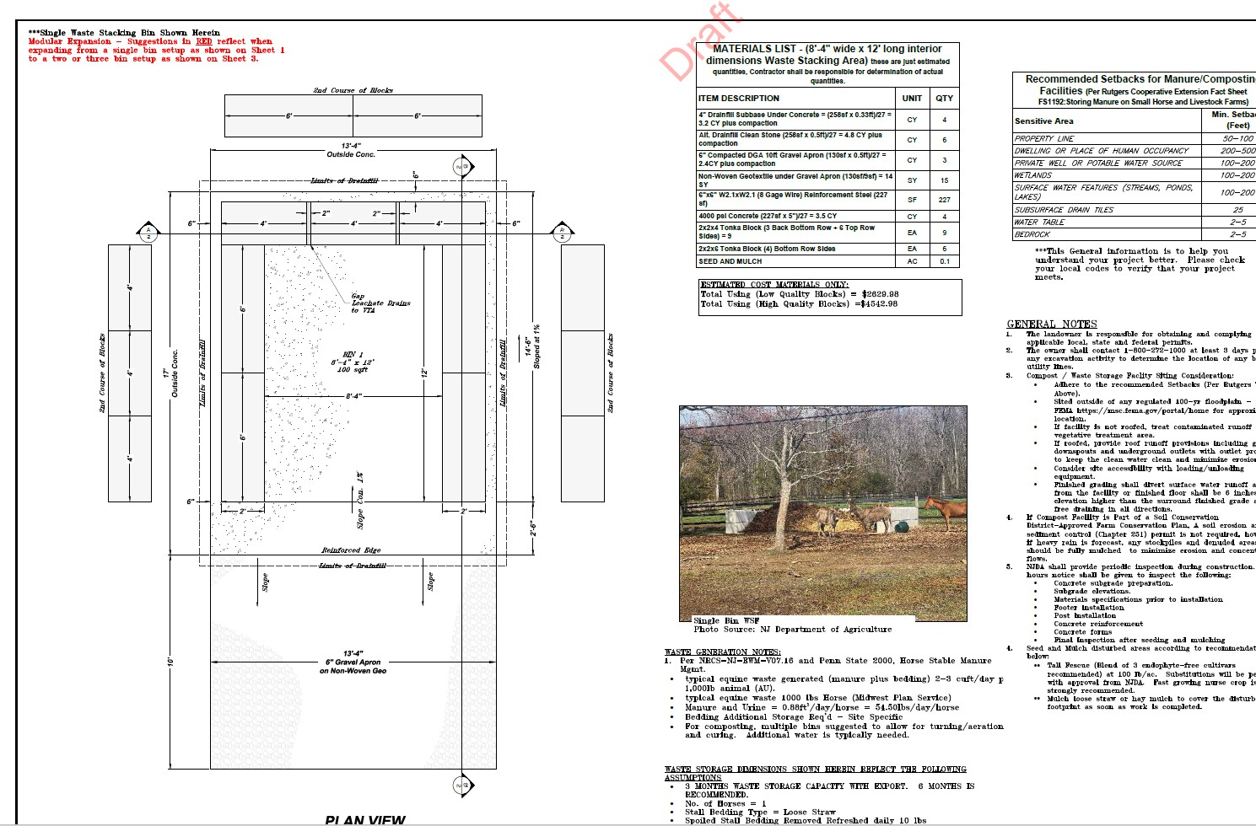
Adapting practices to NJ Farms
Development of technical assistance guidance documents for manure and composing storage structures on NJ livestock farms
Need for simple manure storage structures
Small farms – smaller budgets
DIY & simple

Slide 14

A success story!
Charlie West, owner and operator of West Farm Nursery, located in Branchburg, Somerset County, NJ shared he made a couple connections through using NJ ManureLink. West Farm Nursery specializes in the production of seed, and grafted cultivated varieties of PawPaw’s, American Persimmon’s, and Figs. Additionally, the nursery grows a variety of other plants, including Kentucky Coffee Tree, Comfrey, Osage Orange, and Hazelnuts.
Mr. West said "I discovered NJ ManureLink through Joe Heckman (Rutgers Extension Specialist in Soil Fertility), and I think it's an excellent resource. The platform is incredibly user-friendly and easy to navigate. The mapping feature was especially helpful for identifying manure suppliers in my area. I was able to connect with two local manure posting ads. Unfortunately, I believe not enough people are aware of this valuable service, which has made securing a consistent manure source more challenging.”

Slide 15
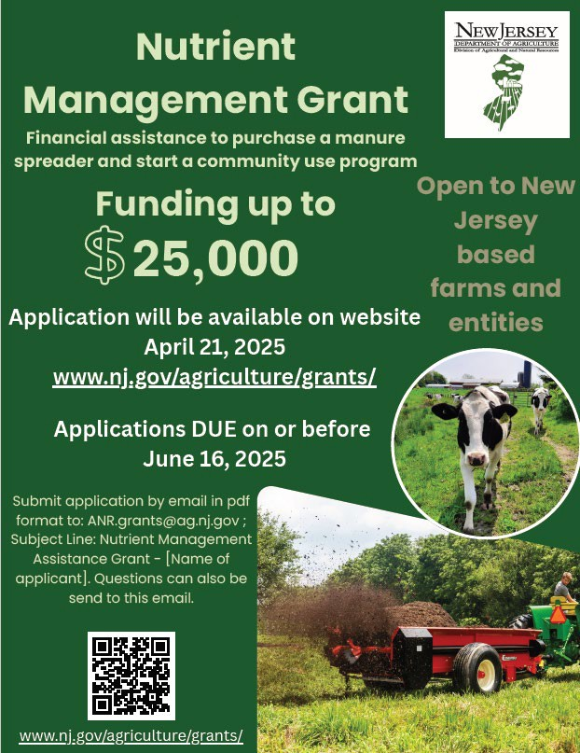
Addressing Nutrient Transport
Nutrient Management Assistance Grant
  Purchase of Manure Spreader
  Establishment of community use program (share, lend, rent)
  Requires and may fund Nutrient Budget or NMPs
  For individuals and entities

Slide 16
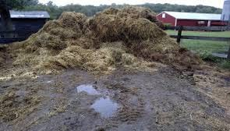

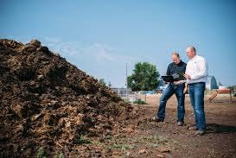
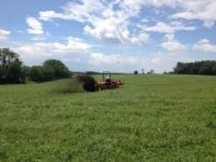
Project Outcomes and Benefits
What We've Accomplished Through the NJ ManureLink CIG:
Expanded knowledge and use of manure export, composting, and compost application
Through on-farm demonstrations and community outreach, we've helped farmers put
BMPs into practice.
Multiple sectors benefited:
Livestock and equine operations found new outlets for excess manure
Composters and crop producers gained reliable sources of feedstock
Urban and rural farms connected through shared goals and materials
Built a strong statewide network
We've fostered relationships across agricultural sectors — creating lasting partnerships and new opportunities.
Created a long-term resource
This project now serves as a free, go-to hub for education, tools, and farmer-to-farmer support.

Slide 17
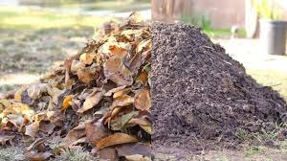
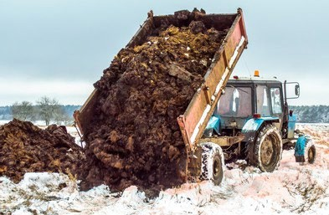
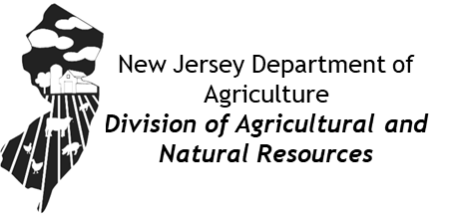

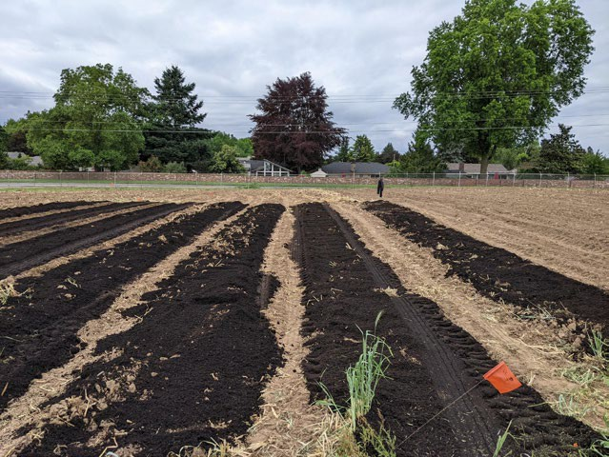
Sandra Howland
Sandra.Howland@ag.nj.gov
609-815-6159

