Slide 1
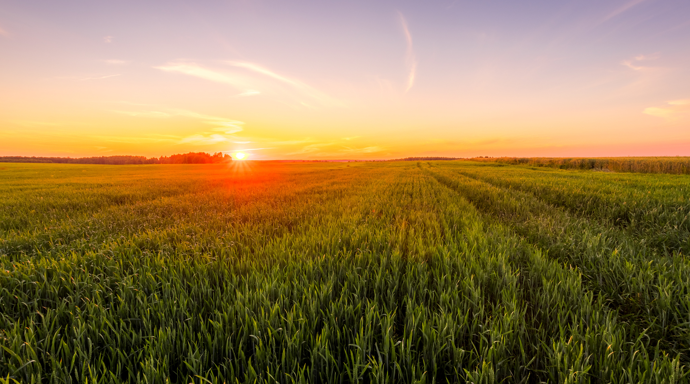

NC Conservation Professional Development & Training Program
Brandy Myers, Training Coordinator
NC Department of Agriculture & Consumer Services
Division of Soil & Water Conservation

Slide 2
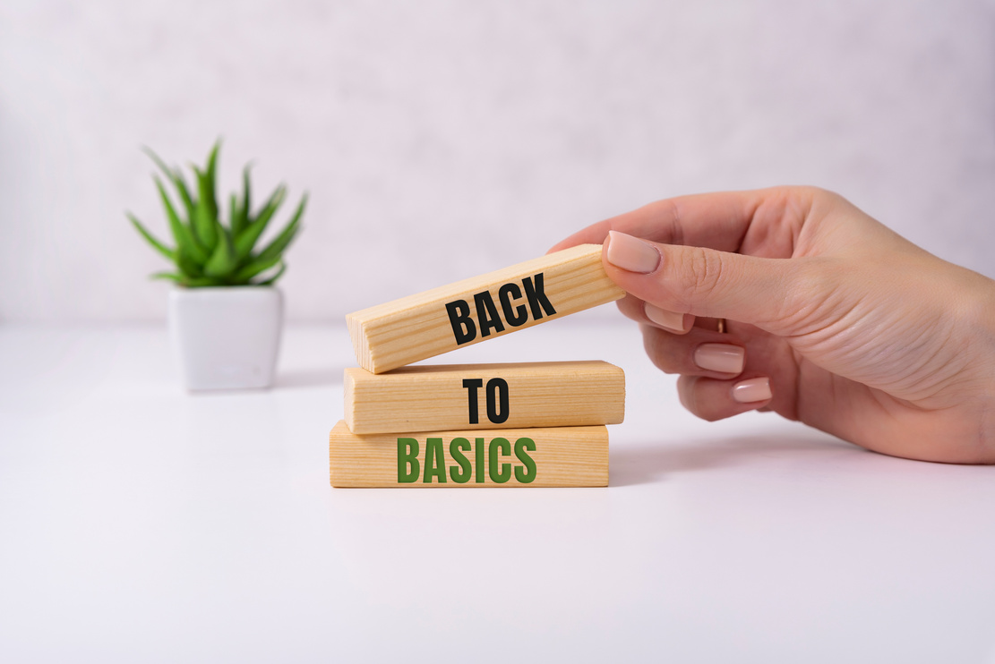


Fundamentals of Conservation Planning
Key points
Conservation Employee Training
Mentorship Program

Slide 3
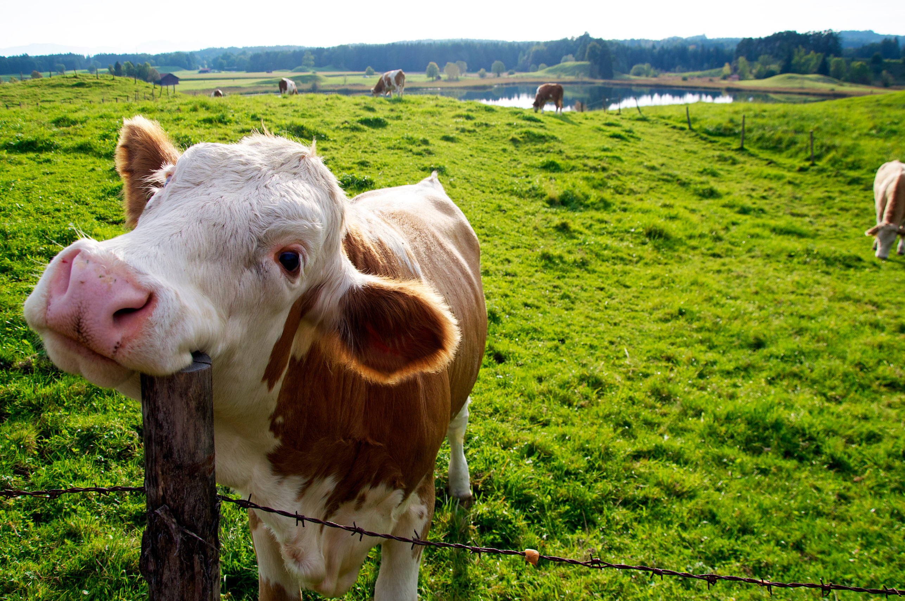



Fundamentals of Conservation Planning
Waynesville, NC
Haywood SWCD
Date:
May 6-10, 2024

Slide 4

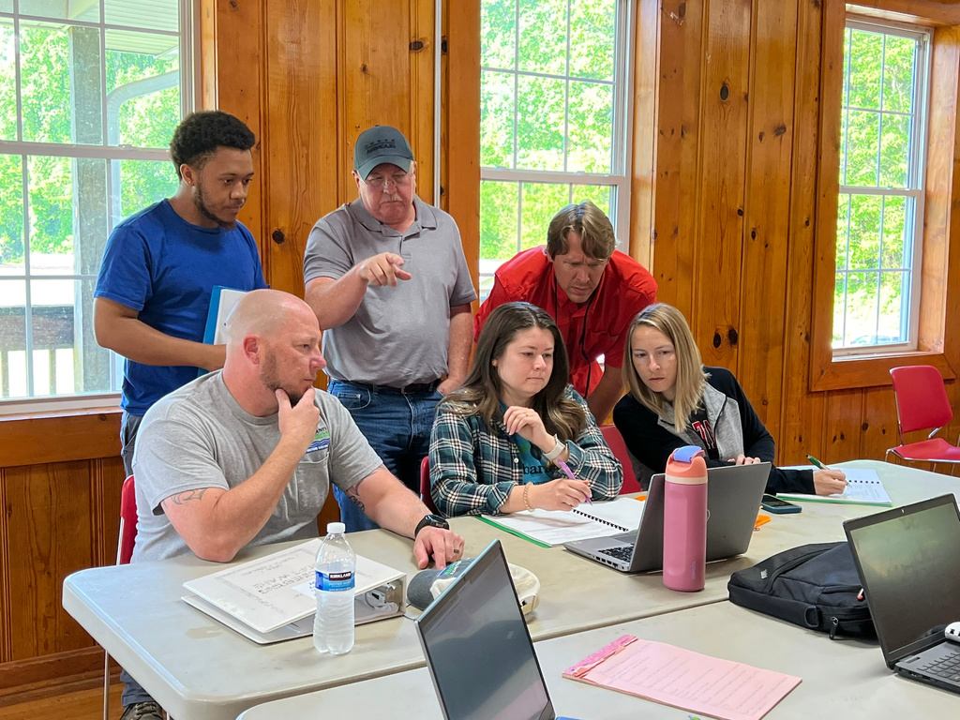
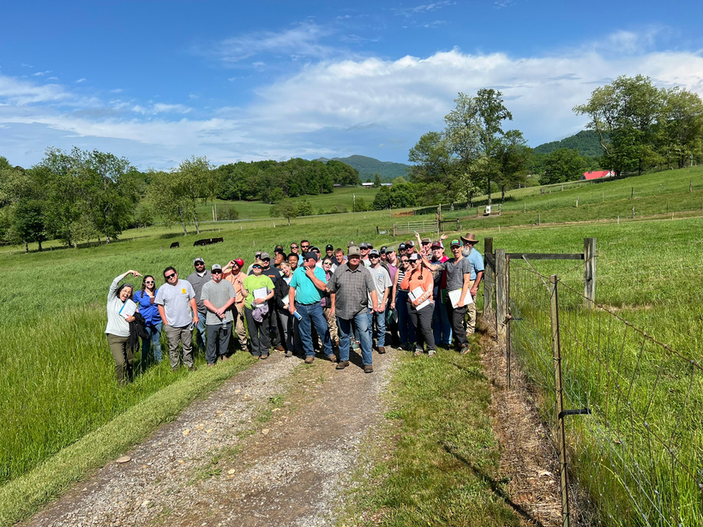
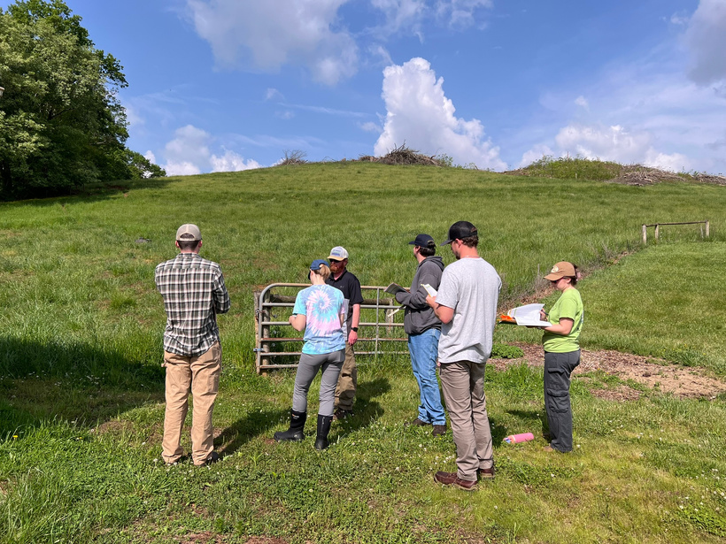
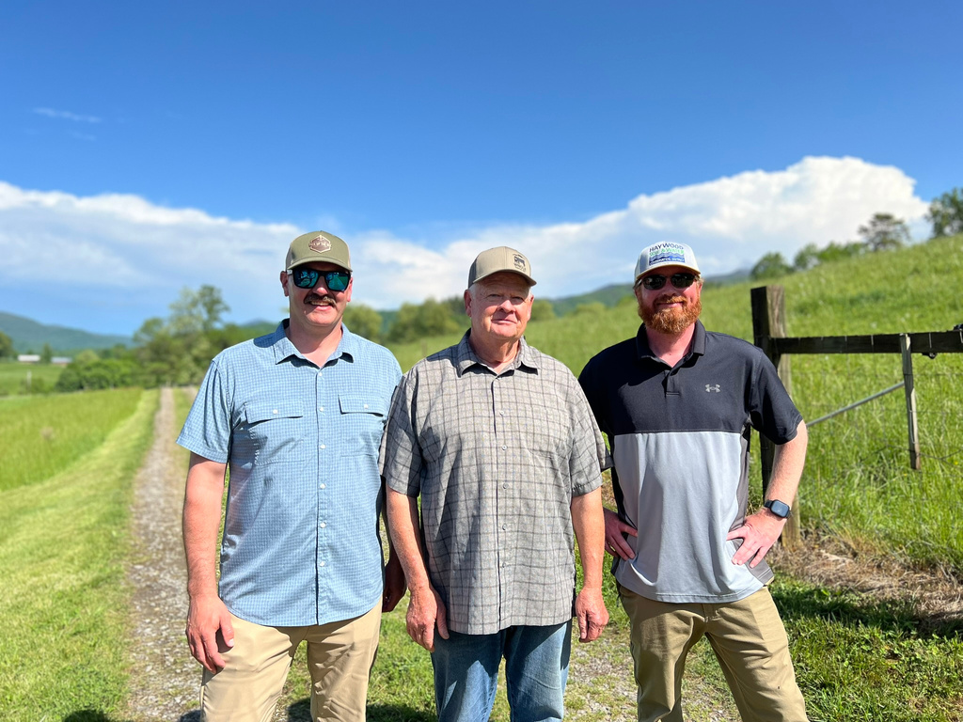
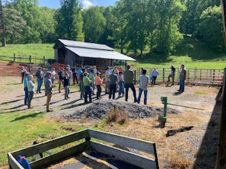
Overview
A week long program that provides early career conservationists with development of skillsets needed for conservation planning through activities, lessons, & mentorship.
Goals
Provide support in skillset development and confidence to grow as conservation planners.
Benefits
Short term vs. long term.

Slide 5


200+ Attendees
Conference Style
Networking
Various Session Tracks
Feedback Sessions
Interactive Learning
Field Trips
Mentoring

Slide 6




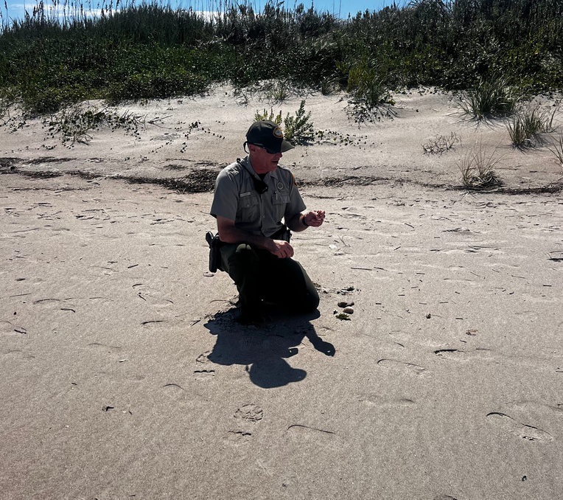
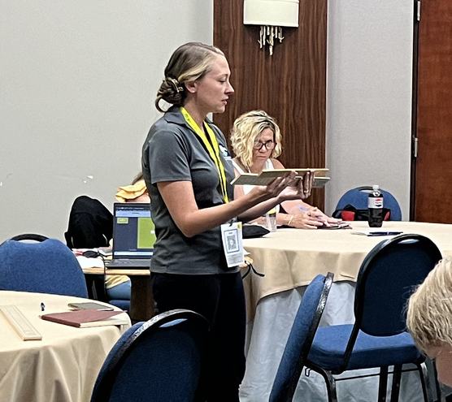
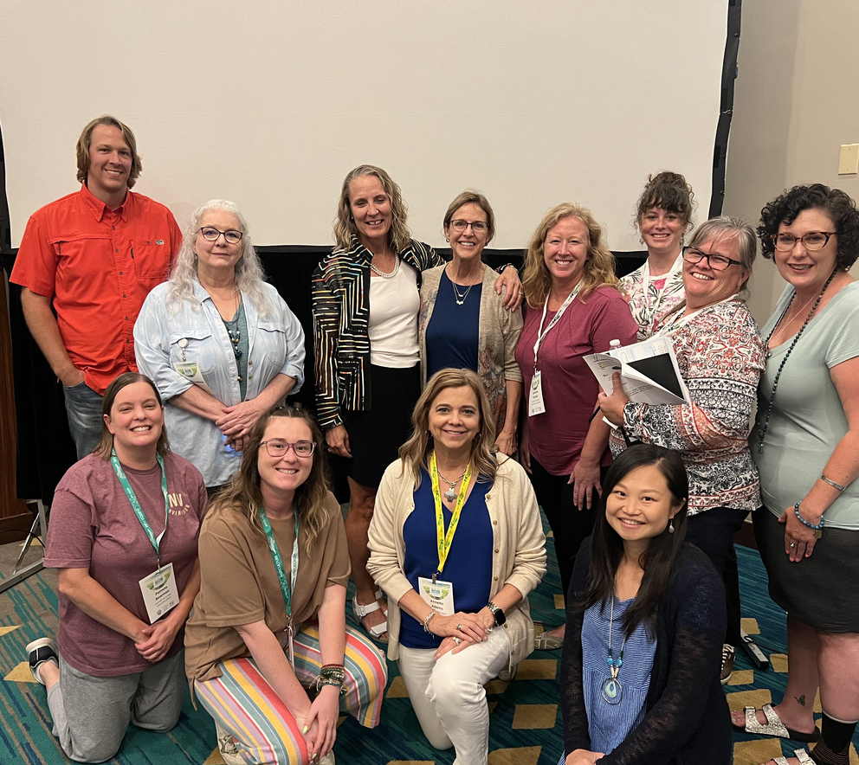
Tracks for every everyone!
Technical
Education
Leadership
Best Managment Practices, Tools, Software, Contracting, & Communication.
Working with Schools, Educational Programs, Science Standards, & Informal Educators Accreditation.
Communication Styles, District Development, Dealing with Conflict, & Trust Building.

Slide 7
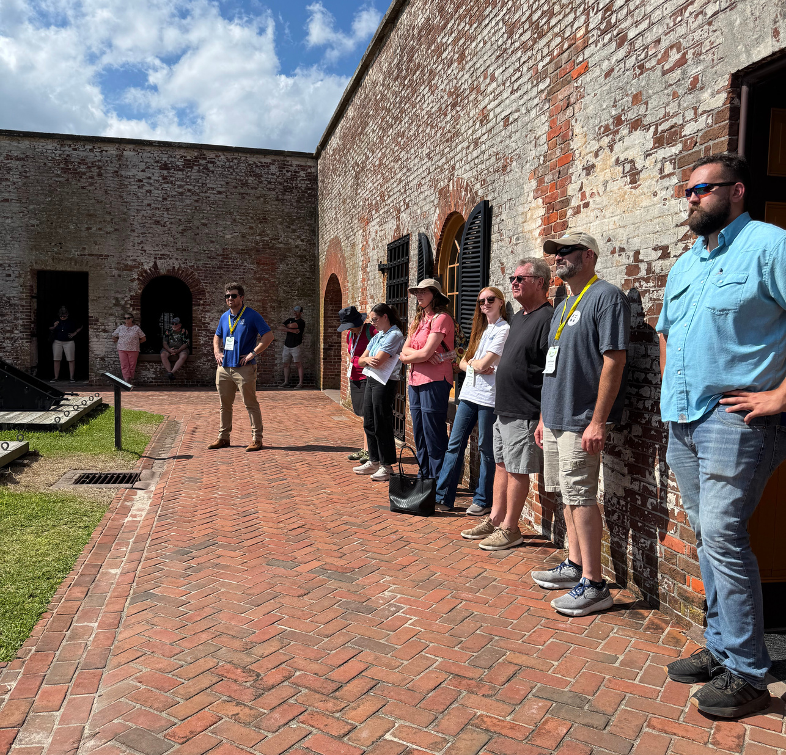
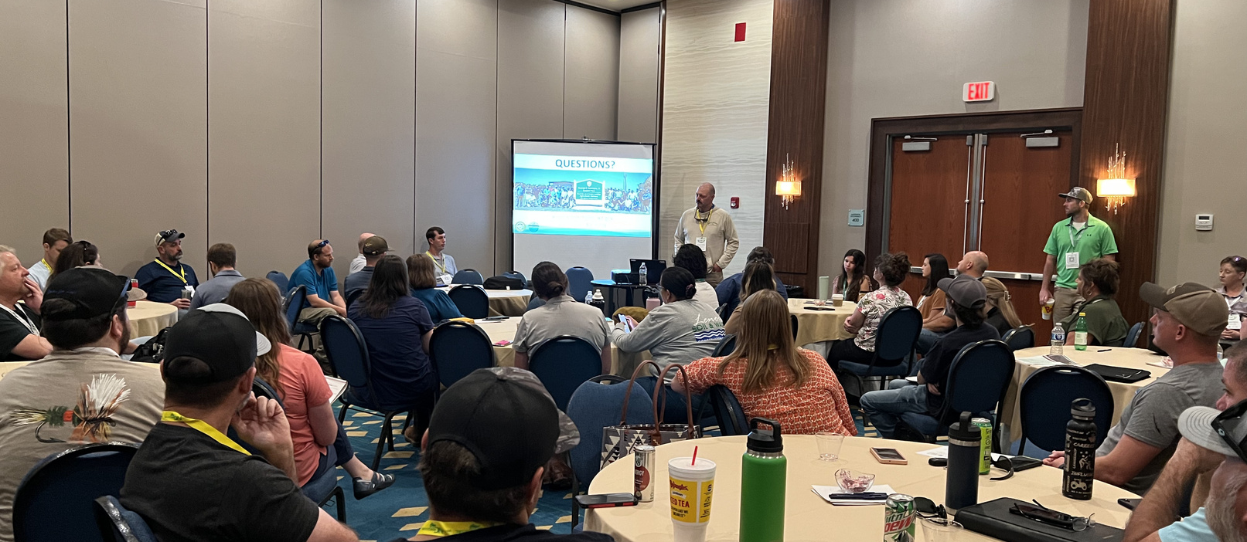
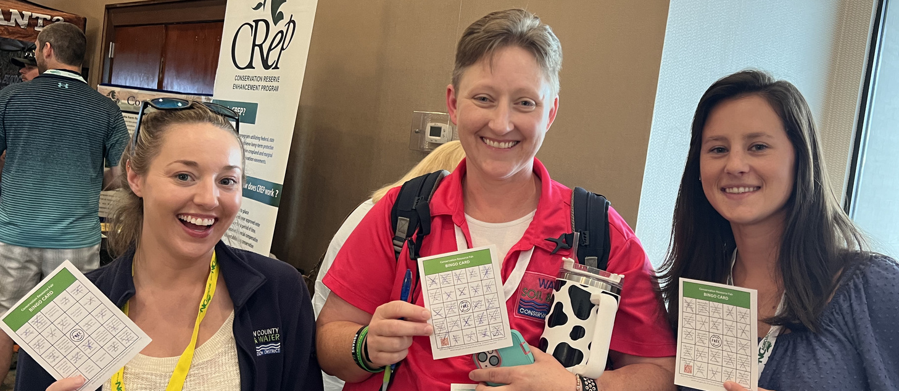
ENGAGING & INTERACTIVE CONTENT
Notes:
Fostering Communication & Connection

Slide 8
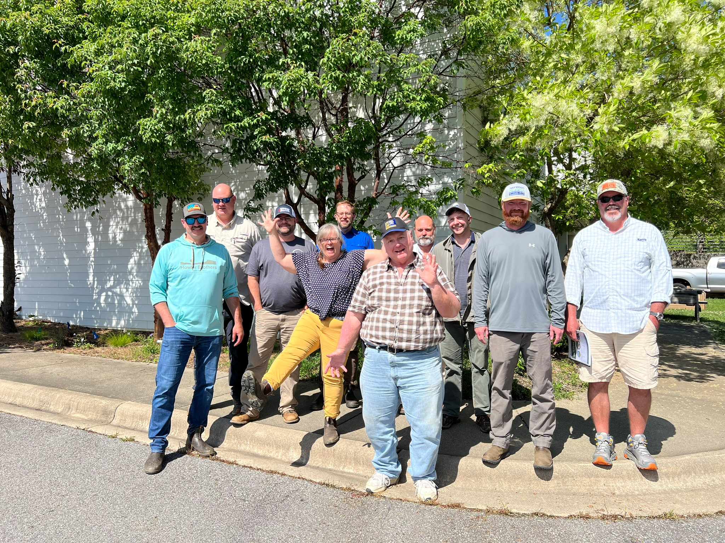
Mentorship
Program
The goal is to identify and empower conservation professionals, particularly district staff, who are dedicated to community service.
By providing resources, tools, accountability, and fostering mentor/mentee relationships, the program aims to enhance community engagement and passion for the work.
This initiative is expected to reduce turnover, boost professional confidence, and instill a deeper sense of purpose in their roles.

Slide 9
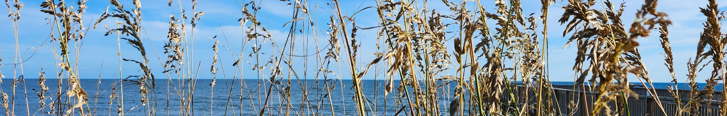

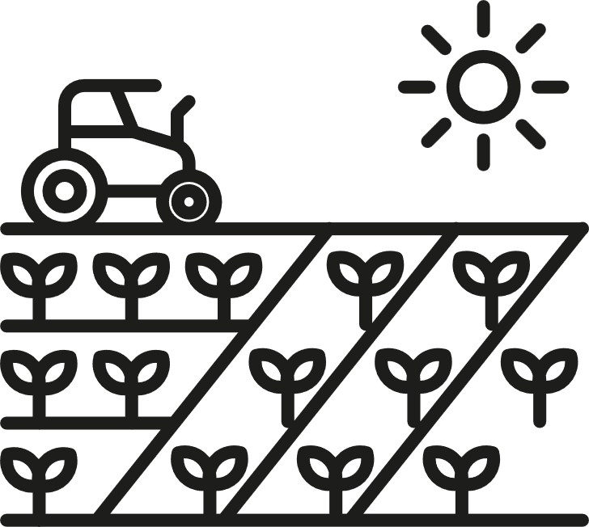

Mentorship Opportunities
MULTI-DAY & LARGE GROUP
ONE-DAY
ONE-ON-ONE
Utilizing these mentorship opportunities and relationships to grow organically through various formats of training. Allow participants a space to ask questions of mentors, hear their stores, and gain real-world information that may aid them in their day to day work.

Slide 10
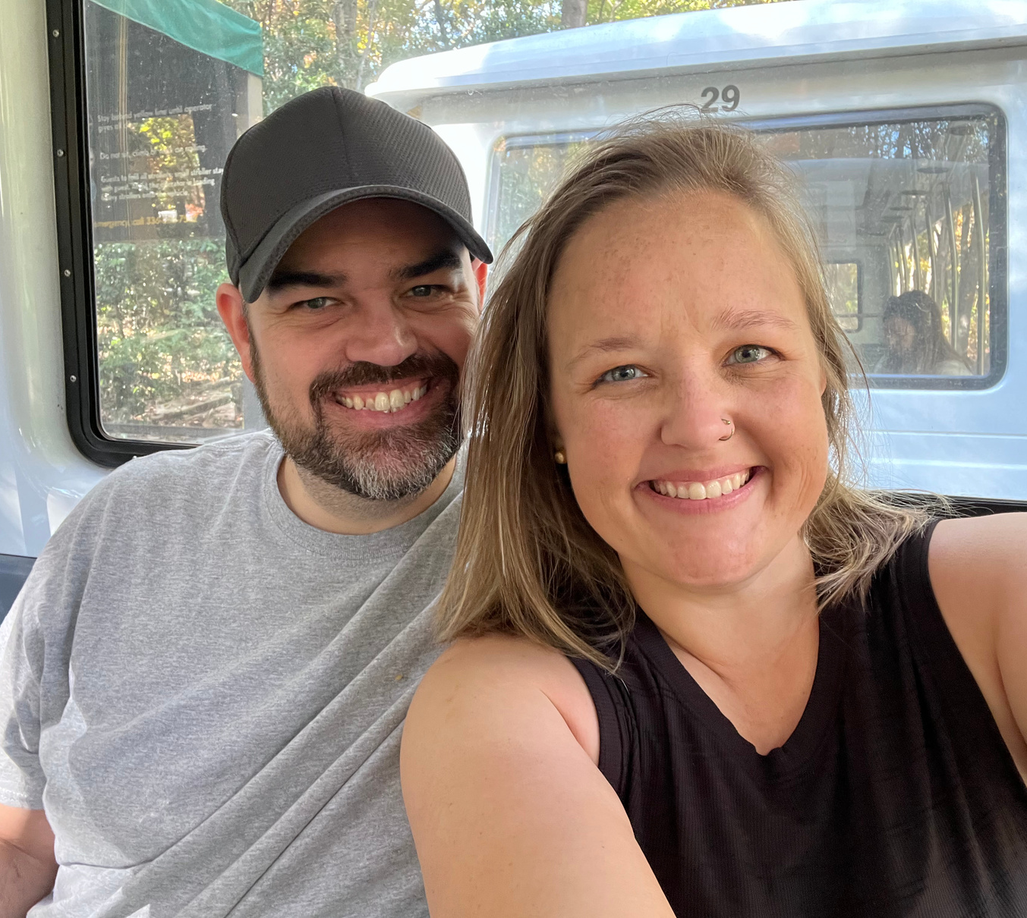
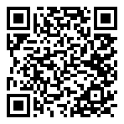




NCDA&CS
Division of Soil & Water Conservation
Training Program Coordinator
Contact:
brandy.myers@ncagr.gov
919-707-3785
in/brandymichellemyers

