Slide 1
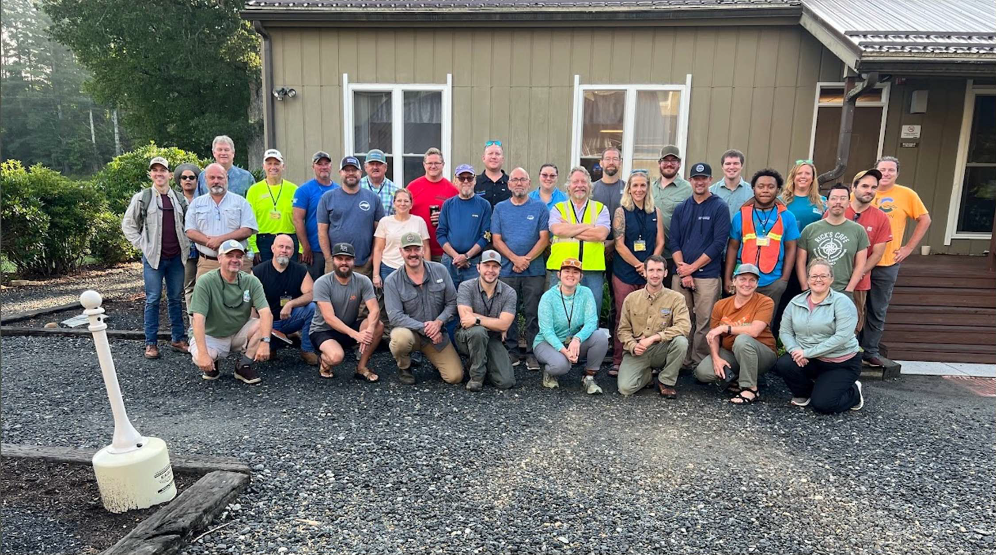


Modernizing Conservation Response:
Digital Tools for Federal and State Disaster Site Reporting

Slide 2






Why?
Hurricane Helene: September 27, 2024
30 inches of rain
Photos courtesy of Asheville Citizen Times

Slide 3
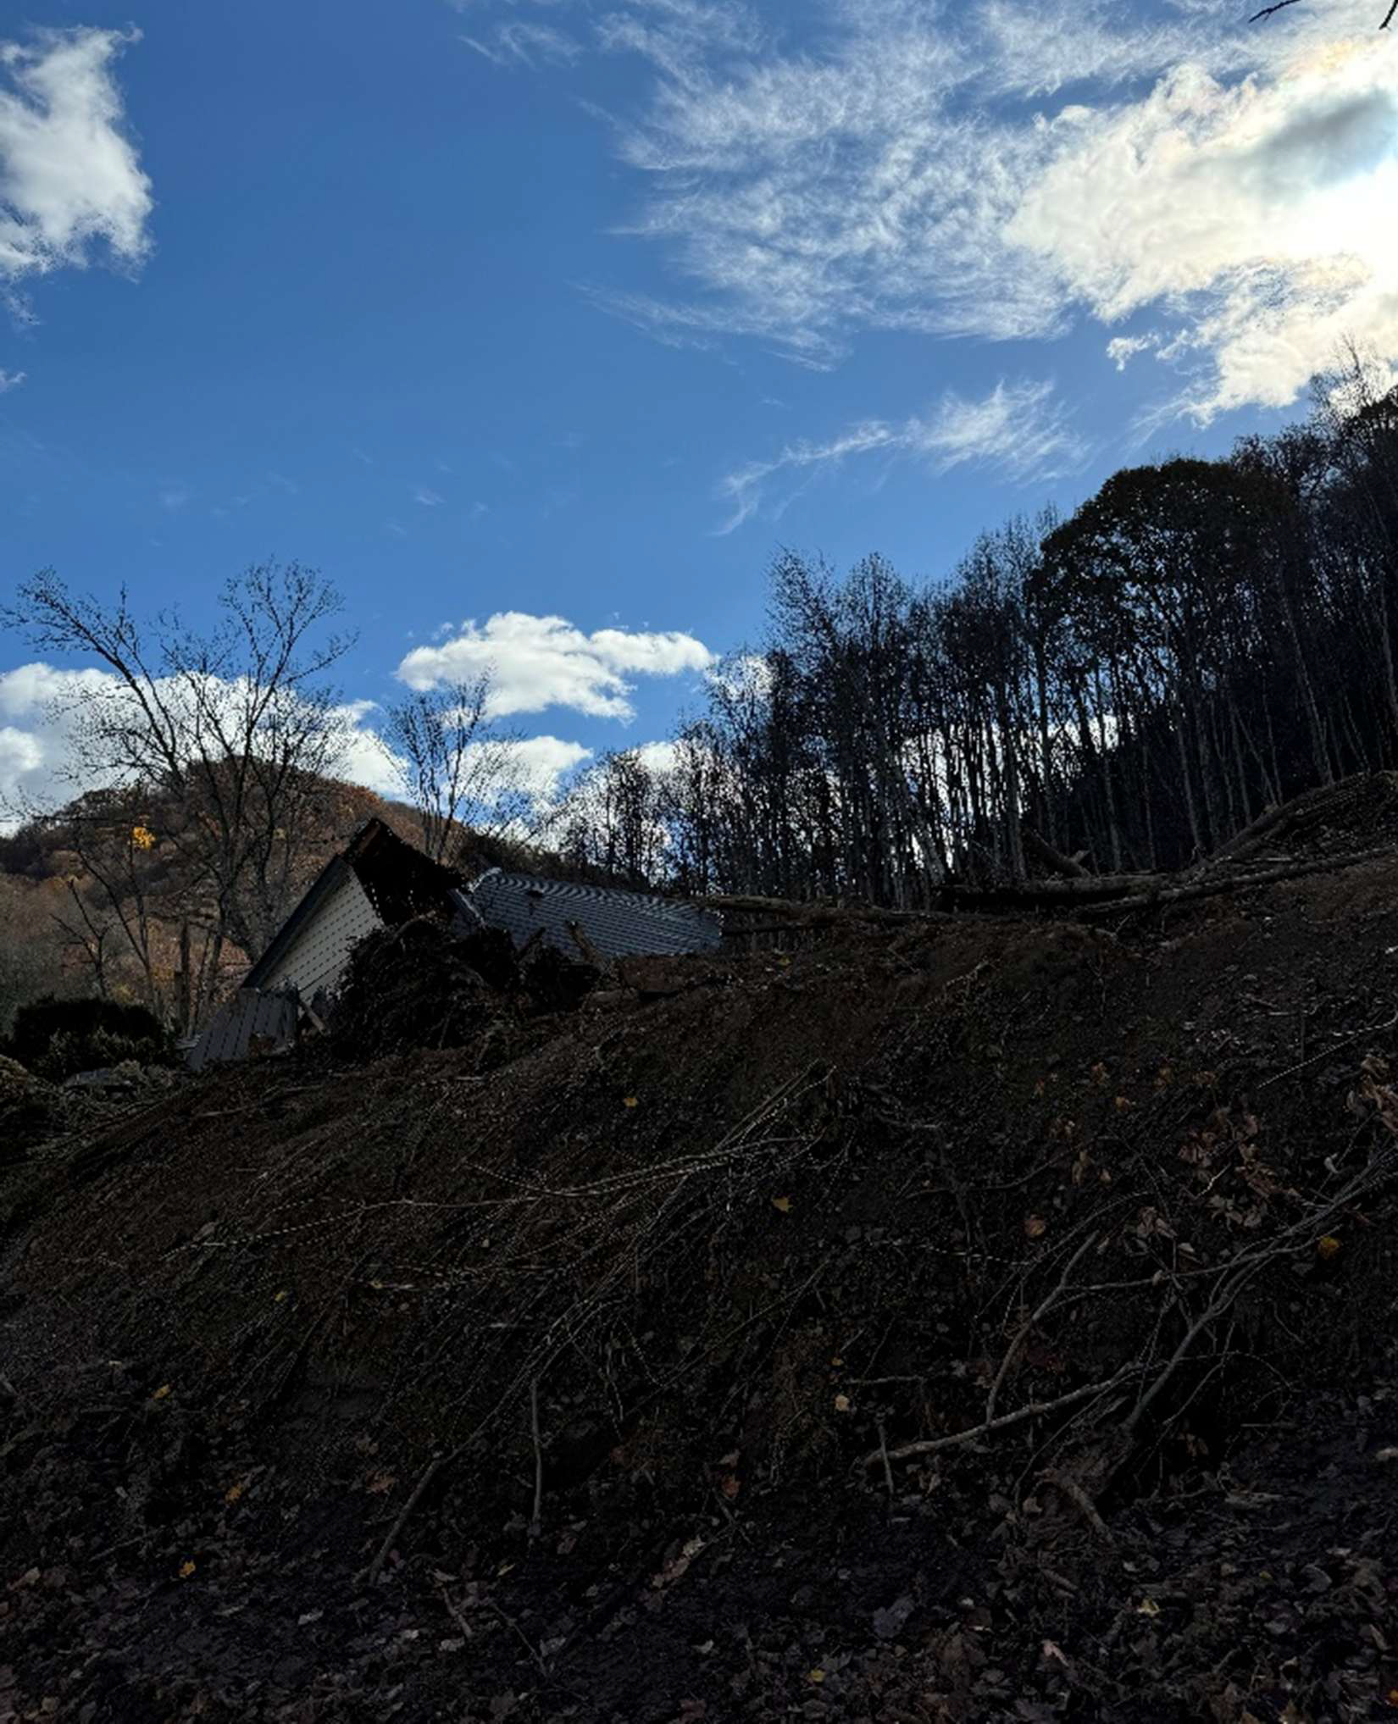
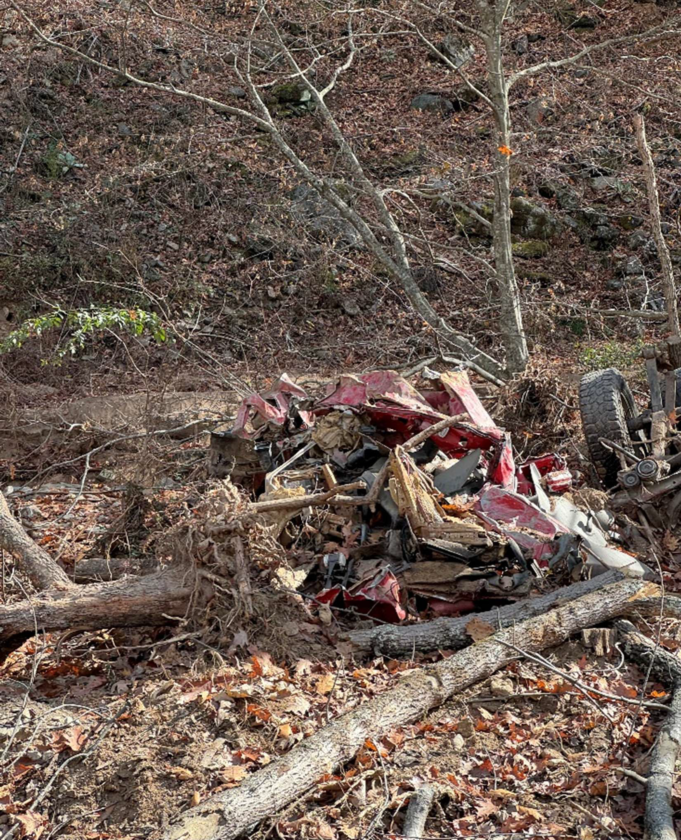
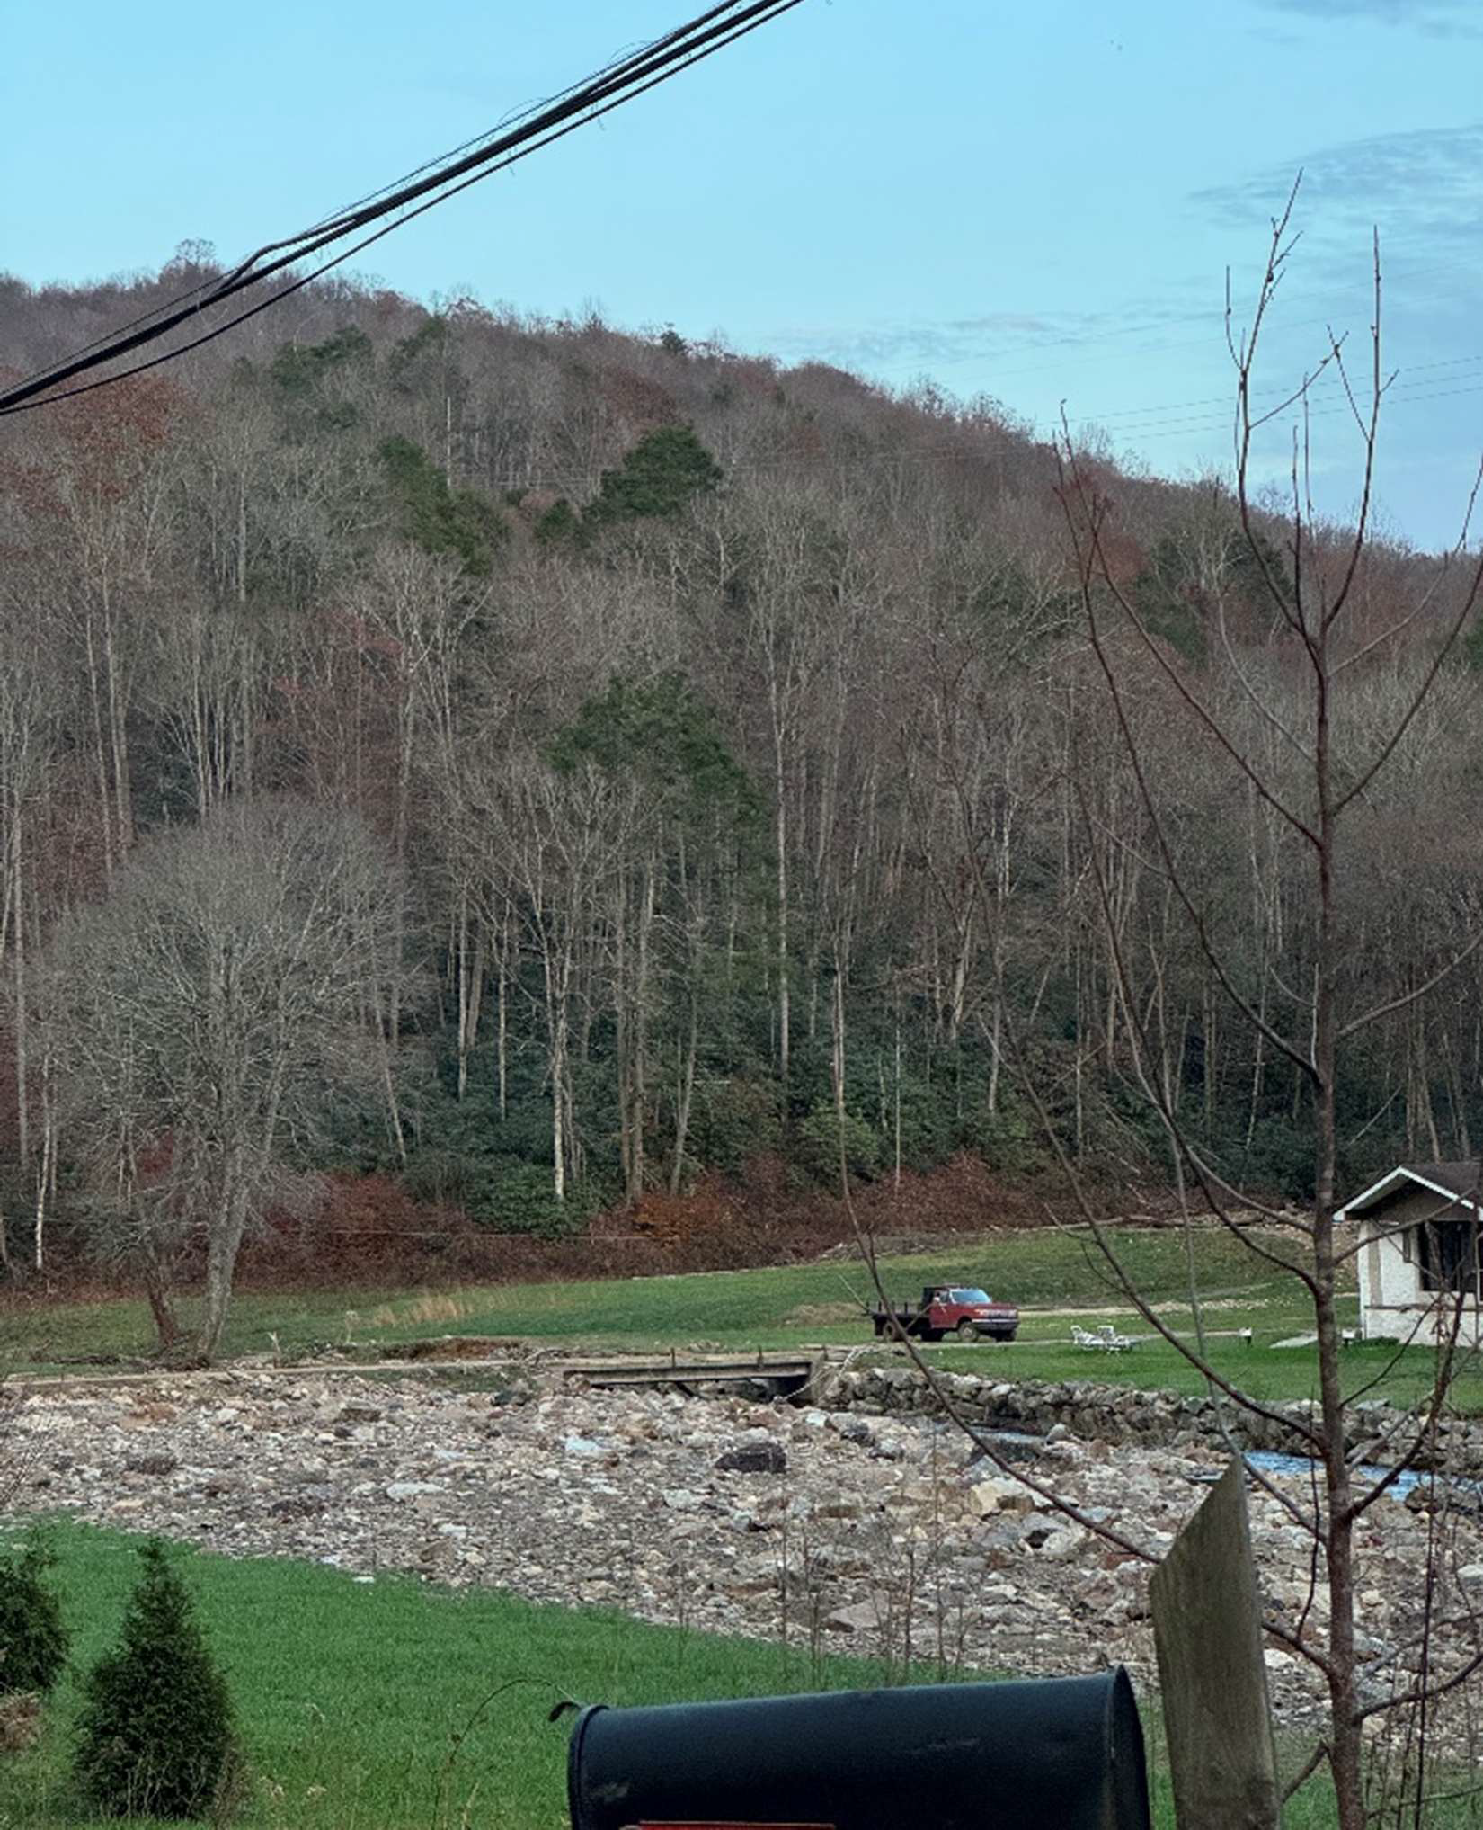

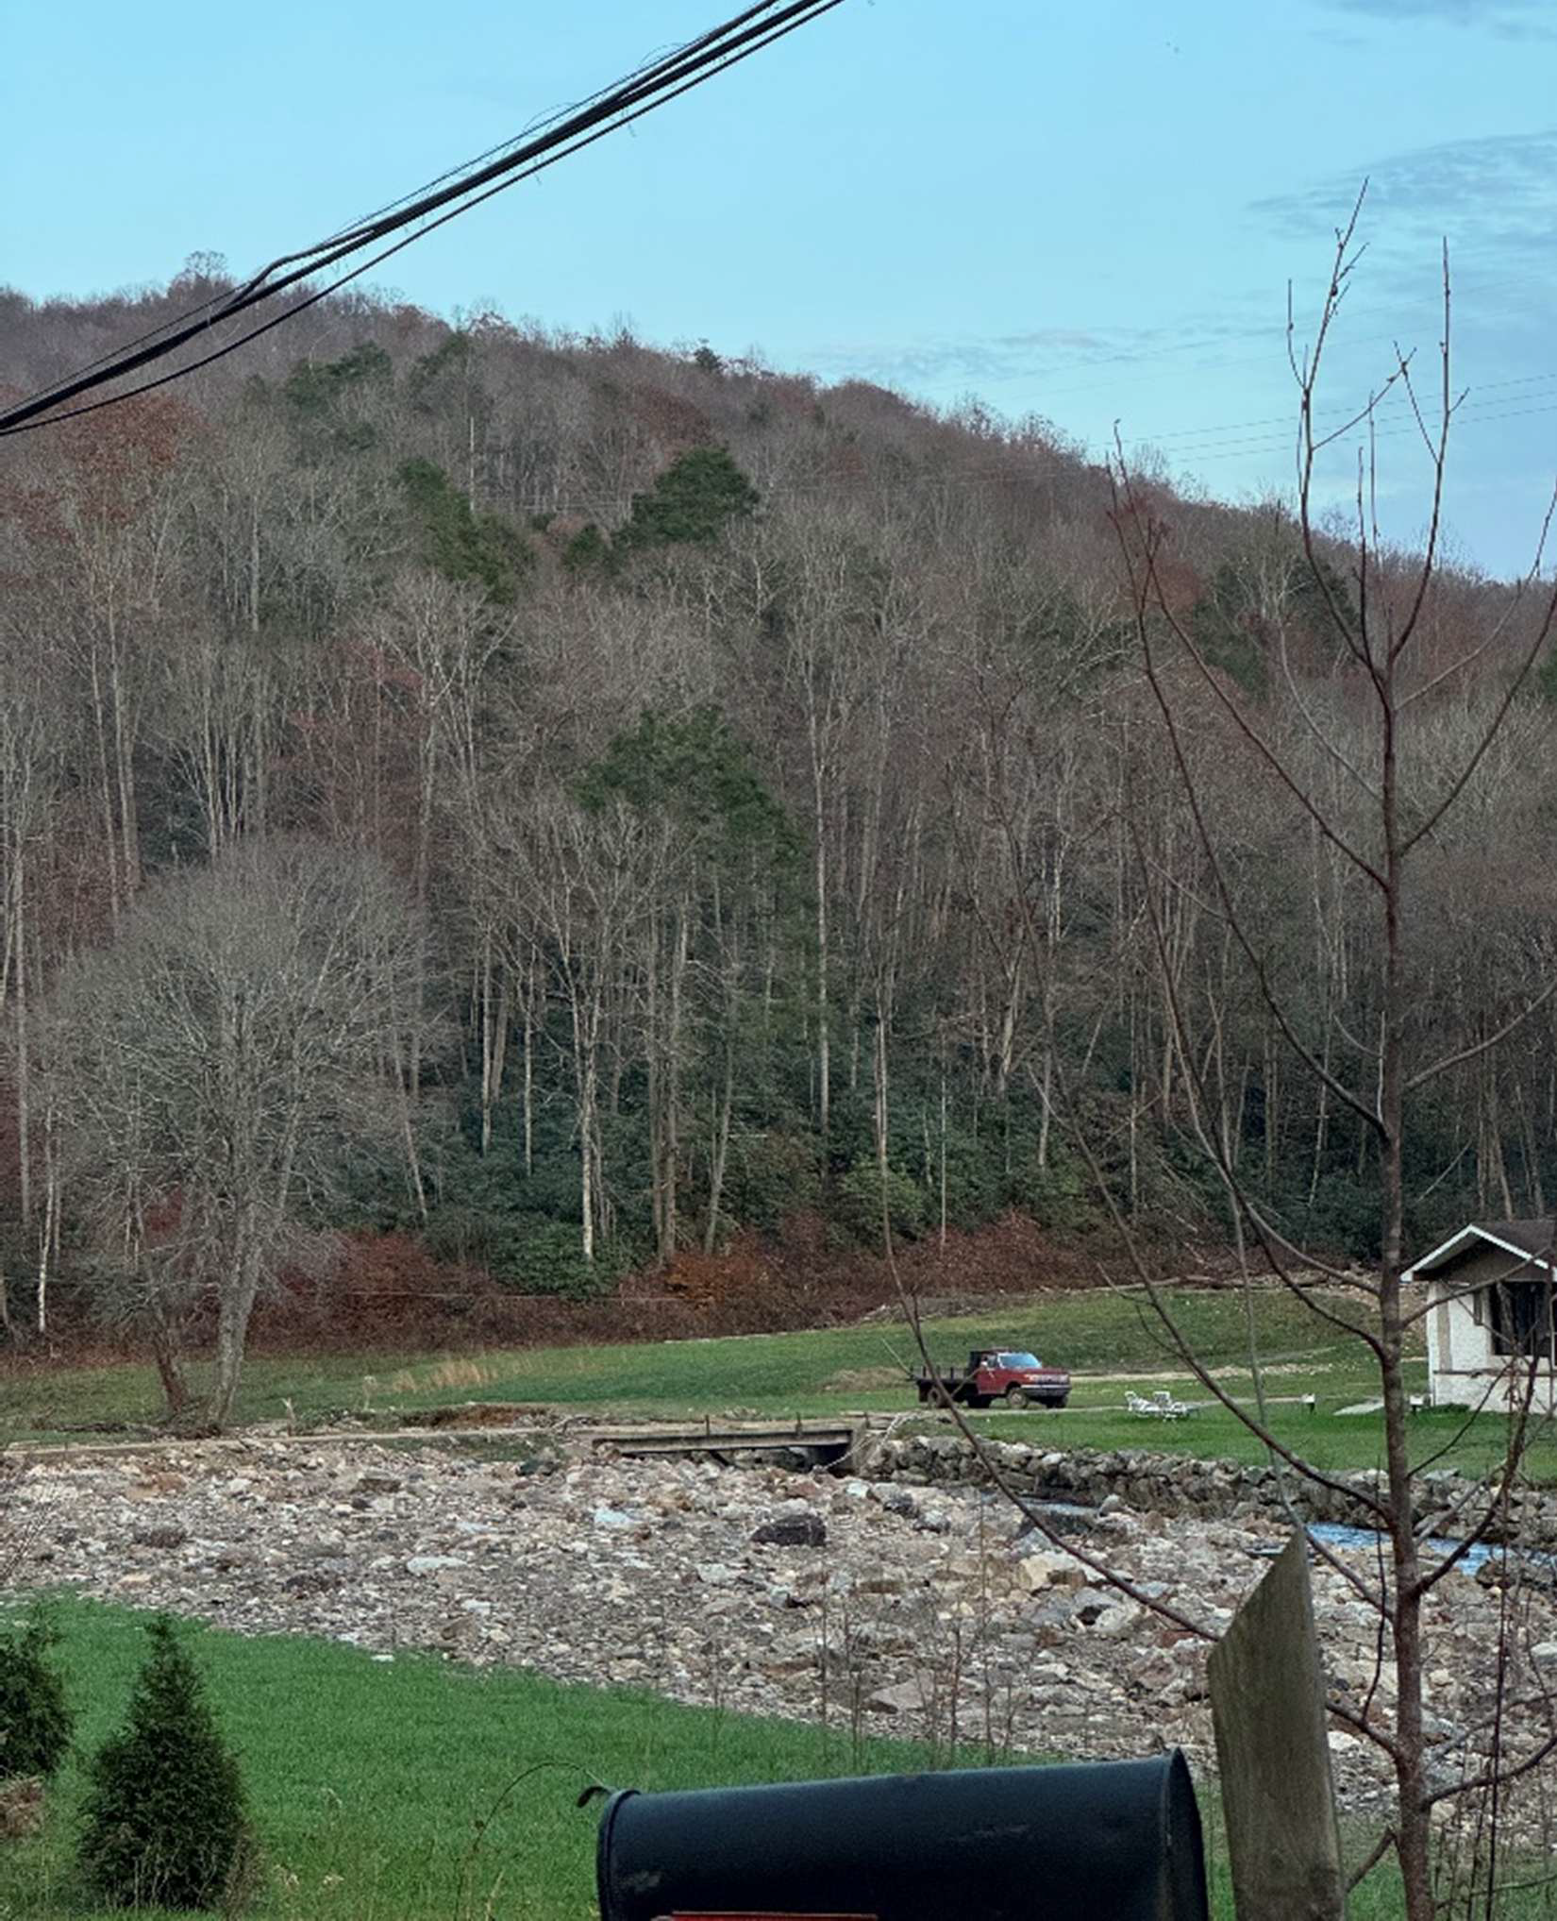
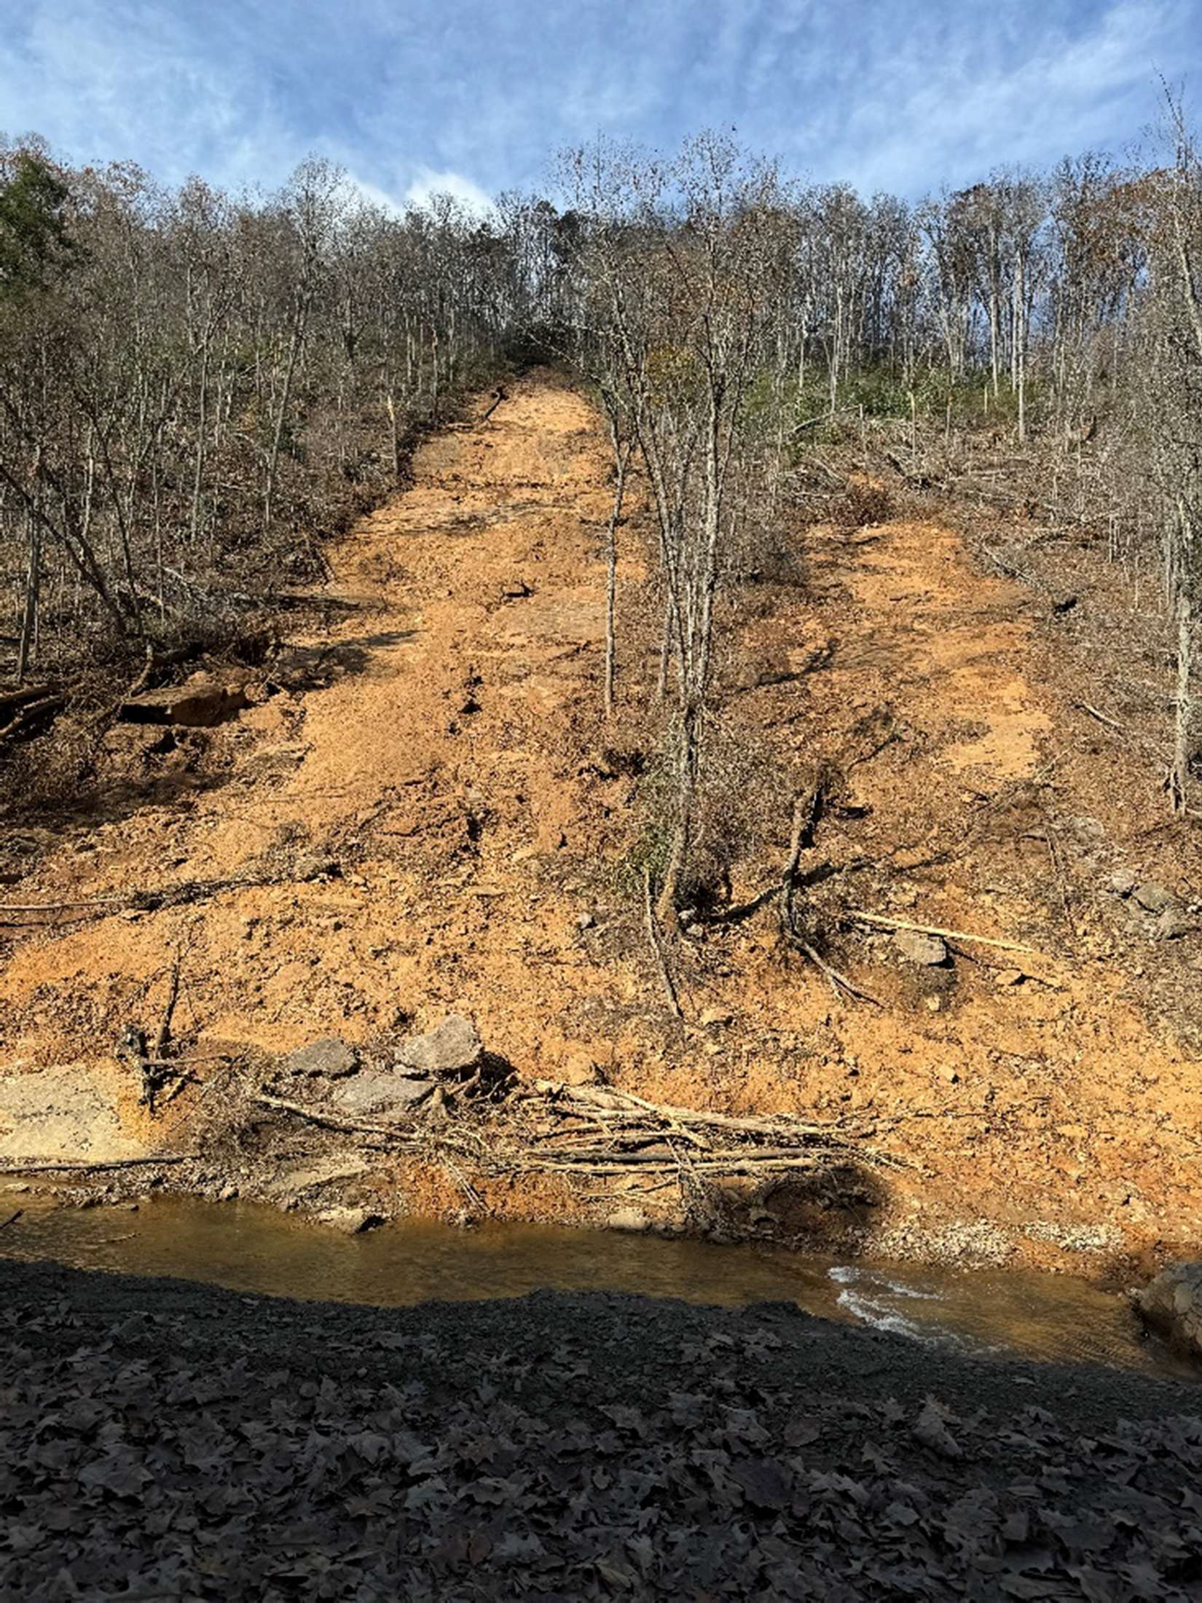
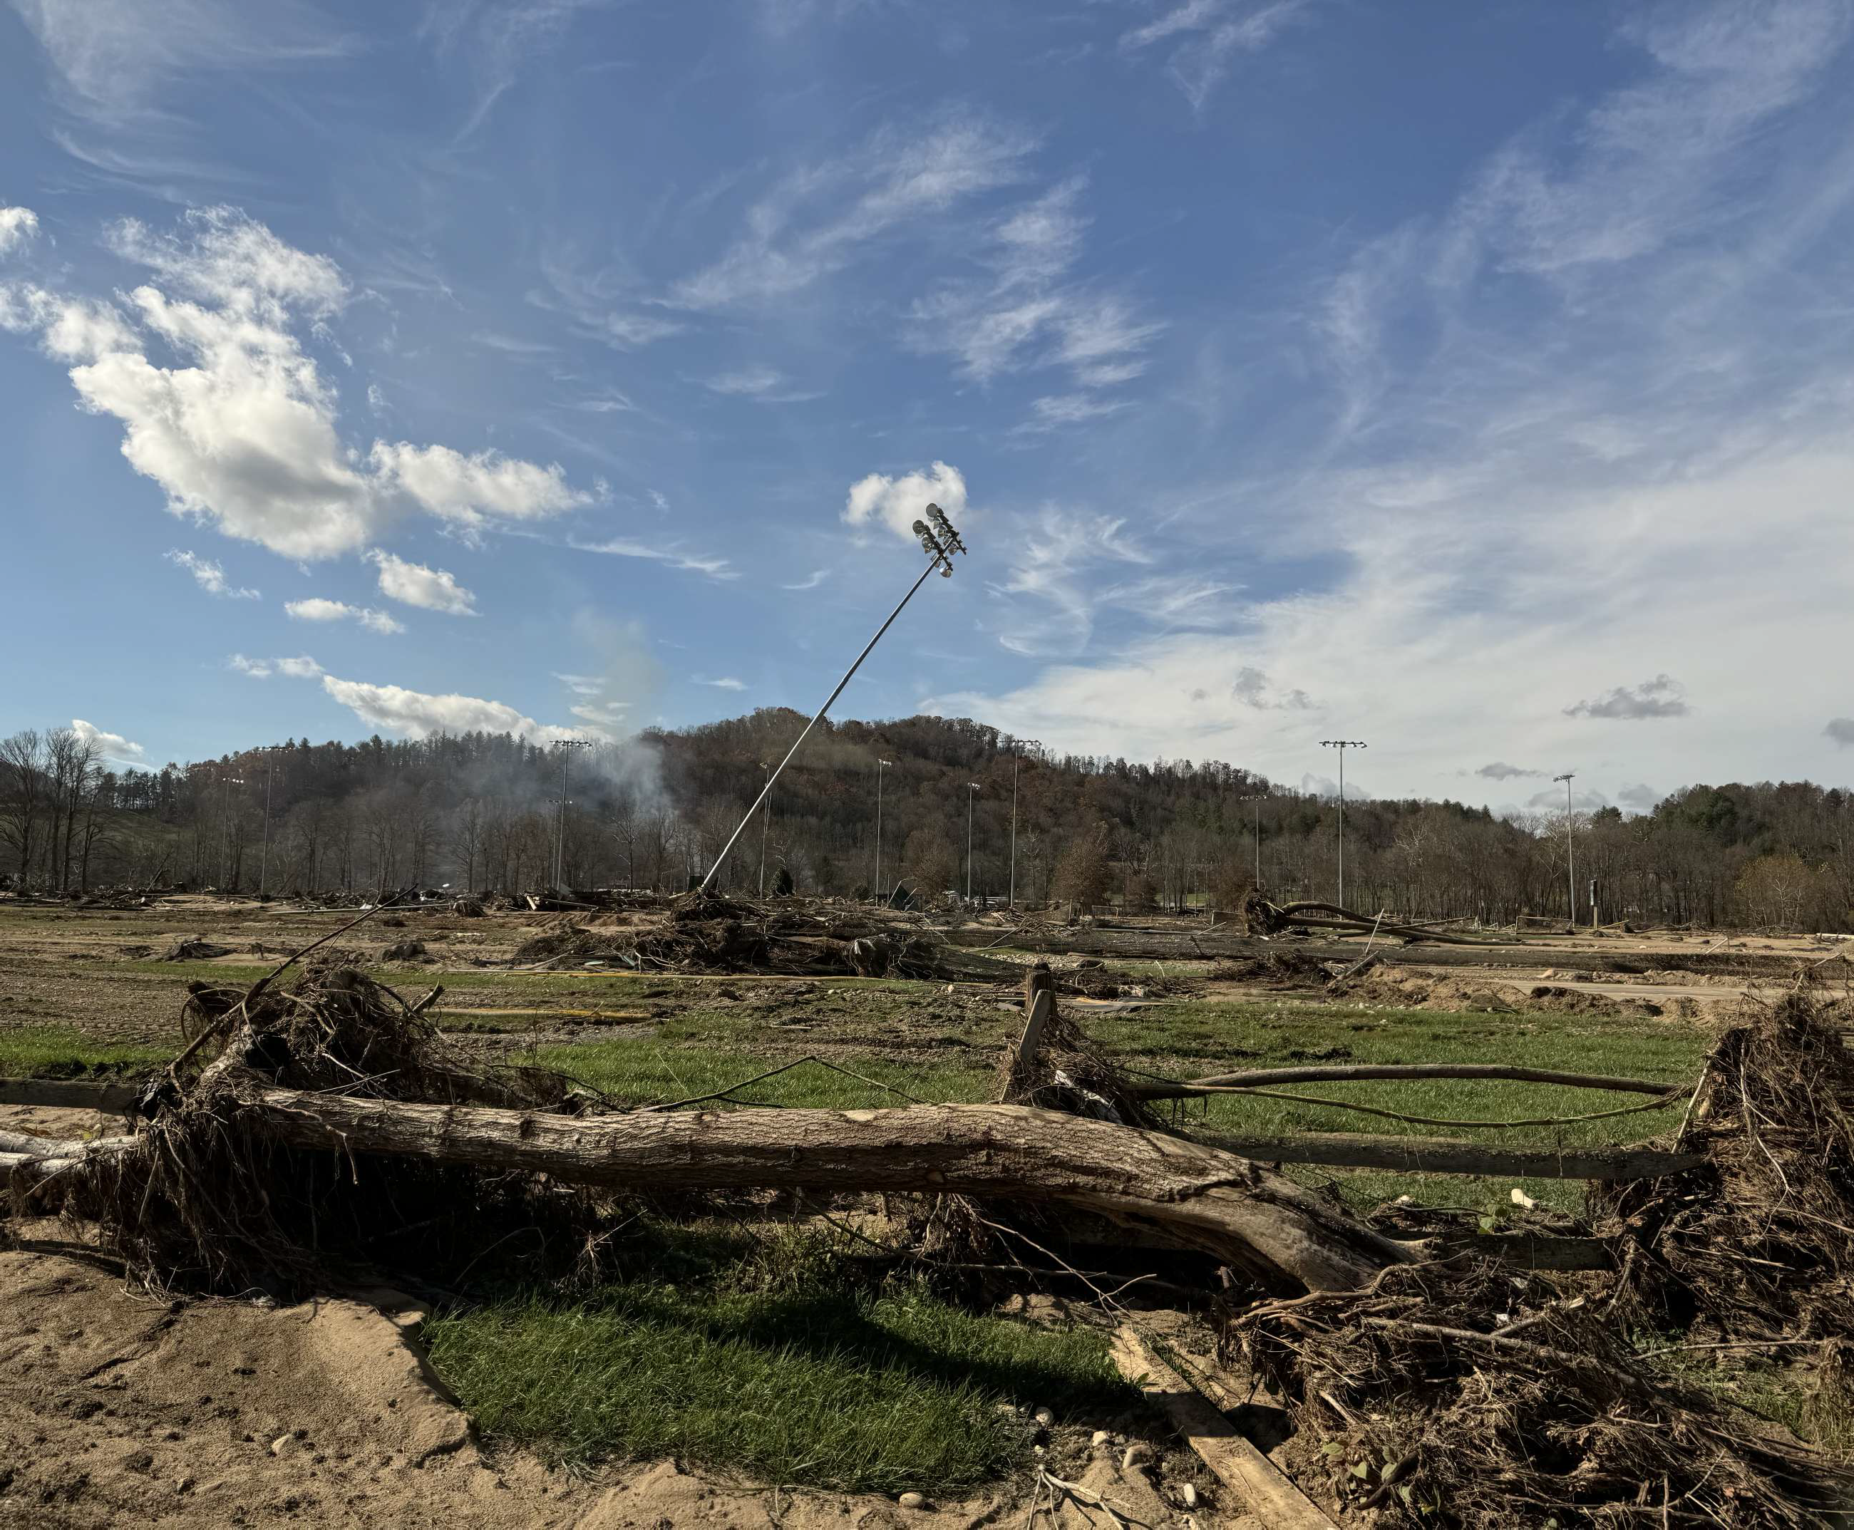
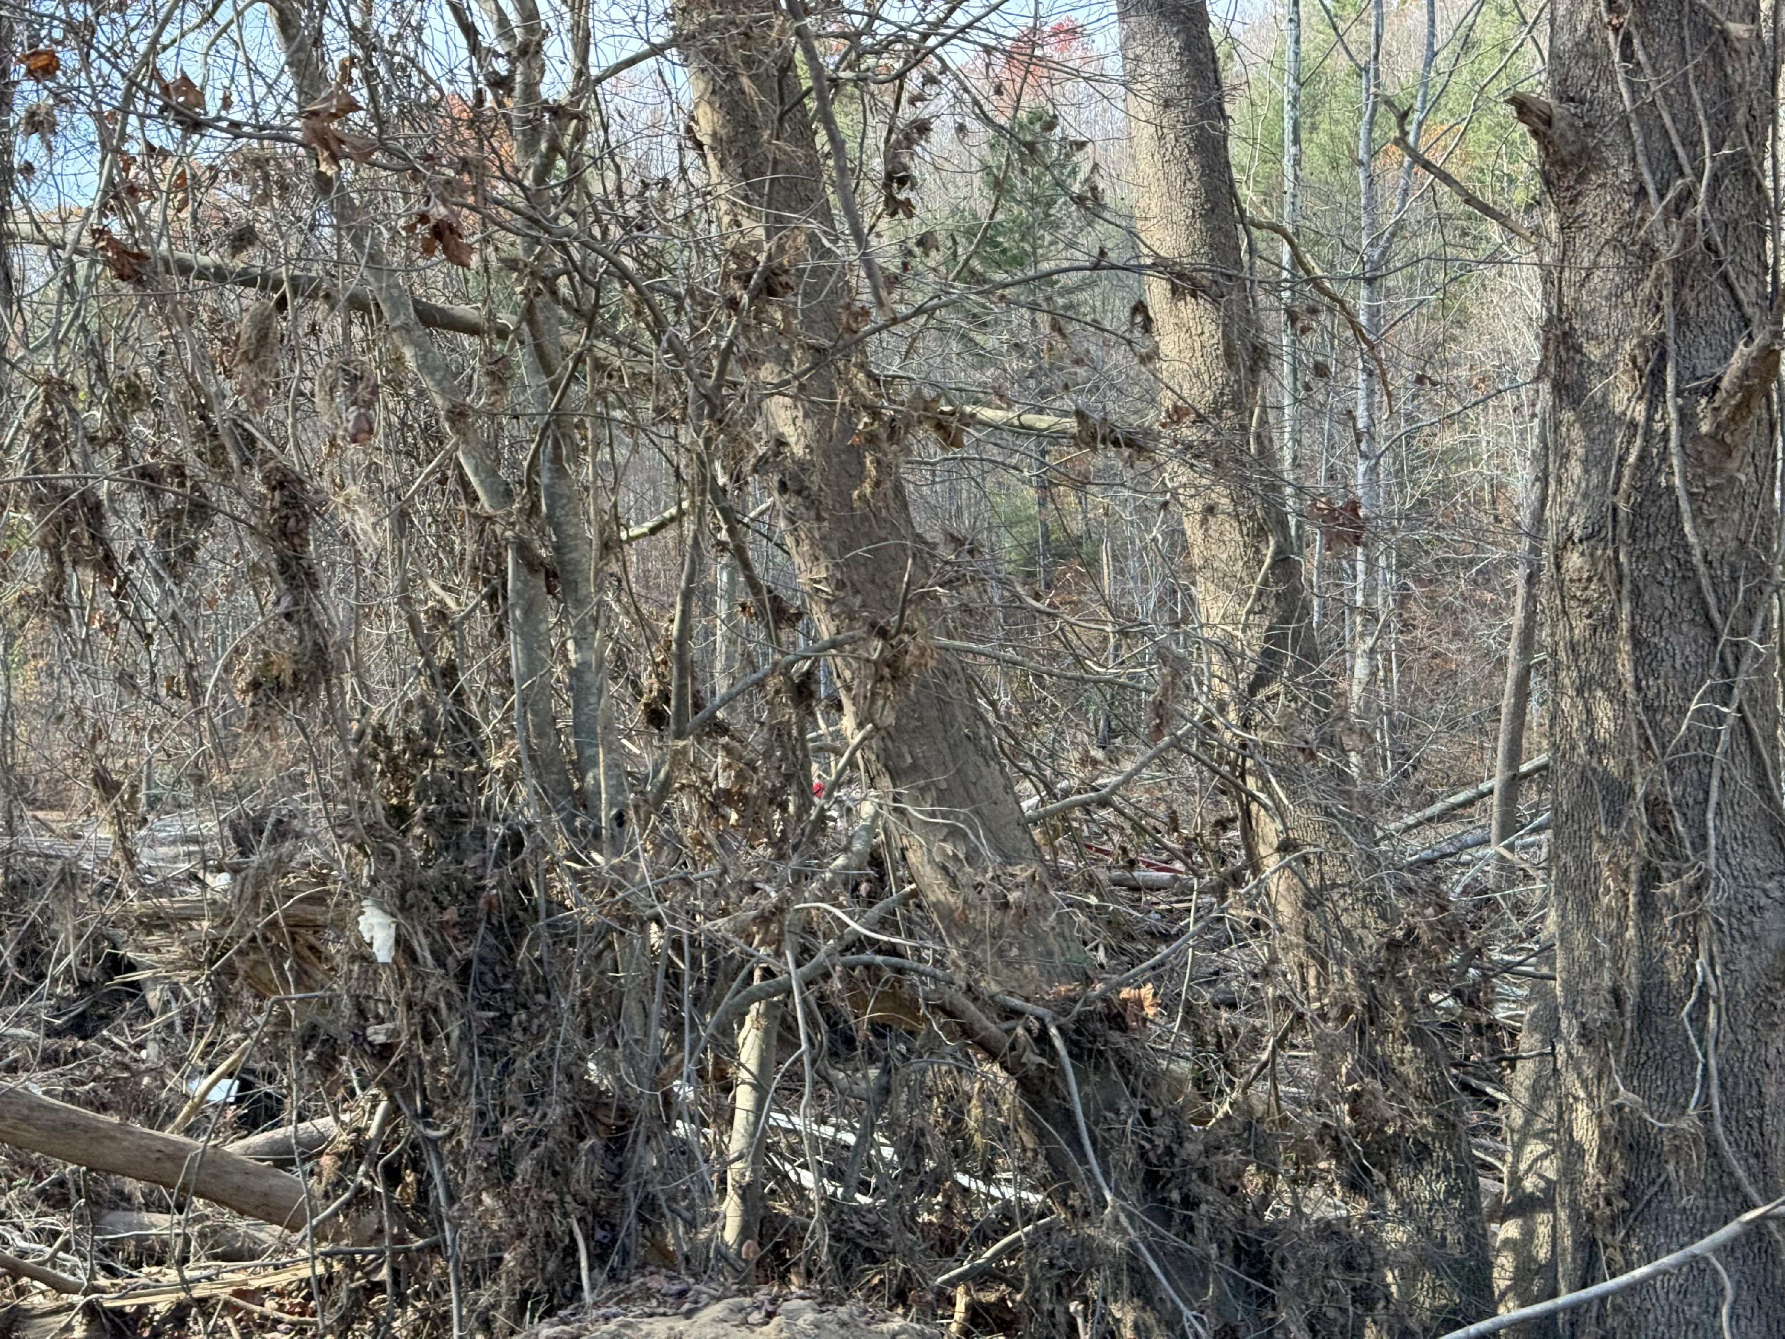

Slide 4
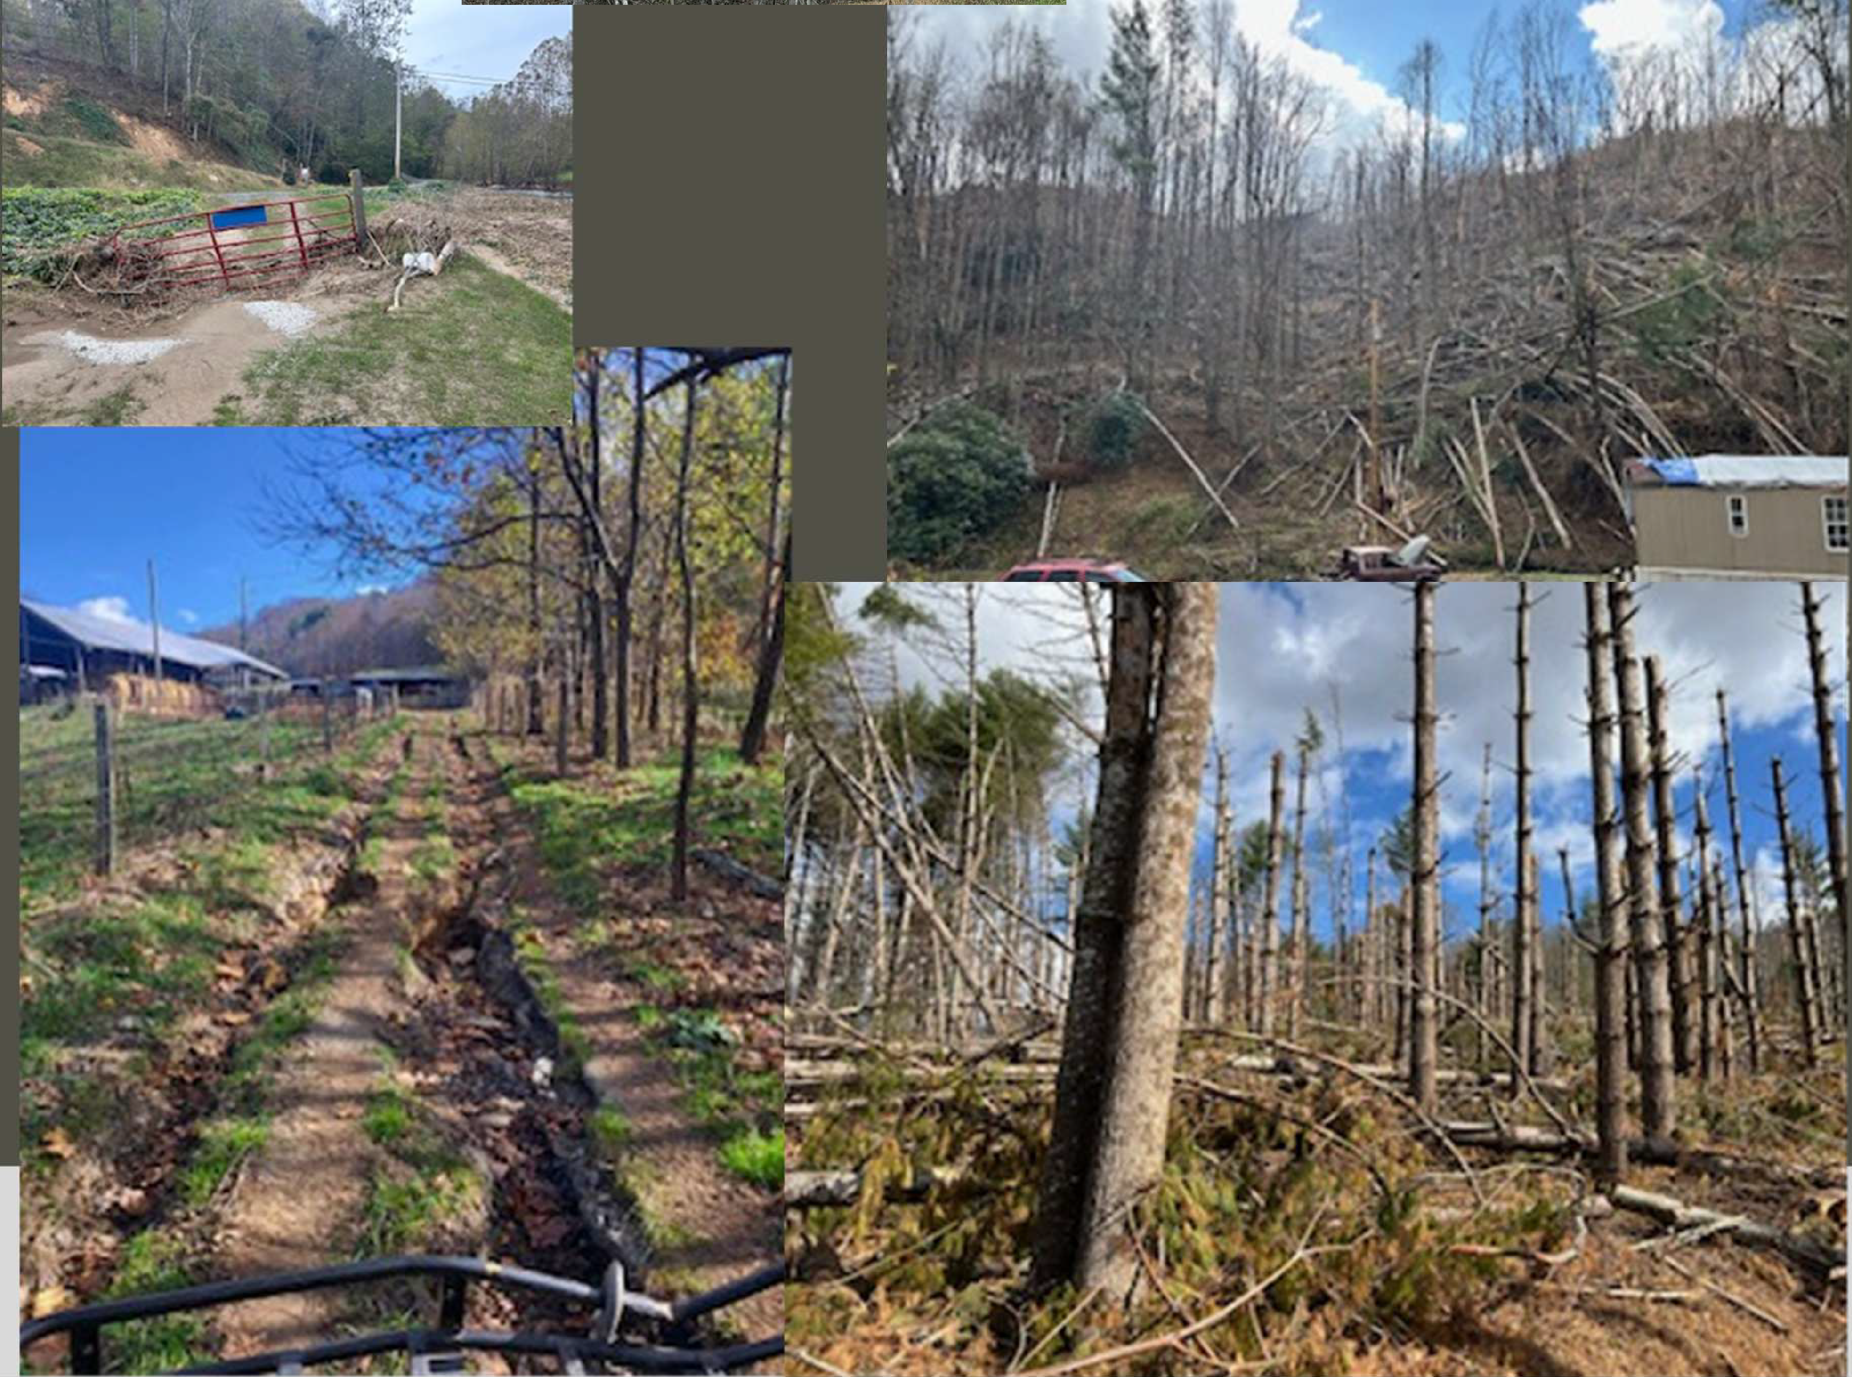
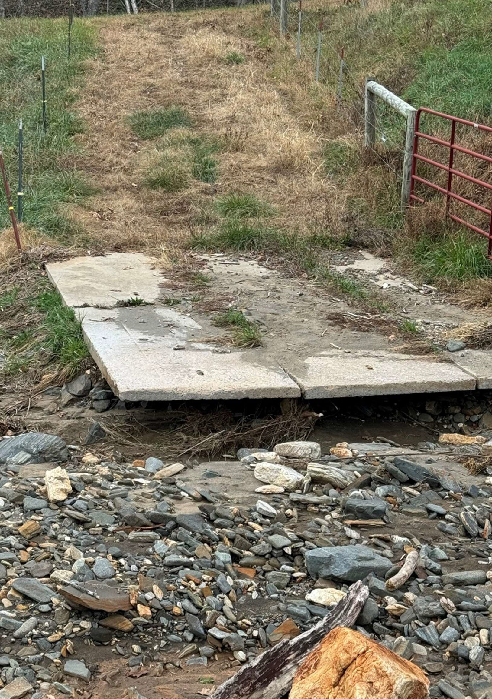

Slide 5
How can conservation staff assess all these sites?
Over 1/3 of the state impacted – not our typical players or storm event
No electronic tool widely available
Help from a data management and staffing perspective needed

Slide 6
Assessment Tool Created
Led to the development of a new tool that can be used for federal and state programs
  Emergency Watershed Program (EWP)
  Streamflow Rehabilitation Assistance Program (StRAP)
Special thanks to division staff: Allie Dinwiddie, Steven Porson and Matt Safford for the development of this tool and the MANY district staff who tested, refined and improved the app.

Slide 7
EWP & StRAP Site Assessment Tool
What is the EWP & StRAP reporting tool?
  Mobile and desktop ArcGIS app to gather data and generate reports for EWP forms
  Projects denied federal funding move to StRAP consideration
Why and How was it developed?
  Simplified and automated the paper process
  Coordinated and streamlined with NRCS & local SWC districts

Slide 8
Data Collection
Field Maps
Survey 123

Slide 9
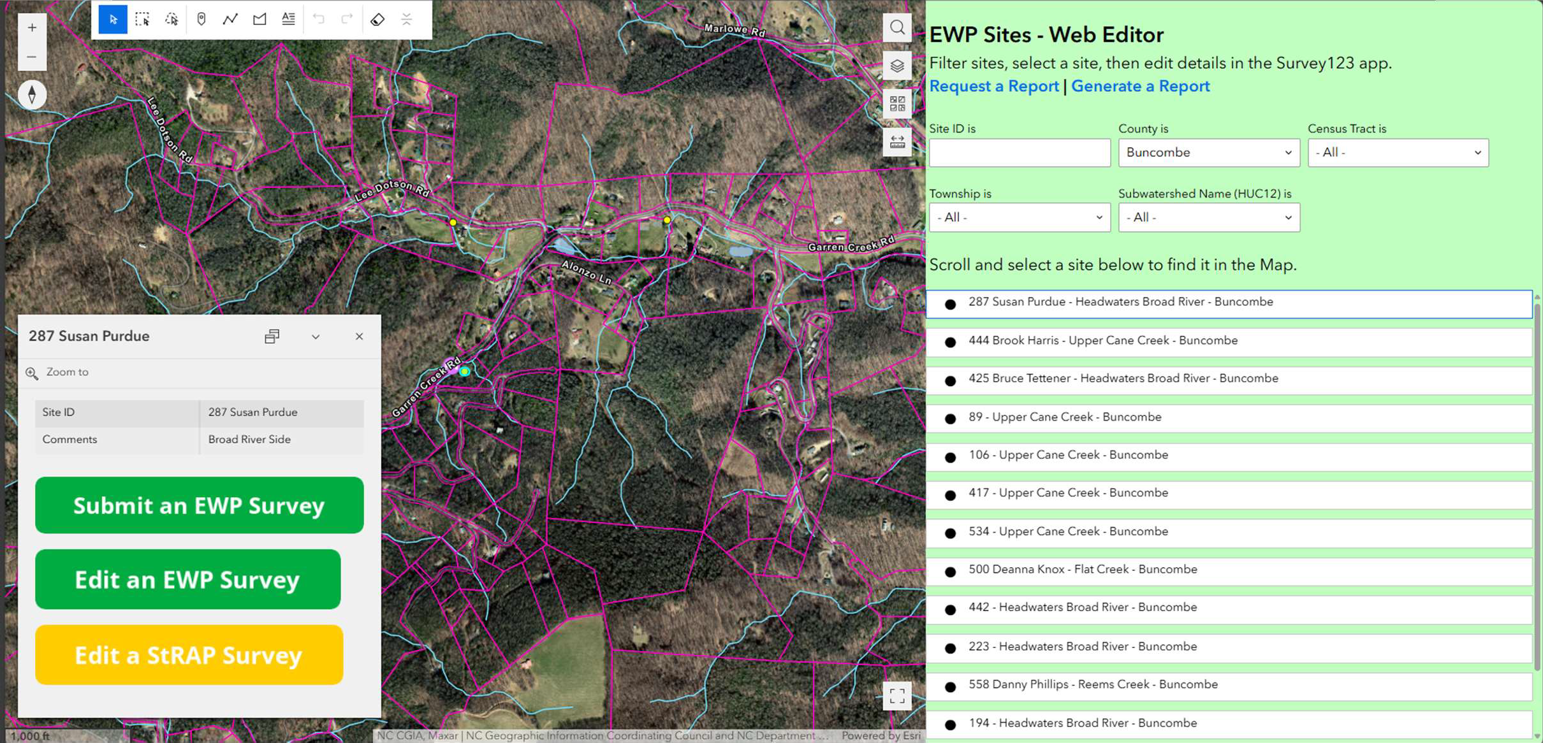
Online Editing

Slide 10
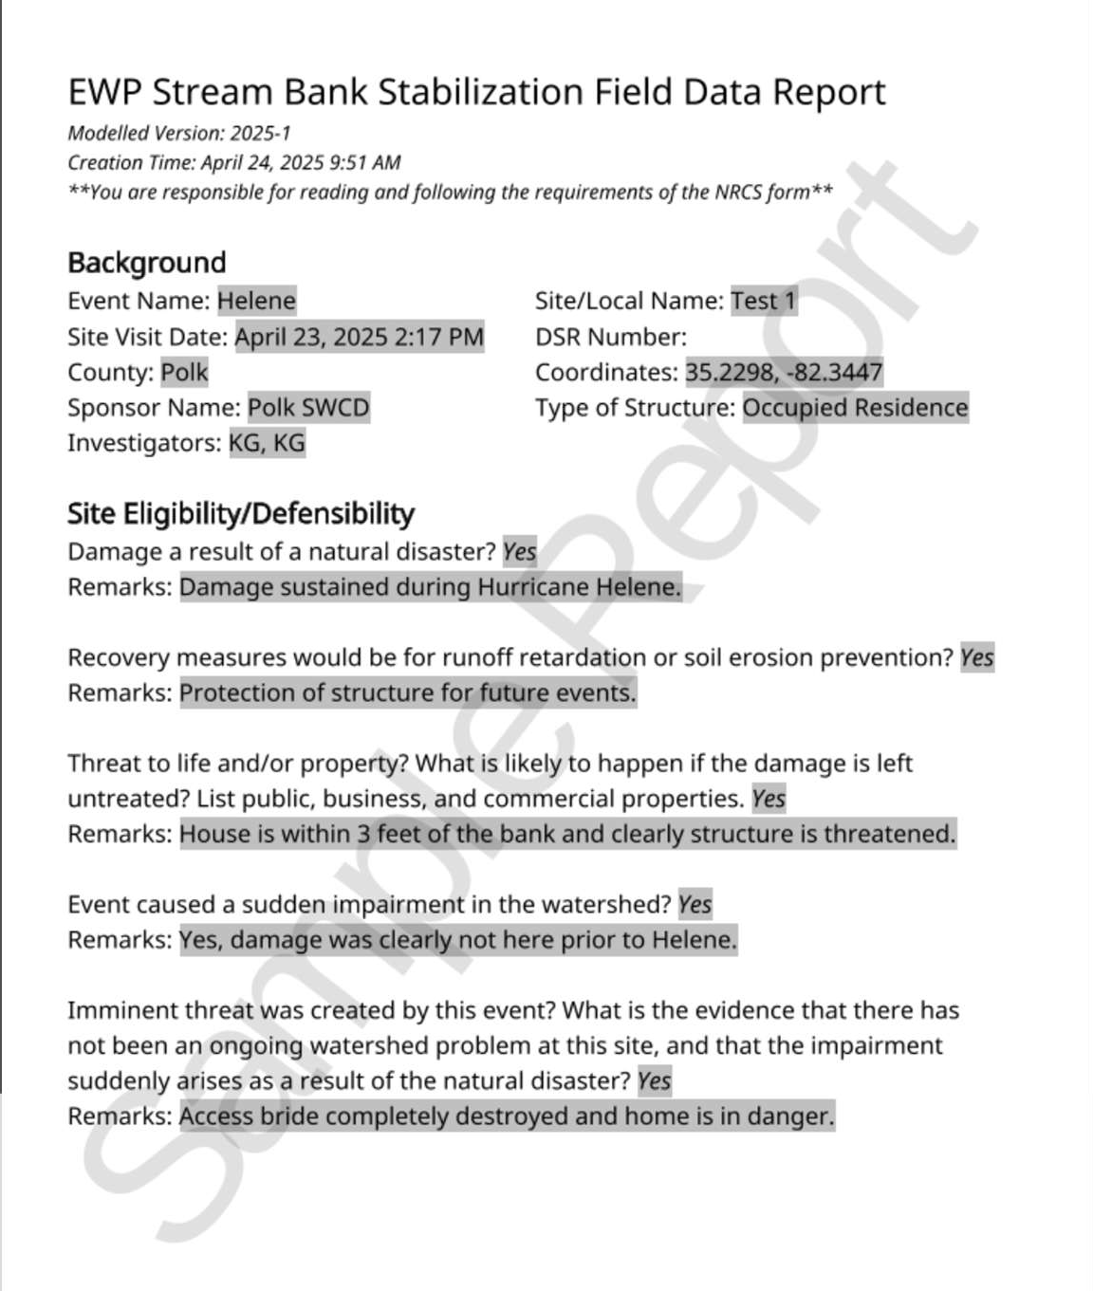
Online Editing and Paperless Reporting
Select and view sites
Markup the map and view post- Helene imagery
Edit details submitted by you or another mobile worker
Generate or request reports within a few clicks

Slide 11
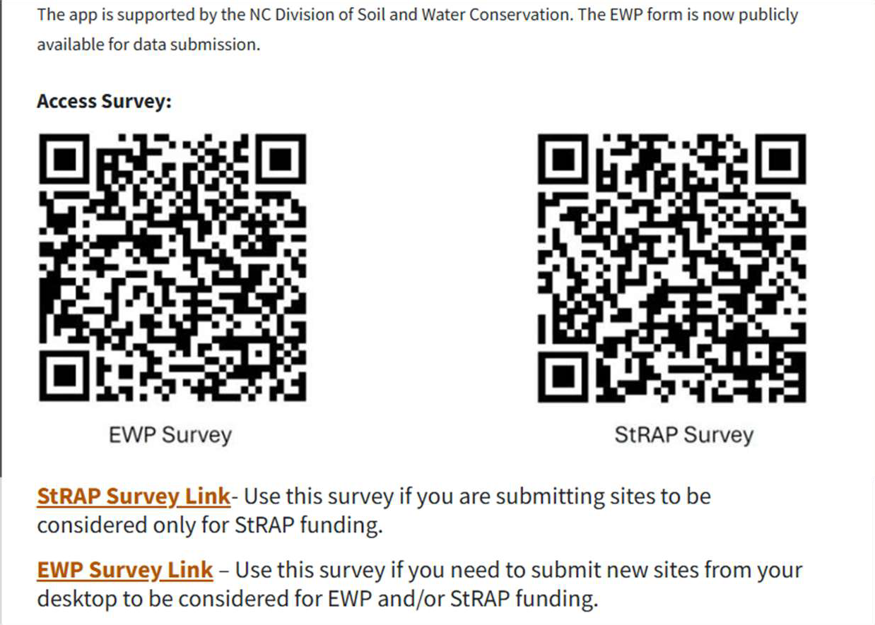
Accessible online!
Hurricane Helene EWP & StRAP Site Assessment Tool | NC Agriculture

Slide 12
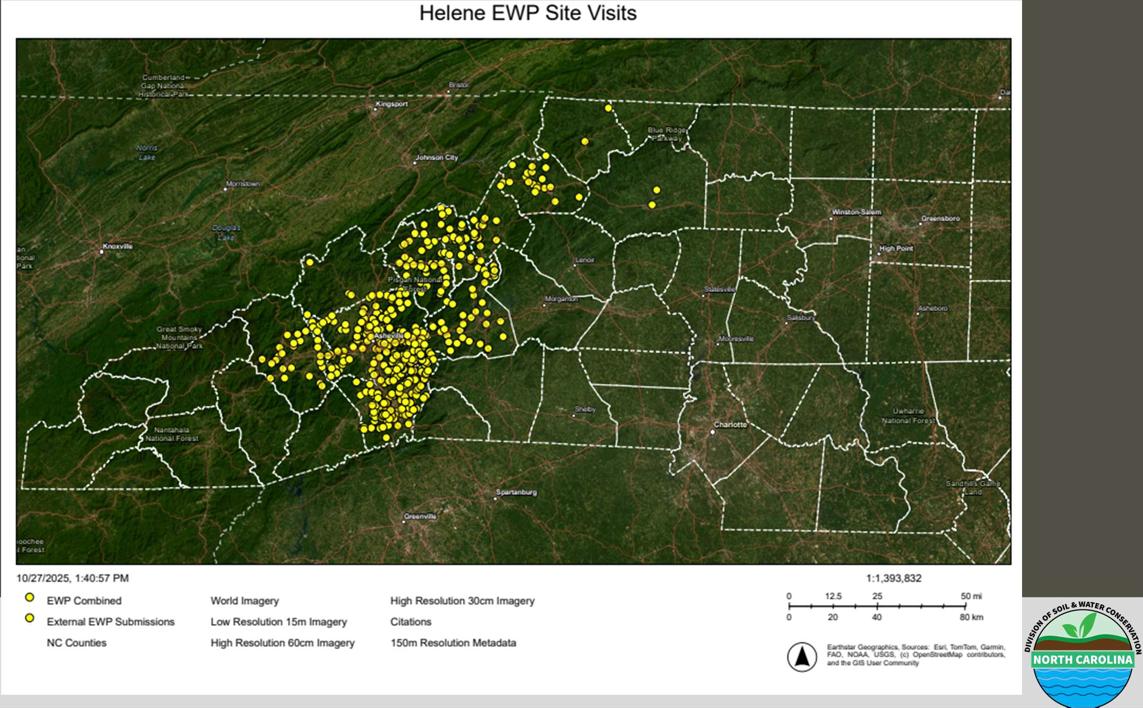

Slide 13
Current State Funding
$40 million total funding
  $25M from Disaster Recovery Bill SL 2024-57
  $15M from Disaster Recovery Act of 2025- Part II
Limitation: “Shall not expend funds ... On any activities that will be, or likely will be, covered by federal funds.”
  Allocations have been delayed as sites covered by Federal funds changed
  FEMA and ACOE have done extensive work
  Federal shut down implications

Slide 14
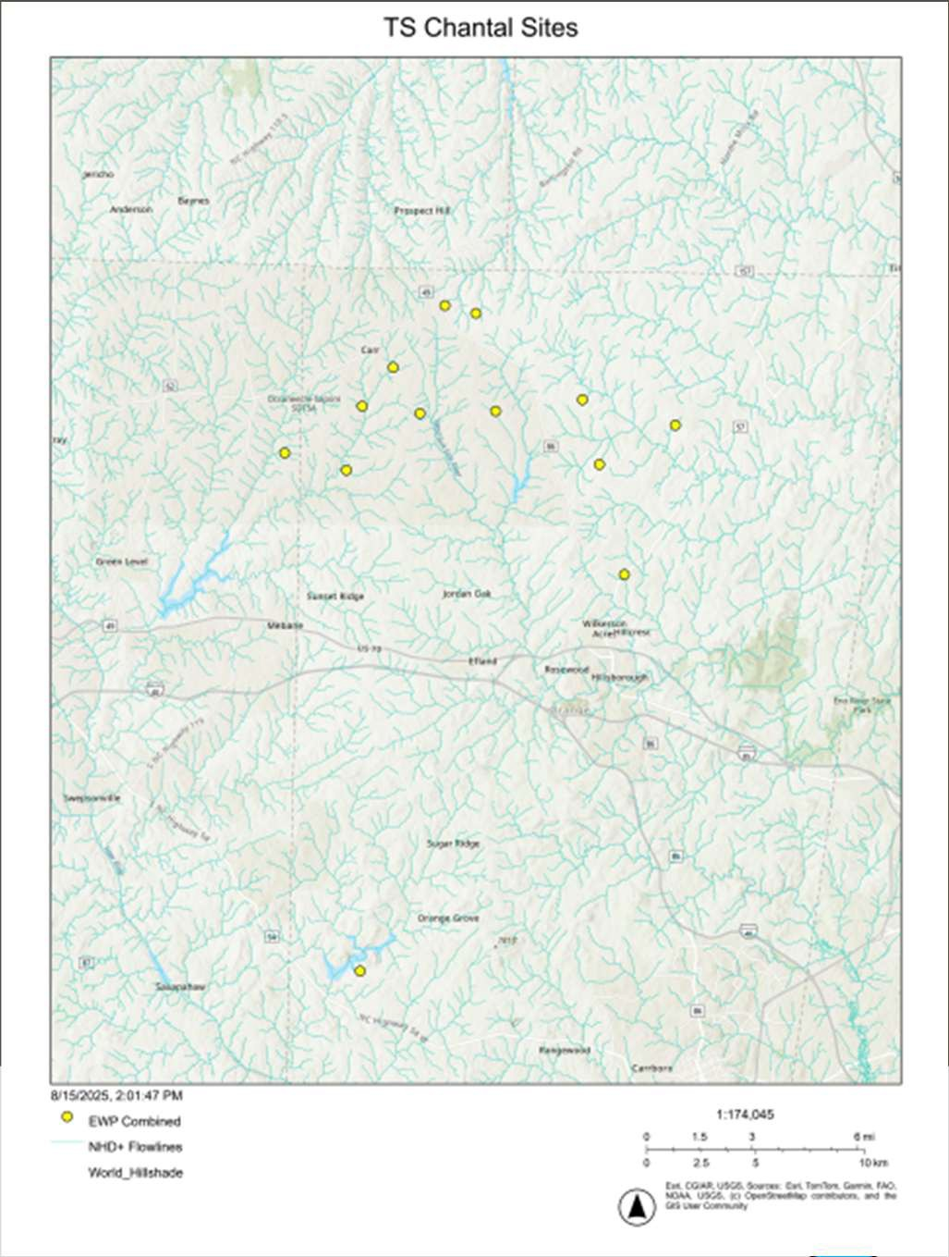
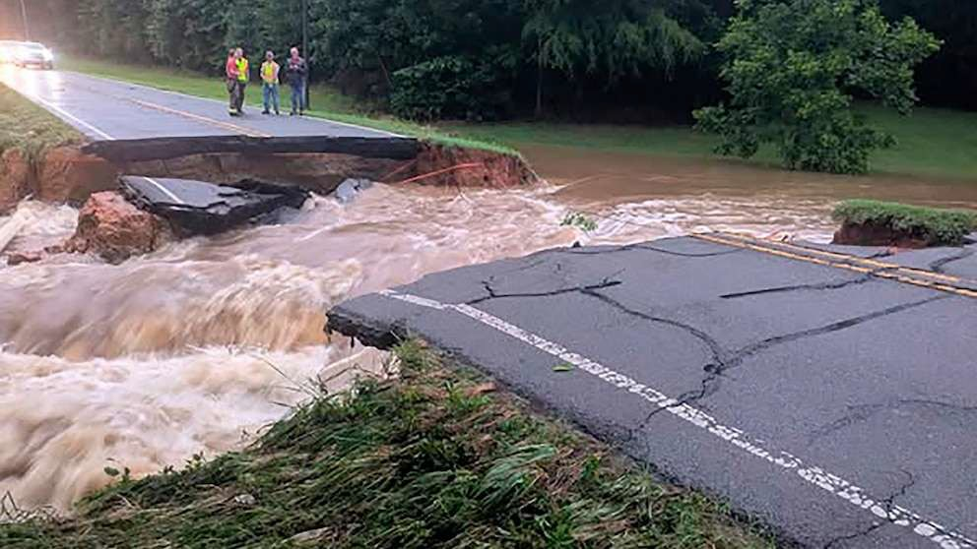
Tool is Available for Statewide Use Tropical Storm Chantal
Central NC: July 6, 2025
Photo courtesy of ABC news

Slide 15
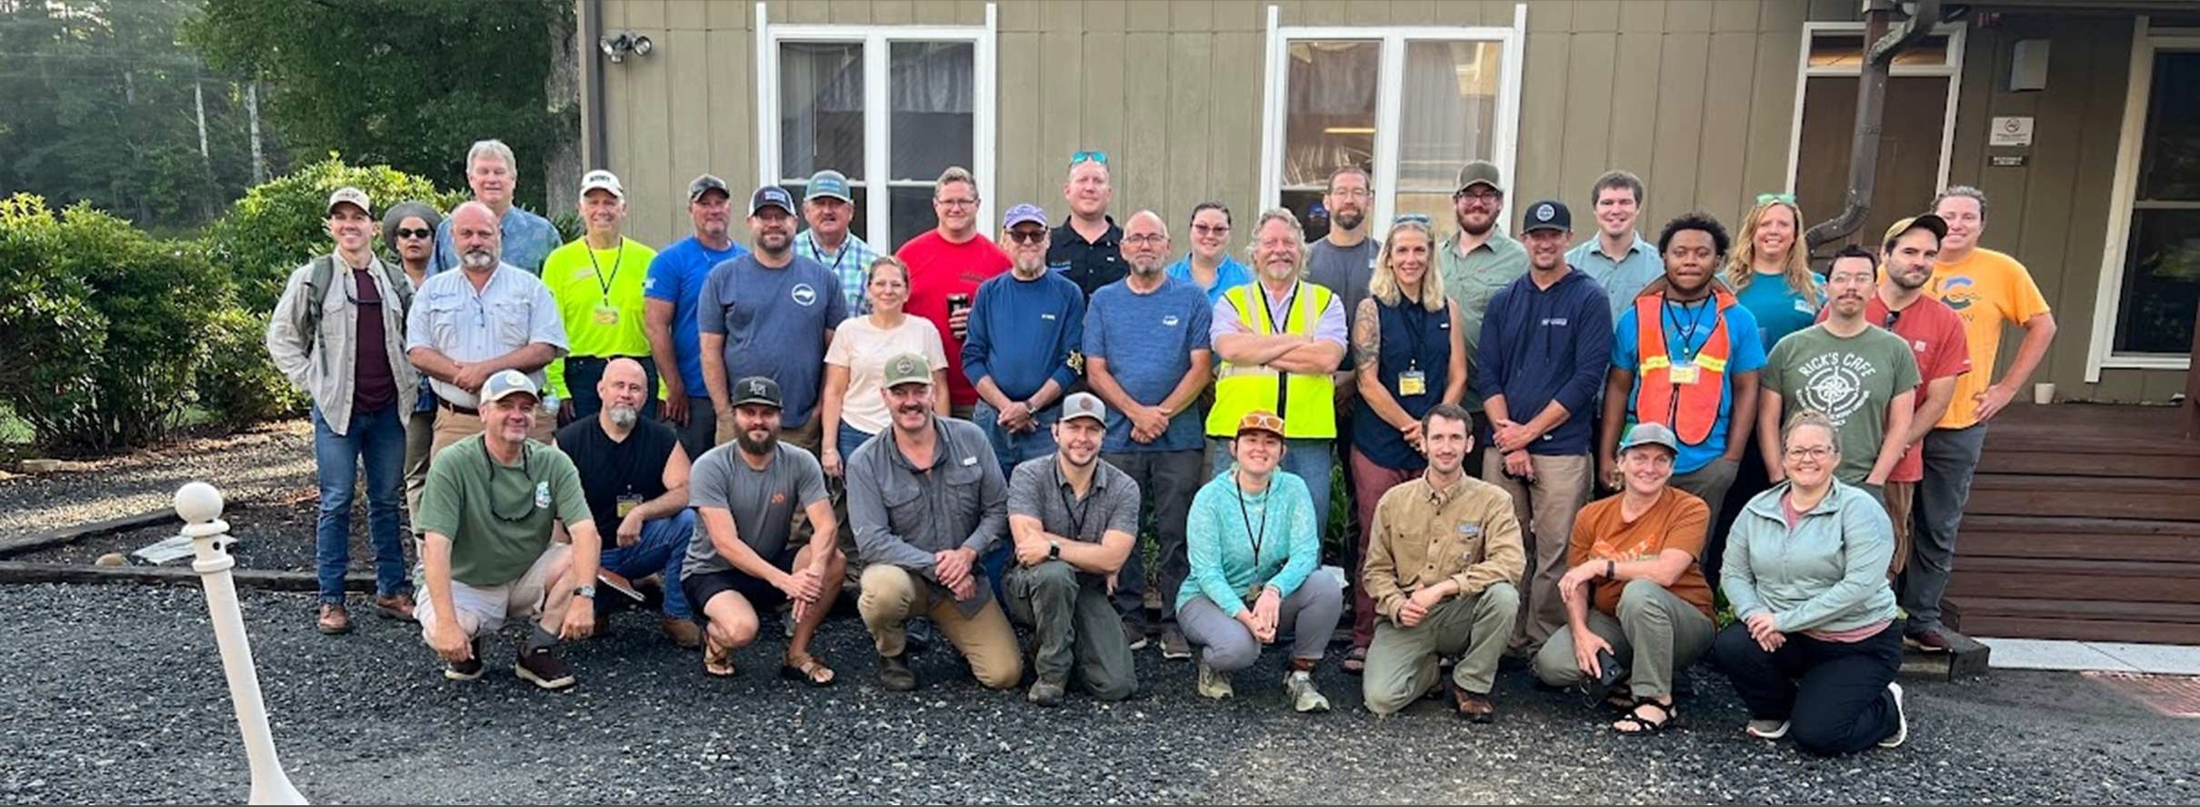
Surge Week – A Success Story
55 people 5 days Assessed 100+ sites 71 sites EWP eligible 3 counties
“When I was a boy and I would see scary things in the news, my mother would say to me, ‘Look for the helpers. You will always find people who are helping.’ Mr. Fred Rogers

