Slide 1


North Carolina Soil and Water Conservation Commission
Job Approval Authority Initiative and Technical Training Program
  Joshua W. Vetter
  Environmental Services Section Chief
  NC Division of Soil and Water Conservation

Slide 2

NC SWCC JAA and Training Initiative
  NC Soil and Water Conservation Commission (SWCC) Job Approval Authority (JAA) Overview
  Training Initiative
    Program goals
    FY 2023 Summary
    Keys to success
    New Resources

Slide 3
What is Job Approval Authority ?
  DEFINITION:
  JAA is the certification granted to an individual who has demonstrated the appropriate knowledge, skills, and abilities to plan, design, and certify installation of a given best management practice.
    Granted by USDA – NRCS or NC SWCC in North Carolina

Slide 4
NC Soil and Water Conservation Commission Job Approval Authority
  Legislation was passed in 2021 giving the NC Soil and Water Conservation Commission (SWCC) authority to grant their own Job Approval Authority (JAA).
  The NC Division of Soil and Water Conservation (DSWC) has primary responsibility for managing and implementing this JAA initiative.

Slide 5
Benefits of NC SWCC JAA System
  Managed and administered by the NC DSWC to meet needs of NC SWCC programs and NC SWCD staff.
  Policies of the program are developed under the guidance of the NC SWCC
  Not reliant on a partnering agency.
  JAA for BMPs unique to NC SWCC programs
Notes:
- Cater the system to meet the needs of state programs and meet specific needs of local district staff
- Ability to adjust or change policy at the state level
- Provides more flexibility

Slide 6
Importance of JAA for NC SWCC Programs
  ALL NC Cost Share Program contracts require JAA
    Contract approval
    Payment approval

Slide 7
NC SWCC JAA System Eligibility
  ELIGIBILE INDIVIDUALS
  SWCD Employees
  County Employees working in a SWCD
  NCDA&CS DSWC Employees

Slide 8
NC SWCC JAA Application Process
SUBMIT application
Division reviews application
Independently prepare materials required to provide evidence of technical competency
Receive on-the-job training
Upload supervisor approval and packets to application
Division presents recommendation to JAA Committee
Attend training classes
Submit materials to technical reference for review
Division presents recommendation to SWCC
Supervisors (Immediate & District) review application and sign for approval
Gain experience planning, designing and installing a BMP
SWCC grants JAA for requested BMP
Tech. reference reviews materials and signs for approval
Create “Request for SWCC JAA” application in Formsite

Slide 9
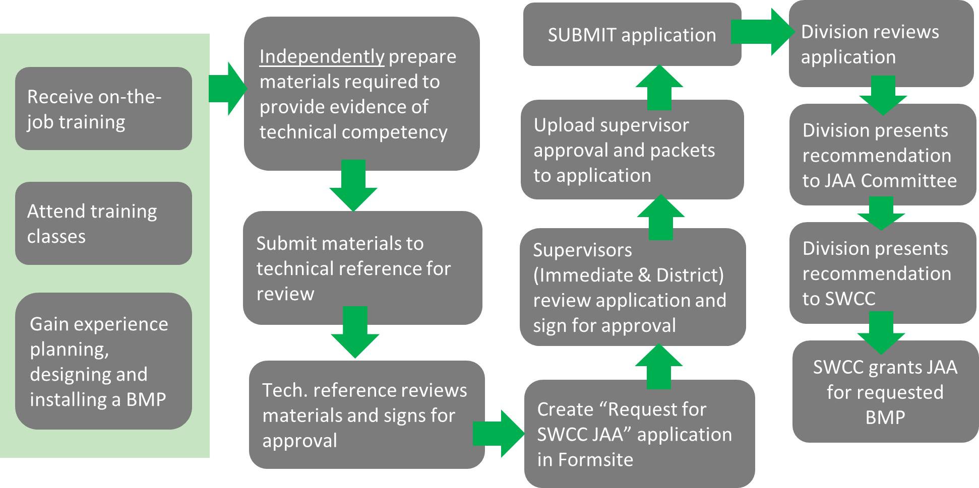
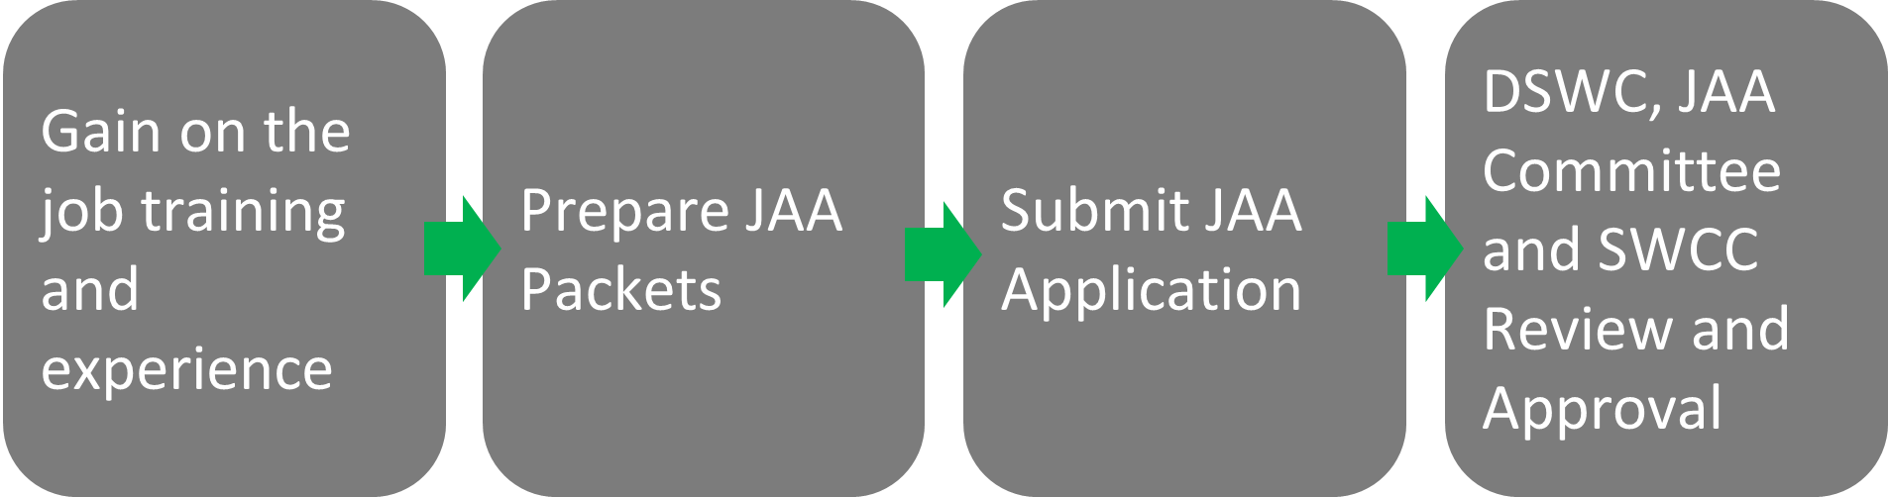
SWCC JAA Application Process

Slide 10
NC DSWC Technical Training Program

Slide 11
Training Program Goals
  Provide technical training to district employees to support JAA initiative
Conservation planning process
BMP Implementation
  I&E, Design, and Construction/Check-out
NC SWCC Cost Share Programs policy
Conservation planning tools (Surveying, RUSLE2, EFT)
Notes:
Provide them with the knowledge, skills and abilities necessary to obtain JAA

Slide 12
FY 2023 Training Program Summary
30 - NC DSWC led trainings held
  15 - BMP Specific Trainings
  7 - Cost Share Program Trainings
  4 - Engineering Field Days
  3 - Soil Science Trainings
  1 - Fundamentals of Conservation Planning

Slide 13
FY 2023 Training Program Summary
Overall
Training Attendance
=
Over 900 SWCD, DSWC and partner agency staff

Slide 14
FY 2023 Training Program Results
"Time well spent!"
"Very helpful to network with other district employees."
"I would recommend the training to new district staff!"
"The Division has made immense progress with available trainings."
"Great time to be a Soil & Water employee with all the training opportunities available!"

Slide 15
Training Program Keys to Success
Dedicated Training Coordinator Position
NC DSWC Training Website
District Involvement
Post Training Surveys
Assistance from Experienced District Staff
Regionally Hosted

Slide 16
New and Upcoming Training Resources
Learning Management System
Mentoring Network
Competency Exams
New Employee Training Curriculum
Recorded Trainings

Slide 17
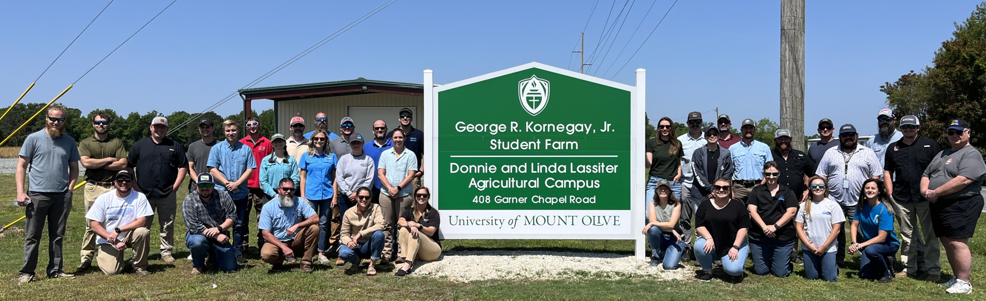
QUESTIONS?
joshua.vetter@ncagr.gov
Cell: 919-740-9759

