Slide 1

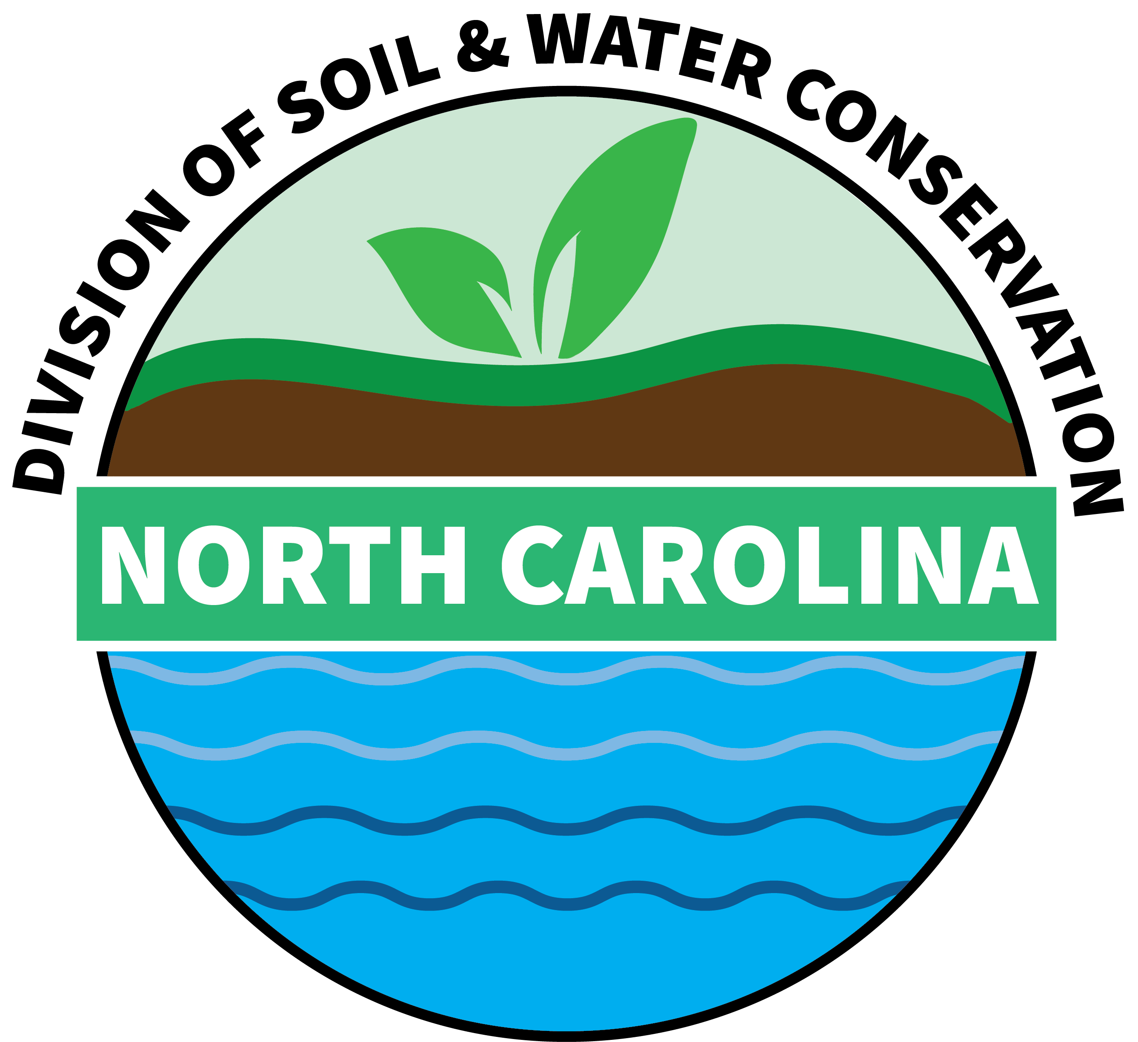
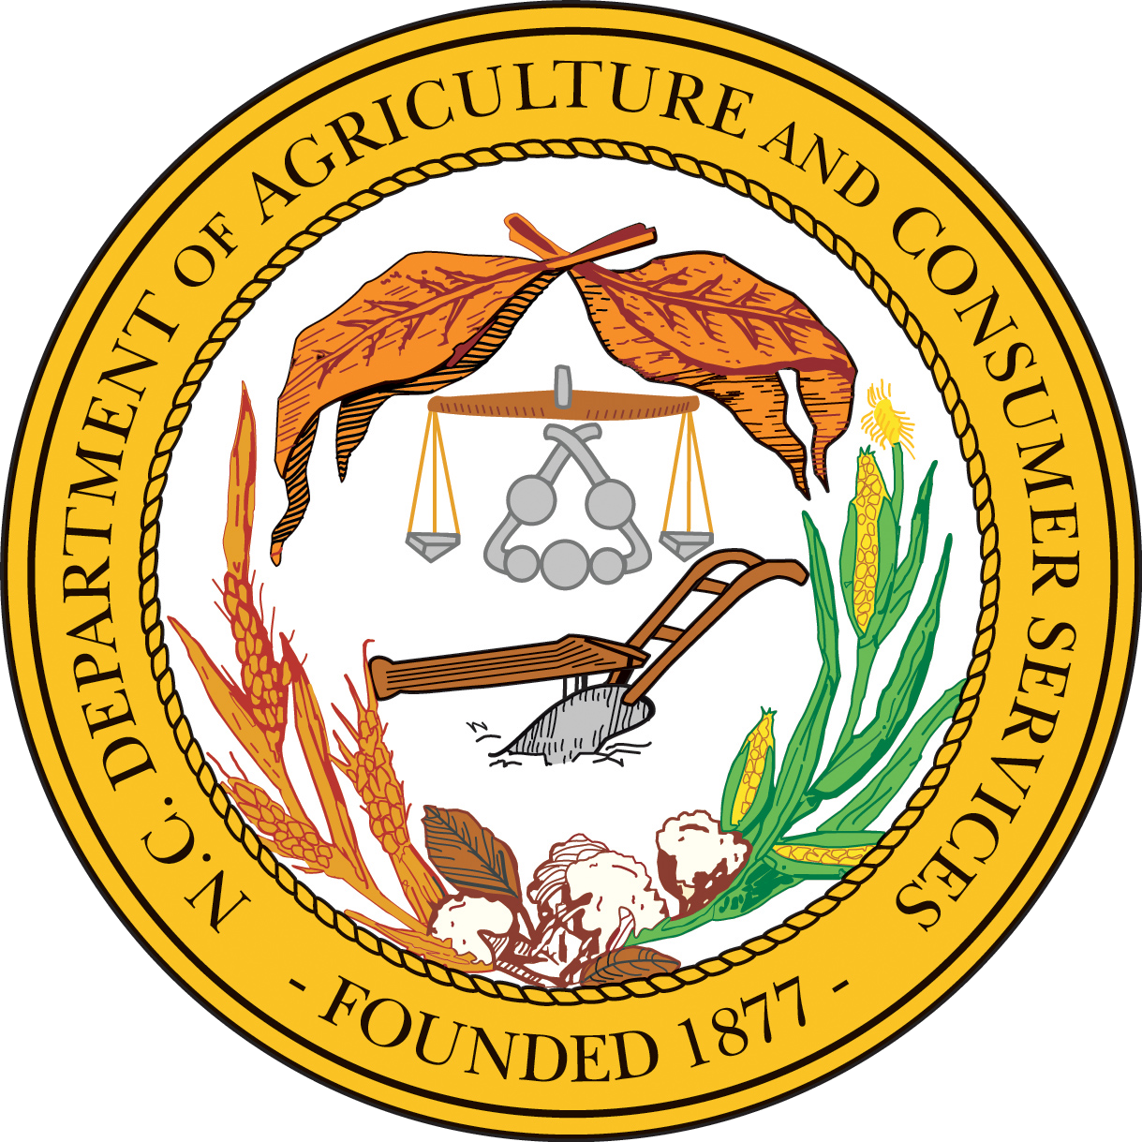
Integrated Water Resources Management & the ‘One Water’ Frontier in North Carolina
Allie Dinwiddie
Nonpoint Source Planning Coordinator

Slide 2
Traditional Water Resources Management
→ Built storage for water supplies
  → Treatment systems for drinking water
  → Sewer infrastructure
  → Wastewater treatment
  → Flooding protection/drainage systems
  → Point and nonpoint source pollution management → Water-reuse and conservation
Water management systems historically have been
designed and managed separately

Slide 3
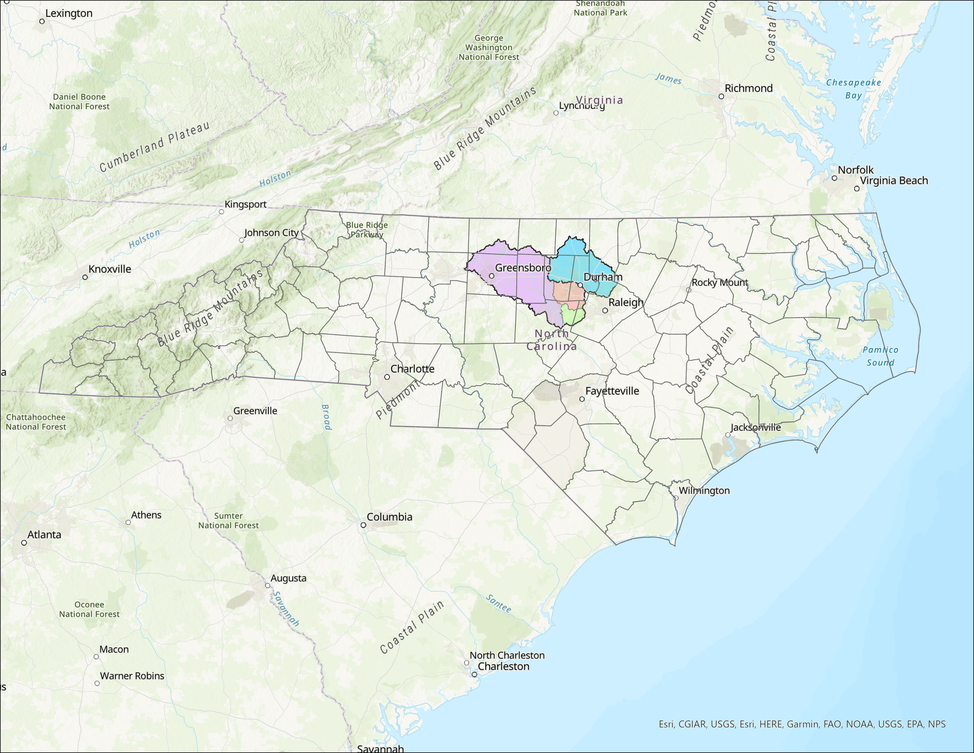
NC Regulatory Framework
Point & Nonpoint Source Nutrient Management
Falls Lake Watershed
Jordan Lake Watershed
Basis is NC’s Chlorophyll-a standard
Regulate pollutant sources in basins & watersheds
  Model-based reduction goals
  Fair, reasonable, and proportionate for source sectors
Notes:
NC does not have a statewide numeric N, P water quality criteria standard

Slide 4

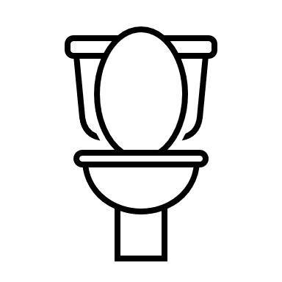

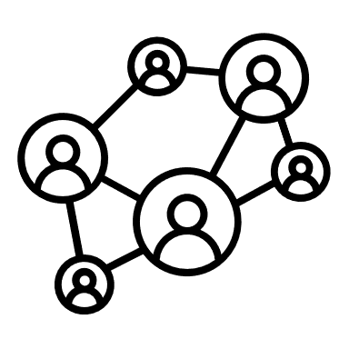
NC Regulatory Framework
Point & Nonpoint Source Nutrient Management
Regulated Sources
Stormwater
Requires jurisdictions establish stormwater programs for new development
Existing development on public land (state/federal)
Wastewater
Discharge limits
Group compliance option
Agriculture
Collective compliance approach N loss accounting on cropland and pastureland and assessing P loss risk
Multiple Sectors
Riparian buffer requirements
Fertilizer application requirements
Nutrient offsets/trading

Slide 5
NC Regulatory Framework
Challenges
Point & Nonpoint Source Nutrient Management
Reactive
Does not encourage cross-sector collaboration
Limited collaboration and stakeholder involvement in development (esp. initial strategies)
Focus is on meeting water quality standard and not ancillary benefits (land conservation, flood reduction, water storage, etc.)
Resource and time-intensive to develop
Subject to interventions (legislative action, etc.)
Notes:
Challenges:
Each sector owns part of the problem
Each sector must find and fund their own reductions
Reductions from baseline must be maintained indefinitely
Everything is quantified in lbs of nitrogen/phosphorus
No incentive for preservation
Creates tensions between source sectors and upstream and downstream user groups
The existing structures of water management discourage this collaboration by instead identifying specific water allocations or pollution allowances (e.g., “nutrient credits”) for each individual or entity in a watershed system.

Slide 6

Today’s
Water
Challenges
Water Quality: Existing and emerging contaminants
Water Quantity: Flooding and drought
Climatic changes & uncertainty
Aging infrastructure
Declining investment
Disproportionate investment

Slide 7

Embrace all water has value
Find right-sized solutions
Source Protection
Stormwater Management
Achieve economic, environmental, and social benefits
ONE WATER MINDSET
Build partnerships and focus on inclusion
Use a systems/life cycle approach
Adopt watershed-scale thinking and action
Wastewater Treatment
Water Supply

Slide 8
Reliable and Resilient Water Utilities
Thriving Places
Competitive Business & Industry
Sustainable Agricultural Systems
Social and Economic Inclusion
Healthy Watersheds
Water conservation, reuse, green infrastructure
Natural infrastructure, protecting forests, utilizing citizen science, managing groundwater
Implementing a ‘dig once’ system, integrated planning, resiliency projects
One Water Approach
Integrated Water Resources Management
Building water safety net, community resilience projects, engagement in water planning & governance
Integrating water stewardship into company strategy, water efficiency & reuse projects, upstream & downstream partnerships
On-farm strategies, upstream & downstream partnerships
Watershed-scale planning & monitoring
Notes:
Each sector owns part of the solution
Funding sources can be integrated
Achievements above and beyond status quo can be continuous
Quantified in terms of co-benefits and projects
Financial incentives for preservation

Slide 9
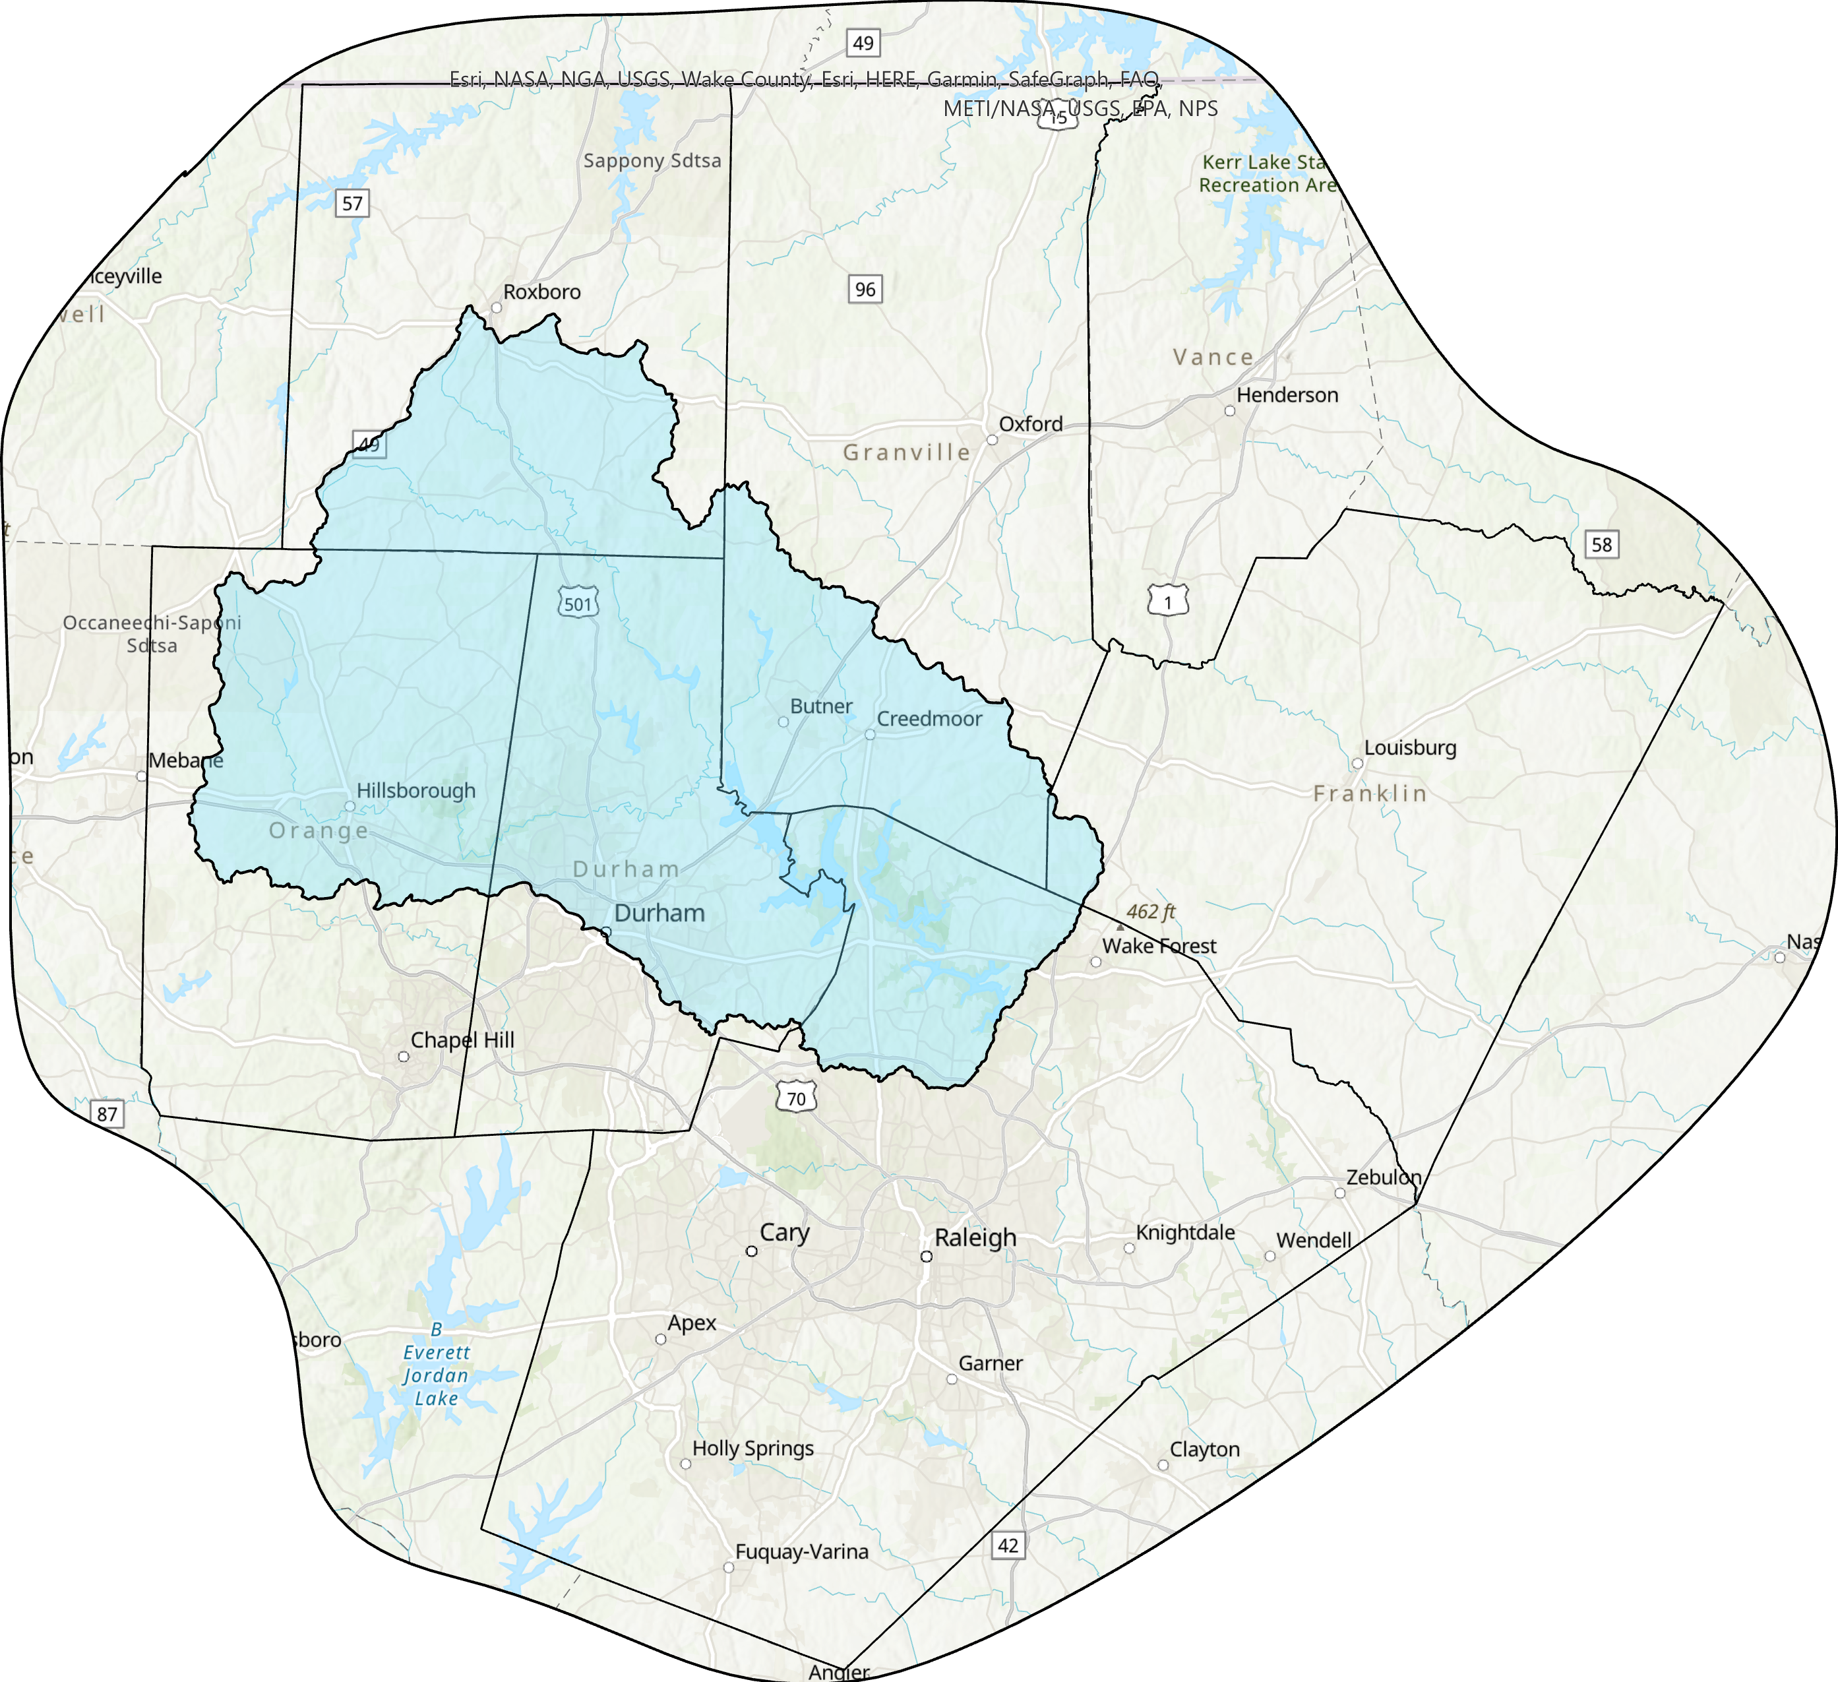

NC One Water Activity
Falls Lake Watershed
Upper Neuse River Basin Association
Members
  Six counties
  Seven municipalities
  One water utility
  Soil and Water Conservation Districts
Active External Stakeholders
  Agriculture
  Environmental groups
  Land conservation organizations
  NC Department of Environmental Quality (DEQ) Division of Water Resources (DWR)
  NC Department of Transportation (DOT)
  NC Department of Agriculture and Consumer Services (NCDA&CS)
  Division of Soil and Water Conservation (DSWC)
Person County
Granville County
Durham County
Franklin County
Orange County
Wake County

Slide 10
NC One Water Activity
MISSION
The Mission of the UNRBA is to preserve the water quality of the Upper Neuse River Basin through innovative and cost-effective pollution reduction strategies, and to constitute a forum to cooperate on water supply issues within the Upper Neuse River Basin by:
Forming a coalition of units of local government, public and private agencies, and other interested and affected communities, organizations, businesses and individuals to secure and pool financial resources and expertise;
Collecting and analyzing information and data and developing, evaluating and implementing strategies to reduce, control and manage pollutant discharge; and
Providing accurate technical, management, regulatory and legal recommendations regarding the implementation of strategies and appropriate effluent limitations on discharges into the Upper Neuse River Basin.
Upper Neuse River Basin Association:
Collected four years of monitoring data in the watershed and the lake
Developed a watershed model to better understand sources of loading
Developed three lake water quality models to illustrate impacts on water quality
Worked with other researchers and organizations
Met with internal and external stakeholders to discuss recommendations
All this was done to make strategy improvements

Slide 11

NC One Water Activity
Innovative Project Highlight
Falls Lake Alternative Rule Implementation –
Existing Development
  Manageable, collaborative, voluntary approach
  Jurisdictions commit to reasonable investments reducing nutrient loading
  Activities known to be beneficial, but that do not have State-approved nutrient credits, are eligible to be funded (e.g. land conservation)

Slide 12

NC One Water Activity
Conclusions on Watershed Needs for a Revised Falls Lake Nutrient Strategy
Additional large-scale nutrient load reductions are not achievable
Collaborative action is needed to protect this resource and maintain uses
Protecting forests and other natural areas is key to long-term management
Long-term nutrient management will be the most effective approach
A watershed organization is recommended to coordinate activities and partnerships

Slide 13



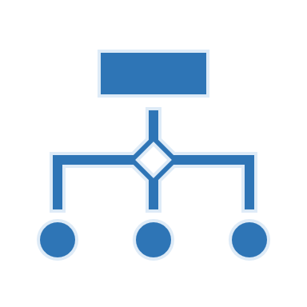



NC One Water Activity
Allow local governments to provide funding support
Support the local food and fiber economy and slow additional land loss
UNRBA Agricultural Recommendations
Utilize existing organizations and state programs to deliver funds and services
Formalize partnerships with agriculture and include representation in watershed organization
Foster collaboration by removing agriculture’s separate collective nutrient reduction requirement
Identify projects and opportunities that benefit agriculture and improve water quality

Slide 14
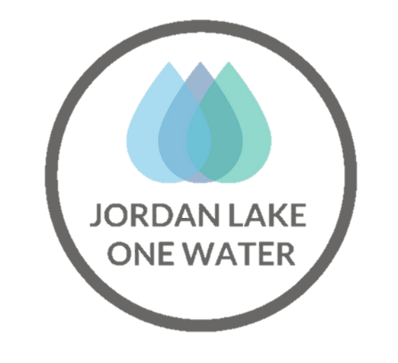
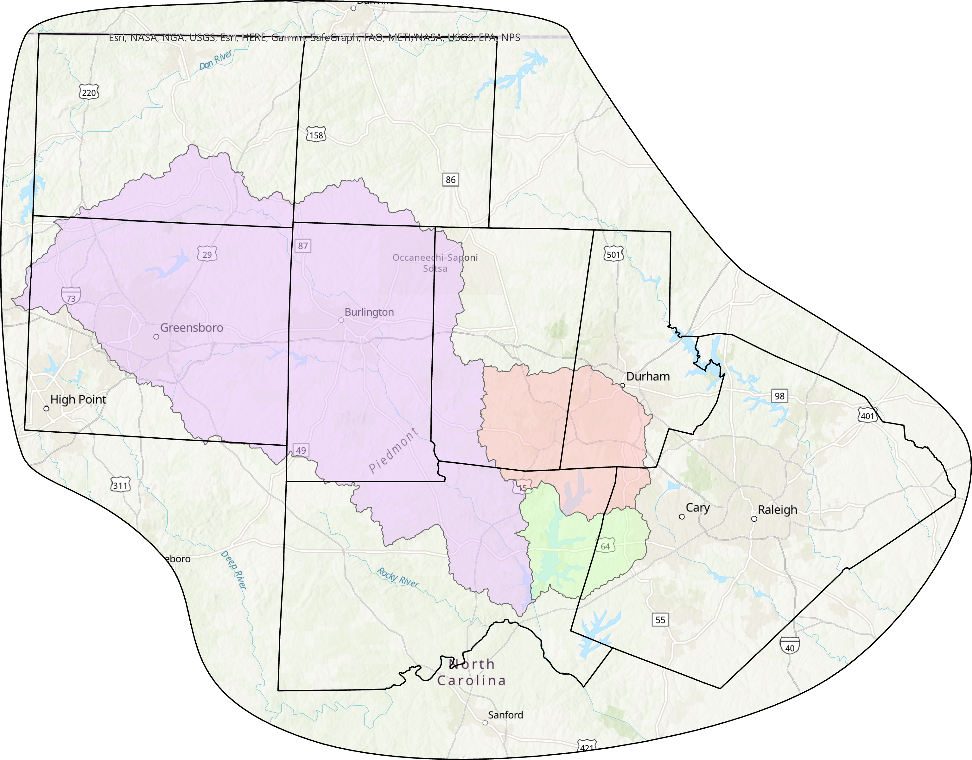
NC One Water Activity
Jordan Lake Watershed
Jordan Lake One Water (JLOW)
Members (so far)
  5 cities and towns
  1 county
  1 state department
  3 nonprofits
  2 businesses/business coalitions
Partners
  NC Department of Agriculture & Consumer Services – Division of Soil and Water Conservation
  NC Department of Environmental Quality
  Regional Councils of Government
  Soil and Water Conservation Districts
Rockingham County
Caswell County
Guilford County
Orange County
Durham County
Alamance County
Wake County
Chatham County
MISSION
JLOW aims to help Jordan Lake Watershed stakeholders meet the shared goal of finding cost-effective, mutually beneficial solutions that protect our water resources and communities. All who live or work in the Jordan Lake Watershed are affected by the management of Jordan Lake’s water quantity and quality and our water future depends on our collaboration.

Slide 15
NC One Water Activity
Jordan Lake Watershed
Jordan Lake One Water (JLOW)
Pursuing organization formalization
Creating equitable organizational governance structures
Anticipate working with NC Department of Environmental Quality to co-develop a regulatory framework for the Jordan Lake watershed that works for all stakeholders
Rockingham County
Caswell County
Guilford County
Orange County
Durham County
Wake County
Water quality improvement for strategy compliance is an objective, but not the organization’s end goal!
Notes:
Registered as a state nonprofit and seeking federal status
Create governance structure to support communication, integration, and collaboration. Equitably engage and coordinate with all stakeholders (upstream, downstream, lakeside).
Create a regulatory framework that:
Removes barriers to cross-sector collaboration
Incentivizes projects with multiple partners and producing multiple ancillary benefits
Reduces tension between upstream and downstream users and sectors

Slide 16

The Frontier
Much remains to be tested, but mindsets and approaches to water resource management in NC are slowly changing!
Transition from nutrient ‘pound-accounting’ approaches
  Build on cooperation & collaboration
    Create watershed organizations with upstream & downstream stakeholders & multiple source sectors to foster new ideas & encourage collaborative work
  Utilize investment-based compliance options & watershed funding pools for cross-sector collaboration
  Pursue & implement projects achieving multiple benefits (social, environmental, economic)
  Develop adaptive programs with periodic re-evaluation
Notes:
Watershed-wide permit for watershed organizations working collaboratively
Transition from nutrient ‘pound-accounting’ approaches
Build on cooperation and collaboration
Create watershed organizations with upstream and downstream stakeholders and multiple source sectors to structure to engagement, foster new ideas, work collaboratively
Utilize investment-based compliance options and watershed funding pools for cross-sector collaboration
Pursue and implement projects achieving multiple benefits (social, environmental, economic)
Develop adaptive programs with periodic re-evaluation built in
Transition from nutrient ‘pound-accounting’ approaches
Build on cooperation and collaboration
Utilize investment-based compliance options and watershed funding pools for cross-sector collaboration
Pursue and implement projects achieving multiple benefits (social, environmental, economic)
Develop adaptive programs with periodic re-evaluation built in

Slide 17

Allie Dinwiddie
Nonpoint Source Planning Coordinator
Phone: 919-707-3795
Email: alexandra.dinwiddie@ncagr.gov
Questions?
Notes:
Registered as a state nonprofit and seeking federal status
Create governance structure to support communication, integration, and collaboration. Equitably engage and coordinate with all stakeholders (upstream, downstream, lakeside).
Create a regulatory framework that:
Removes barriers to cross-sector collaboration
Incentivizes projects with multiple partners and producing multiple ancillary benefits
Reduces tension between upstream and downstream users and sectors

