Slide 1
Missouri’s Targeted Watershed Projects
Using pilot programs, modeling, and alternative funding to further conservation goals in high priority areas
NASCA Annual Meeting
Oct, 28 2025
Fort Worth, Texas

Slide 2
Program Overview
$50 million annual cost-share program
6,000+ contracts
55 available “practices”
114 SWCDs
65+ 8-digit, and nearly 2,000 12-digit HUCS
Historically we only track tons of soil saved for practices in the SGE resource concern (29% of total available)
Highly diverse state in terms of topography, soils, geology, agriculture, and associated water quality problems.

Slide 3
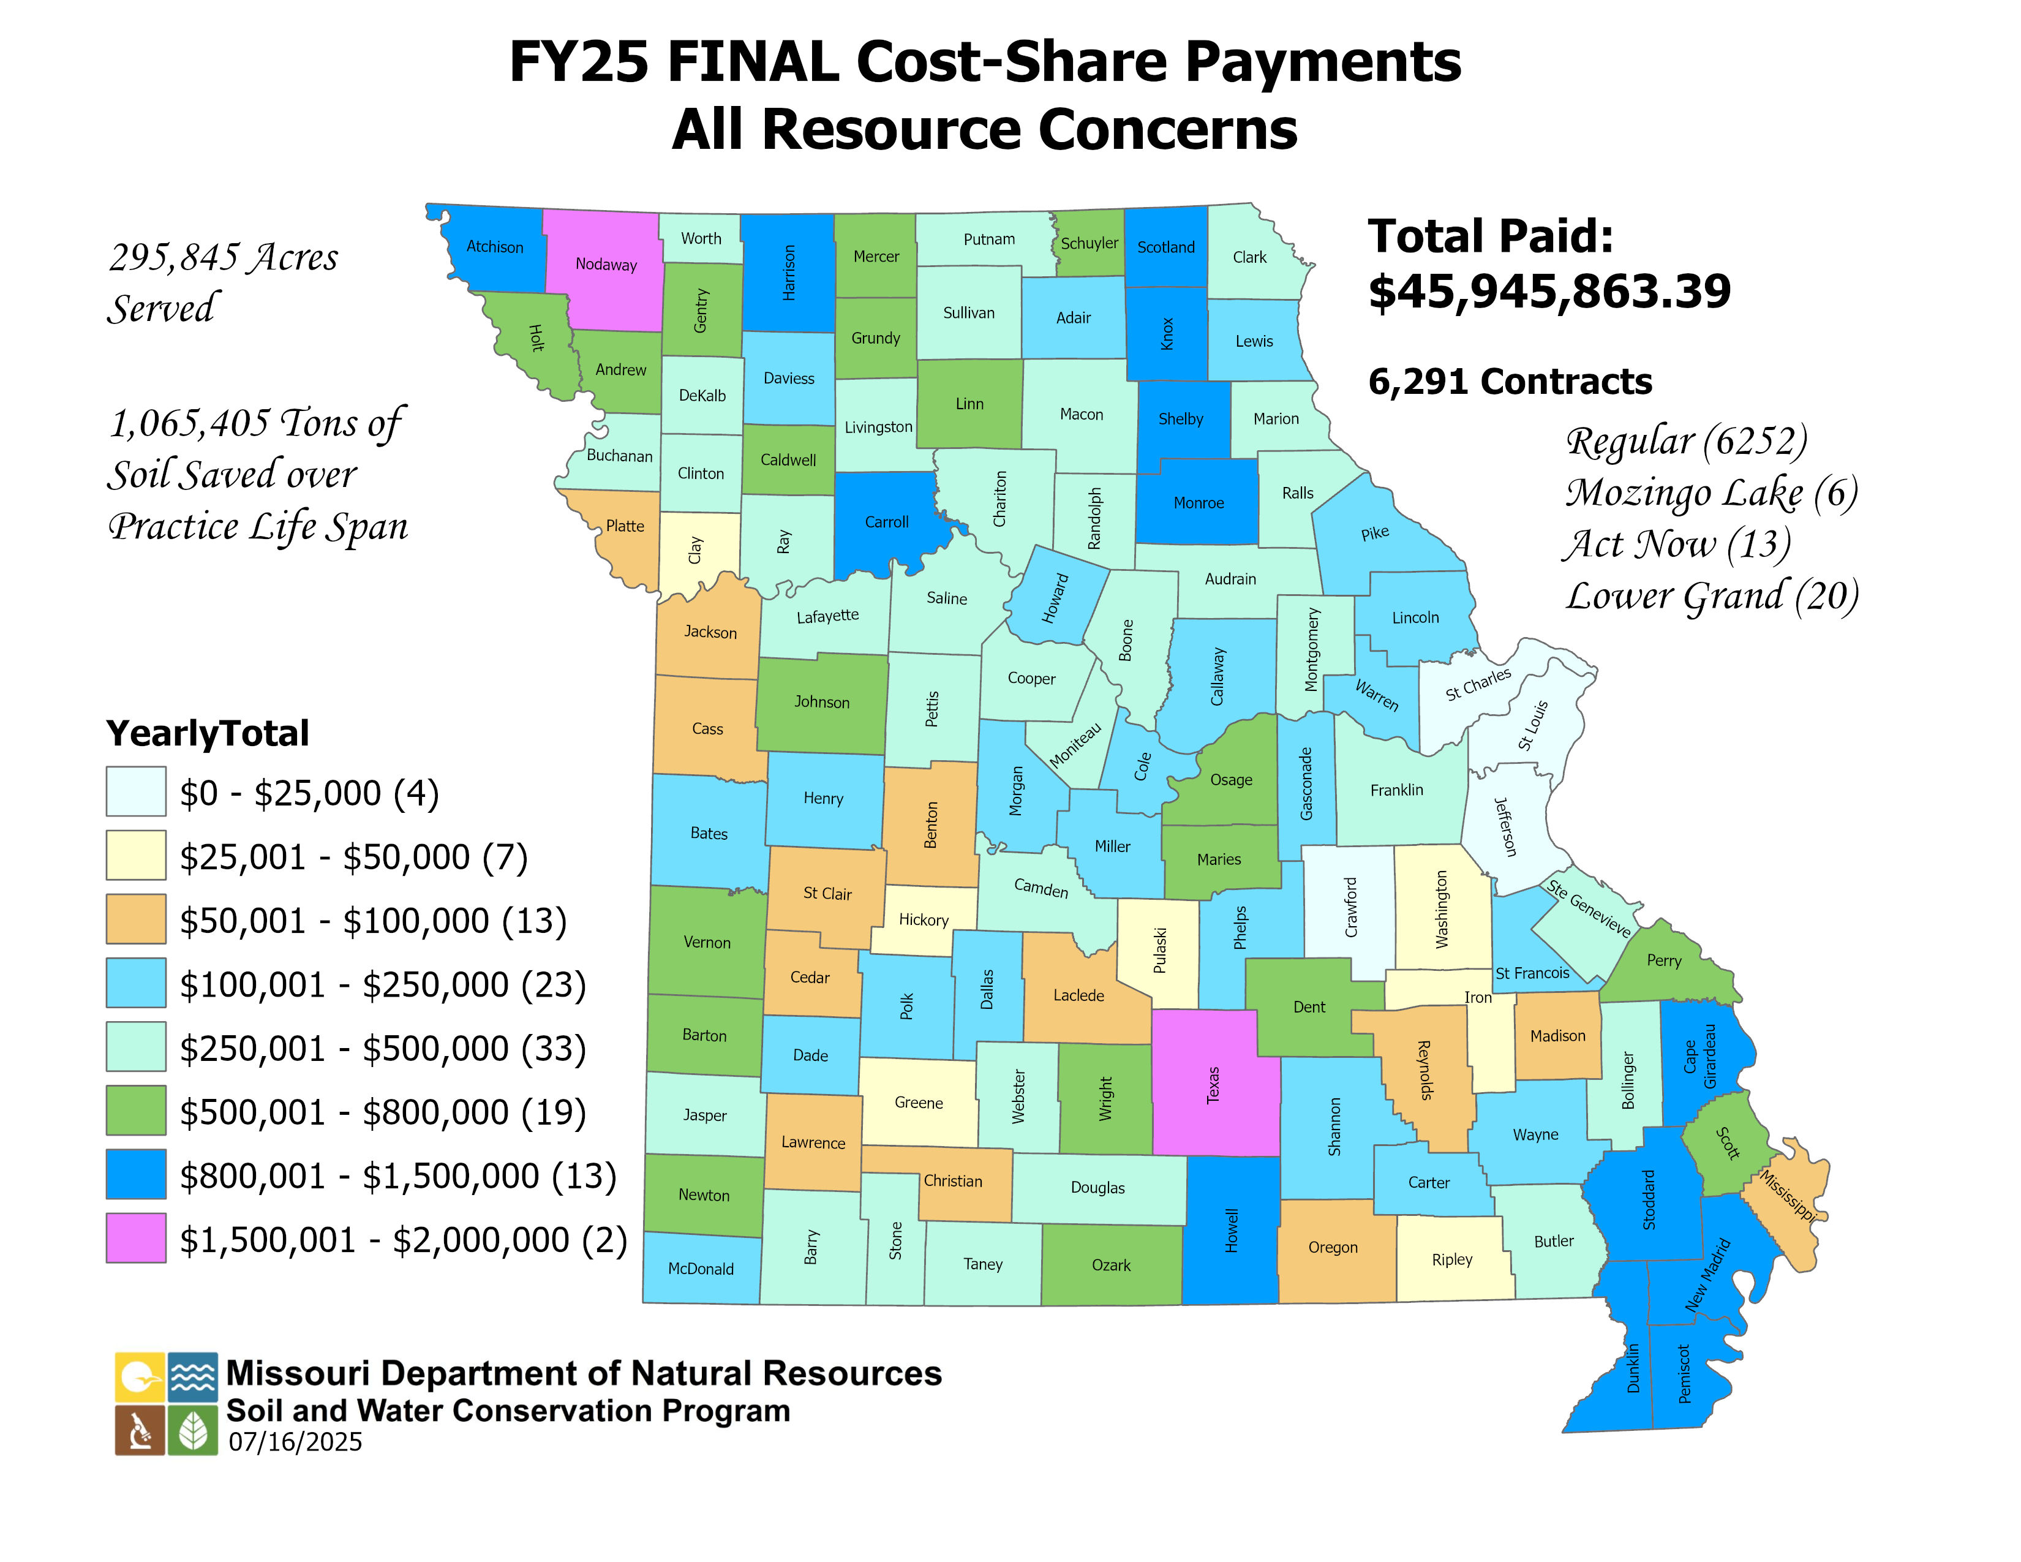

Slide 4
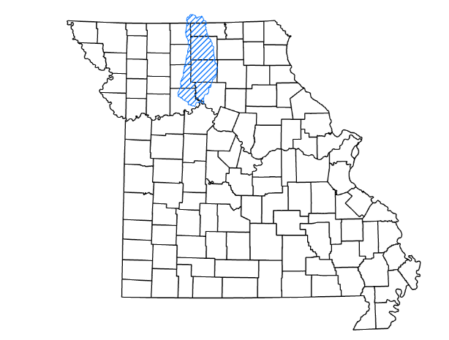
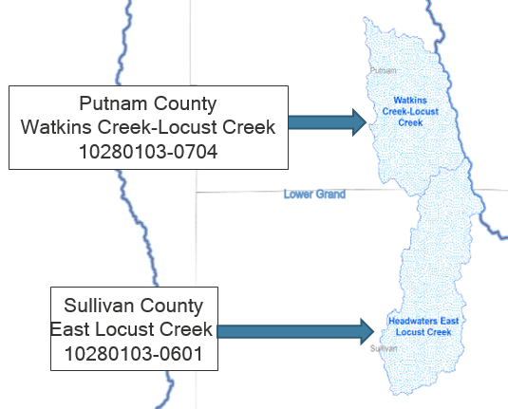
Lower Grand Targeted Cost-share Pilot
Lower Grand Watershed
Two HUC12 watersheds in northern Missouri were selected for a targeted cost-share pilot initiative
Selected streams are 303(d) listed with a long history of bank erosion, sedimentation, and nutrient/nonpoint contaminants
Monitoring and modeling are being conducted for both chosen watersheds by USGS and Program Staff
Water-quality and hydrologic data from six USGS surface-water monitoring sites located in selected streams
Program staff modeling of nutrient and sediment reductions based on installed practices

Slide 5
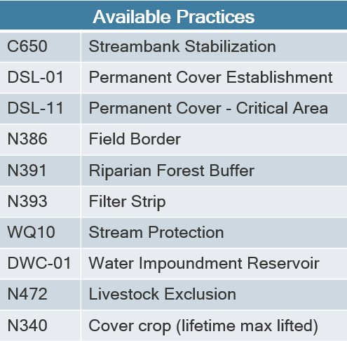
Lower Grand Targeted Cost-share Pilot
Practices offered at 90% cost-share
Promoting practices not conventionally utilized within the watershed
Selected practices that provide the most significant reductions of sediment and nutrients
Pilot began in September of FY24
Currently runs through the end of FY26
Twenty-nine practices completed or currently in-progress for a total of $358,471
13 - WQ10
12 - DWC-01
3 - N472
1 - DSL-01

Slide 6
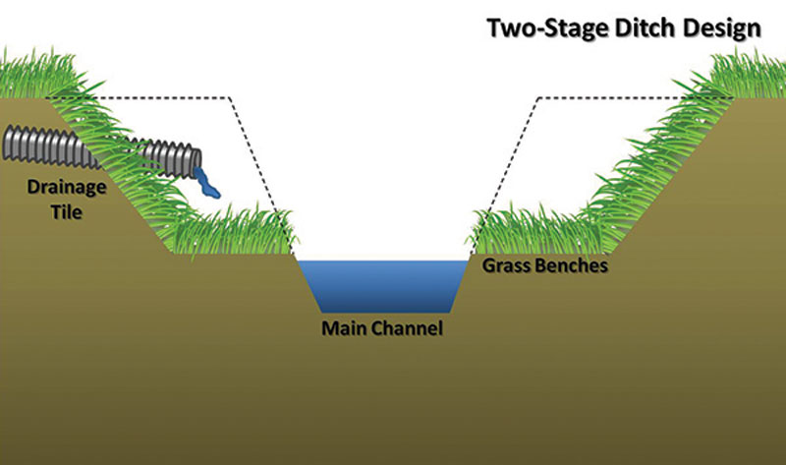
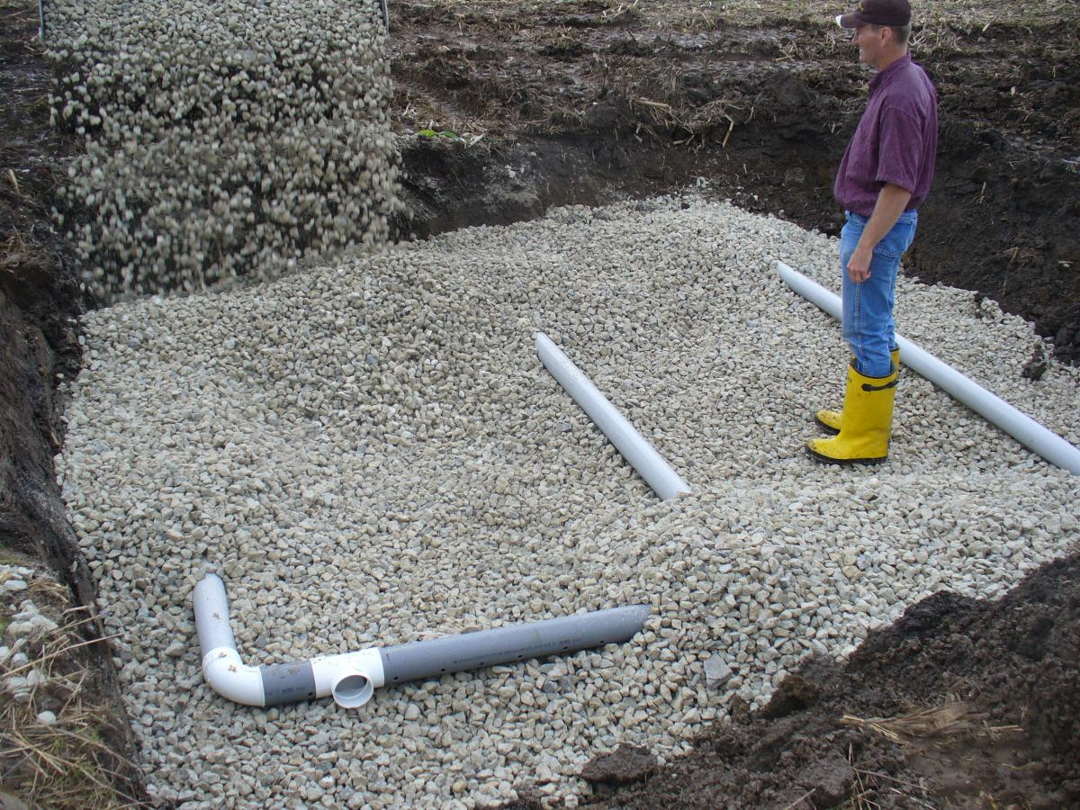
Gulf Hypoxia
Gulf Hypoxia Task Force Grant from EPA
Two Stage Ditch
Southeast MO
Evaluate water quality benefits and ditch stabilization
Filter strips and field borders
Lower Grand Watershed – Northcentral MO
Adjustment to OPI to increase utilization
Blind inlets for terrace systems statewide
Additionally doing a research project with Mizzou on water quality benefits and costs

Slide 7
NLR Modeling
The SWCP invested in a position focused on NLR modeling with the goals of:
Better communicating the benefits of the PSWST
Determine the best, most efficient practices for a given scenario
Support the states Nutrient Loss Reduction Strategy
Cost-share conservation practices are modeled to determine potential water quality benefits of these practices beyond the soil savings currently tracked
EPA’s PLET model
Purpose is to provide CALCULATED estimates of reduction in the following:
Nitrogen
Phosphorus
Sediment
Biological Oxygen Demand (BOD)
Focused first on Targeted Project Watersheds (HUC 12)

Slide 8
Compilation of Previous Modeling performed
Type of practice | N Reduction (lbs/year) AVERAGE PER ACRE | P Reduction (lbs/year) AVERAGE PER ACRE | Sediment Reduction (tons/year) AVERAGE PER ACRE | 2014-2024 C-S # Contracts | 2014-2024 Acres served | N Reduction (lbs/year) STATEWIDE (based on per acre FY2014-2024) | P Reduction (lbs/year) STATEWIDE (based on per acre FY2014-2024) | Sediment Reduction (tons/year) STATEWIDE (based on per acre FY2014-2024)
Cover Crop Total | 5.22 | 1.38 | 0.50 | 21,922 | 1,400,040 | 7,310,620.8 | 1,928,393.3 | 693,393.1
DSL-01 Total | 1.06 | 0.07 | 0.00 | 4,379 | 113,851 | 120,226.8 | 7,481.6 | -
DSL-11 Total | 1.93 | 0.33 | 0.11 | 296 | 550 | 1,060.6 | 180.7 | 62.8
DSP-02/DSL-02 Total | 1.43 | 0.09 | 0.00 | 1,757 | 49,610 | 71,168.2 | 4,420.4 | -
Fld Border Total | 6.10 | 1.35 | 0.47 | 160 | 6,872 | 41,922.3 | 9,272.1 | 3,257.3
N410 Total | 3.08 | 0.73 | 0.24 | 4,057 | 223,067 | 687,788.4 | 163,244.1 | 54,414.7
N472 Total | 8.01 | 1.47 | 0.53 | 2,324 | 62,917 | 504,210.8 | 92,408.8 | 33,564.9
Pond Total | 3.62 | 0.57 | 0.21 | 2,784 | 53,084 | 192,243.3 | 30,123.2 | 11,251.0
Terrace Total | 3.50 | 1.04 | 0.39 | 9,760 | 166,111 | 580,559.1 | 172,313.4 | 64,585.7
WASCoB Total | 6.20 | 0.94 | 0.30 | 2,878 | 33,922 | 210,217.1 | 31,814.2 | 10,030.8
Waterway Total | 2.98 | 0.87 | 0.32 | 3,635 | 120,322 | 358,419.8 | 104,338.9 | 38,471.5
WQ10 (Use Excl + Stream Protect) Total | 5.85 | 0.69 | 0.30 | 964 | 8,135 | 47,577.3 | 5,600.0 | 2,408.2
Grand Total | 234.08 | 61.76 | 0.47 | 54,916 | 2,238,481 | 10,126,014.4 | 2,549,590.8 | 911,440.1

Slide 9

Questions?
More Information:
https://dnr.mo.gov/land-geology/soil-water-conservation

