Slide 1
Missouri Nutrient Modeling
Missouri Department of Natural Resources
Soil and Water Conservation Program
Jennifer Pellett

Slide 2
Modeling Efforts
SWCP is modeling the nutrient and sediment reductions from cost-share projects completed in specific HUC 8 watersheds, which correspond to current RCPP Targeted Watershed projects.
  Watersheds included are:
    10300104 Blackwater
    07110006 South Fork Salt
    07140101 Cahokia-Joachim
    10290103 Little Osage
    10280102 Thompson
Mozingo, 10240013-0303, modeling is in addition to the RCPP watersheds.

Slide 3
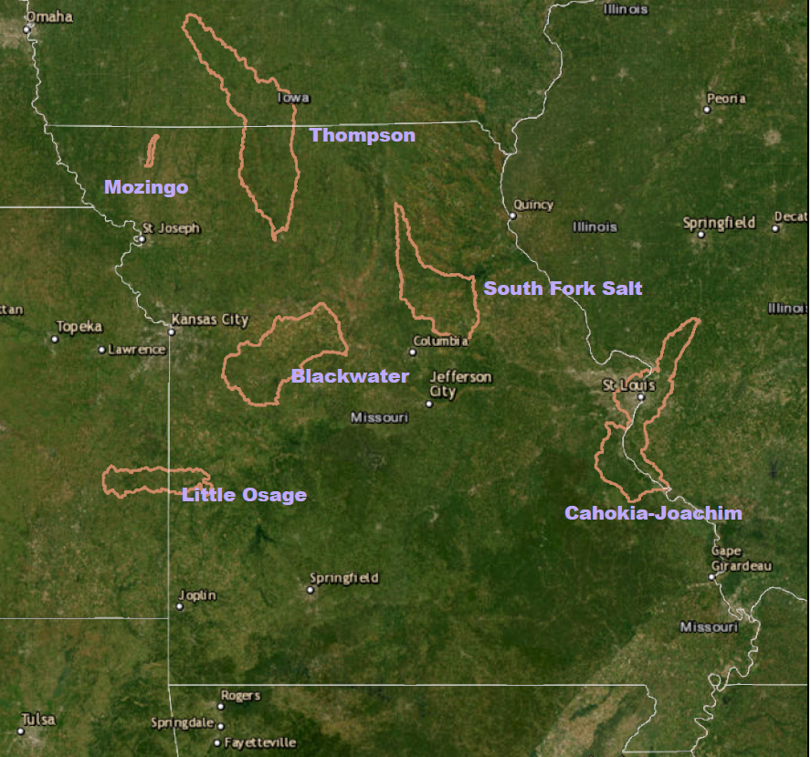

Slide 4
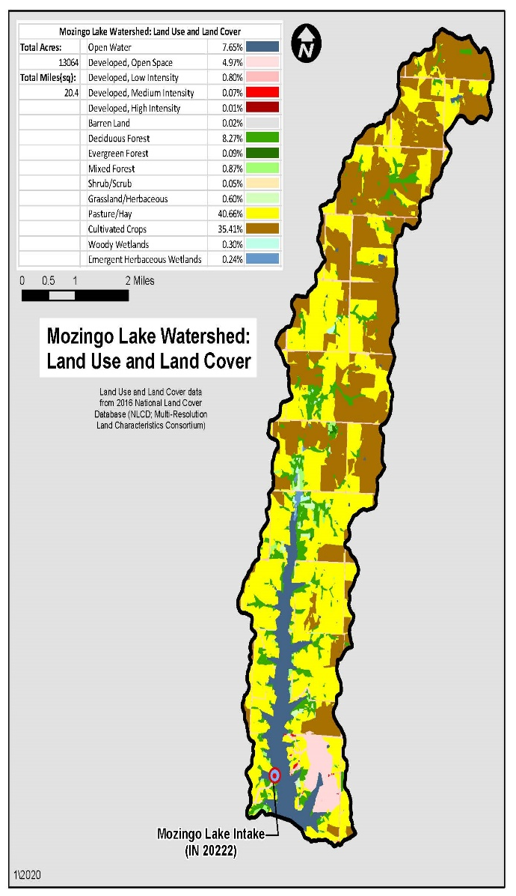
Nutrient Modeling – the Beginning
Mozingo Lake is a reservoir in NW MO containing 1006 acres of water, and has about 30,000 users
This 13,064 acre watershed lake is broken out into:
  Urban – 3000 acres
  Forest – 2000 acres
  Crops – 2832 acres
  Grass – 3248 acres
In January 2020, Mozingo Lake had elevated levels of cyanobacteria showing up in the raw water tests, high enough to trigger warning signs at the lake to limit use.
Since 2020, there has not been another excessive level of cyanobacteria.

Slide 5
WHY
USGS has stream gauges that contain auto samplers that are able to measure many types of water analysis, including pH, DO, conductance, turbidity, N, P, etc.
Two of these auto samplers are located at Mozingo Lake. One is at the inflow and another one at the dam.
Because of current and future targeted watershed assistance, and the ability to achieve actual results of sediment and nutrients within the lake, it was determined that MO SWCP needed to invest in nutrient modeling as the next step.
The modeling and actual data results can assist in determining which of the SWCP 50+ practices may be most effective.
This can determine BMPs for the future for various scenarios.

Slide 6
HOW
MO has developed its own mapping program where every practice, since the beginning of FY2022 (July 2021) has been input and can be tied to specific contracts.
This locates a specific practice in a specific watershed, and has other potential data such as erosion reduction information and acres served available for data analysis.
The following image shows just the farms in Missouri that have applied conservation practices through MO SWCP since July 2021.
This image reflects 12,625 contracts paid for a total of $79,224,890 of payments.
Only 66% of MO is considered AG land.

Slide 7
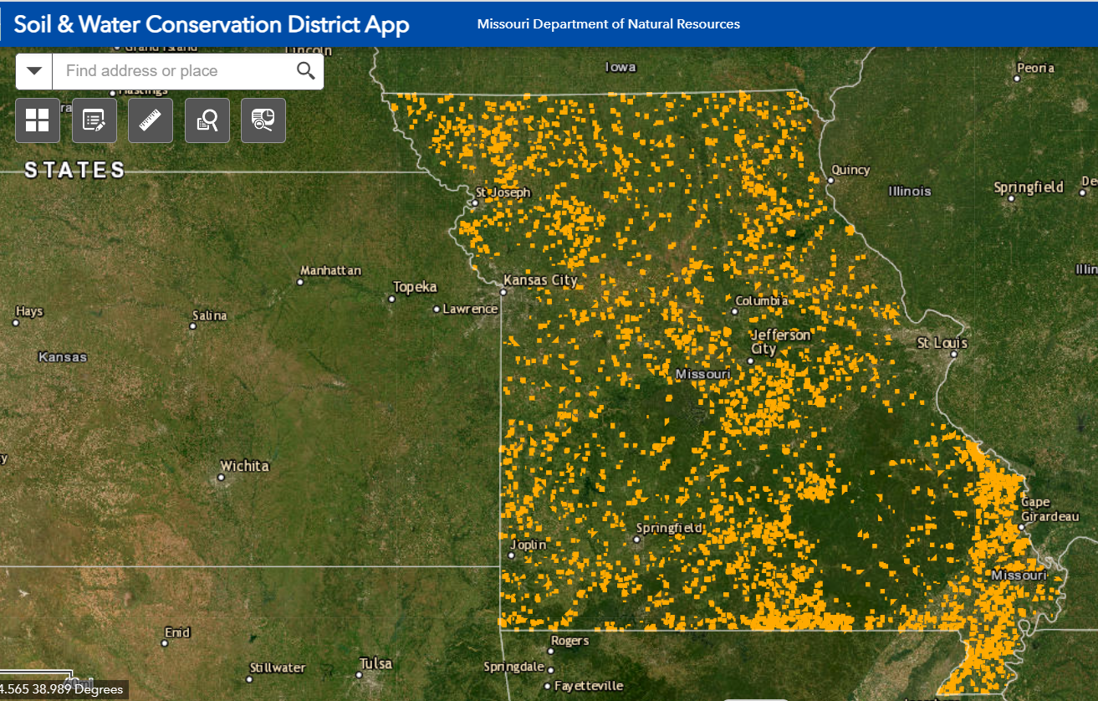

Slide 8
HOW
MO SWCP started by using an online EPA designed model called PLET (Pollutant Load Estimate Tool), which replaces EPA STEPL.
This model has been further refined by a contracted engineering firm to take the default values in the PLET and adjust it for the soils and environments found in MO.
The modeling numbers are now more representative of conditions found in each specific HUC8.
Program staff are adjusting PLET default values for the P-value and R-value within the USLE formula and the % Nitrogen and % Phosphorus in the soil for each HUC 12.

Slide 9
Modeling Efforts – RCPP CY 2022
Preliminary results from calendar year 2022 from five completed RCPP HUC 8 watersheds. Data is combined:
    255 BMP practices
    9272.06 acres impacted
    $1,880,530.54 in state cost share assistance
    Total Nitrogen reduction: 44,886.89 lbs/year
    Total Phosphorus reduction: 11,798.54 lbs/year
    Total Sediment reduction: 4,143.04 TONS/year

Slide 10
Modeling Efforts - Mozingo
Preliminary combined results from January 2020 - June 30, 2023 for Mozingo data.
    43 BMP practices
    2202.4 acres impacted
    $417,025.41 in state cost share assistance
    Total Nitrogen reduction: 7197.68 lbs/year
    Total Phosphorus reduction: 2367.74 lbs/year
    Total Sediment reduction: 1149.9 TONS/year

Slide 11
Future Plans
Continue to model the existing RCPP watersheds as data is developed and Mozingo Lake.
Work with MO State targeted HUC 12 watersheds that will be modeled.
The hope is to have modeling for all cost-share eventually.
Use of modeling data to drive the selection of future projects.

