Slide 1
Building Capacity for Conservation in MO
NASCA Annual Meeting
Oct. 7, 2024
Melissa Simmons-District Coordinator
Jake Wilson-Environmental Supervisor

Slide 2
State Cost-share Program

Slide 3
FY25 Appropriations
Program Administration
Program Salary Social Security/Medicare
Health Insurance Retirement Worker’s Comp Program E&E Building Costs ITSD
DNR Department Support
Soil and Water Conservation Program
Other,
$1,254,463
Program Admin,
$3,893,404 5%
Other
Research
2%
Conservation Monitoring Refunds
Sales Tax Collection State Auditor Attorney General
District Oper,
$20,840,899 27%
District Operations
District Salary
Social Security/Medicare Health Insurance Retirement
Worker’s Comp District Administration ITSD
District Contract Audits Surety Bond
Technical Assistance
Total:
$75,988,766
Cost-Share,
$50,000,000 66%

Slide 4
Where we are now
With increasing workloads on both the state and federal side, and tremendous turnover rates, technical capacity (engineering, conservation planning, CR) is reaching a breaking point
This is both a hiring and training issue
Adding Technical staff at the state level has proven impossible due to legislative budget process
State is somewhat unique in how we support SWCDs (Personnel and admin funding)

Slide 5
What have we tried?
Failures/Lessons Learned
Placing Engineers in Districts (District Grants)
Sharing Employees across districts
Encouraging Cross Training
Successes
Sharing employees across districts
Encouraging cross training
Private Technical Assistance (not TSPs)
Leaning on partners

Slide 6
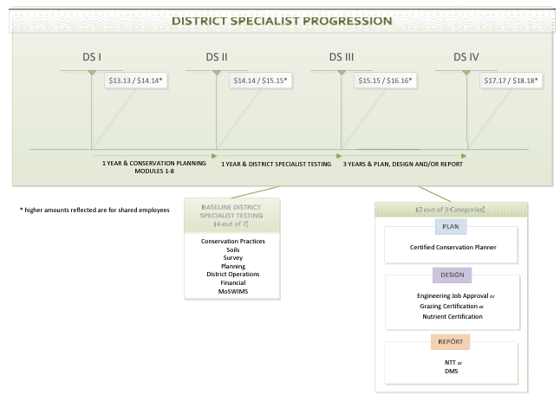
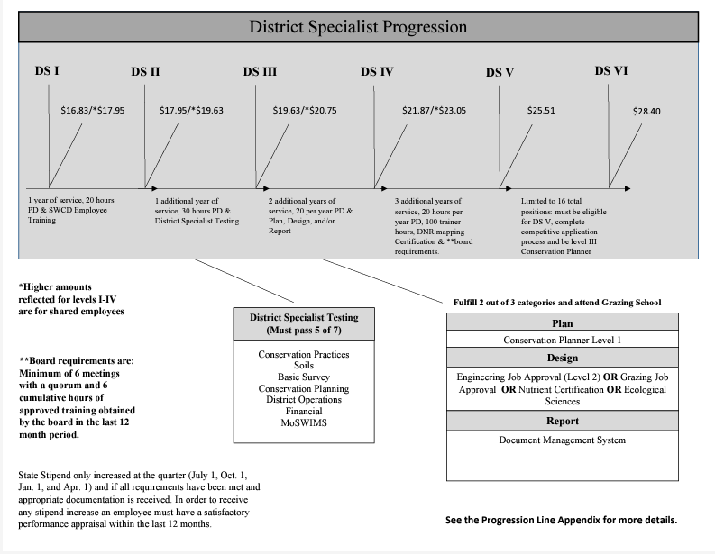
Progression Line
For each DSVI we are adding a new DSI position for a total of 16 additional staff (296 total)

Slide 7
Performance Funding
Districts may receive up to 1% of previous years cost-share payments
Board chooses how they use
Salary, health insurance premium, mileage, info-ed
Are presented with metrics (percentile rank) so they see what areas need improvement
Based on 4 measures
Administrative score, acres served, diversity of practices, board metrics
$320,000 going to districts this FY
Highest=$11,900!

Slide 8
Contribution Agreements
MFA
Assist the Department in development and implementation of workshops and field days for private landowners to help promote soil and water management objectives, as well as the common-ground conservation improvement mission of both MFA and the Department.
20 landowner visits per year
4 field days
Identify training opportunities
New and emerging technologies

Slide 9
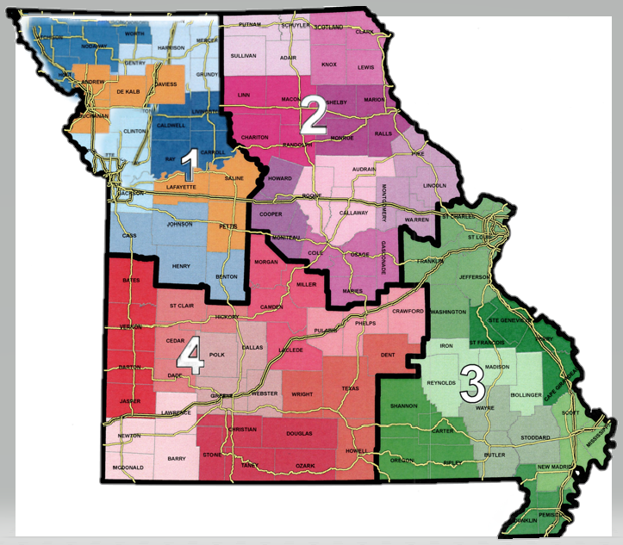
Contribution Agreements
NRCS
Original 5 year agreement provided for 30 FOSA shared employees
50/50 State and NRCS
$1 million annually
Also provided District engineers
Amended to support an Archaeologist

Slide 10
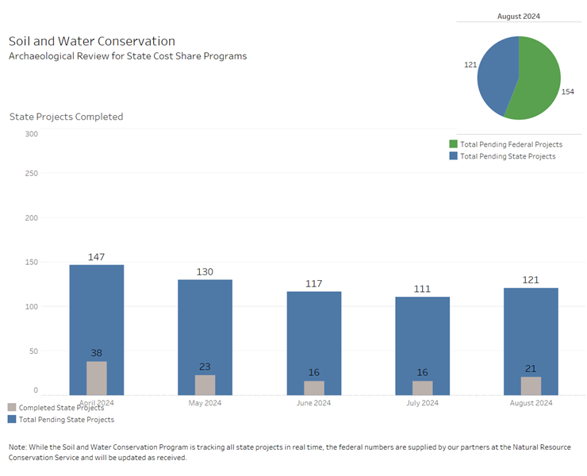
CR Tracker

Slide 11
Contribution Agreements
New NRCS Agreement
Continue with FOSA shared model
18 FOSA techs
Provide engineering assistance
5 PEs housed in NRCS area offices, but administered through a SWCD
Provide specialized conservation planning assistance
4 rapid response specialty conservation planners
Continue to support Archaeologist

Slide 12
Partner Contributions
MASWCD
CA for Archaeologist, Training Coordinator, and Engineer
Conducted Training needs and mentorship survey
Hosted Grazing management trainings
Working on more analysis and training development
Seeking NACD Grant for District Staff

Slide 13
Partner Contributions
NRCS
Due to reporting district work in CD/CART, have been able to increase staffing: 289 in 2019 to 400+ today
Financially support CAs with DNR-SWCP, MASWCD, PF/QF, NWTF, MO Cattlemen etc…
EQIP+CSP for this year >$100 million

Slide 14
Training
Implemented standardized District Specialist training in FY21
150 have completed
Implemented online testing app*
Implemented program planning retreat* that led to in depth analysis and rework of how we organize and deliver training resources
Six Sigma Green Belt/Lean analysis of efforts to date.
Incentives for board training*
*Idea Implemented in part from NASCA Annual Meeting

Slide 15
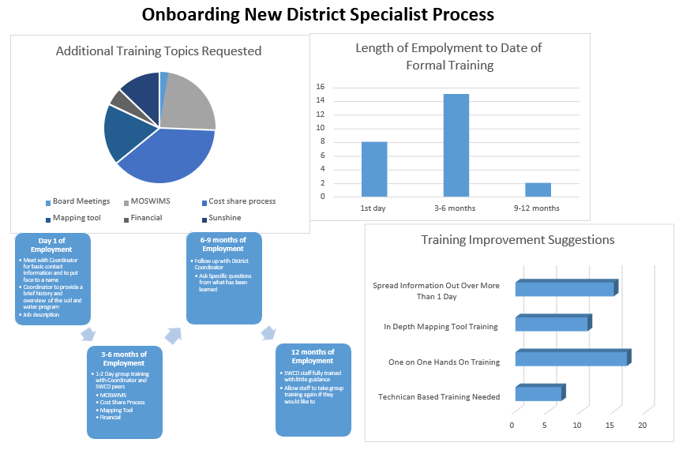

Slide 16
Training Portal
At our first ever program retreat, a facilitated deep dive into our operations showed that our training resources were not well standardized, accessible, and organized.
As a result, program staff have been working on a training portal that employees and board members will have access to:
best hiring practices
employee management
district policies
videos on how to do things in our accounting and contract management system for visual learners
quick reference guides and tools

Slide 17
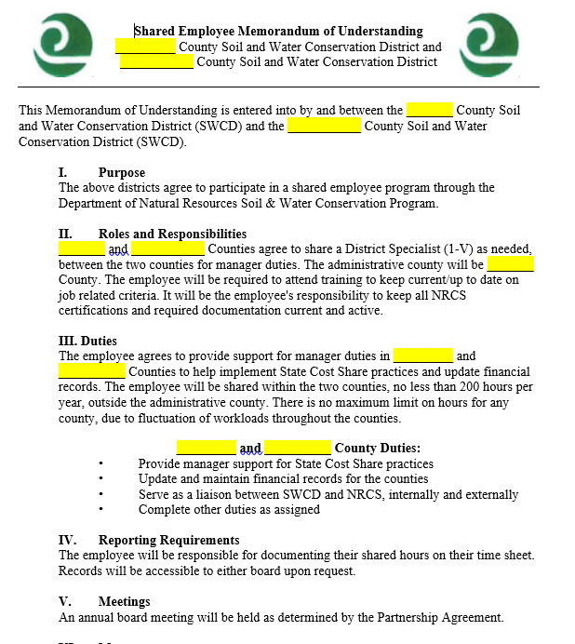
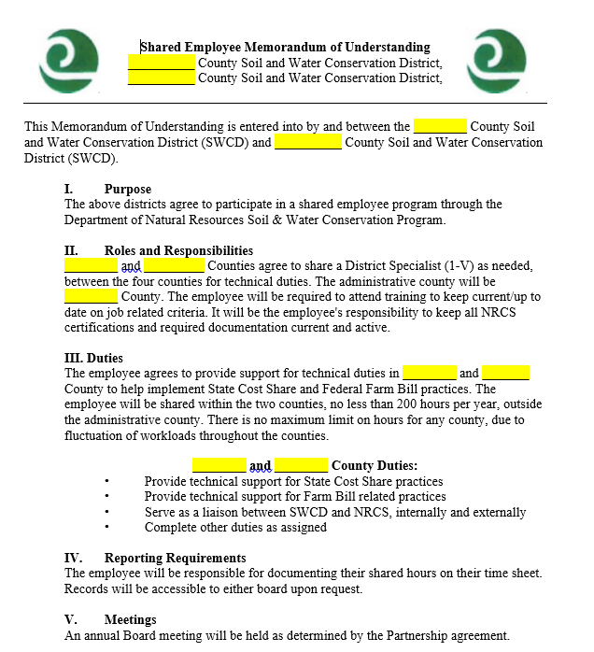
Manager MOU
Technician MOU

Slide 18
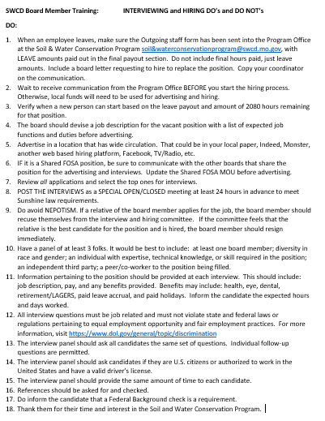
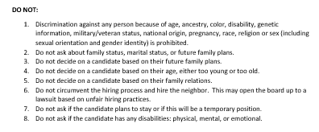
Hiring Do’s…
…and Do Not’s

Slide 19
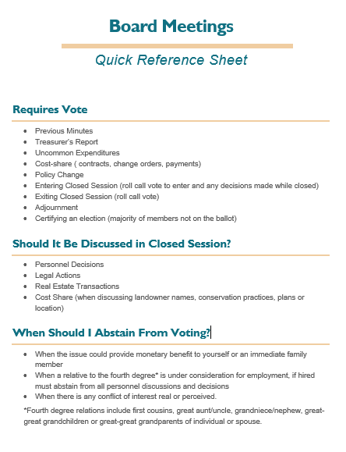
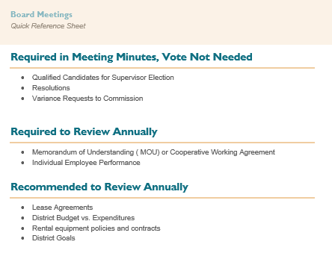

Slide 20
Where do we go from here…
Staffing
Continue to ask for FTE
Hire/Onboard 20+ district specialists, 5 engineers, 4 specialty planners, 1 watershed coordinator…
Training
Meet and greet for district staff on first day
District networking/idea sharing in each coordinator area 2-3 times a year
Group mapping training in each area 2 times a year
Work with NRCS to develop a training plan for new technicians with monthly goals(in MOA)

