Slide 1

BWSR/NRCS Soil Health Programming
October 8, 2024
Jill Sackett Eberhart - BWSR Board Conservationist
NASCA - Duluth, MN
September 24, 2024

Slide 2
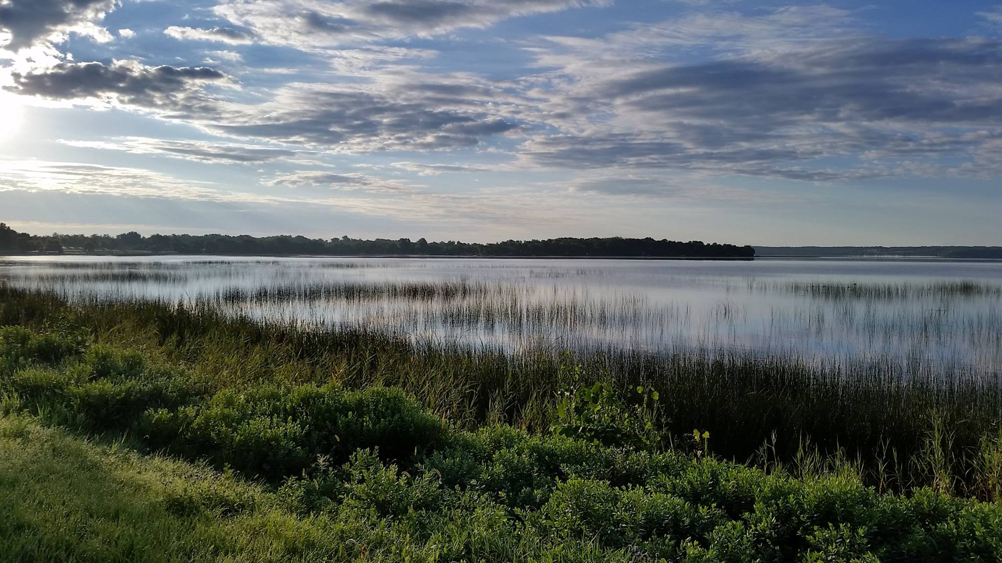
BWSR’s mission
Improve and protect Minnesota’s water and soil resources by working in partnership with local organizations and private landowners.
Notes:
BWSR’s mission is to improve and protect Minnesota's water and soil resources by working in partnership with local organizations and private landowners.
We are uniquely positioned through state law to develop and implement programs resulting in healthy soil and clean water.
As the state’s water and soil conservation agency, we direct, coordinate, and provide funding to local governments to help private landowners and communities meet their conservation goals and responsibilities. The 78% of state land that is held in private ownership -- farms, forests, and urban areas totaling approximately 41.7 million acres -- contribute greatly to Minnesota’s production of environmental goods and benefits.
BWSR staff members in Bemidji, Brainerd, Duluth, Detroit Lakes, Mankato, Marshall, Rochester, St. Paul, and Waite Park provide assistance in easements, wetlands, engineering, buffers, ecology, watershed planning, grants, and partner training.
BWSR’s activities are governed by an appointed board whose 20 members represent citizens, local
governments, state natural resource agencies, and the University of Minnesota. The board is the state's administrative agency for soil and water conservation districts, watershed districts, metropolitan watershed management organizations, and counties that are responsible for land and water management. The board sets a policy agenda designed to enhance conservation delivery through these governmental partners. Board members, including the board chair, are appointed by the governor to staggered four-year terms.

Slide 3
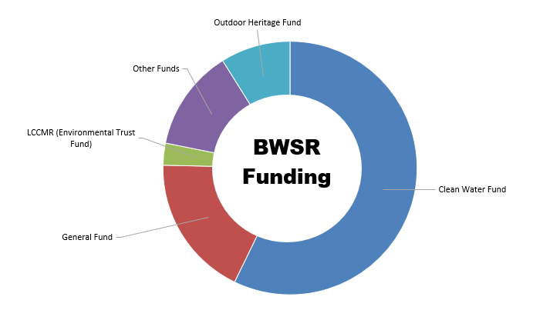
BWSR Funding – FY22/23 Biennium
General Fund: 18%
Clean Water Fund (CW, L&L Amend.): 57%
Outdoor Heritage Fund (CW, L&L Amend): 9%
LCCMR (Enviro Trust Fund): 3%
Other: 13%
Notes:
FY22/23 numbers
Clean Water Land and Legacy Amendment (56% of the vote in 2008) which increased sales and use tax rate by 3/8 of 1% and began July 1, 2009.
Other = Inter-agency agreements; special revenue (agreements w/ non-state agencies); Federal funds; and Bonding funds.
76% of BWSR funds is passed through to our partners
18% agency operations.

Slide 4


How did we (BWSR) get here . . .
Creation of MN Office for Soil Health “MOSH” with University of Minnesota (WRC and Extension)
“State Cost Share” grant (103c.501) allows Non-Structural Practices
BWSR staff review CC Demo program with recipient SWCDs
BWSR Board Authorizes Cover Crop Demo Grants
(Competitive)
Continued MOSH funding
1st CWF Soil Health
(Competitive)
Continued MOSH funding
1st Gen Fund Soil Health
2017
2018
2019
2020
2021
$350K CWF
$100K NRCS
$1M CWF
$400K GF&CWF
$3.5M CWF
$0 GF
$350K CWF
$1.3M GF
Notes:
Standard BWSR eligible practices have been structural and vegetative, primarily following NRCS practice standards or enginnered designs. Sediment basins. Conservation cover. Grass waterways. But starting with the FY2017 State Cost Share grants via the Erosion Control and Water Management policy (103c.501), nonstructural land management practices (1 year lifespan….some of the “typical” soil health practices like cover crops and strip-till) became eligible. Sticks in my mind because it was my first year here at BWSR and I joke I would have never joined the team if cover crops weren’t eligible . Also when the flat rate financial assistance option came to existence.
In calendar year 2017, the Minnesota Office of Soil Health (MOSH) was formed.
In FY2020, Cover Crop Demo grant rolled out as a pilot. Includes landowner surveys and half-way point sitdowns with the grantees to discuss progress and what could change and what could stay the same

Slide 5
How did we (BWSR) get here . . .
Amendments to 103C.501
103F.06 Enacted
Gen Fund Soil Health
CWF Soil Health
NRCS RCPP Award
Soil Health Delivery Grant rolls out
Soil Health Staffing Grant rolls out
McKnight Award for State Soil Health Action Framework
Climate Smart – VT Alliance Project rolls out
Continued MOSH funding
RCPP – AFA rolls out
2024
2022
2023
2025
$12M CWF
$21M GF
$25M NRCS
~$3M USDA
($16M direct to farmers)
$450 GF&CWF
$25M NRCS
$5 M CWF
(+Staffing & Delivery)
$85K McKnight
~$3M USDA
($16 M direct to farmers)
$17.6M GF
$6.4M CWF
Notes:
State Soil Health Framework -
Amendments to 103c.501 resulted in large changes in our General Fund grants to SWCDs, but continued to allow NLMPs.
103F.06 is the State statute that established BWSR’s soil health programming

Slide 6
How New funding fits together
Phase 1
Soil Health (additive) Staffing
(General Fund)
Phase 2
Soil Health Delivery
(Clean Water Fund)
Phase 3
Soil Health Practices
(RCPP)
Staffing
Practices
Education & Outreach

Slide 7
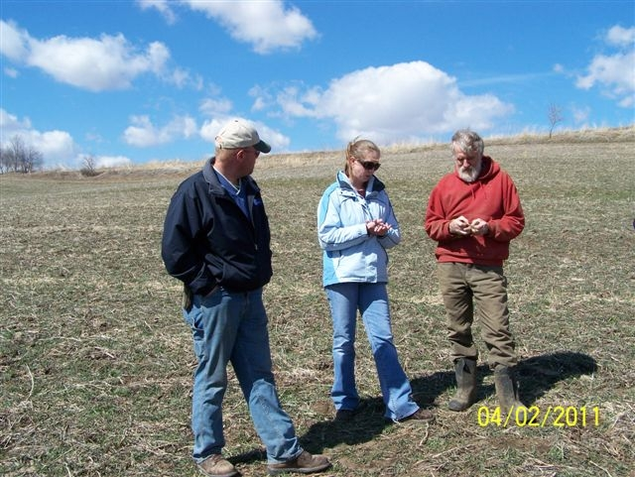
State Funds – Soil Health Staffing
Soil Health Supplemental Staffing Grant (Phase 1)
To create additional local points of contact to work with landowners on increasing utilization of soil health practices and systems that advance the principles of soil health
Competitive (SWCDs), statewide RFP (~$17.6M GF)
Increase
  Trusted local expertise (Staff/assistance capacity)
  Partnerships
  Mentorship and farmer-to-farmer learning support
Notes:
Districts only
Spring-ish 2024
36 FTE equivalences just from the grant (SWCD staff, coop staff, private agronomists, farmer mentors)

Slide 8

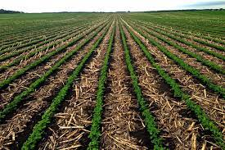
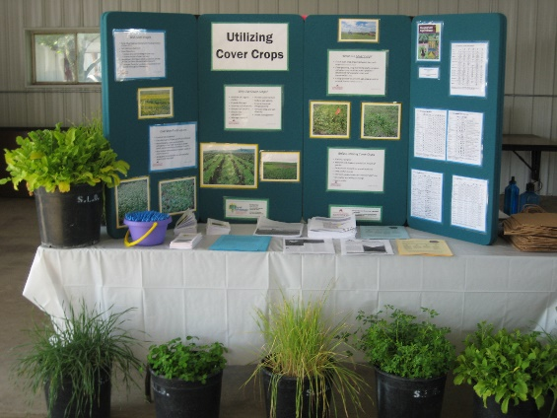
State Funds – Soil Health
Delivery Grant (Phase 2)
Soil Health implementation (financial assistance), education/outreach, staff time
Non-competitive (RFI), statewide, formula based
  Rolled out Summer 2024
  $6.4 Million awarded
  Local policy driven
Notes:
SWCDs only
Similar to a regular Clean Water Fund grant
Equipment will not be eligible

Slide 9
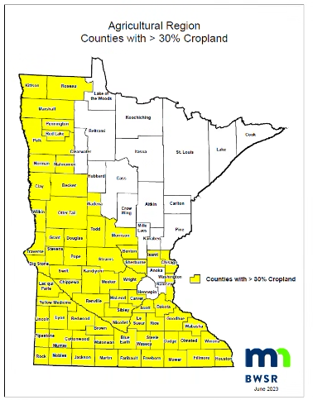

Federal Funds – RCPP
Regional Conservation Partnership Program (RCPP)
Advancing Soil Health in Minnesota Agriculture
  Soil health practice implementation
Total Funding Request: $25 Million
  Match ($17.6M GF; $6.4M CWF; $5 CWF T/E)
Alternative Funding Agreement (AFA)
Counties with greater than 30% agriculture
Still under negotiation
Notes:
The Advancing Soil Health in Minnesota Agriculture project will offer financial incentives to producers for implementing soil health best management practices and systems such as no-till, strip-till, rotational grazing and cover crops.
Application awarded (email 11/1/23). BWSR Press release 11/6/23.
RCPP through an alternative funding arrangement/agreement (slightly different from RCPP “classic”)
$25 million awarded
Greater than 30% agriculture counties
Application was done this way at a suggestion for how to make the application more competitive
Still in negotiations with NRCS
Winter 2025

Slide 10

BWSR Minnesota Soil Health Contacts:
Jared House – Soils Program Coordinator
  Jared.House@state.mn.us
  302-407-3856
Tom Gile – Resource Conservation Section Manager
  Tom.Gile@state.mn.us
  507-696-1974

