Slide 1
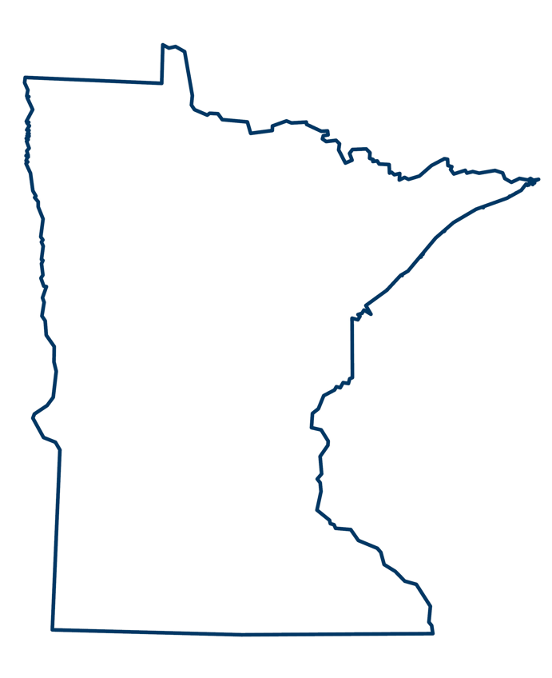
88 SWCDs
87 counties
69 Watershed Districts
853 Municipalities
11 Federally recognized tribal govts
3 major drainage basins
4 biomes
Notes:
….and lots of partnerships and programs and opportunities to solve local solutions via the same statewide programs but in slightly or vastly different contexts

Slide 2
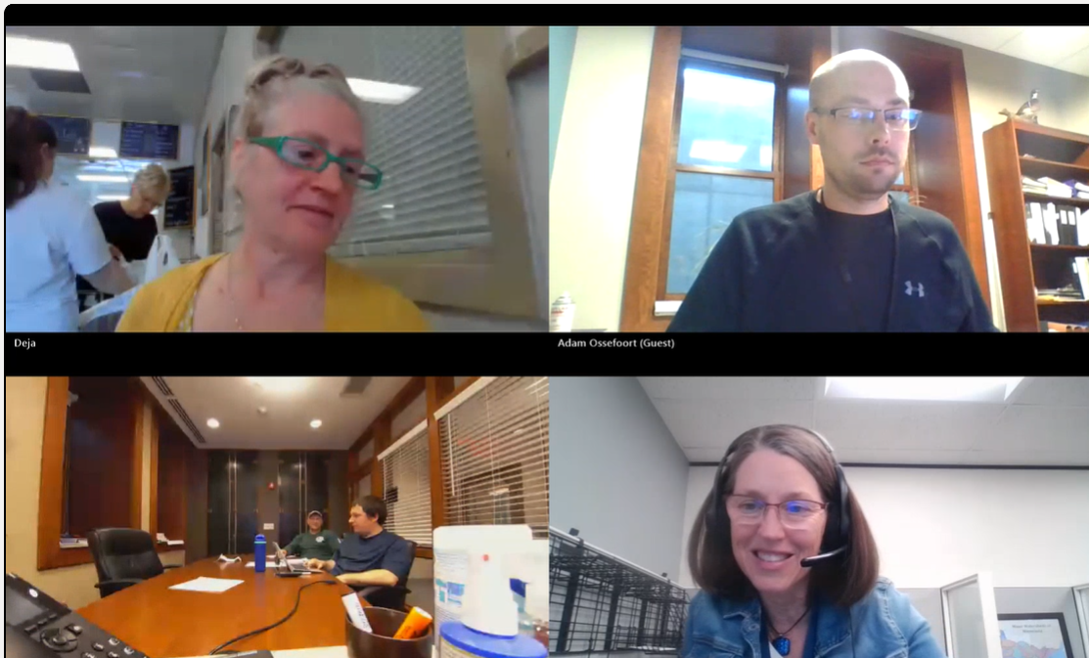
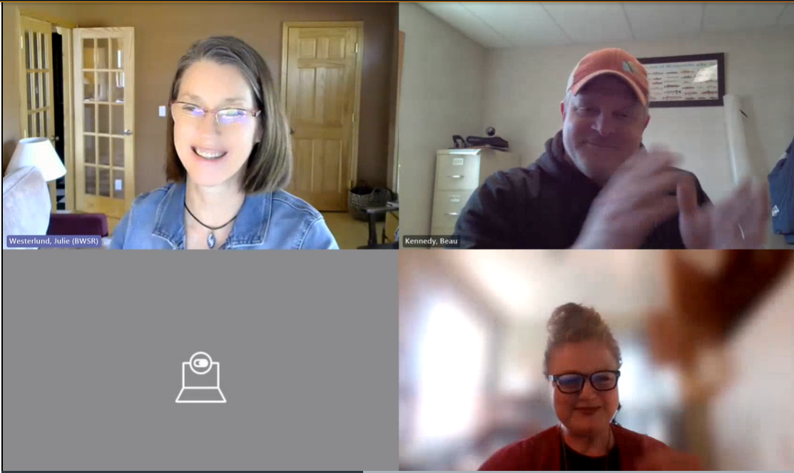
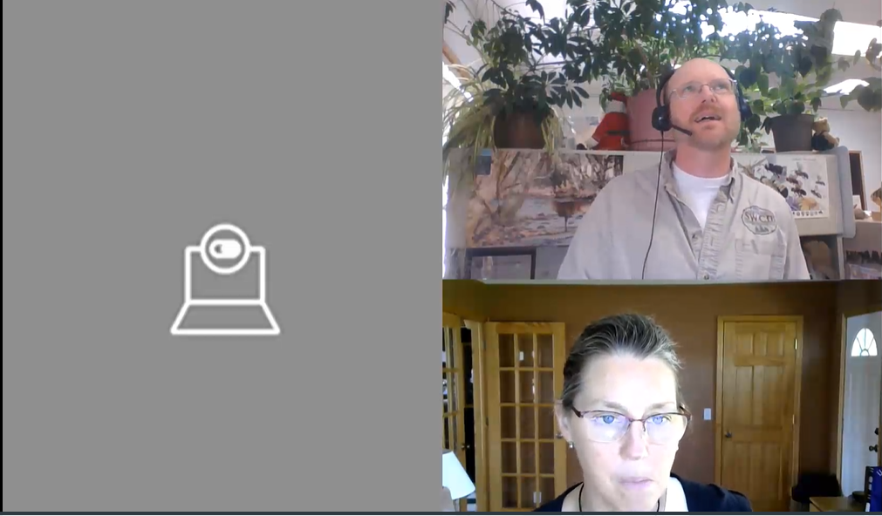
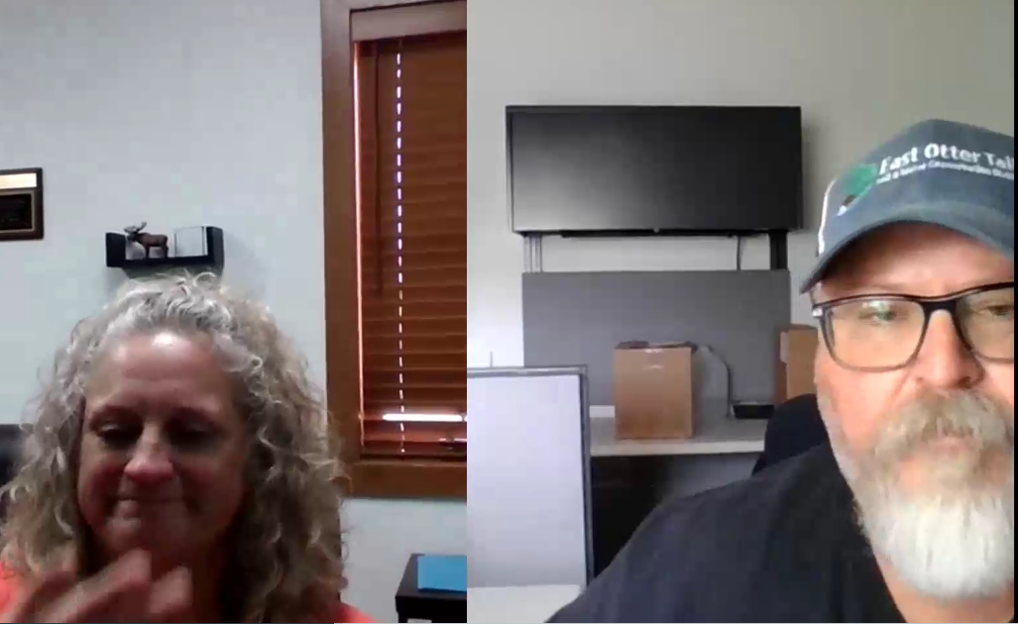
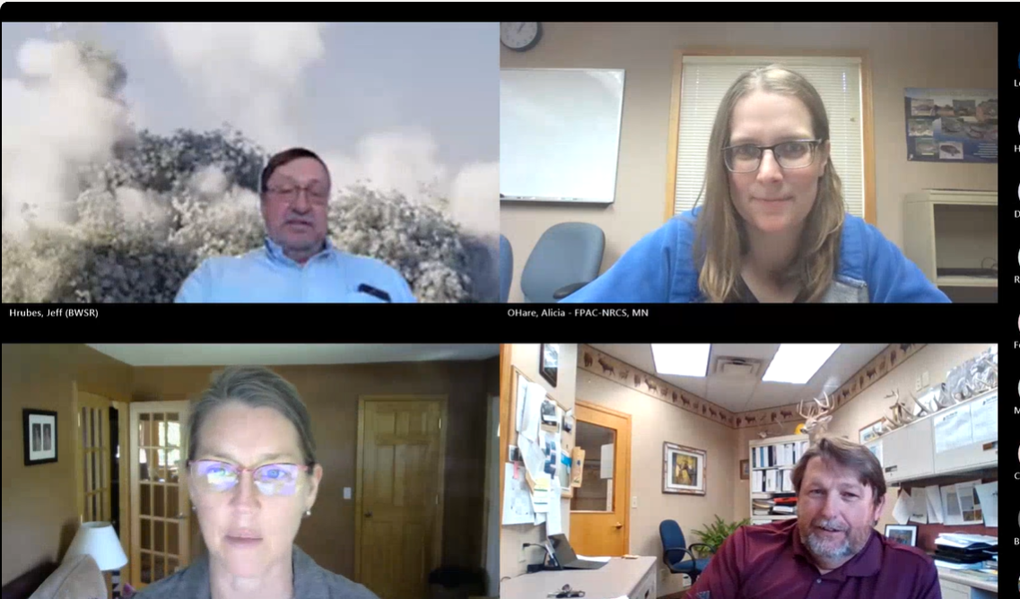
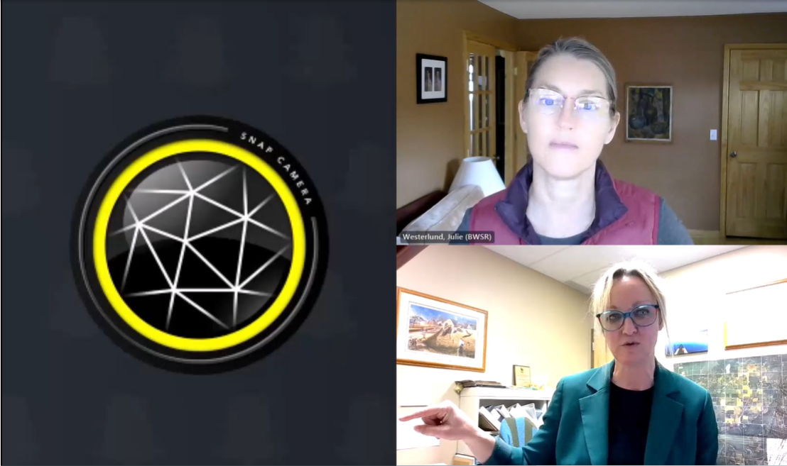
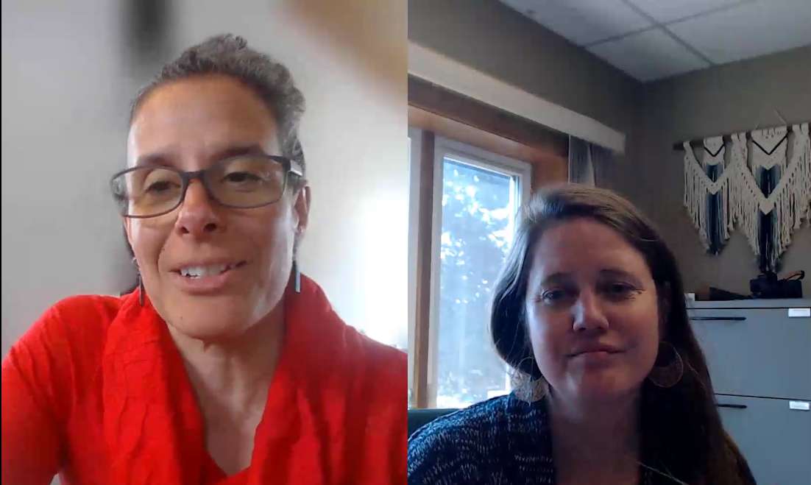
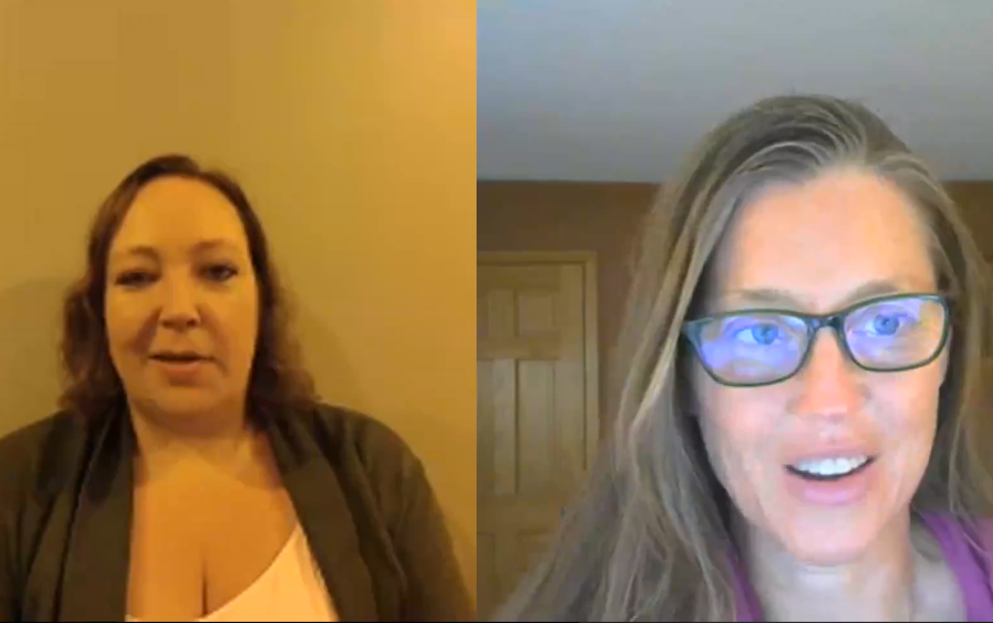
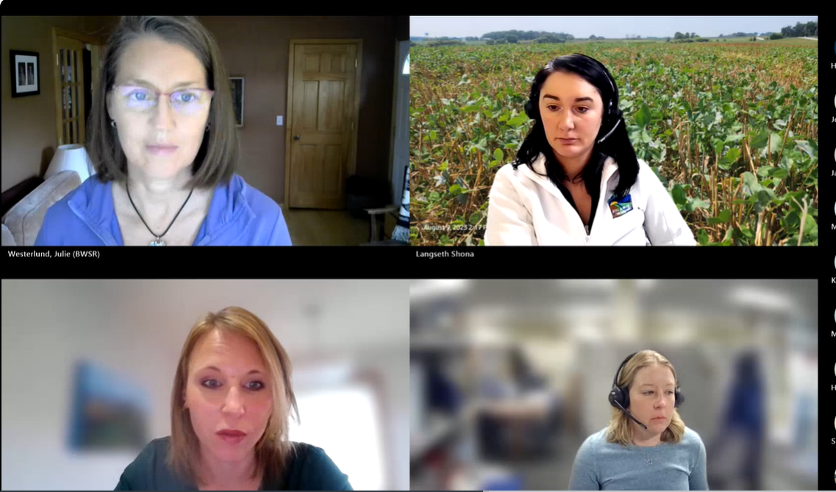
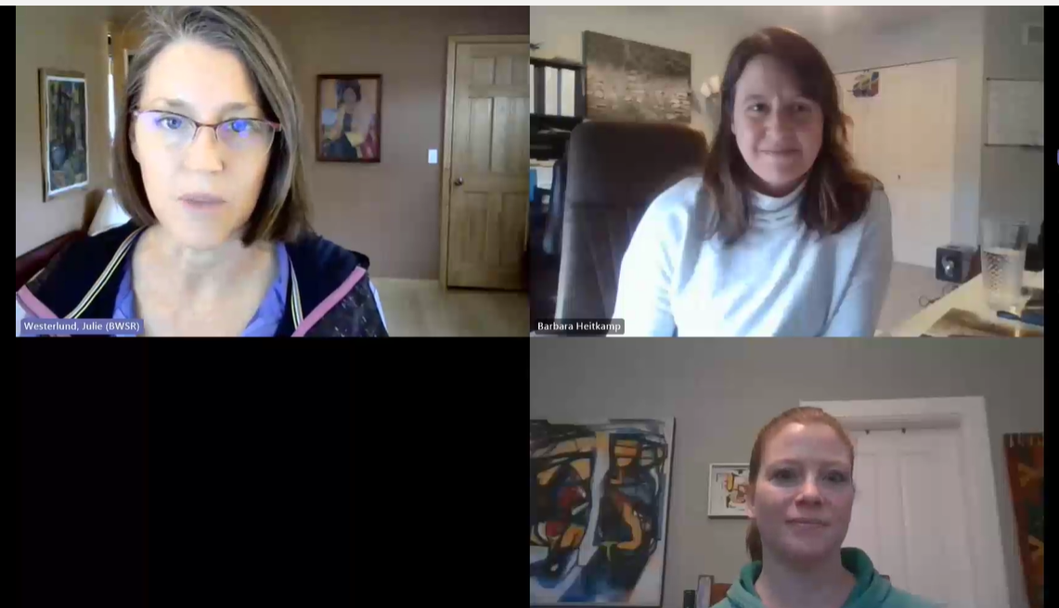
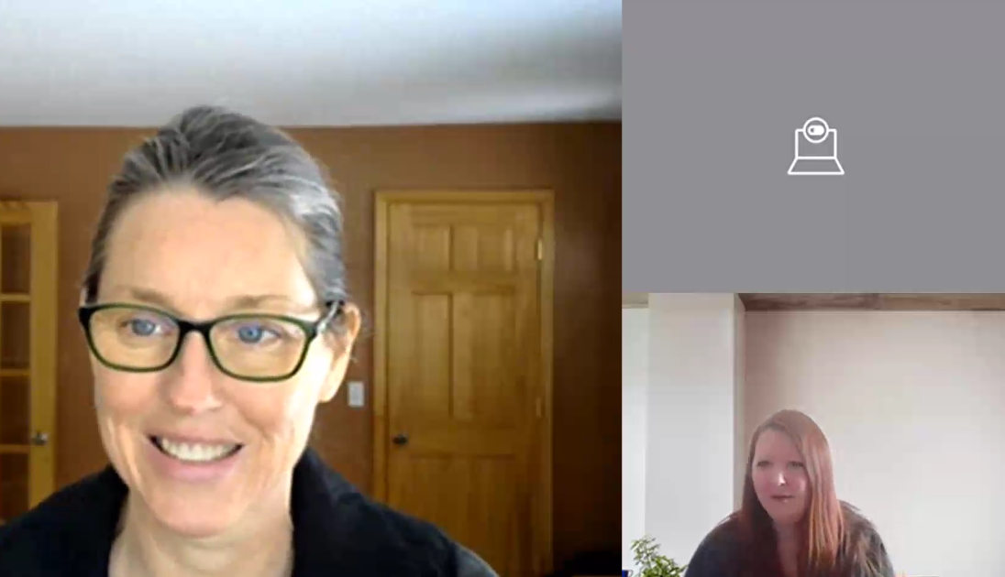
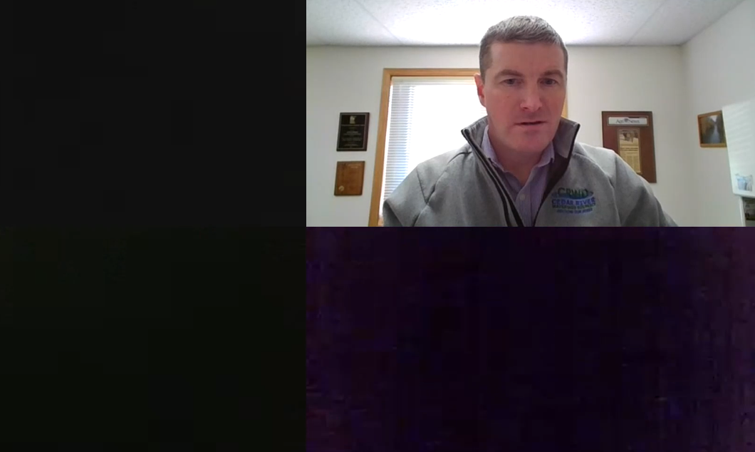
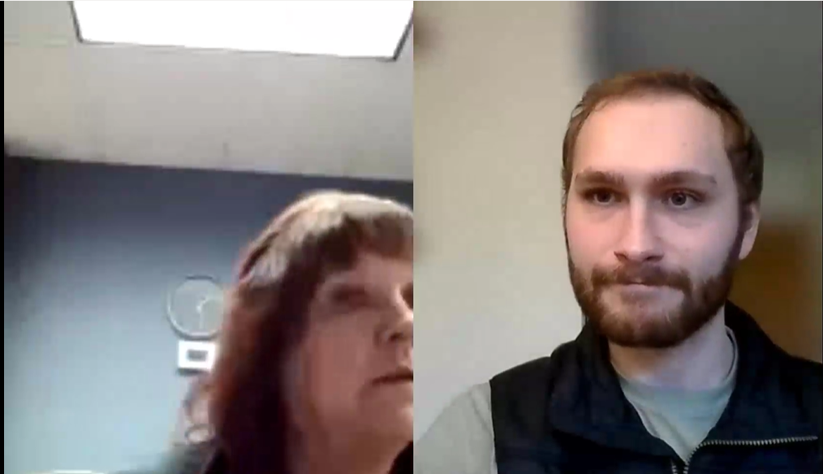
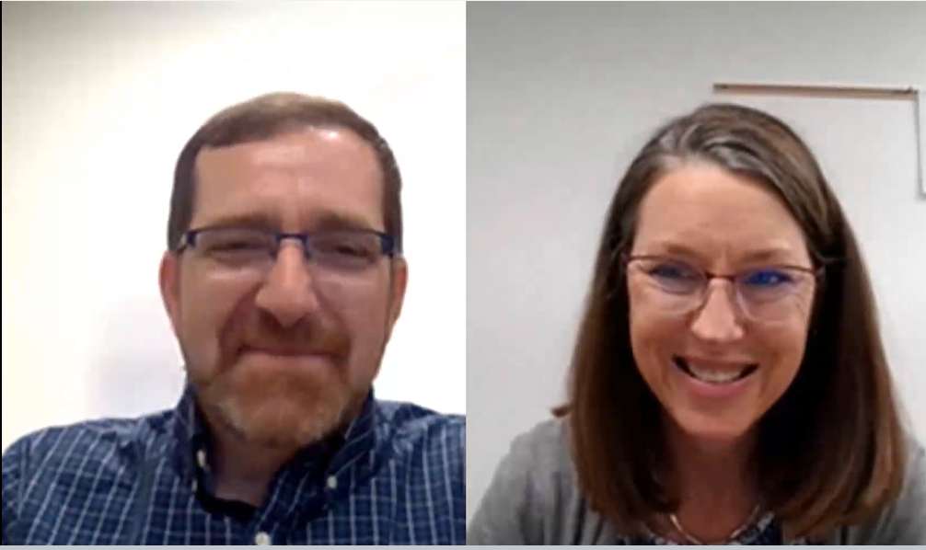
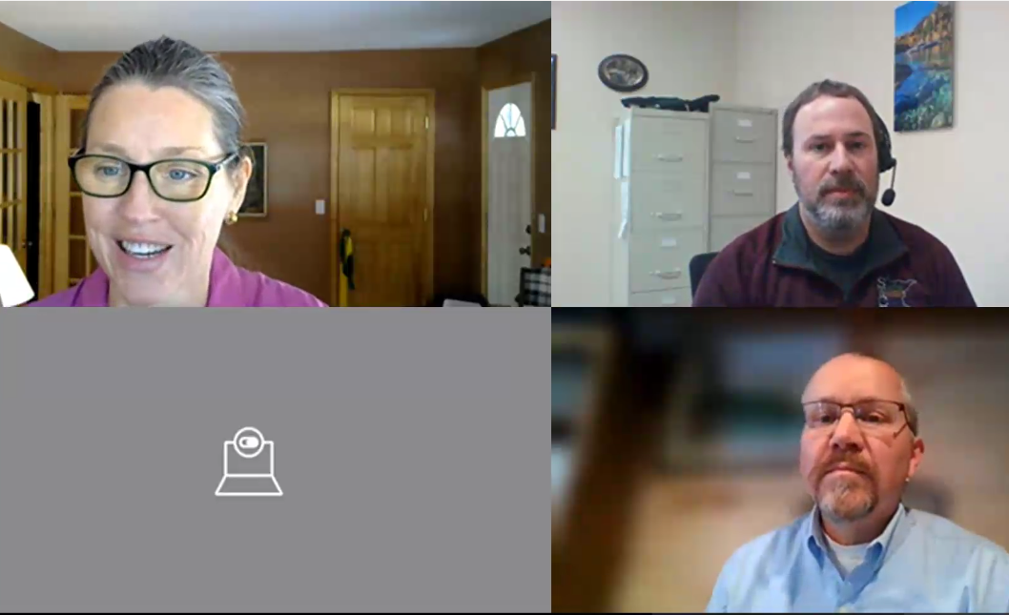
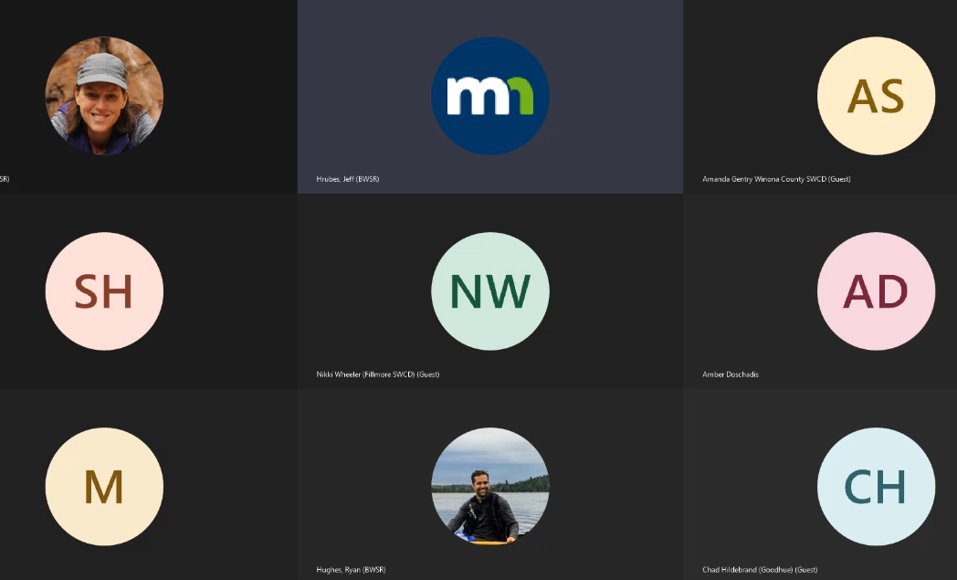
Local Implementers Discussions
Notes:
Jeff: The local implementers discussions is a way for local implementers to share their great solutions with each other. It’s peer-to-peer learning, facilitated by BWSR.
These are hour-long, informal sessions that occur once every three weeks or so in the first half of the year.
There’s no set format. People can just come and talk or they can offer a power point presentation or walk through a live demo of something.

Slide 3
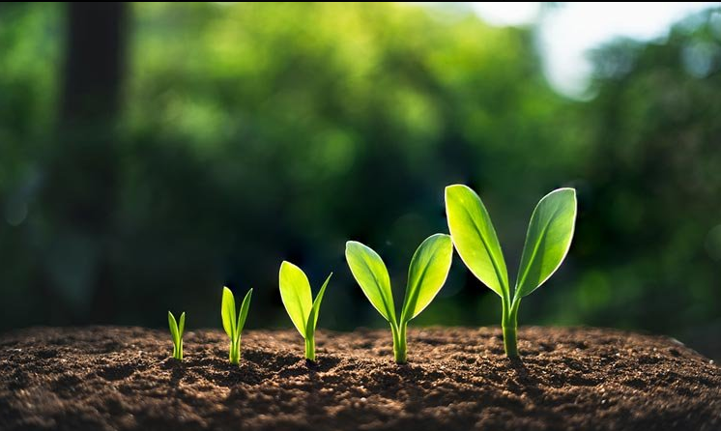
Notes:
Julie: These sessions started as a small group of folks who were at a similar place in their plan development and were trying to figure out how to build a system to track their implementation. Jeff got a handful of people together, invited me, and we went “hey, that seemed pretty effective.”
We decided to see if we could attract more folks and whether they’d receive it positively, and it’s grown into something people are telling us has value and is useful.
Participants have spread the word we continue to see good attendance at the sessions, even though the participants are all very busy.

Slide 4

Notes:
Jeff: Ryan, this is for you. We saw an opportunity to make things better and took it. No one told us to do this.
We didn’t create a project plan or convene a bunch of committee meetings (we did talk it through with our supervisors who gave us the okay).

Slide 5

By the Numbers
25 Sessions
55 LGU presenters
278 participants
1203 live attendee hours
254 screencast views
Notes:
Julie: Just to give you a sense of our efforts and the participation. Over the past 2.5 years we’ve held three “rounds” of sessions in winter and spring.
Average of 48 attendees/session

Slide 6
A Sampling of Topics
Ways of Working Better
Tracking implementation
Using drones in conservation work
Adding staff who work remotely
Land use ordinance discussions with local officials
Tribal water quality work
Working with JPBs
Working with agronomists
Programs, Projects, and Practices
Lakeshore
Private forest
Irrigation
Groundwater protection
Nonstructural land management
Using PTMApp
Mapping for forest protection
Public outreach
Notes:
Average of 48 attendees/session

Slide 7

Local Implementers Discussions
Notes:
Jeff: We have evidence that the sharing works because we know local partners have been in contact w/each other. That never would have happened before this forum.

Slide 8
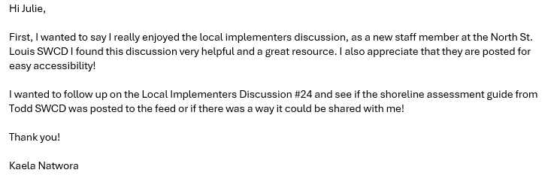
Local Implementers Discussions
Notes:
Julie: One testimonial: “very helpful and a great resource”

Slide 9
