Slide 1

MN Program Update
Ryan Hughes and Henry Van Offelen
MN Board of Water and Soil Resources
October 3, 2023

Slide 2
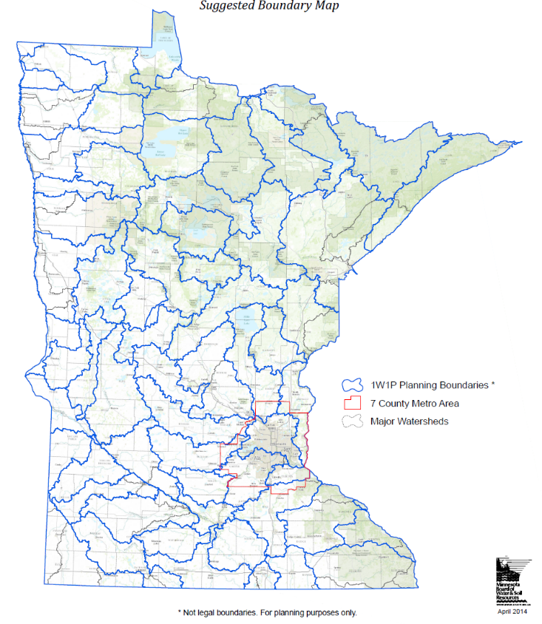

Three Big Ideas
Working together on local issues
Go as the water flows
Linking data to local action
Notes:
1W1P is based on a few big ideas. And again, I suspect these concepts apply to the work you are doing here in Indiana, so I’m not claiming they are unique, but they are foundational, and for Minnesota, transformational.

Slide 3

The Challenge
Minnesota’s water quality (and other) problems far exceed the available resources to fix them.
Minnesotans expect to see measurable progress toward clean water (especially before 2034).
Notes:
The legacy fund backdrop:
1) Minnesota’s water quality (and other) problems far exceed the available resources to fix them.
2) Minnesotans expect to see measurable progress toward clean water (especially before 2034).

Slide 4
Working on Local Issues
State
Cities
Shared vision and goals
Public
Counties
SWCDs
Watershed Districts
Special Interests
Tribes
Federal
Notes:
{This slide is animated}
In the “Three Big Ideas” module, we discussed how the program brings together partnerships of local governments into one process where they establish a shared vision and goals for a common watershed. Counties and soil and water conservation districts, and watershed districts where they exist, are the core of the planning process. They play a key role in water management, each with their own authorities and duties, and engagement from officials in this process is a really important element of what makes planning efforts successful.
{click}
Local governments work in partnership with many other groups, including other government partners. Working with the public and non-government groups – like agricultural producers, lake associations, recreational interests, non-profits, or businesses will also be important to the plan’s success.

Slide 5




Previous Approach - Local Plans
Watershed Districts
Counties
SWCDs
County Plan
SWCD
Plan
Watershed District Plan
Notes:
Traditionally, each of these local governments has established a plan for their jurisdiction laying out what activities they will do regarding their duties, with their statutory power and funding sources.
____________________________________________________________________________________
Those local water issues get addressed in a number of ways through local powers and authorities. Counties are responsible for regulations and land management, drainage, public health, transportation, and more issues that connect directly or indirectly to water management. They can levy funds and get state grants to pay for these activities. Soil and Water Conservation Districts work with private landowners to get conservation projects on the ground – and since such a large part of Minnesota’s land base is privately owned, they play a key role. However, they don’t have the ability to raise funds themselves. Watershed Districts, where they have been established, can do a range of activities and have funding mechanisms.

Slide 6
Previous Approach to Local Conservation Funding
ad valorem taxes
Grants
County Program Aid (State $)
funds from ad valorem taxes (allocated by county)
grants
ad valorem taxes
grants
Watershed Districts
Counties
SWCDs
Notes:
{this slide is animated.}
Local water issues I just discussed get addressed through local powers and authorities, each granted in Minnesota statutes.
Those statutes allow counties {click} to raise ad valorem taxes for revenue. They also receive funding through grants and other mechanisms.
Similarly, watershed districts {click} can levy taxes and receive grants.
While SWCDS {click} can also receive grants, they rely on county funds, allocated by county boards, to do their important job. They have no authority to raise funds on their own.
____________________________________________________________________________________
Those local water issues get addressed in a number of ways through local powers and authorities. Counties are responsible for regulations and land management, drainage, public health, transportation, and more issues that connect directly or indirectly to water management. They can levy funds and get state grants to pay for these activities. Soil and Water Conservation Districts work with private landowners to get conservation projects on the ground – and since such a large part of Minnesota’s land base is privately owned, they play a key role. However, they don’t have the ability to raise funds themselves. Watershed Districts, where they have been established, can do a range of activities and have funding mechanisms.

Slide 7
Water Management Transformation
Collaborative planning
Coordinated implementation
Measurable results
Shared vision and priorities
Resource – focused, data driven
Multiple funding sources
Notes:
One Watershed, One Plan IS a key element of a transformation in how we manage water in Minnesota. It represents a lot that’s new. And our experience since the program started is that while change can be hard, it’s worth doing to get better results for our state’s precious water resources.

Slide 8
Planning process - Committees
Policy Committee
One official from each board/council
Represent participating entities, which make decisions
May host joint public hearings on behalf of participating entities
Advisory Committee
Staff, state agencies, others
Make recommendations
Steering Team
Local staff, BWSR BC, consultants
Handle logistics
Notes:
{this slide is animated.}
{click} The main role of the policy committee is to represent the participating entities, which are the decision makers in the process. The policy committee may also host public hearings or other events on behalf of participating entities.
{click} The advisory committee’s role is just as it sounds – to advise the policy committee about what should go into the plan. Members of the advisory committee bring scientific information and public values, both of which are crucial to the planning process.
{click} While the program doesn’t require it, most planning efforts also establish a steering team, which is a subset of the advisory committee made up of local staff and the BWSR board conservationist and any consultants that may be hired to help manage the process or write the plan.
{click} The steering team’s role is to handle the logistics – organizing meetings, determining agendas, taking notes, sending out materials for discussion, and generally keeping the process on track, on time, and on budget.

Slide 9
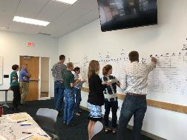
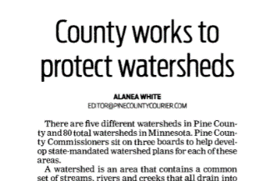
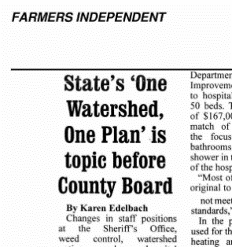
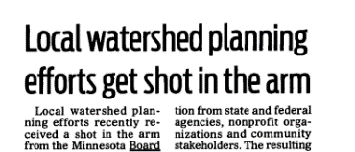
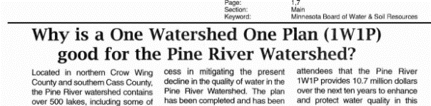
Plan Elements
Land and Water Resources Narrative
Priority Resources and Issues
Measurable Goals
Targeted Implementation Schedule
Plan Implementation Programs
Plan Administration and Coordination
Notes:
These are the main elements that must be in each plan.

Slide 10
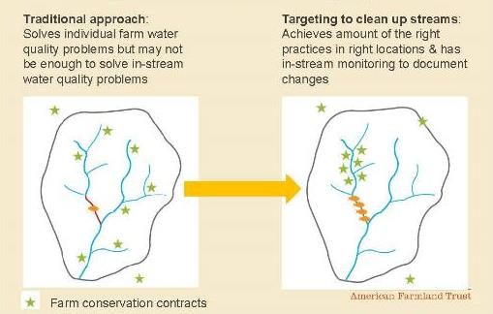
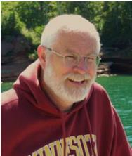
Targeting Conservation
Concentrating implementation efforts in smaller scale (HUC-10 and HUC-12) watersheds is the best way to get tangible clean water results in a reasonable time frame with limited dollars.
“constrain the scale in space and time”
Notes:
The legacy fund backdrop:
1) Minnesota’s water quality (and other) problems far exceed the available resources to fix them.
2) Minnesotans expect to see measurable progress toward clean water (especially before 2034).
Building on success:
The targeted watershed program was the original place we tested this. Large grants for projects focused on relatively smaller (HUC-10 and HUC-12) watersheds.
Our theory:
Concentrating implementation efforts in smaller scale (HUC-10 and HUC-12) watersheds is the best way to get tangible clean water results in a reasonable time frame with limited dollars.

Slide 11
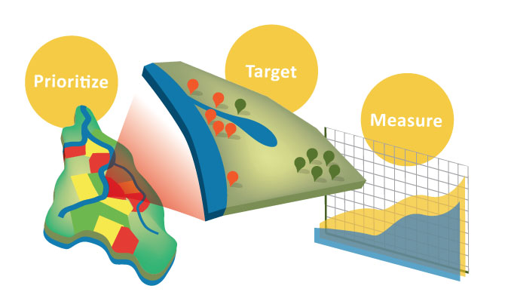
Making Choices to Show Results
T
P
M
Notes:
{this slide is animated}
Which leads us to the third big idea behind one watershed, one plan: making choices to show results. In order to make meaningful progress toward their shared goals, planning partnerships will need to do three main things:
First: {click} Prioritize, which means strategically deploying resources to the areas and issues that matter most to local communities. Watershed science and local opinions will guide decisions about priorities.
Second: {click} Target, which is to use the most effective means of solving the problem by putting the right practice, policy or program in the right place at the right time through targeted implementation in those priority areas.
Third: {click} Measure your results and show the public you’ve invested their money well.

Slide 12
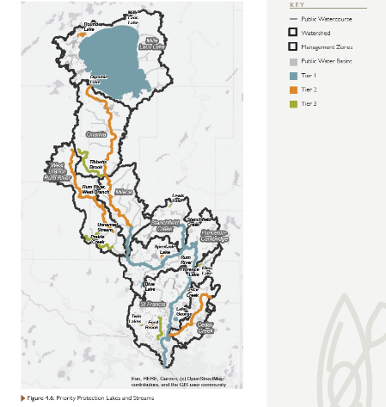
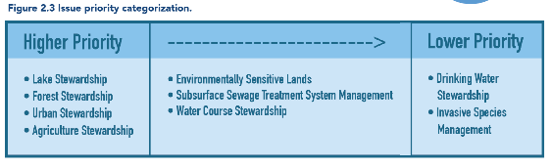
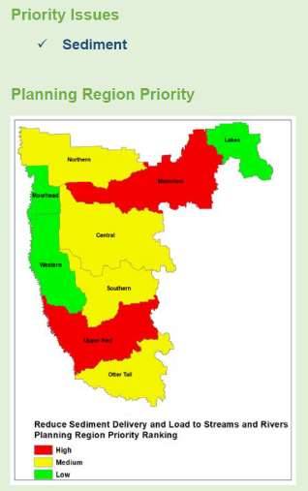
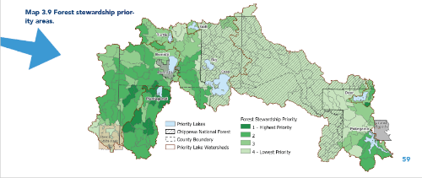
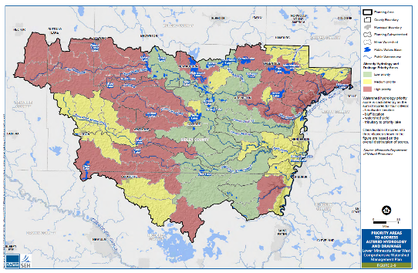
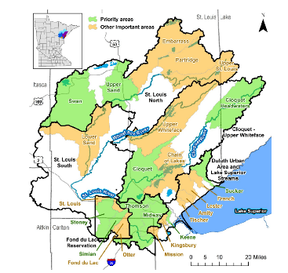
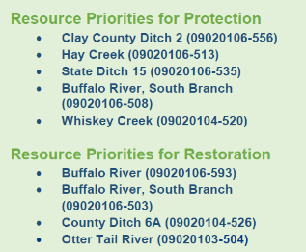

Slide 13
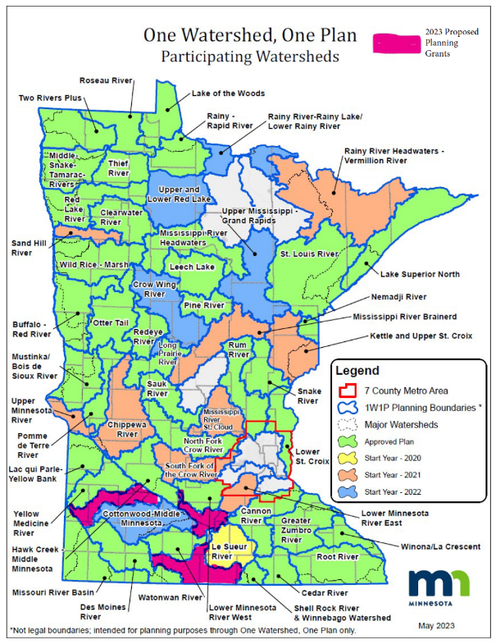
Status of planning efforts
60 total planning boundaries (excluding metro)
54 participating + 3 pending = 95%!
40 approved
4 nearing approval

Slide 14
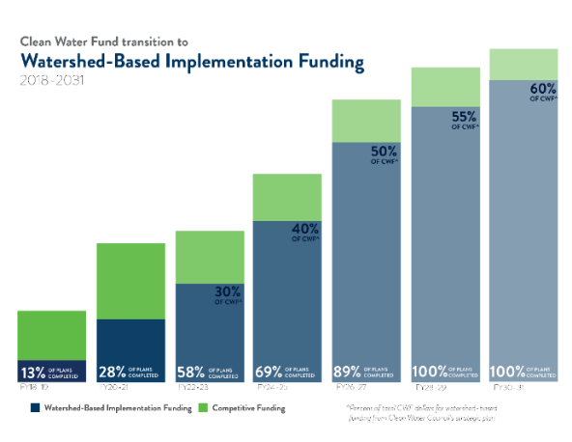

Post plan implementation

Slide 15
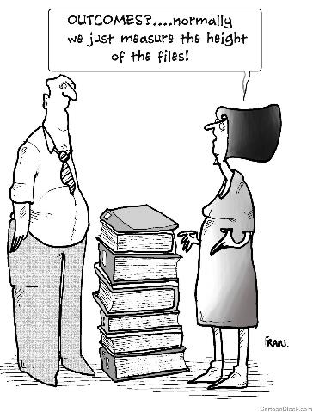

Notes:
There’s a huge emphasis on accountability with the clean water fund, and a real need to show that these funds are making a difference. The concept of measurable outcomes refers to whether water resources are protected or improved. Are clean lakes staying clean? Are polluted waterways getting cleaned up? Is there enough clean drinking water for people, economic activity, and ecosystems?
These questions go beyond the number of projects and programs that get implemented to the important questions people care about.
Of course, this isn’t only about legacy funds. Any public entity must make thoughtful and careful decisions about how to spend public dollars.
The need to show meaningful progress is an important theme in the One Watershed, One Plan program.
Cartoon used with permission {J. Westerlund}

Slide 16
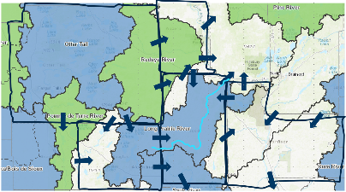

Outcomes
Higher quality plans to guide local conservation delivery
Varying degrees of functioning watershed partnership groups
Varying degrees of thoughtful targetted implementation
Projects, projects, projects

Slide 17
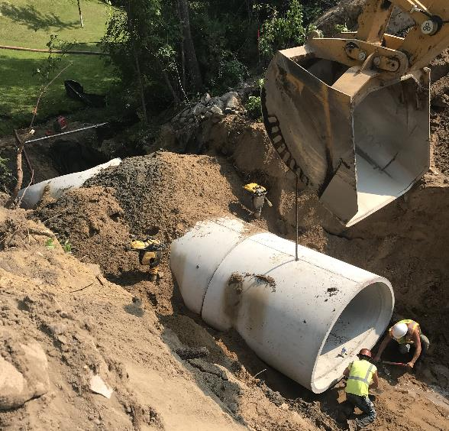
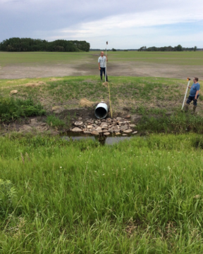
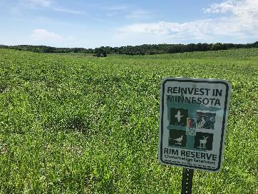
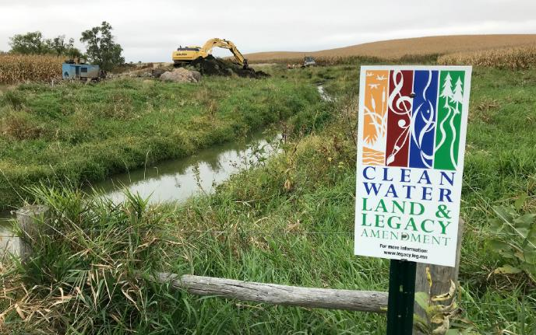
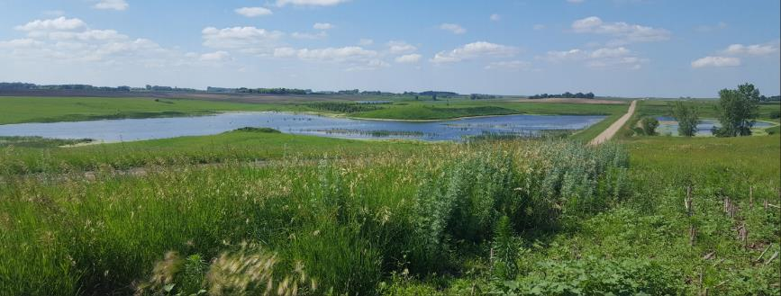
BWSR
Cass County; Ulteig Engineering
Pennington SWCD
Steve Snyder
BWSR
Notes:
The future of watershed management lies in the partnerships formed during planning, and a solid plan on which to base implementation decisions. BWSR’s intent for the future is to provide stable, reliable funding to supplement implementation via the legacy amendment. Of course, that depends on the legislature appropriating enough money to support the existing plans as well as new plans that come on line. BWSR is committed to doing what we can to make that happen.

Slide 18
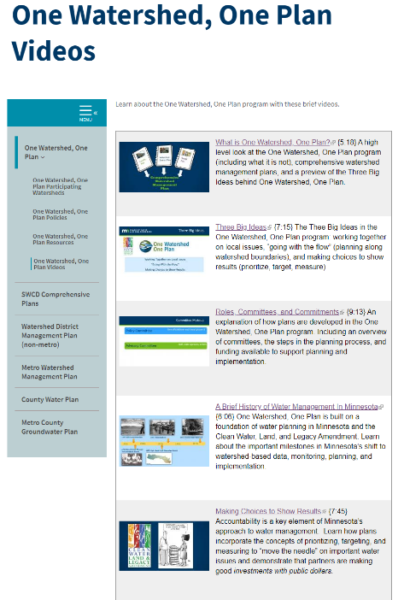
https://bwsr.state.mn.us/one-watershed-one-plan-videos
What is One Watershed, One Plan?
Three Big Ideas
Roles, Committees, and Commitments
A Brief History of Water Management In Minnesota
Making Choices to Show Results
Notes:
Hopefully you’ve had a chance to view the videos…

Slide 19

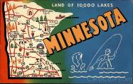
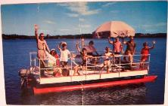
Feel Free To Contact Us!
Henry.van.offelen@state.mn.us
Ryan.hughes@state.mn.us

