Slide 1
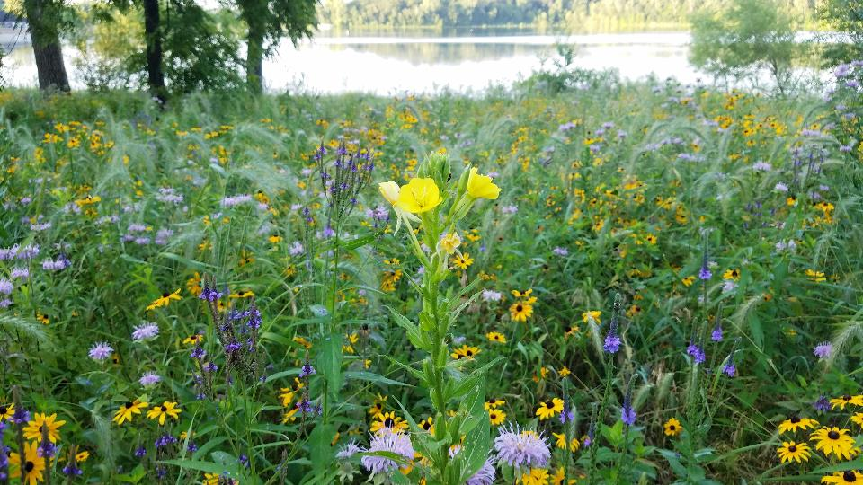
BWSR’s Living Landscape Initiative
Jason Beckler, Ecological Science Conservationist

Slide 2
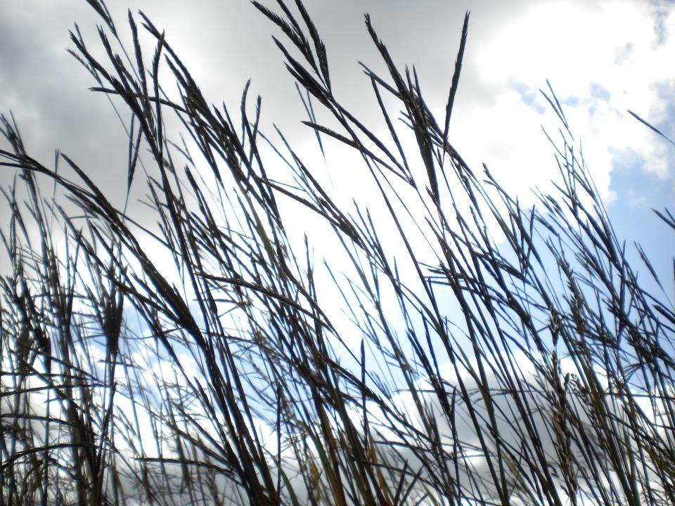

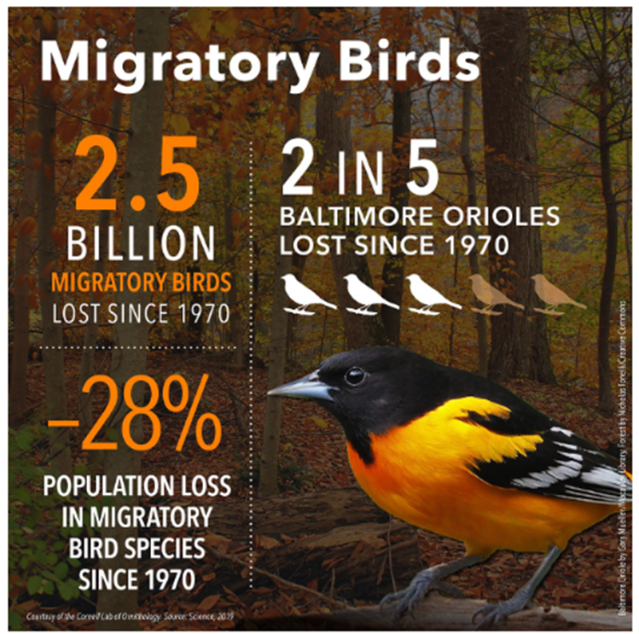
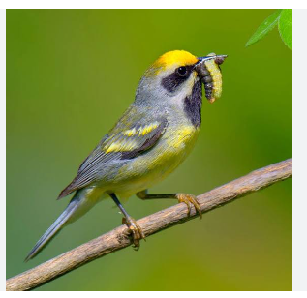
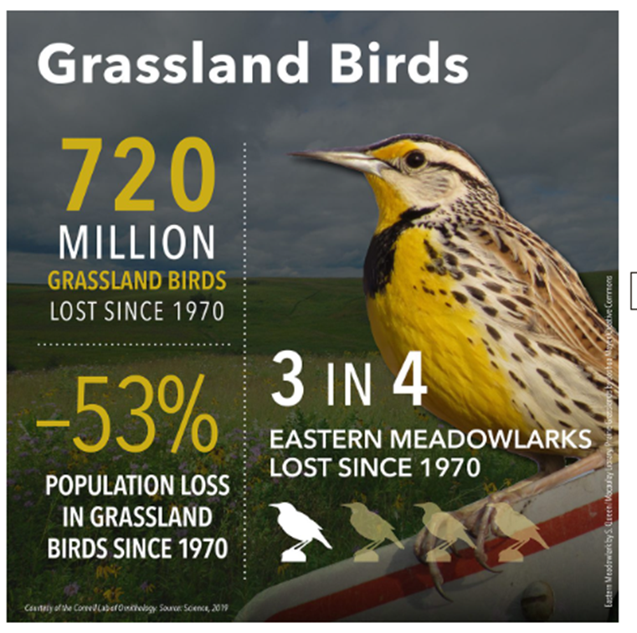
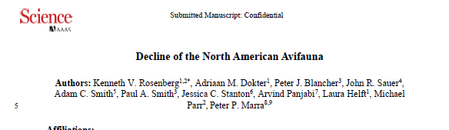
Birds need Bugs!
Bird species are also in significant decline with 3 billion less birds or 29% decline in North America since 1970
_{Rosenberg etal. 2019}

Slide 3
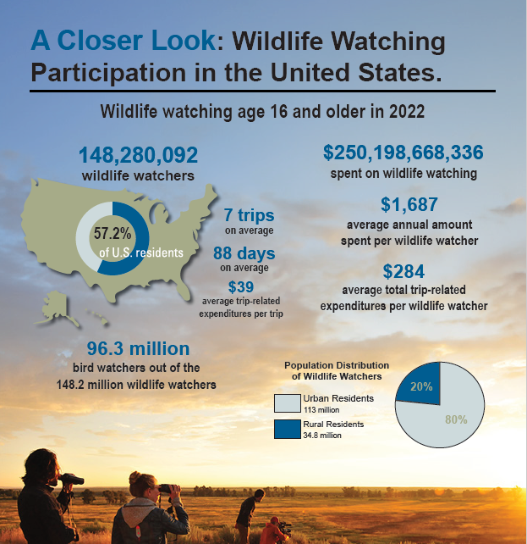
People Care about the Outdoors

Slide 4
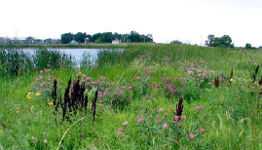
What is BWSR’s Living Landscapes Initiative?
Integrates habitat into residential, agricultural, and utility landscapes.
Aligns multiple programs and partners (SWCDs, watershed/utility/tribal/city/county/nonprofit/for-profit/federal and university partners) to create strategic habitat networks across Minnesota, guided by statewide priority-area mapping.
Goals:
Increase awareness about declining wildlife and plant populations
Build habitat corridors and structure
Engage diverse communities
biological health of landscapes to meet soil health and water quality goals
Support pollinators that sustain our food production and ecosystems
Build landscape resiliency

Slide 5
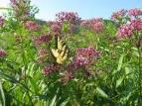

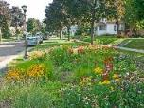
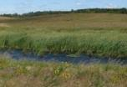

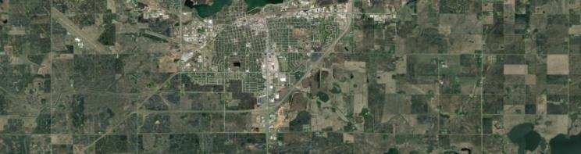

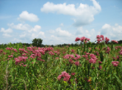
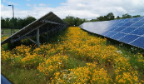
BWSR’s Living Landscapes Initiative
Habitat Enhancement Landscape Program
Maximizing BWSR Programs to Support
Biodiversity, Build Corridors & Increase Resiliency
Lawns to Legumes
Cost-share Projects
Connecting to DNR, USFWS, USDA & Other Conservation Lands
Weed Management
Program
Easement & Wetland Programs
Over 300,000 acres
Habitat Friendly Solar
Addressing Rapid Declines in Biodiversity

Slide 6
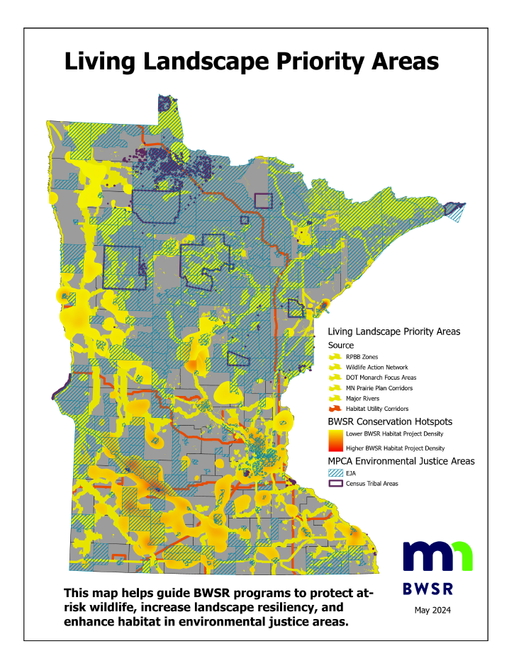
Priority Areas
Created to guide BWSR efforts to protect at-risk wildlife, increase landscape resiliency, and expand habitat corridors along waterways, roads and utility corridors.
Guide decision making for the BWSR Living Landscapes Initiative including project selection for individual conservation programs.
Updated periodically to add new habitat corridors that are being developed across the state.
Giving our partners the opprotunity to recommend edits

Slide 7
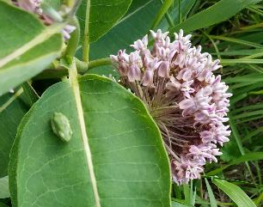
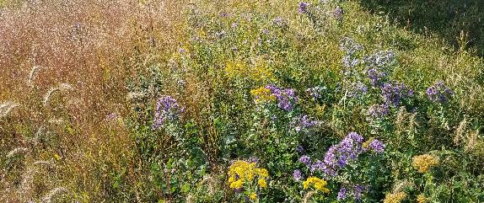
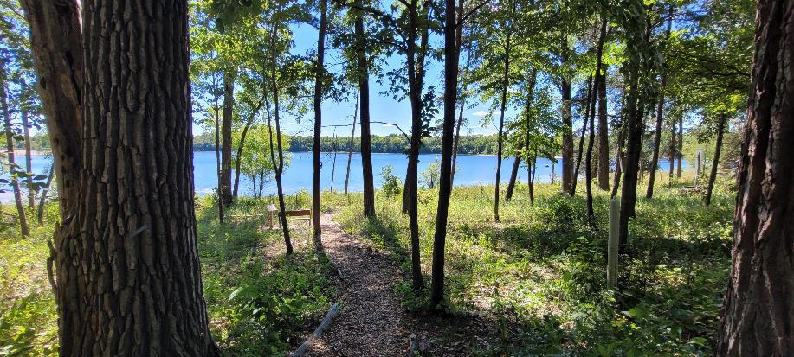
Habitat Enhancement Landscape
Program (HELP)
Overview
This program is focused on restoring and enhancing strategically located, diverse native habitat across Minnesota natural areas, conservation lands and open spaces to benefit populations of pollinators and beneficial insects as well as overall plant and wildlife.
Received $4M of general funds in 2023

Slide 8
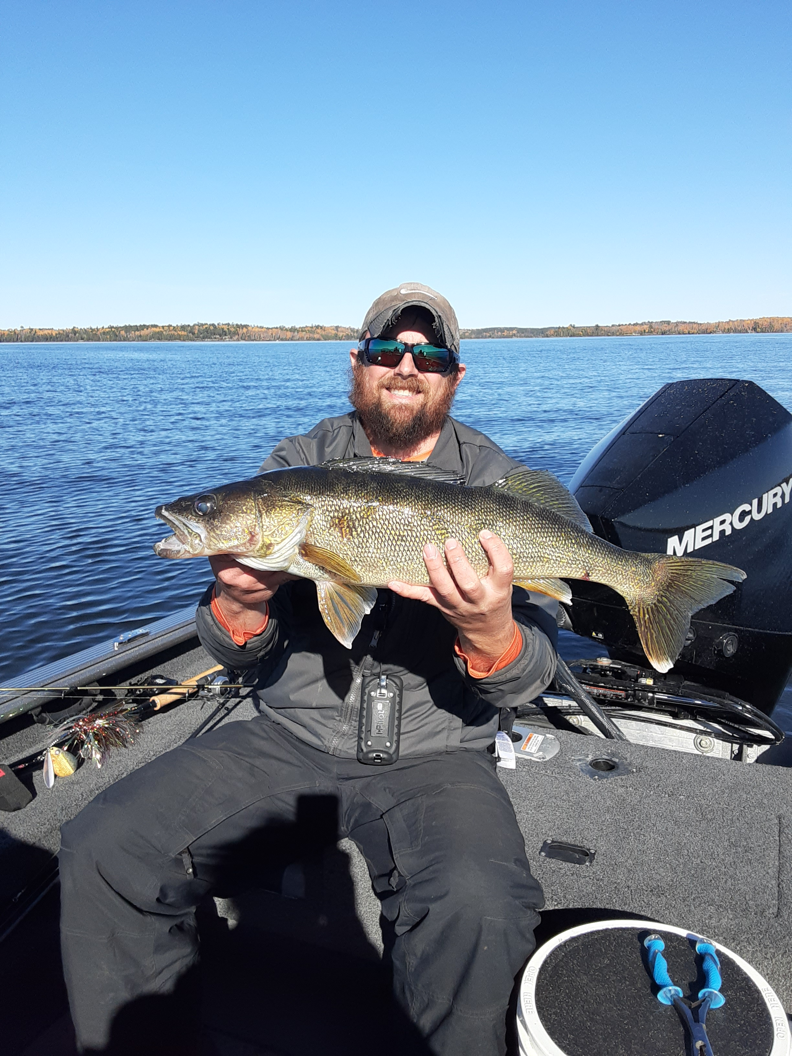
Habitat Enhancement Landscape
Program (HELP)
Eligible Applicants:
Soil and Water Conservation Districts
Watershed Districts
Watershed Management Organizations
Cities
Towns
Contractors
Nongovernmental Organizations
Tribal Governments
Counties
Local Government Joint Power Boards
Park Districts

Slide 9
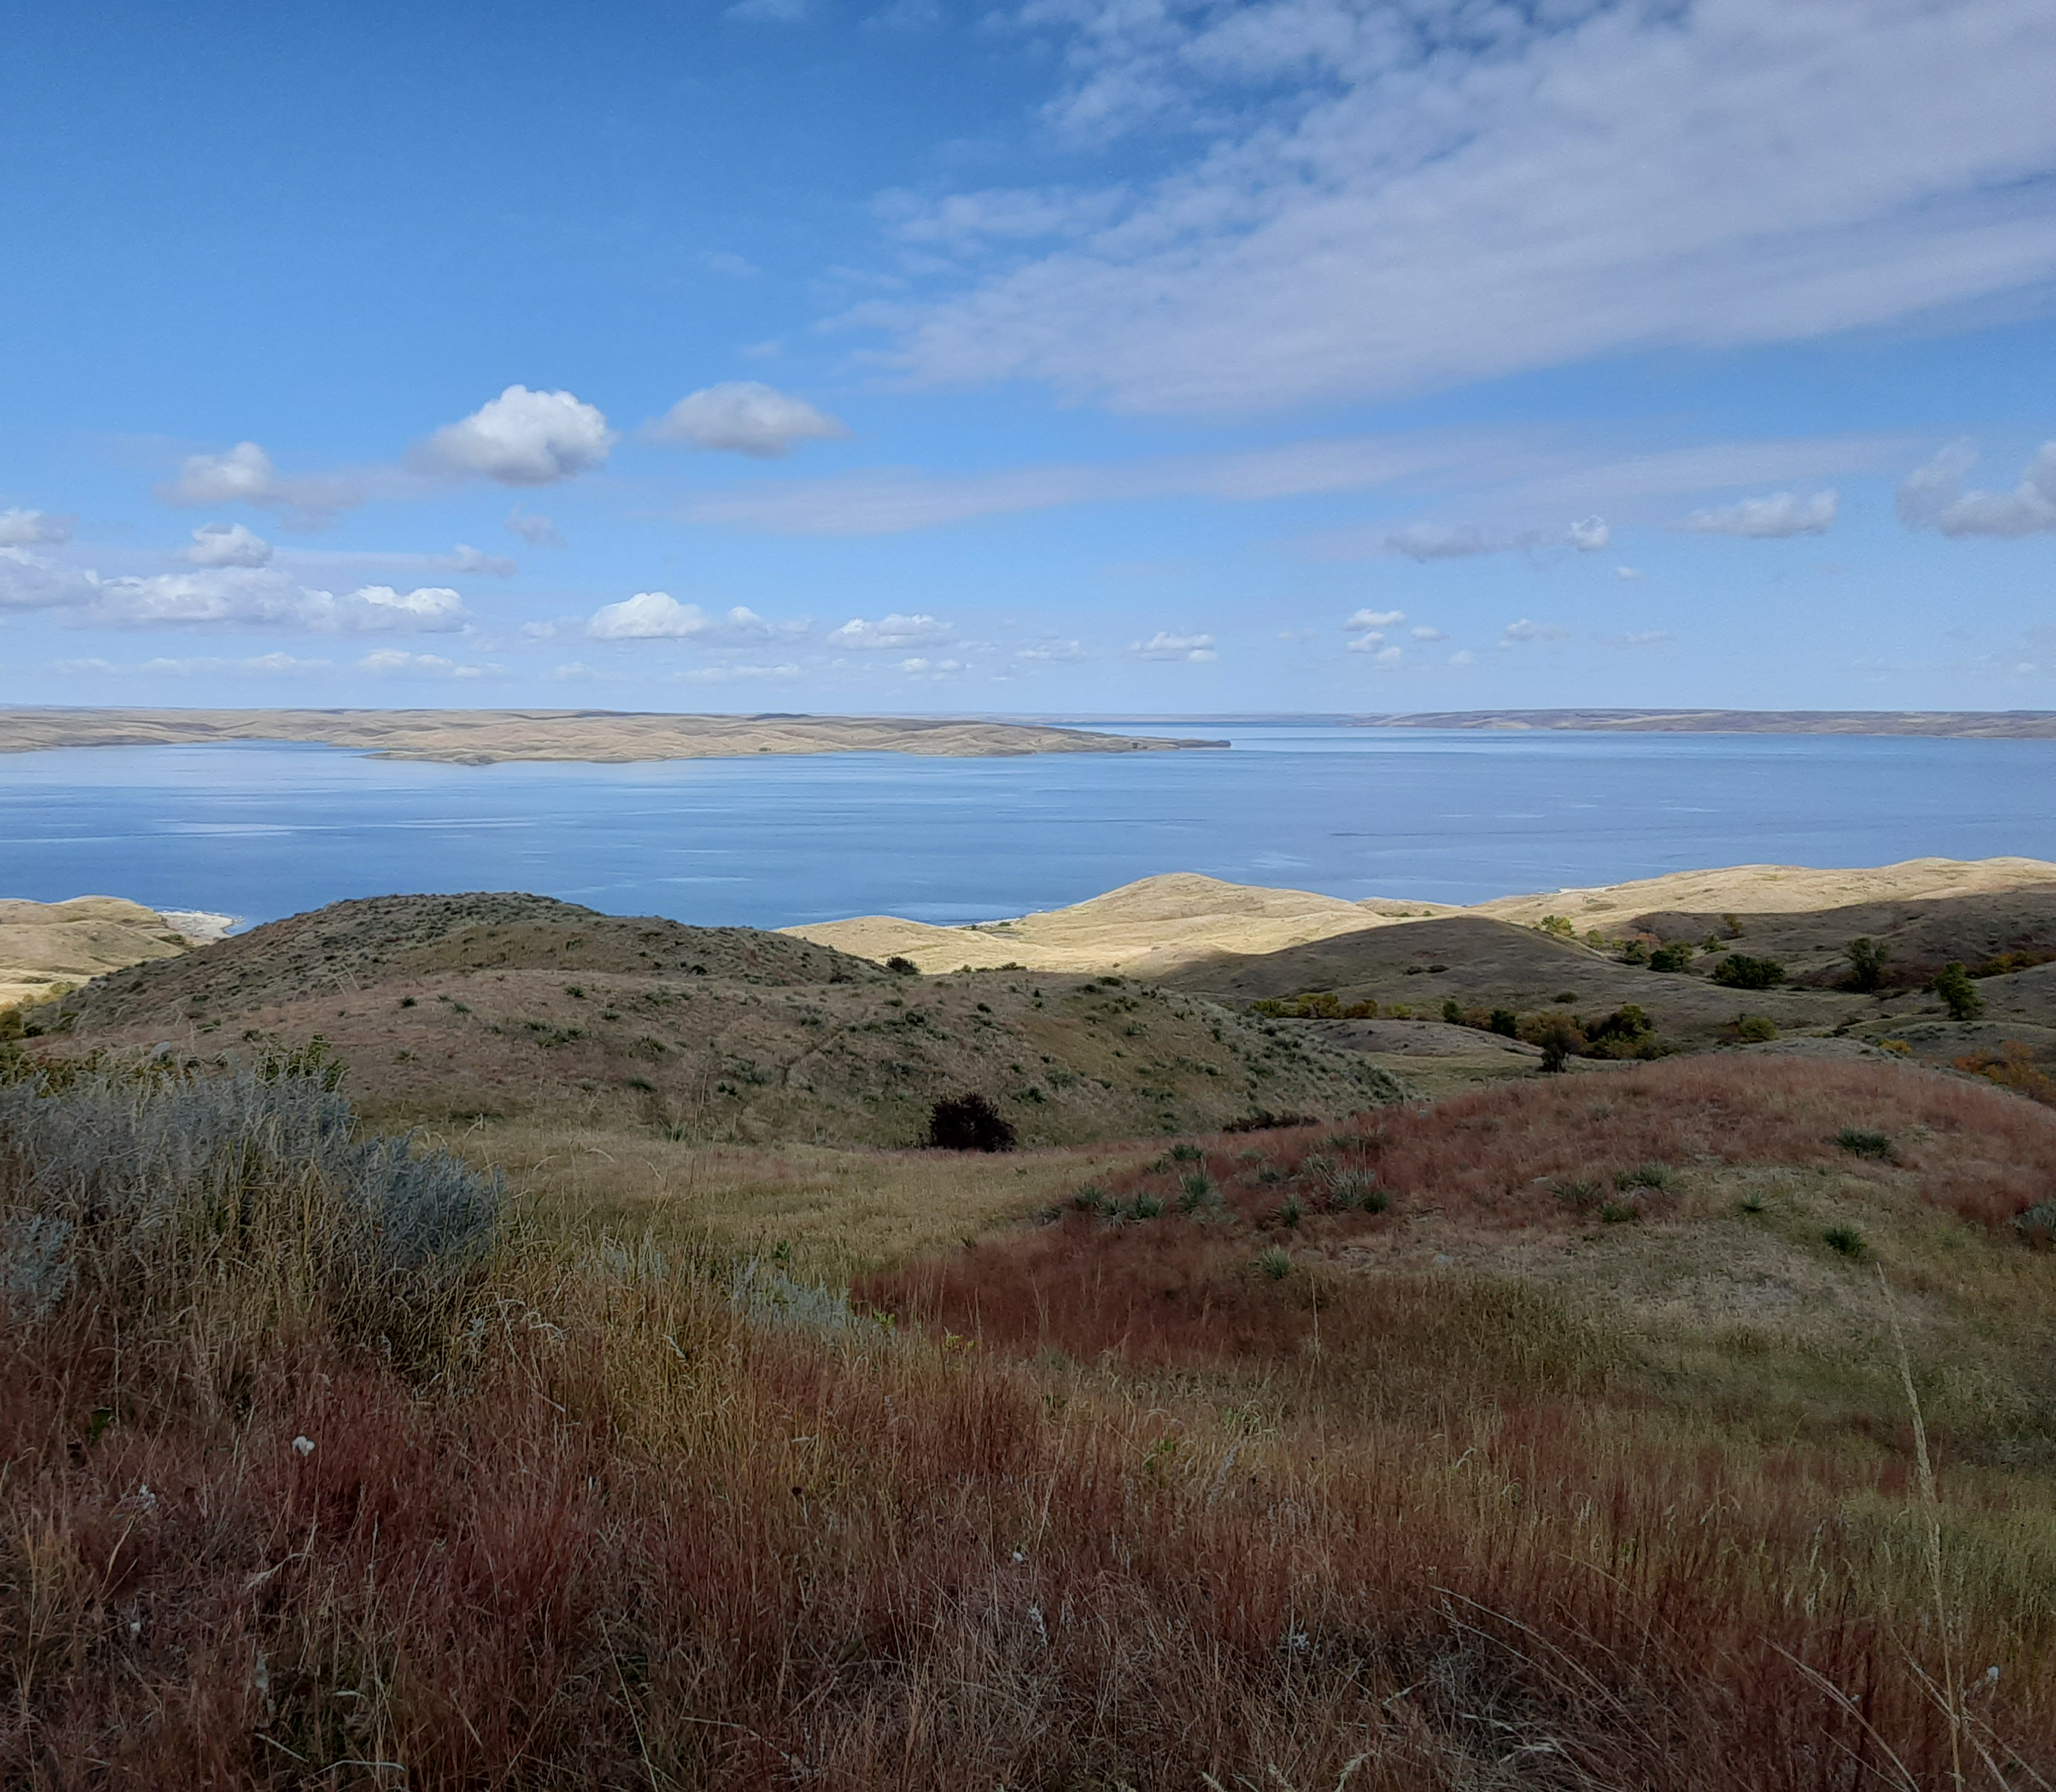
CRP State Incentives Program
Overview
The Conservation Reserve Program State Incentives Program grant funds are made available to CWMP Partnerships for the purpose of providing landowner incentive payments to install or adopt Continuous Conservation Reserve Program practices that improve or protect water quality and/or provide pollinator and wildlife benefits.

Slide 10

Lawns to Legumes Individual Support
The Blue Thumb Partnership is playing a key role for individual support
Working with individual support recipients
Coordinating Workshops
Working with MCAD students
Coordinating coaches
Notes:
Offers a combination of workshops, coaching, plantings guides and cost share funding for installing pollinator friendly native plantings in residential lawns. MN residents can apply to be reimbursed for up to $400 in costs associated with establishing pollinator habitat in their yards.
Working to recruit more coaches. Contact BWSR

Slide 11
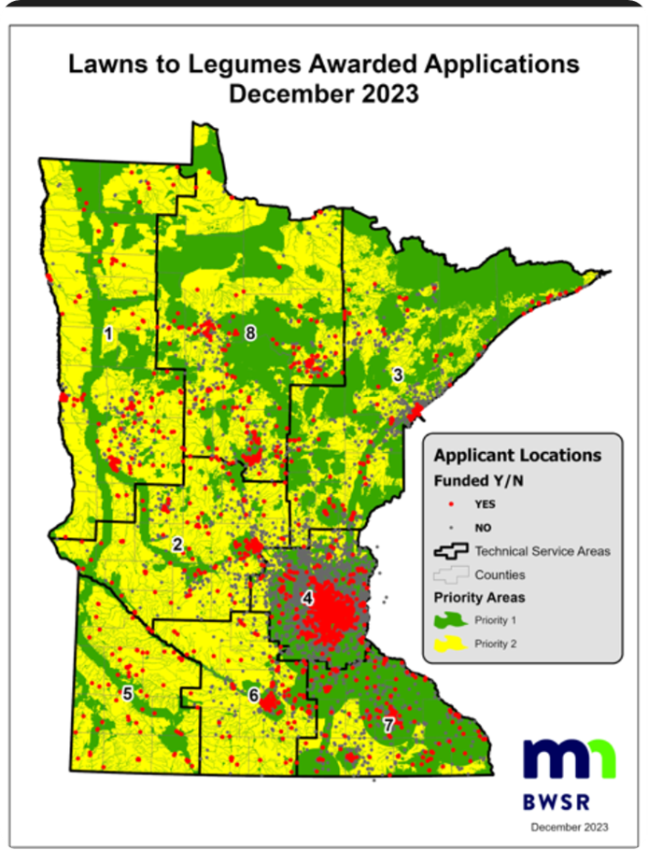
Lawns to Legumes Individual Support
Spring 2024 Plating Grant Awards – 3000 14,000 applicants
Notes:
Offers a combination of workshops, coaching, plantings guides and cost share funding for installing pollinator friendly native plantings in residential lawns. MN residents can apply to be reimbursed for up to $400 in costs associated with establishing pollinator habitat in their yards.
Working to recruit more coaches. Contact BWSR

Slide 12
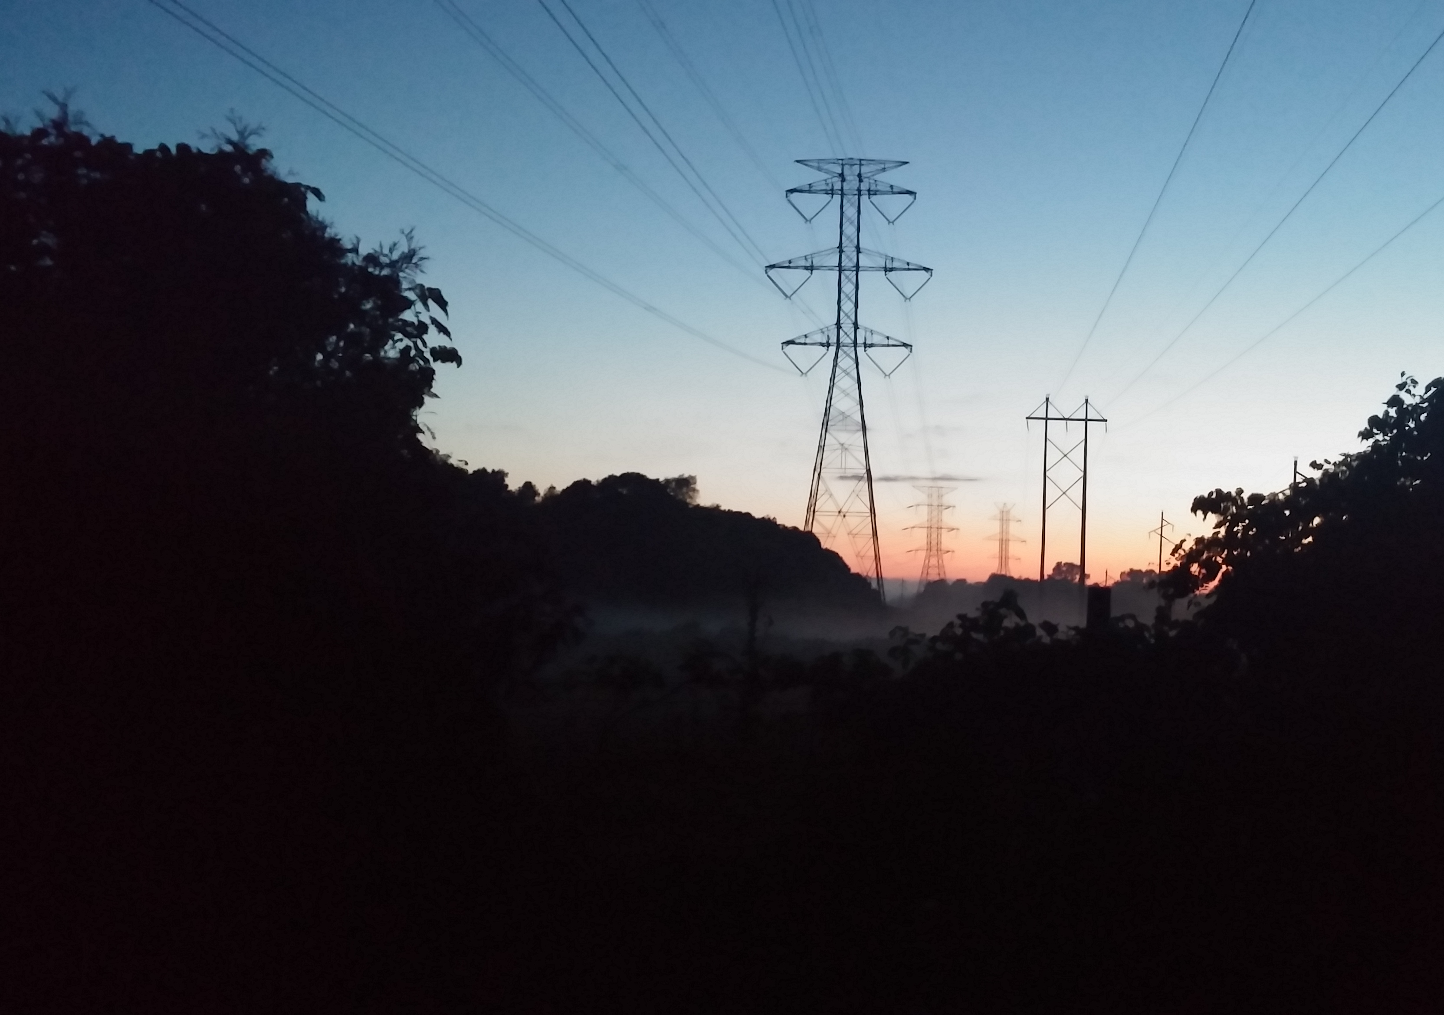
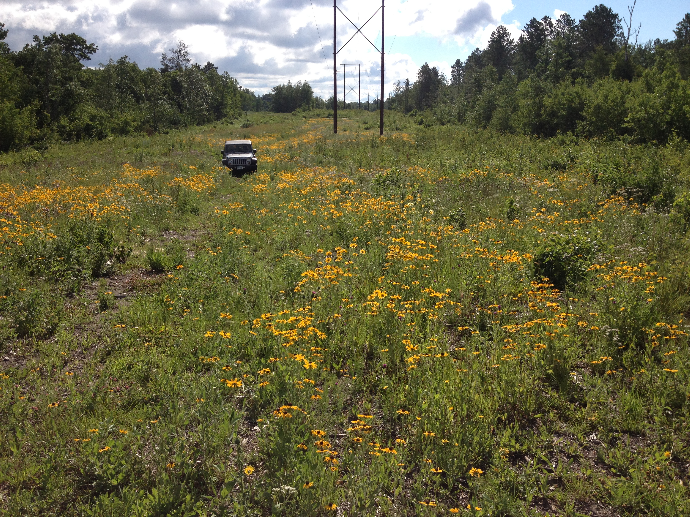
Habitat Friendly Utilities Program Goals
Promote conservation co-benefits
Collaborate with the larger conservation community to help ensure project success
Provide a standard and assessments to guide project success

Slide 13
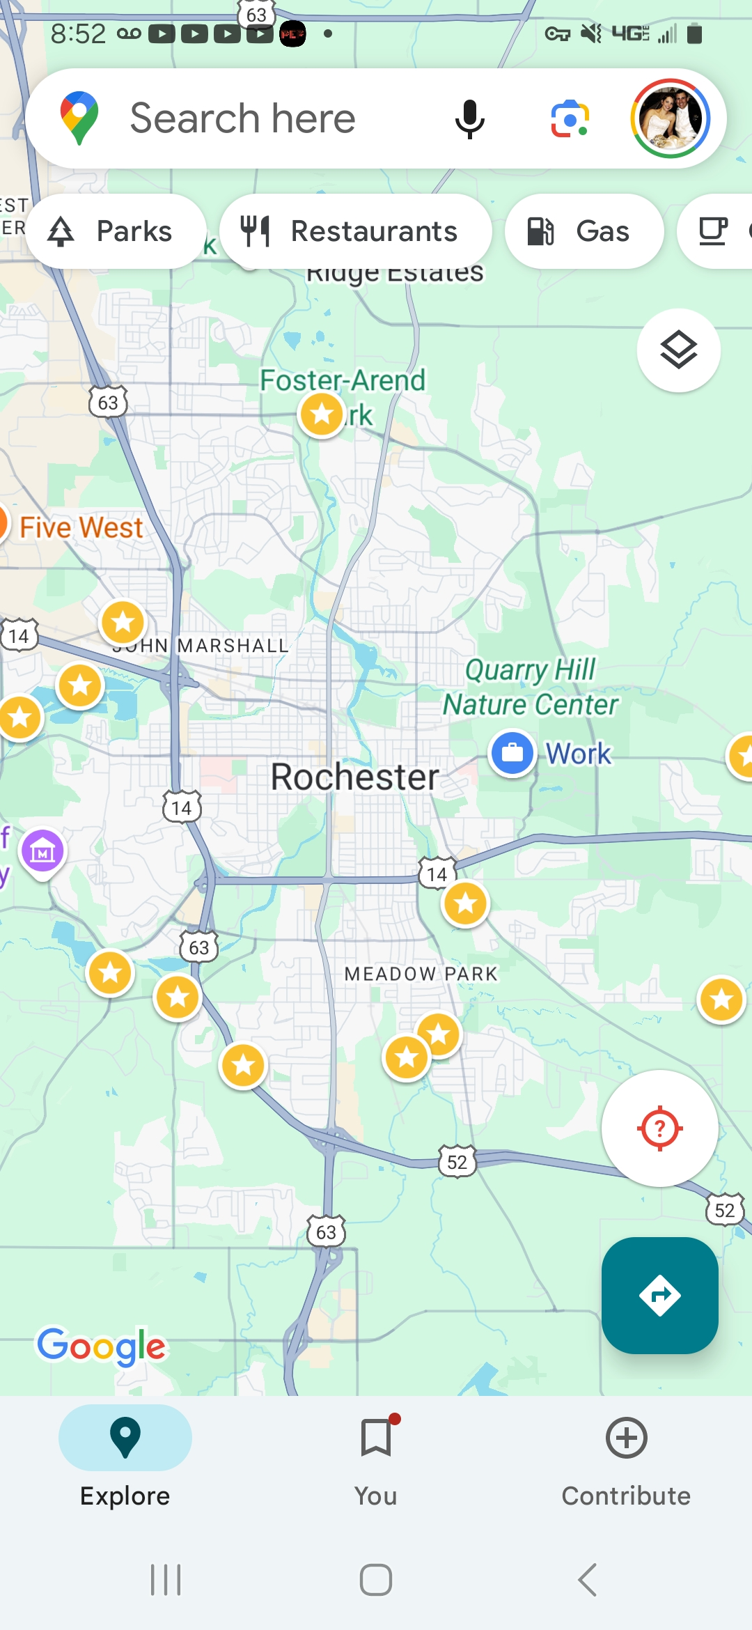
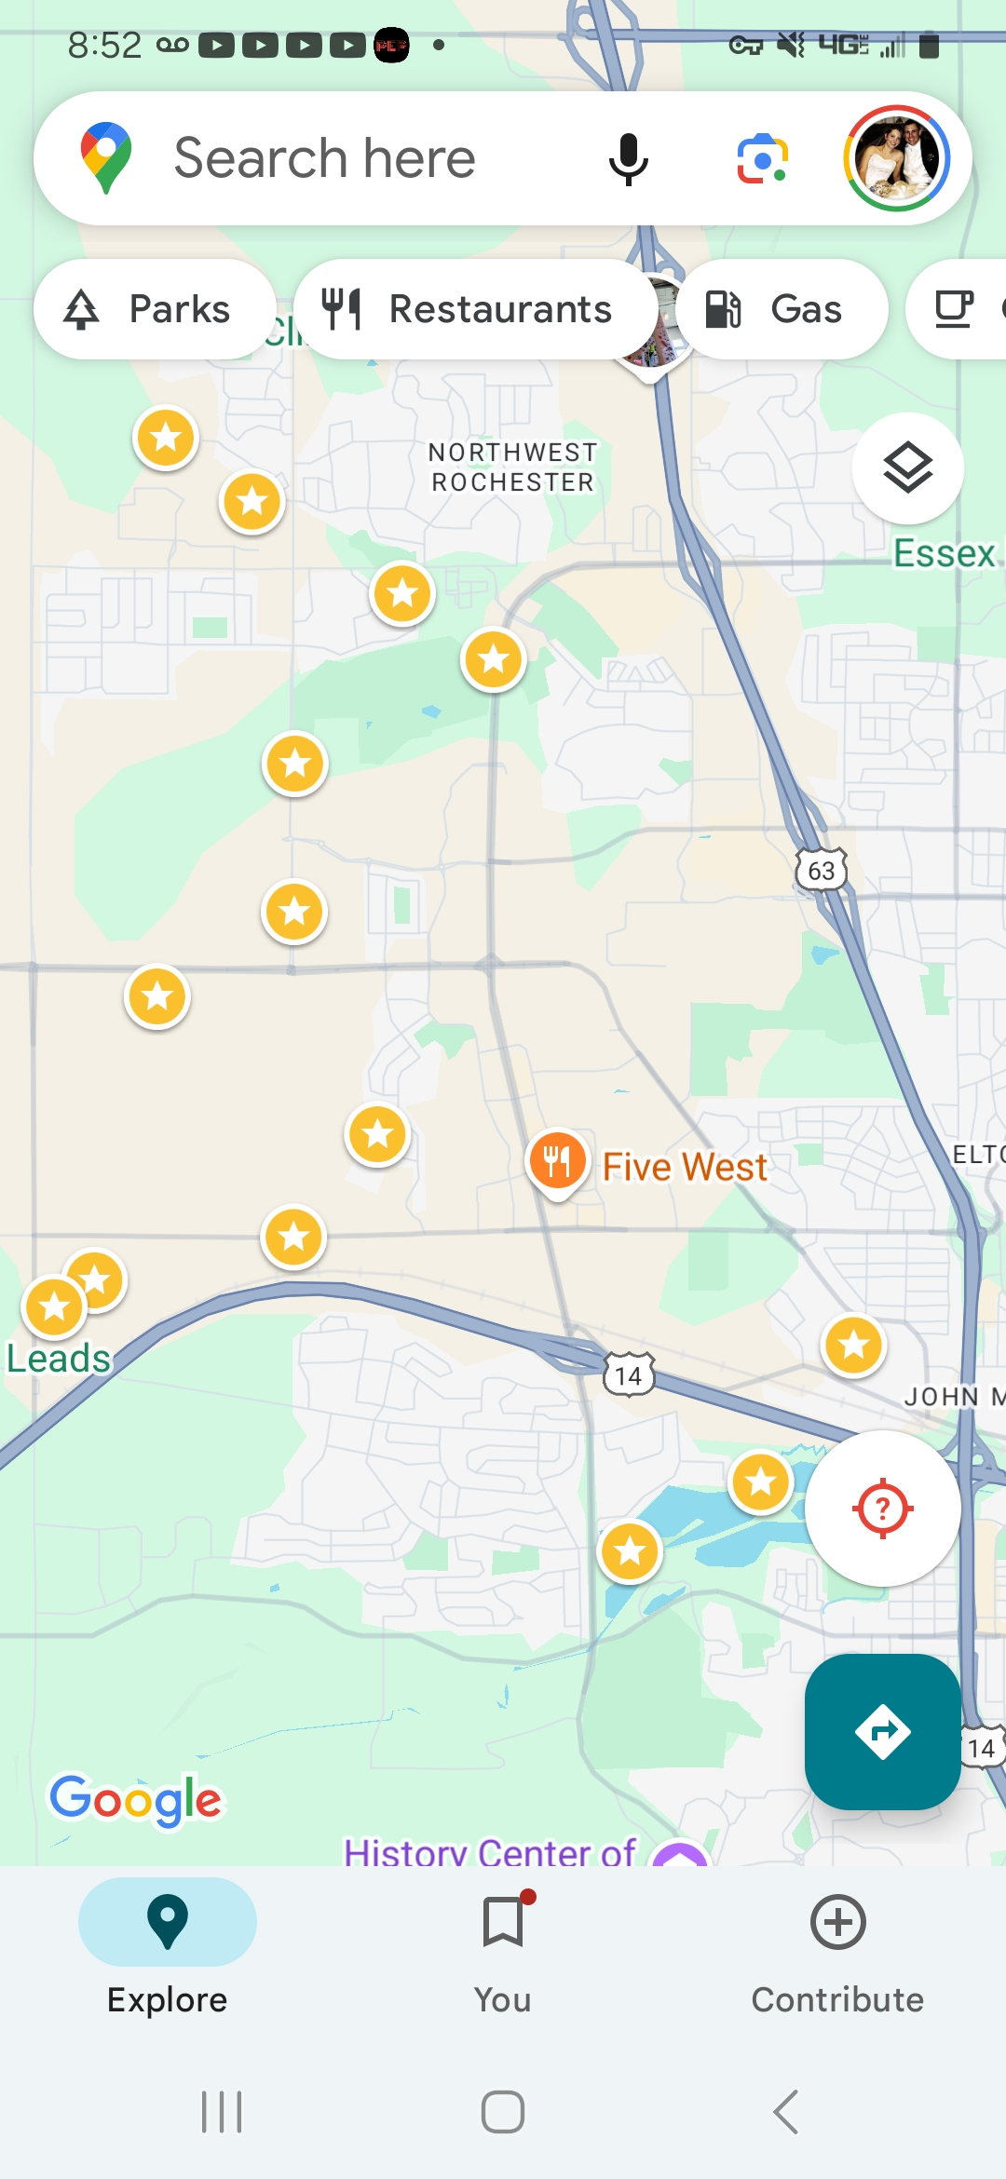
Rochester Public Utilities
RPU Pilot Site Ranking Criteria
Year-round access
Recent woody vegetation removal – clean site
Riperian – water quality improvements
Public access
Land outside of the ROW owned by the City of Rochester

Slide 14
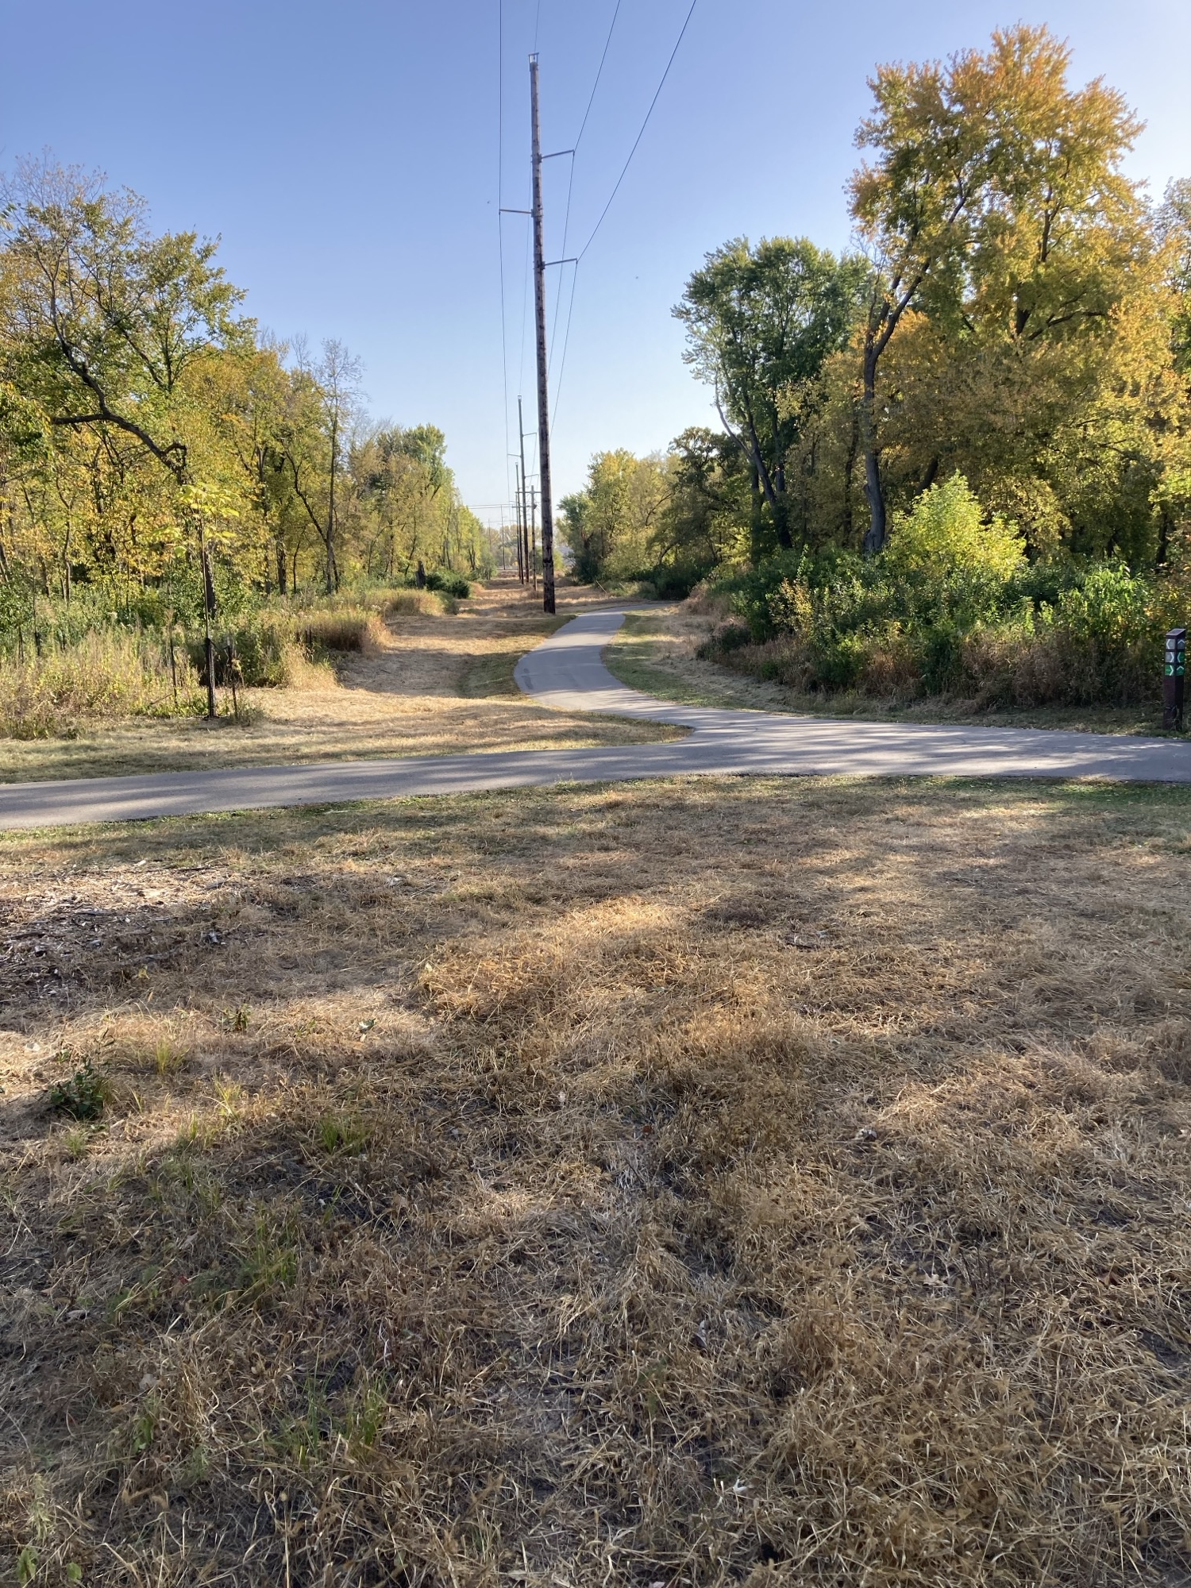
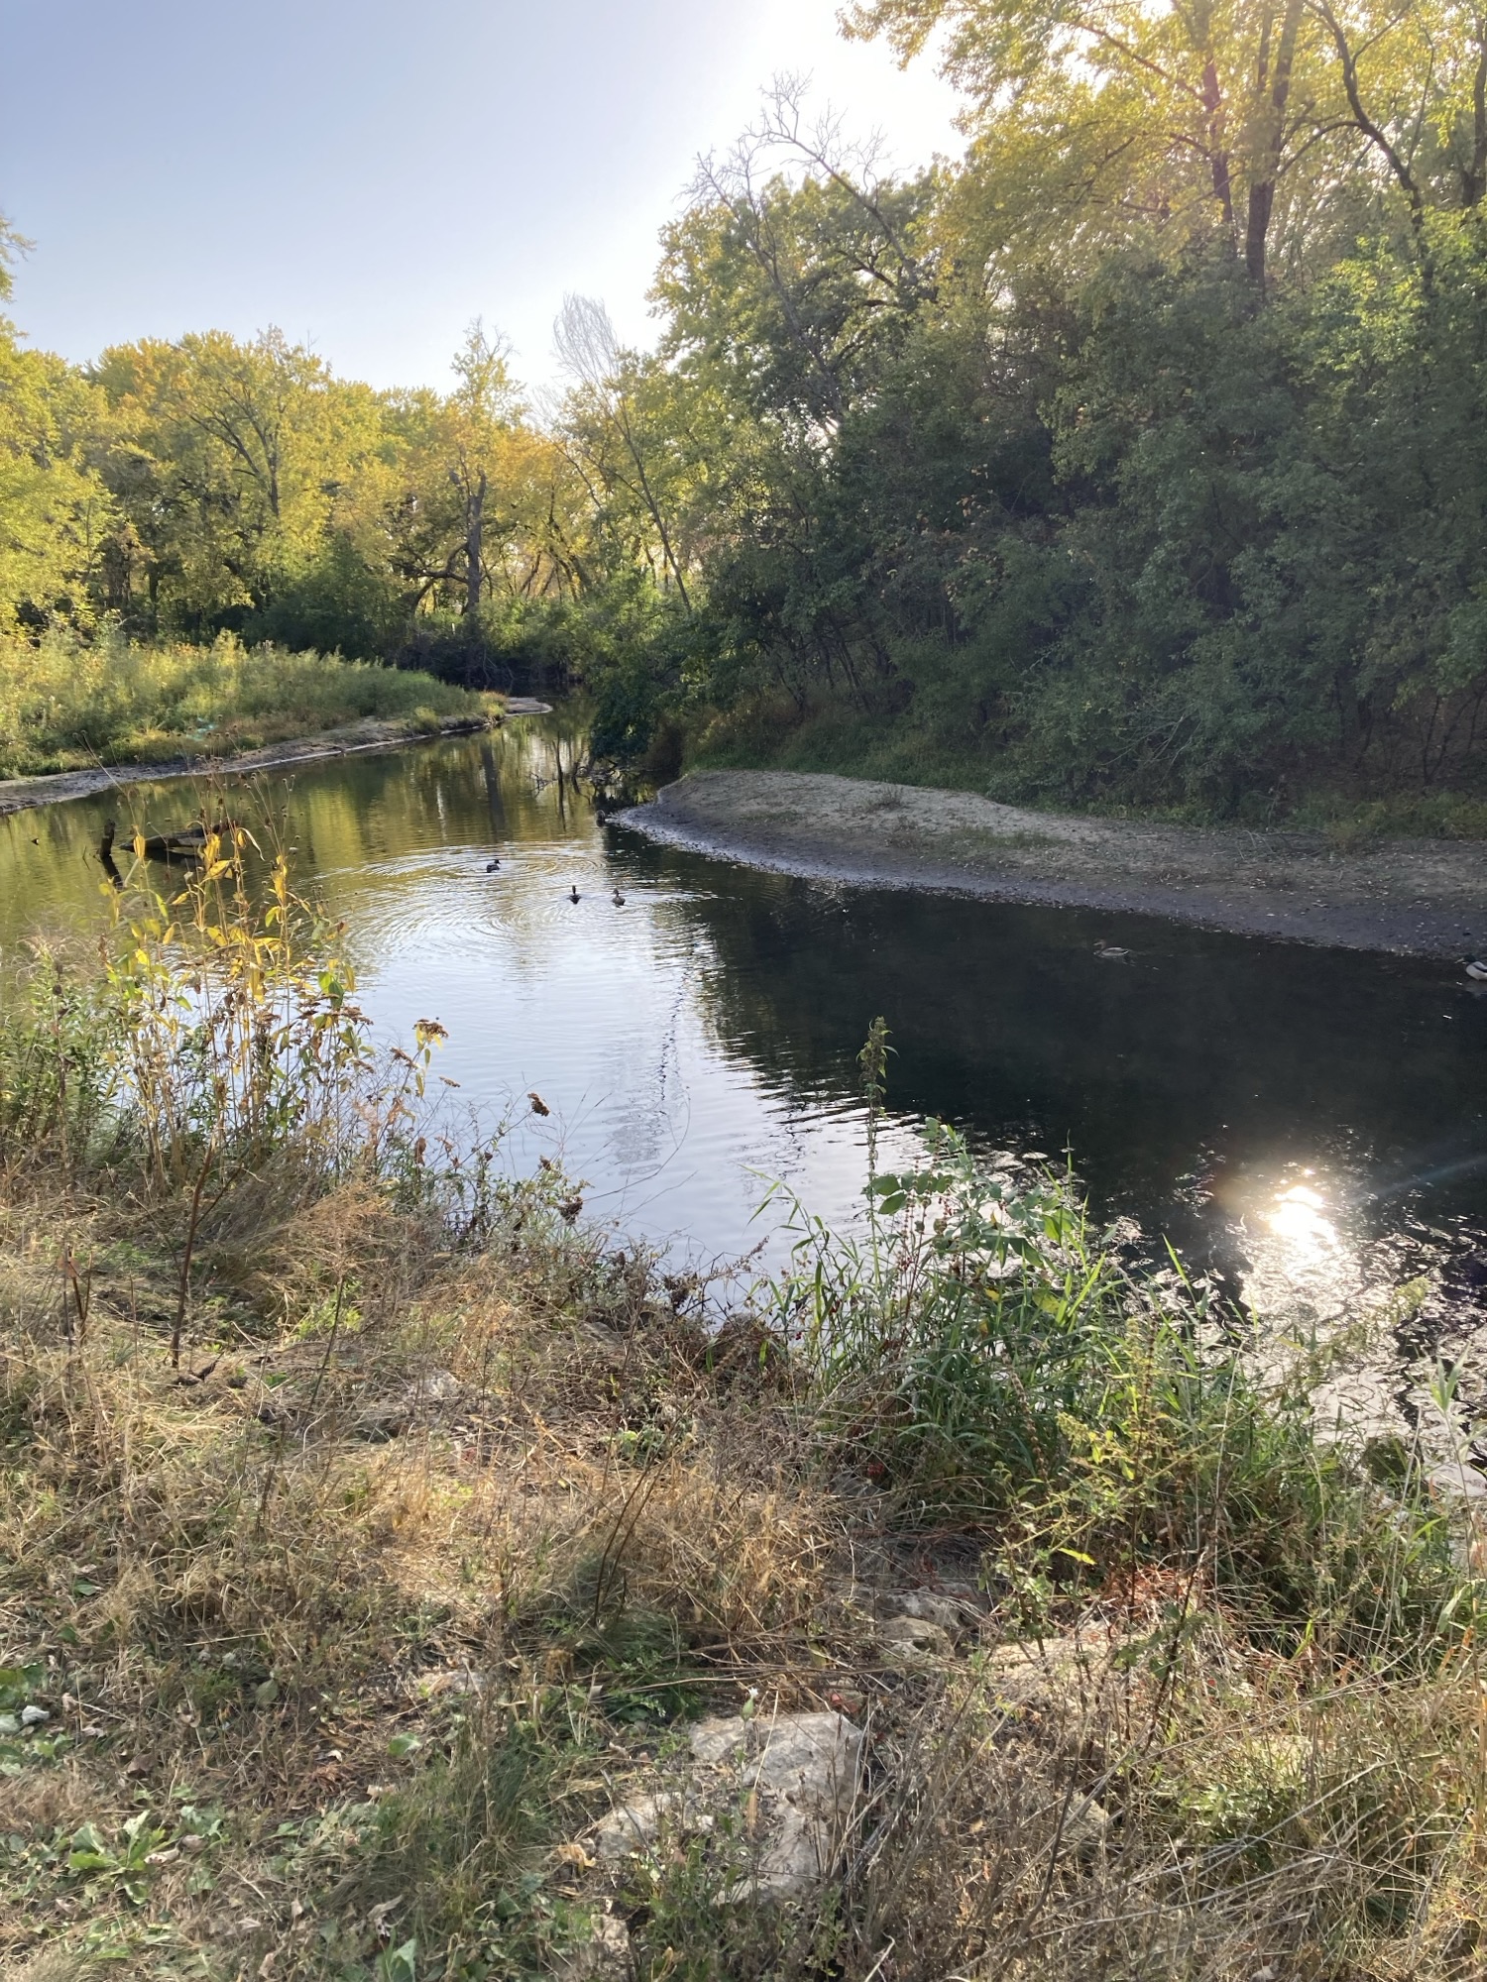
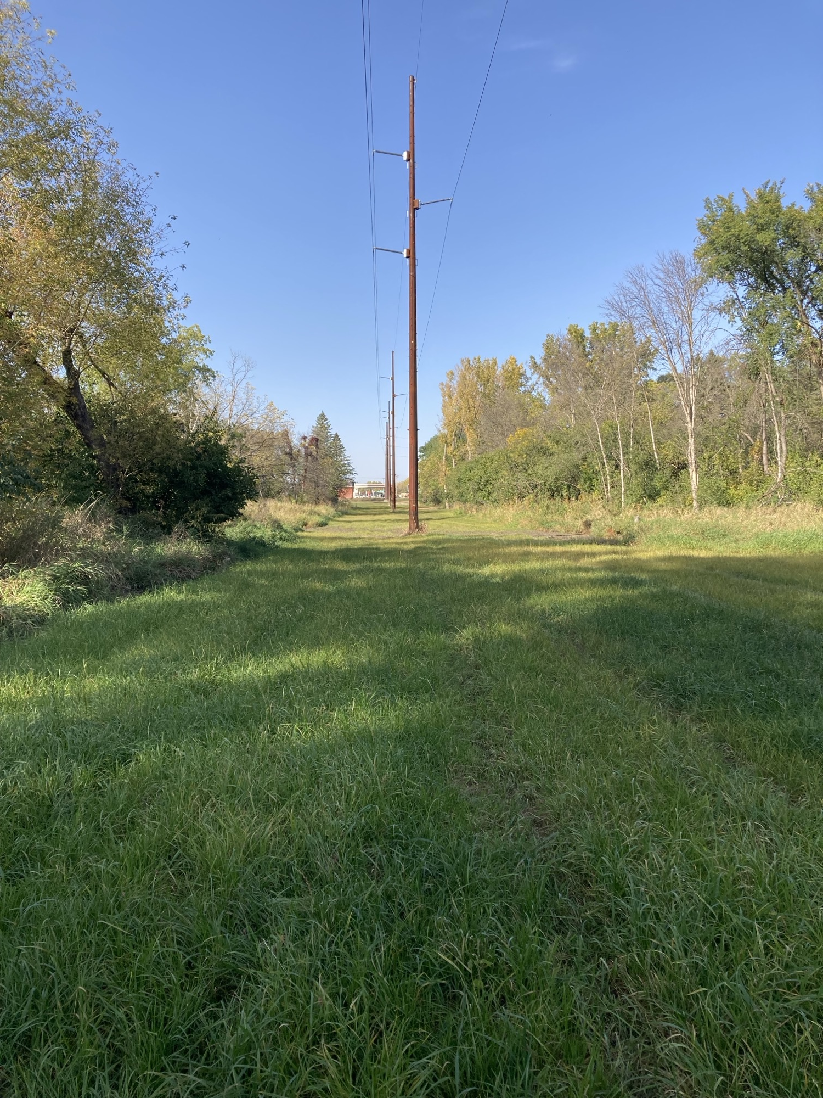
Rochester Public Utilities

Slide 15
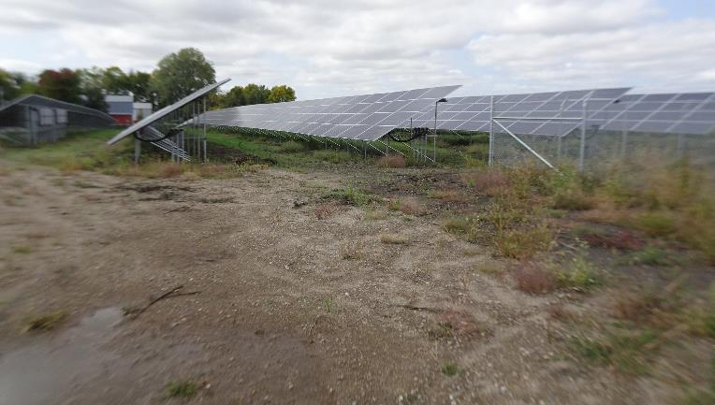
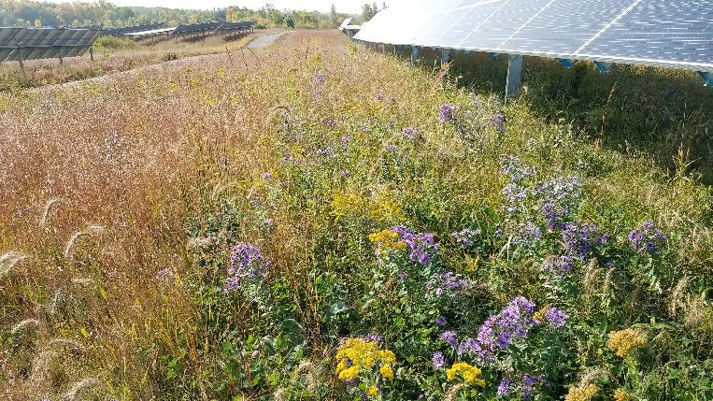
Habitat Friendly Solar Program
_{This?}
_{OR}
_{This?}

Slide 16

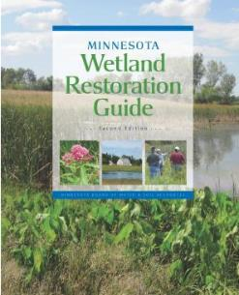
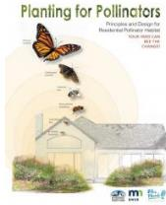
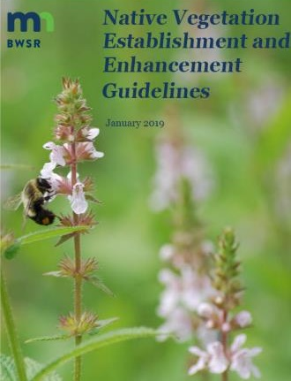
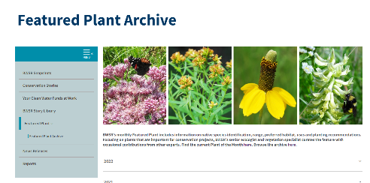
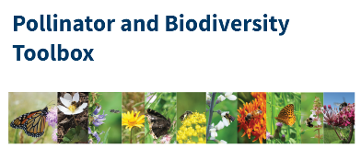
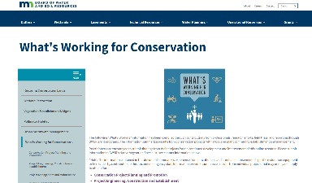


Related Resources
State Seed Mixes (70+ mixes and fact sheets)
Native Vegetation Guidelines
BWSR Climate Action Steps recently posted to website
Other Key Resources

Slide 17
Looking Ahead / Lessons for Other Agencies
Continue to expand program authority and appropriation flexibility.
Build shared funding pools and outcome reporting frameworks.
Pilot innovative, cross-sector demonstration projects.
Further interagency coordination
Need for statewide habitat outcomes/widgets
Continue momentum for programs
Build new programs (Oak Savanna)
Continue refining restoration methods

Slide 18
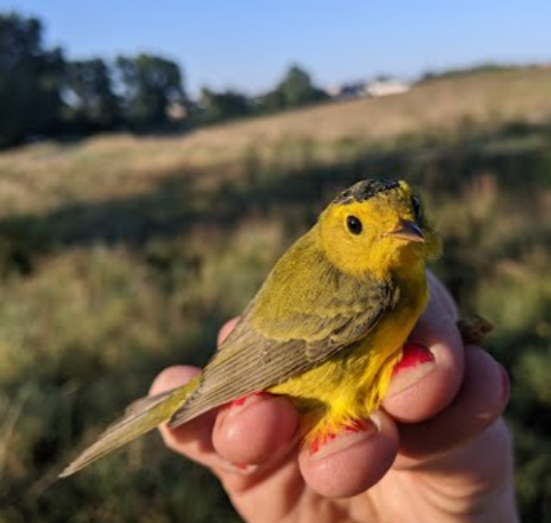
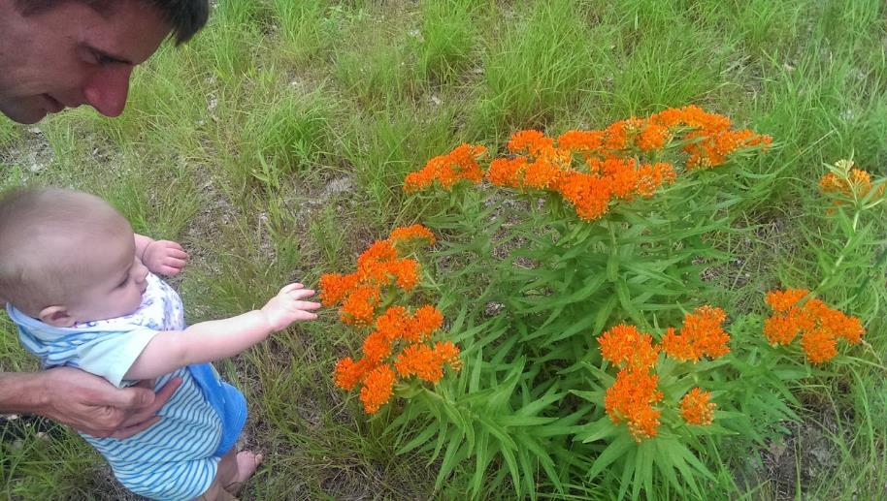
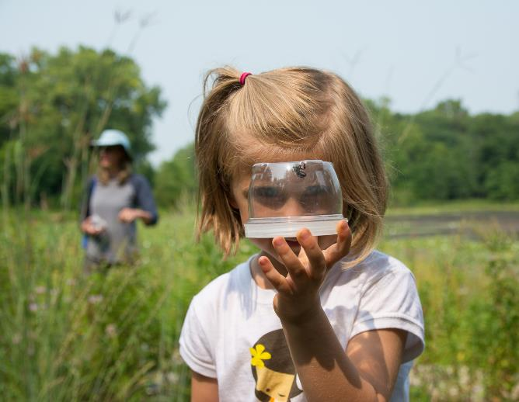
Questions?
For more information contact Jason Beckler at jason.beckler@state.mn.us or at 507-829-8204
Wilson’s warbler, Mike Goodnature
Paul Raymaker

