Slide 1
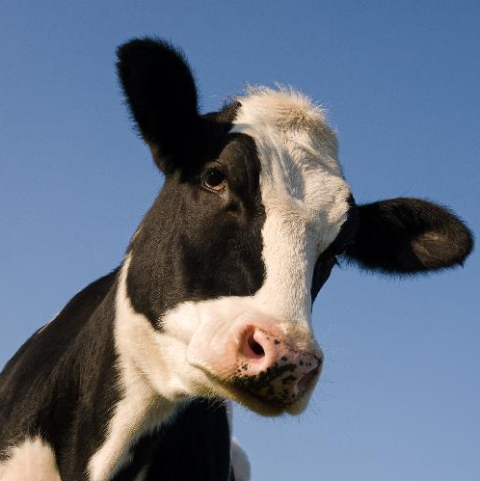


Overview of Accounting Support to Michigan’s Conservation Districts
NASCA Staff Sharing Session
October 7-8, 2024
Nadene Berthiaume
Southeast Michigan Regional Coordinator MDARD Conservation Programs Unit

Slide 2

Accounting Challenges in Michigan Conservation Districts
Accounting requirements in Conservation District (CD) law, other laws, and most grants
Gaps in accounting knowledge, skills, and abilities
MDARD requires CDs to use QuickBooks
Limited tools and resources to help
Notes:
Like other states, CDs are required by law to follow certain accounting practices and standards
Gaps in accounting knowledge/skills include:
Managers with little to no accounting background or training
Little room in CD budgets for accounting/bookkeeping training or to hire dedicated accountants/bookkeepers
High manager turnover results in starting over, and over
Most CD directors don’t have the skills, background, or confidence to offer support
MDARD requires CDs to use QuickBooks but has limited resources to provide support
The accounting manual is old, outdated, and possibly inconsistent with current laws and requirements
We do not have access to QuickBooks
We had limited skill and experience in accounting/bookkeeping with our district support staff
Third-party contractors not meeting training/support needs and would end up doing it for them instead of teaching them how to do it themselves

Slide 3

Calling in the Professionals
Contract with a local Certified Public Accountant (CPA) firm
One-on-one assistance
Trainings (webinars and in-person)
Consultation on governmental accounting questions
Dedicated QuickBooks and governmental accounting specialists
Notes:
We discontinued the accounting support agreement with previous third-party contractor
Put out a bid for services knowing it would be more expensive than before
Found a reputable CPA capable of providing the level of support we wanted, and districts needed
Timely responses
Knowledgeable in QB Online and QB Desktop
Able to develop and provide training content on topics requested by us/CDs
A source for many of the “grey area” questions we have/get around CDs and governmental accounting
Despite being a large firm, they dedicated 2-3 staff to work on the contract so that relationships could be established (with us and CDs) and for consistence guidance

Slide 4

Increasing Our Internal Capacity to Provide Support
Opportunity to bring on new staff
Skillset and interest to provide accounting support
Main point of contact on CPA contract
Refined process and improved support being provided
Notes:
Due to a retirement, we had the opportunity to fill a regional coordinator position
Accounting experience was not a requirement of the position posting but identified as a desirable skillset
Nadene not only had accounting & QuickBooks experience (along with all the other required qualifications) but a desire to use it to help support districts
Nadene took over as the main point of contact with the CPA firm, establishing a relationship with their dedicated staff and helped them better understand CDs which allowed them to provide better support
Refined process: & improved support:
Initial rollout of the CPA one-on-one support was clunky and a few CDs were taking advantage of the free support, eating up the funding/support available to others
Recommended a change to the process for better tracking of usage as well as awareness of types of issues/support being provided
Now initial requests for support are referred to Nadene by the district’s regional coordinator/field staff
Nadene meets with the district to understand the situation and provides one-on-one assistance if it’s within her ability
If it’s beyond Nadene’s ability she refers them to CPA firm with an estimate of how much time they can allocate to helping with the issue

Slide 5

Lessons Learned
Relationships count
Building trust to overcome fears
Known unknowns and unknown unknowns
These in-depth looks help identify broader training needs
Notes:
Until a trusting relationship is established they might be afraid to ask questions, afraid to let anyone in their system, afraid to say they don’t know
They might know there’s an issue but don’t know how to resolve it or they might not even know they have an issue
They don’t know what they don’t know
The more one-on-one support we provide the more trends in knowledge gaps can be identified and addressed through group trainings and development of support tool/resources

Slide 6

Outcomes
Protecting Michigan’s investment
Increased transparency
Clearer reporting results in faster payments received
Better understanding and better decisions locally
Improved support to CDs (and growing)
Notes:
Protecting the State’s investment:
Better financial reporting
Accurate usage of funds
More assurance on government funds being administered by districts
Increased transparency:
Internal- easier for boards to understand financial reports and financial standings
External- better data for audits, more confidence in financial reports if ever FOIA’d
Faster payments
Easier for MDARD staff (and other grantors) to read/approve financial reports resulting in fewer delays in grant payments being issued
Better data to make decisions with rather than guessing, not knowing, or not being able to trust the numbers
Improved support:
More ability to support districts’ accounting needs than before
Working on a QB online subscription for Nadene/MDARD staff to provide better 1-on-1 support and training materials
Working on developing a relationship with Treasury to help with governmental accounting grey areas and support needs
Hoping to wean off 3rd party contractor support as we develop more internal capacity to provide support and resources

Slide 7

Questions?

Slide 8
MDARD Conservation Programs Unit Field Staff Contact Information
John Switzer
Conservation Programs Unit Manager
SwitzerJ3@Michigan.gov
517-881-5172
Nadene Berthiaume
Southeast Michigan
Regional Coordinator
BerthiaumeN@Michigan.gov
810-348-6259
Christy Roman
Northeast Michigan Regional Coordinator
RomanC@Michigan.gov
517-243-0117
Jim Pawlowicz
Northwest Michigan
Regional Coordinator
PawlowiczJ@Michigan.gov
231-357-4357
Rachael Guth
Upper Peninsula
Regional Coordinator
GuthR@Michigan.gov
906-251-8727
Jack Knorek
Southwest
Regional Coordinator
KnorekJ@Michigan.gov
517-243-0072

Slide 9


Thank you!
@MichDeptofAg

