Slide 1

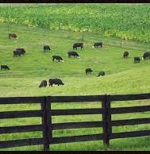
Kentucky Nutrient Management
Kimberly Bartley
Environmental Scientist
Kentucky Division of Conservation

Slide 2
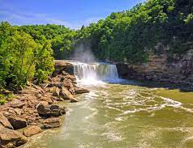
Kentucky Water at a Glance
Average of 55 inches of rain per year
More than 90,000 miles of rivers and waterways
Drain to Ohio, Mississippi and Tennessee Rivers
KARST topography
Nearly 60% of Kentucky’s waterways are impaired
Kentucky is a Diverse AGRICULTURE STATE

Slide 3
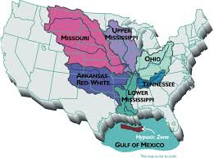
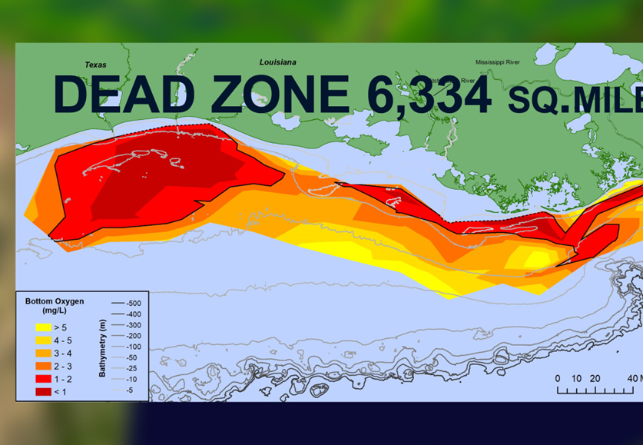
GULF HYPOXIA ZONE: Facts
41% of the United States drains to the Mississippi. And then empties in the Gulf of Mexico
Nutrient overload
Oxygen Depletion Occurs
Aquatic animals die or flee
Area can increase or decrease each year

Slide 4

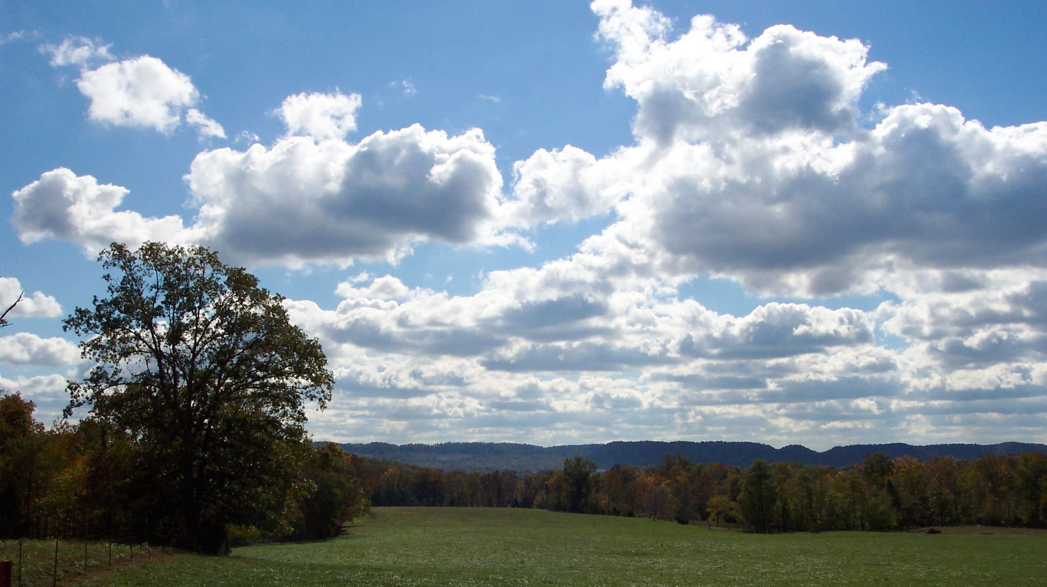



WHY
Cleaner water
Reduce treatment cost
Fishing industry
Recreational impact
Landowner responsibility

Slide 5

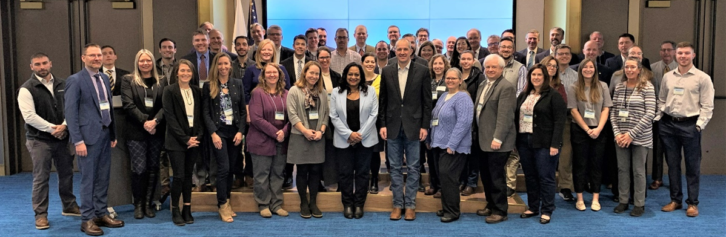
EPA Mississippi River – Gulf Hypoxia Taskforce
Established in 2001
5 federal agencies
11 states
Goal – reduce nutrient and sedimentation
Restore and protect the waters of 31 states

Slide 6
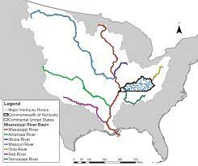
Kentucky’s Nutrient Reduction Strategy
Strengthen PARTNERSHIPS
Reduce nutrients by %
Address agriculture impact
Install Best Management Practices
Developing nutrient management plans
Education

Slide 7
Kentucky Nutrient Management Grant
US EPA Section 319 Grant Funds
Multi-Agency
5 Year Funding
$130,000
Best Management Practices
Target Watersheds

Slide 8
Division of Conservation
Promote Ag Water Quality Plans
Landowner Education
Ky Nutrient Management Plans
Watershed Awareness
Reduce Agriculture Impact
Cost Share Assistance

Slide 9
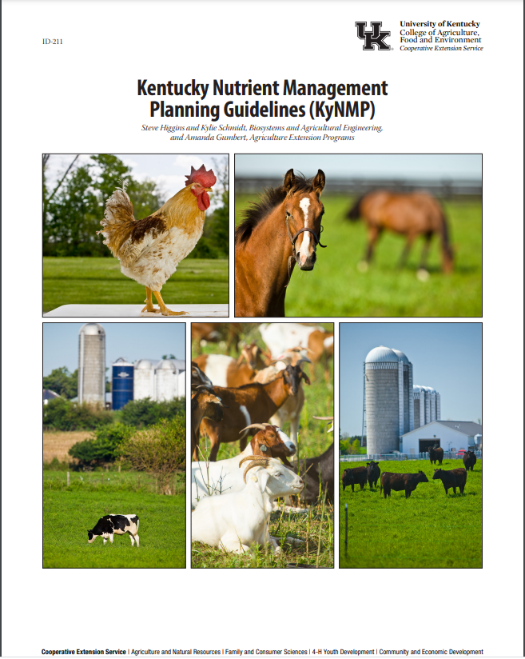
What is a Ky Nutrient Management Plan? (KYNMP)
Educational tool
Landowner plan
Assessment for livestock production of nutrients
Crop recommendations
Plan for draw down of nutrients

Slide 10
Why a landowner needs a KYNMP
Handling livestock Waste
USDA Farm Service Agency Loan
State Cost Share
Division of Water Referral
Landowner Request
Ag Water Quality Act

Slide 11
Process
Referral through Division of Conservation
7 field staff
Farm visit or consultation
Gather information
Utilize planning tool to get information
Review with landowner
Referral to Cooperative Extension Service

Slide 12
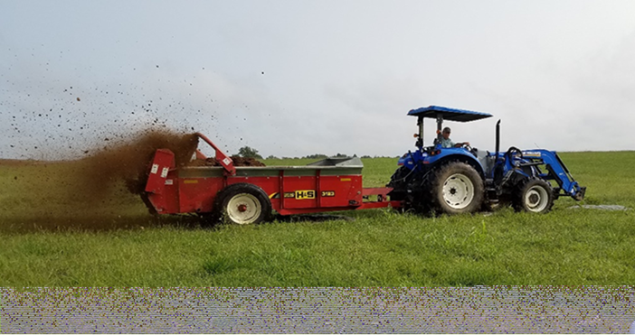
Required Information
LANDOWNER INFORMATION
General Info
Operation information – livestock type, feed rations, lagoons, buildings, confinement, etc.
DISTRICT OR NRCS ASSISTANCE
Cost share assistance
Update Agriculture Water Quality Plan
Water citation letter & pictures
Aerial maps

Slide 14


Slide 15


Landowner Education
Nutrient management concepts
Soil and manure samples
Composting
Mortality disposal
Agriculture water quality
Manure application
Nutrient management plan summary and recommendations
Manure = Liquid Gold

Slide 16

Pros
Education
One on one interaction
Assist other agencies
Completed over 100 plans
Assisted 135 landowners
Cons
Manpower
Compliance
Improving tools
Landowner hesitancy
Ongoing monumental task
DOW mandates

Slide 17
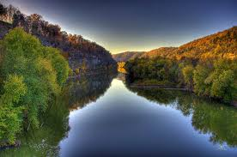
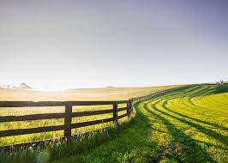
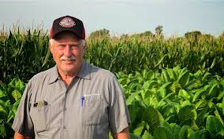
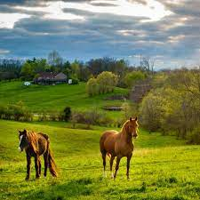
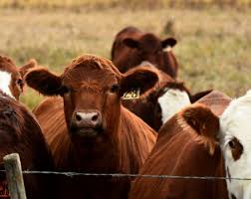
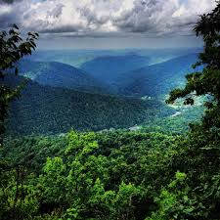
End Goal
Improve Water Quality
Educate Landowners
Reduce Kentucky’s Contribution
MAKE A DIFFERENCE

Slide 18


