Slide 1
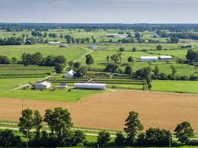
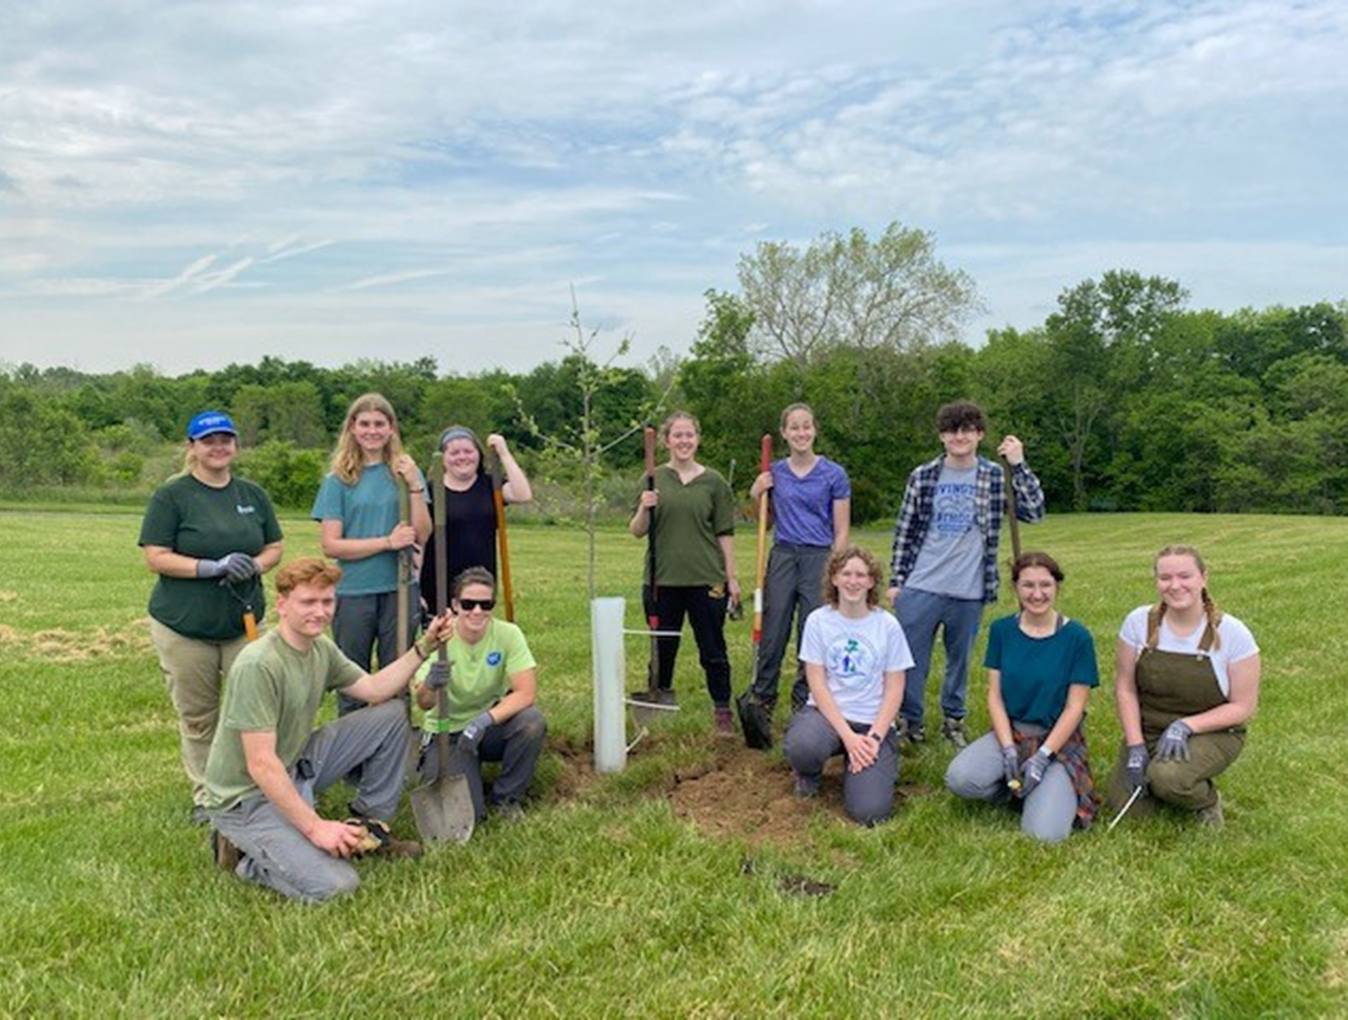
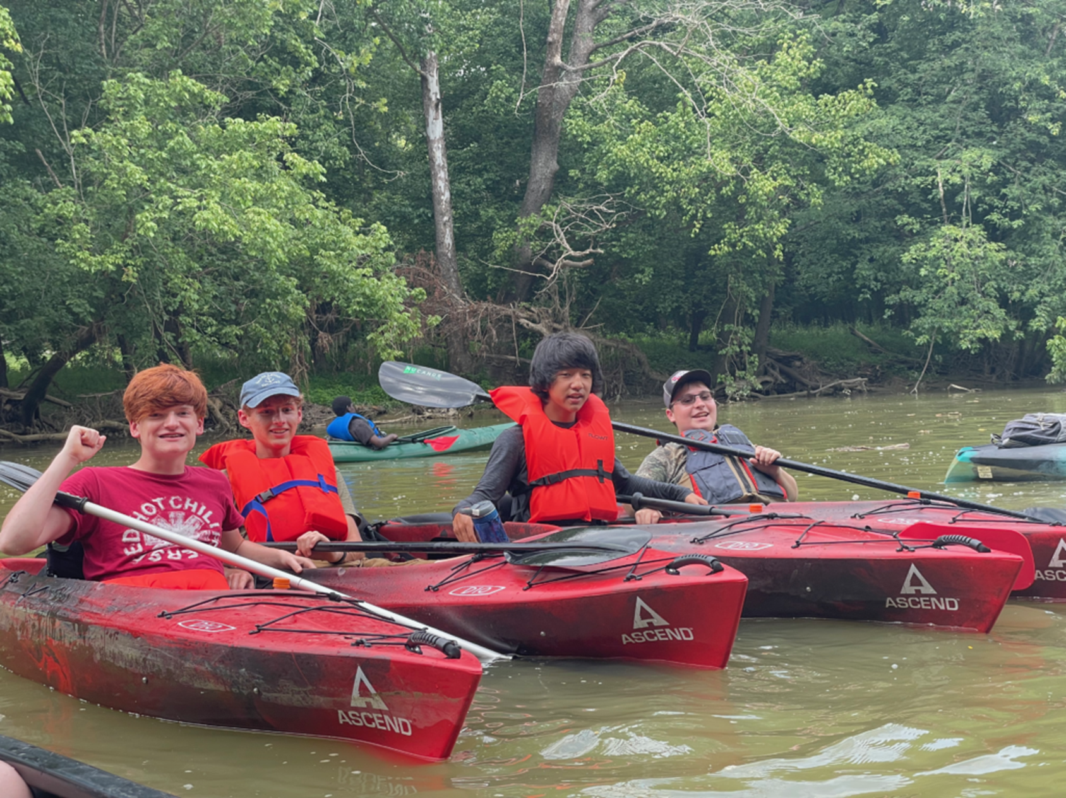
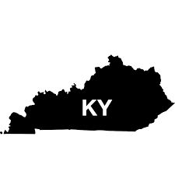

KENTUCKY
Junior Conservation Boards
Notes:
BCCDKY started their first Jr. Board in 2021 after a LEAF Academy student asked “what else can I do to stay involved in conservation?” That student was Ava Reed, who became our Jr. Board president, served two terms, went on to get hired as a high school intern, and is about to start her environmental science degree at Morehead State University!

Slide 2



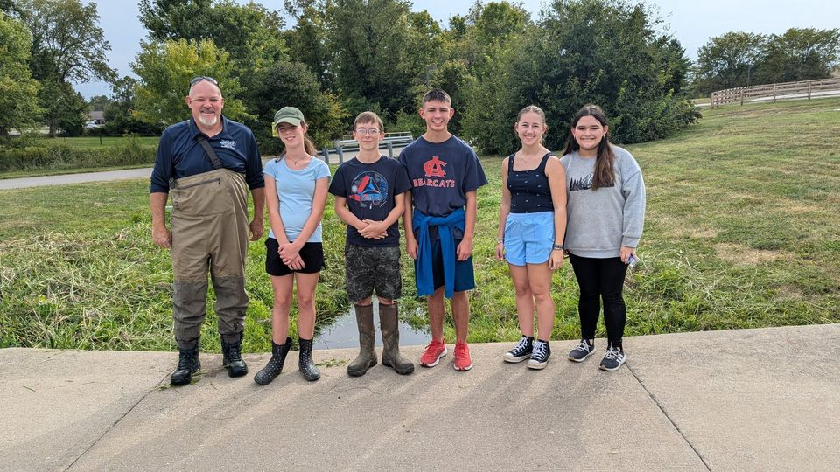
What is a Junior Board?
A group of middle or high school students with an interest in conservation, agriculture or the environment.
Students that have a future interest in holding an elected position on a conservation district board.

Slide 3
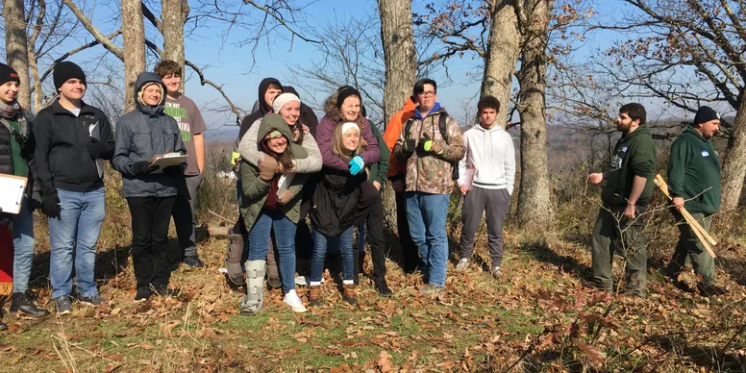
Why start a Junior Board?
Expand outreach
Showcase your district
“Built In” Envirothon team
Expand volunteer base (get stuff done!)
Encourage confidence, leadership, responsibility and compassion.
Represent the youth voice
Recruit the next generation of conservation district leaders

Slide 4
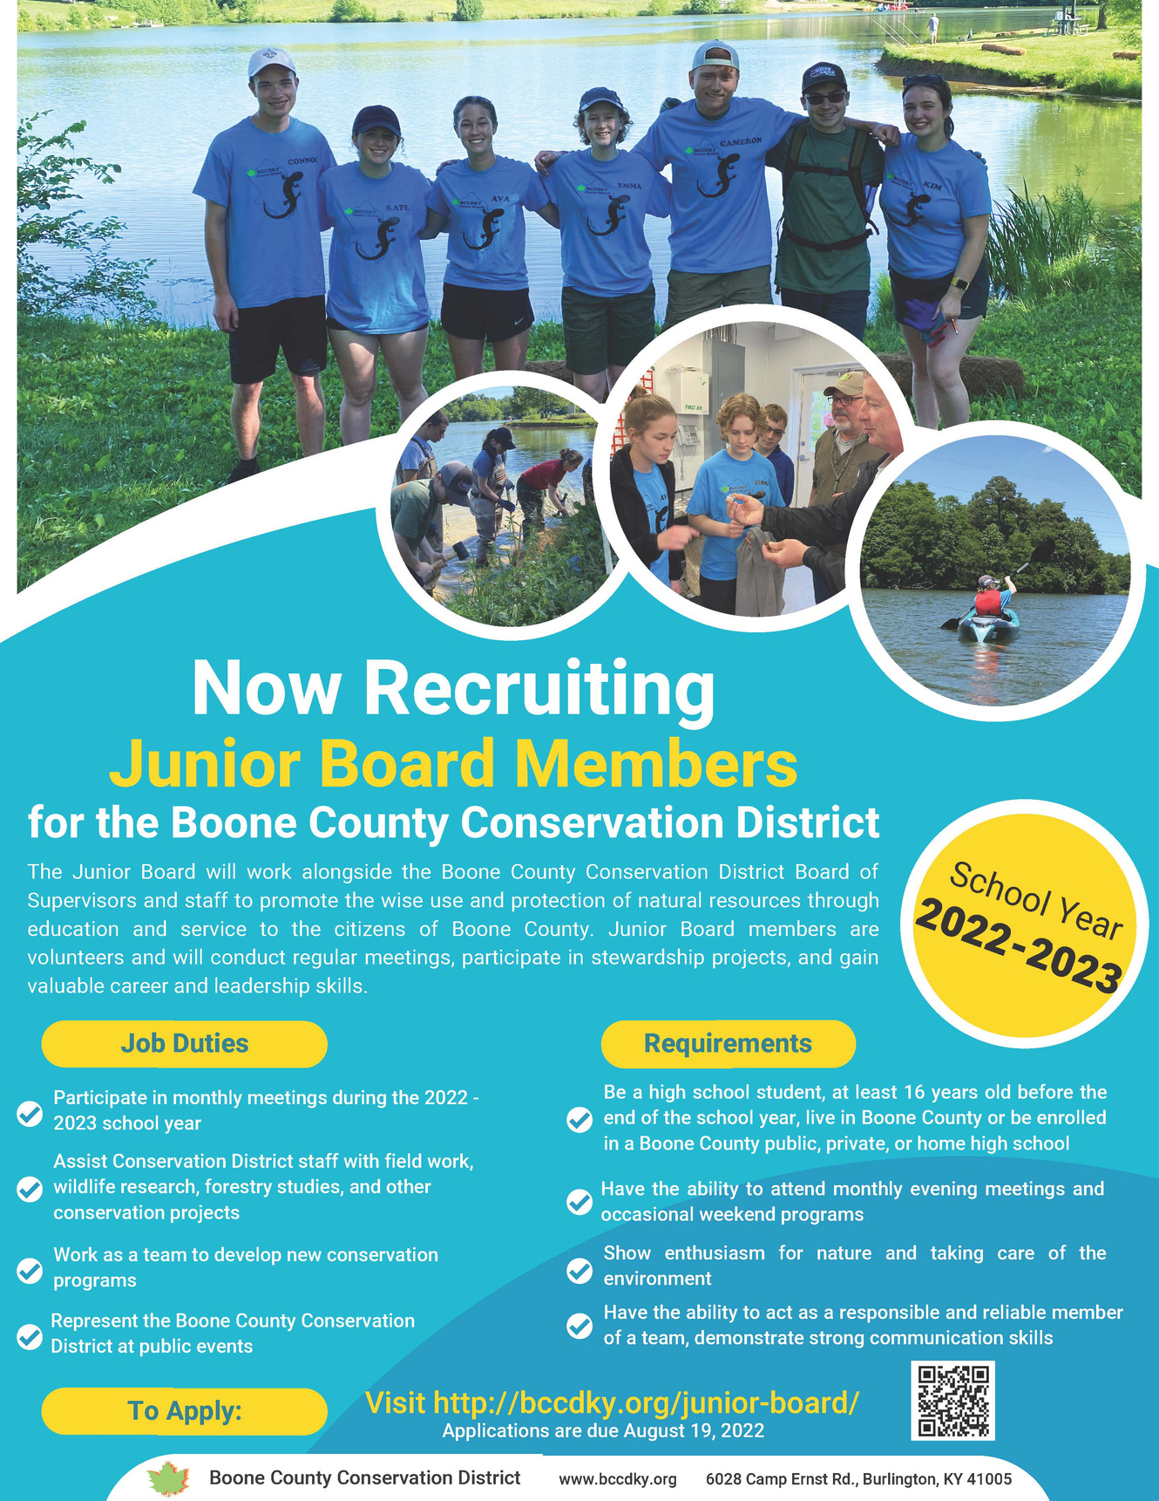
Building A
Junior Board
Recruitment & Contacts:
Previous programs
Social media, e-newsletter
4-H, FFA, environmental clubs
Cattlemen's and Farm Bureau
Membership:
Applications
References
Age and county requirement
Notes:
We used to require age 16+, but participation was low and kids become too busy in their junior and senior year (although we do have some). We require a short (200 words) essay about why conservation is important to them. We did require a letter of reference one year, but since then our board has become less formal. Applications are collected through a google form, and includes a liability waiver signed by parents.

Slide 5
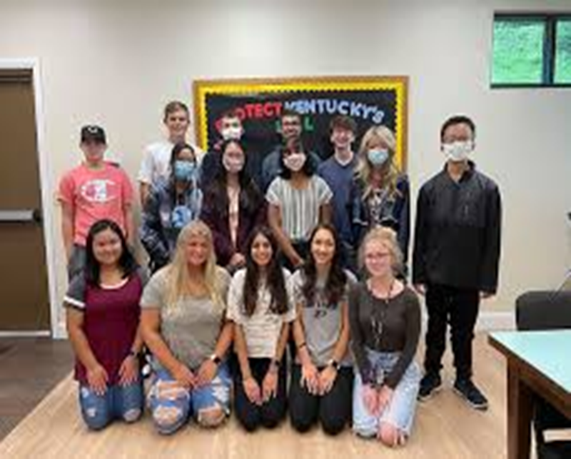
GETTING STARTED
Energetic staff!
Recruit a board member to help!
Advertising
Contact schools: public, private & home school sector
Use outside agencies
Parent involvement
District social media

Slide 6
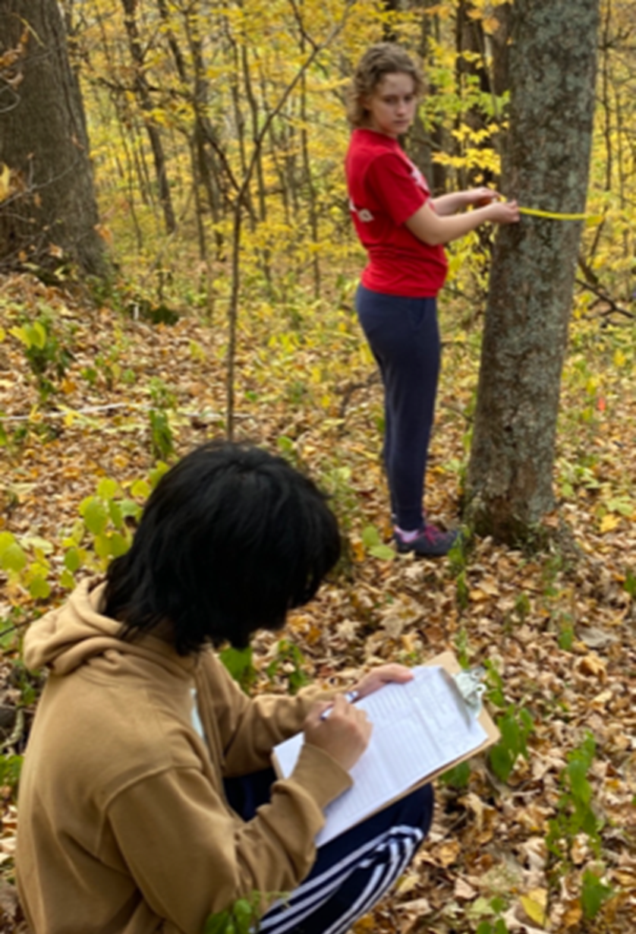
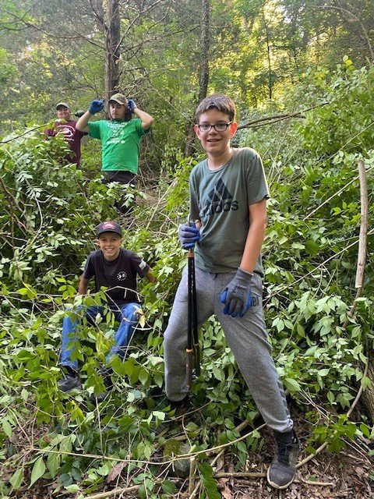

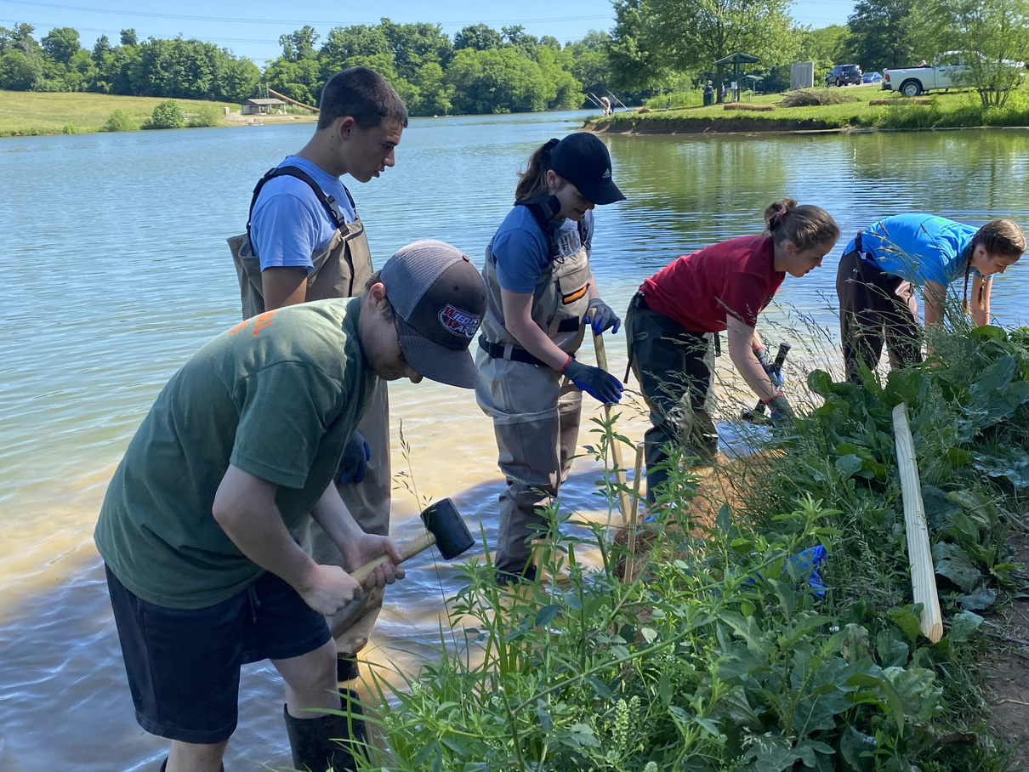
How KY’s Junior Boards got started
Notes:
Our programs are designed to build on one another. Conservation Kids Camp (ages 9-12) feeds into L.E.A.F! Academy (ages 13-15), and LEAF Academy feeds into Junior Board (high school students) which feeds into college internships. College interns then go on to get seasonal or full time jobs with us or our partners!

Slide 7
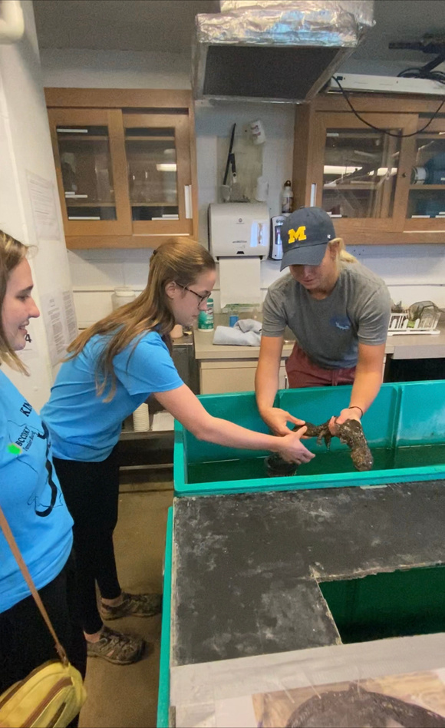
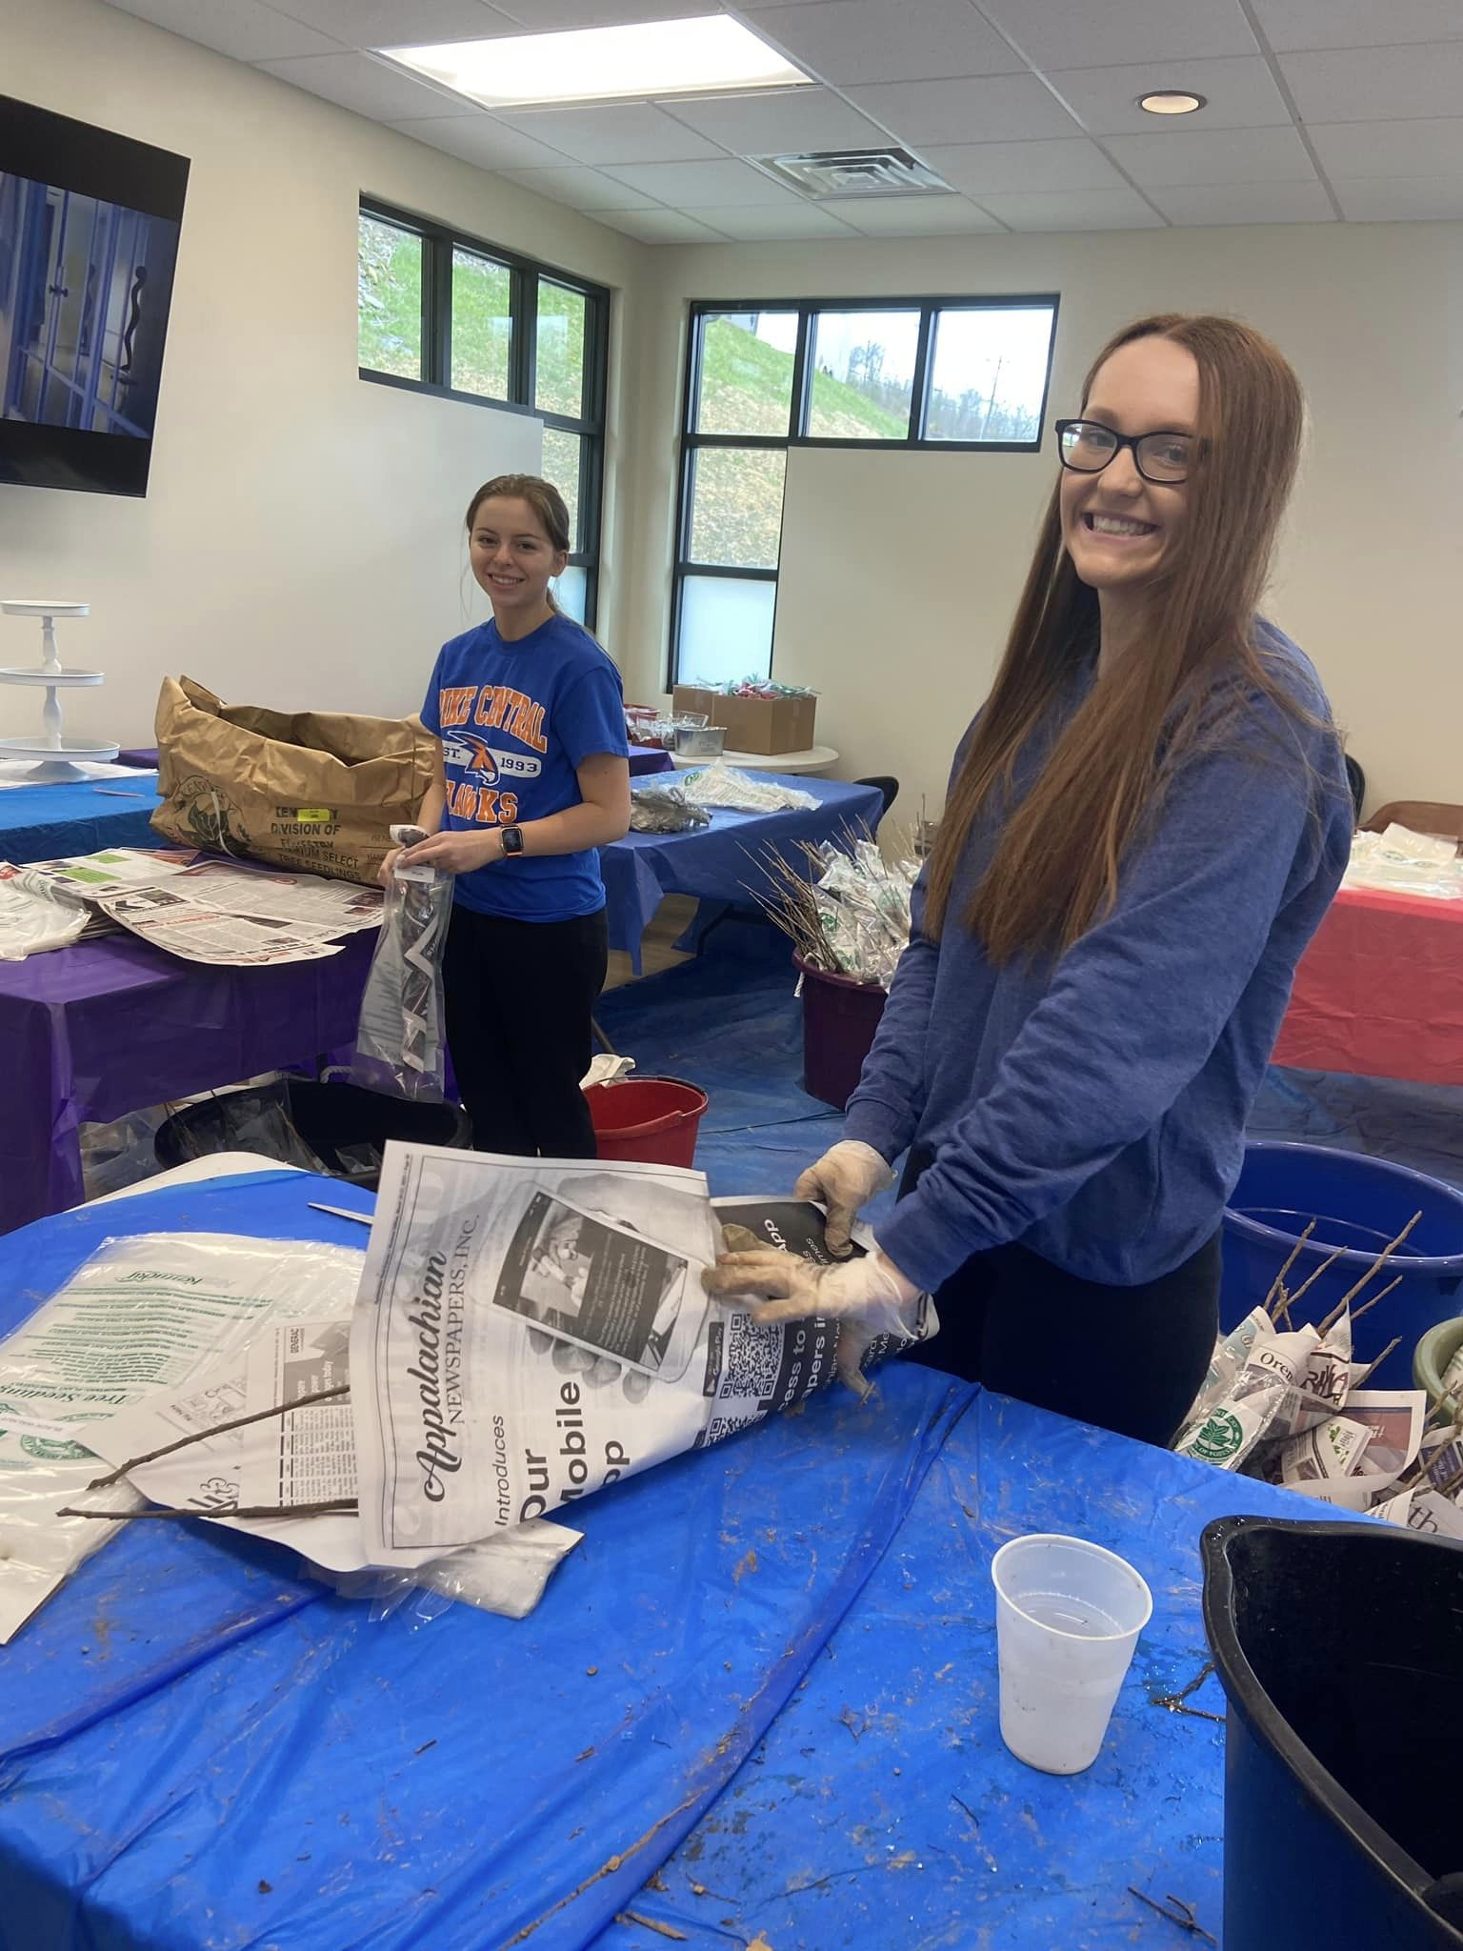
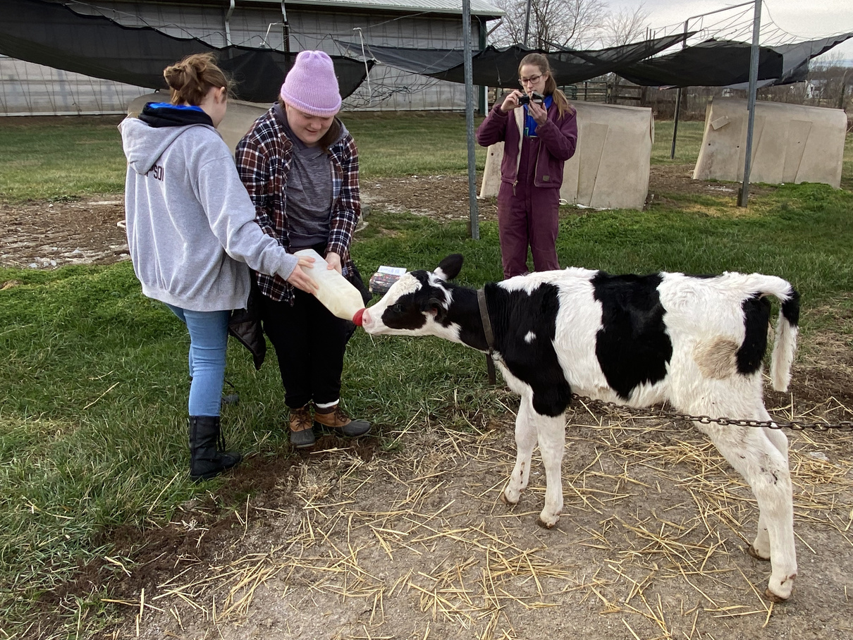
ACTIVITIES
Meetings
Run like a business meeting
Officer elections
Explore the outdoors
Tours, job shadowing, nature hikes, farm field days
Volunteer & community service opportunities
Project ideas and goals
Notes:
Big Project: Some years we give the JB a list of example projects, let them vote on one, and it will be their job to plan and complete the project from top to bottom. Examples: installing coir logs for bank stability at a popular fishing pond and planning a native orchard at a public park. JB members contacted landowners, wrote grant for funds, picked the trees, and did the work!

Slide 8
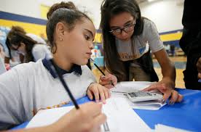

BUDGETING
Junior Board works with district
Develops activities
Learns about budgeting
Compiles a budget
$1000 - $5000
Sky is the limit
Fundraising
Donations from local businesses

Slide 9
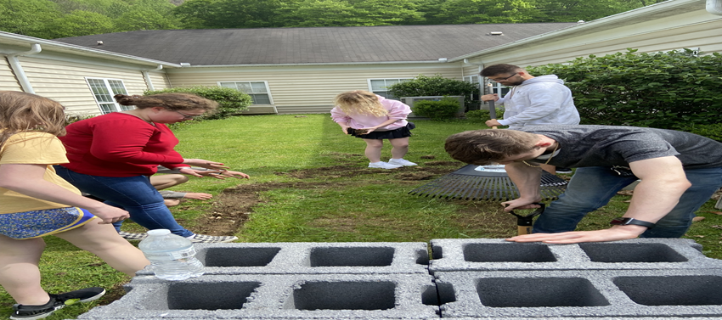
The KEYS to Success
Make it your OWN
Partnerships!
Involve the district board
Community and youth engagement
FOOD ☺ FUN

Slide 10
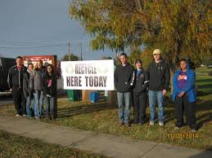
Activities
Community clean up
Assist with district activities
Tree plantings
Hospital or nursing home visits
Gardens
Adopt a stream
Assist with K-5 activities
Envirothon
Clothes drive
Trunk or treat
Recycling
Assist other agencies: forestry, wildlife, water & aquatics
Festivals and tabling
Farm days
College, career and scholarship opportunities, volunteer opportunities
CONSERVATION DISTRICT BOARD INTERACTION

Slide 11
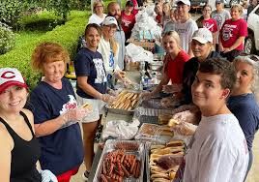
What’s in it for students?
New friends
Career exploration
Experience
Scholarship & internship opportunities
Looks good on a resume
Training for a future seat as an elected official
FOOD & FELLOWSHIP

Slide 12
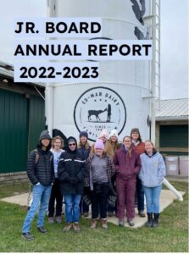
Share the experience
Junior board meets with district to present report of accomplishments
Budget accountability
Presents possible goals and activities for the next year

Slide 13
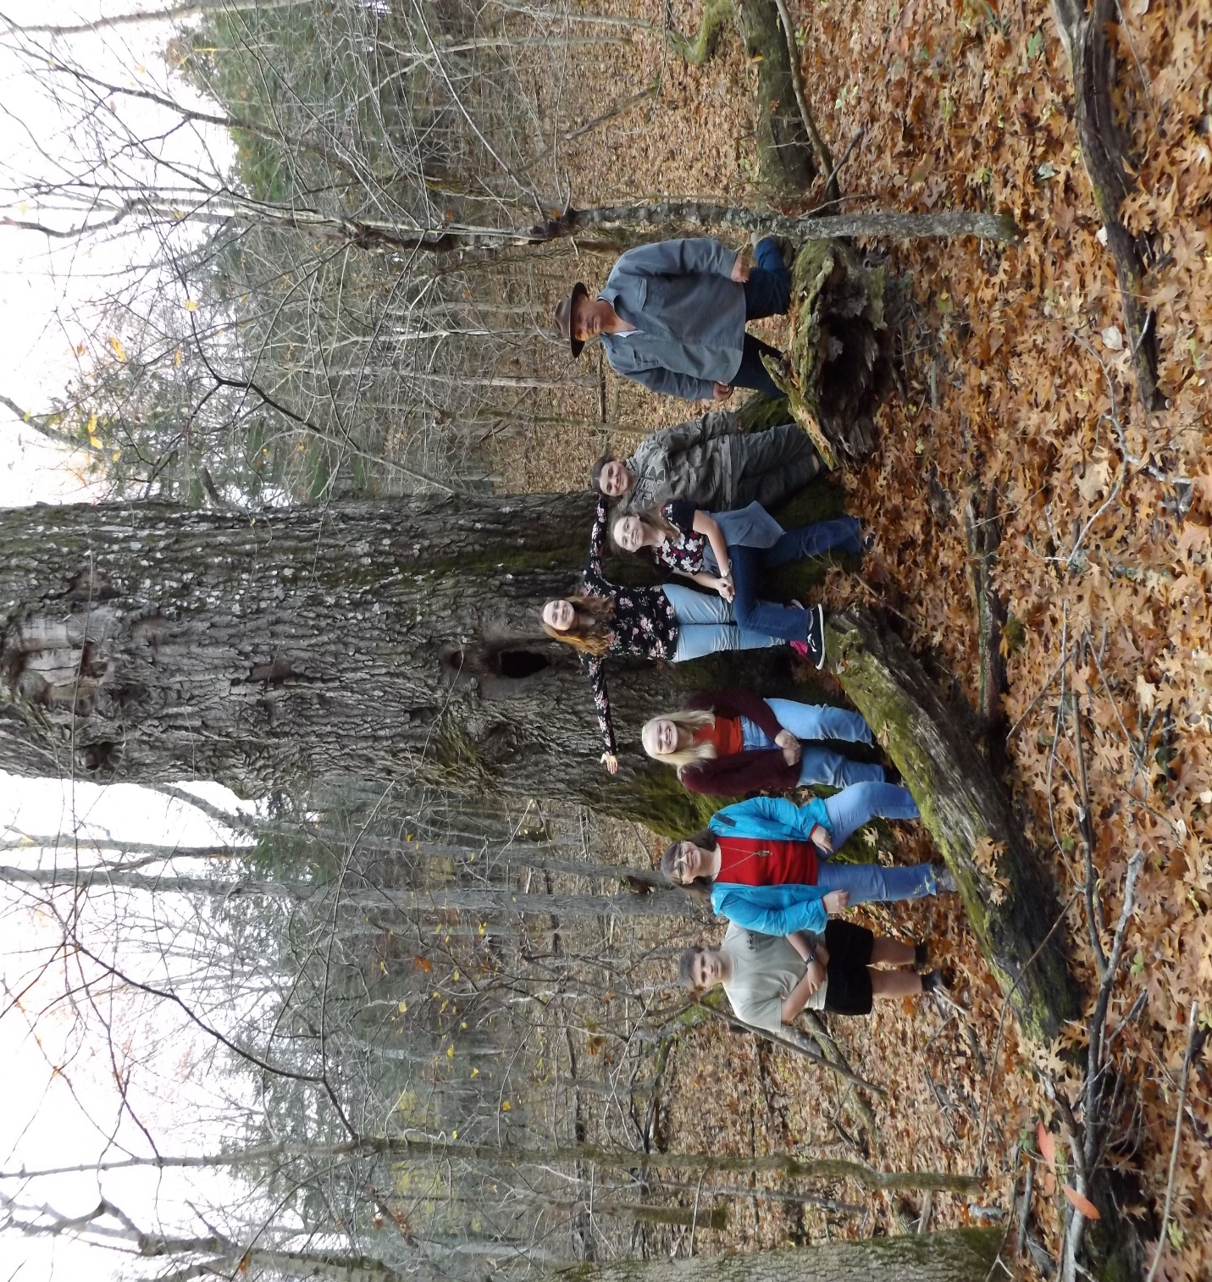
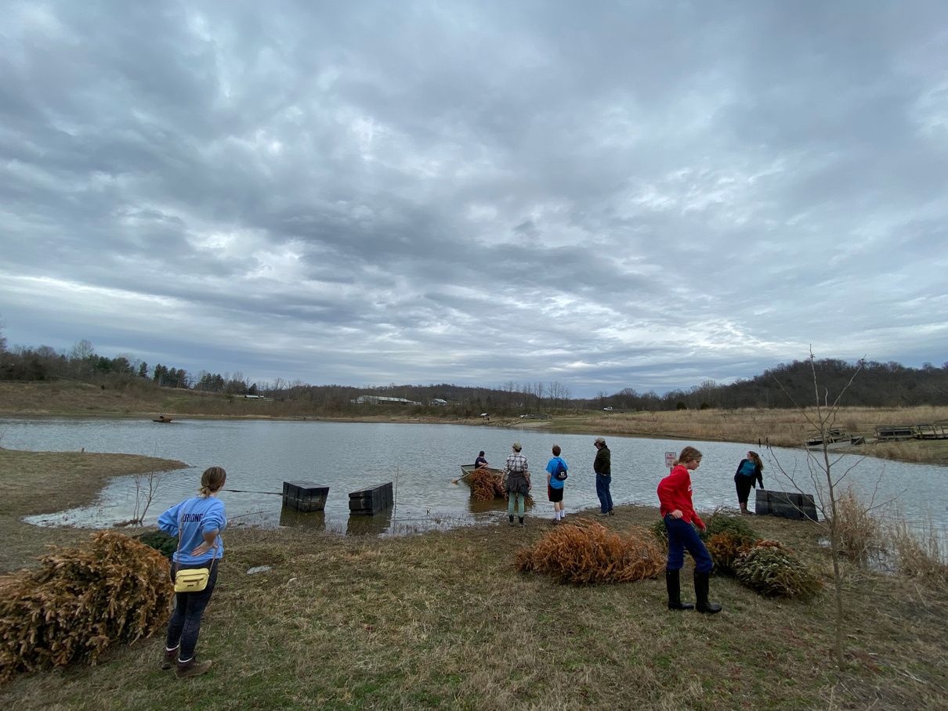
Diverse Junior Boards Across Kentucky

Slide 14
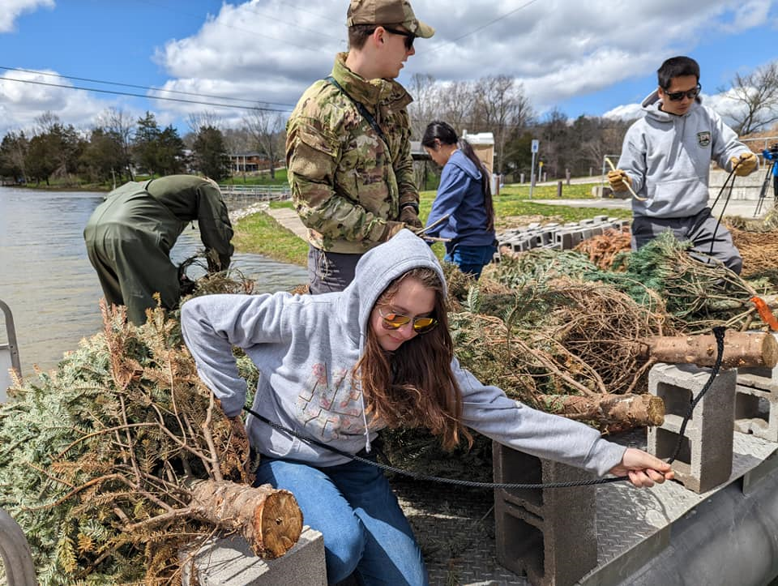
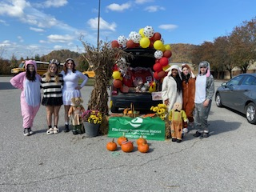
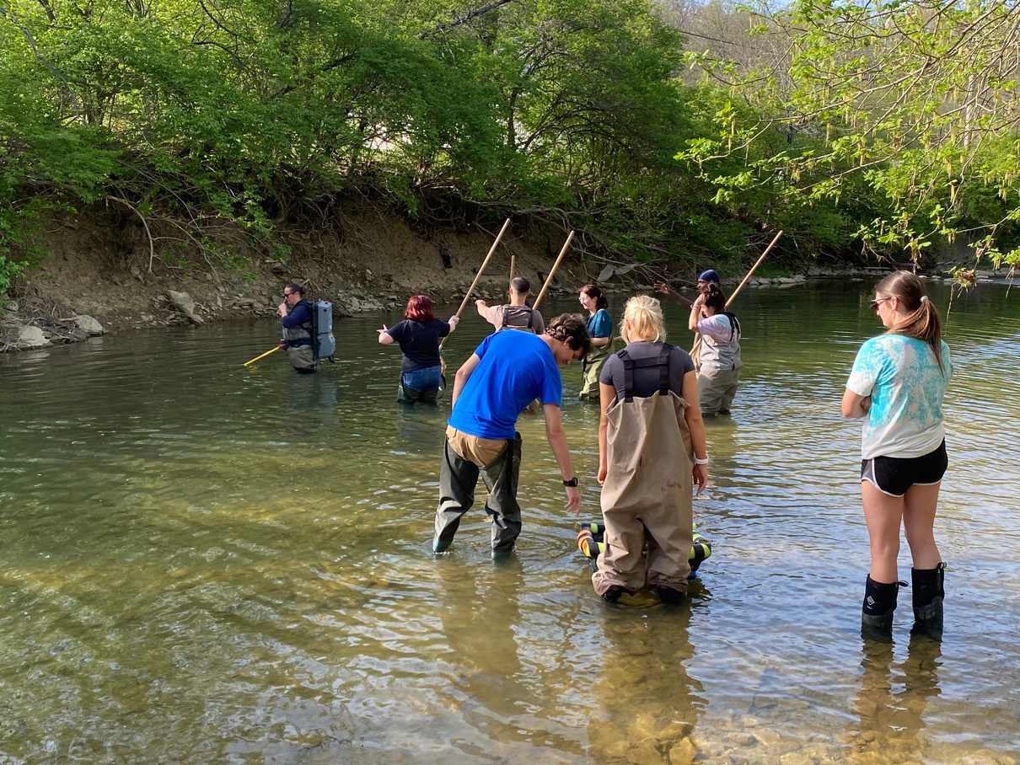
Diverse Junior Boards Across Kentucky

Slide 15
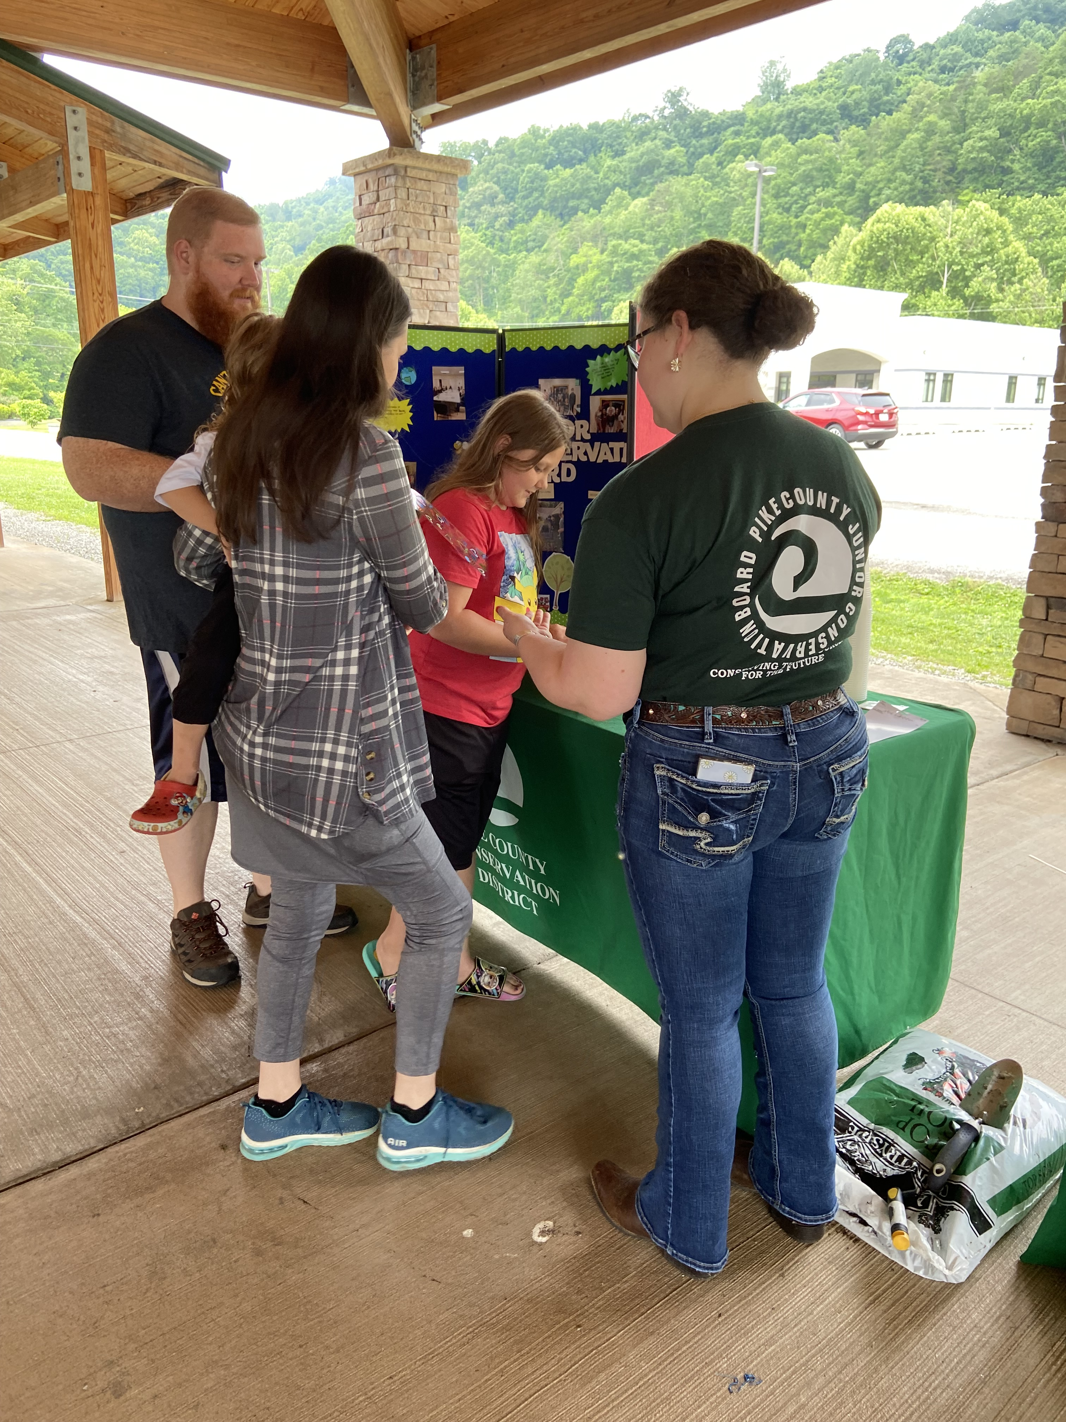
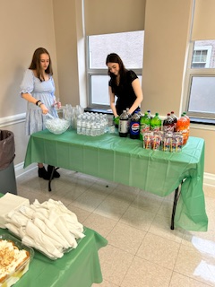
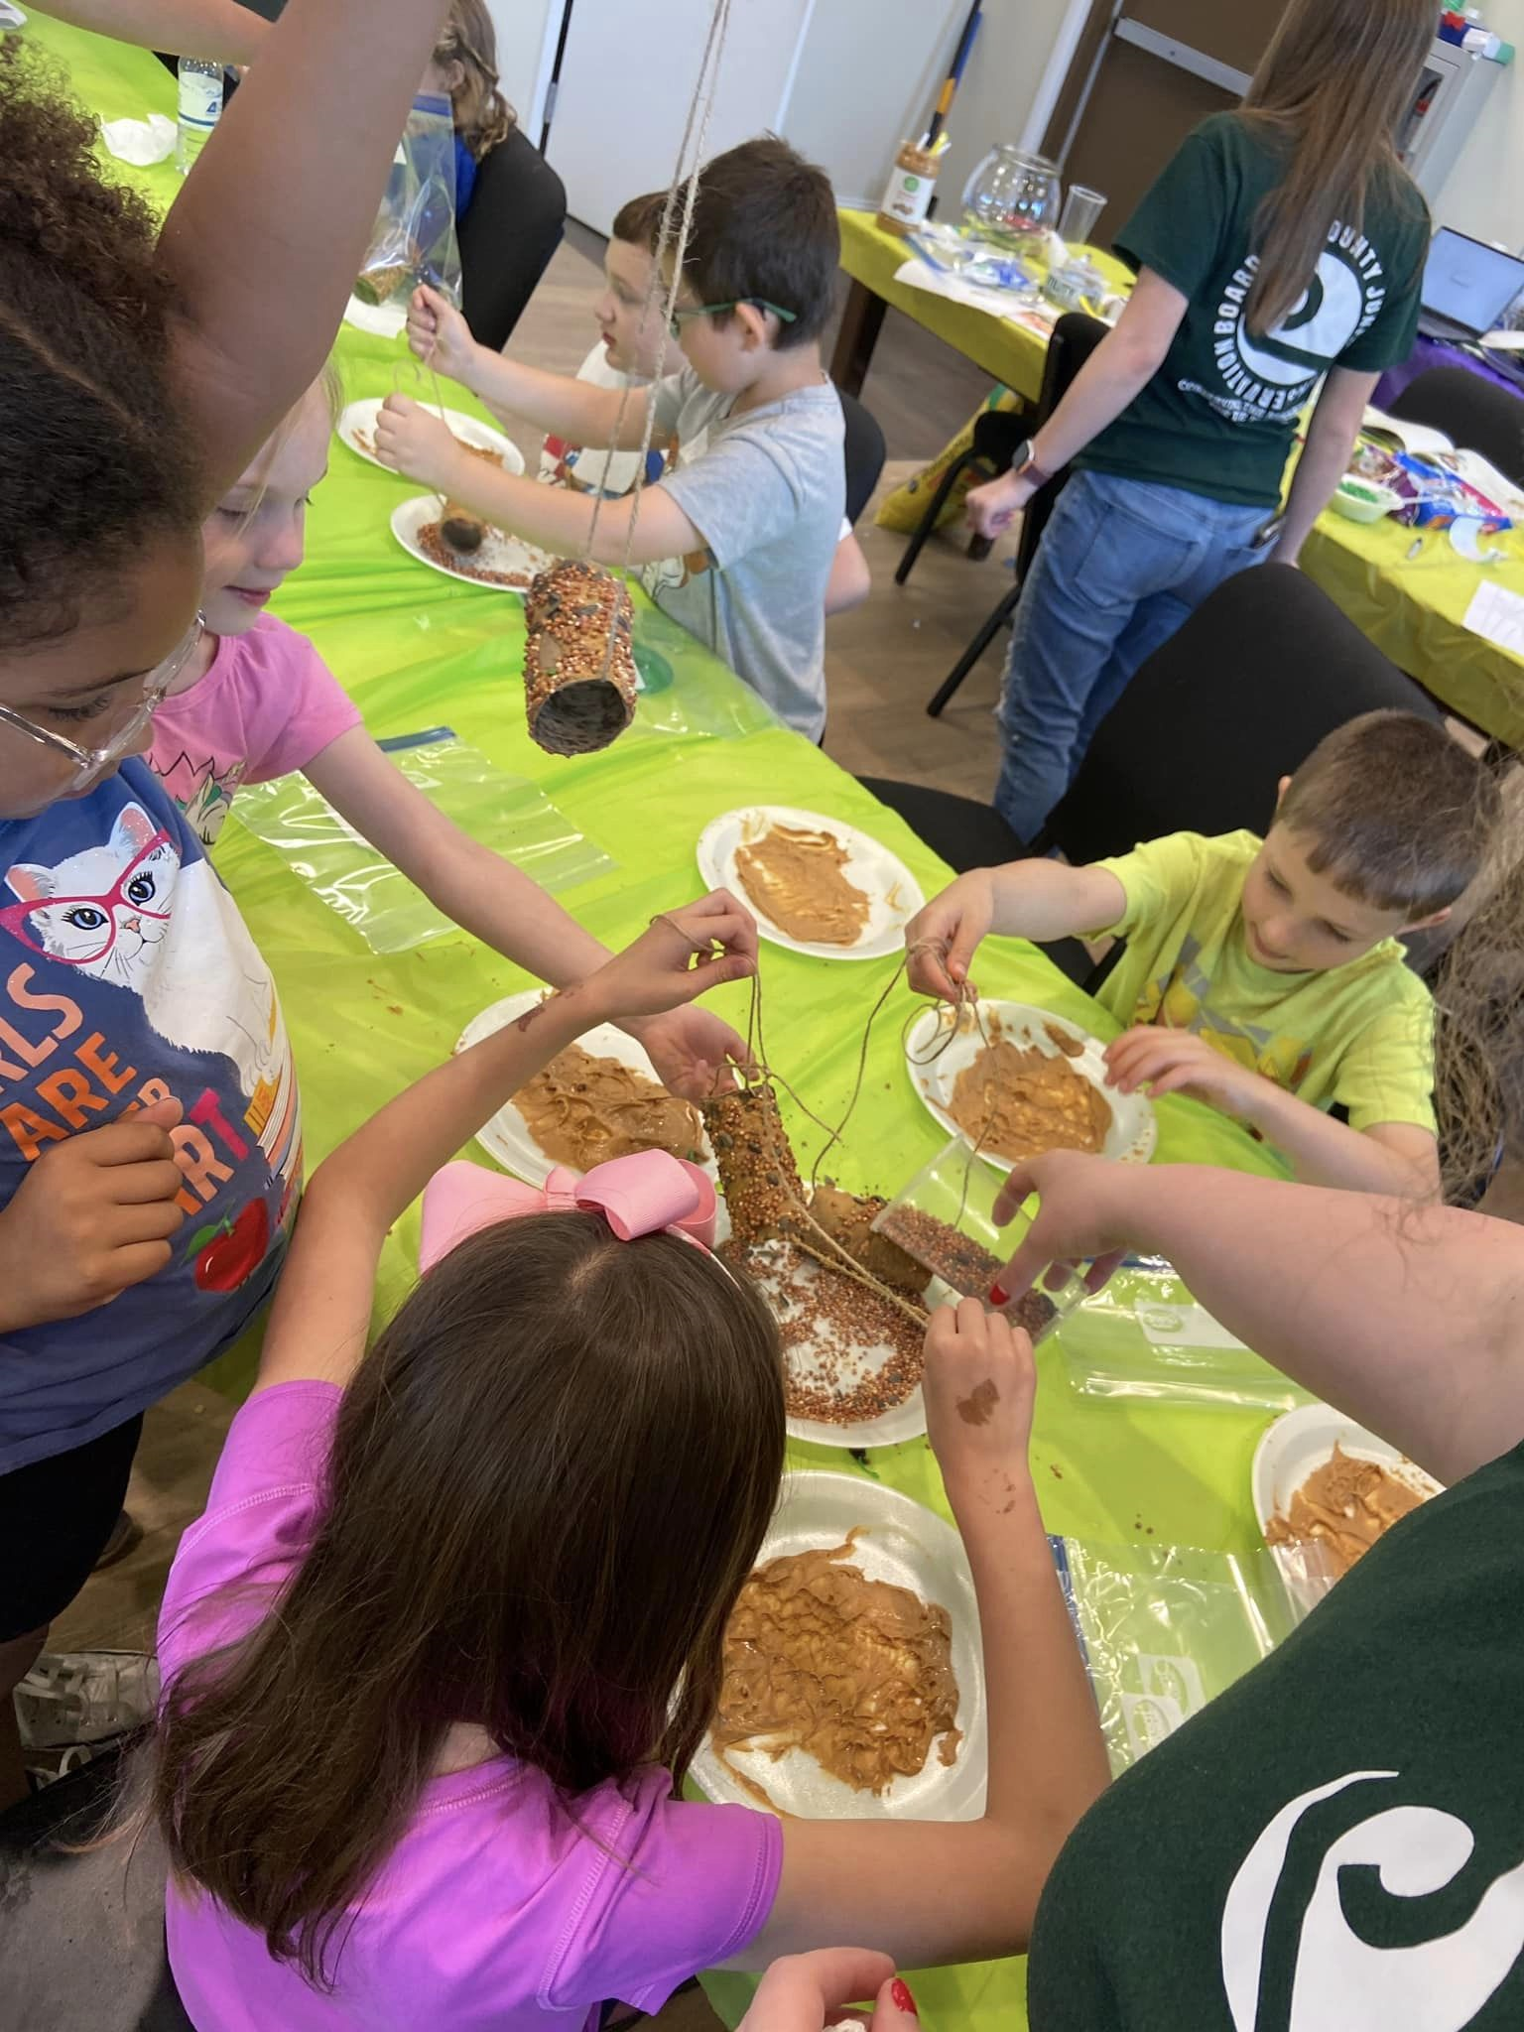
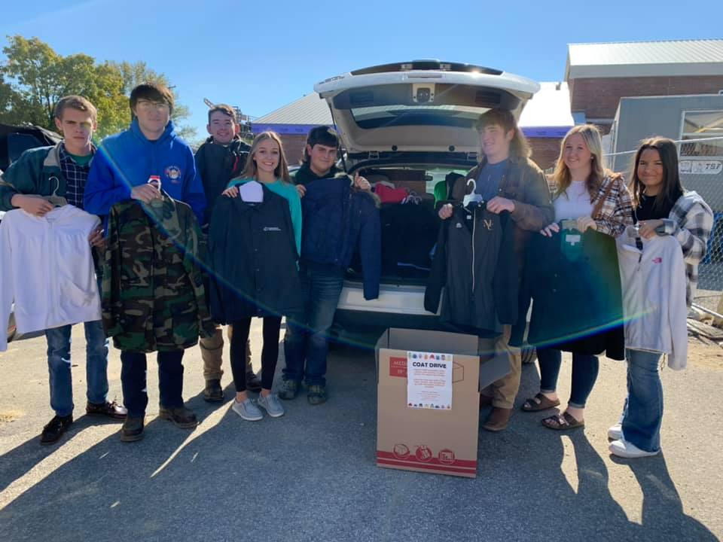
Diverse Junior Boards Across Kentucky

Slide 16
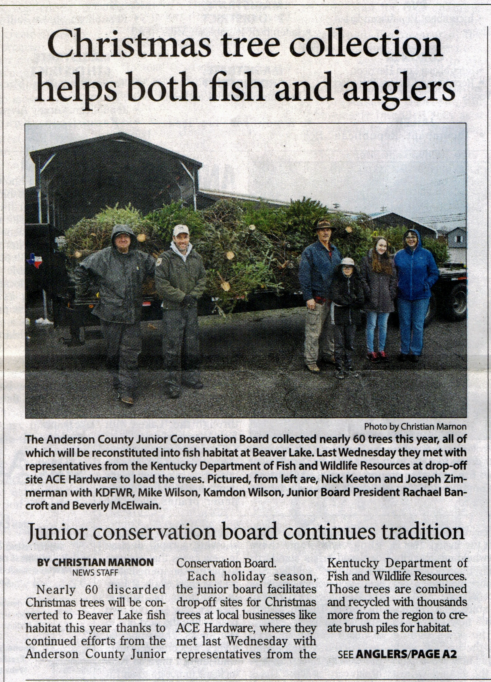
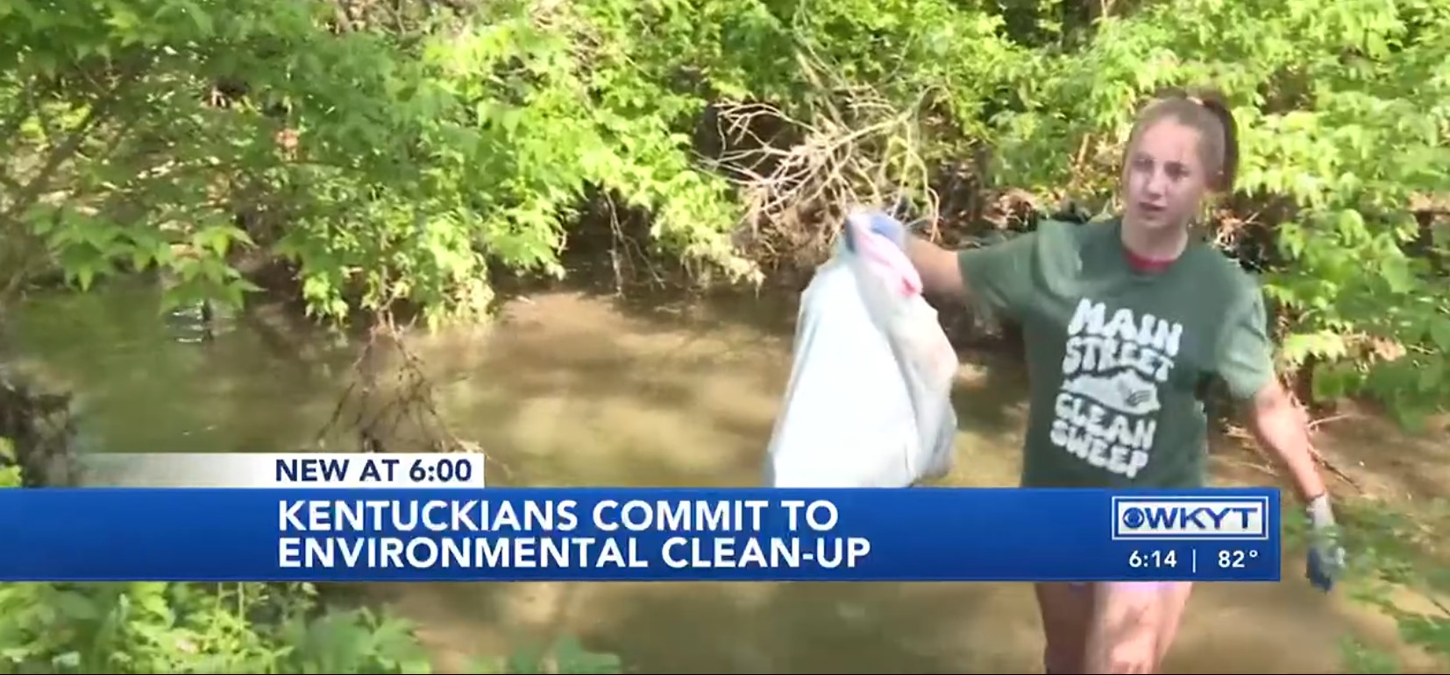
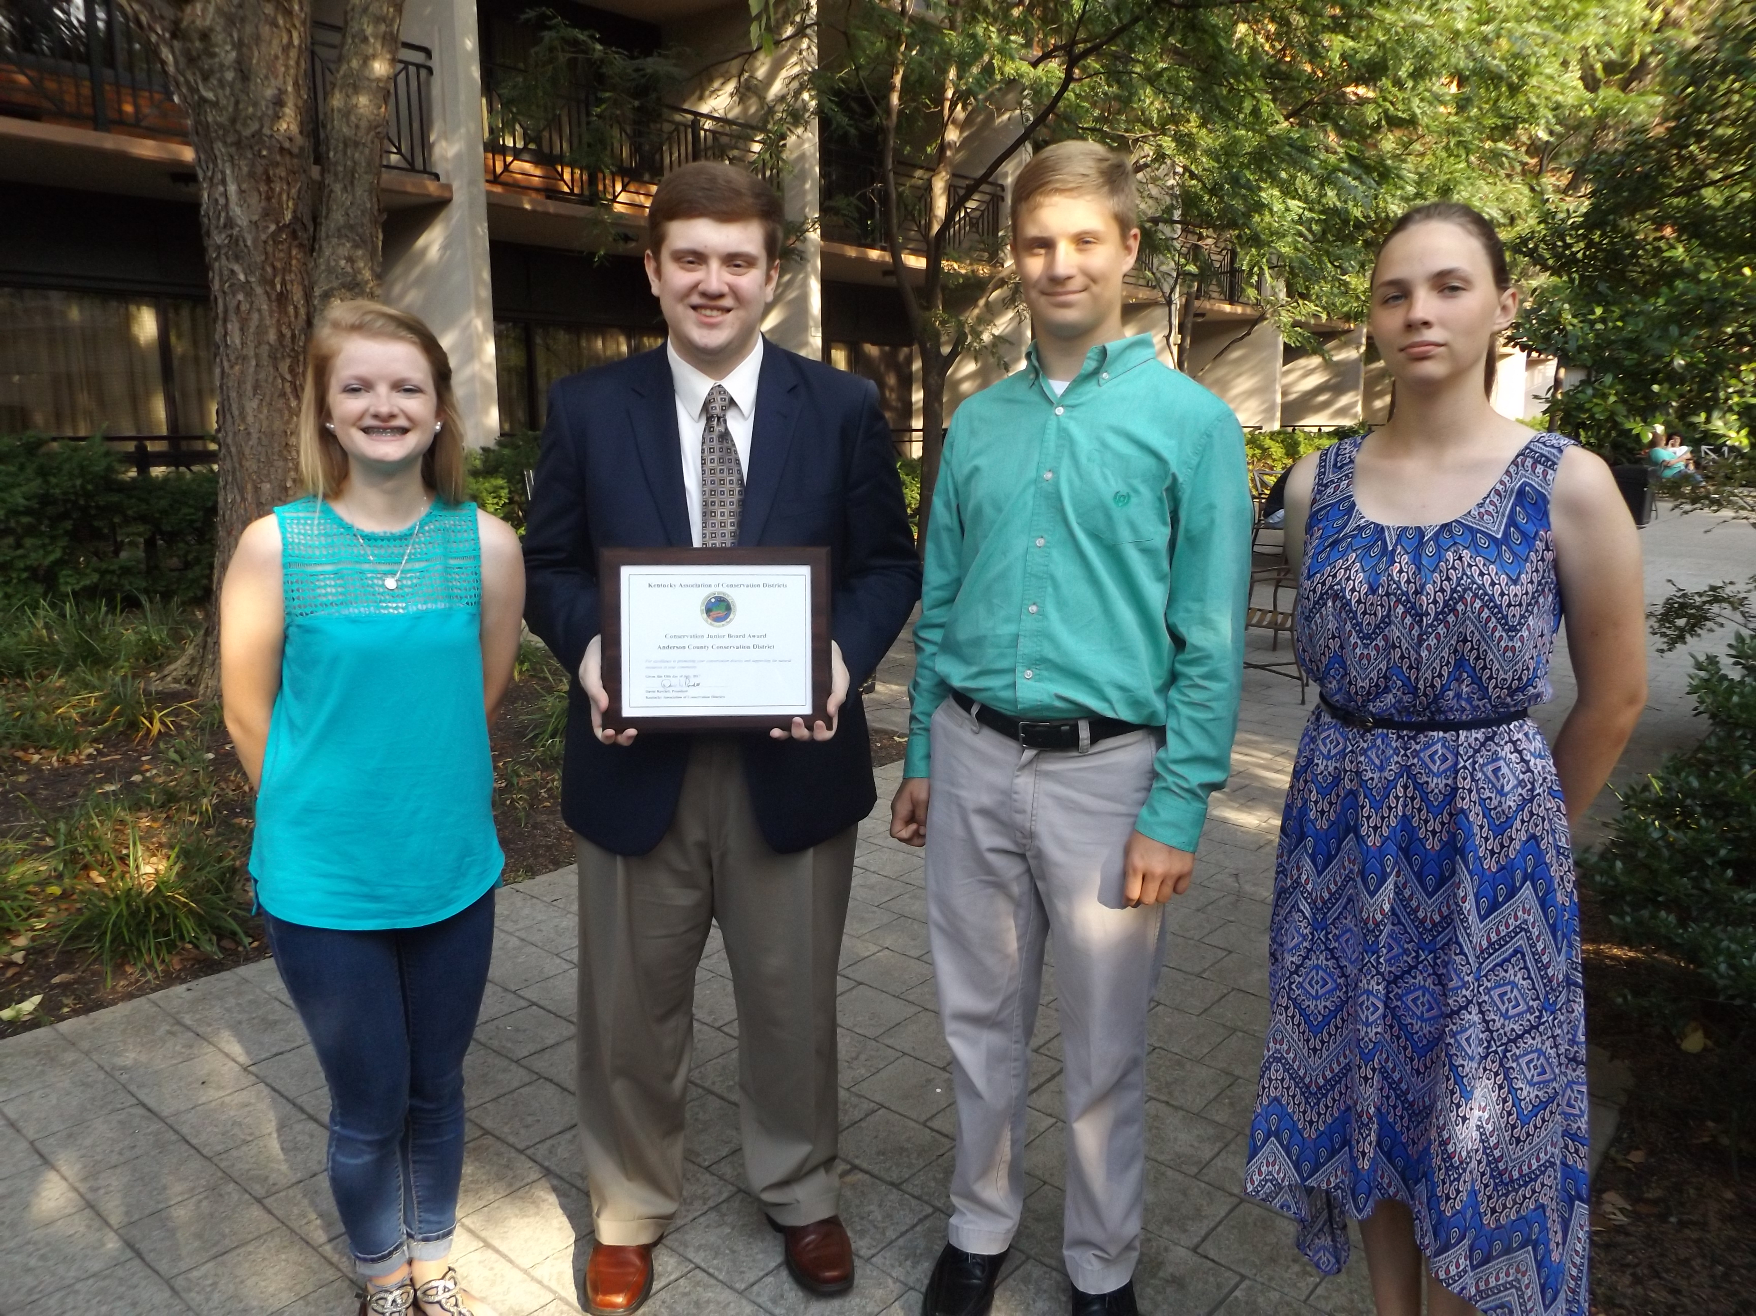
Diverse Junior Boards Across Kentucky

Slide 17
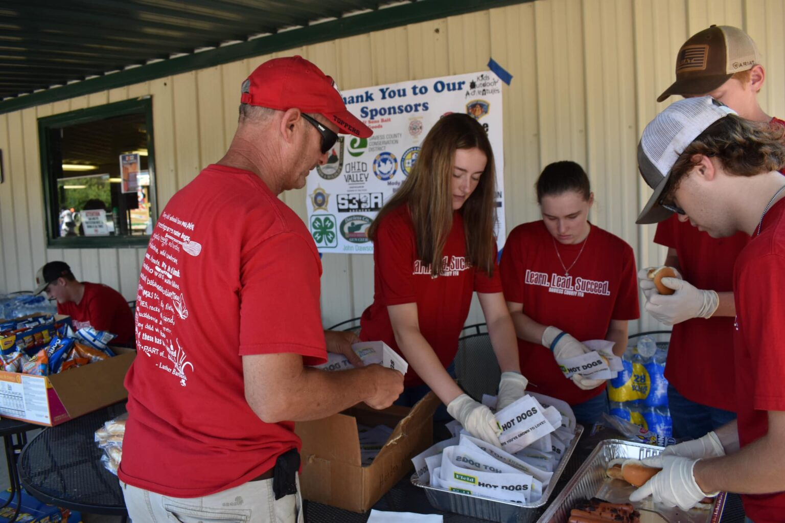
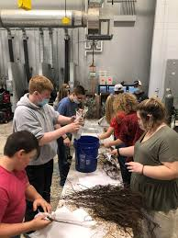
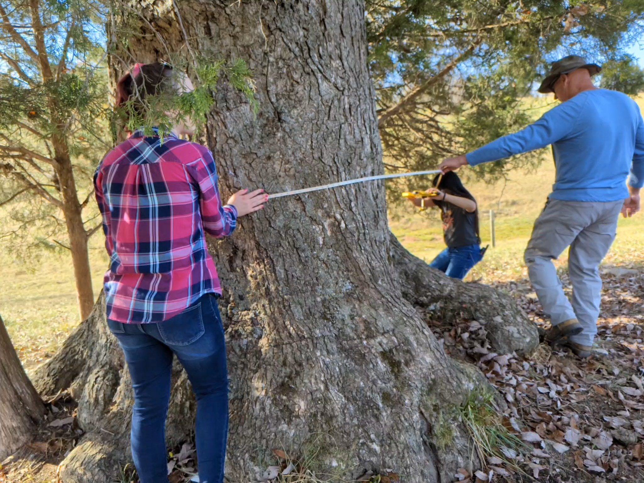
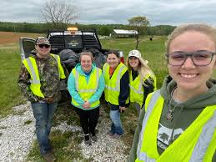
Diverse Junior Boards Across Kentucky

Slide 18
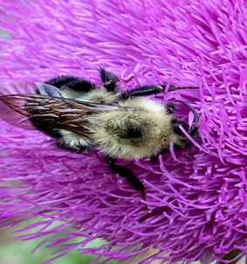
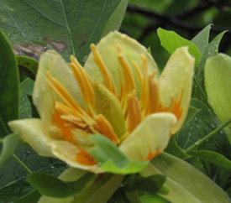
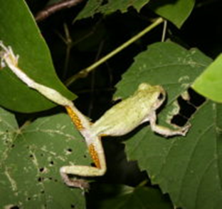
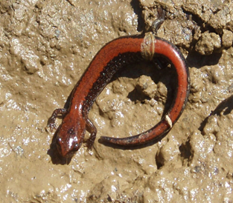
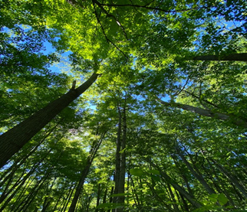
QUESTIONS?
Want more information? Contact Kimberly.Bartley@ky.gov

