Slide 1

Kentucky
Conservation District Operations Manual
PRESENTED BY <<Chelsea Durbin>>
Division of Conservation

Slide 2
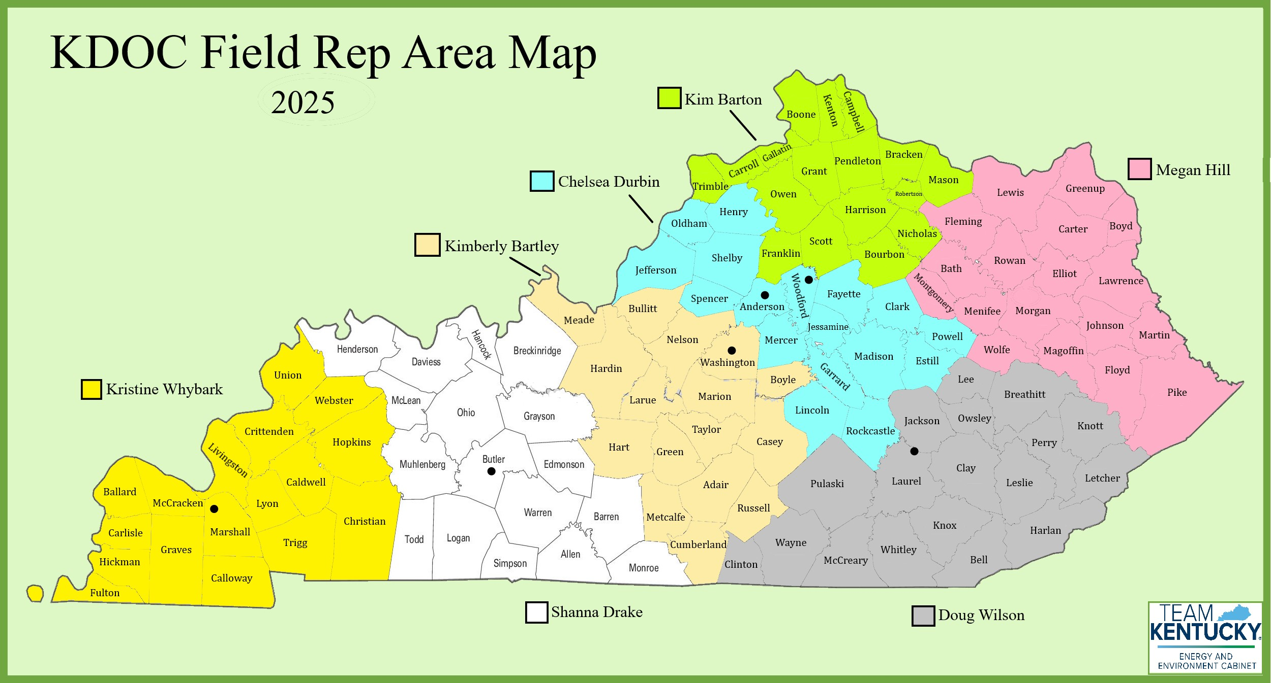

About Us
Our Division is housed in the Department of Natural Resources within the Energy and Environment Cabinet.
We have 8 field staff spread across the state and 5 Frankfort staff including our Director and Assistant Director.
Kentucky has 120 counties making it the fourth highest in the country.
Each of the Field Reps have between 16-18 counties to cover.
Notes:
We have 7 field reps and 1 field staff who is our state cost share coordinator. We also usually have at least one intern each summer. Frankfort is our capitol city and is located at the red star.

Slide 3
Background
Based on discussions during the pandemic, Field Rep Shanna Drake collaborated with her counties via monthly Zoom calls for a full year, during which each county developed their own operations manual tailored to their specific district.
During these calls, they reviewed their activities for that month, including the creation of 'cheat sheets' to assist with their tasks and other relevant matters.
Although the general format was covered in these meetings, each district customized their manual to include the applicable details for their county.
Notes:
Just a little background on how this manual was developed.

Slide 4

Overview
Can be a physical binder or an electronic folder.
It will help the person who keeps the office going if you’re not able to be contacted.
Consider it a “one-stop shop” for the information needed to run the office.
For each section, include items as paper copies, electronic copies, or links to each thing online.

Slide 5
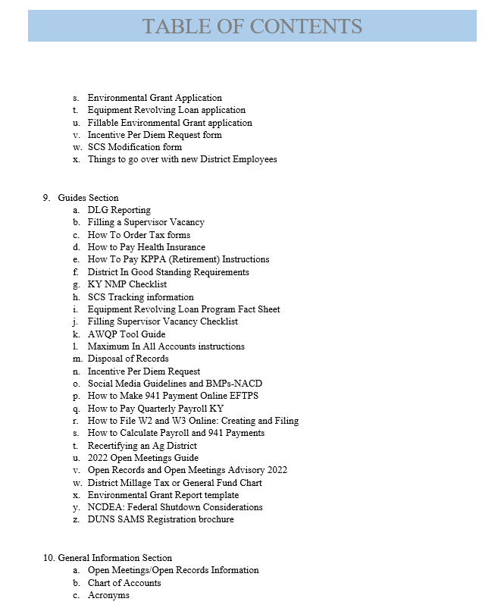
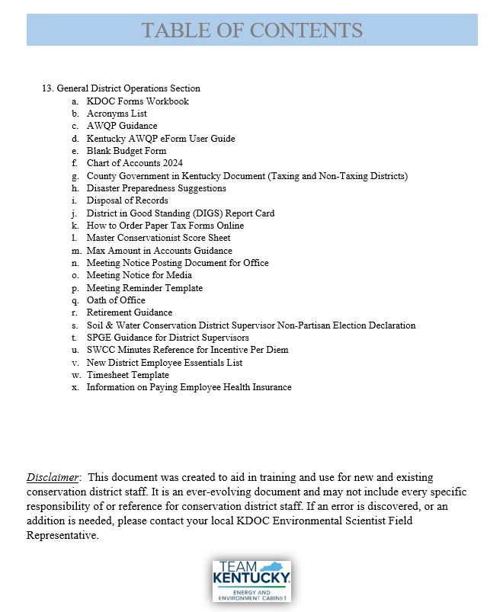
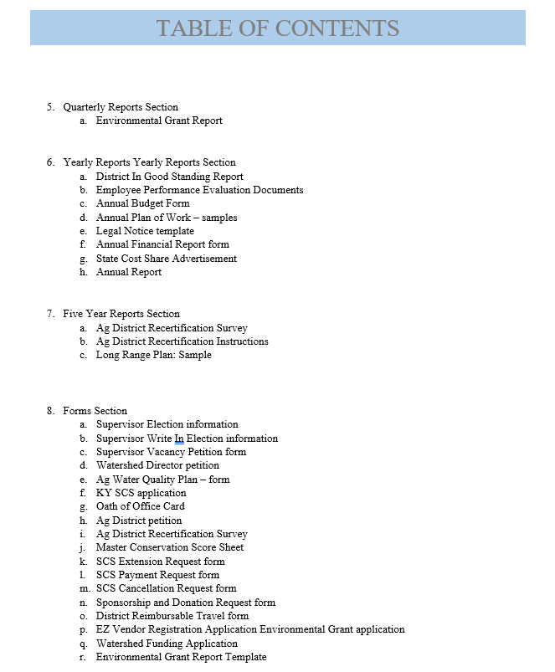
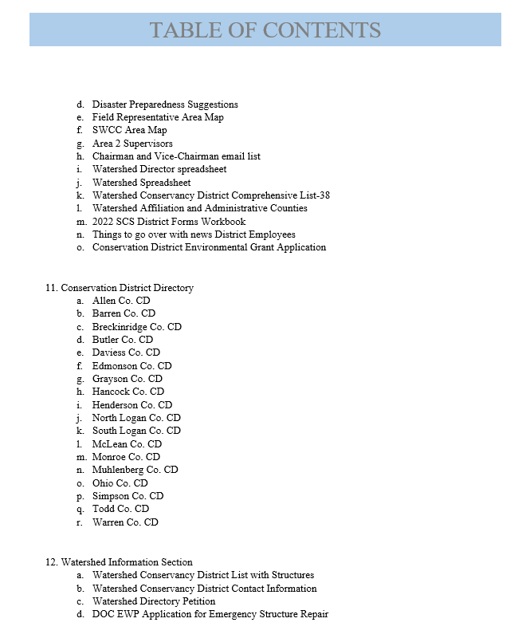
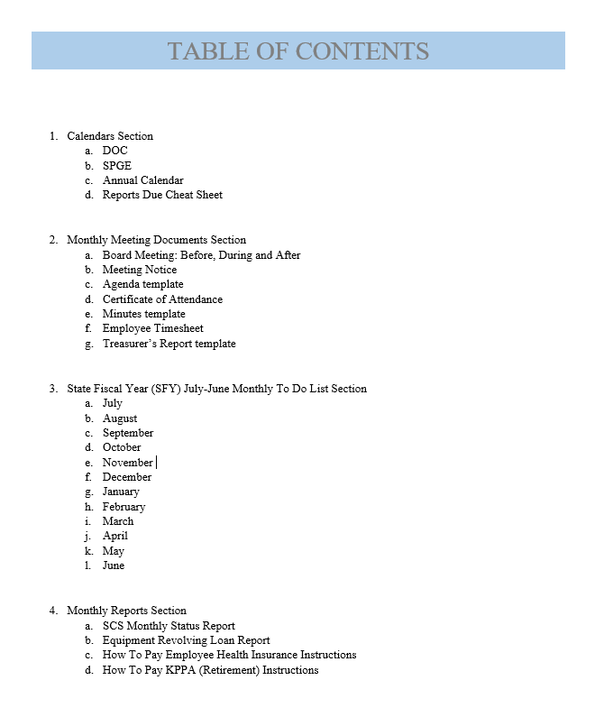
Organization
Notes:
Now we’re going to go over the general organization of the manual. I’m going to quickly cover some of the main points in this table of contents. Keep in mind that the way that this is organized can definitely be changed to reflect how your own districts function. This format was designed around how districts run in Kentucky.
Calendars from different entities
Monthly meeting section – notices, agendas, reports, timesheets, certificate of attendance, etc.
SFY Monthly To-Do List – can include the reports from the first section but could also include any regular events or tasks.
Reports – Monthly, Quarterly, Yearly, 5 Year
Forms - Include blanks/templates and instructions - State programs, Local programs, District business
Guides – more formal SOP for commonly used websites and processes
General Info – How to for many district tasks
Conservation District Directory – or a general contact info section for state/federal agencies, school districts, supervisors, etc.
Watershed Conservancy District Info
General District Operations

Slide 6
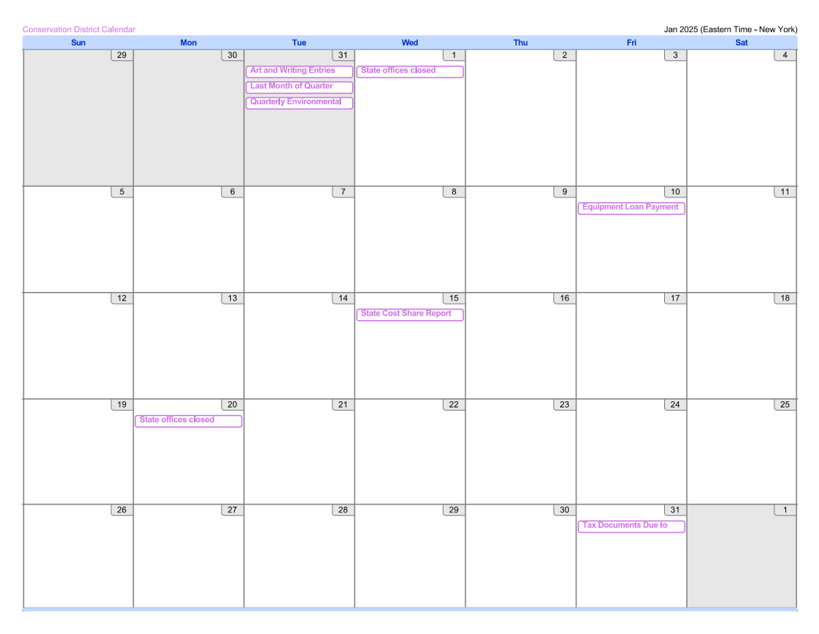
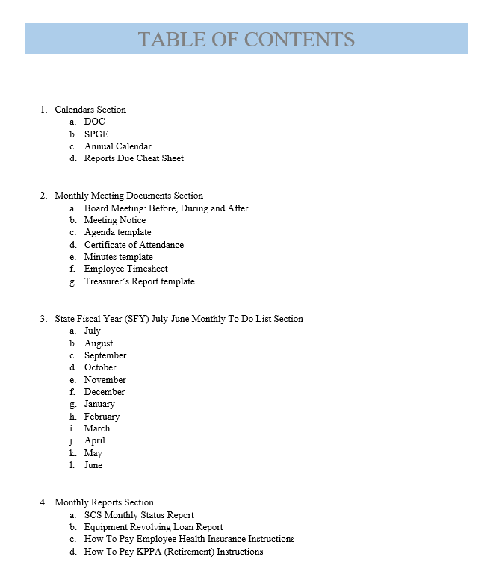
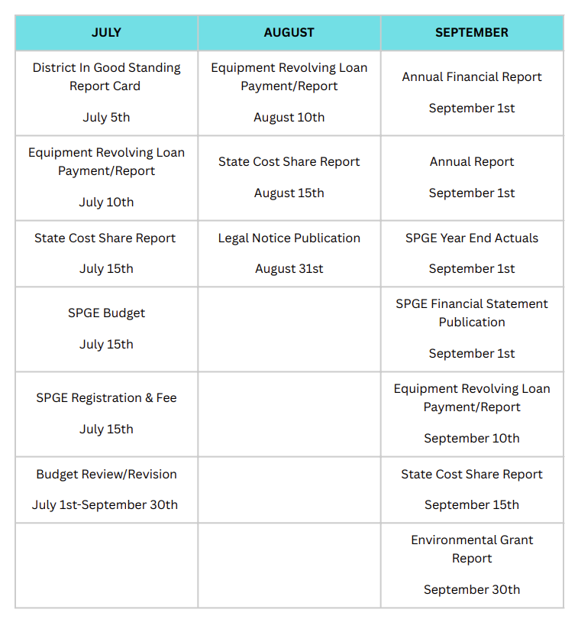
Entry Examples
Notes:
Include calendars provided by each agency that requires reports or submissions.
This might include:
Division of Conservation
Department of Local Governments
Internal Revenue Service
Could have a summary document like this cheat sheet that shows what’s due each month.

Slide 7
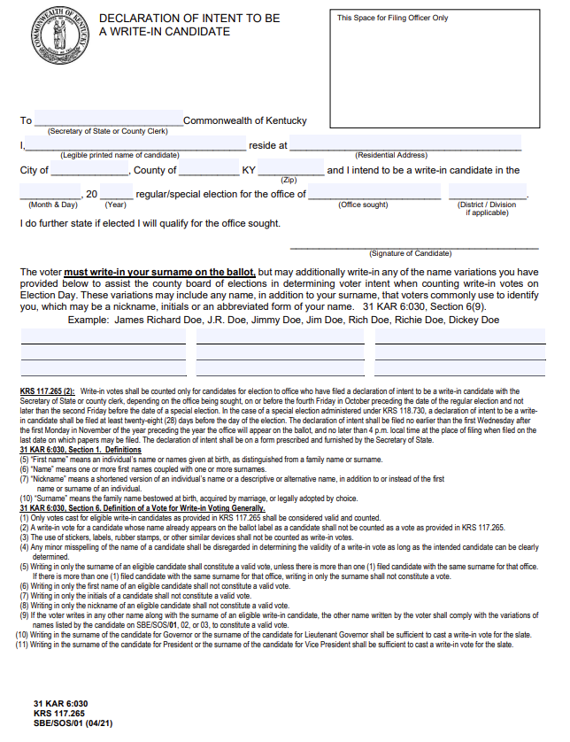
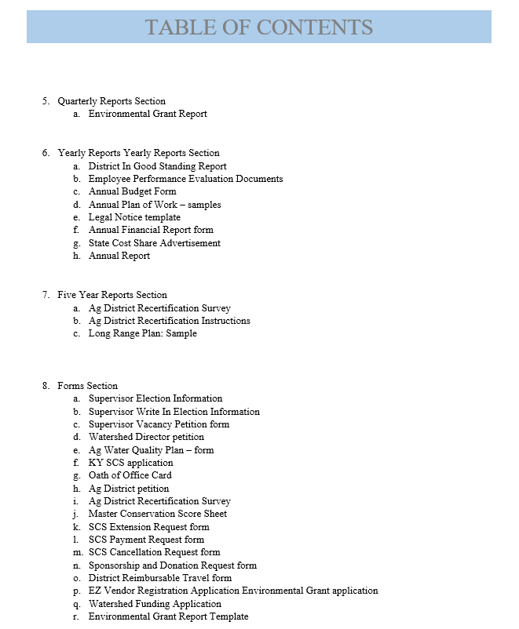
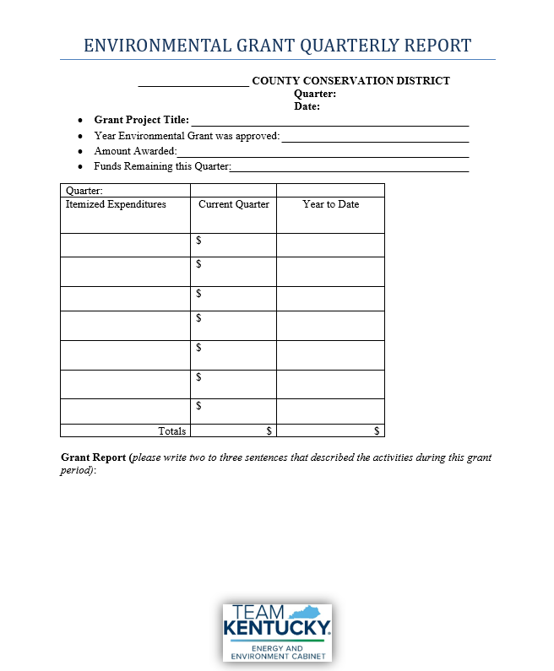
Entry Examples
Notes:
Include blank forms or templates and their instructions for:
State programs
Local programs
District business

Slide 8
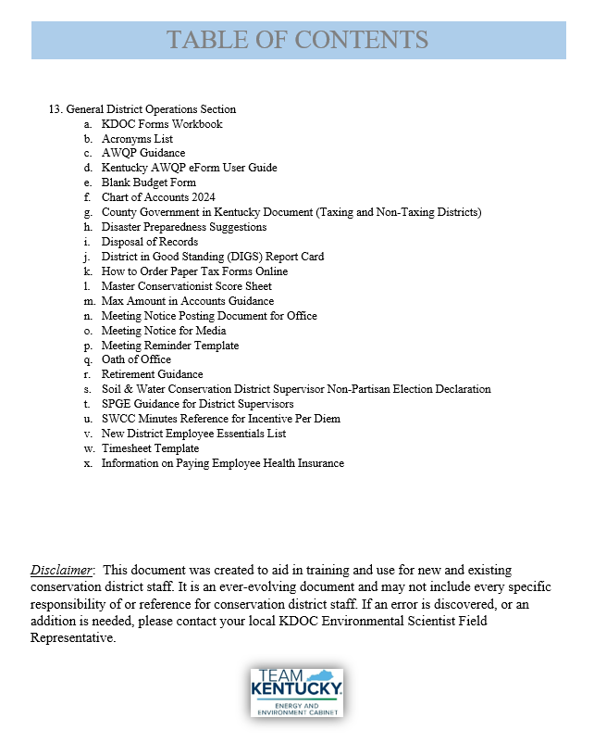
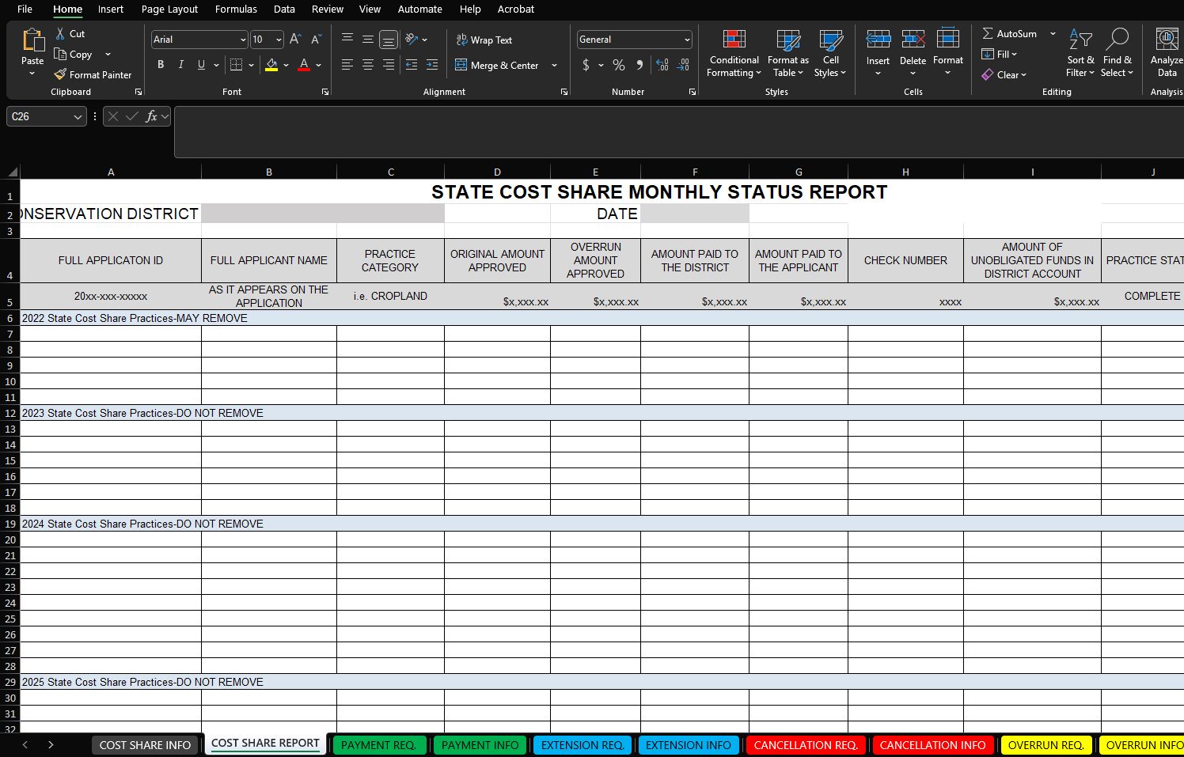
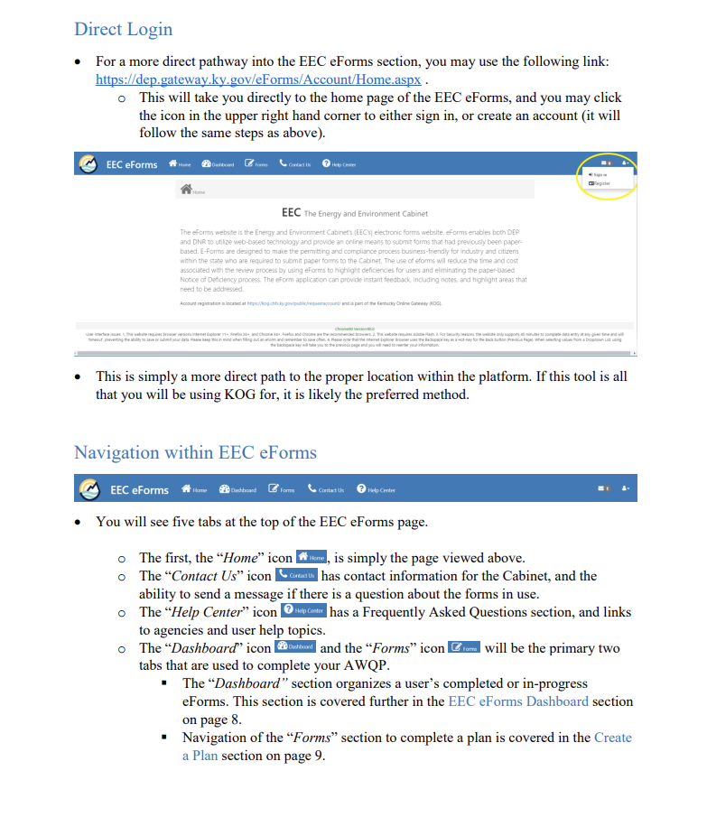
Entry Examples
Notes:
Include things that are part of the month-to-month district operations plus other items that might be handy to have.
Suggestions include:
Workbooks
Scoring sheets for programs
Maps
Acronyms
Lists of other members in partnerships
Open meetings/open records information

Slide 9
Reminders!
This layout was designed based on how Kentucky districts function in general.
Feel free to move or change up the sections to make the most sense for your state and districts.
Notes:
Some key reminders about this operations manual.

Slide 10
Reminders!
This is something that Shanna helped her districts create, not something that she created for them.
This isn't something that DOC going to formalize and put on our website for use.
We have offered, and will continue to offer, to work with the district admins to help them create their own manuals.

Slide 11



EEC.KY.GOV
FACEBOOK
INSTAGRAM
@KentuckyEEC
KentuckyEEC
KentuckyEEC

