Slide 1
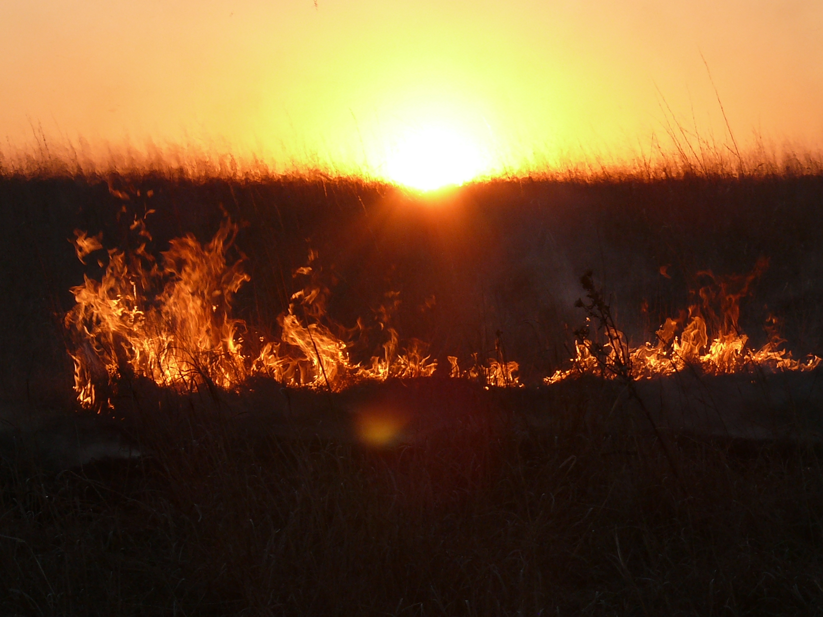

Partnership is Progress
Marsha Meyer
Cathy Thompson
Kansas Department of Agriculture
Division of Conservation
October 2023
Sit Dolor Amet
Notes:
Let us know if you would like the photo changed

Slide 2
TRAINING PARTNERSHIP BACKGROUND
Prior to 2020, DOC staff spent one 8 hour in person session.
During covid, created Teams meeting approach
After covid: Hybrid approach
  3 Teams training sessions 1 – 3 hours in length
  1 in person training, DM led (4+ hours.)

Slide 3
WHAT WAS MISSING
Assisting boards with recruitment and hiring
Accounting/QuickBooks/Payroll
Technical (mapping, etc.)
Basic NRCS training

Slide 4
BACKGROUND CHECK VS. START DATE
District computers for QuickBooks, but few have internet
Primarily managers use NRCS computers
Time delay waiting for background checks, which delays training

Slide 5


WHY CREATE A PARTNERSHIP?
Train new managers sooner
Strong relationship with KACD
Value of training
High District Manager turnover
Better equip managers for success

Slide 6
Collaborative Conservation Grants and Agreements (CCGA)
“Building capacity in the Kansas Conservation Partnership to effectively communicate and deliver conservation programs”
$675,966 total for three years. Training share: $229,500.
Partnership breakdown to training:
  Federal funds: $124,500
  KDA-DOC funds: $75,000
  KACD funds: $30,000

Slide 7
Collaborative Conservation Grants and Agreements (CCGA)
Grant funds awarded for:
  Leadership and Field Services Coordinator
  Social media training for all districts
  KACD website renovation
  Enhanced training
Former DM hired; Position started in December 2022

Slide 8
Coordinator Position Description
Conduct training, leadership and outreach to conservation districts
Increase visibility and access to Climate-Smart agriculture and forestry
Increase awareness of soil health principles and practices
Promotes improved water quality in source water protection areas.

Slide 9
DOC and KACD TRAINING PARTNERSHIP
KACD Trainer is in office first week of hire
Onboarding new hire
Preparing for board meeting
Payroll
QuickBooks
After LincPass is received, basic NRCS training is provided
Pitney Bowes, copy machine use, ordering supplies, etc.

Slide 10
DOC and KACD TRAINING PARTNERSHIP
DOC training – after background approval
Introductory training for DOC staff and programs
Business session (minutes, financials, required reports, open records and meetings, etc.)
In-person DM led session
State Cost Share Process

Slide 11
DOC and KACD TRAINING PARTNERSHIP
DOC Training Continued
CSIMS – Cost Share Information Management System
Individual sessions when setting up contracts or payment

Slide 12
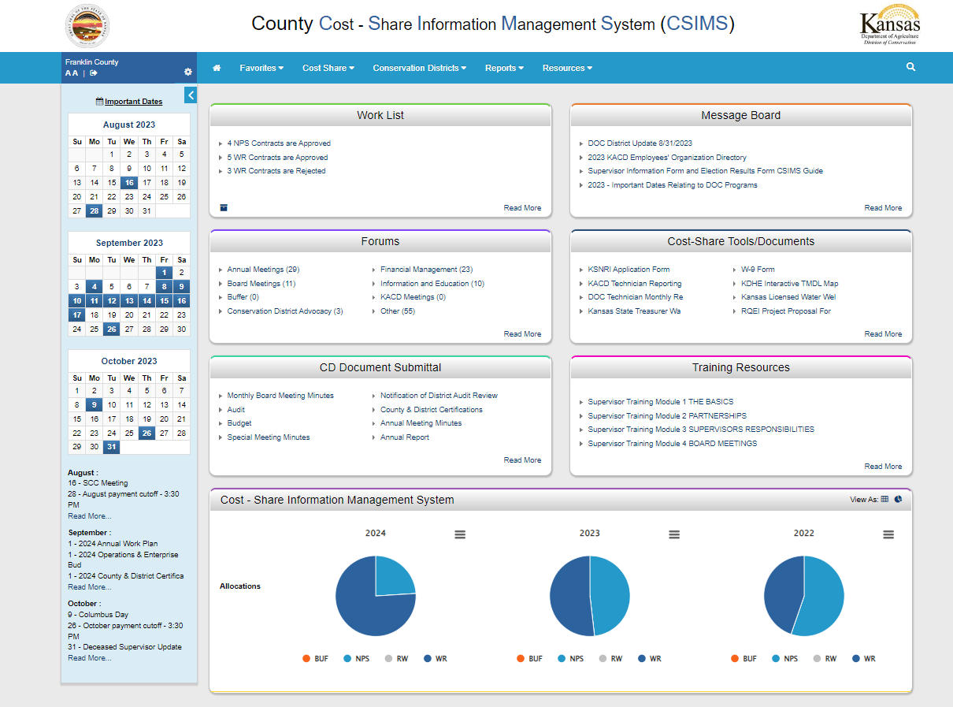
DOC and KACD TRAINING PARTNERSHIP

Slide 13
DOC and KACD Training Workshop
Three-day workshop held in August
Developed and presented by DOC, KACD, and NRCS
Each district received a $300 to cover hotel costs (included in grant)
2022 workshop for ALL managers (90% attendance)
2023 workshop new managers only – 13 attended

Slide 14
Annual Workshop Agenda
Building a Successful CD-NRCS Relationship
NRCS Administrative Items
CD Responsibilities – Meeting the MOA Responsibilities
NRCS Programs – What they mean for districts
Building the Capacity of the Kansas Conservation Partnership (Social media for districts)

Slide 15
Annual Workshop Agenda Con’t.
QuickBooks Basics and State Cost Share Program
NRCS Tools/Map – How to use tools to enhance both NRCS and District products
CD Manager panel / Open Forum

Slide 16
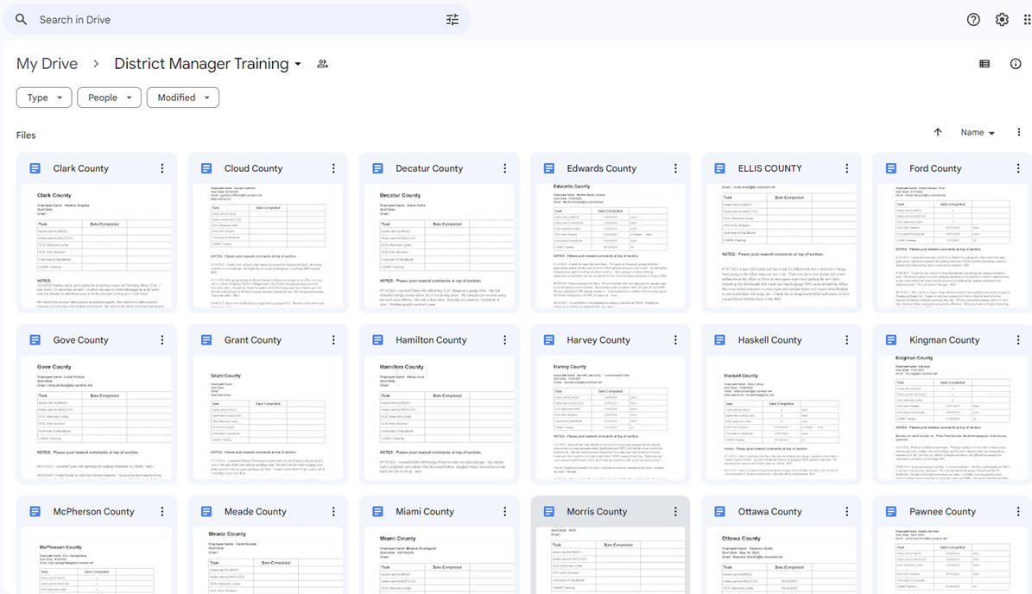
Communication
Google Drive – page for each district
DOC and KACD have access
Call or meet every two weeks

Slide 17
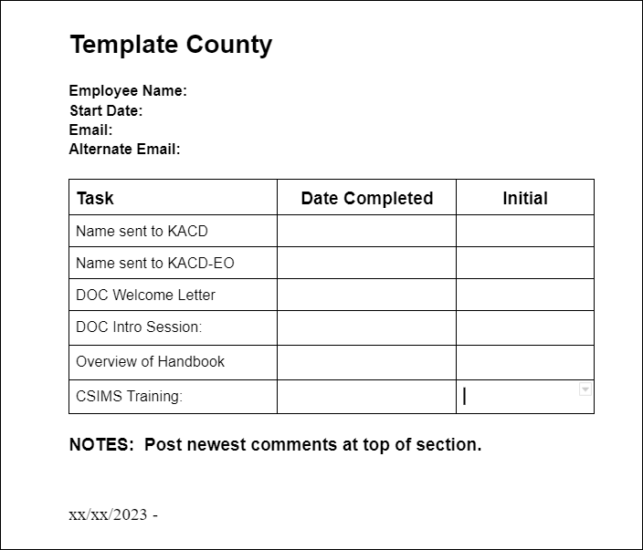
DOC and KACD Training Partner Communication

Slide 18
DOC and KACD Training Results
2022 Q1 – Q3
  22 new managers
  6 left before year end (27%)
2023 Q1 – Q3
  12 new managers
  1 left before year end (10%)

Slide 19

DOC and KACD Partnership

Slide 20
Kansas Department of Agriculture
Division of Conservation
Cathy Thompson
Program Consultant
Cathy.Thompson@ks.gov
785-564-6619
Marsha Setzkorn-Meyer
Conservation District Program Coordinator
Marsha.Setzkorn-Meyer@ks.gov
785-564-6625
THANK YOU
20

