Slide 1
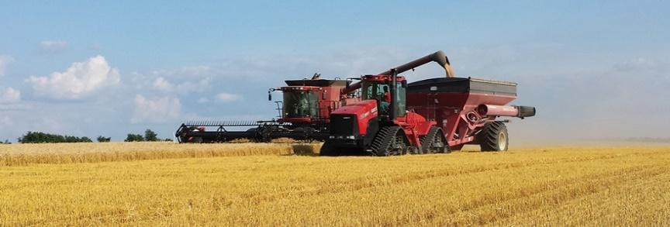
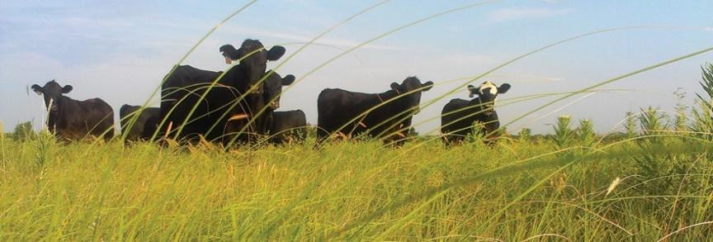
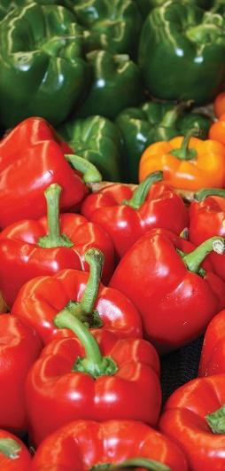

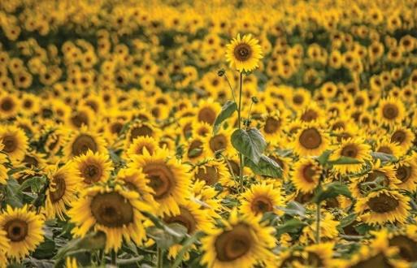
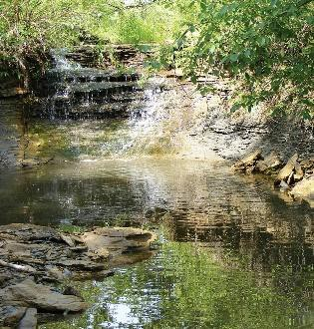
Saving the Ogallala
 | SERVING THE STATE’S LARGEST INDUSTRY… AGRICULTURE
Jacob Dooling
Water Conservation Program Coordinator
Kansas Department of Agriculture, Division of Conservation
October 27, 2025

Slide 2
Depletion of the Ogallala Aquifer threatens Kansas farmers and communities.

Slide 3
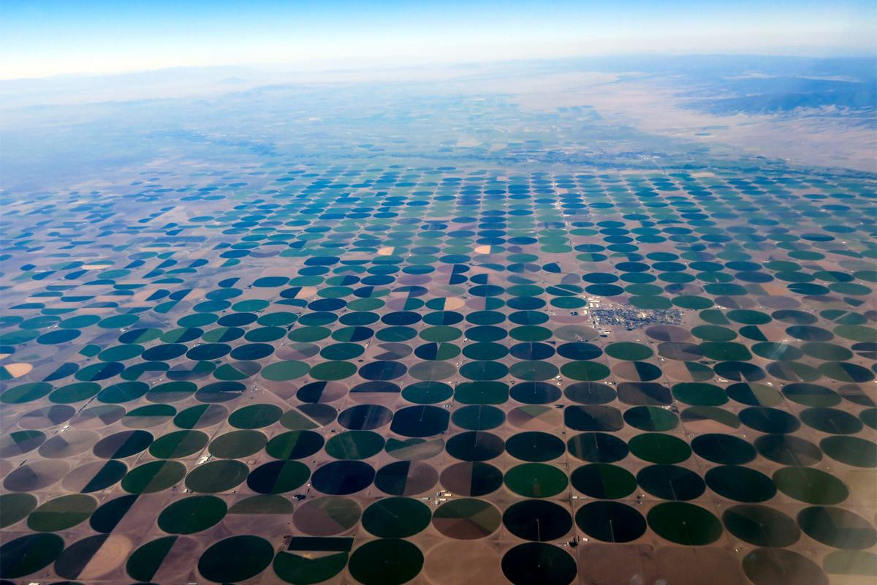
Irrigation circles

Slide 4
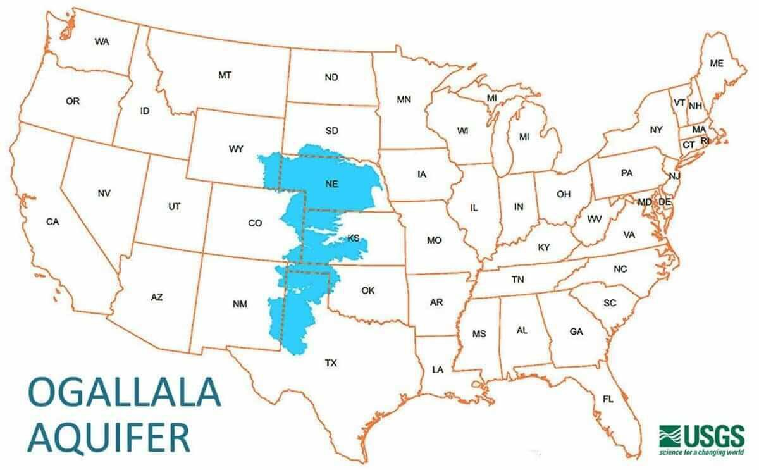
aka High Plains
Aquifer

Slide 5
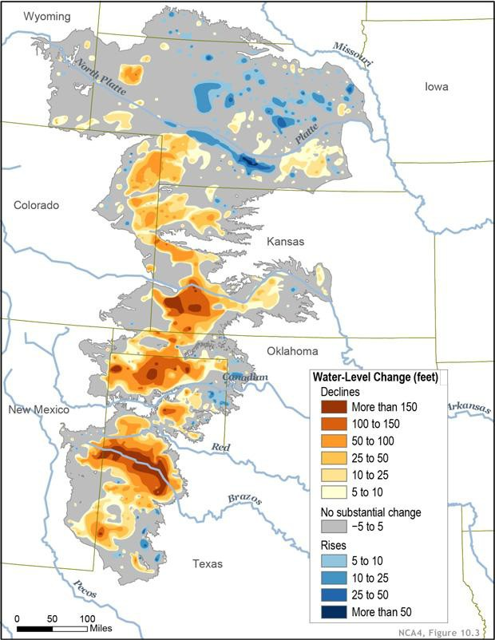
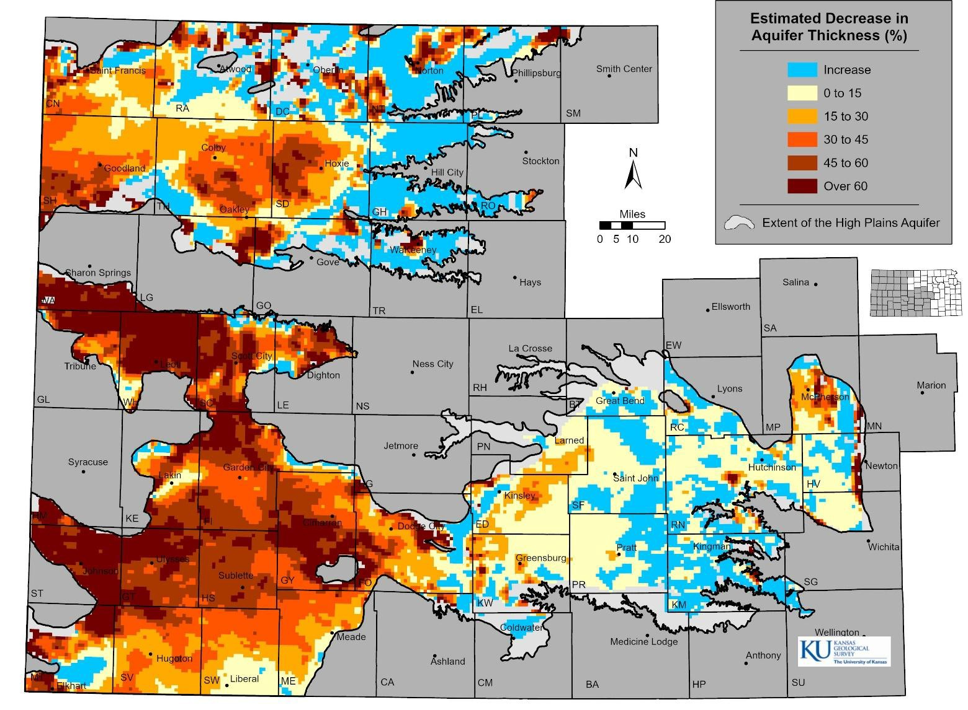

Slide 6
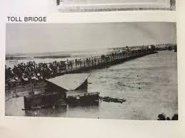
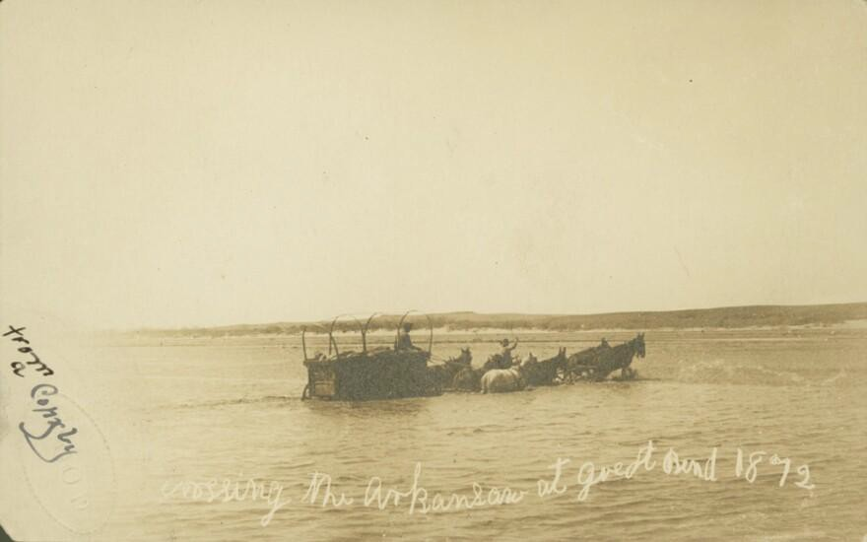

Arkansas River in 1800s – Dodge City and Great Bend

Slide 7
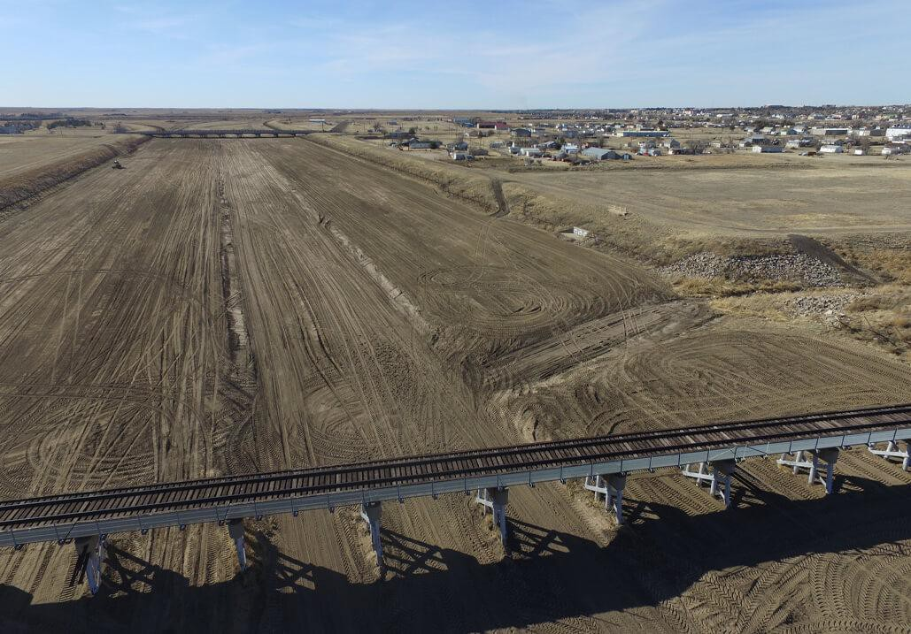
Dodge City - Arkansas River today

Slide 8
Why Save the Ogallala?
Kansas is agriculture state
Farmers grow corn for local feedlots and dairies
180,000 in 130 dairy farms
5.95 million cattle in ranches and feed yards
Communities running out of water
Water Quality – Uranium

Slide 9
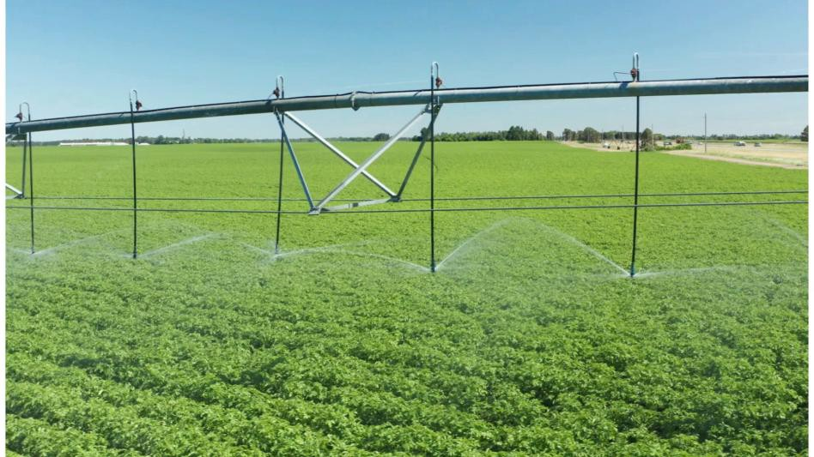
DOC Water Conservation Programs
Conservation Reserve Enhancement Program
Water Transition Assistance Program
Irrigation Technology Initiative

Slide 10
Irrigation Technology Initiative - ITI
Working with five established Groundwater Management Districts (GMD)
Five managers rather than 38
Not all counties were completely covered in GMD area
Irrigation expertise

Slide 11
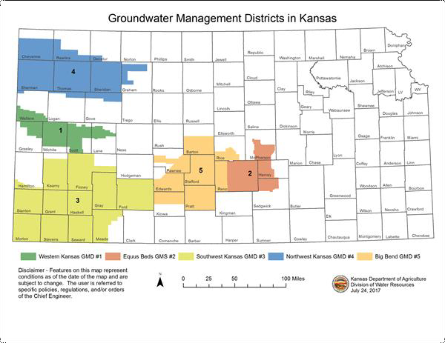

Slide 12
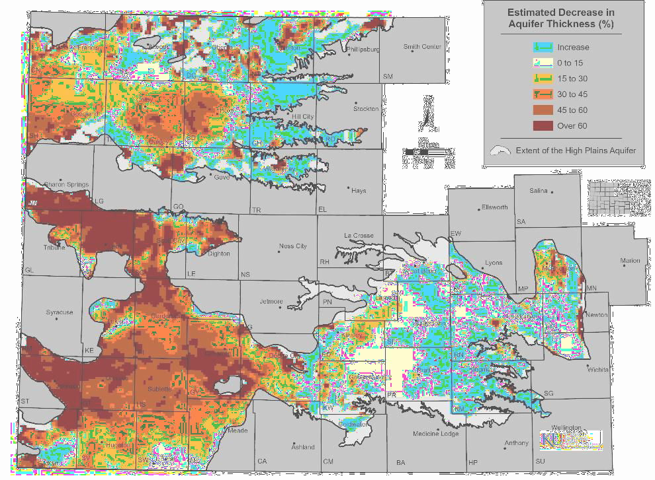

Slide 13
Irrigation Technology Initiative - ITI
State initiative was intended to be introduction/baseline or pre- requisite for RCPP.
FY 2025:
$1.3 million initial allocation
$150,000 per GMD, excess funds for Technical Assistance/Admin Fees

Slide 14
Irrigation Technology Initiative - ITI
1 Lead System Evaluator 3 System Evaluators
Training and certification on Natural Gas, Electric, and Diesel Fuel pumping plants

Slide 15
Irrigation Technology Initiative - ITI
Practices available
Irrigation System Evaluation
Crop Uniformity Evaluation
RCPP Practices
Irrigation System, Microirrigation (441)
Sprinkler System (442)
Irrigation Water Management (449)
Pumping Plant (533)

Slide 16
Saving the Aquifers
Results and Impact
GMD 1: 55 evals, 7 nozzle packages, 3 Field Net sensors
GMD 2: 0 evals
GMD 3: 6 evals
GMD 4: 25 evals
GMD 5: 3 evals

Slide 17
Saving the Ogallala
“When the well is dry, we know the worth of water”
Benjamin Franklin

Slide 18
THANK YOU
 | SERVING THE STATE’S LARGEST INDUSTRY… AGRICULTURE
Jacob Dooling
Water Conservation Program Coordinator Jacob.Dooling@ks.gov
785-477-4339

