Slide 1

IDALS Urban Conservation Program
National Association of State Conservation Agencies
October 8, 2024

Slide 2

Urban Conservation Program Structure
Established in 2008 and expanded in 2014 with adoption of Iowa Nutrient Reduction Strategy
Address urban and transitional Ag/Urban areas - bridging resource concerns and populations
Primary objectives of improved water quality, reduced erosion, and mitigating flood risk
5 Full Time Urban Conservationists

Slide 3
Urban Conservation Program Function
Provide financial and technical assistance for design and implementation of stormwater management practices
Work across agencies, funding sources, programs, and communities
Assist communities, developers, consultants, homeowners, agencies, and others
Advantage of urban education, information, and outreach requirements

Slide 4
Water Quality Initiative
Cost Share Program Example
FY 2015 – 2024
126 Total Urban Projects Funded
  84 Completed, 18 Under Construction, 22 Design/Planning Phase
50% Cost Share
  $14.6M WQI Practice Funding
  $48.5M Partner Contribution
Provides Supplemental and Catalyst Funding

Slide 5
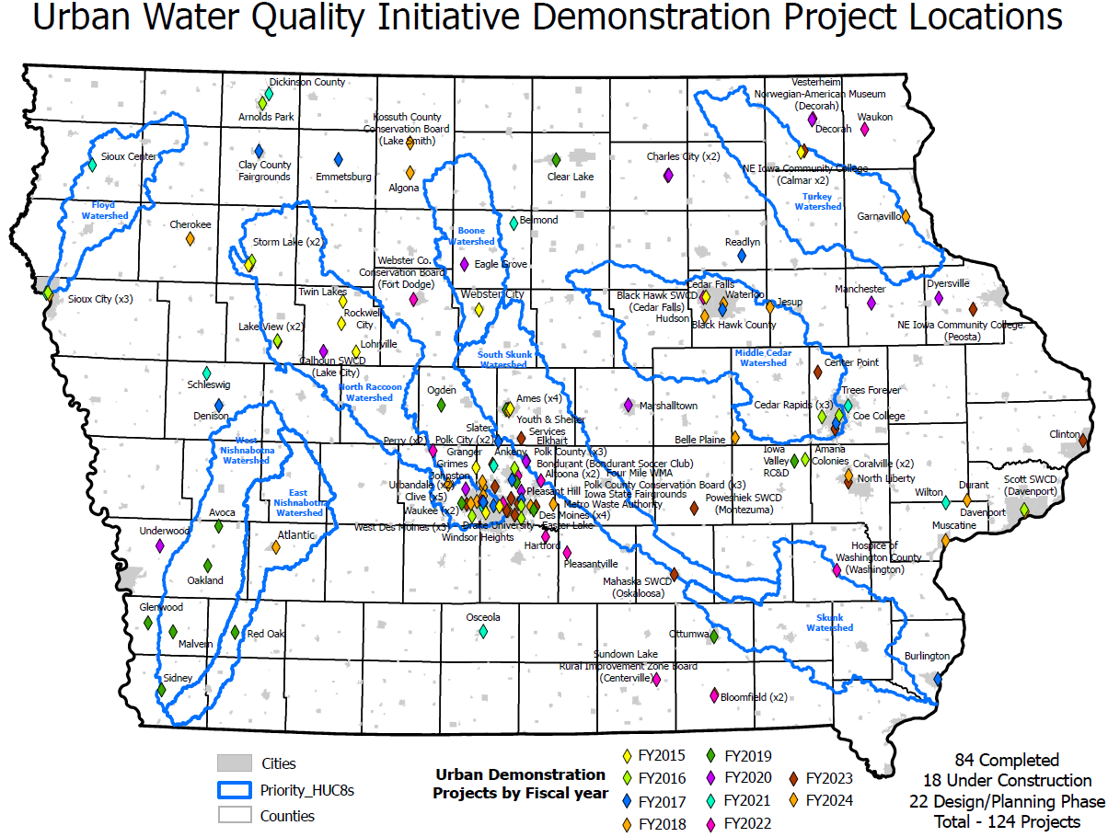

Slide 6
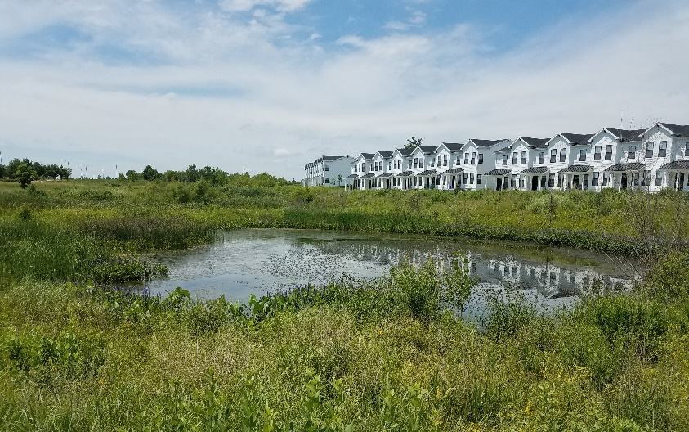
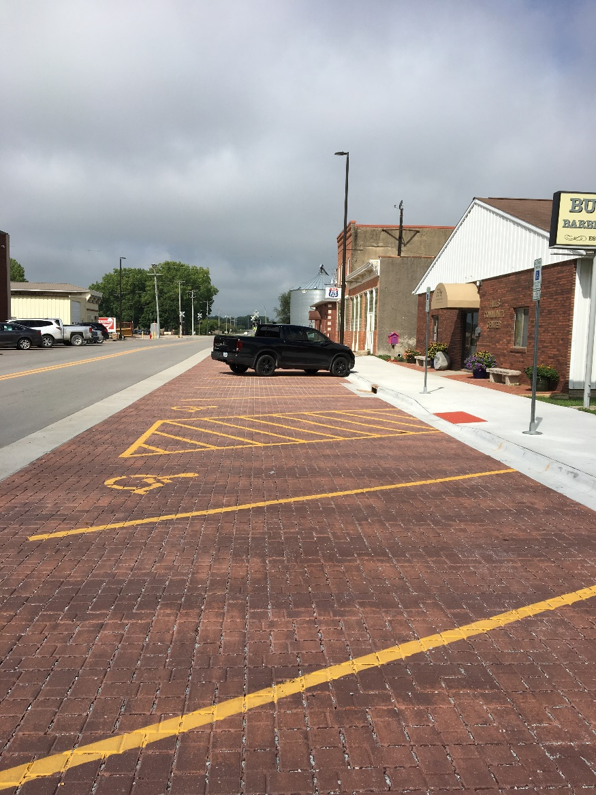
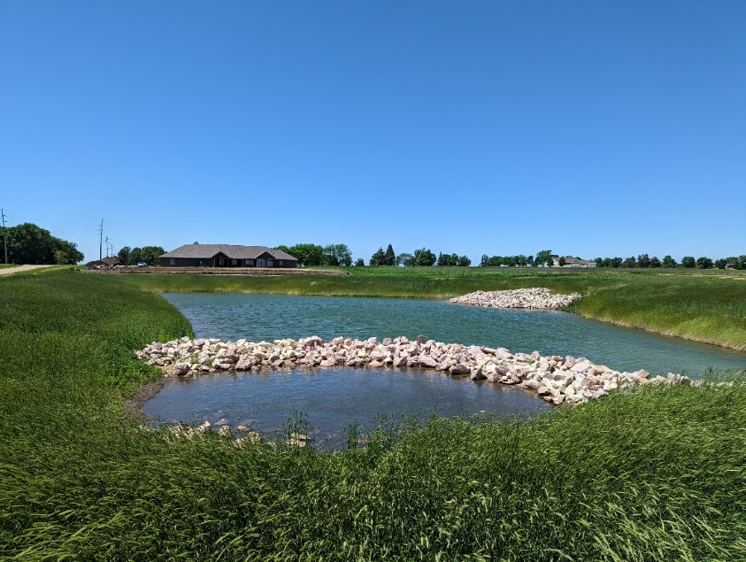
Completed Practice Examples
Stormwater Wetlands
Permeable Pavers
Wet Pond

Slide 7
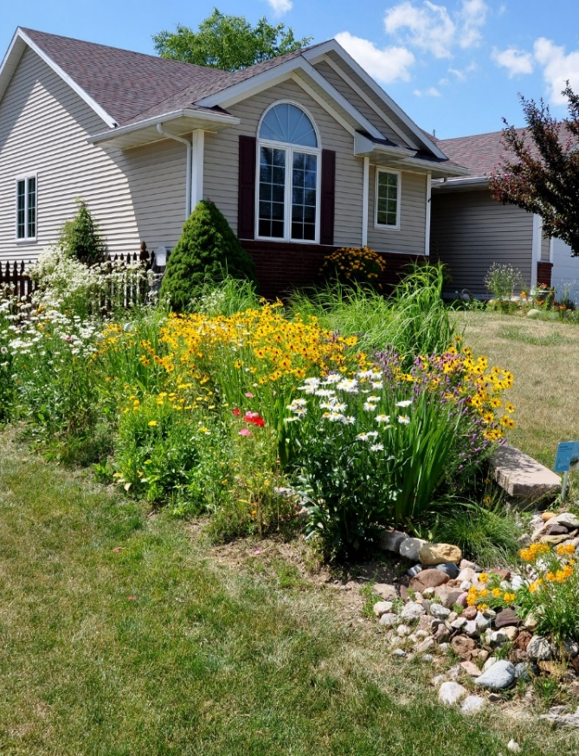
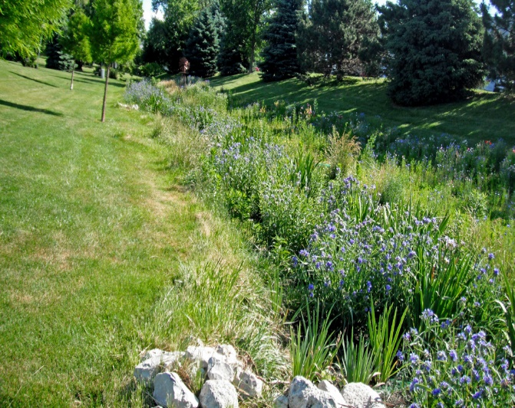
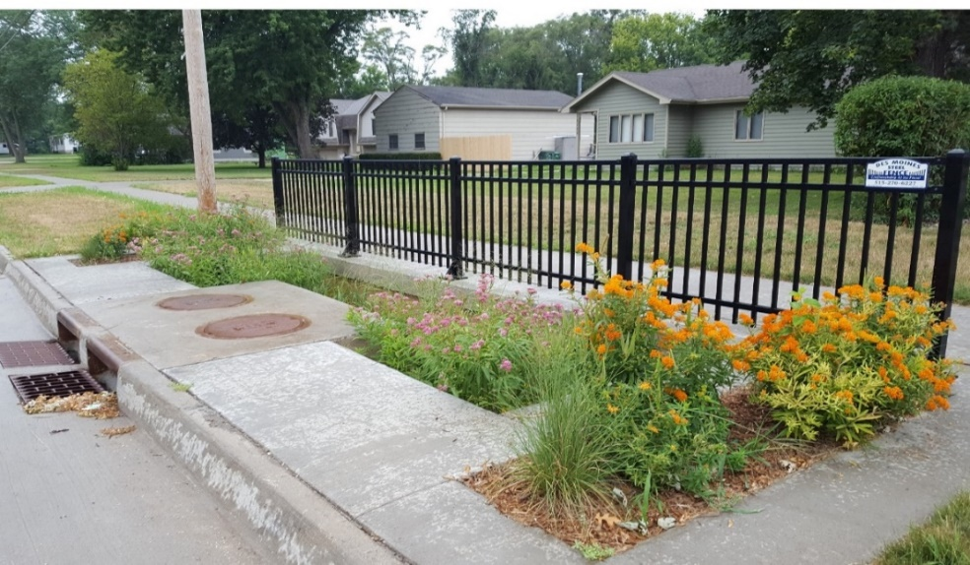
Completed Practice Examples
Bioswale
Rain Garden
Bioretention Cell

Slide 8
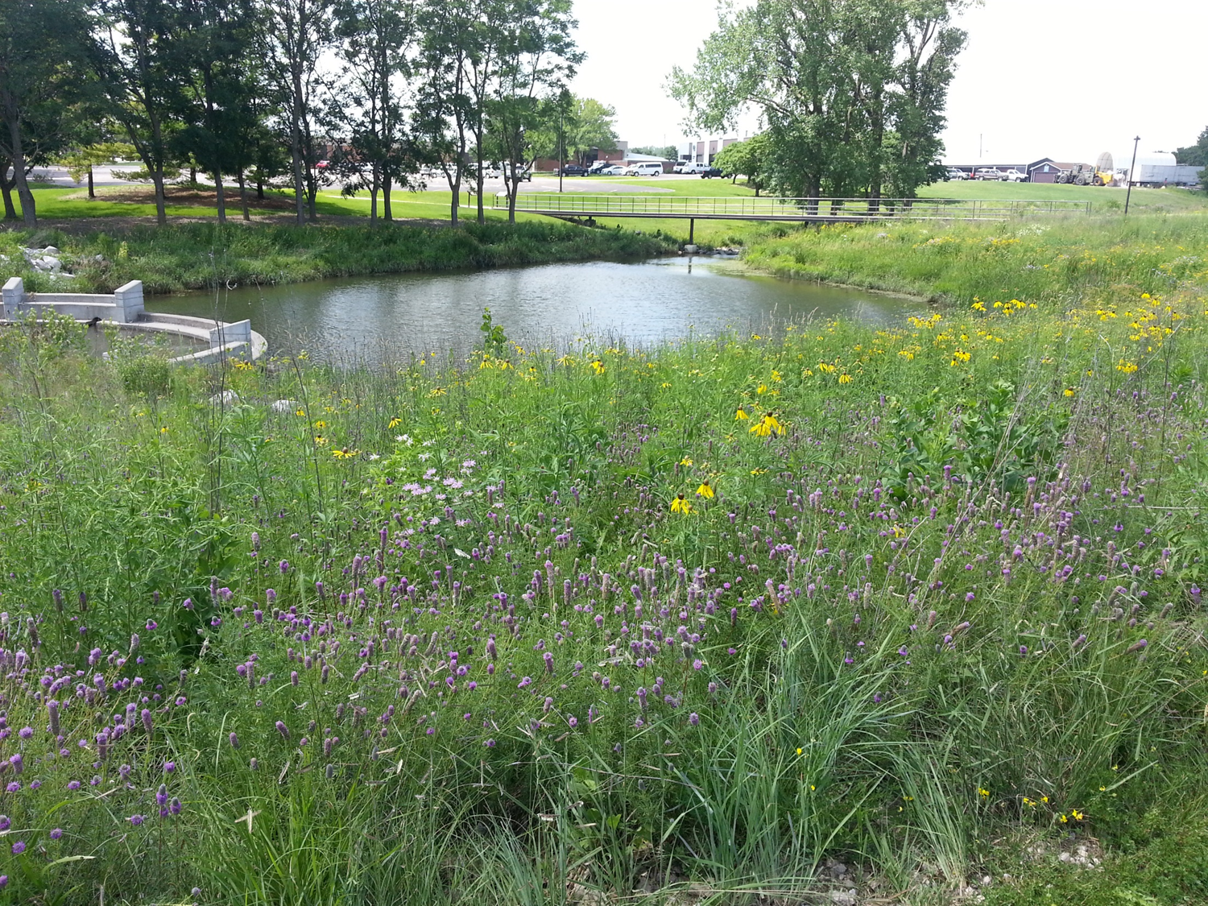
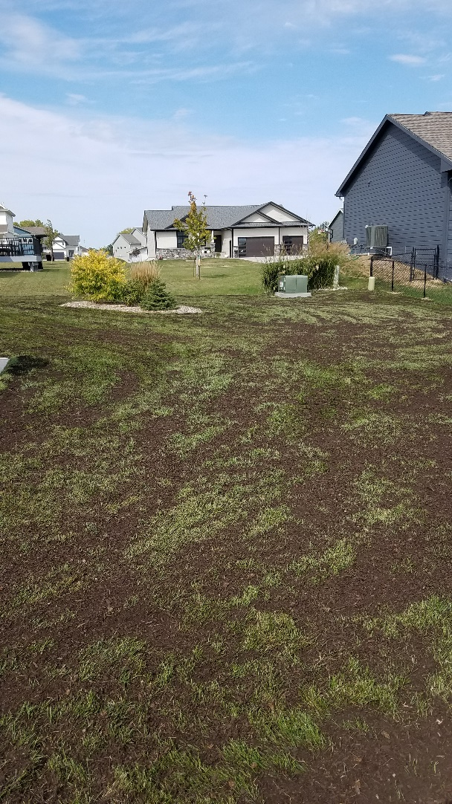
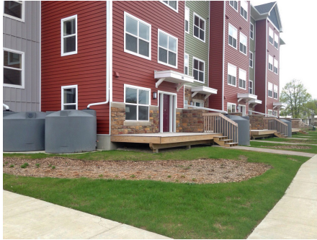
Completed Practice Examples
Soil Quality
Restoration
Native Landscaping
Rain Harvesting

Slide 9

Contacts and Additional Information
Will Myers, Field Services Will.Myers@iowaagriculture.gov 515-281-7818 | Paul Miller, Urban Conservationist Paul.Miller@iowaagriculture.gov 515-281-5833
Ann Seda, Urban Conservationist Ann.Seda@iowaagriculture.gov 515-725-0150
https://www.cleanwateriowa.org/urban

