Slide 1

Iowa’s Financial and Reports Management System (FARMS)
Kate Bussanmas, Deputy Director
Division of Soil Conservation and Water Quality
October 2023

Slide 2
History
1973 – Iowa began cost share program (50th anniversary!)
LOTS of paper and snail mail (eventually email)
Inability to track programs and dollars spent
Difficult for Districts to track dollars spent by Program
2008 - Financial And Reports Management System (FARMS) released
Many Improvements:
Singular spot for tracking from application to completion
Reporting options
Searchable

Slide 3
History, continued
Original FARMS was an improvement, but far from perfect
Technology changes
Document storage limitations
Unable to communicate with State’s accounting system
More funding options added complexity
Original FARMS could no longer functionally be updated!

Slide 4
“New” FARMS

Slide 5
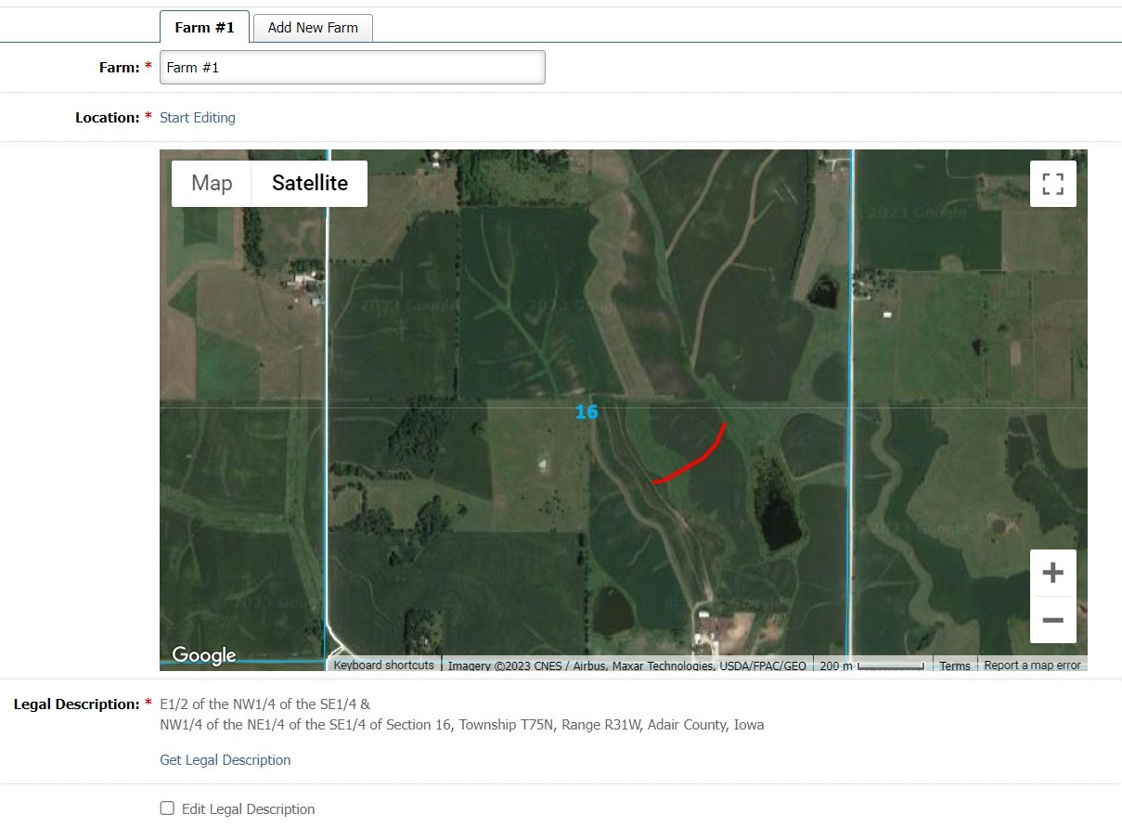
Mapping Function
Legal Land Description required for maintenance agreements
Previously – Done manually
Very time consuming to do by hand for EVERY PRACTICE
Now – Uses Google Earth imagery and drawing tool
Automatically populates into maintenance agreement

Slide 6
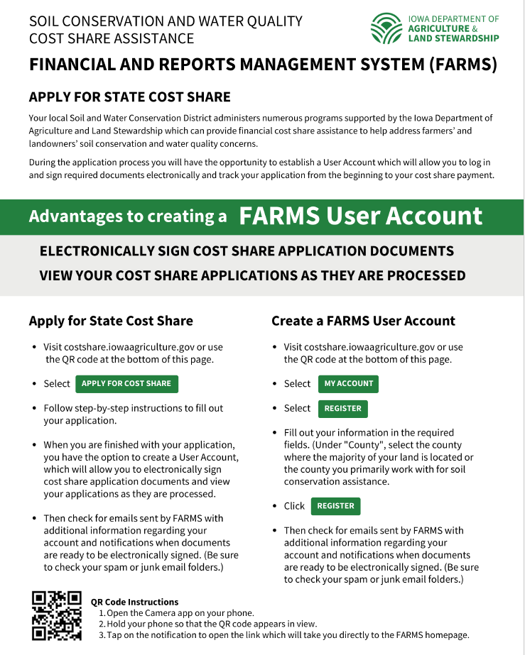
Electronically Sign Documents
Applicants/landowners as well as Technicians can use E-sign
FARMS sends email notifications to Users
Daily email to staff indicating what was signed in previous day

Slide 7
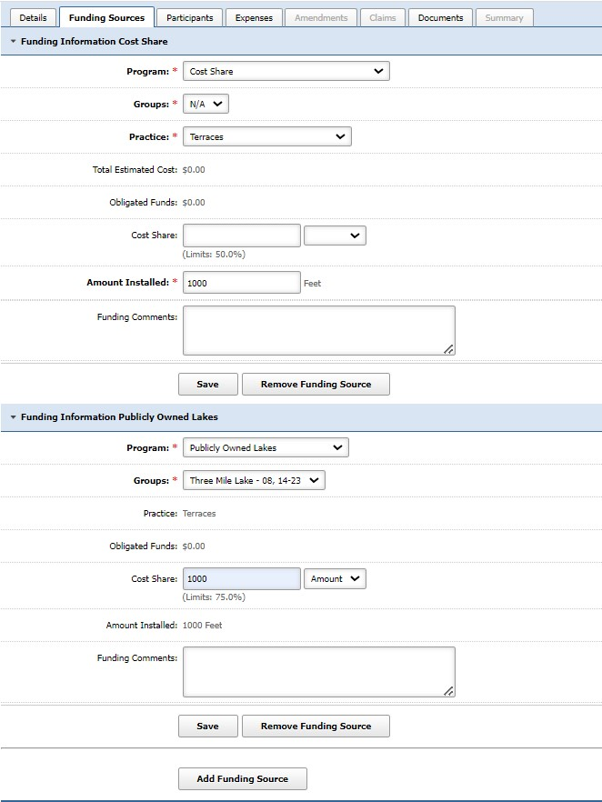
Multiple State Funding Programs on Single Application
Previously - each funding source required a separate application
Now - one application and single set of documents to sign
Saves time for staff and customers
Less items/documents to store on the server

Slide 8
Document Storage
Copies required for records retention
Required significant physical space and staff time to file
Due to staff turnover and other priorities, many offices had mini storage rooms of old documents!
Upgrade provides for storage of signed and supporting documents (invoices, estimates, etc.)
Allows IDALS Accounting staff to pull documents electronically for audit vs. removing physical file from offices

Slide 9
Electronic Processing of Claim Payments
Previously – Claim document emailed to IDALS Accounting
Was then printed and shared between staff for review/confirmation
Claim info hand-entered into State’s financial database to issue warrant
Now – Claim document uploaded into FARMS
Claim shows up in report accessed by IDALS Account staff
Reviewed electronically and staff add “approval”
Automatically uploaded into State database for processing and issue warrant
Significant time and resource savings!

Slide 10
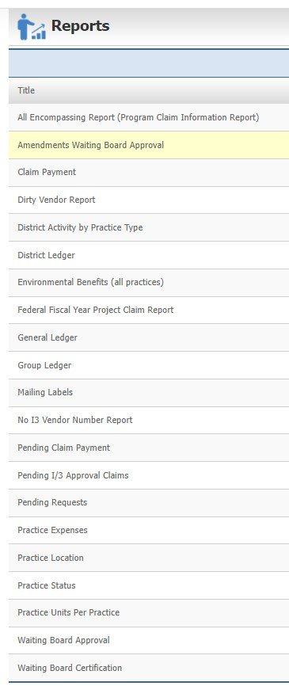
Reports
Pre-developed reports
Statewide or District-specific (depending on user’s access capability)
Can be pulled by Fiscal Years, Programs, Districts, Project Status, and Statewide
Display items like project/program, cost share, costs, quantities, landowner info, environmental benefits, milestone dates

Slide 11
Training
Test sites
Exact copies of real sites, but allows staff to get comfortable with FARMS
Live training (in-person or virtual)
FARMS Handbook
Developed by a team of users and program administrators
How-to’s, tips, step-by-step processes

Slide 12

QUESTIONS??
Kate Bussanmas (Not FARMS Expert)
(515) 281-5853
Kate.Bussanmas@iowaagriculture.gov
Mike Franklin (FARMS Expert)
(515) 281-6145
Mike.Franklin@iowaagriculture.gov

