Slide 1
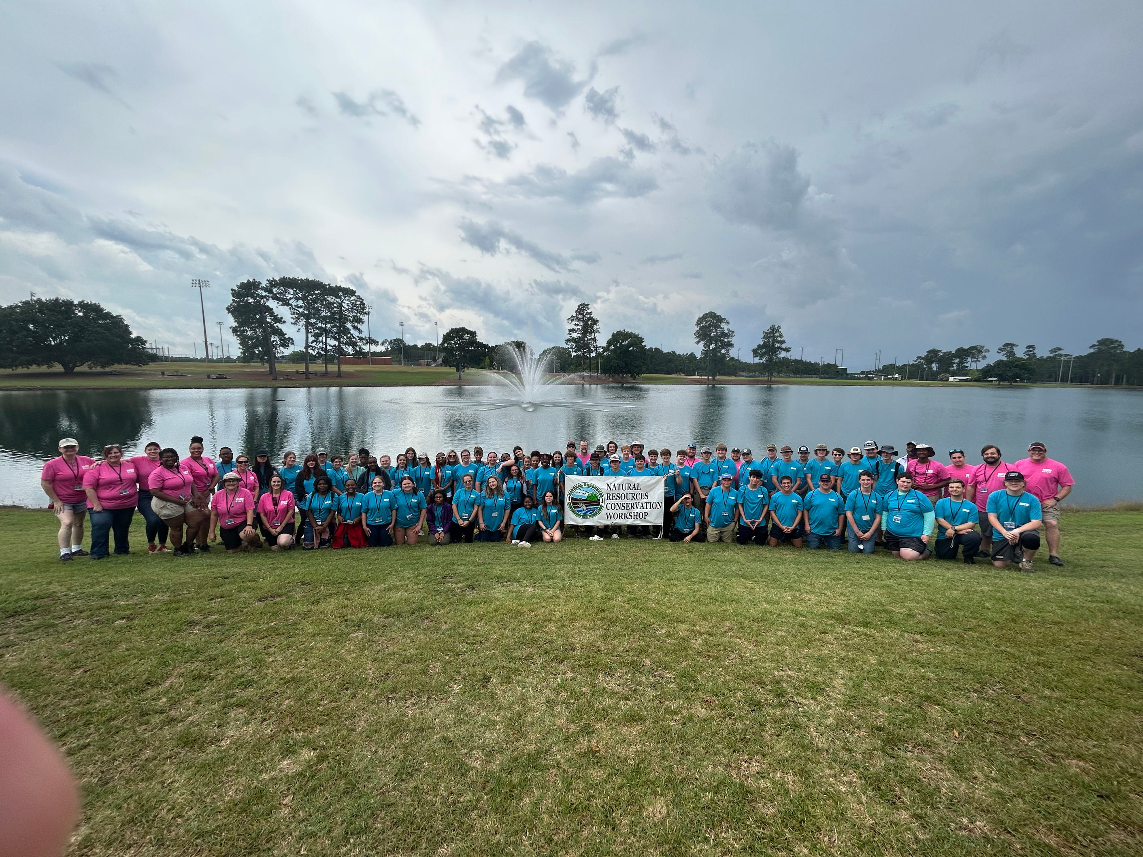


GEORGIA’S NRCW:
MEMOIRS OF A NEW DIRECTOR
MICHELLE CONNER
CONSERVATION REGIONAL MANAGER

Slide 2
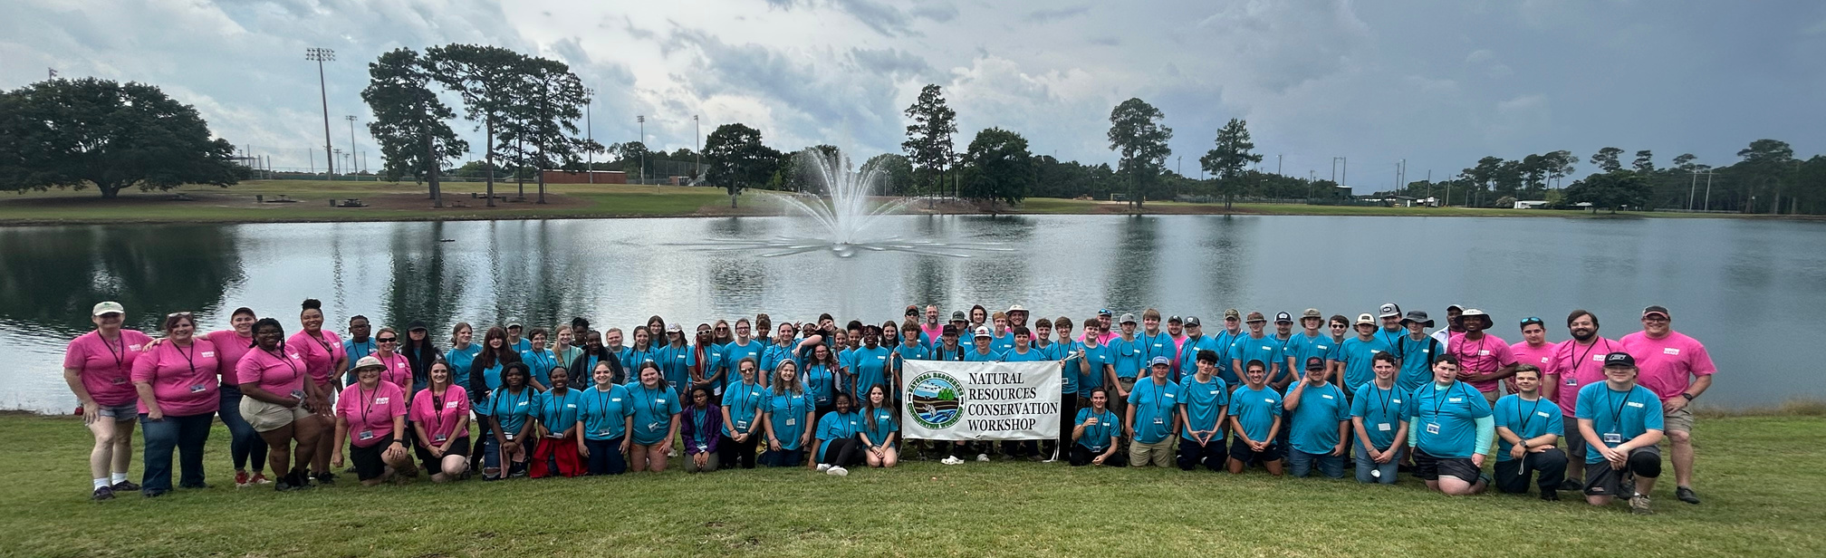

First a little background..
Since beginning in 1962, over 13,000 students have attended NRCW.
ABAC in Tifton, GA became its permanent home in 1995.

Slide 3








Valuable Partners
Executive
Committee
Instructors
Advisors
Volunteers

Slide 4
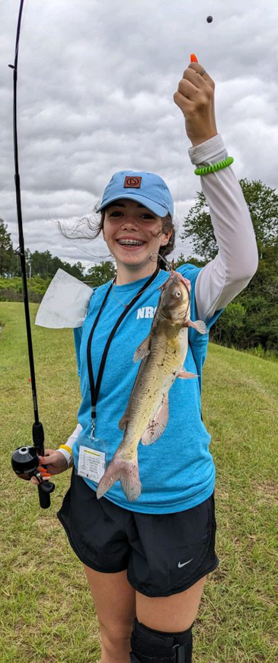
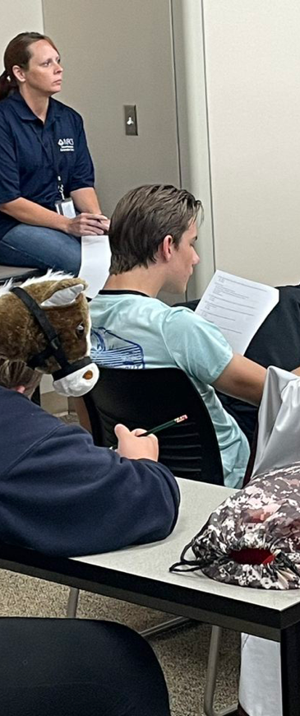
Experiential Learning
Topics include rediscovering Georgia water resources, sustainable agriculture, wildlife management , soils and conservation planning, Georgia costal resources, fisheries management, forest protection, forest management, and mining conservation
In addition to instruction and hands on opportunities students have the opportunity to discuss both educational opportunities and carer paths with multiple collgeg representatives and professionals who work in the field of Natural Resources

Slide 5
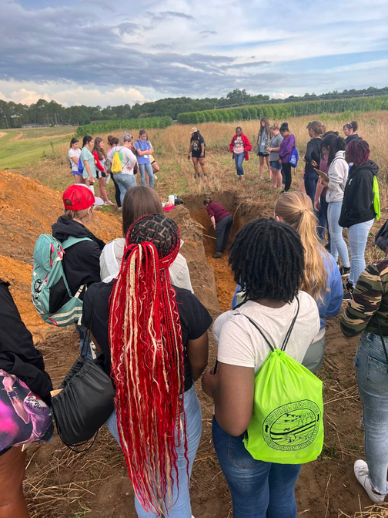
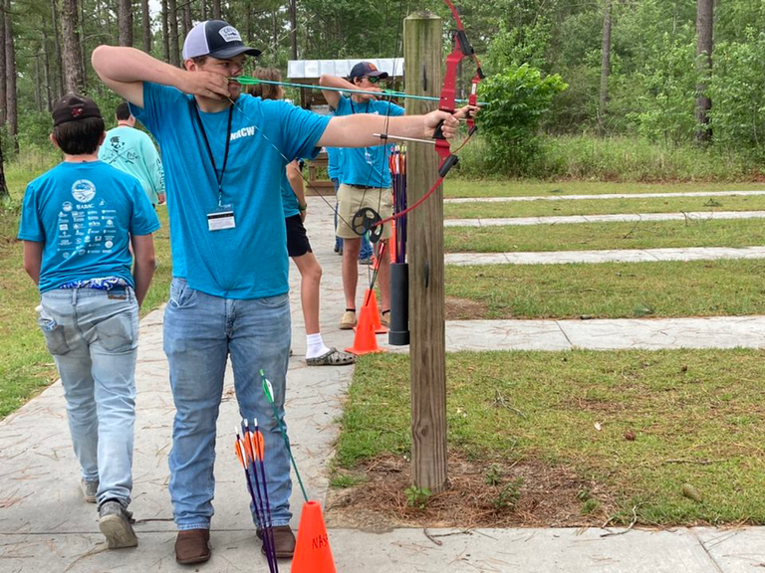
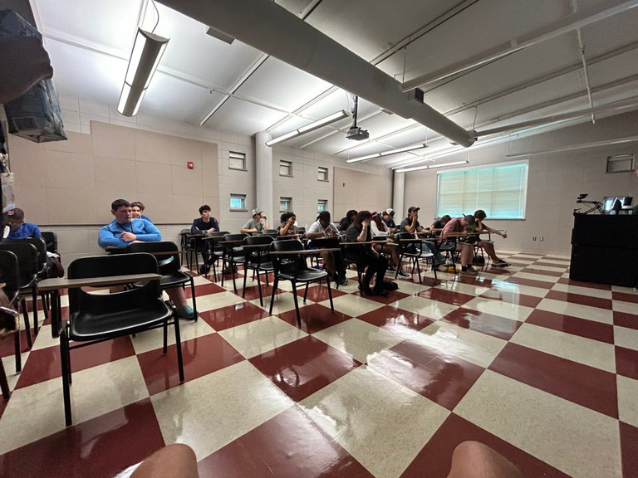
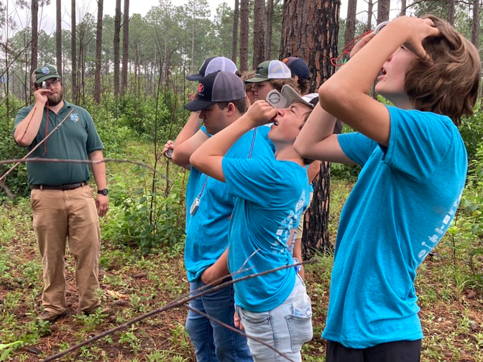
68 students from 44 different counties, representing 27 districts
Over 30 Valuable Partner Volunteers served as instructors, advisors, and volunteers
Over $25,000 in Scholarships awarded
.....and memories and experiences that will last a lifetime!!

Slide 6
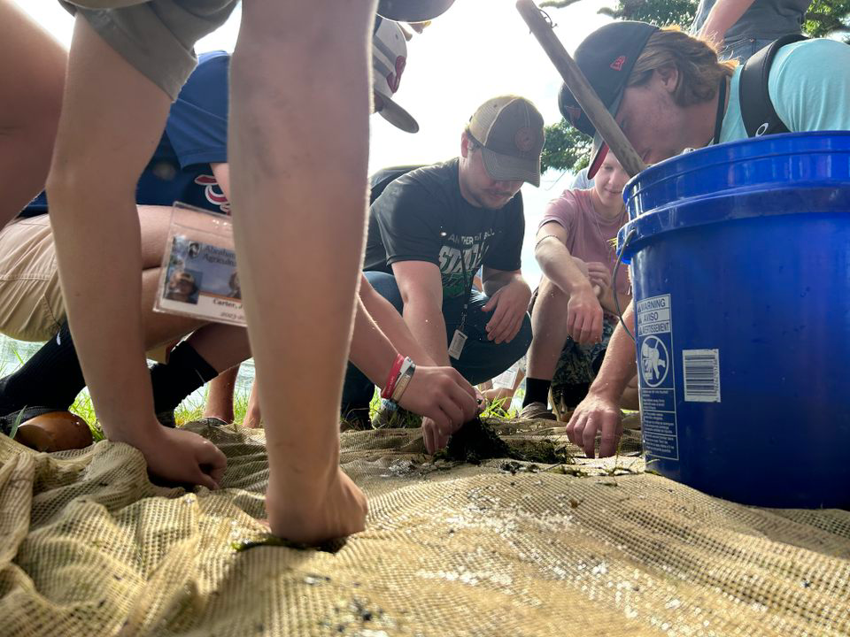
A THANK YOU TO OUR DISTRICTS
All students are sponsored by their Conservation District at NO COST to the students or their families.

Slide 7

And to the point...
Challenges and Successes

Slide 8
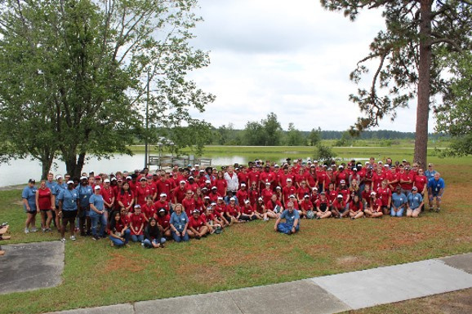
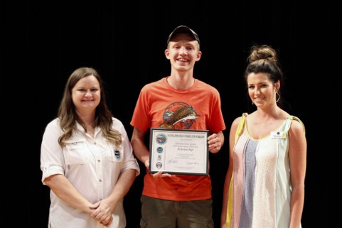
2019- Fresh Meat!
EVERYTHING! The program, committee, location, awards, Scholarships, registration process..
What’s New
Racism, Minors on Campus, Crammed pack 4 day workshop, very little free time, student drop off and pick up
Challenges
I SURVIVED! Sucesscully dealt with a racism complaint, handled my first program repremand of a vounteer, NO STUDENT INJURIES!
Successes

Slide 9


2019- Ready for year 2!!
online registration, addition of 5th day
What’s New
Challenges
Successes

Slide 10

2019- Ready for year 2!!
What’s New
Challenges
Successes
BUT I SURVIVED!

Slide 11
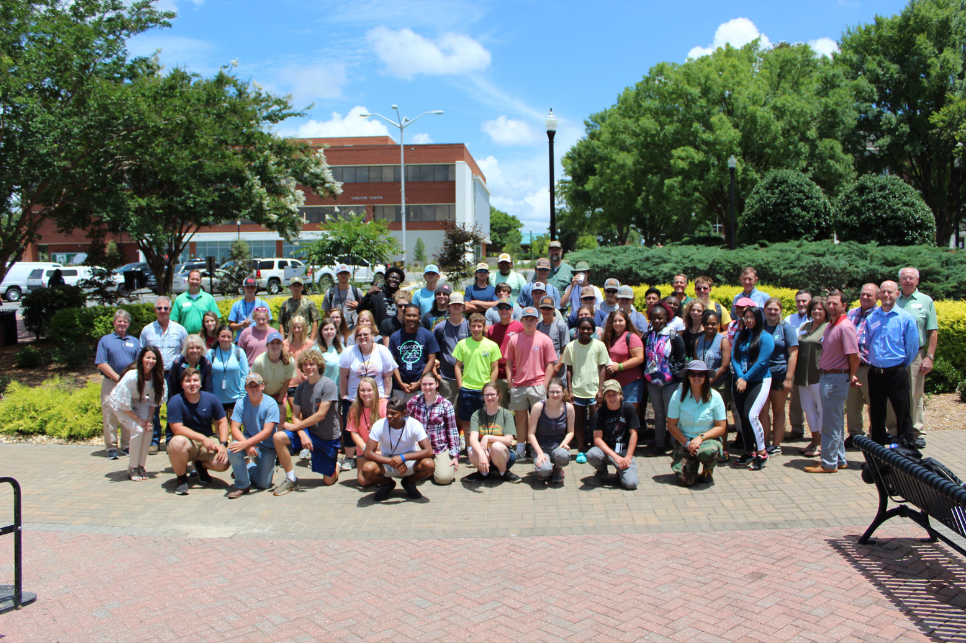
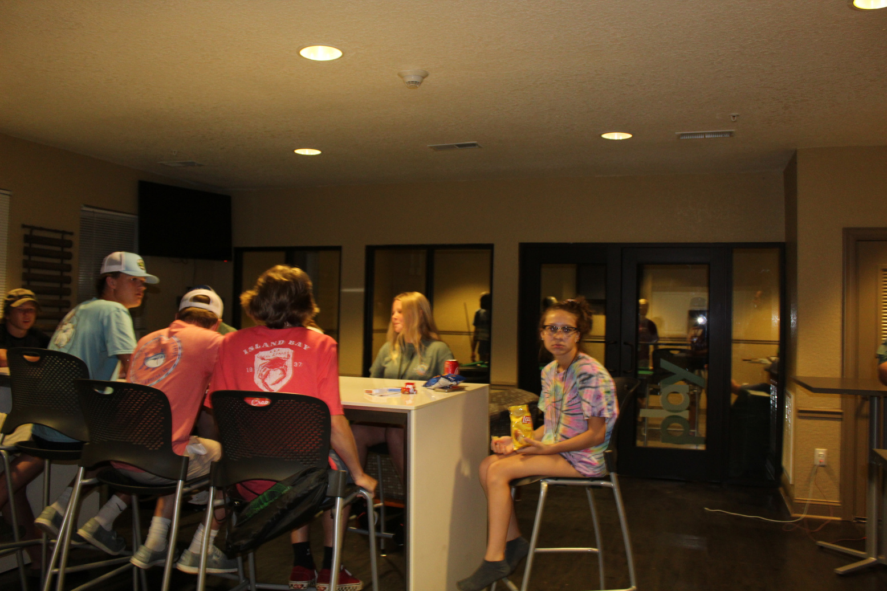
2021- Celebrating 60 years!
Implemented online registration, addition of 5th day, new College and Career Day
What’s New
Low volunteer numbers for advisors, almost had to cancel! 2 students per district due to covid restrictions. My daughter went 😱
Challenges
Established new minority scholarship, how to handle gender diversity, 60th year banquet, awarded over 40K in Scholarships!
Successes

Slide 12
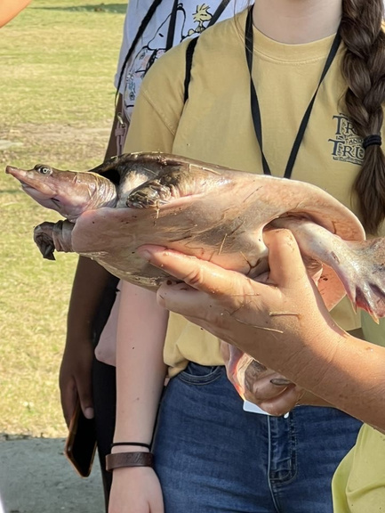
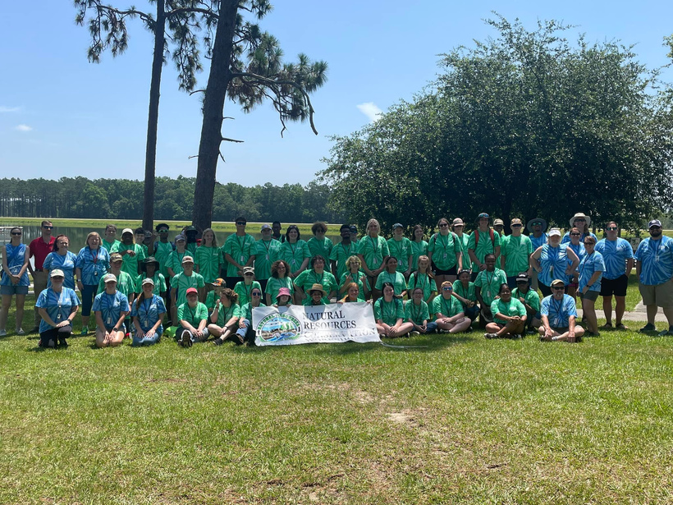
2022- Building off of successes
Handled registration and bus coordination. Added more field trip and hands on experiences
What’s New
Advisor numbers still low, student numbers lowest in history
Challenges
Many return volunteers that established themselves as a reliable team.
Successes

Slide 13
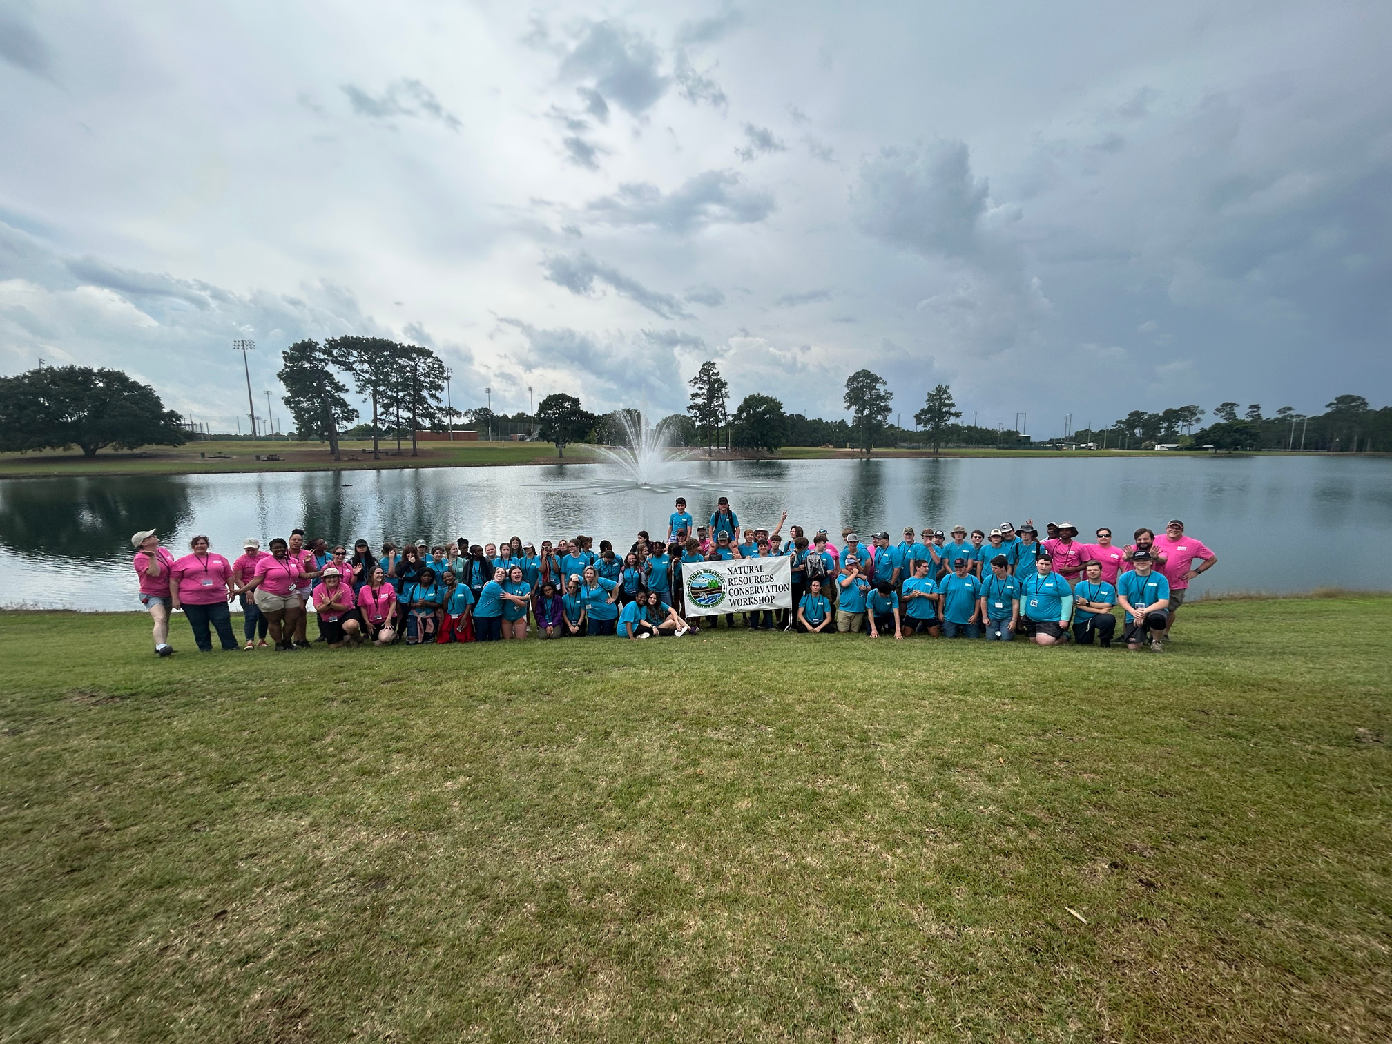
2023- Its a Bouncing Baby Workshop!!
What’s New
Challenges
Successes
Voluntold my Manager
to come participate 🤭
Handed College and career day to GACD
Unfortunate color choices
Numbers still low for advisors and students, advisor commitments, behavior issues!
Great group of returning advisors, bus coordination assigned to other GSWCC staff

Slide 14
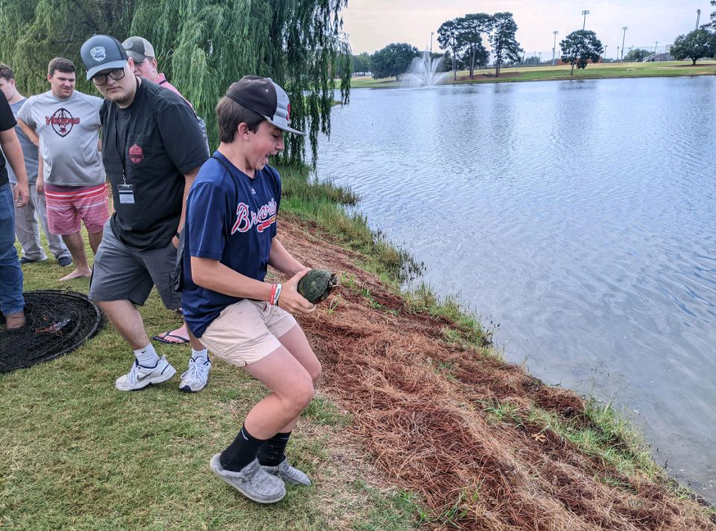
Time to share!
Other burning questions..
How to ensure advisor volunteer numbers?
Do other youth program directors get paid some kind of compensation?
What suggestions to improve for continued growth and success?

Slide 15
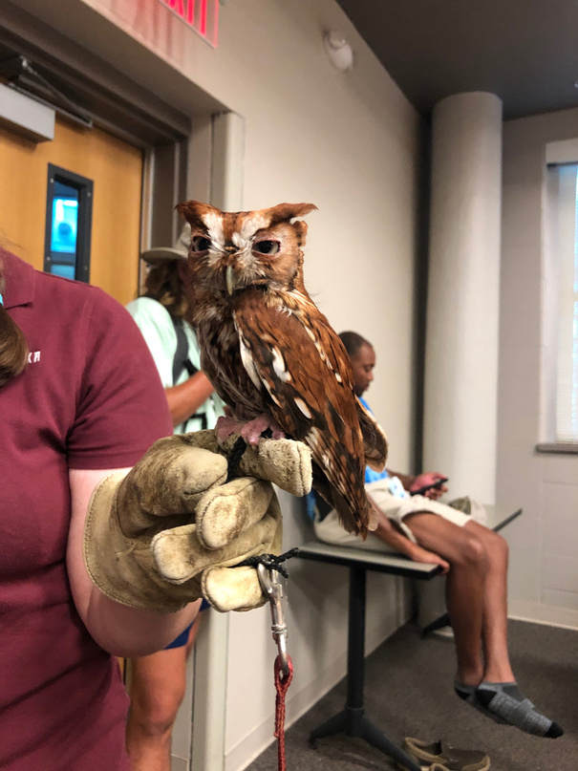
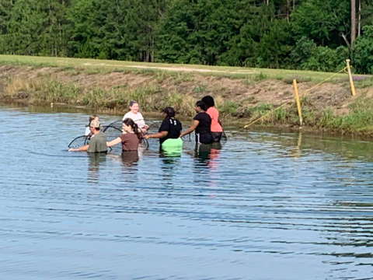
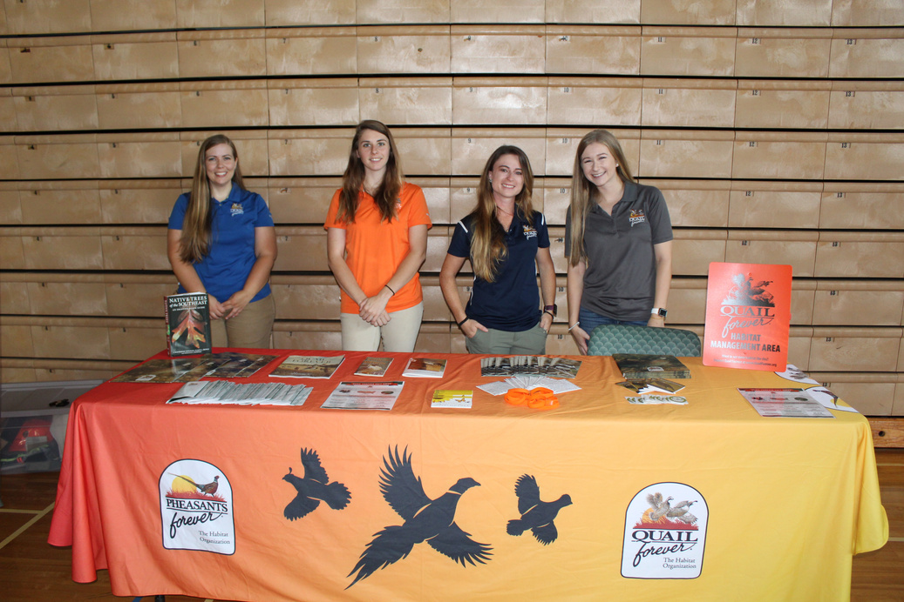
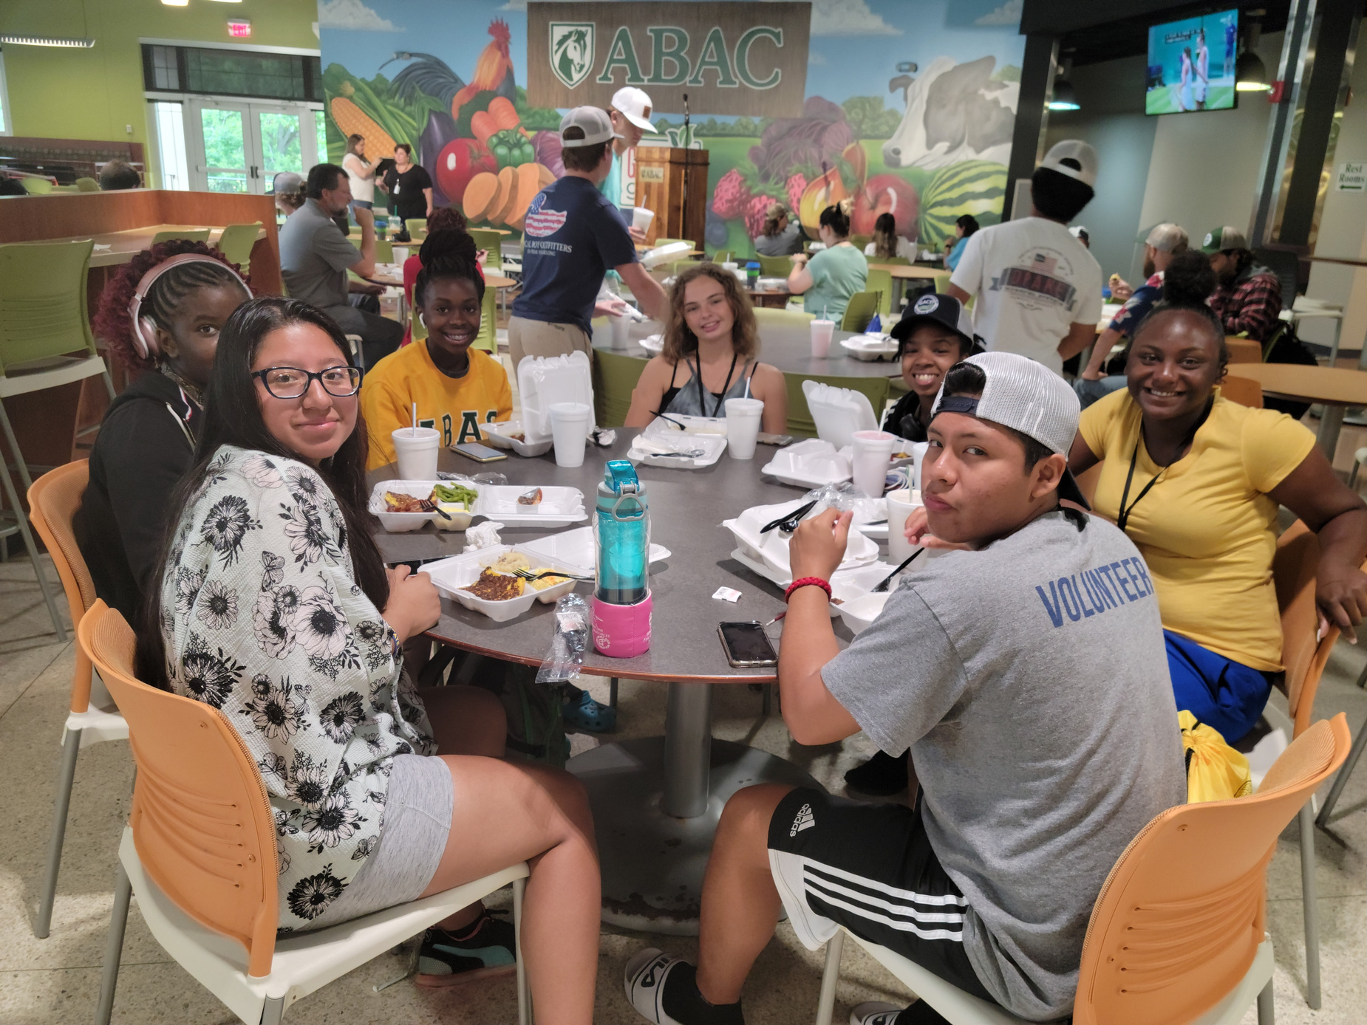
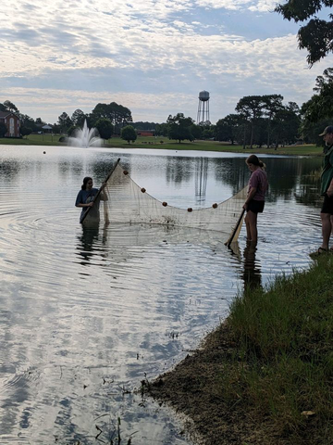
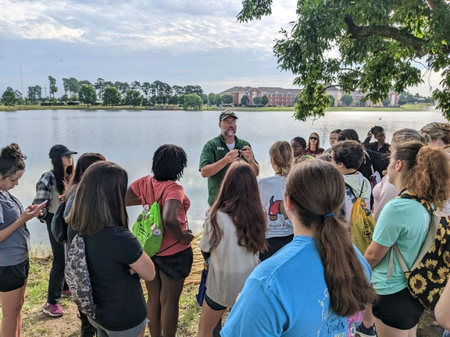
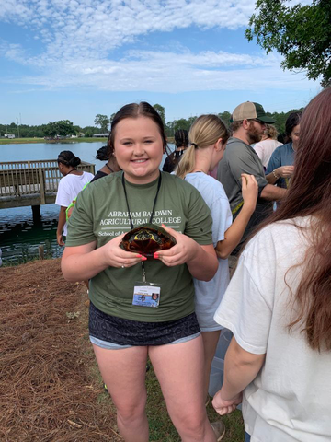
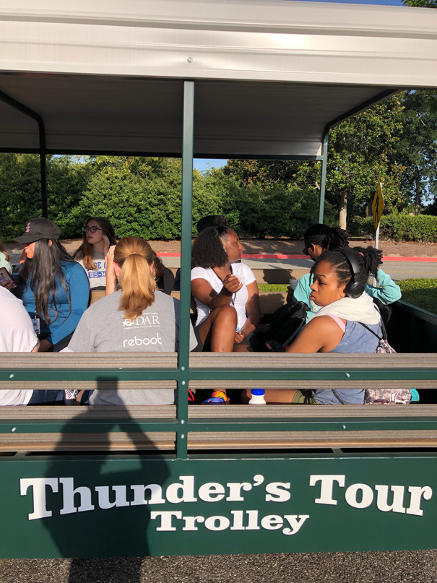
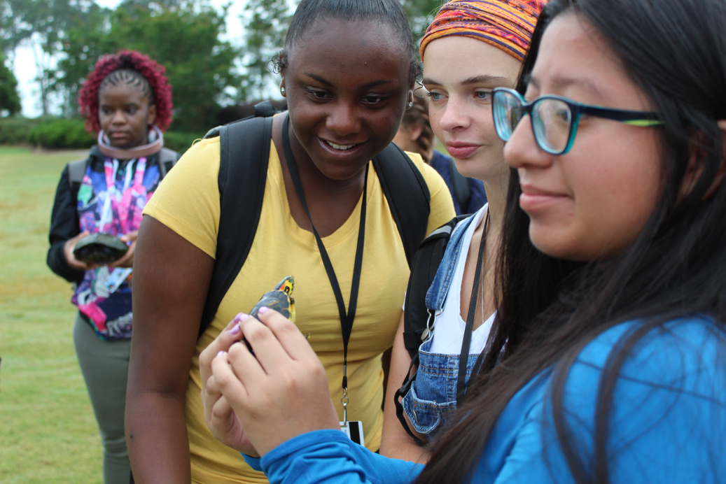
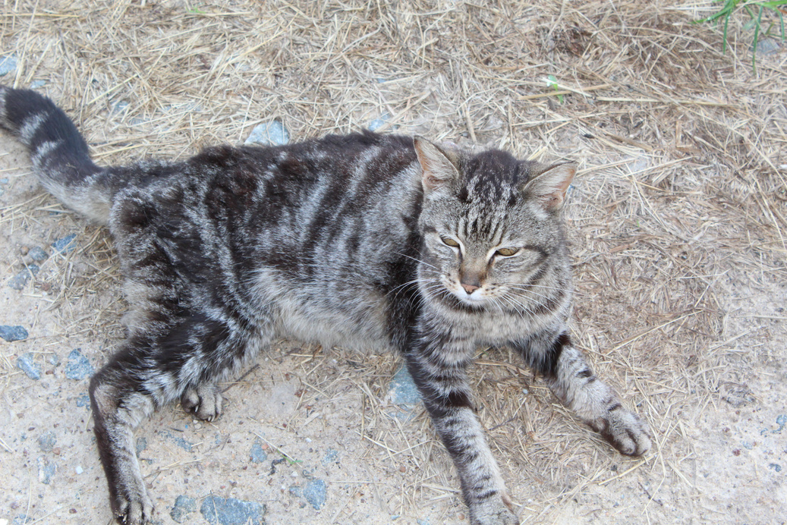
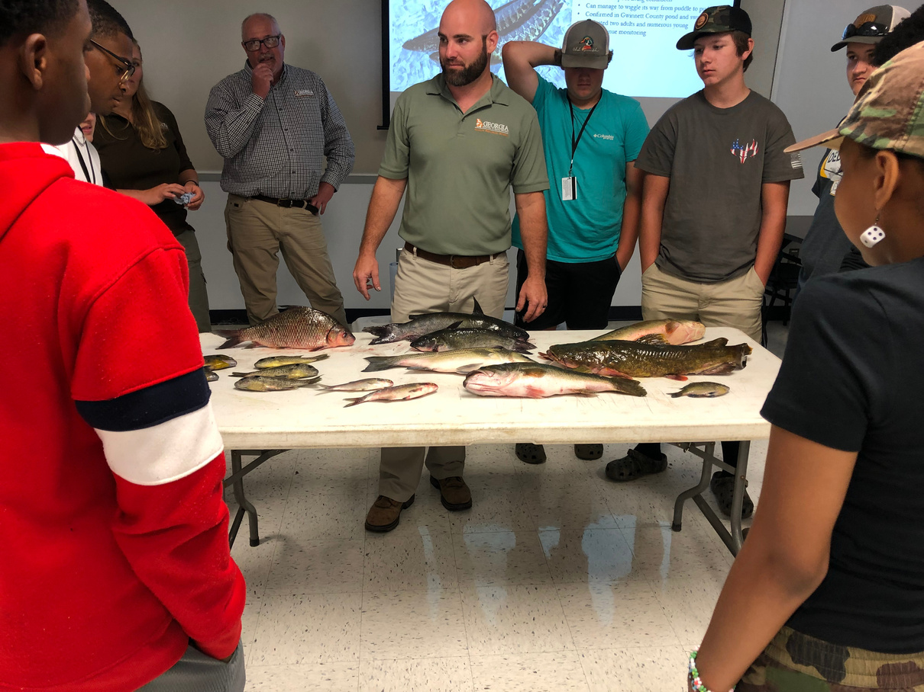
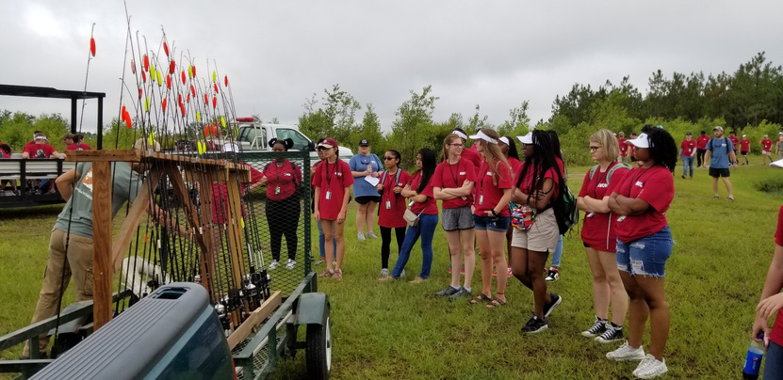
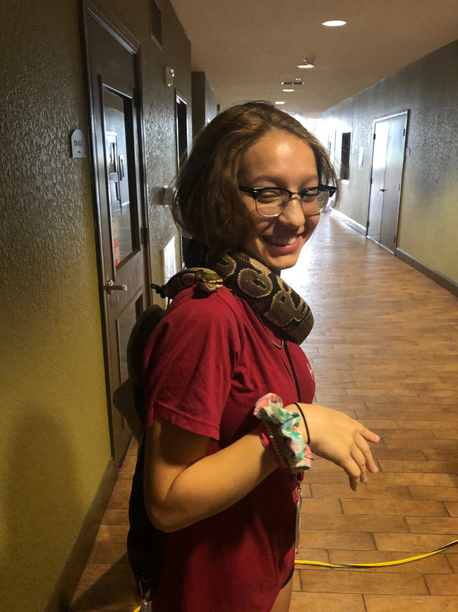
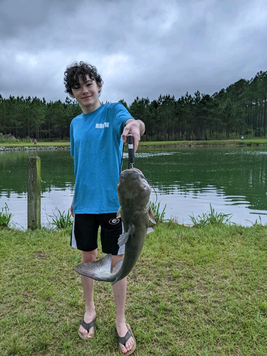
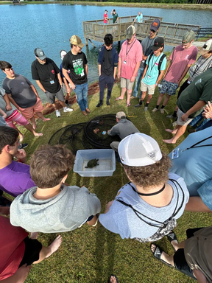
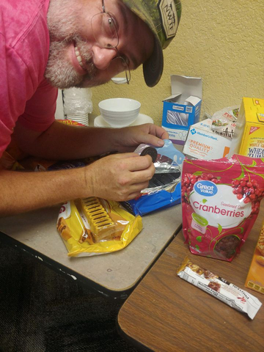
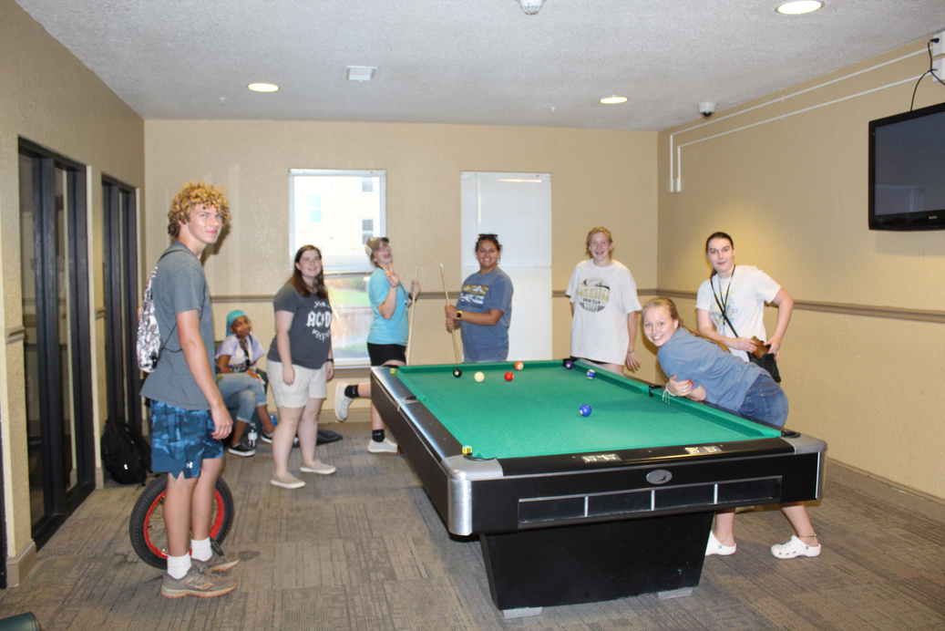
Michelle Conner
michelle.conner@gaswcc.ga.gov
706-431-0477

