Slide 1

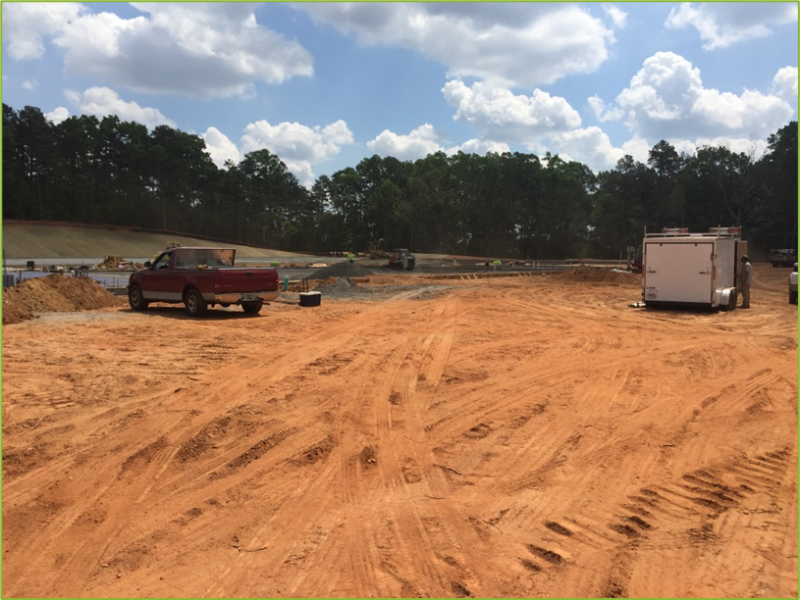
Erosion & Sediment Certification Program
for people involved with land disturbing activities
NASCA State Sharing Session
October 2025, Fort Worth, TX
Michelle Conner
Conservation Regional Manager
Notes:
Welcome. Today I'll give an overview of Georgia’s Erosion & Sediment (E&S) Education & Certification Program, developed by the Georgia Soil & Water Conservation Commission.
The program was created to ensure anyone involved in land-disturbing activities is trained and certified to protect water and reduce urban erosion.

Slide 2
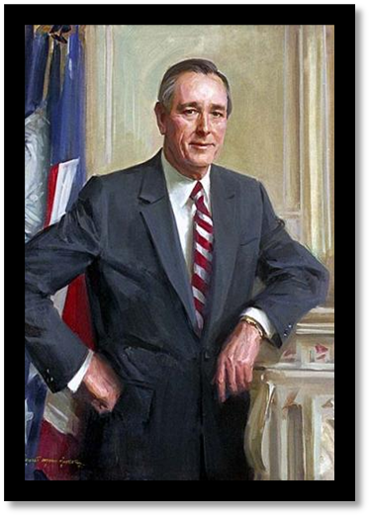

When & Why?
Purpose: Provide training that would establish a baseline to reduce erosion from land disturbing activities statewide.
1975: Georgia Erosion and Sedimentation Act was passed
2003: House Bill 285
2007: House Bill 463 and other amendments
Purpose
Educate permittees on the State and Federal rules and regulations governing Land Disturbing Activities in Georgia.
  NPDES
  GESA
  State Waters
  BMPS
GESA; State law that regulates land-disturbing activities to prevent soil erosion and the resulting sedimentation os state warers.
Mandatory education and certification was created by legislative amendments, and GSWCC was tasked to develop and run the program.
Develop sustainable practices that boost local economic activities, particularly in fishing and tourism, ensuring long-term benefits for the community.
Pictured: George Busbee, Governor of the State of Georgia, signed into law the Erosion & Sedimentation Act of 1975 .
Notes:
Georgia first passed the Erosion & Sedimentation Act in 1975.
The modern mandatory certification program was created by legislative amendments in 2003 (House Bill 285); those 2003 amendments added education/training certification requirements and tasked GSWCC (with EPD and stakeholder input) to develop and run the program. Later amendments (House Bill 463 in 2007 and ongoing rulemaking/policy updates) refined requirements.
The purpose of the program was to provide training that would establish a baseline statewide to reduce erosion from urban development sites, protect water quality, and ensure consistent, professional application of best management practices (BMPs) on land-disturbing projects across the state.
The law recognized that education and mandatory certification were necessary to improve outcomes on the ground.

Slide 3
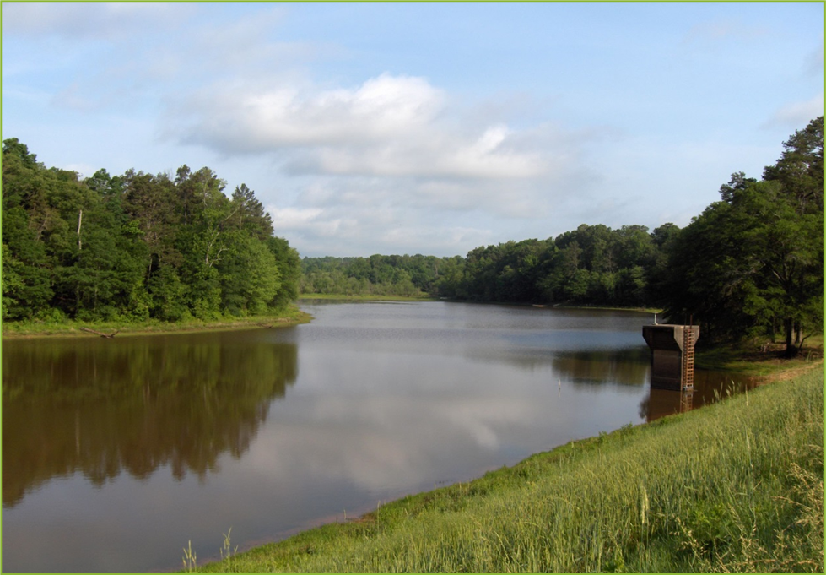
How Georgia’s Program was Developed
Administered by GSWCC
Partnership with Georgia Enviromental Protection Division
Governor-appointed Stakeholder Board* created.
*State Bill 96
Policy, procedures, and program rules were posted as official GSWCC documents and rulemaking.
State agency charged with regulating Georgia’s air, land, and water resources through state and federal environmental statutes.
State and local stateholders from across the state worked with GSWCC and GA EPD to develop rules, course standards, testing, levels and systems.
2025 legislative session transferred Stakeholder Board powers to the Overview council, so the E&S program and manual are administered by the same board.
Notes:
The Georgia Soil & Water Conservation Commission (GSWCC), working with the Georgia Environmental Protection Division (EPD) and a Governor-appointed stakeholder advisory board, was charged with developing rules, course standards, testing, certification levels, and recertification systems.
Policies and procedures, along with program rules, were posted as official GSWCC documents and rulemaking.

Slide 4

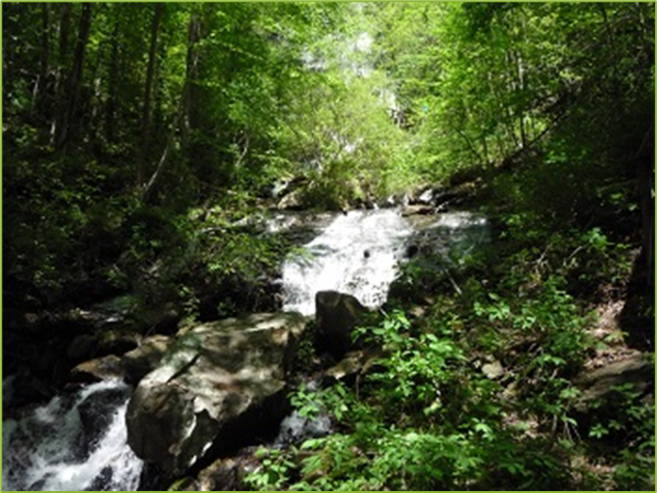



Impacts & Benefits
Consistent Statewide Training and Standards
Improved BMP Installation, Inspection, and Compliance
Protection of Georgia’s Water Resources from Sedimentation
District funding opportunity though course sponsorship
Notes:
This program has improved BMP installation and inspection quality, created consistent standards statewide, and strengthened protection of Georgia’s water resources against construction-related sedimentation.
Conservation Districts have the opportunity to schedule courses in their areas, taught by GSWCC staff, that can help bring funds into the district.

Slide 5
Certification Levels
Subcontractor Awareness
Level 1A:
Fundamentals
Level 1B:
Inspectors
Level II:
Design Professionals
Basic information (2 hours)
Contractors and site personnel (1 Day)
Regulatory/contract inspectors (2 days)
Engineers and plan reviewers
Recerts/ Continuing Ed
Become a Certified Trainer
Trainer I
Trainer II
Required for all certification levels.
10 Years experience or Bachelors Degree and 5 years Experience required.
Certified to teach Awareness, 1A, 1B, and Recertifications
Certified to teach Level II and Level II Recertification
Notes:
Certification levels include Level IA for contractors and site personnel, Level IB for inspectors, Level II for design professionals, and advanced certifications for plan preparers.
Each level aligns with different responsibilities in erosion and sediment control.
GSWCC uses a level-based system. Main levels and audiences:
Level I A — Fundamentals (initial and often called "Blue Card"): basic E&S fundamentals; intended for personnel who conduct or oversee on-site control activities. Attendance at approved Fundamentals Seminar required to apply for Level IA certification.
Level I B — Advanced Fundamentals (often called “red card” for inspectors): 2-day course for regulatory enforcement inspectors and contracted inspectors; focuses on inspection, compliance, and enforcement.
Level II — Introduction to Design / Design Professionals: courses targeted to design professionals, plan reviewers, engineers, landscape architects; includes plan preparation and design elements. (Online self-paced Level II recertification courses are available.)
Plan Preparer / Design Professional Certifications: separate certification for those preparing E&S plans or performing design work; these require additional coursework and demonstrated competence.
Continuing Education (recertification): periodic CE hours required;
GSWCC provides a list of approved courses and online self-study options for recertification.
Exam/recert requirements commonly include a minimum passing score (e.g., 70%) and issuance of certification card upon passing.
Awareness is not a certification therefor does not require recert just awareness to be retaken

Slide 6
Course Content
GESA
NPDES Permitting
State Waters
Best Management Practices (BMPS)
Georgia Erosion and Sedimentation Act
Execute erosion mitigation strategies to protect and restore the shoreline.
Develop eco-friendly tourism and local businesses.
  Structural
  Vegatative
Inspection & Enforcement
Plan Review & Design
Manual for Erosion & Sediment Control
Level 1B
Level II
Level 1A, 1B, and both Level II Certification types require a passing score of 70%
Trainer I and Trainer II Certifications require a passing score of 85%
Recertification is required every 3 years or within a year of expiration date.
Notes:
Common topics across courses:
-Georgia Erosion & Sedimentation Act basics and state rules
-Erosion & sediment control BMPs (vegetative & structural)
-Plan review principles, permitting (NPDES), buffers
-Site inspection procedures, documentation, and enforcement
-Safety, site management, and local program overview
-Design calculations (Level II/design tracks) and manual references
Delivery methods: in-person seminars, multi-day workshops, and self-paced online recertification courses approved by GSWCC.
Application & exam: applicants register for GSWCC-approved seminars; many tracks require successful completion of an exam (commonly 70% passing threshold) and the issuance of a certification card (mailed within a set period). Recertification requires approved CE credits from approved courses online or in-person.

Slide 7
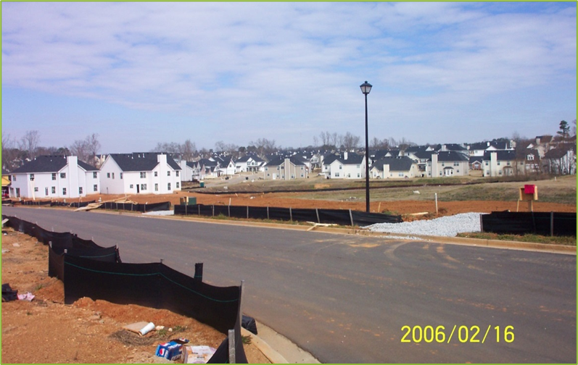
Program Connections to Conservation Districts
Local Issuing Authorities (LIAs)
Conservation Districts
GSWCC
  Partners with EPD on regulatory actions
  Issues permits
  site inspections
  provides updates to Conservation Districts monthly
  turns in semi-annual reports to GSWCC
  Approves all ES&PC plans needed for land disturbing activities, technical review provided by GSWCC on behalf of the Districts.
  Can issue Memorandum of Agreements with LIA for ability to review their own plans
  partners with GSWCC and LIAs on technical assistance requests and complaints
  provides technical assistance and program management
  manages all administrative actions related to district programs and responsibilities
  technical assistance and complaint assistance/resolution
  provides training, sponsored by districts.
Notes:
Enforcement linkage: local issuing authorities enforce the Act; certified personnel are expected for regulated activities.
GSWCC coordinates with EPD and local governments.
Guidance materials: GSWCC publishes the Manual for Erosion & Sediment Control in Georgia (amended periodically — e.g., 2016 edition updates) and policies/procedures docs used in training and exams.

Slide 8

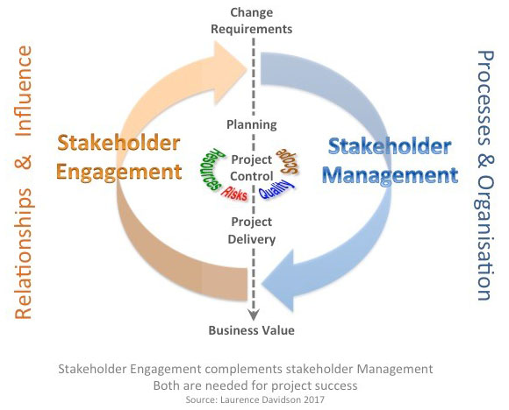

Program Establishment Steps
01
02
03
Legislative Step:
Consider whether to use statute or other administrative rule.
Stakeholder Engagement:
Needed to help design feasible requirements and course content.
Rollout and Recertification Plan:
Discuss initial certification deadlines and recertification requirements.
Notes:
Emphasize legislative step first — Georgia’s program is statutory (HB 285) and implemented by an existing state commission (GSWCC). Other states should consider whether to use statute or administrative rule.
Highlight stakeholder engagement (GSWCC worked with EPD and a Governor-appointed advisory board) — this helped design feasible requirements and course content.
Discuss phased rollout and recertification (initial certification + continuing education) rather than a one-time exam only; include online recert options for access and lower cost.
Rules are changing and material is updated to cover any changes.

Slide 9
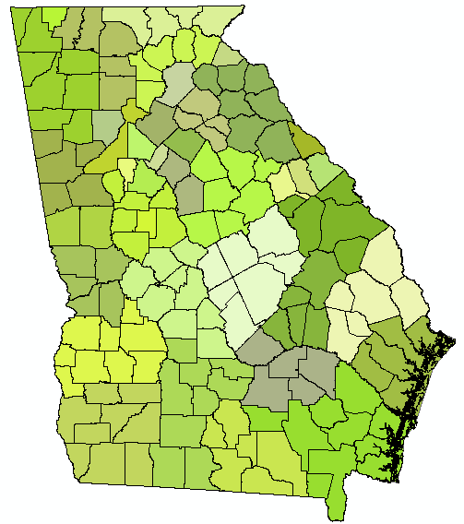



Thank You!
Contact me with any questions!
michelle.conner@gaswcc.ga.gov
706-431-0477
GSWCC Main Office
4310 Lexington Rd., Athens, GA 30605
https://gaswcc.georgia.gov/

