Slide 1
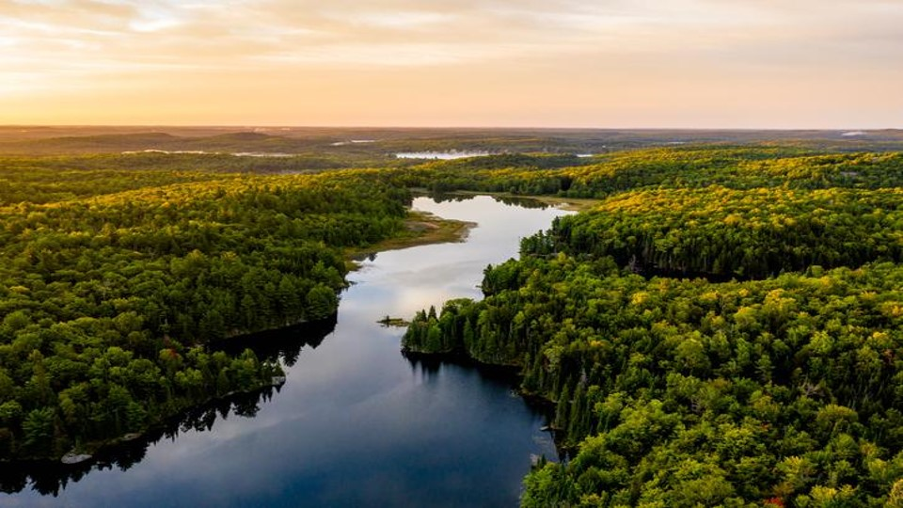

CT Council ON SOIL AND WATER CONSERVATION
Lilian Ruiz
Executive Director

Slide 2

Landowner Support for Forest Resilience

Slide 3
Funding provided by the U.S.D.A, Forest Service through the Forest Stewardship Program, and under the Inflation Reduction Act: Preparing to Serve the Underserved as administered by the CT DEEP Division of Forestry

Slide 4

A TWO-PART PROGRAM: 1. CAPACITY BUILDING FOR CONSERVATION PLANNING 2. COST SHARING FOR IMPLEMENTATION
$3.6 million grant managed by the Council
Supports non-industrial private & municipal forest landowners
Builds Capacity for Conservation Planning
Provides cost-share funding for adaptation & sustainable forestry
Goals:
Boost forest resilience
Engage underserved landowners
Improve forest health & program accessibility across Connecticut
4

Slide 5
TSP R² Training:
Program AT A GLANCE
$300,000 funded by a USDA Forest Service IRA – Forest Stewardship grant via a non-competitive state allocation.
focused on workforce development to serve underserved landowners.
Train CT-licensed forest practitioners to become and remain NRCS Technical Service Providers (TSPs).
Equip practitioners to effectively engage landowners about resilient forestry.
Partners: CSWC (delivery), CT DEEP (oversight), CT NRCS (standards and certification)

Slide 6
TSP Training part 1 and 2
TSP TRAINING, PART 1 PROGAM INTRODUCTION | TSP TRAINING, PART 2 NRCS REGISTRY SIGNUP
Introduction to TSP R² Program and NRCS cost share programs and practices | Provides one-on-one assistance in creating online accounts required for NRCS TSP program
6-hour In-Person Training in November | 2-Hour In Person Training in November
Required for current TSPs and TSP recruits | Required for TSP recruits
$115 per training hour | $115 per training hour

Slide 7
TSP ORIENTATION & CONSERVATION PLANNING TRAINING
TSP ORIENTATION & CONSERVATION PLANNING TRAINING | FOREST MANAGEMENT PLAN SUBMISSIONS
A training session specific to conservation planning | Develop and submit a representative forest management plan for review and approval by NRCS.
8-Hour In Person Training in January | Ideally within 6 months of completing TSP trainings
Required for TSP recruits | Required for TSP recruits. The final step to becoming a TSP.
$115 per training hour | $2500 upon NRCS approval of a plan and acceptance as a TSP.

Slide 8
Tools for Engaging Landowners Effectively (TELE) workshop
2-day, 14 hour in-person, hands-on workshop to design outreach to underserved landowners.
Small cohort (~15); learn → apply methods (audience, message/channel, metrics).
Leave with a ready-to-use outreach plan + 1-hour virtual follow-up.
Held In August ‘26 and ‘27
$115 per training hour

Slide 9
Forest Resilience Cost Share:
Program at a glance
$3.3M funded by a USDA Forest Service IRA – Forest Stewardship grant awarded through a competitive opportunity, focused on implementing resilient forestry practices on private and municipal lands.
Supplements federal dollars to fund 100% of the implementation of resilient forestry practices in Connecticut’s rural, non-industrial private woodlands.
Partners: CSWC (delivery), CT DEEP (oversight), CT NRCS (standards and certification)

Slide 10
HOW THE PROGRAM WORKS
CCSWC subawards cost-share payments to landowners for resilient forestry practices
Aligns with NRCS EQIP/CSP conservation planning and implementation

Slide 11
ELIGIBILITY
Landowners engaged through CT NRCS
Ensure agreements reflect current payment rates

Slide 12
Cost‑Share Rules
Standard landowners: up to 25% of NRCS fixed per‑unit rates (not to exceed 100% total)
Non‑standard landowners: up to 10% (not to exceed 100% total)

Slide 13



Contact information
Lilian Ruiz: ctcouncilswc@gmail.com
Andrea Urbano: Andrea.Urbano@ct.gov
Todd Bobowick: todd.bobowick@usda.gov

