Slide 1

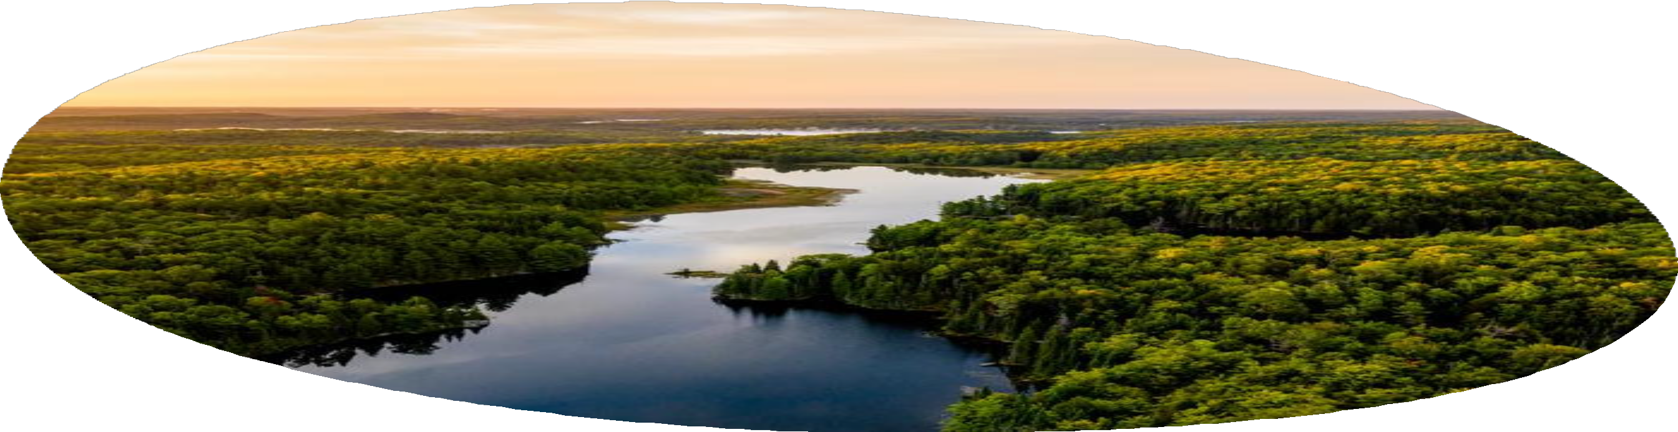
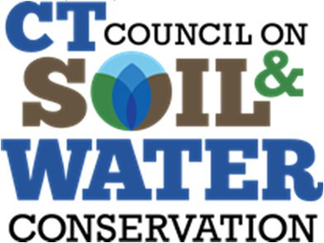
Protecting Drinking Water Sources in CT
Lilian Ruiz Executive Director
NASCA Annual Meeting
October 6, 2024

Slide 2
What is SourceWater Protection??
“Source water protection is a proactive approach to safeguard, maintain, or improve the quality and/or quantity of drinking water sources and their contributing areas.” – American Water Works Association (AWWA) Source Water Committee
2

Slide 3
Public Drinking Water in Connecticut
3 October 7, 2024

Slide 4
Drinking Water Watersheds and Reservoirs in Connecticut
566,059 acres (884.5 sq mi) or 17.8% of the territory
4 October 7, 2024

Slide 5
How can we protect drinking water supplies?
With limited resources, limited time, limited funding, how can smart decisions be made to protect drinking water sources?
In Connecticut, most land‐use decisions are made at the town level (169). There is no county government.
Zoning may not identify/consider source protection areas
Lots of available data on land characteristics and land use…..in lots of different places
Decisions and Development are often done at the parcel level
5 October 7, 2024

Slide 6
USDA NRCS
Create a state‐wide GIS inventory of land use in all source water protection areas.
Allows for the identification and prioritization of source water protection areas for both quality and quantity.
Cooperative Conservation Agreement
Source Water Protection Project
2. Expand knowledge of the watershed technical community about source water protection, main issues, etc.
3. Development of an outreach plan designed to increase participation in Farm Bill and other technical and financial assistance programs that address watershed needs.
Partners:
CT Council on Soil and Water Conservation
CT Dept. of Public Health – Water Supply Division (DPH)
Southwest Conservation District (SWCD)
Eastern Connecticuty Conservation District (ECCD)
4. Produce 2 watershed plans.
5. Conduct Local Work Groups!!!
6 October 7, 2024

Slide 7
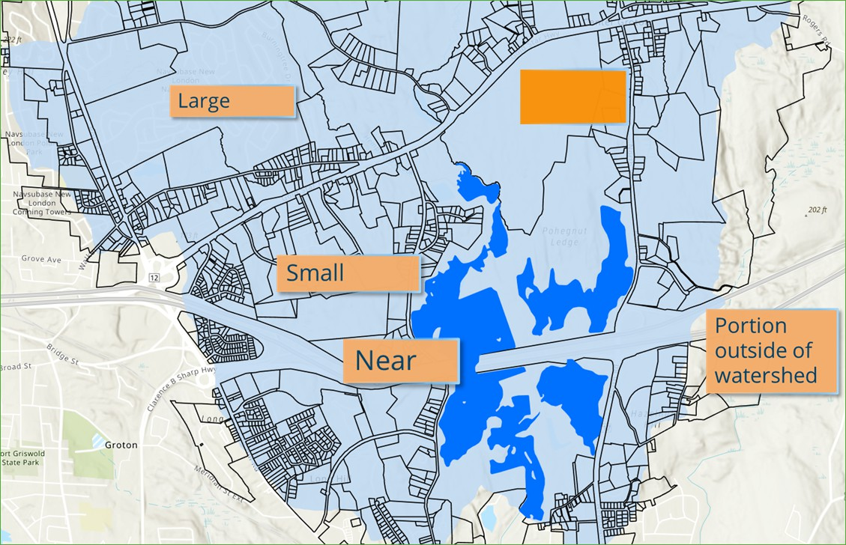


Contractor: UCONN CLEAR: https://clear.uconn.edu/projects/sourcewater/
Collect parcels to cover public supply watersheds and aquifer protection areas
Identify and define metrics for prioritization
Collect input data layers to inform metrics
Calculate metric values for each parcel
Apply points to each metric for prioritization
Agricultural
Far
Metrics
Far
1.
2.
3.
4.
5.
6.
7.
8.
9.
10.
11.
Distance to tributaries/reservoirs Contains stream bank/riparian land Distance to wetland
Distance to treatment plant intake Soil Type (drainage/depth)
Slope Parcel Size
Agricultural land Commercial/industrial land Forest land
Residential land
7

Slide 8
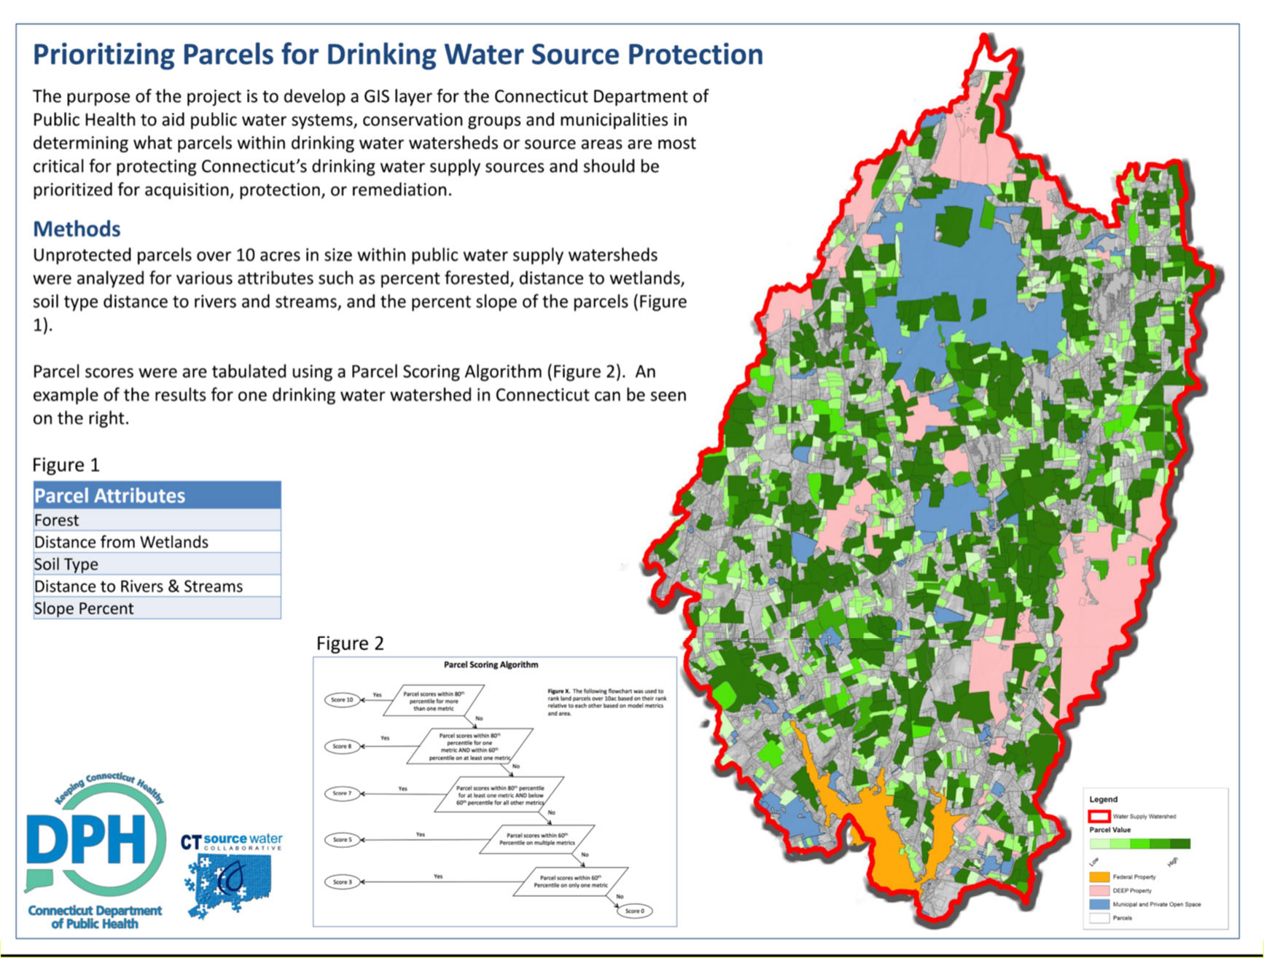
USDA NRCS
Cooperative Conservation Agreement
Source Water Protection Project
8 October 7, 2024

Slide 9
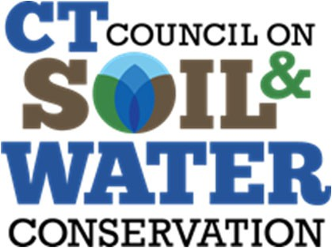
Contact:
Lilian Ruiz, Executive Director
CT Council on Soil and Water Conservation ctcouncilswc@gmail.com
9
4/27/2022

