Slide 1
Colorado State Conservation Board
Online Supervisor Training

Slide 2
Online Supervisor Training Update Objectives
Align CSCB’s Online Supervisor Training with NACD and NASCA recommended training elements
Update content presentation to meet the needs of HB21-1110, an Accessibility Law for Colorado State and Local Governments
Update content to reflect any new policies/laws/information that directly impacts Colorado Conservation Districts
Migrate curriculum to a more user-friendly platform
Notes:
CO currently a silver state – 75% of curriculum meets recommend training elements
HB21-1110: HB21-1110 makes it a state civil rights violation for a government agency (including local governments like CDs) to exclude people with disabilities from receiving services or benefits because of lack of accessibility.
The act adds language to strengthen current Colorado law related to protections against discrimination on the basis of disability for persons with disabilities, specifically as those laws relate to accessibility to government information technology.
Any Colorado government entity that doesn’t meet the Office Information Technology ’s web accessibility standards could be subject to injunctive relief, meaning a court order to fix the problem; actual monetary damages; or a fine of $3,500 payable to the plaintiff, who must be someone from the disability community.

Slide 3
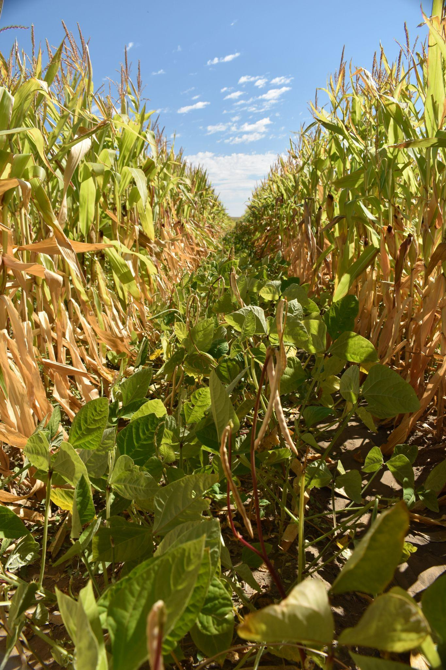
CSCB’s Online Supervisor Training Curriculum
17 modules (powerpoint + quiz)
History of the Conservation Movement, Your Role as a Supervisor, Elements of a CD, CD Partners, Meeting & Officers, Ethics, Fiduciary Responsibilities, Planning, Legal Responsibilities & Insurance, Policies & Procedures, Employee Relations, Local/State/Federal Law, Fundraising, Elections & Board Recruitment, Resolution Process, Legislative Relations, and Building Partnerships
Quizzes consist of 8-10 questions
Voluntary (but highly encouraged!) and incentive based
Transitioning from Moodle to Google Classroom platform

Slide 4
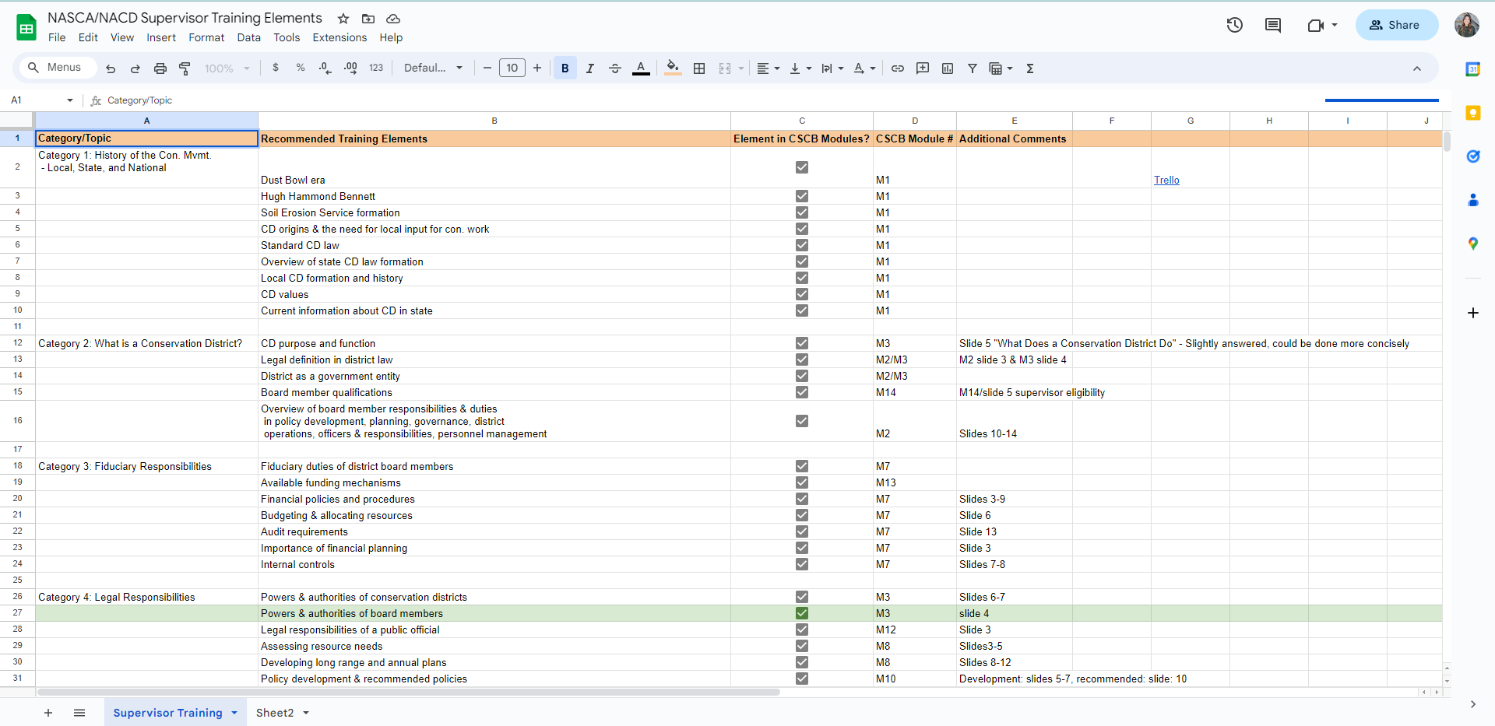
Initial Steps: Figure Out What We’re Missing (And What Needs To Be Updated!)
Notes:
Cross referenced with NACD recommended training elements and resources available on the NASCA website.

Slide 5
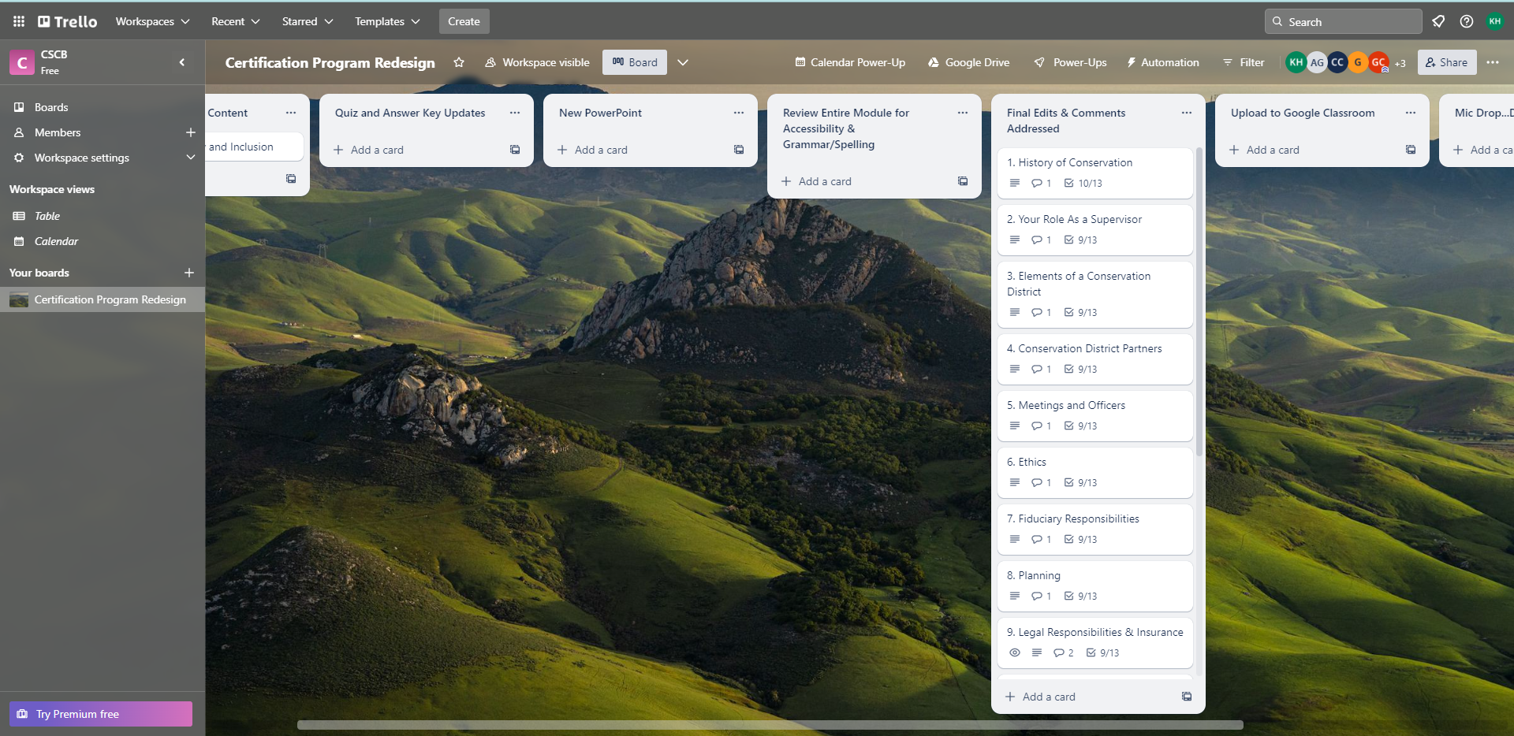
Keeping Track of Changes: Trello

Slide 6
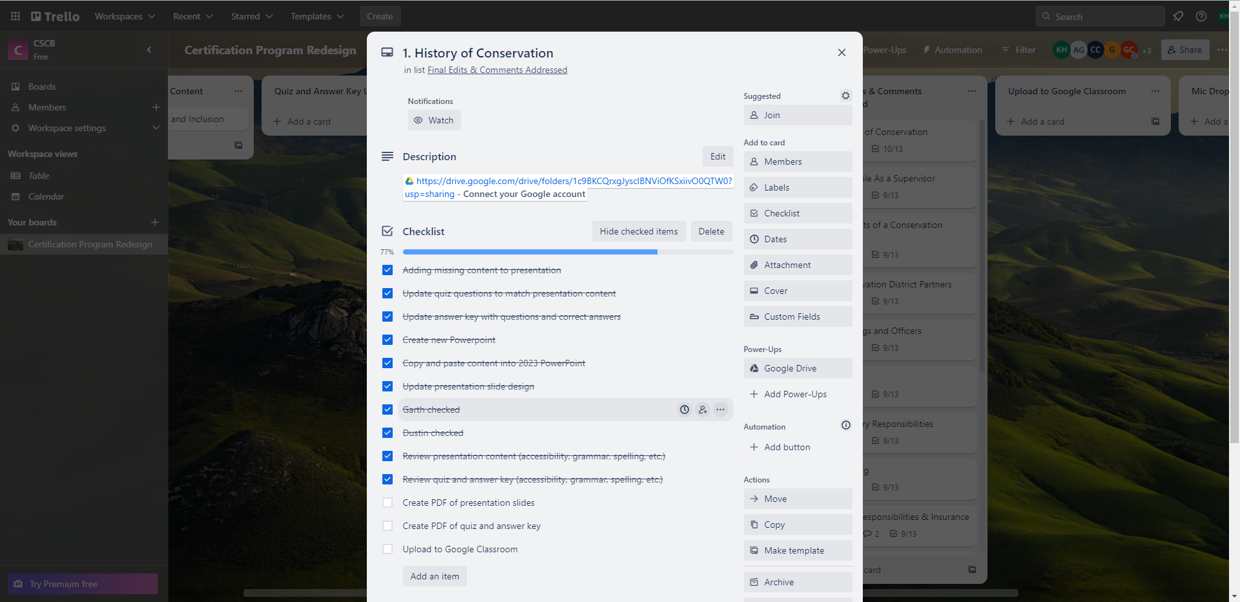
Keeping Track of Changes: Trello

Slide 7
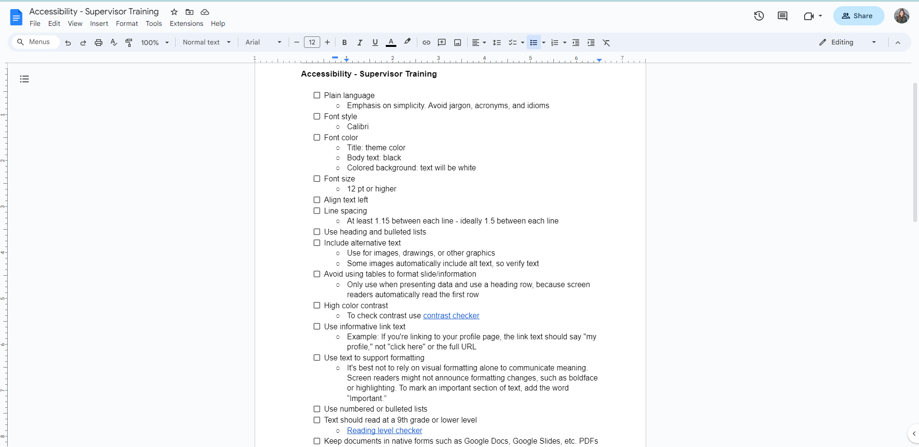
Making Edits with Accessibility in Mind
Notes:
Worked in conjuncture with and under the guidance of CDA’s Process Improvement Manager who is overseeing the Department’s progress towards HB21-1110 by July 2024.

Slide 8
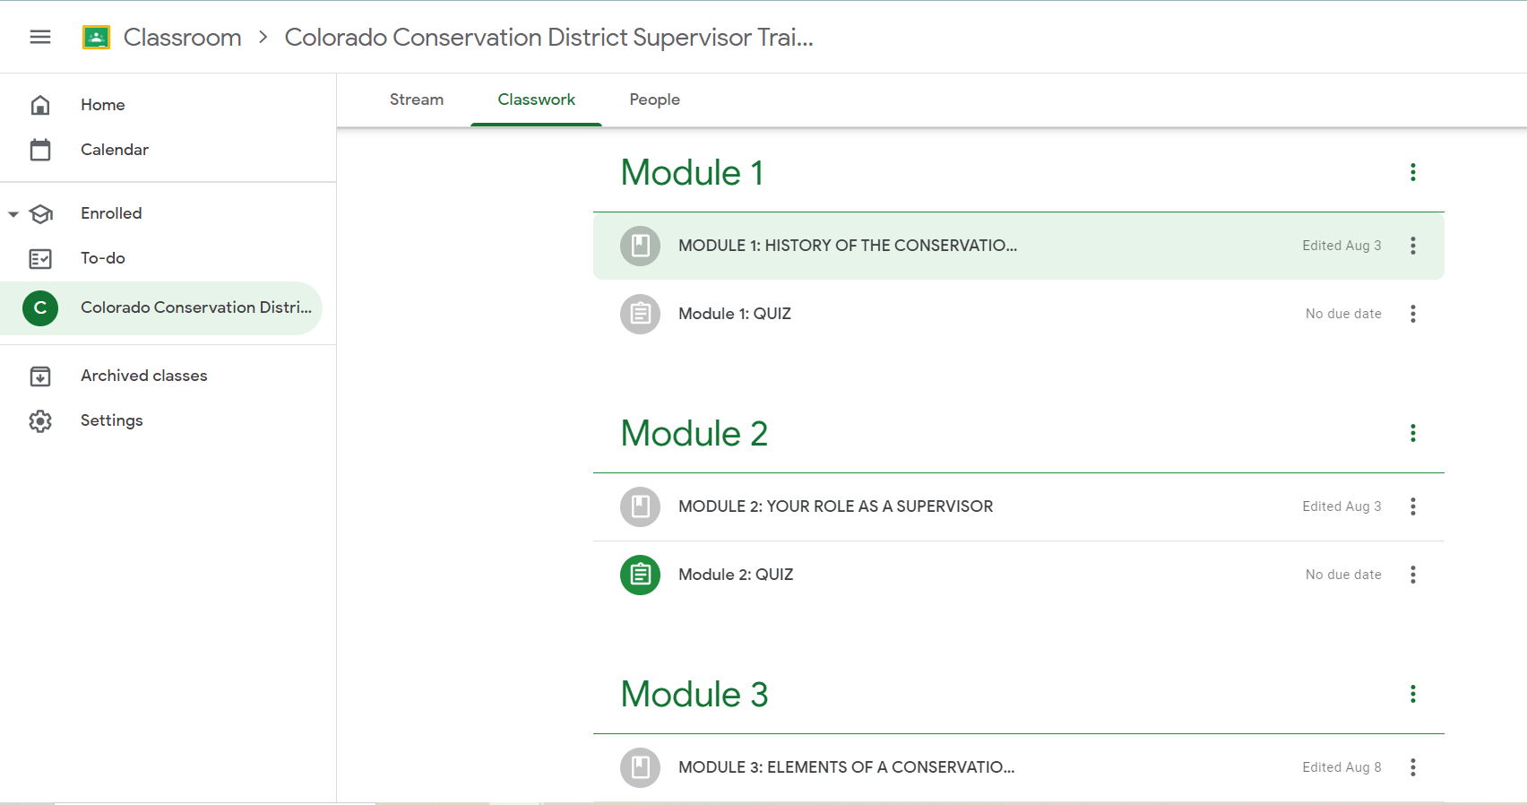
Materials to Support Success
New Curriculum Platform:
Google Classroom
Video recording for first time logins to reference
Written instructions for accessing curriculum
Including FAQ
Multiple formats for accessing content
Plain text PDFs of curriculum
Normal PDFs of curriculum
Upcoming: recording of field staff sharing curriculum presentations
Think of it as a podcast – perfect for the Conservation District Board Supervisor always on the go!
All of these will be available on our CSCB Conservation District Operations website.
Notes:
Reasons for using Google Classroom: CDA uses Google Workspace applications; Google powerpoints (Slides) and Google Forms for the quizzes work seamlessly with our internal applications; anyone with an email can access content; much more simple than the Moodle platform (which was built for a more intensive higher education class/curriculum).

Slide 9
Kayla Hladky
NE Regional Field Specialist
kayla.hladky@state.co.us
303-947-3334

