Slide 1


Customer Service &
The Customer Experience

Slide 2

Who am I?
Rakel Sanchez
Grants Manager for Colorado Department of Agriculture
Managing Grants PROS:
Managing grants is a rewarding job. I get to assist producers and conservation districts implement different projects across the state. I get to help them reach their conservation goals and make a difference on the land we all use and love.
I literally get to give out money.

Slide 3
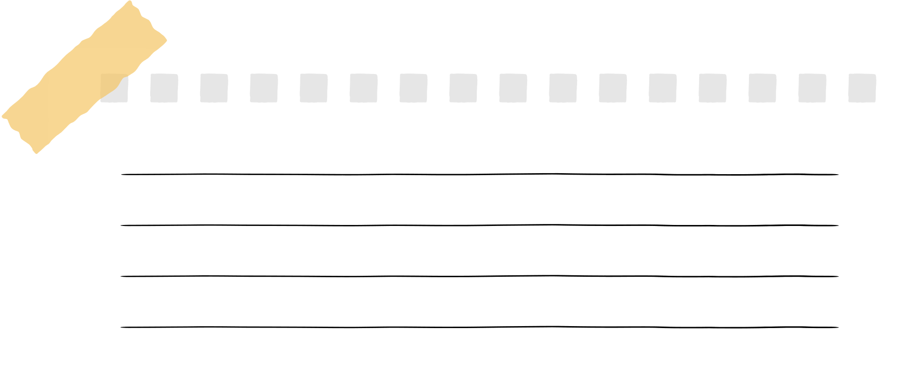
Managing grants cons:
rules! rules! rules!
As a grants manager there are a lot of rules. Depending on the funding source you must hold all your grant recipients accountable to whatever set rules there may be. I love rules. I don’t operate well in grey areas. But believe it or not, not everyone is like me. Being the one in charge of holding people accountable to the rules means having to have difficult conversations from time to time.
I’m here to show you that you can have difficult conversations while still delivering exceptional customer service.
X Rules
X Rules
X Rules
X Rules

Slide 4
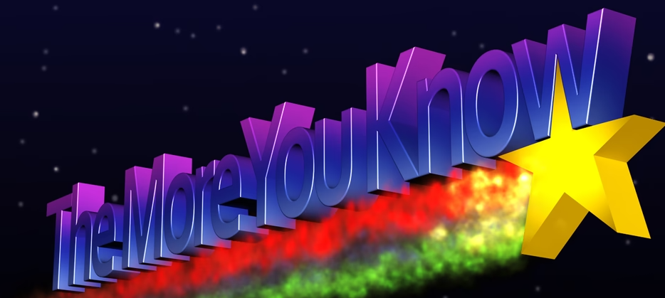
Customer Service
You know what it is. I know what it is. You’ve probably had good customer service. You’ve probably had bad customer service, but hopefully you can learn something new today from me.
cus·tom·er serv·ice
  the assistance and advice provided by a company to those people who buy or use its products or services.

Slide 5




Define your customers
Partners
Conservation Districts
Producers
Stakeholders
The person on the phone
with the wrong number

Slide 6


In short..... ANYONE!
Anyone can be a customer. Whether they are a future customer or a current customer they are having an experience with you. Even the person with the wrong number. One day they might need your services and they are going to remember how you made them feel. Even if it was only a brief encounter, treat everyone with respect

Slide 7


TOP TIPS!
Smile through the phone
Actively listen
The answer is never no
Go the extra mile
Own up to your mistakes
Empathy
Communication is key
The golden rule

Slide 8



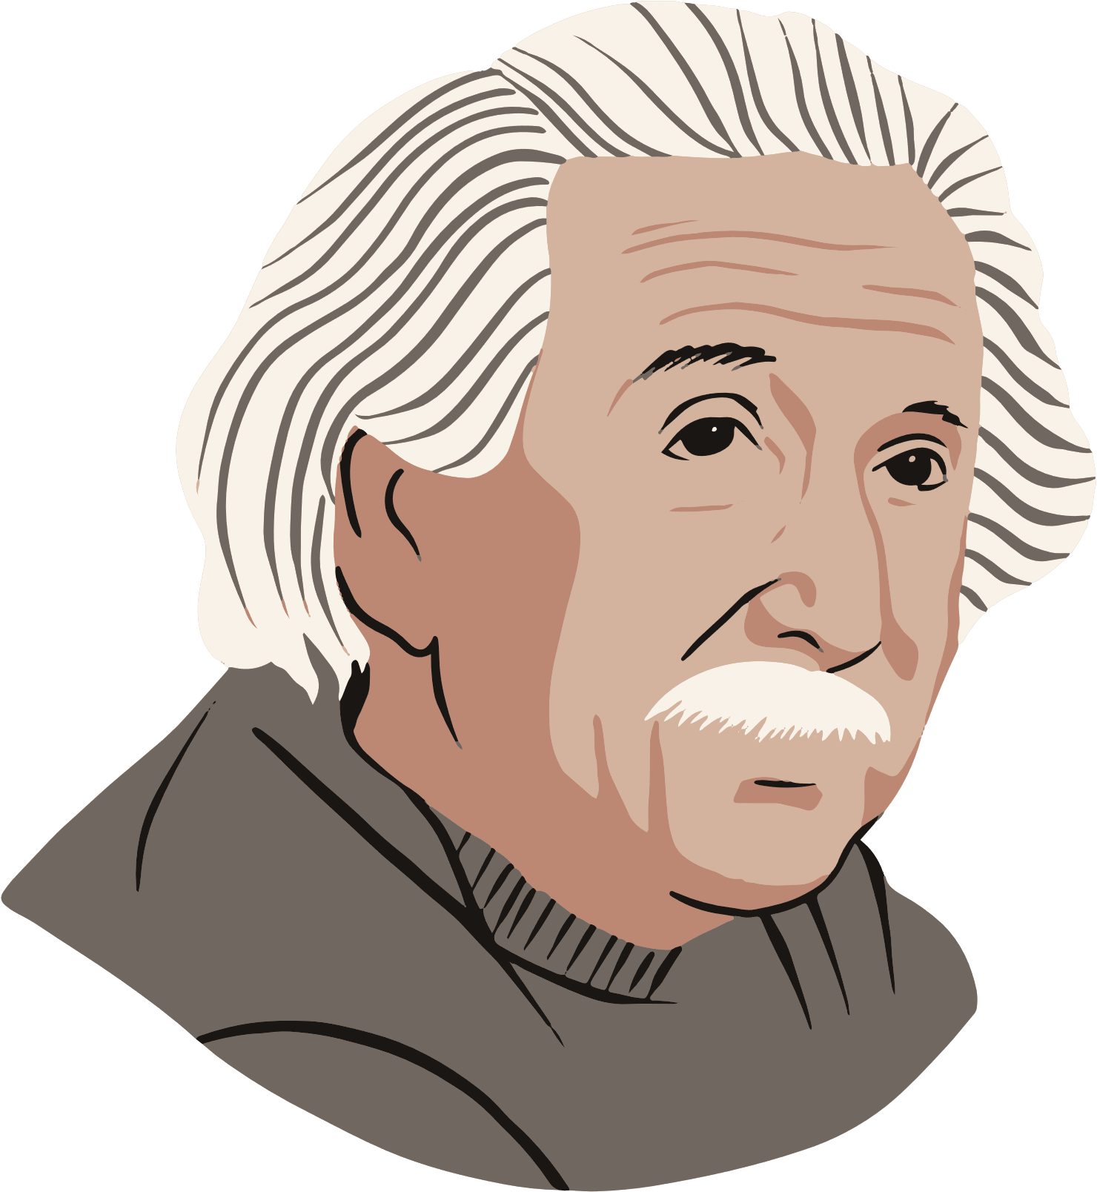
Smile through the phone..... or email
People can sense a smile though the phone
It sets the tone for the entire interaction
you get the energy you give
It puts the person at ease (and you)
Its Science
Smiling through the phone isn’t just for your customers. Its for you too. It's been proven that smiling boosts the individual's mood and attitude as well. Most of my correspondence is through email and emails have tone too. Don’t believe me? Ever got a text saying ‘K’ and you just knew there was a tone to it. Try to smile through your emails as well.

Slide 9
People want to be heard
Active Listening
Empathy
Communication
Own it
When someone is frustrated, they want to feel heard. Listen with intent and try to truly understand why they are frustrated. You might not be able to fix the problem but just showing that you care and empathize with the person can help them feel validated. Its all about tone. Think about a time where you felt frustrated about something that was out of your control. How would you want to have been treated. Put yourself in their shoes and be patient.
Did you make a mistake? Own it! People are humans and the majority will respect your ability to communicate ownership and apologize. Figure out how to make it right.

Slide 10
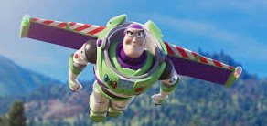
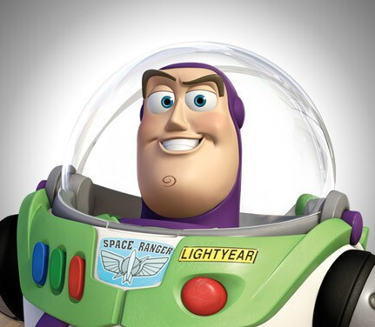
To infinity.... and beyond
The answer is never no
Go above and beyond
Ok, sometimes the answer is no. Especially when it comes to the RULES. But its never I don’t know. If you don't know the answer to something, find it. If you can’t help a person because they called the wrong department, guide them in the right direction. It might take a couple of extra minutes, but that person will not forget that you went above and beyond to help them.
How do I go above and beyond as a grants a specialist?
Notes:
Talk about different examples of going above and beyond like finding more match for producers. Or explaining the different processes. Or reaching out to people to explain new opportunities coming up.
Or how a producer said I was the 5th number they tried off the website (in my own department) looking for the soil program when someone in my department could have looked up the info and gave it to them and saved them all the trouble.

Slide 11
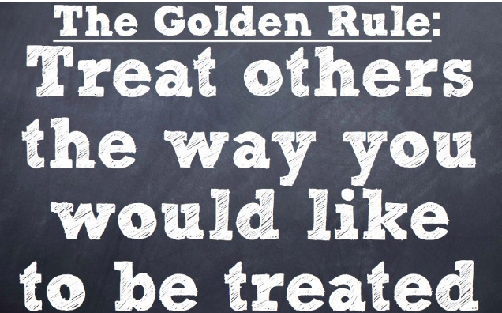
The Golden Rule
When in doubt follow the golden rule. Treat people the way you want to be treated. I’ve always taken it a step further and treated people the way I wanted my grandparents to be treated or my mother.
Notes:
Talk about different examples of going above and beyond like finding more match for producers. Or explaining the different processes. Or reaching out to people to explain new opportunities coming up.
Or how a producer said I was the 5th number they tried off the website (in my own department) looking for the soil program when someone in my department could have looked up the info and gave it to them and saved them all the trouble.

Slide 12



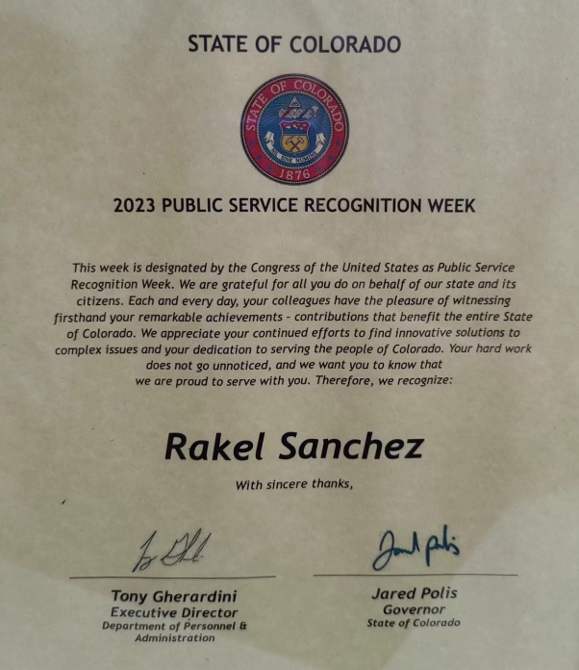
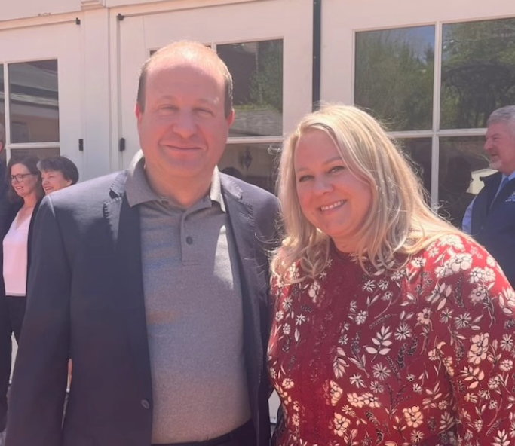
Thank you!
Rakel Sanchez
rakel.sanchez@state.co.us

