Slide 1
District Conservation Technician Program
Rakel Sanchez
District Operations Manager
Colorado State Conservation Board
rakel.sanchez@state.co.us
Garth Schaefer
Southeast Regional Field Specialist
Colorado State Conservation Board
Garth.Schaefer@state.co.us

Slide 2
District Conservation Technician Program Background
The Colorado State Conservation Boards (CSCB) District Conservation Technician (DCT) program was developed as a way to preserve and increase conservation technical assistance to landowners.
It allows the Conservation Districts to apply for 80% cost-share to employ technical staff to implement conservation practices/planning on Private Land
The technician is a district employee and all responsibilities and decisions about employment ultimately reside with District Board of Supervisors.
tate - only found JB in Denver

Slide 3
Eligibility Requirements
Districts must be in Statutory Compliance according to CSCB Standards. Districts are considered Statutory compliant once they have submitted the following documents
*budget *exempt from audit *election fillings *supervisors list *long range plan
Districts must have an active Unique Entity ID (UEI) with Sam.gov in order to receive federal funds
Districts must submit an application and budget that outlines all of the expenses, including match.
Applications are solicited in August for the following year, however if a district comes up with a need in the middle of the year they can reach out to the grant administrator

Slide 4
District Conservation Technician Program Funding Sources
TTT
The Colorado State Conservation Board (CSCB) currently has two separate DCT Programs made possible with the assistance of two different funding sources through NRCS.
Farmbill - 2003
Inflation Reduction Act (IRA) - rolled out January of 2024
We have a third technician program we are in the middle of rolling out through AmeriCorps called Working Lands Climate Corps.

Slide 5
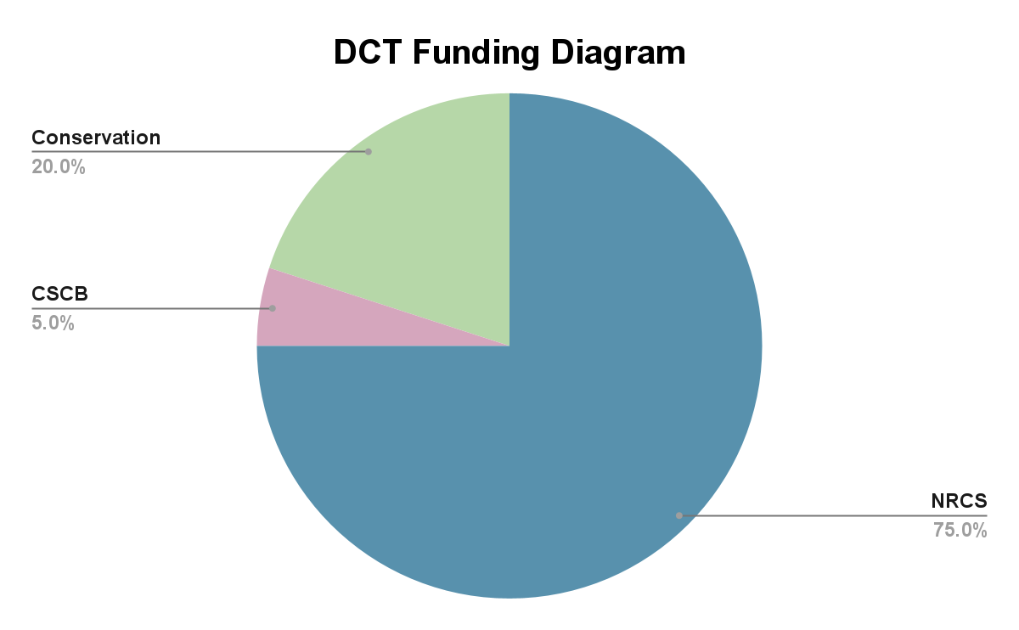
Technician Funding Breakdown
NRCS pays 75% of the technician Salary
CSCB pays 5%
CD’s pay 20%
The technician spends 80% of their time implementing conservation practices/planning activities
The technician can spend the other 20% of their time on technical projects at the districts discretion. Not administrative duties.

Slide 6
2024 IRA….By the Numbers
6
12
districts who haven’t been able to participate in the past
applications
$856,261
13.5
total budget submitted(for the first year!)
new positions funded

Slide 7
2024 Farmbill….By the Numbers
19
Conservation Districts
25.5
positions funded
1,436,752.00
Award Request (NRCS 75% and CSCB 5%)

Slide 8
Reporting Rules and Requirements for the District Conservation Technician Program

Slide 9
Technical Supervision
80% of the Technician duties are IRA or Farmbill-NRCS duties
NRCS helps provide training, computers, and access to vehicles at the Discretion of the NRCS Resource Team Lead
Technical Supervision
While working on NRCS projects, the District Conservation Technician works under the job approval authority of the NRCS state engineer
Allocation and supervision of daily workload is generally undertaken by the field office NRCS RTL.
The board may or may not allocate specific times when the technician is to work on technical duties not related to NRCS technical assistance (which cannot exceed 20% of the technician’s time).
Notes:
The District must have adequate insurance coverage in order for the DCT to be able to use the NRCS vehicles or four wheelers.

Slide 10

Specific activities related to the DCT agreement with NRCS will address:
Greenhouse gases
Climate smart activities- Soil conservation, Water etc.
Ag Forestry
Planning and Outreach.
Allowable activities for District Technician 20%
Includes activities such as providing technical assistance to District programs (not program management)
Preparing and delivering technical information/workshops to landowners (not event management for programs)
Writing technical parts of grants (not general grant writing), etc.
These positions are not for administrative duties.
Notes:
the district manager cannot be the DCT

Slide 11
The DCT is a District Employee
Administrative Supervision
The Technician is a District employee. Although these technicians work closely with NRCS, they are not NRCS employees, nor would they be working in the districts community without the business and financial investment of the District.
The District is solely responsible for hiring and terminating. They are responsible for Administrative Supervision of the DCT
The NRCS CANNOT participate in the interview process
The District must notify the CSCB Grants specialist with start dates and termination dates within one week
The DCT must always introduce themselves as an employee of the conservation district whether its on the phone or in person meeting with a landowner
Part of their position is raising awareness for the conservation district
Notes:
It is important that the District Board, the district manager, the NRCS Resource Team Lead (RTL) and the technician are clear on parameters such as decision authority and procedures around leave requests, sick time, overtime, and grievances.

Slide 12
Reporting Requirements
The Districts are required to submit short quarterly reports using a template that we provide them on our website. The district has 15 days after the quarter ends to submit their report.
Each quarter the district must report:
The number of hours the technician worked.
Date of any performance evaluations (enter “NONE” if none performed)
Work duties and hours not related to NRCS Farmbill/IRA/CTA-01 planning or practices – e.g., writing or presenting technical information for newsletters or events; providing technical conservation advice for tree or seed sales; sub-division reviews, etc.
Training received (if any) by technician(s) [hours and type of training]
Number of board meetings held, and number attended by technician(s) – must be minimum of half of meetings held each year.
Notes:
attend at least half the board meetings each year, but we prefer half the board meetings held each quarter

Slide 13
Publicity Efforts
A secondary goal of the program, after providing conservation technical assistance, is to
promote awareness of conservation districts. With this awareness comes recognition by
communities and potential district sponsors such as county commissioners or local
businesses.
We require the district to generate a minimum of 2 publicity efforts and include copies in their quarterly reports. CSCB envisions these publicity efforts as:
Press release to local papers, publications, radio
Article or Powerpoint show in District newsletter and/or web site
Article for other publications – such as The Conservator, CSCB the Scoop etc.
Presentation of DCT or done by the DCT at meetings
Poster in District office or local businesses
Poster on District display at events or public places
Social media stories regarding accomplishments of the DCT for the district
Notes:
not only are they introducing themselves as district employees and act as ambassadors for the districts but we have an opportunity to highlight their success stories through publicity efforts. A lot of my farm bill districts submit more than the minimum. Some are harder to get to do the minimum.

Slide 14
Match
NRCS has allowed the Districts to use both Cash Match and In-kind Match in helping pay for the technicians salary for the IRA-DCT Program. Districts can only use Cash Match for the Farmbill program.
Cash Match Examples:
Technician salary
Technician salary taxes, Social Security, Medicare, PERA (employer portion only)
Workers’ Compensation and unemployment insurance deductions
Technician health and retirement benefits (employer and employee portion)
Technician training costs (see training section for more information on allowable training)
Technician travel costs – cost of vehicle insurance/non-owned and hired auto rider coverage*, occasional IRA-DCT personal mileage paid.
District-owned building office space and overheads – provided no rental income gained from the building. Maximum of $2,000/yr. for a full-time position
Technician/grant administration costs*- at flat rate defined by the CSCB and must also be documented on the Reimbursement Request form.
Technician position advertising expenses
Contracted payroll services (must be attributable directly to the IRA-DCT program)
Technician communication costs directly attributable to the technician position only

Slide 15
In-Kind Match
NRCS allowing In-Kind match has given us the opportunity to get districts who might not have had the funds in the past to participate. In-Kind match is the calculated monetary value of non-cash contributions that support programmatic work. It is typically in the form of personnel, goods, and services, including direct and indirect costs.
In Kind Match Examples:
Volunteer Hours
Equipment
Communal/shared utility costs.
Communal/shared equipment use costs.
Board member technician supervisory time (not actual cash cost).
Communal/shared insurance costs such as general liability.

Slide 16
2025 Projections

Slide 17
2024 |  |  | 2025 |  |  | Variance
Farmbill |  |  | Farmbill |  |  | Farmbill
Award Requested | technicians |  | Award Requested | technicians |  | Award Requested | technicians
$1,436,752.00 | 25.5 |  | $1,502,942.00 | 26 |  | $66,190.00 | 0.5
IRA |  |  | IRA |  |  | IRA
$684,856.00 | 13.5 |  | $793,199.00 | 14.5 |  | $108,343.00 | 1

Slide 18
Building Capacity
“We as DCTs help the NRCS and Conservation District get programs out the door and back to the producer efficiently and effectively.”
~Milkayla Sharpe, DCT for Baca County Conservation District

Slide 19
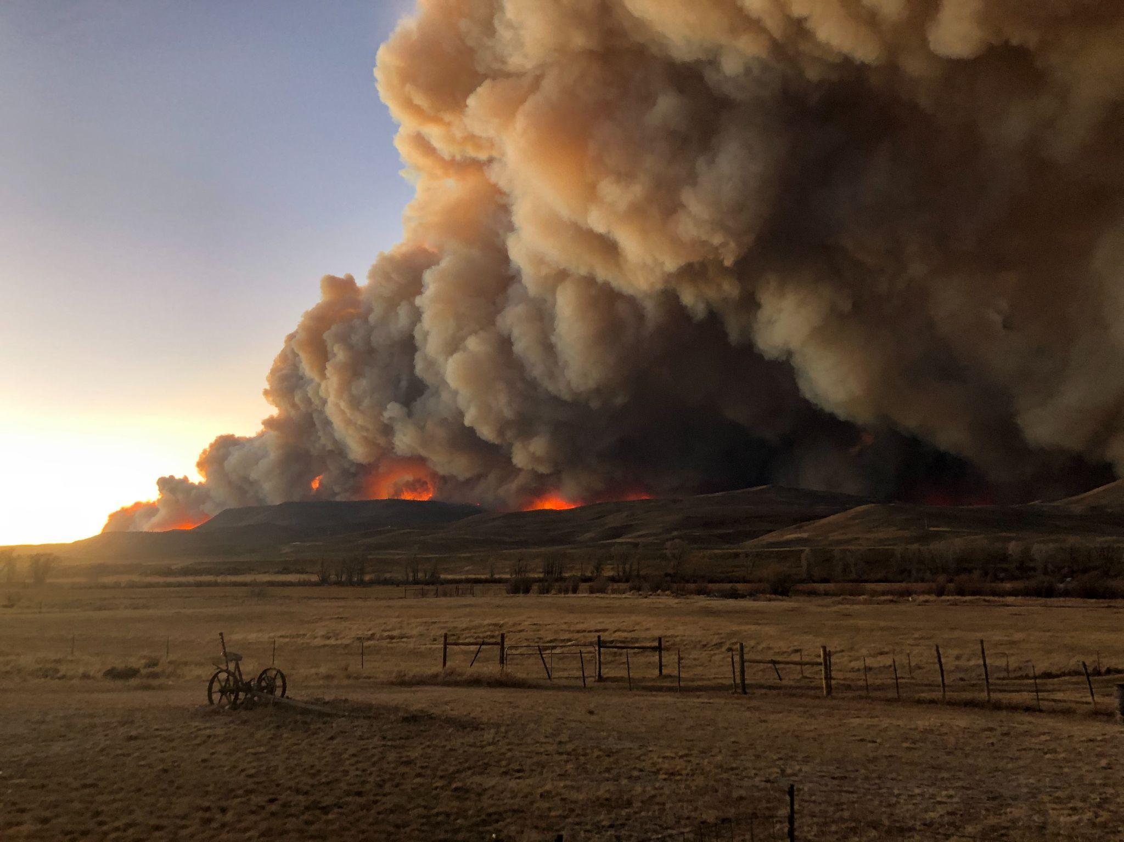
Conservation Forestry
Success
“The DCT program is the backbone of our conservation forestry work”
~Garrett Stephens, Director of Jefferson Conservation District

Slide 20
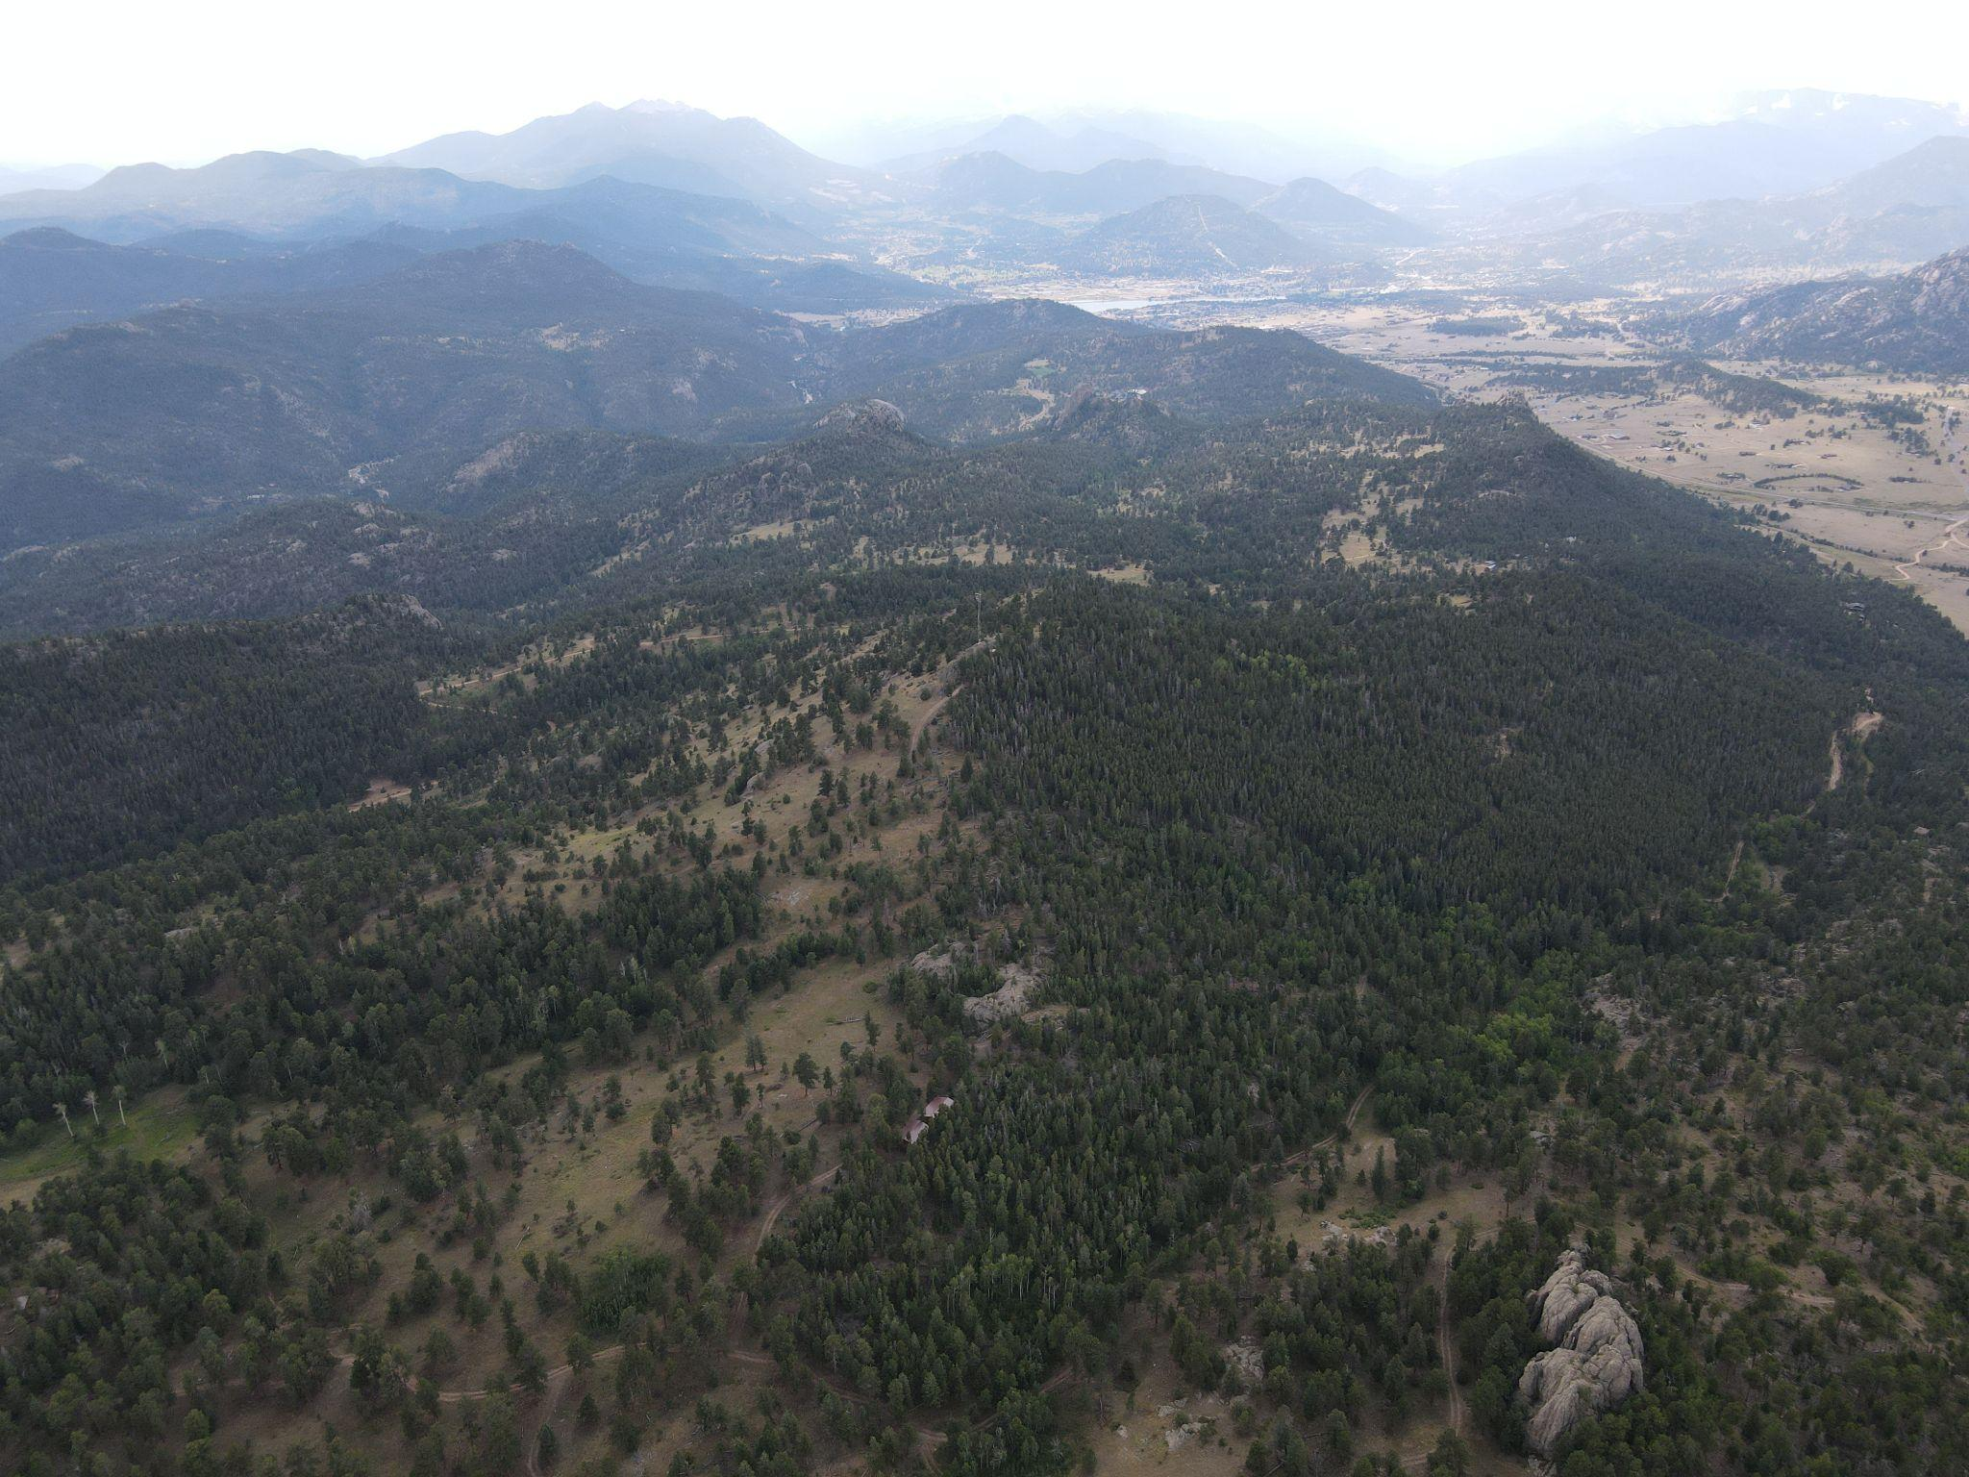
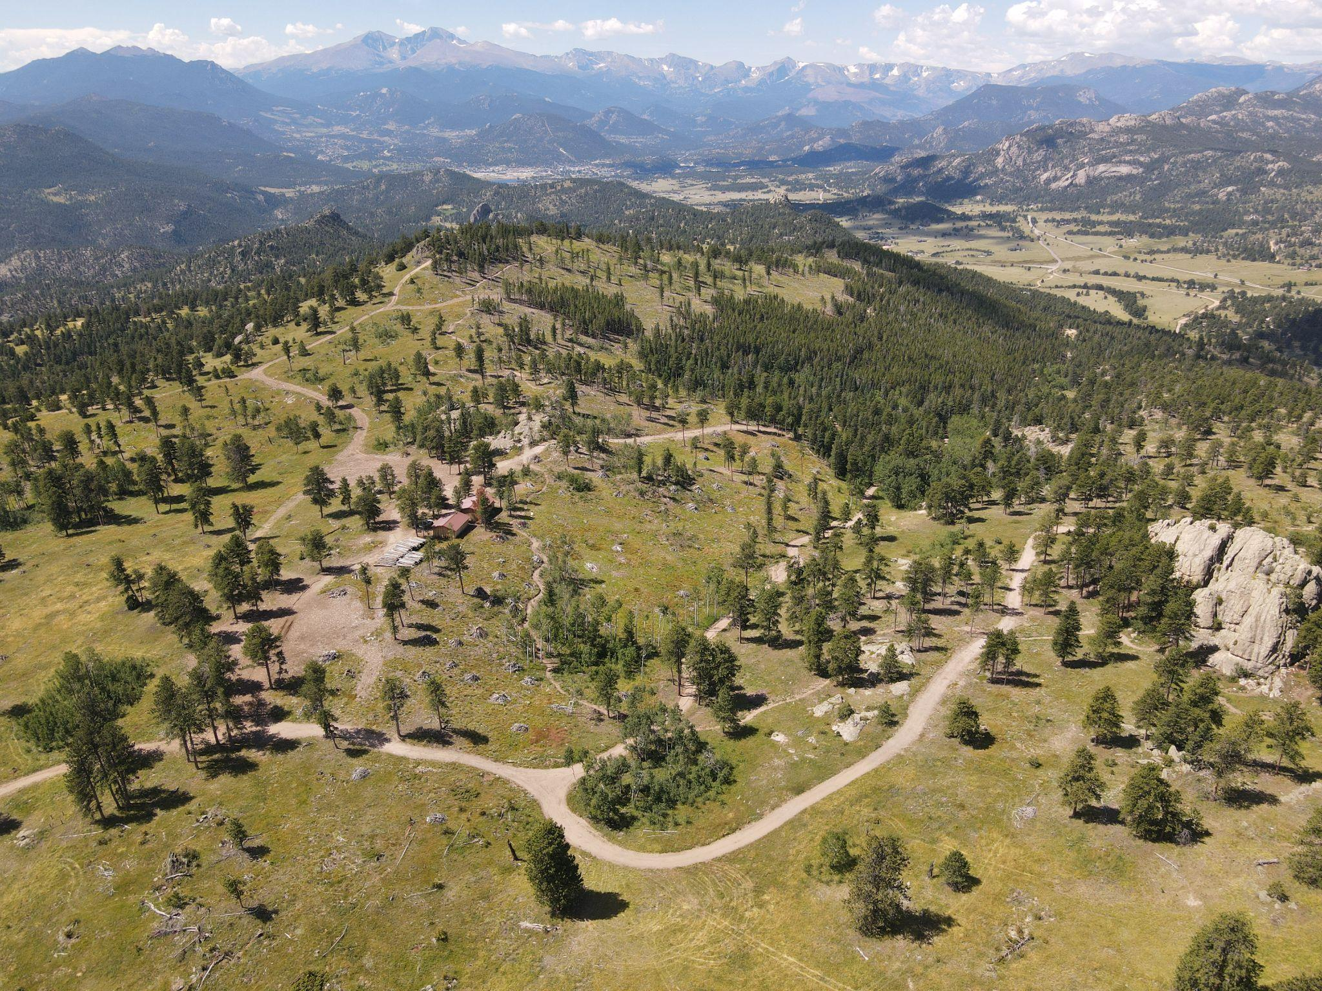
Jefferson and Larimer Conservation Districts
After several large fires in the 1990s/2000s, NRCS started funding forestry projects.
JCD and LCD identified a resource need: fire mitigation for forest landowners.
Focus on multi-benefit resource concerns: forest health, wildlife, grazing, and wildfire mitigation.
Not a traditional NRCS agriculture program…
Before
After

Slide 21
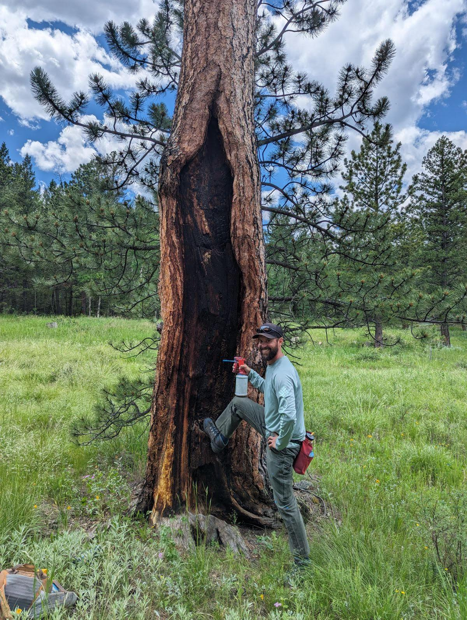
Forestry Landowners
Many landowner don’t know how to go from a plan to implementation.
Districts utilizes DCT foresters throughout the process from planning to implementation.
The district hires and manages forestry contractors and pursue additional funding to match grants.
Gets NRCS funding on the ground.

Slide 22
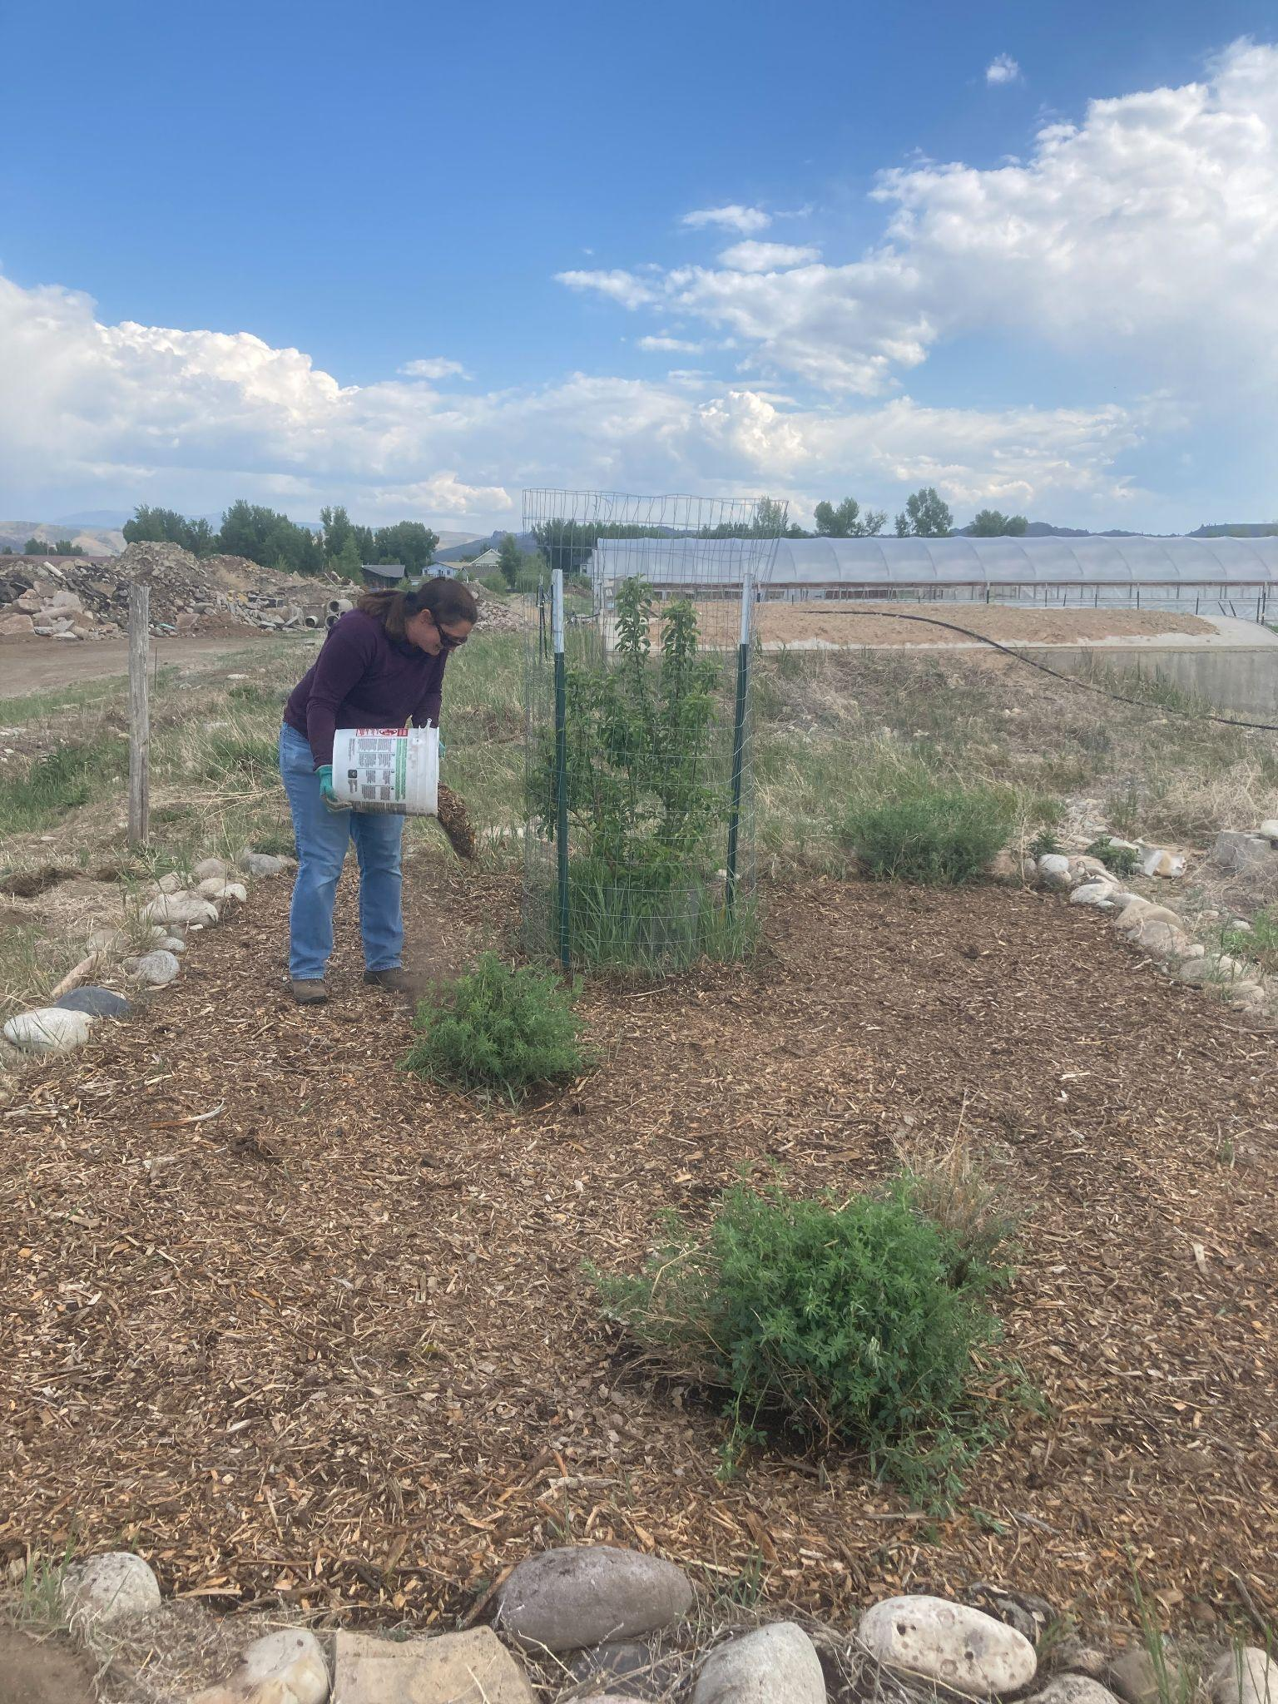
DCTs + Conservation Districts = On-The-Ground Conservation
“Districts are more nimble and responsive to local landowner’s needs than the federal system, allowing flexibility and opportunity for accomplishing conservation on the ground in a timely and innovative manner.”
~Aleshia Rummel, DCT for Gunnison Conservation District

Slide 23
Challenges

Slide 24

Partnerships
The 80/20 split of DCT time between NRCS and the district is challenging if their goals are not closely aligned.
NRCS is not as nimble; requirements around computers, vehicles, and training.
DCTs may sometimes have a preference for one organization’s work over the other.
NRCS unable to participate in interview process

Slide 25
Thank you!
Rakel Sanchez
District Operations Manager
Colorado State Conservation Board
rakel.sanchez@state.co.us
Garth Schaefer
Southeast Regional Field Specialist
Colorado State Conservation Board
garth.schaefer@state.co.us

