Slide 1



Program Overview
Mike A. Guess
Water Use Registration
Program Coordinator

Slide 2


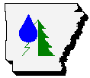




History of Water Registration in the State of Arkansas
Water-use registration began in the 1950’s
The current registration program began in 1985
The program is administered by the Natural Resources Division (NRD) of the Arkansas Department of Agriculture
Through the cooperation of various local, state, and federal agencies the Water-use Registration Program has become one of the country’s most comprehensive inventories of site-specific water usage data from more than 55,000 surface and groundwater withdrawal points

Slide 3

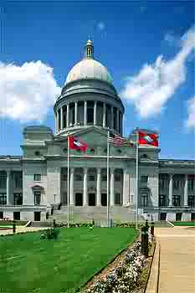
The Laws and the Rules & Regulations
Arkansas codes pertaining to the Water-use Registration Program: § 15-22-205, § 15-22-215, § 15-22-301, § 15-22-302, § 15-22-913, § 15-22-914, & § 15-22-915
Title III – “Rules for the Protection and Management of Ground Water”
Title IV – “Rules for the Utilization of Surface Water”

Slide 4
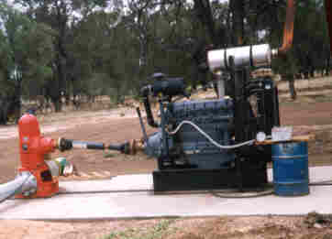
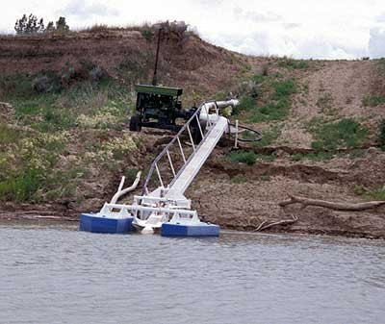
Withdrawals that Need to be Registered
Any non domestic under ground water withdrawal (well or natural spring) that has the potential of 50,000 gallons a day (35 gpm flow rate) should be registered
Any surface water withdrawal, that is not from a pond/lake in the exclusive ownership of one person, not diffused surface water, or not recirculated surface water, that withdrawals 1 acre foot or more a year (325,851 gals) should be registered

Slide 5
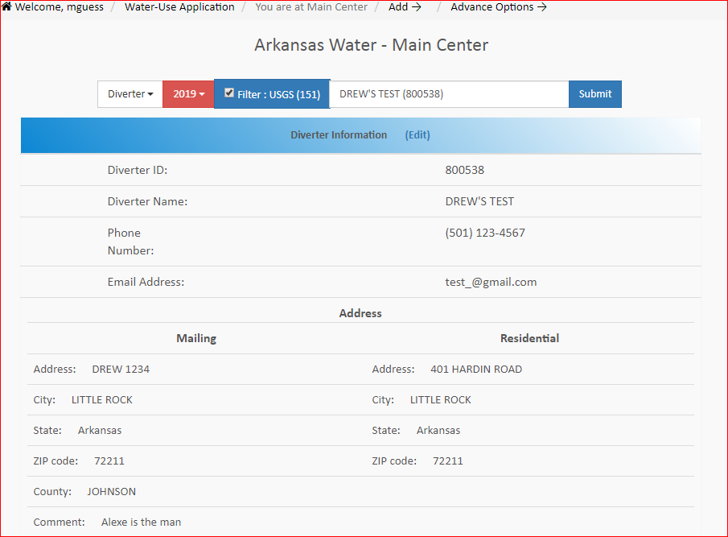
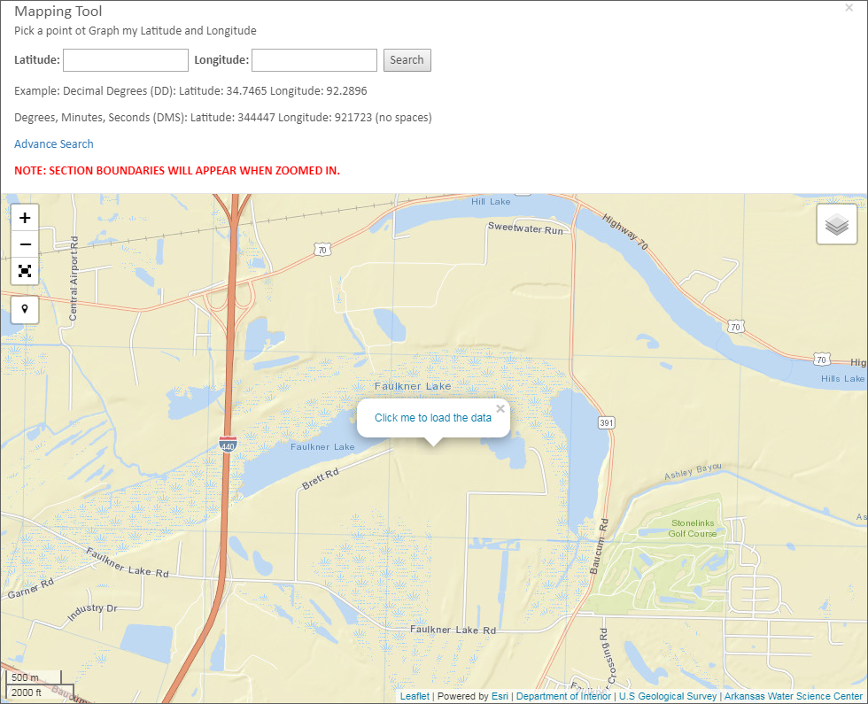


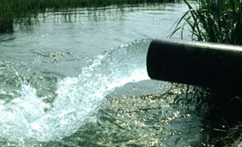
Information That is Required
Contact information: name, address, etc… of water user and/or land owner
Location of withdrawal: latitude & longitude and legal description
Pump information: type, horsepower, etc…
The type and use of the water withdrawn
Monthly and annual withdrawal amounts

Slide 6
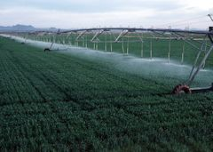
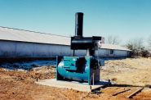
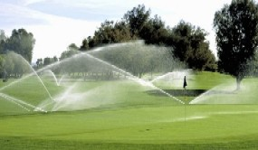
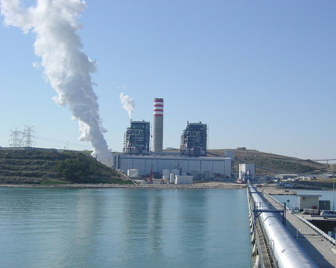
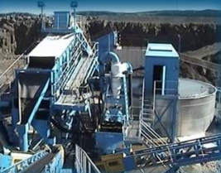
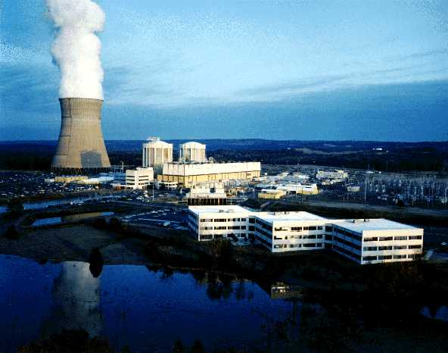
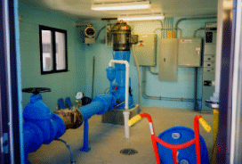
Types of Registered Water Users
Agricultural Usage
Irrigation
Agriculture
54,000 Withdrawals
1700 Withdrawals
Non Agricultural Usage
Commercial
Industrial
120 Withdrawals
195 Withdrawals
Mining
Power Supply
915 Withdrawals
55 Withdrawals
Water Supply
940 Withdrawals

Slide 7
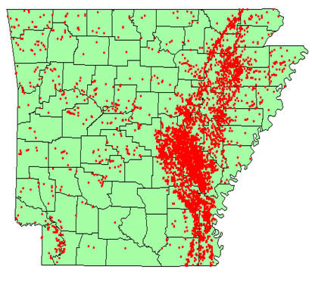
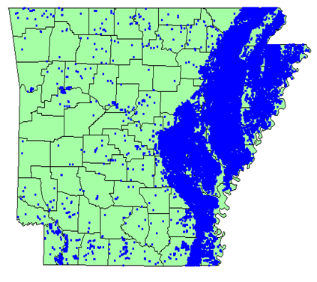
Registered Withdrawals
Surface water: 7,400 sites
Ground water: 49,800 sites
3.4 b. gal./d. Withdrawn
7.2 b. gal./d. Withdrawn

Slide 8


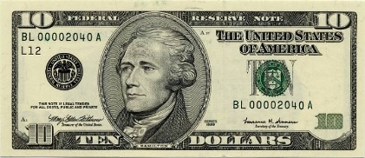

Natural Resources Division Responsibilities
Inventory the surface and ground water resources by registering water users, each year from October 1 thru March 1
Collect from water users a registration fees of $10.00 per withdrawal site
Contact and collect penalties from delinquent water users (water users that fail to report and/or pay fees before March 1 registration deadline)
Delegate authority to those other agencies and organizations that assist with the registration program
Provide assistance and training to those organizations that assist with water-use registration

Slide 9

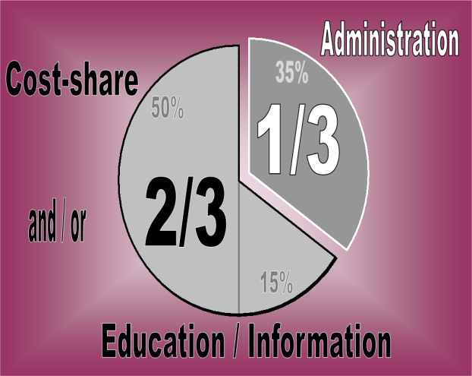
Commission’s Allocation of Registration Fees
Fees and penalties collected by the ANRC are deposited in the Arkansas Water Development Fund
Two-thirds (2/3) of all funds deposited shall be used for an education and information program and/or cost sharing for water conservation and development
The remaining one-third (1/3) must be used for the administration costs

Slide 10
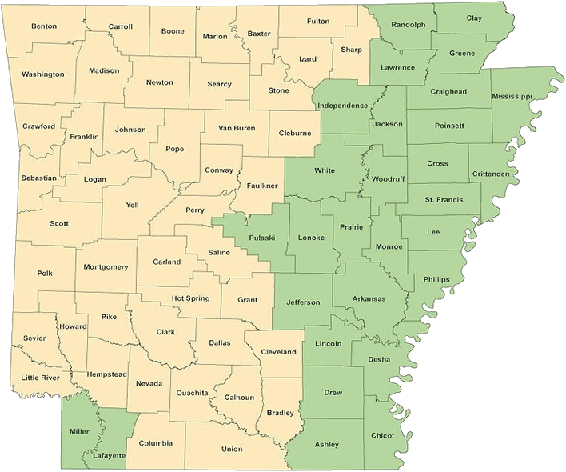
Arkansas Association of Conservation Districts Responsibilities
Through a cooperative agreement with NRD
Required to allocate registration money the same as NRD
29 districts register agricultural water users in their district
Enter information directly into the registration data base through the data entry website
Keep half (1/2) of all registration fees and two-thirds (2/3) of penalties in the their district
Districts in green participate in the Water-use Registration Program

Slide 11
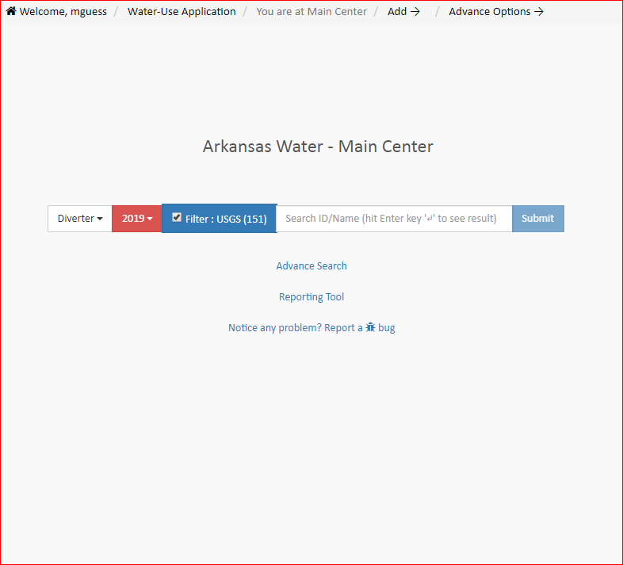

U S Geological Survey Responsibilities
Through a cooperative agreement with NRD
Develop and maintain the water-use registration data base
Develop and maintain the website data entry program in which all registration data is entered into the data base
Provide assistance and training to all of those who use the data entry website

Slide 12



Natural Resources Conservation Service Responsibilities
Provides Internet connection to some of the conservation districts that participate in the Water-use Registration Program
Provides office space to the districts
Provides a computer to certain districts to enter registration data on the data entry website

Slide 13

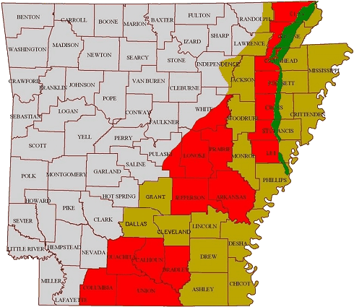
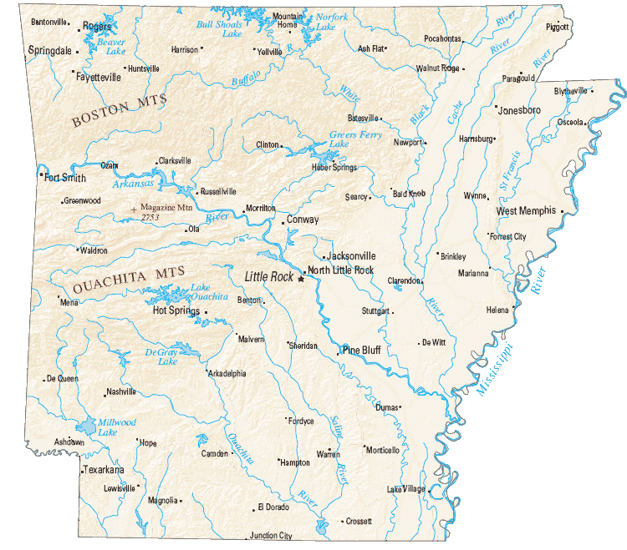
How Registration Data is Used
NRD Uses of Registration Data
Ground water data is used:
To help develop comprehensive ground water protection program
To help designate critical ground water areas
To help establish ground water rights within critical areas
Surface water data is used:
To help allocate water in times of shortages
As a basis for determining the state’s overall usage
As Water needs for inclusion in the Arkansas Water Plan

Slide 14
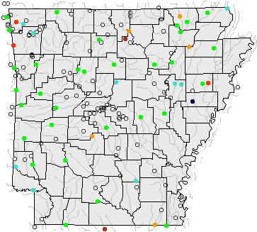
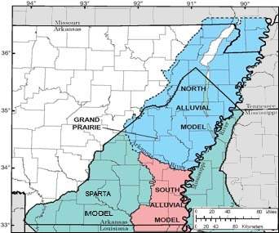
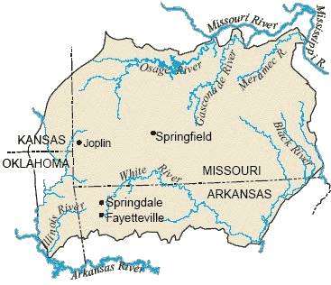



How Registration Data is Used
USGS Uses of Registration Data
Ground water flow model input
River assessment (White River)
Water level program – potential study sites
NAWQA – determination of potential sample locations
Data Provided to Others:
US Forest Service – identify water users in major forests
NPS – Flow data for Hot Springs and other areas of the State
USACE – Flow data for model input
Data is provided to numerous other organizations as requested

Slide 15
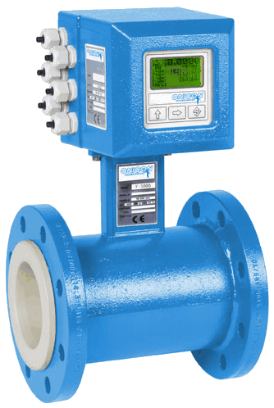
Benefits to Registered Water Users
Cost share program to help off set costs for water conservation practices, up to 40% (Example: land leveling, flow meters, poly pipe, ditches, etc…)
Registered ground water users have the benefit of being grandfathered, if they are in an area that is declared a critical ground water area (A three year history of registration records is required)
Registered surface water users are insured a precedence to water over a non registered water user, in times of allocation
If a registered water user is involved in a legal dispute over water they will have a better position over a non registered water user

Slide 16
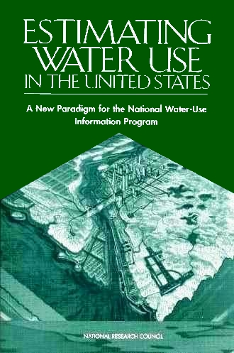

Summary
Arkansas’ Water-use Registration Program provides protection to insure that the state’s water resources are here for everyone to use for centuries to come
Arkansas’ Water-use Registration Program is so successful because of the efforts and cooperation of all of those involved. This includes all the users that accurately report their withdrawal information and water usage
For more information contact:
Mike Guess; Water Use Registration Program Coordinator
Natural Resources Division
101 East Capitol Avenue, Suite 350
Little Rock, AR 72201
Phone: (501) 682-3966
E-mail: mike.guess@arkansas.gov
Website: https://www.anrc.arkansas.gov/

