Slide 1
The Field Staff’s Guide to the Galaxy
How to Navigate Problems, Personalities, and Program Implementation
Nick Richardson

Slide 2

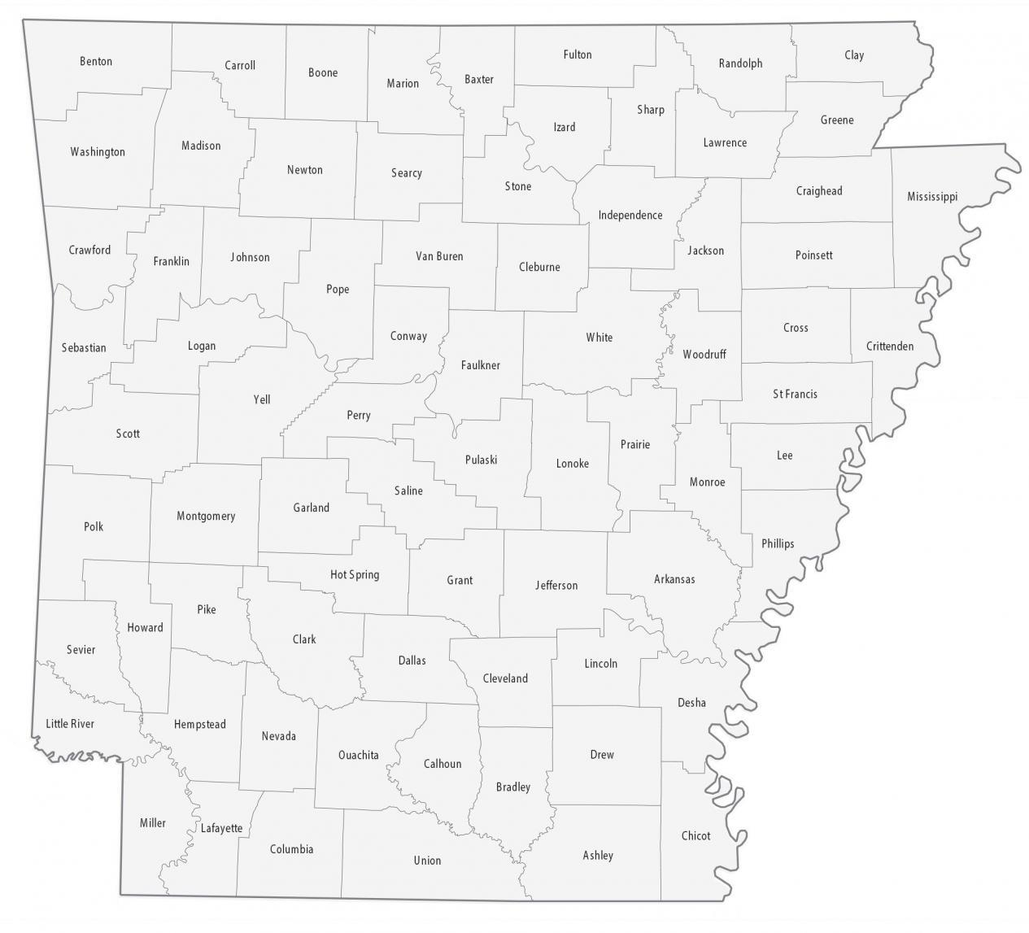

Slide 3
Problems
Vehicle Maintenance, Audits, Legislative Changes, Theft, Scheduling, FOIA Requests, Technical Difficulties, Reporting, Deadlines, Rule Changes, Wildlife, Funding, Applications, Memorandums, Flat Tire, Meeting Times, Board Meetings, End of Year Reports, Formatting, File Types, Well Water Usage, GIS Registration, Insurance, Names, COVID, Communication Issues, Lack of Training, Employee Burnout, Conflict Resolution, Work-life Balance, Workload, Office Politics, Outdated Technology, Resistance to Change, Accountability, Difficulty, Illiteracy, Laziness, Triage, Network Issues, Miscommunication, Water Quality Technicians, Training, Sams Numbers, Federal Paperwork

Slide 4
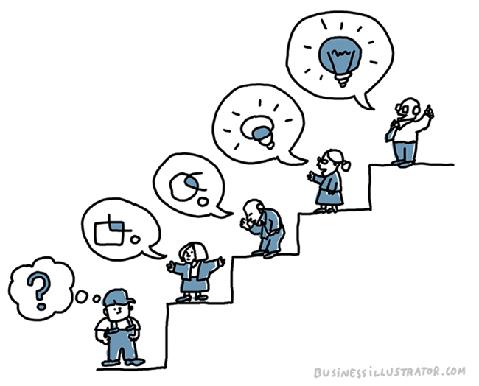
Communication
Legislation
Conservation Partnerships
Internal

Slide 5

Legislative Changes
The Legislative session of ’23
Altered Title 2
Rules Governing Conservation Districts
8 pages of rules removed
“Let me know if I’m doing something wrong”

Slide 6



Conservation Partnerships
NRD (Natural Resources Division)
AACD (Arkansas Association of Conservation Districts)
AACDE (Arkansas Association of Conservation District Employees)
NRCS (Natural Resources Conservation Service)

Slide 7

Internal
Monthly Field Staff Round-up
Shared Microsoft Teams folder
Specialization

Slide 8
Triage
Good
Bad
Ugly
“Keep your Sanity”
Determining which Districts and Programs need your attention
“Fires to put out”

Slide 9
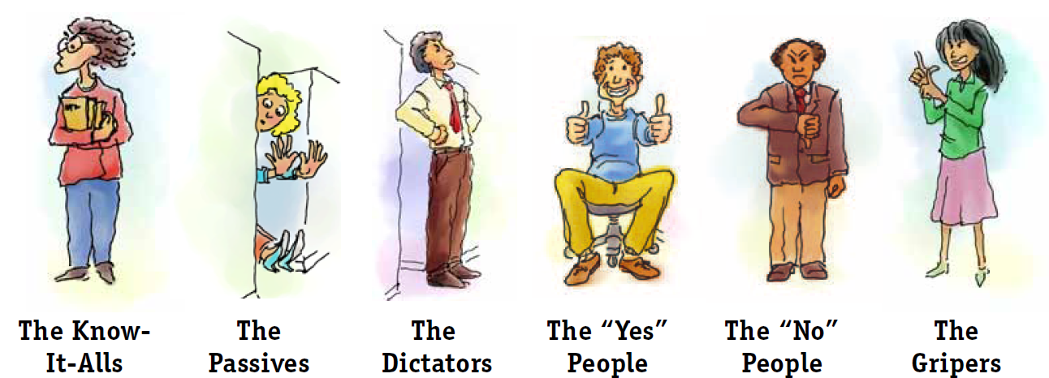
Personalities
75 Conservation Districts
5 Board Members Each
1 Employee Minimum
450 Different Personalities

Slide 10

Secret Weapon
In Arkansas, any writing, sound, or video that reflects the performance or lack of performance of an official function is considered public record and can be subject to FOIA
Minutes and recording required for all board meetings
If they continue to lack decorum:

Slide 11
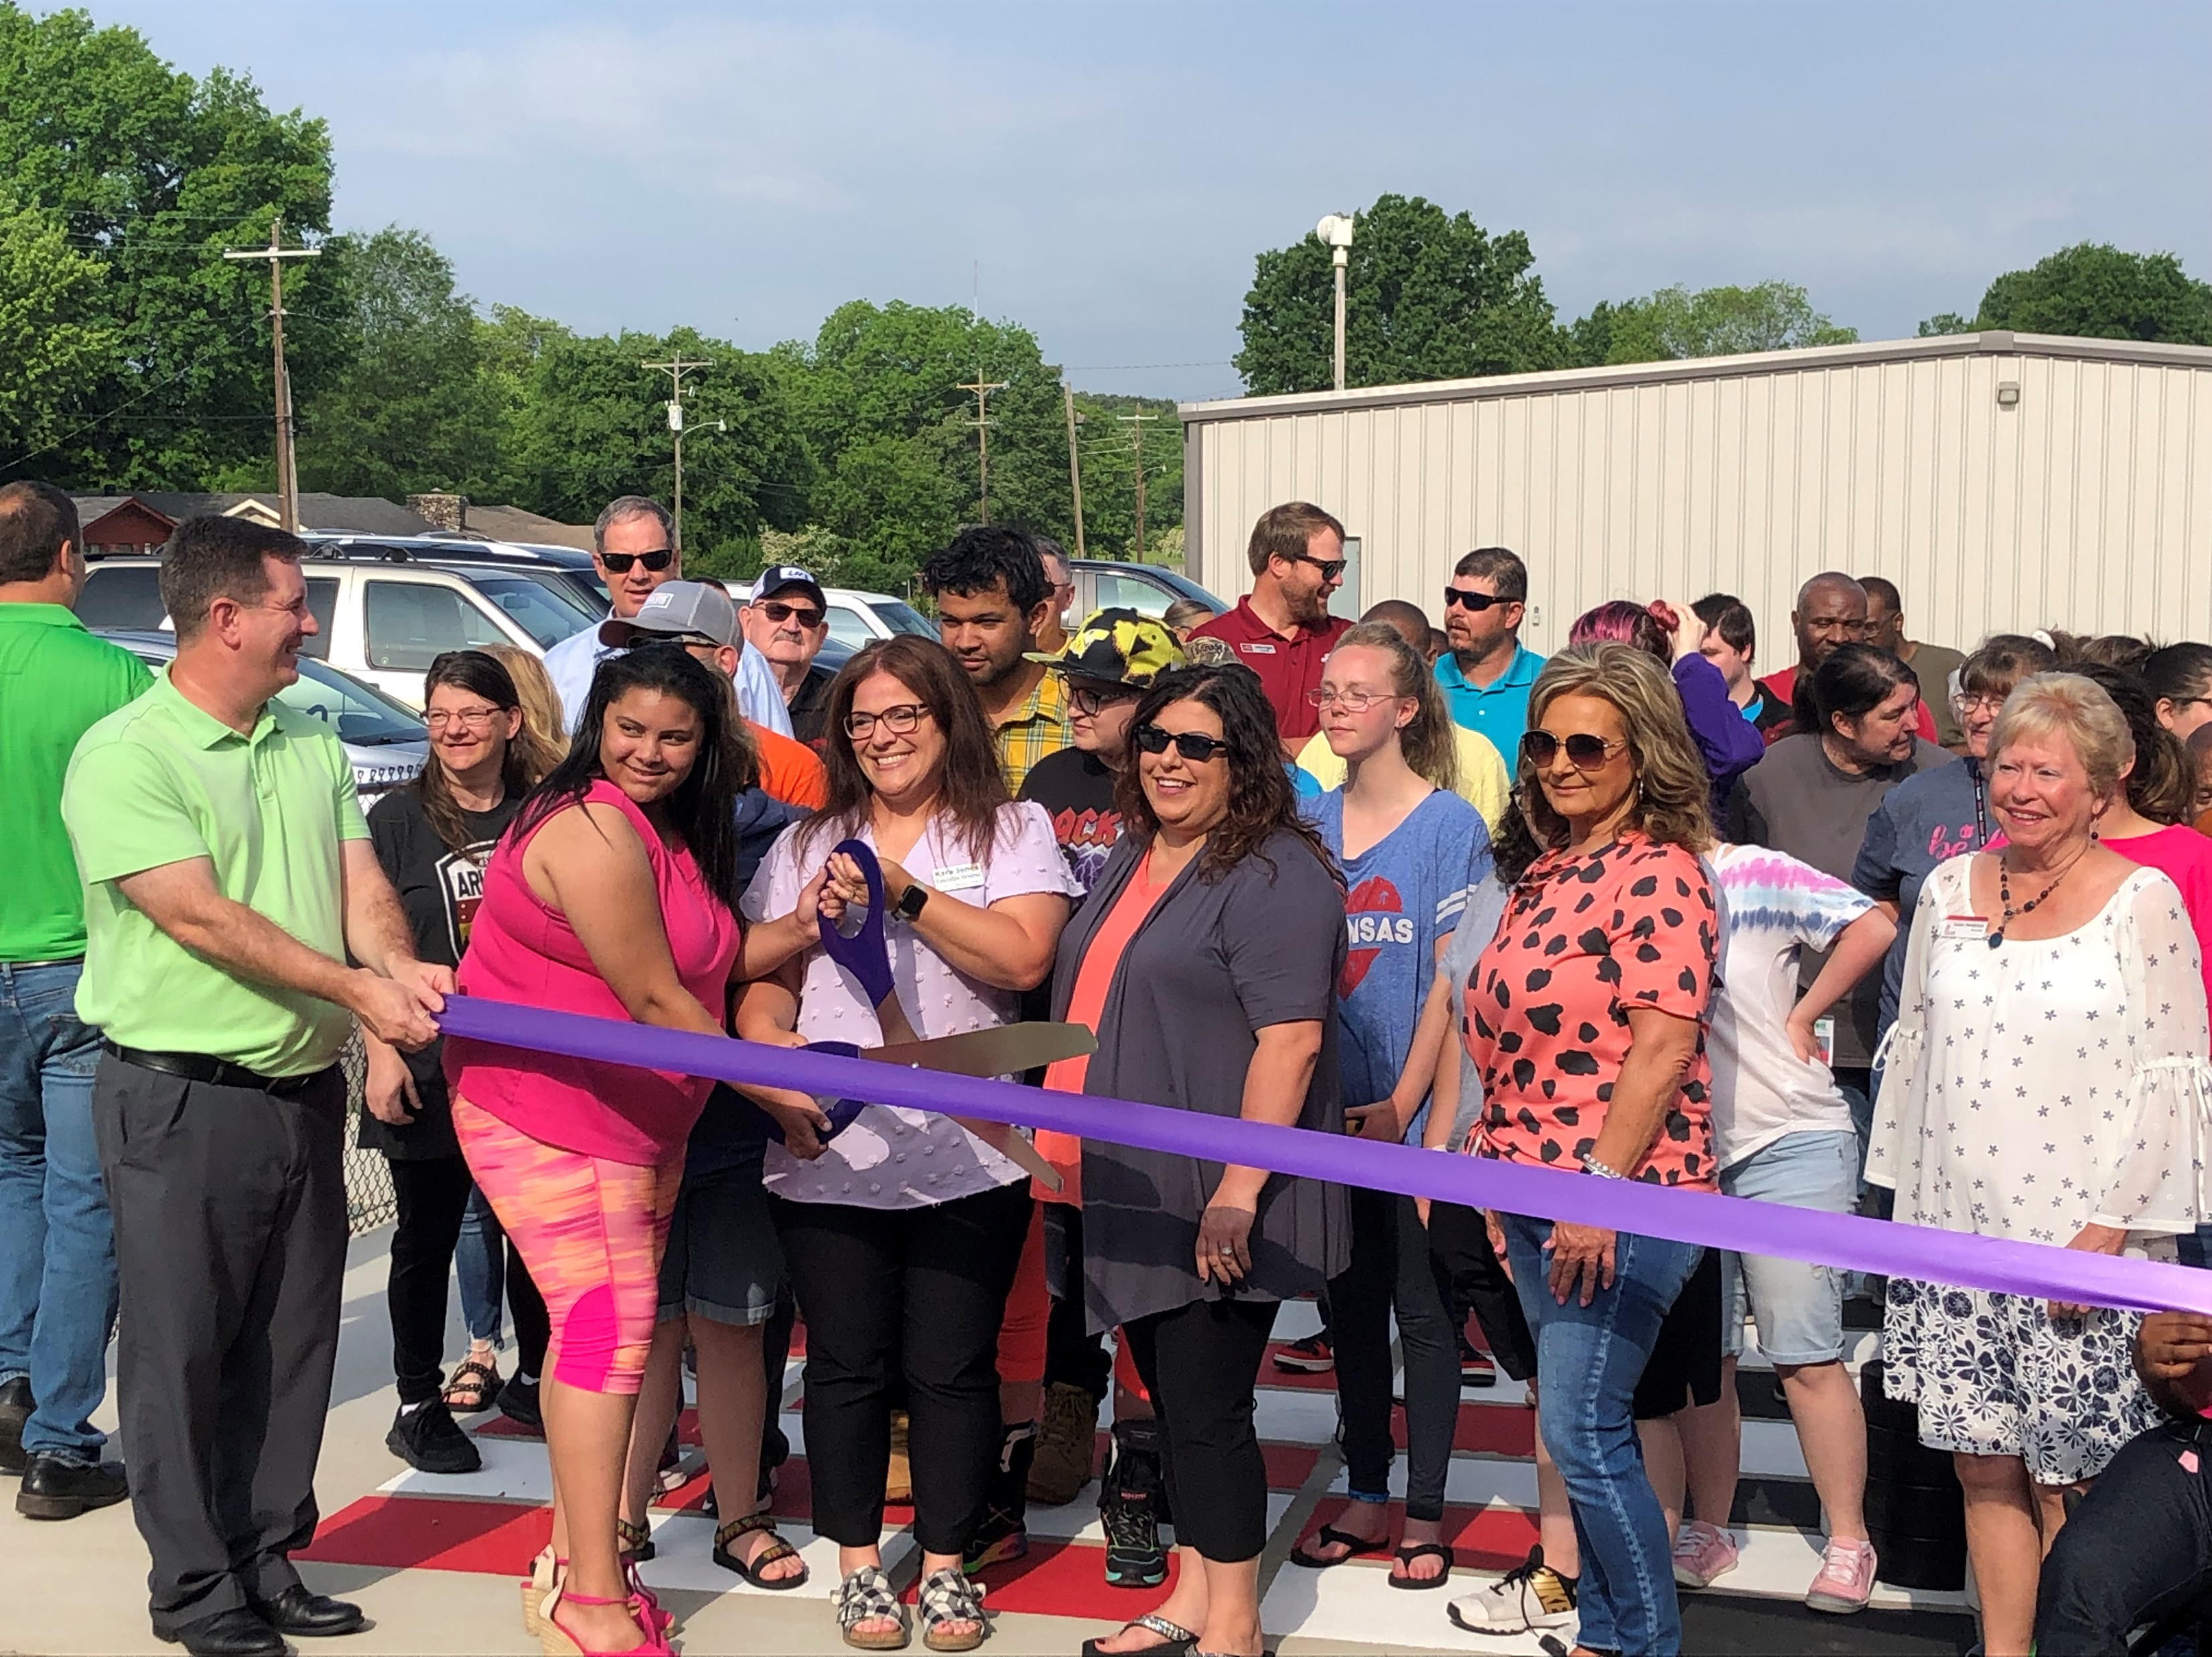
Program Implementation
State Grants to Districts
Application Ranking
Quarterly Activity Reports

Slide 12
Application Ranking
Developed a ranking criteria
Anonymous ranking to prevent bias
Ranking committee recommends funding based on ranking criteria and feasibility
Commission approves recommendations

Slide 13
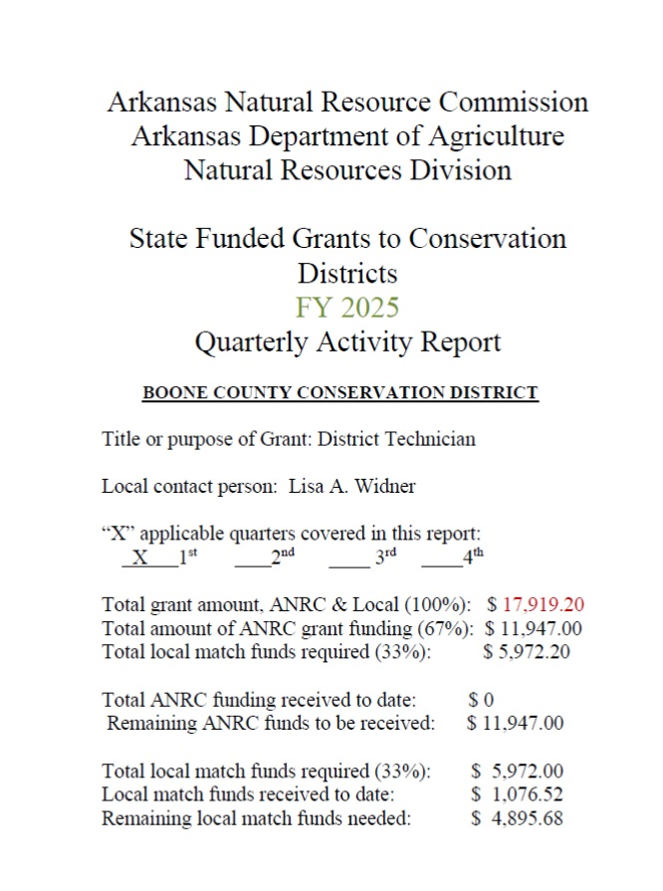
Quarterly Activity Reports
Includes:
All information to identify the grant
What money has been spent and how much remains
Summary on what work has been done
Measures of Success

Slide 14
The Answer to the Universe
In “The Hitchhikers Guide to the Galaxy” the answer to Everything is:
42
In conservation related field work the real answer to everything is:
“You can let this job drive you crazy, or you can drive home and laugh about it”

Slide 15
Questions?
Nick Richardson
Environmental Program Coordinator
Arkansas Department of Agriculture – Natural Resources Division
Phone (501) 231-0458
nicholas.richardson@agriculture.arkansas.gov

