Slide 1

Arkansas Dashboard Compass
Navigating with Data
Megan Perkins
Agriculture Program Manager
Arkansas Department of Agriculture

Slide 2
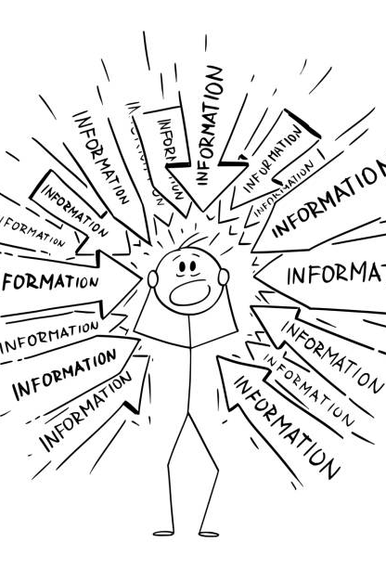
Information Overload
Programmatic data
Funding resources
Communication

Slide 3
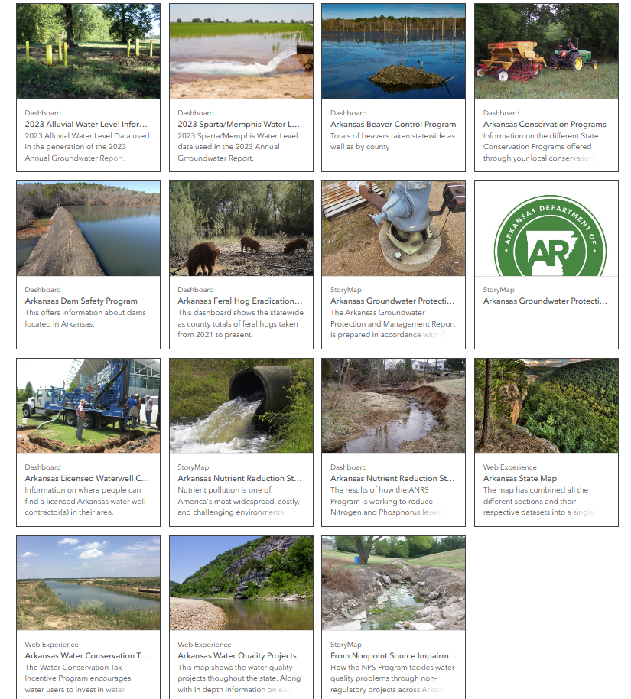
MAPS AND APPS
Arkansas Department of Agriculture
15 map/apps
  8 dashboards
  4 story maps
  3 web experience

Slide 4
Bringing Data to Life
Interactive visual display of data
Measure of success
Identify gaps
Tool for users

Slide 5
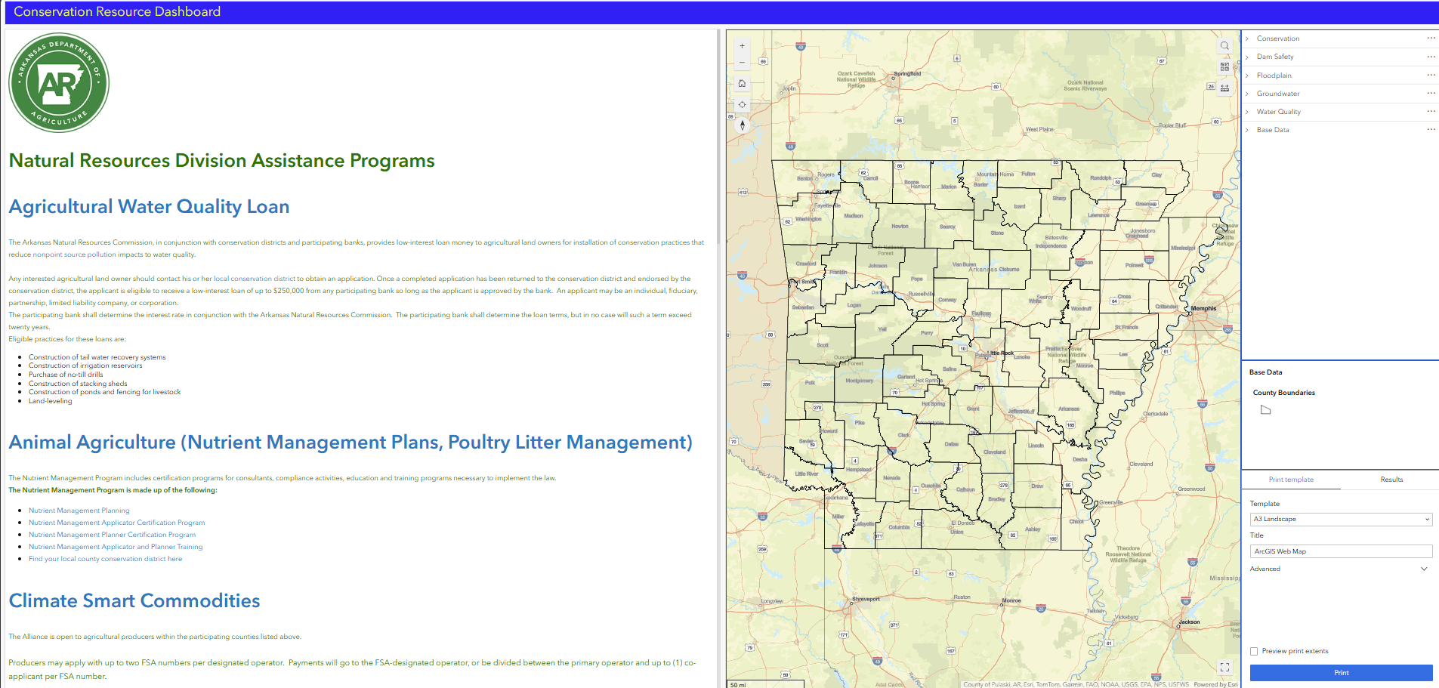
Dashboards & Conservation Districts
Arkansas Conservation Programs
Provides information on programs in one place
Access to data and information
Tool for decision making
  Locally Led
  Funding opportunities
Communicating impacts

Slide 6
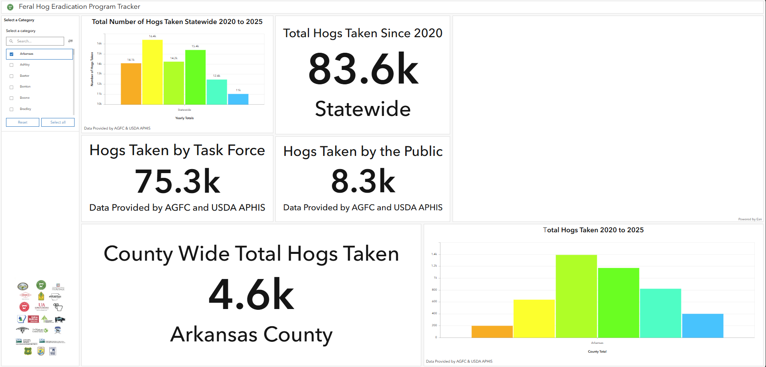
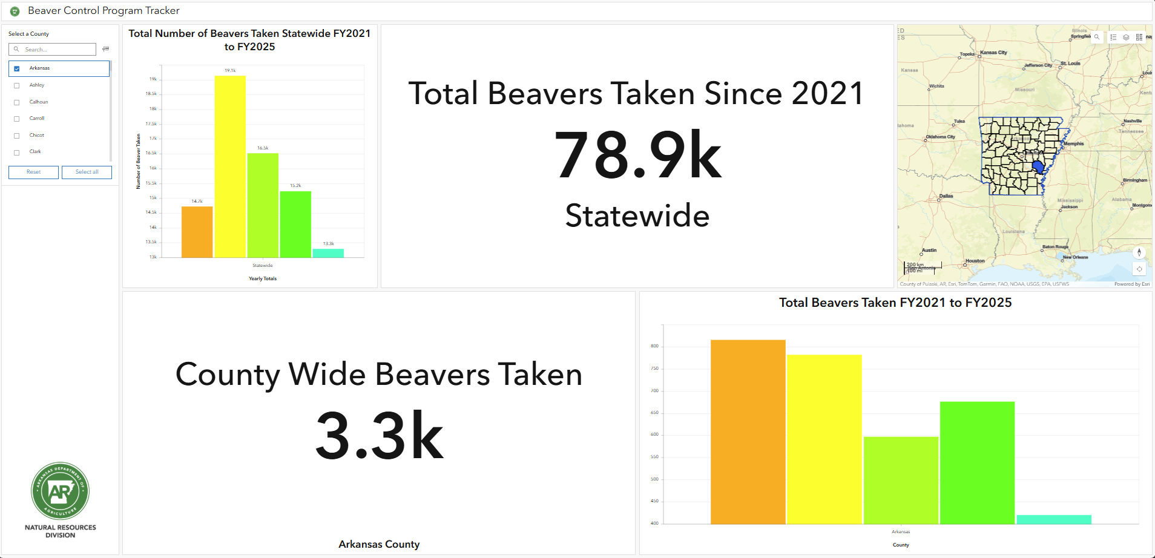
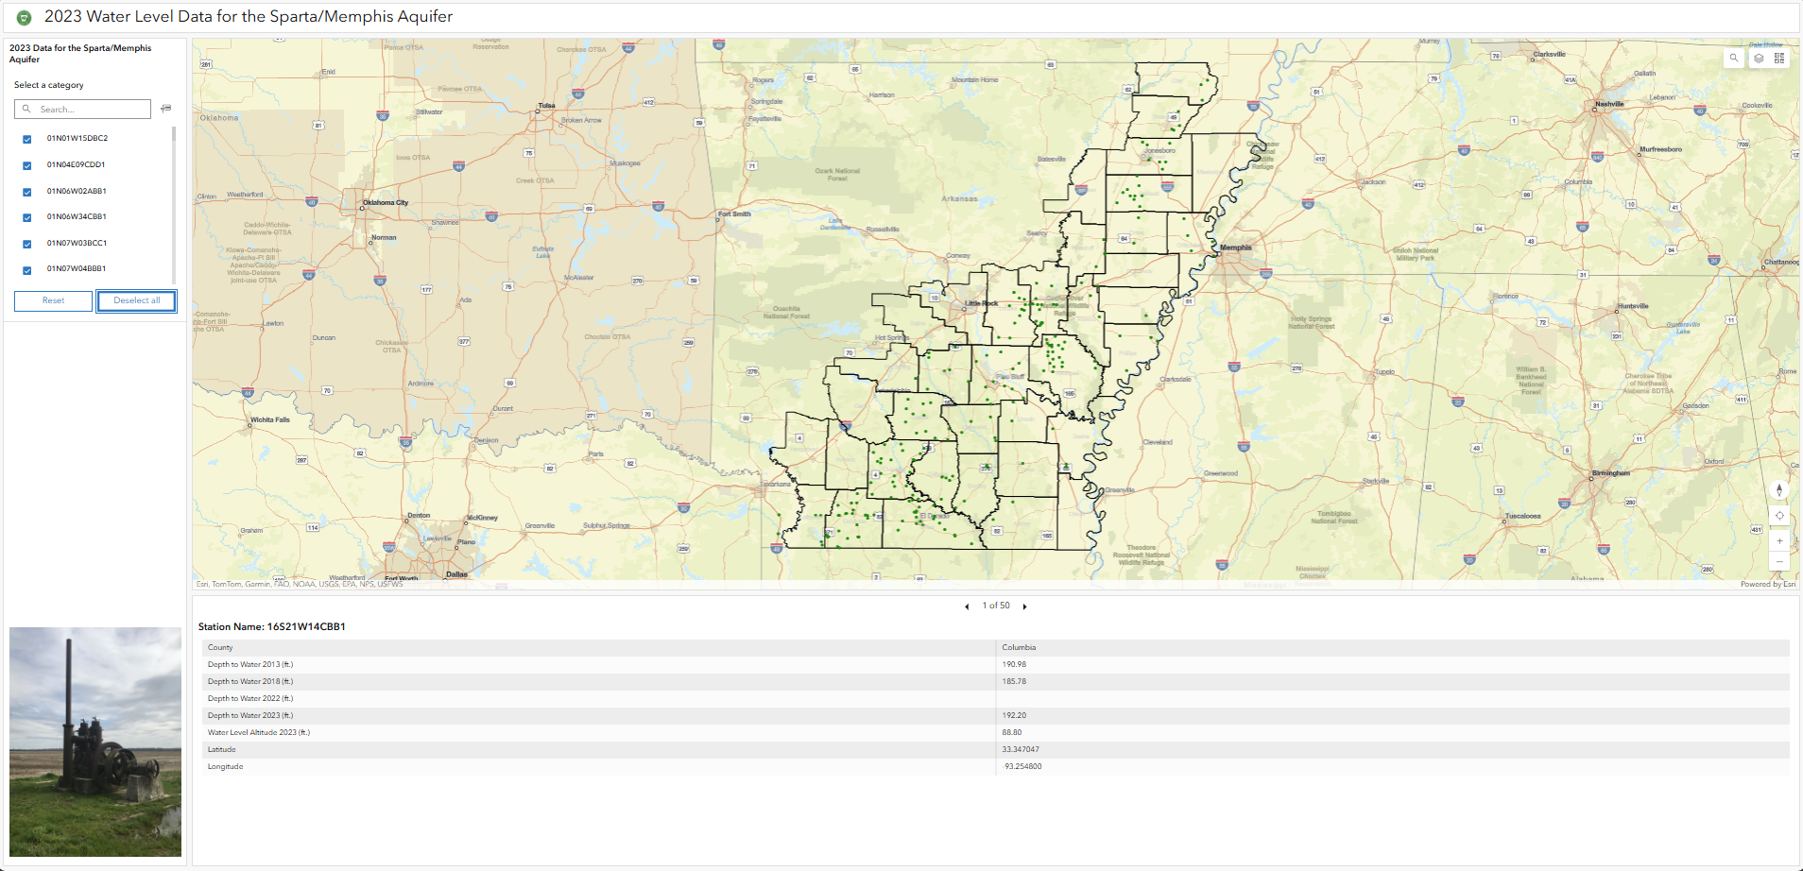
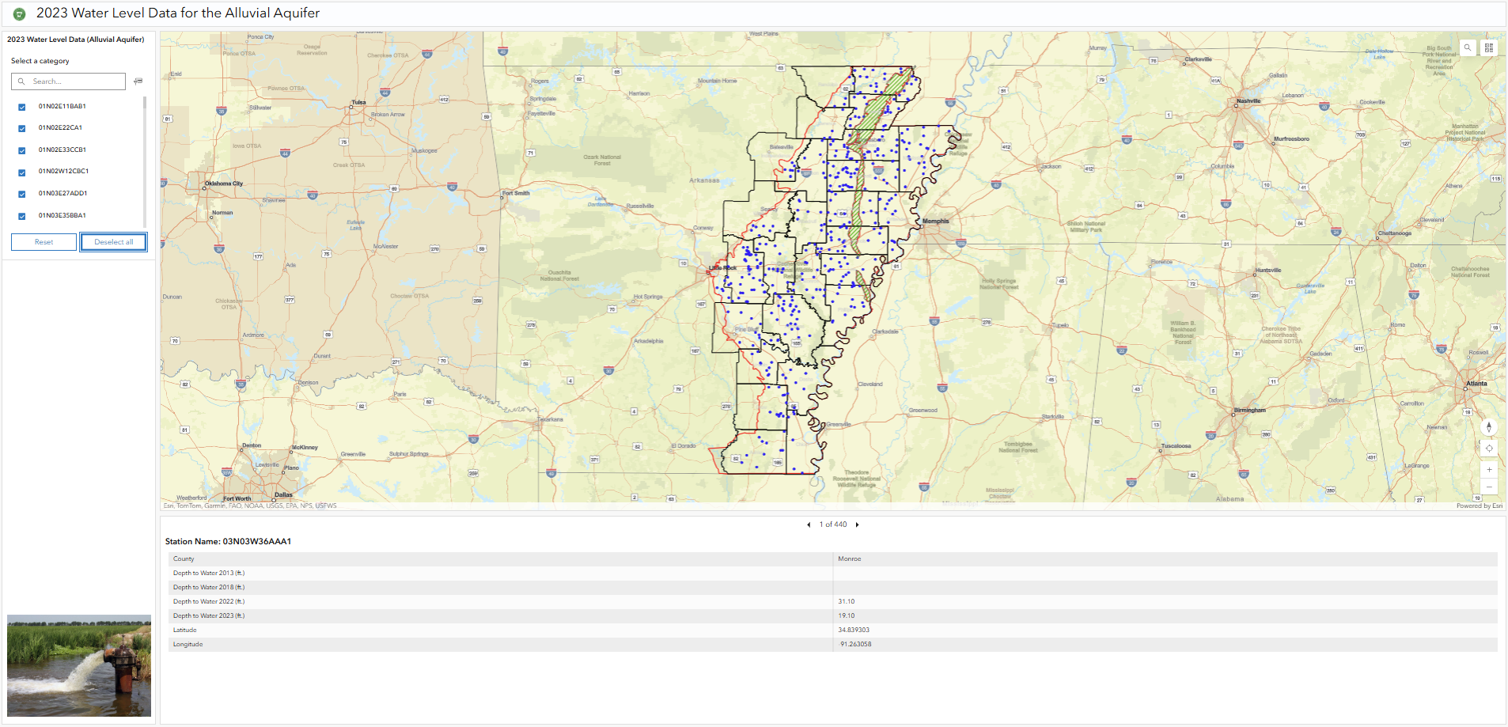

Slide 7
What’s Next
Incorporate partner data
Promote to further encourage data driven decision making
Provide additional programmatic data
Training for programs and funding opportunities

Slide 8

Megan Perkins
Agriculture Program Manager
Arkansas Department of Agriculture megan.m.perkins@agriculture.Arkansas.gov

