Slide 1








Alabama’s Conservation Rebates Reconstructed

Slide 2
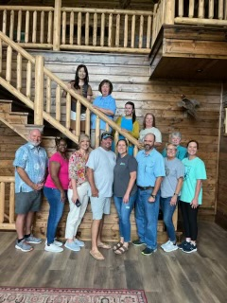
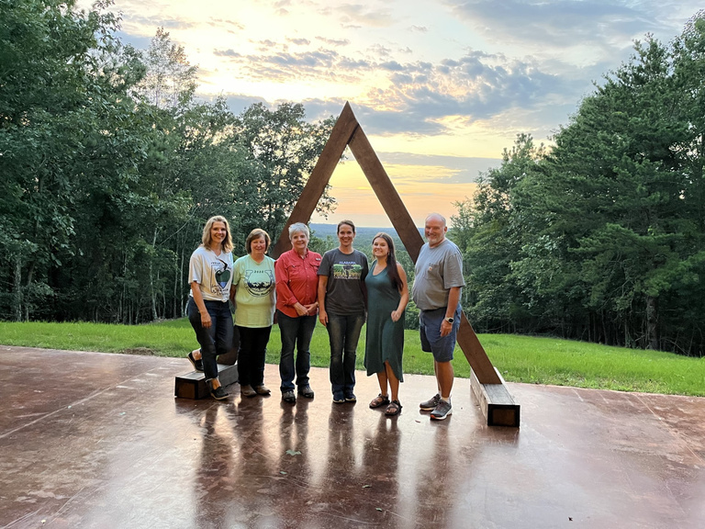
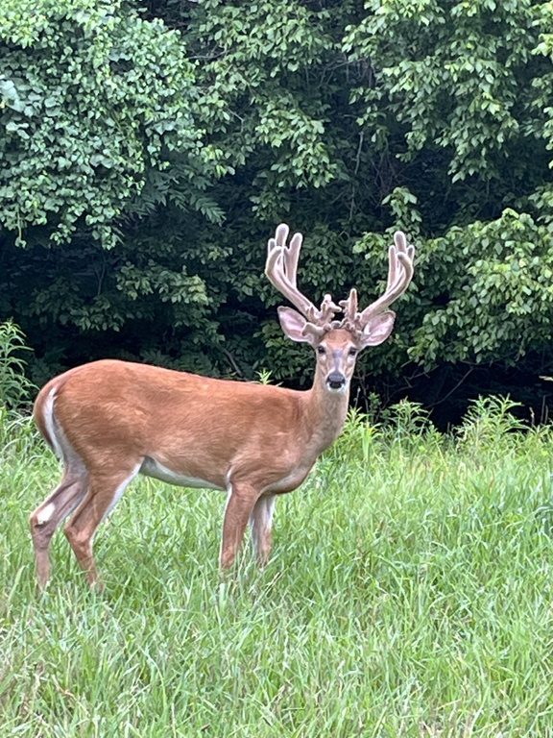
Alabama’s Bourbon, Bullets & Bonding: How Our Annual Staff Retreat Increased Productivity

Slide 3




What do you mean by Reconstructed?
The Alabama Soil and Water Conservation Committee tackled its rusty and antiquated Conservation Incentive Program (CIP) to make it more concise and user-friendly. We were tired of funding recycled, unfunded NRCS EQIP applications and decided to target small farmers not being served by NRCS programs. That new focus, coupled with increased state funding and new management tools, breathed new life into the tired program.

Slide 4
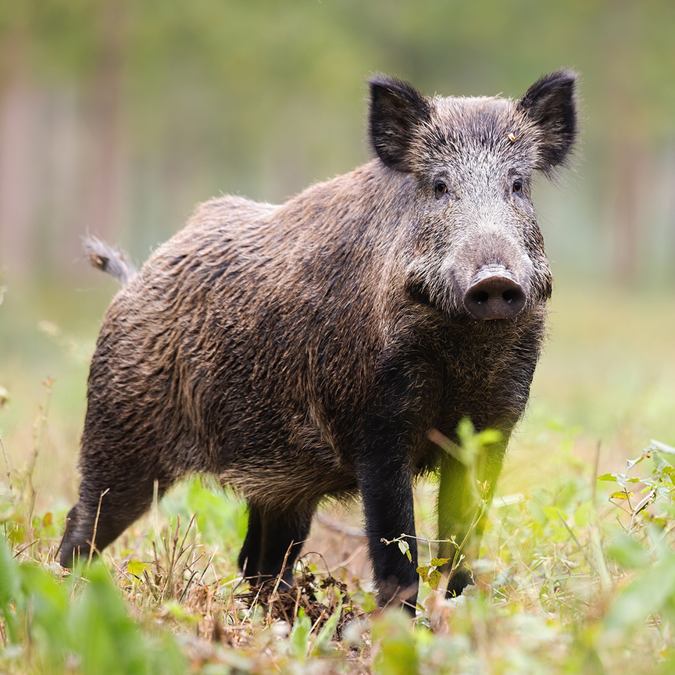
KEY WORDS
Feral swine are a hot topic among legislators
The Lt. Governor's Chief of Staff who is a big advocate of ours said “Don’t use Cost Share”

Slide 5
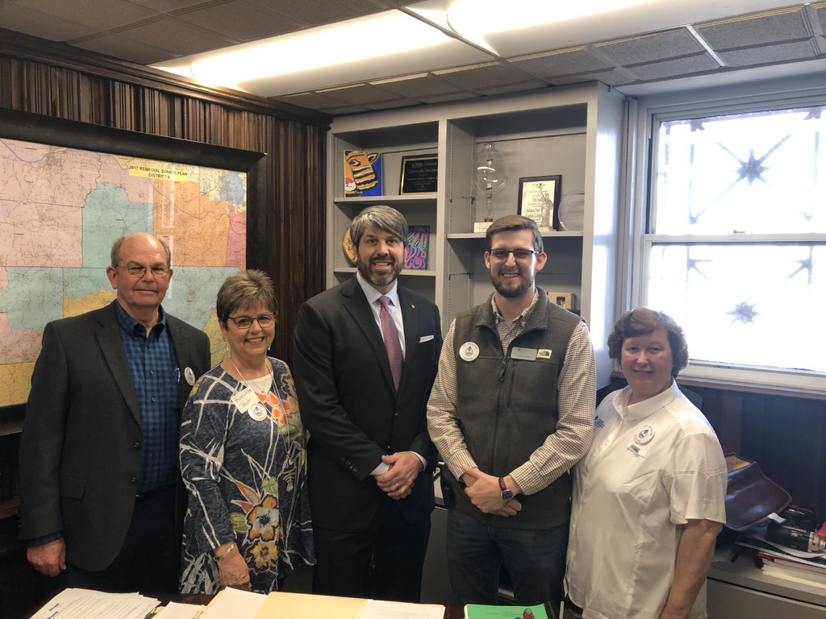
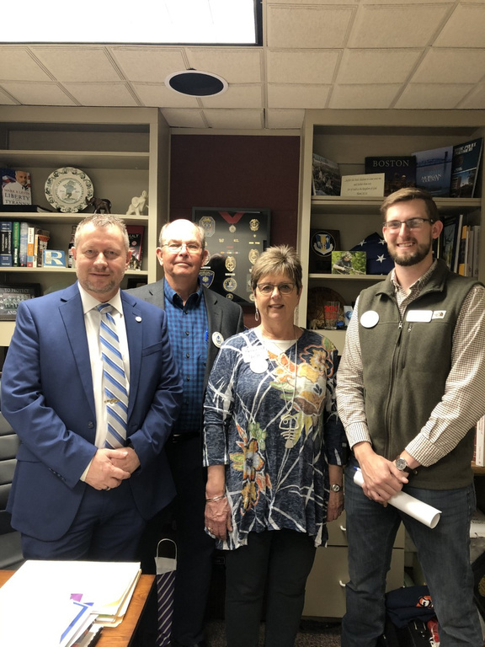
Meet with your Legislators

Slide 6
Increasing funding to $20,000 for all 67 counties is a significant boost for environmental sustainability and conservation.
Collaborating with the Alabama Association of Conservation Districts and emphasizing key words was crucial in securing this funding. It will enhance soil and water conservation efforts, benefiting the environment and local communities.
This shows how advocacy, collaboration, and persuasive language can positively impact state-level policy and resource allocation for critical conservation programs.
USING KEY WORDS CHANGED OUR REBATE FUNDING FROM $0 TO $1.34 MILLION

Slide 7





THINK OUTSIDE THE BOX
Environmental Quality Incentive Program

Slide 8




Interacting on Social Media to Cultivate Fresh Ideas
Promoting CIP through AL.com

Slide 9
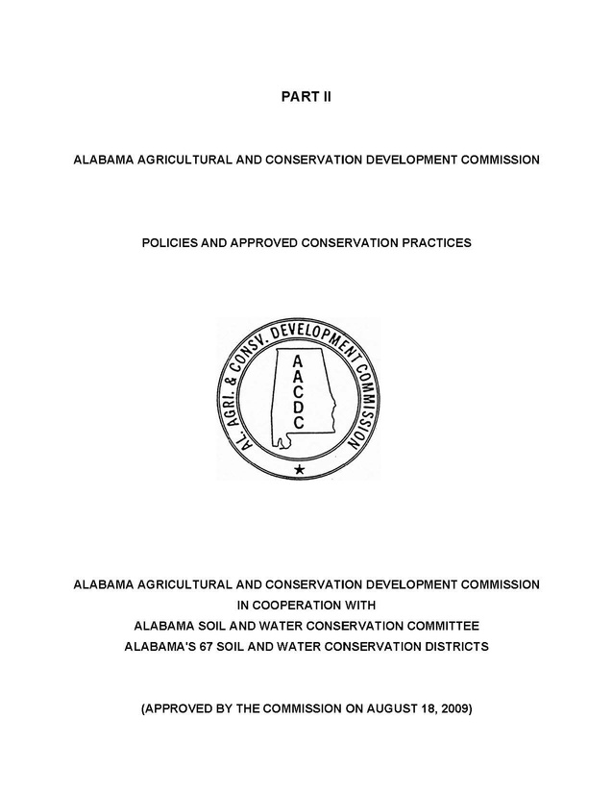
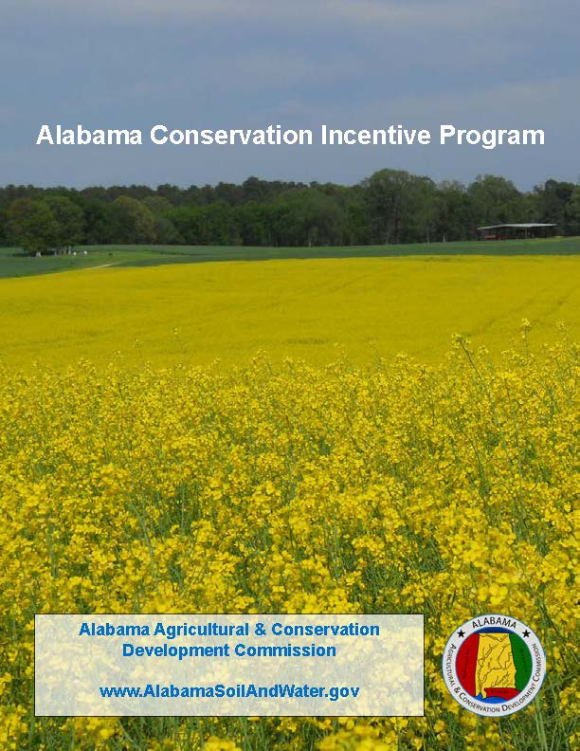

Out with the OLD In with the NEW

Slide 10

Conservation Incentive Program New Direction
RESOURCE CONCERNS
EROSION
CONTROL
WATER
QUALITY
FORESTRY
WILDLIFEWI

Slide 11
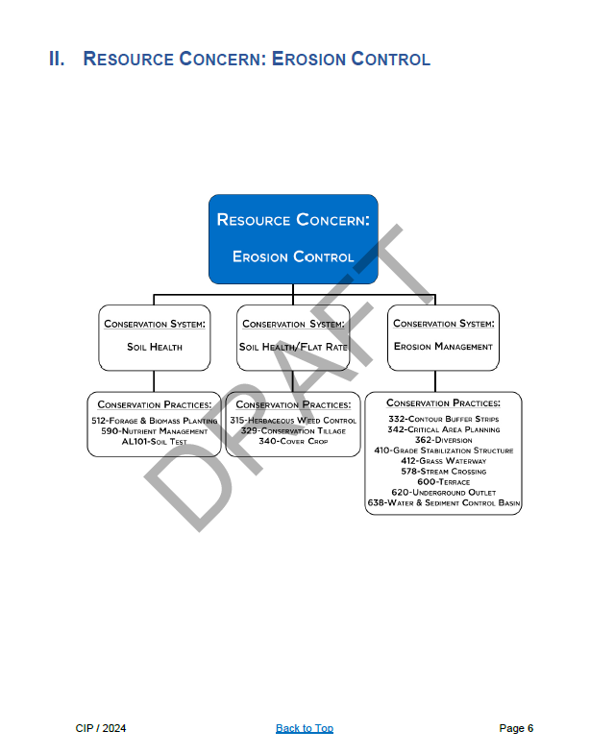

Slide 12
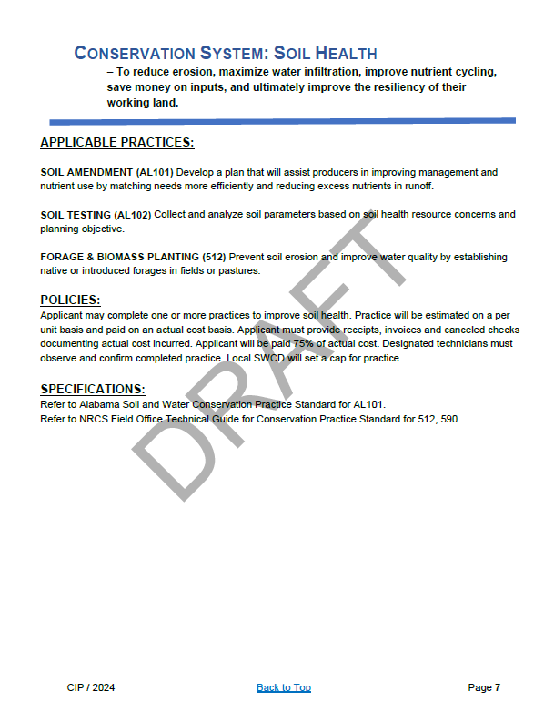
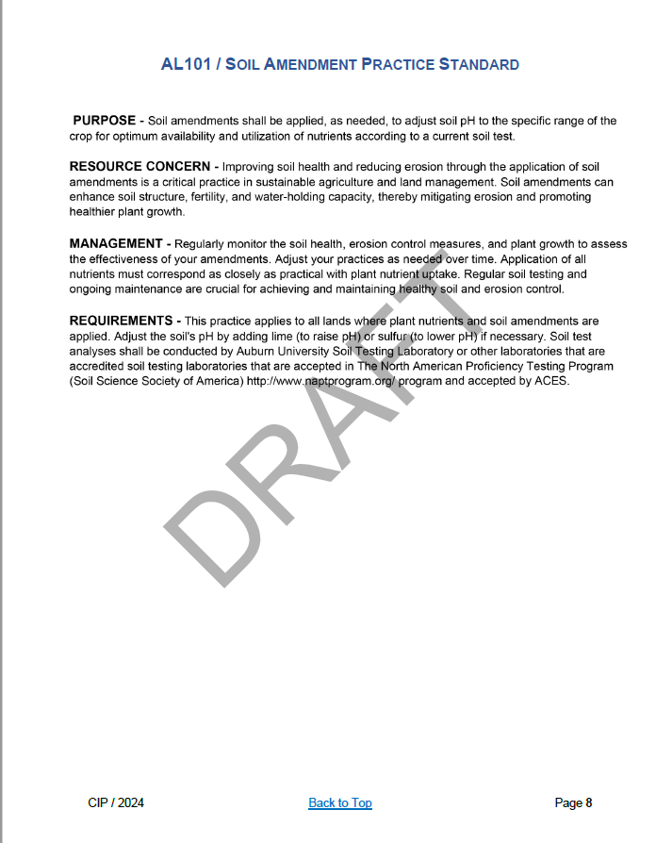
Alabama Practice Standard
CIP / 2024 Back to Top Page 8

Slide 13


Rebate or Flat Rate
75% Rebate
Flat Rate
Cover Crop
Conservation Tillage
Herbaceous Weed Control
Majority of the conservation practices are paid 75% rebate based on receipts

Slide 14

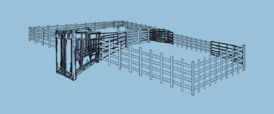
NEW CONSERVATION PRACTICES
Soil Amendment
Soil Test
Corral System
Feed Trough
Trapping Assistance
Advanced Irrigation Management Tools

Slide 15
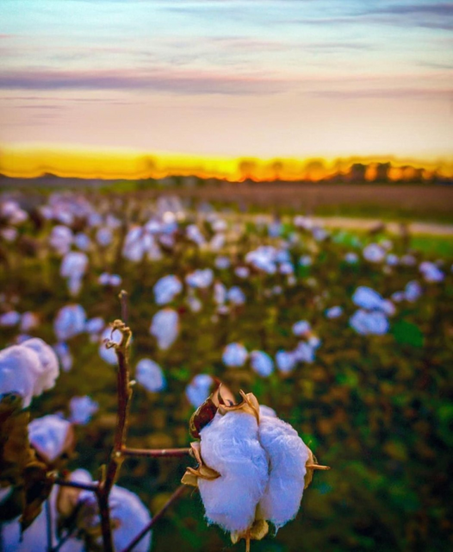
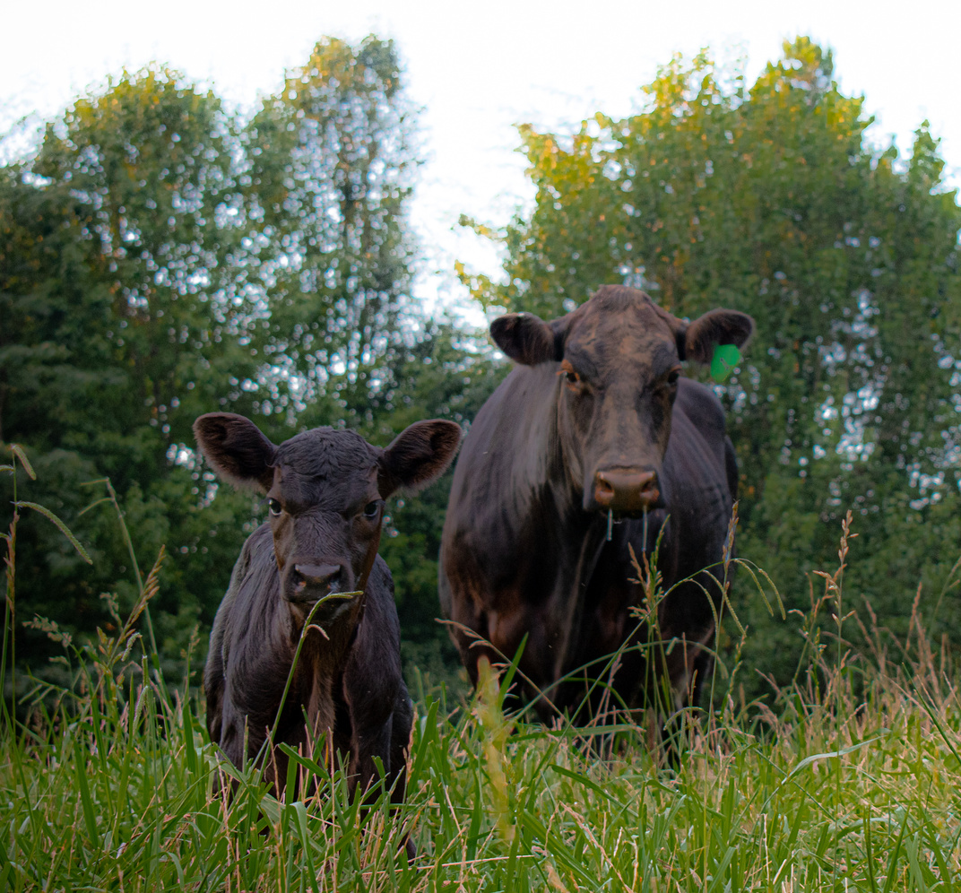
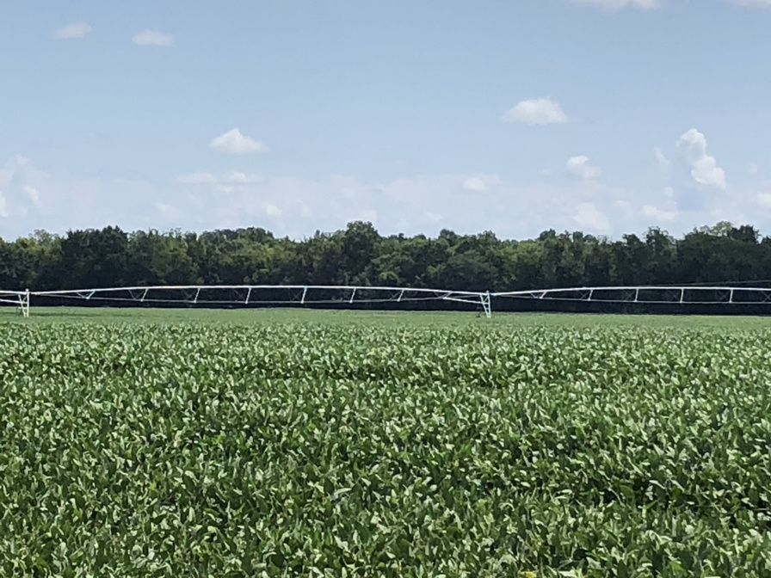
Growing Together
Growing our Rebate program to make a positive impact to
meet our producers needs while growing our partnerships
Partners
Alabama Soil & Water Conservation Committee
Alabama Soil & Water Conservation Committee Alabama Association of Conservation Districts

Slide 16


Slide 17


Contact Us
Kathy Gotcher
Senior Conservationist
AL Soil & Water Conservation Committee
Email Address
kathy.gotcher@swcc.alabama.gov
Phone Number
334-832-0242

Slide 18
Thank You

