Slide 1


Kathy Gotcher
Senior Conservationist
Cassandra Guilford
Soil and Water Conservation Specialist
BRIDGING PERSPECTIVES
Enhancing State-Level Conservation
through Diverse Field Experience

Slide 2
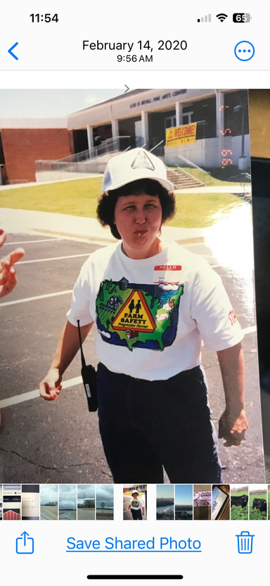
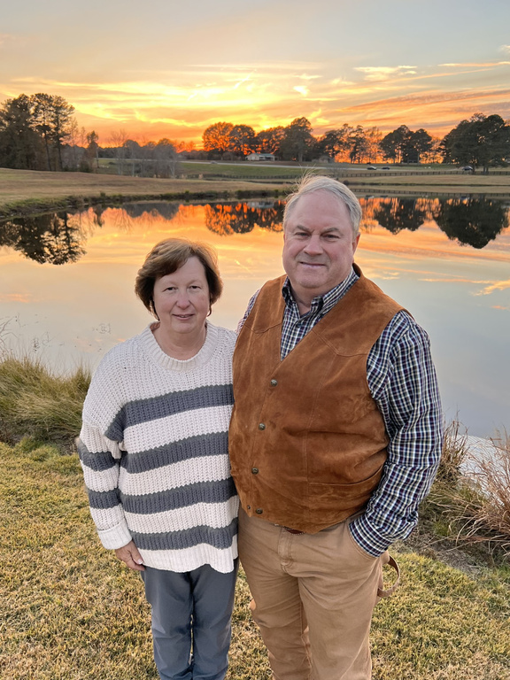
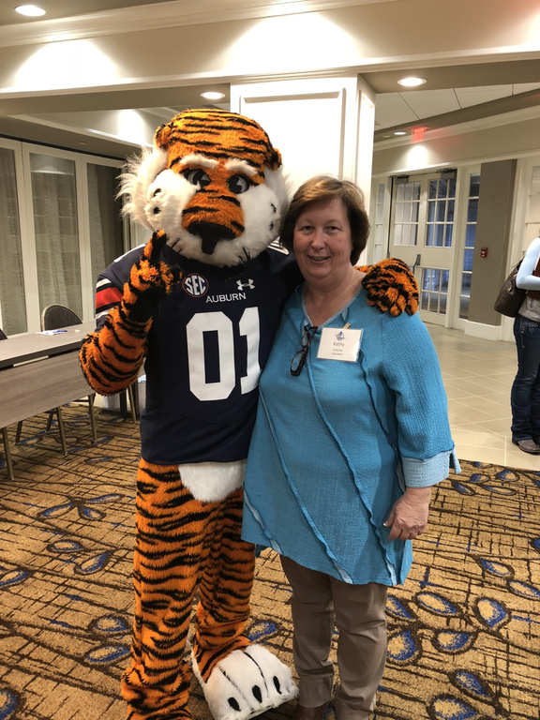


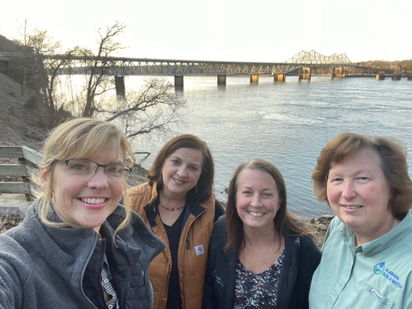
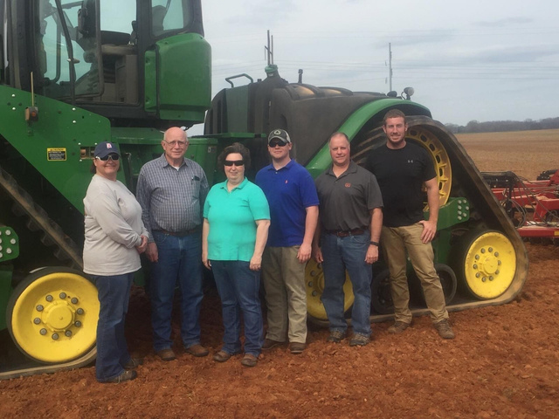
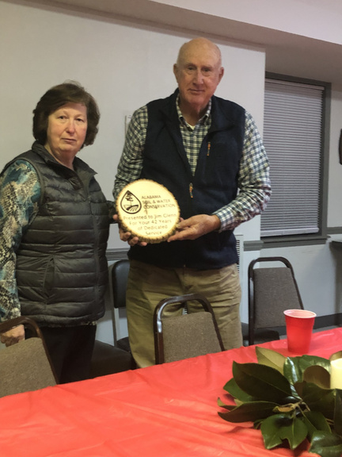
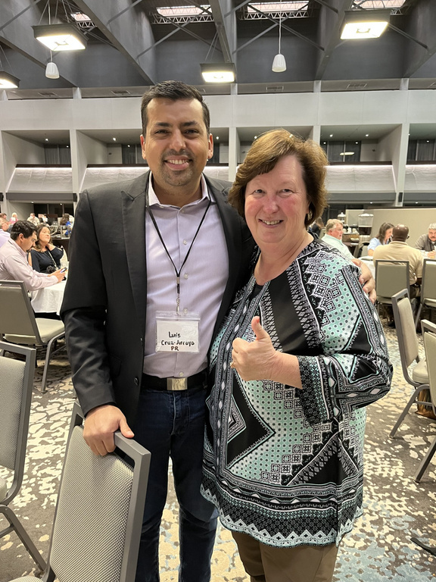
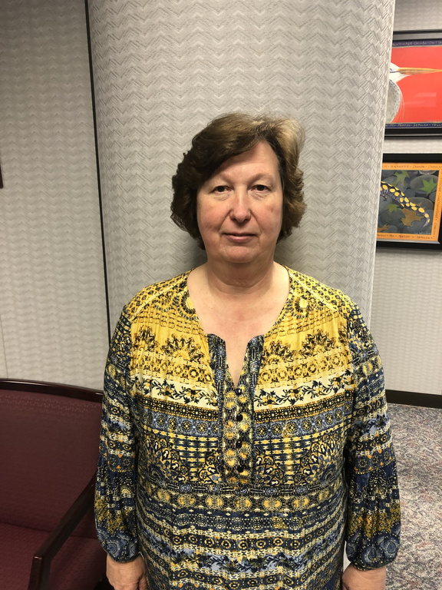
moving
on
UP

Slide 3
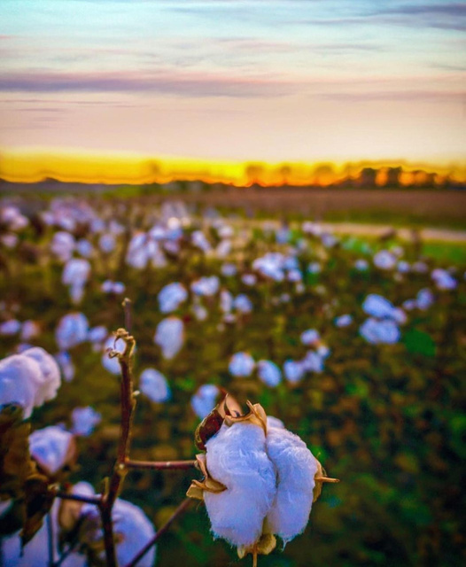


NRCS CAREER
Started December 1986
Soil Conservation Technician
Soil Conservationist
Resource Conservationist
District Conservationist

Slide 4
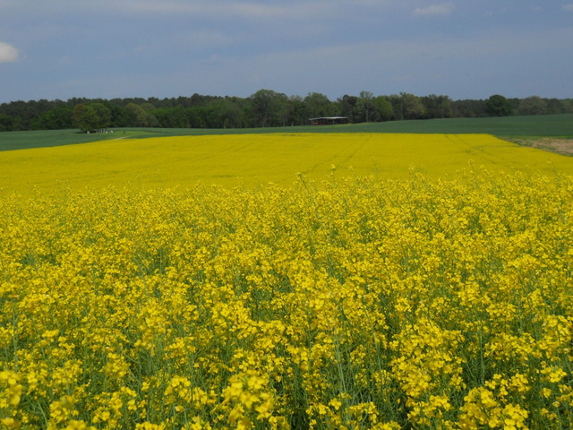
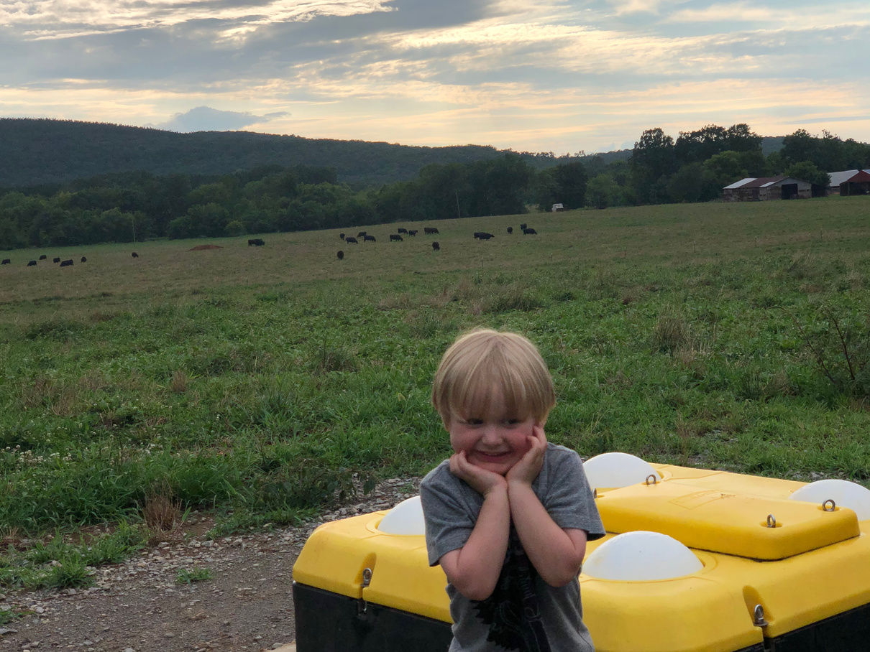
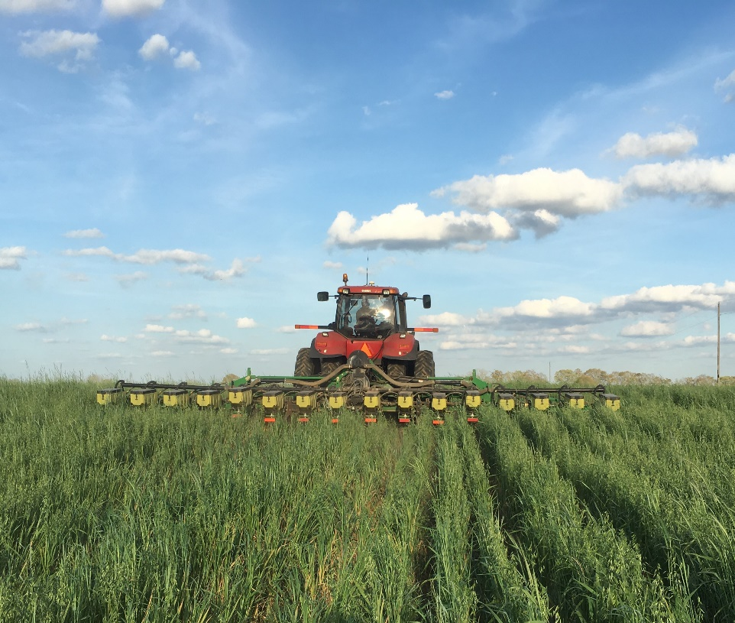

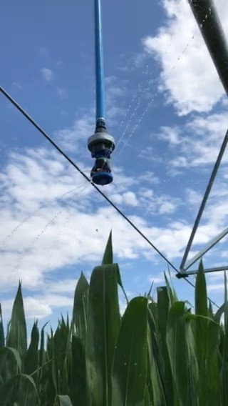

Slide 5

NRCS CAREER
BE BRAVE
TAKE RISKS
HAVE COURAGE
SEEK ADVENTURE
Retired December 31, 2019

Slide 6


ALABAMA SOIL & WATER CONSERVATION COMMITTEE
Begin February 18, 2020
Primary Job Responsibility Alabama Irrigation Initiative
Then .......

Slide 7
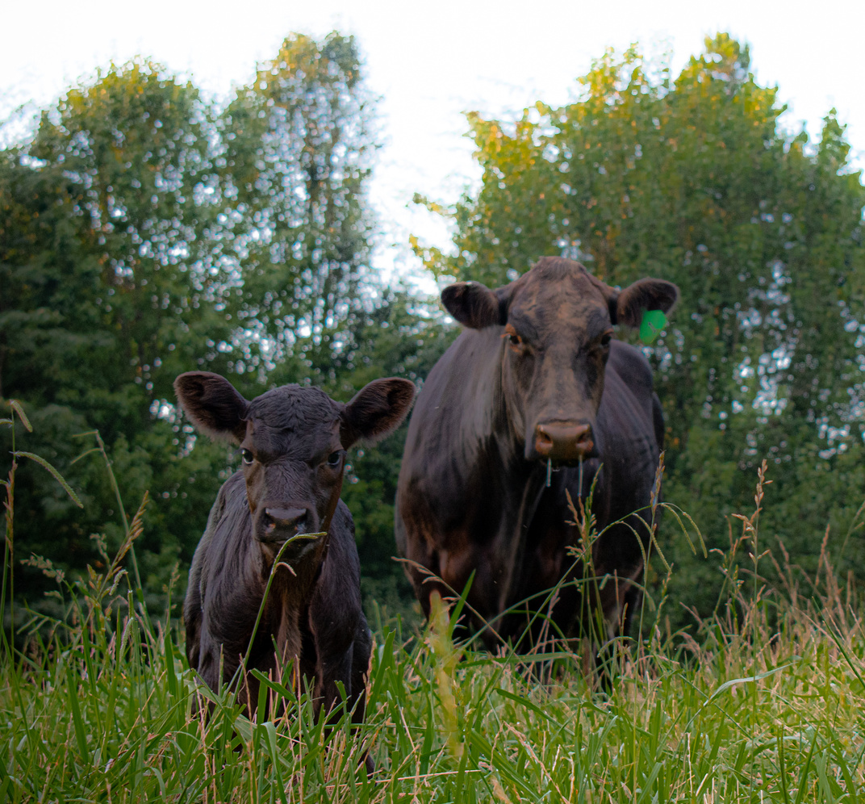
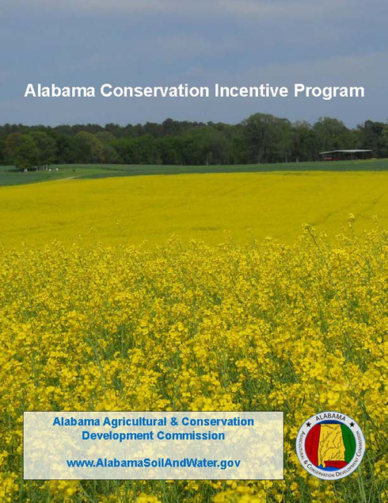
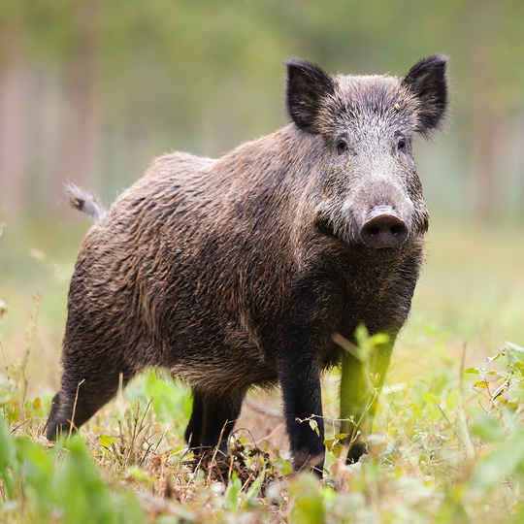

Slide 8
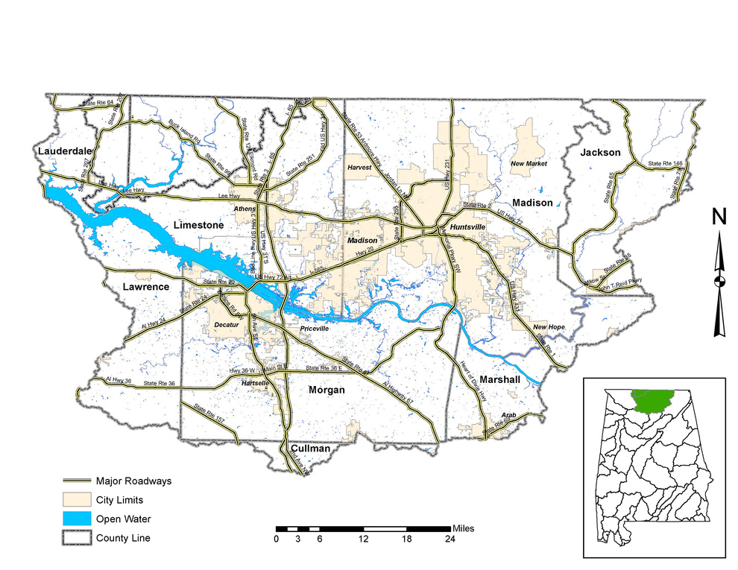

Economic Impact
Middle TN Irrigation Summary
Producers: 41
Funds Paid: $4,786,020.95
Producers Share: $5,086,290.48
New Acres Irrigated: 3,748.1
Number of Systems: 67

Slide 9




FIRST FLOOR
DON’T THINK OUTSIDE THE BOX
HANDS ARE TIED
BE BRAVE
MANUALS
RESTRAINTS OF MANUALS

Slide 10


SECOND FLOOR
SEARCH FOR
TAKE RISKS
RISK TAKERS

Slide 11

THIRD FLOOR
KEEP PUSHING
HAVE COURAGE
AGREE TO DISAGREE

Slide 12
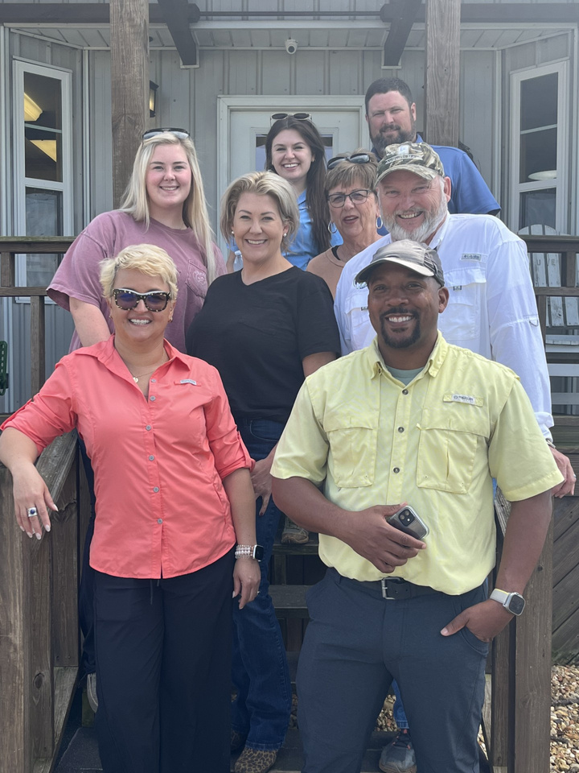
TOP FLOOR
Working together to achieve success in our shared goals
AACD -
COURTNEY BAKER
NRCS – BLAKE GARNER
SWCD –
HENRIETTA TAYLOR
SPRUELL FARMS - LIZ & MADDIE
AL SOIL & WATER – DR. BILL PUCKETT
NATIONAL NRCS HEADQUARTERS – ASTERID MARTINEZ
NATIONAL NRCS HEADQUARTERS – RALPH SMITH

Slide 13
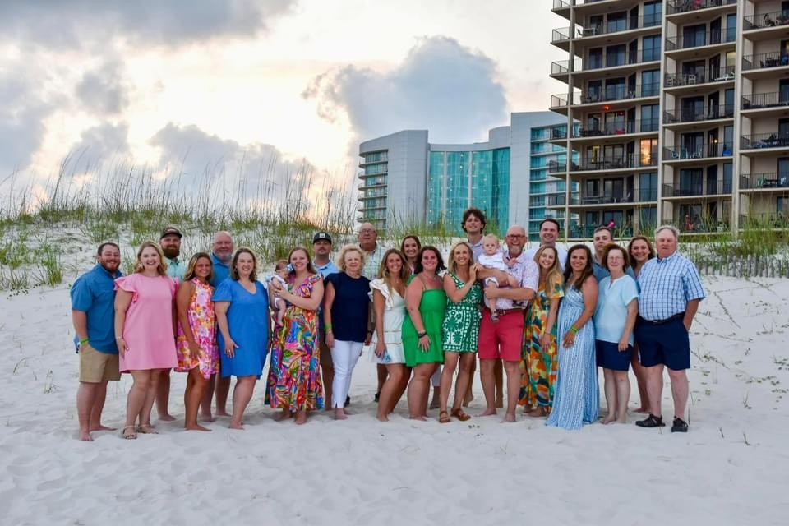
SEEK ADVENTURE

Slide 14
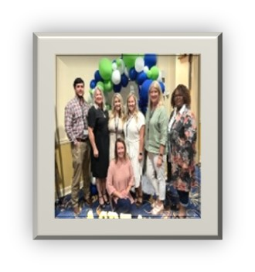
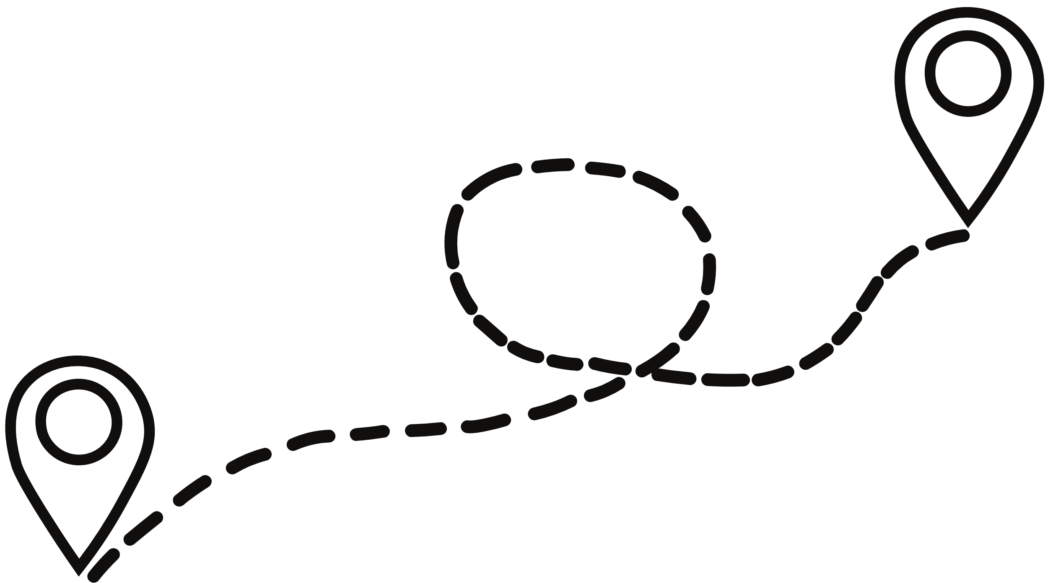
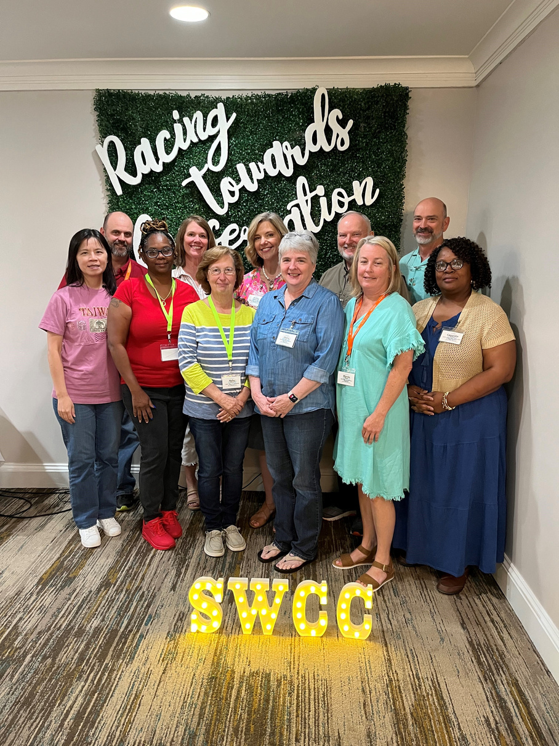
FROM DISTRICT OFFICE
STATE OFFICE
to

Slide 15

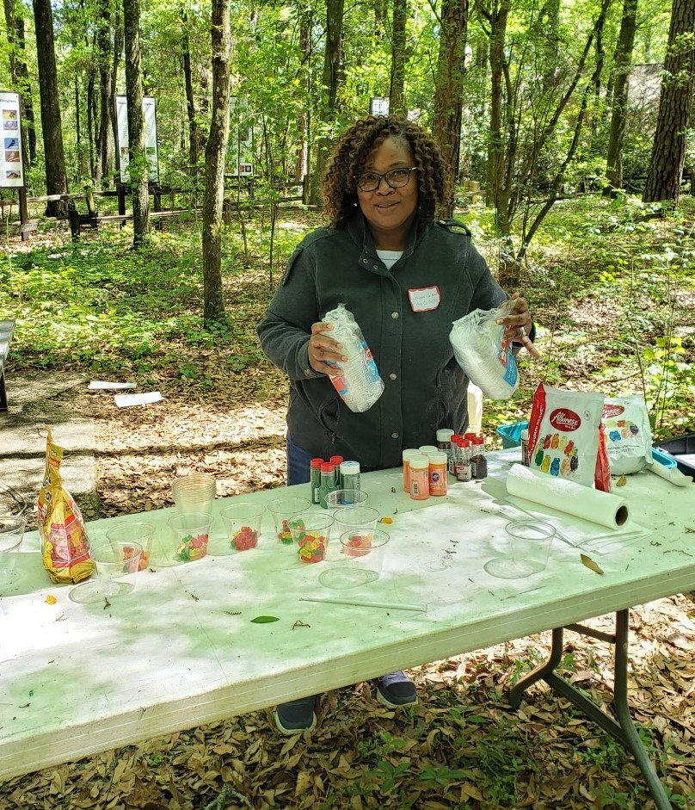
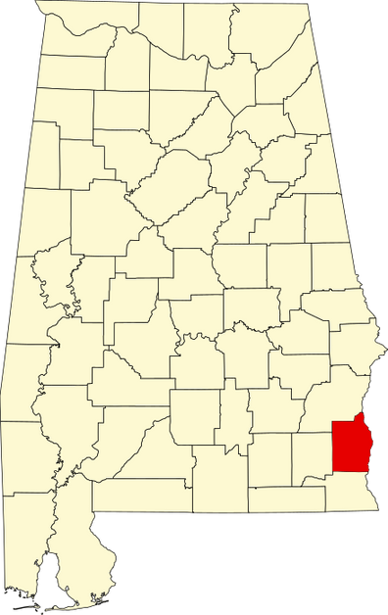
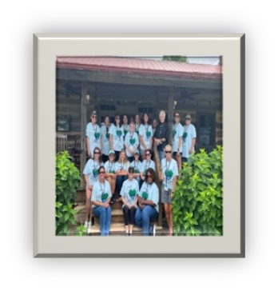

DISTRICTADMINISTRATIVE COORDINATOR (DAC)
2019

Slide 16




DAY-TO-DAY
Administrative
Financial Management
Public Interactions
Trainer (ATP)
DAC RESPONSIBILITIES
PROGRAMS
AFO/CAFO (Poultry Operations)
ATP (Administrative Technical Planning)
CIP (Conservation Incentive Program)
FSCP (Feral Swine Control Program)
PARTNERSHIPS
NRCS
FSA
EXTENSION
FORESTRY

Slide 17

2024

Slide 18



STATE OFFICE RESPONSIBILITIES
DAY-TO-DAY
PROGRAMS
PARTNERSHIPS
District Support
District Resource
ATP Trainer
Other Duties as Assigned… small fires
Management
Payments
Training
Expanding
Fostering
Networking

Slide 19
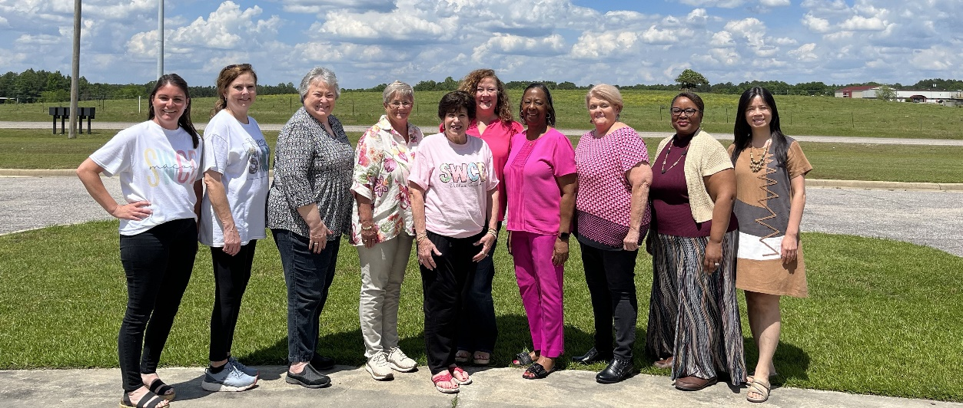
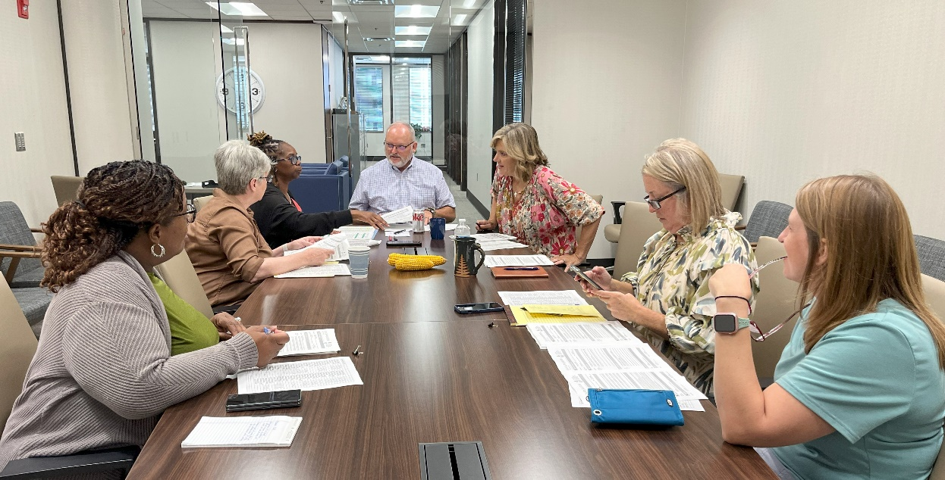
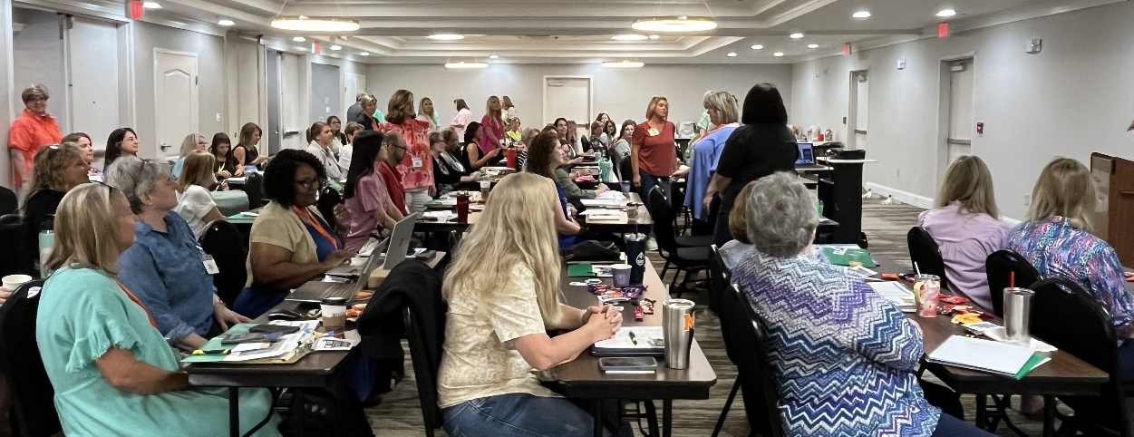
BENEFITS
UNDERSTANDING DISTRICT NEEDS:
Former DAC brings firsthand knowledge of district challenges. Able to anticipate hurdles, tailor support, foster stronger relationships.
PRACTICAL POLICY DEVELOPMENT:
Experience in district operations leads to policies that are practical and effective.
PROMOTING ACCOUNTABILITY:
Ability to drive districts towards greater accountability, productivity, and independence.

Slide 20
THANK
YOU
Kathy Gotcher
Senior Conservationist
Alabama Soil and Water Conservation Committee
334-832-0242
Email: kathy.gotcher@swcc.alabama.gov
Cassandra Guilford
Soil and Water Conservation Specialist
Alabama Agricultural & Conservation Development Commission
334-235-3241
Email: cassandra.guilford@swcc.alabama.gov

