Slide 1



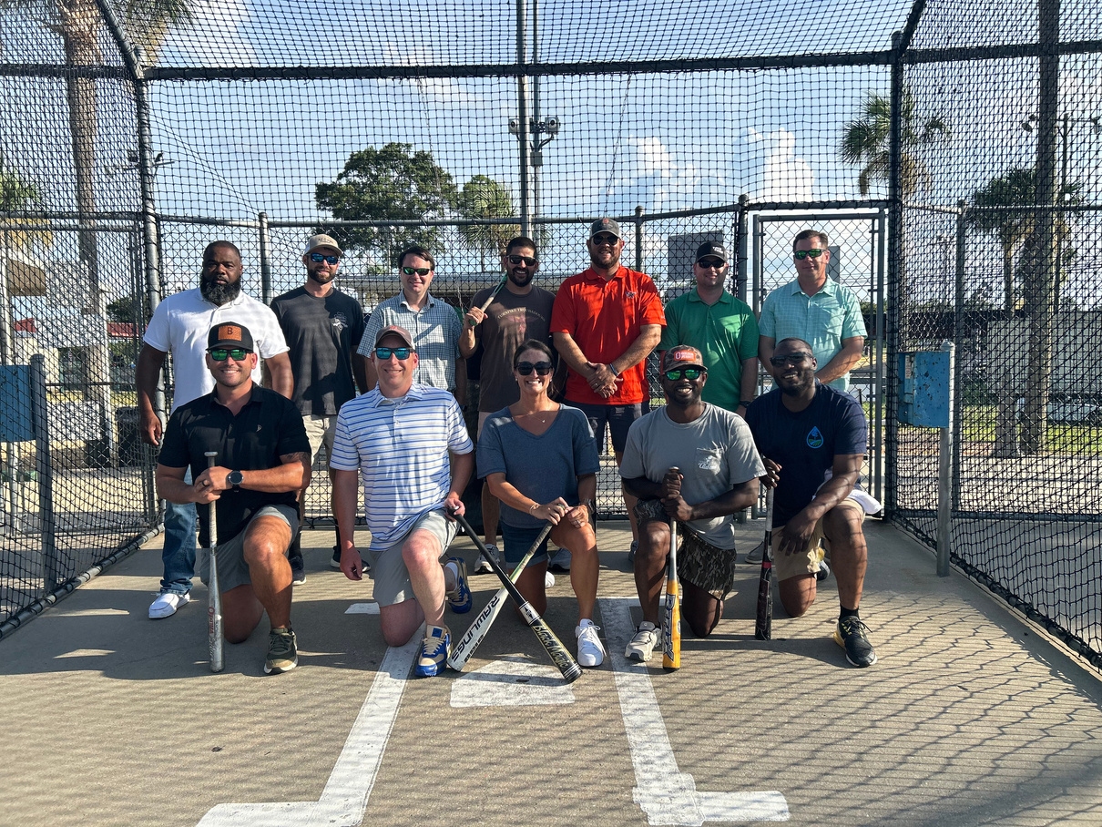
EMERGING LEADERS IN CONSERVATION
SOIL AND WATER CONSERVATION
EMERGING LEADERS IN CONSERVATION
Alabama Soil and Water Conservation Committee
Notes:
We took EVERYTHING you guys said in the last meeting and got to work. This is a decent compromise on your perspectives.
We hope that this program's success will lead to a better onboarding program, which may thin out some of the content in this program.
How do we feel about this logo and name? ELC
Decision to be made: keep this logo and name or workshop it more?

Slide 2
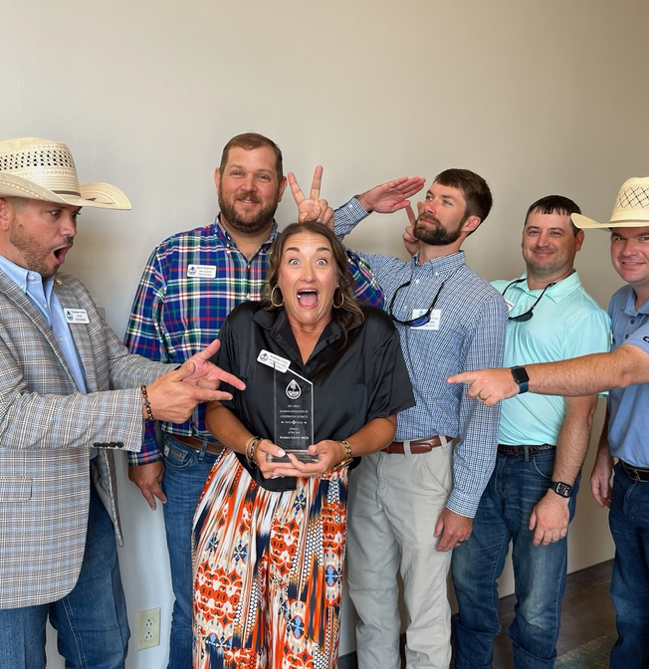
01
02
PERSONAL
PROFESSIONAL
OUR OBJECTIVES
Communication Leadership
Business
Partnerships
Empowering a new generation of leaders to champion soil and water conservation through policy (Policy and Political Structure), professional (business partnerships), and personal development (Communication & Leadership).
The Emerging Leaders in Conservation (ELC) equips emerging leaders with the skill, knowledge and networks to drive sustainability, inspire their districts, and build a more resilient future for the state of Alabama.
03
POLICY & EDUCATION
Policy
Political Structure
Notes:
Let's read over these 3 Ps of ELC, but keep in mind before decisions are made, these topics go into way more in terms of content. We will get into that a bit later.
Decision to be made: how do we feel about the mission statement. Any changes?

Slide 3

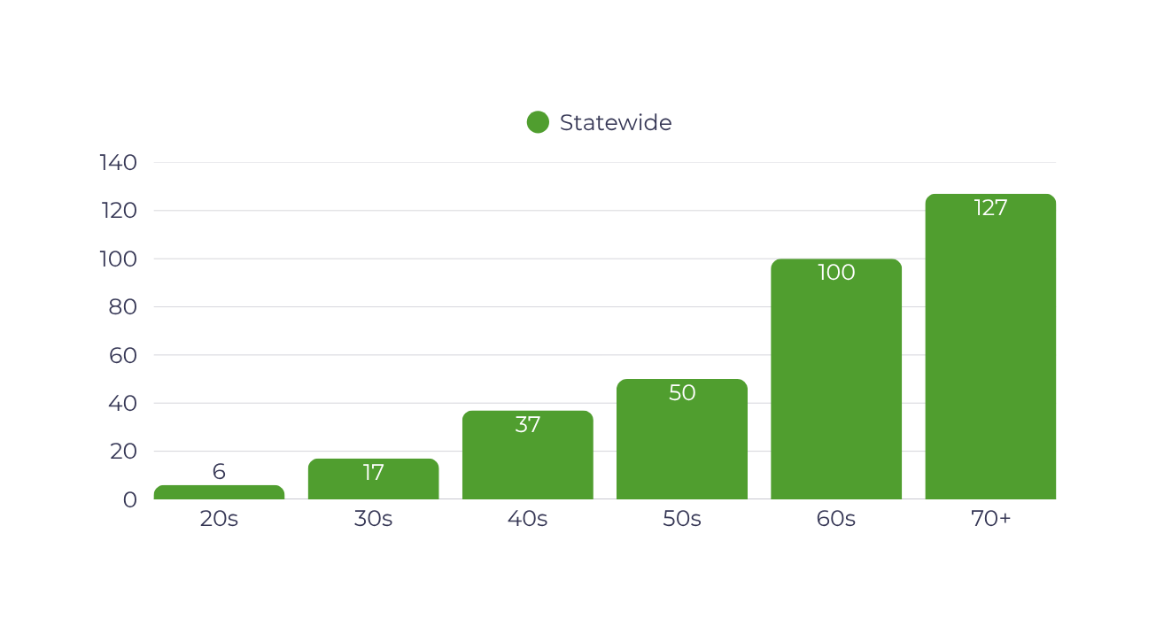
ORGANIZATION RESEARCH
Supervisors and Advisors in our organization under the age of 50 are outnumbered eight to two.
We have under 23 total under the age of 40.
AGE
Notes:
Decision to be made: after next slide

Slide 4

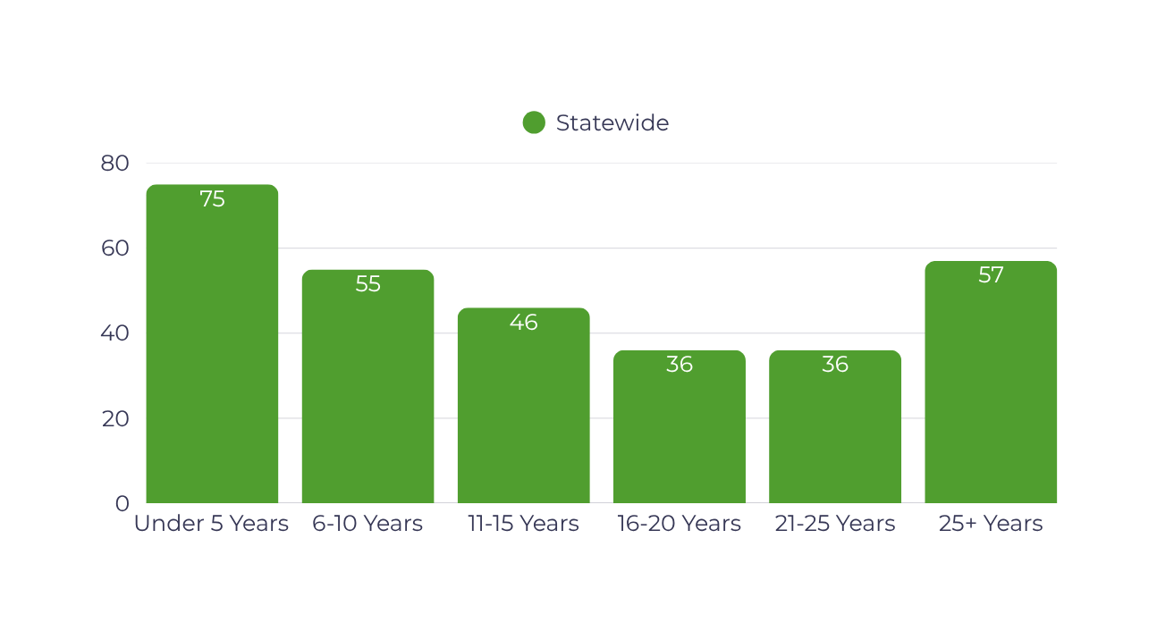
ORGANIZATION RESEARCH
Four Supervisors and Advisors out of Ten in our organization are under five years of service
YEARS OF SERVICE
AS MEMBERS
Notes:
Decision to be made:
1. What is our eligibility process?
2. Should we include a spot for a DAC and a spot for an NRCS agent?
Side note: This IS factoring in that supervisors only have a few years term. This is based on that start date and not overall potential service.

Slide 5








SESSION TIMELINE
Cohort One
MAY
JULY
NOVEMBER
JANUARY
APRIL
JULY
NOVEMBER
MARCH
Personal Development
East Central AL
Know Yourself Content
&
Basics of Leadership Content
Professional Development
Southeast AL
Organization and Farm Structure Content
Professional Development
Southwest AL
Capstone & Luncheon
Professional Development
Northwest AL
Business Content,
Policy Content,
&
Etiquette Content
Policy & Educational Development
Central AL
State House Visit
&
Media Training Content
Professional Development
West Central AL Partnerships Content
Policy & Educational
Development
Southwest AL
Graduation Banquet
Policy & Educational Development
Washington D.C.
NACD Fly-In
Notes:
Take a look at the line above the area, this is where our objectives - our 3 Ps come into play.
Decision to be made: Which areas will be best for each piece of content?
Do we want to use NACD's annual fly in as our trip to DC? This would rearrange our timeline to fit DC into that Y2Q1 slot (March). We could also have our graduation Y2Q4, then the next quarter just go on the trip with NACD.

Slide 6
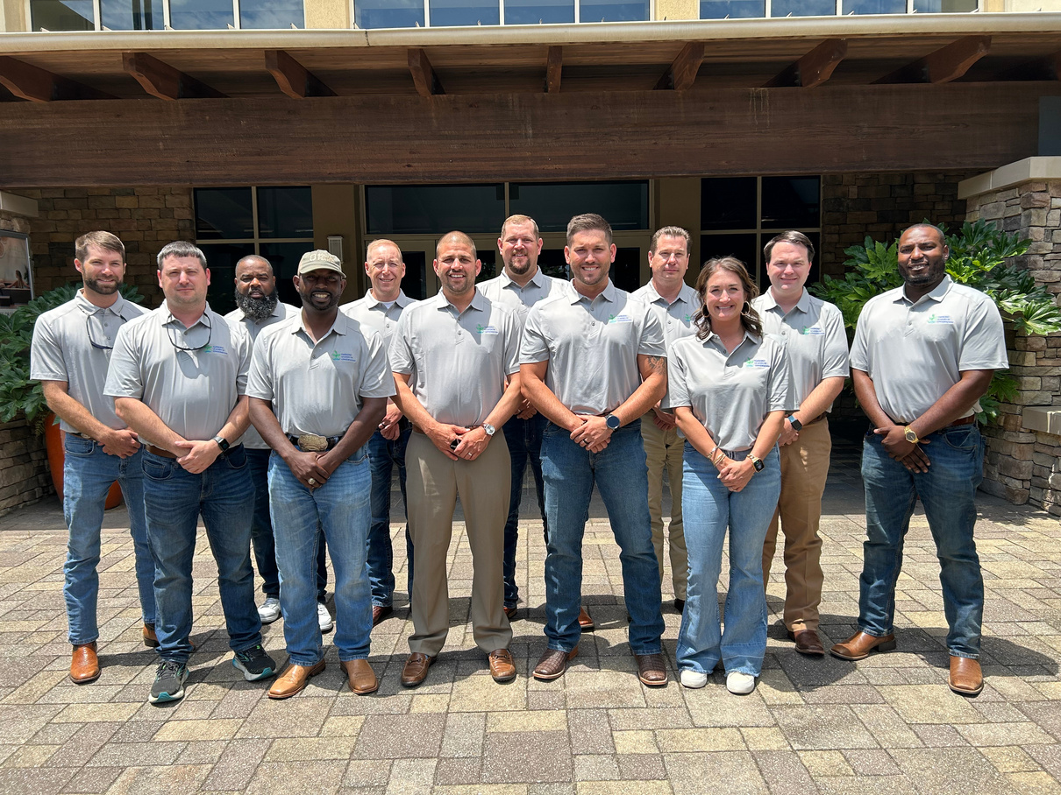
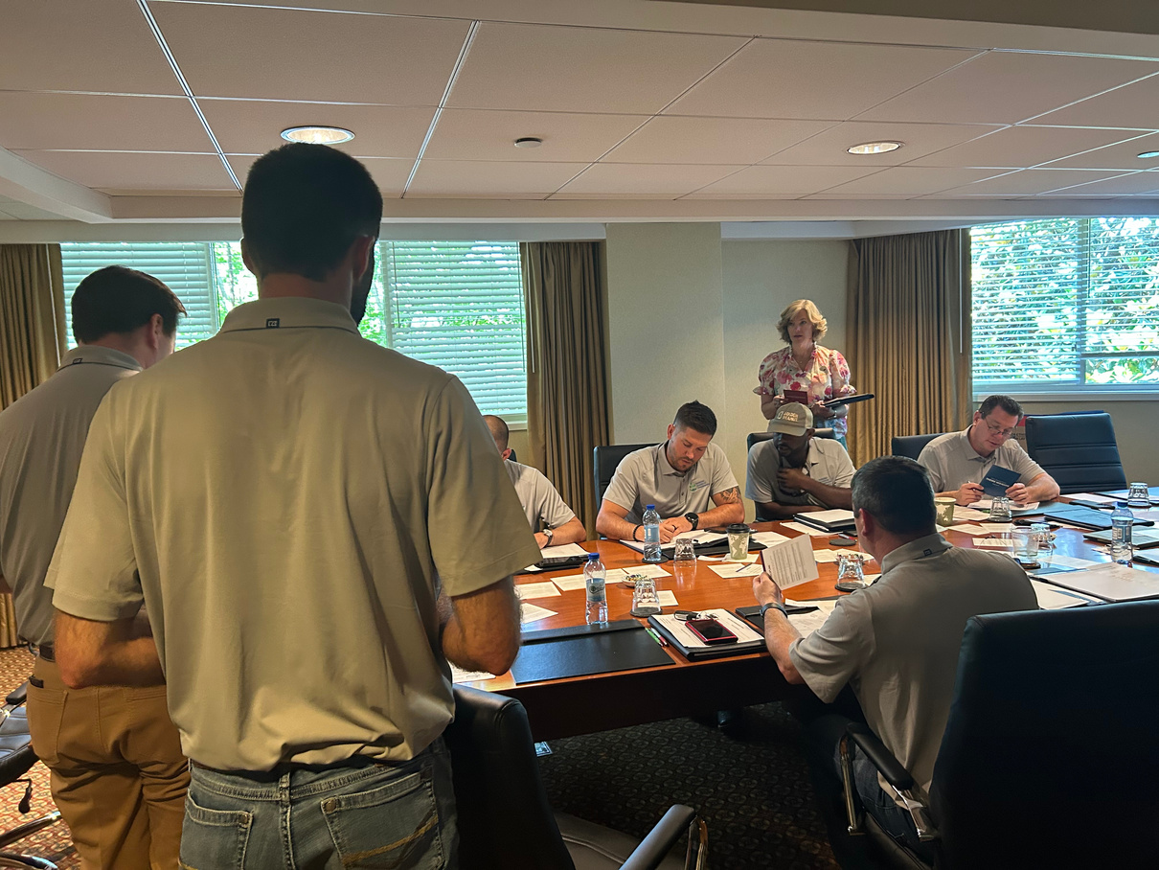
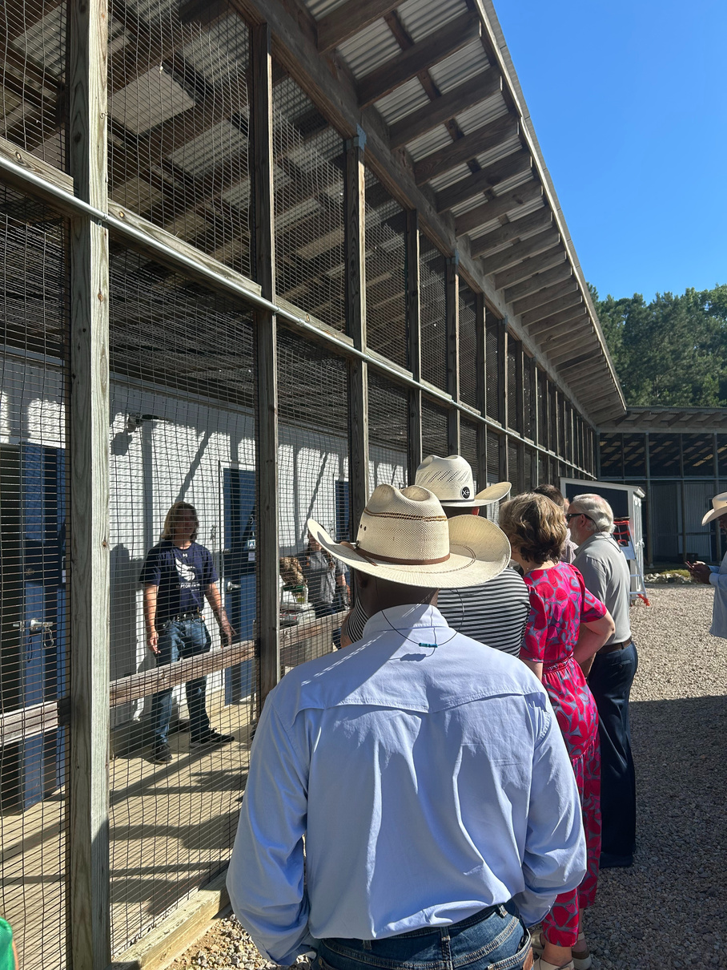
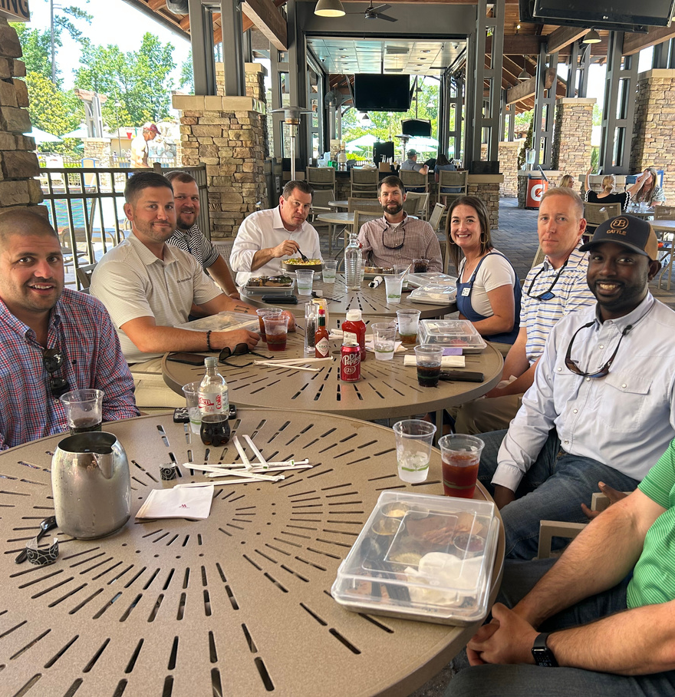
SESSION ONE
Sessions:
Generational Divides
DISC
KAI - Problem Solving
Strength Finders
Filing Travel
Productive Oral and Written Communication
Elevator Pitching Public Speaking
Feedback:
Need more breaks for business calls
More time for organic round table discussions
More icebreakers to learn about each other
More public speaking refreshers
Notes:
Let's read over these 3 Ps of ELC, but keep in mind before decisions are made, these topics go into way more in terms of content. We will get into that a bit later.
Decision to be made: how do we feel about the mission statement. Any changes?

Slide 7
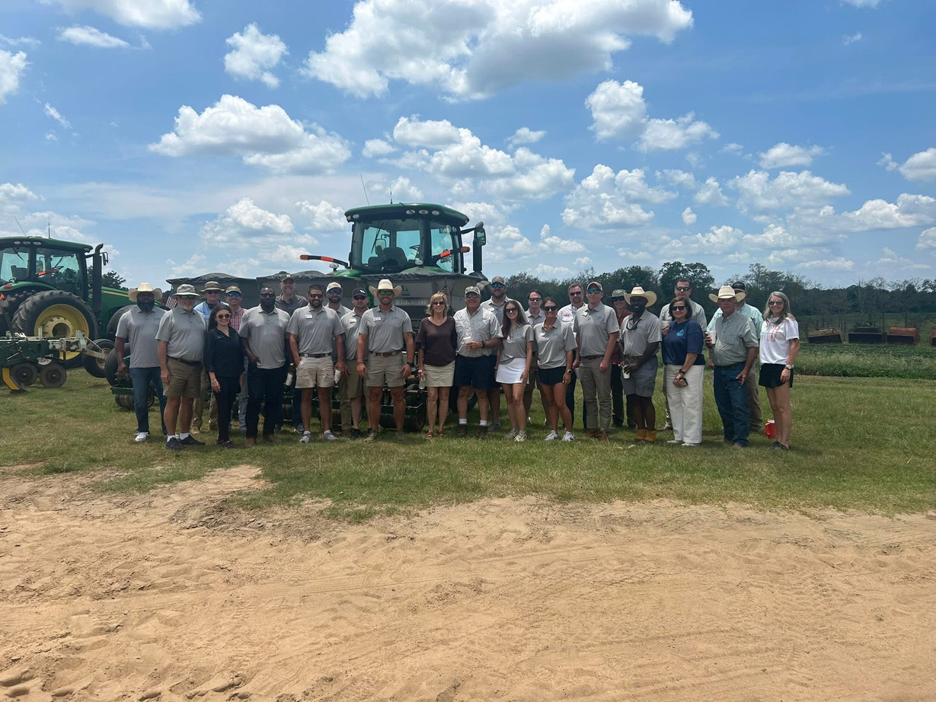
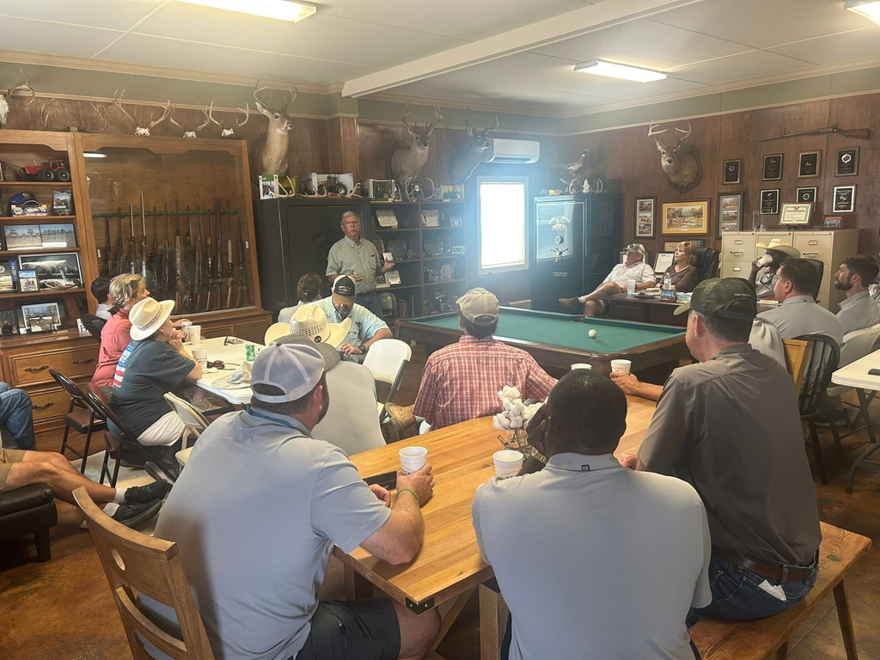
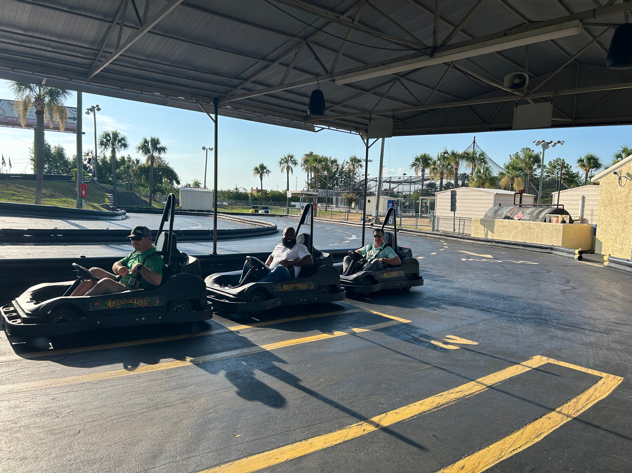
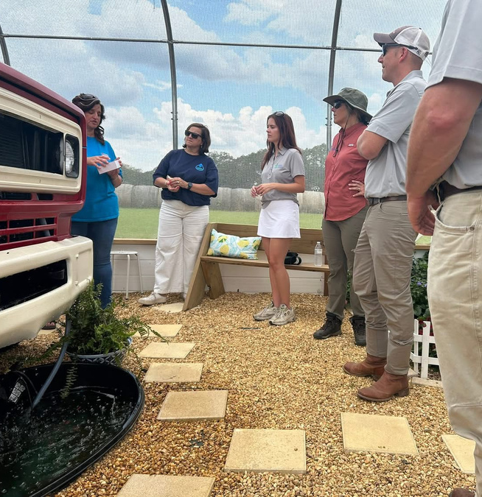
SESSION TWO
Sessions:
Acronyms
Hugh Hammond Bennett Film
Organizational Structure
How Statutes Inform Roles and Responsibilities
Discussion on Optimizing the Role
Conservation Programs Breakdown
Farm Tour
Butterfly Garden Tour (District Funded)
Feedback:
More information on the statutes
Would like to learn about financial responsibilities and finding grants
More round table discussion time
Diet Coke
Notes:
Let's read over these 3 Ps of ELC, but keep in mind before decisions are made, these topics go into way more in terms of content. We will get into that a bit later.
Decision to be made: how do we feel about the mission statement. Any changes?

Slide 8
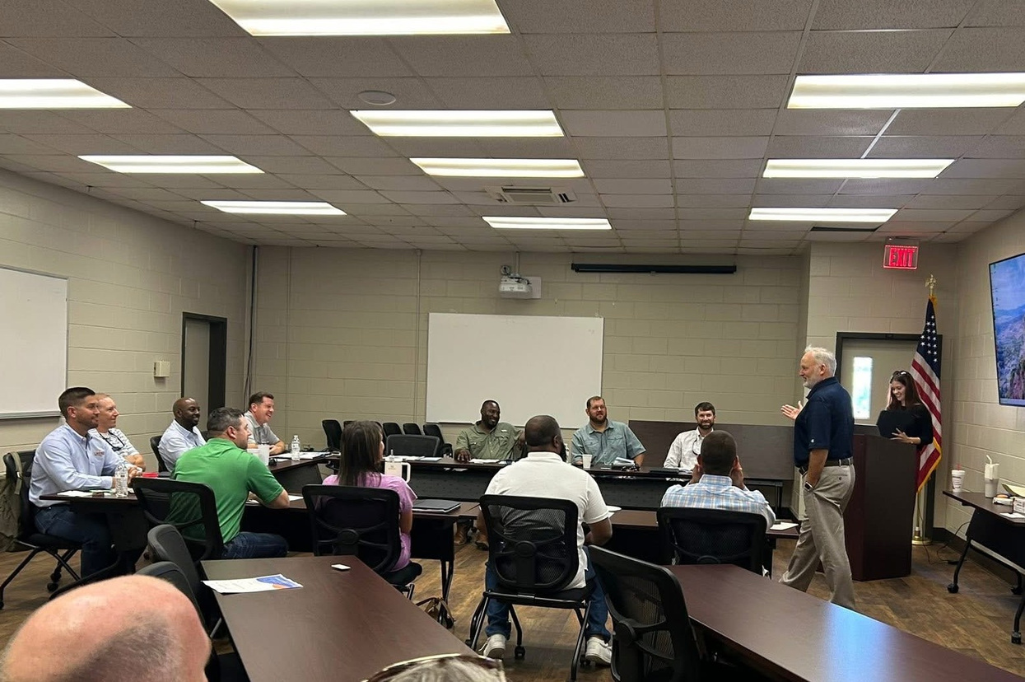
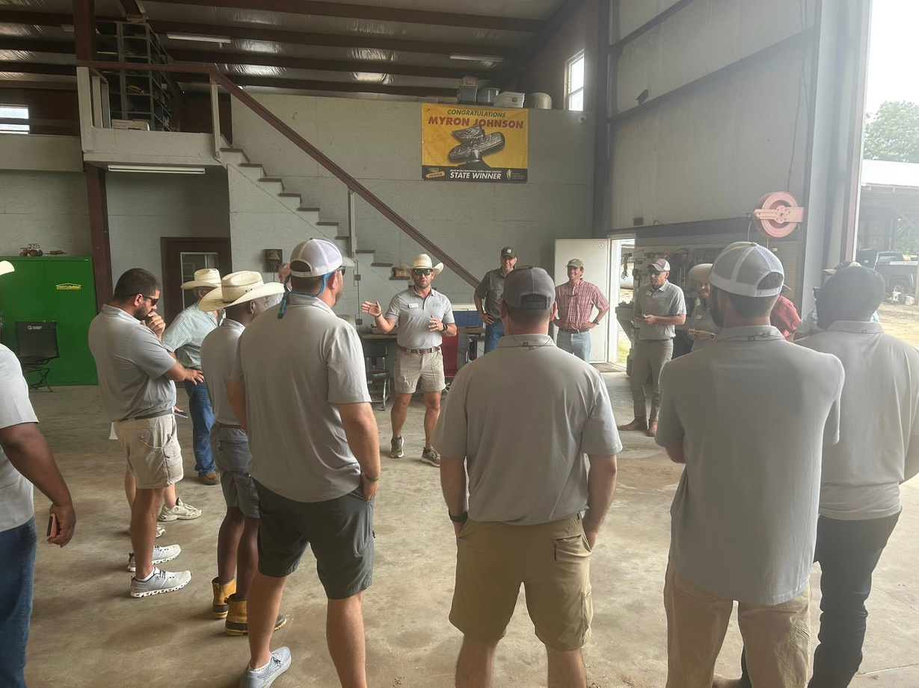
SESSION THREE
November
Looking Forward To:
Round Table Discussion
Q&A with Committee Leadership
Capstone Project:
Supervisor Onboarding Program
Notes:
Let's read over these 3 Ps of ELC, but keep in mind before decisions are made, these topics go into way more in terms of content. We will get into that a bit later.
Decision to be made: how do we feel about the mission statement. Any changes?

Slide 9
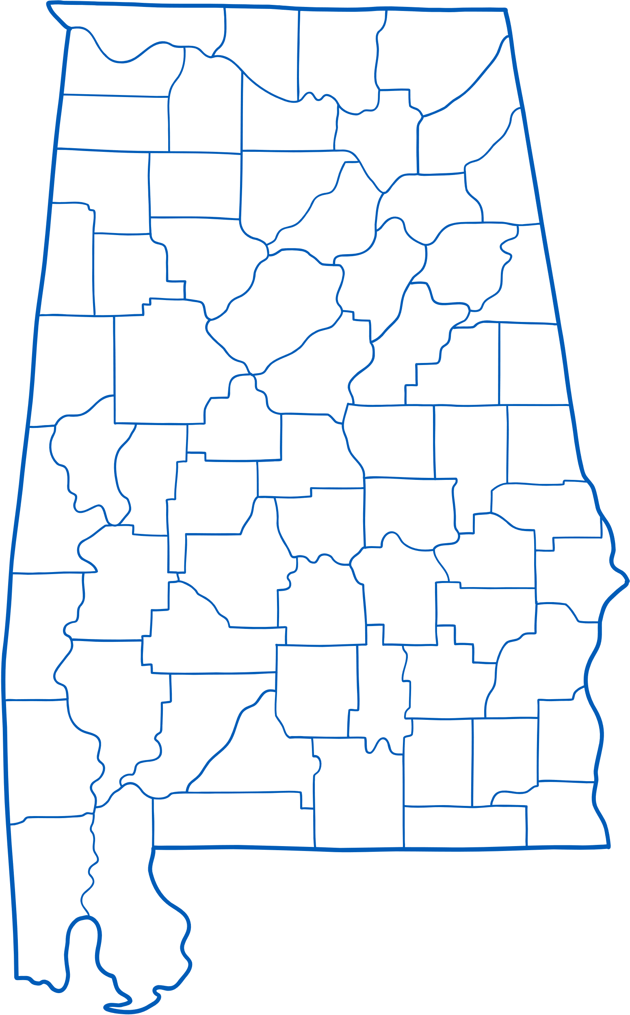
Andrea Crain
Jamie Vann
Will Gotcher
Madison County
Madison County
Mitchell Henry
Colbert County
Matthew Bentley
Lawrence County
Zach Brannon
Morgan County
Winston County
First Cohort
Chad Christian
Tuscaloosa County
Darrell McGuire
Dallas County
Darren Beachem
Bullock County
Justin House
Monroe County
Emmanuel Bankston
Cameron Smith
Henry County
Conecuh County

Slide 10
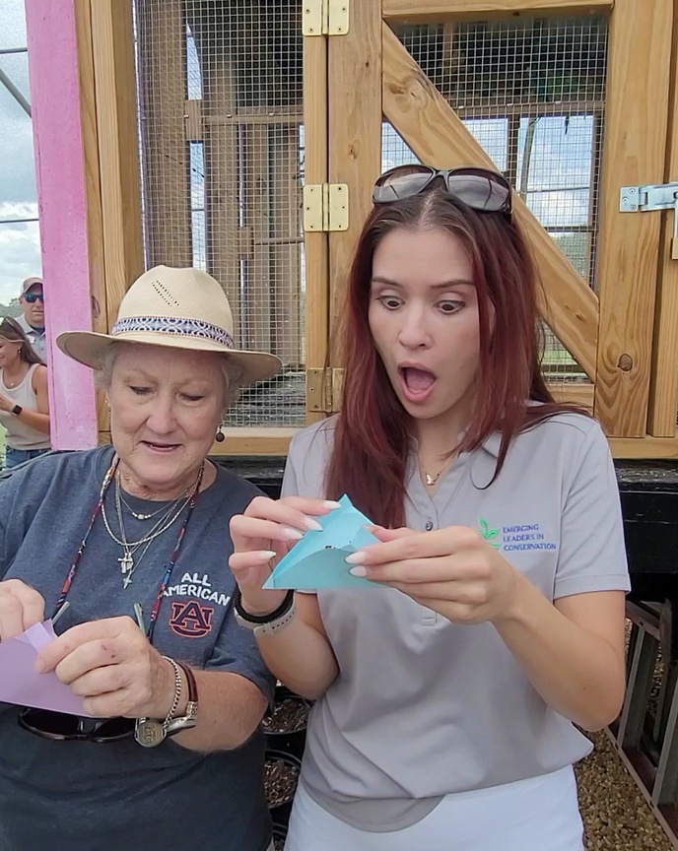
KEEP IN TOUCH
harli.willis@swcc.alabama.gov
(334) 832-8569
Harli Willis

